Slide 1

Exercise Physiology 101
Russell R. Pate, PhD
Arnold School of Public Health
University of South Carolina

Slide 2
Topics
Physiologic responses to acute exercise
Functional adaptations to chronic exercise
Mediation of health effects of exercise

Slide 3
Physiologic responses to acute exercise

Slide 4
Physical Activity
Any bodily movement produced by skeletal muscle that requires energy expenditure
Exercise
Physical activity that is planned, structured and repetitive that has an objective the improvement of physical fitness.

Slide 5
Physical Activity Involves WORK
Work = Force x Distance
(kg•m) (kg) (m)

Slide 6

60 kg man steps up 0.25 meters
Step Height
Work = 60 kg x 0.25 m = 15 kg•m
426.8 kg•m = 1 kcal

Slide 7

Work Requires Energy Expenditure

Slide 8
Energy Expenditure
Involves metabolic breakdown of food-derived energy stores to produce ATP
Energy can be expended aerobically or anaerobically

Slide 9
ANAEROBIC
AEROBIC
CARBOHYDRATES
FATS
PROTEIN
O₂
ATP
CO₂
H₂O
LACTIC ACID
ATP
Energy!
ATP ADP + P +
Muscle Contraction, Biosynthesis, Active Transport

Slide 10
VO₂
Rate at which oxygen is consumed by the body (ml O₂/kg body mass/min)

Slide 11
MET
A Metabolic Equivalent Unit
Used to estimate the rate of energy expenditure during physical activity relative to resting metabolic rate (1 MET)
1 MET = 3.5 ml O₂/kg body mass/min

Slide 12
Aerobic Energy Expenditure During Graded Treadmill Exercise
Maximal exercise

Slide 13

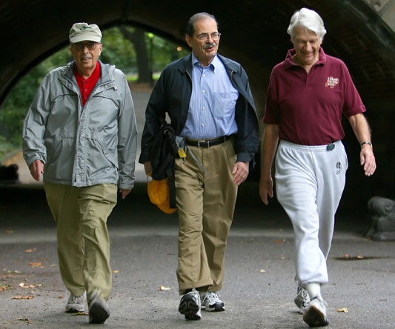
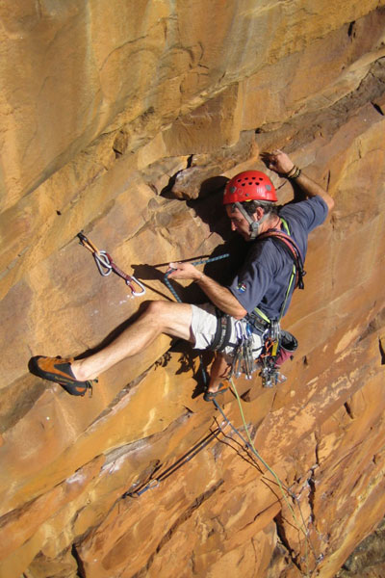
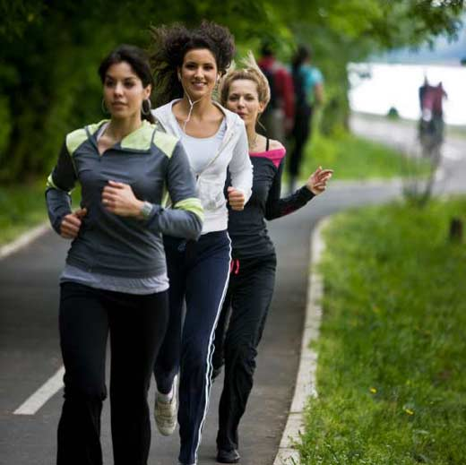

Different activities require varying rates of energy expenditure

Slide 14
Energy Expenditure (METS)
0 2 4 6 8 10 12 14 16 18 20 22 24

Slide 15
VO₂
Increased VO₂ during physical activity requires increased cardiorespiratory function to support increased O₂ delivery to active muscle
VO₂ = Q • A – VO₂
Q = HR • SV
Q = cardiac output; HR = heart rate; SV = stroke volume
A – VO₂ = Arteriovenous Oxygen Difference
Notes:
The maximal rate at which oxygen is taken up by the tissues depends on central and peripheral factors; the maximal rate at which the heart can beat; the maximal volume the heart can pump PER beat, and the maximal rate at which the skeletal muscle tissue can extract oxygen.

Slide 16
Cardiovascular response to graded exercise
22
HR
20
18
Cardiac Output (liters/min)
Q
16
14
12
SV
10
8
6
4
2

Slide 17
SUMMARY
  Physical activity involves work, and energy expenditure is required to support that work
  Muscles can produce energy through either aerobic or anaerobic metabolic processes
  Different forms of physical activity require widely varying rates of energy expenditure (VO2, METs, Kcal/min)
  During physical activity adjustments in cardiovascular function are needed to support increased energy expenditure

Slide 18
FUNCTIONAL adaptations to chronic exercise

Slide 19
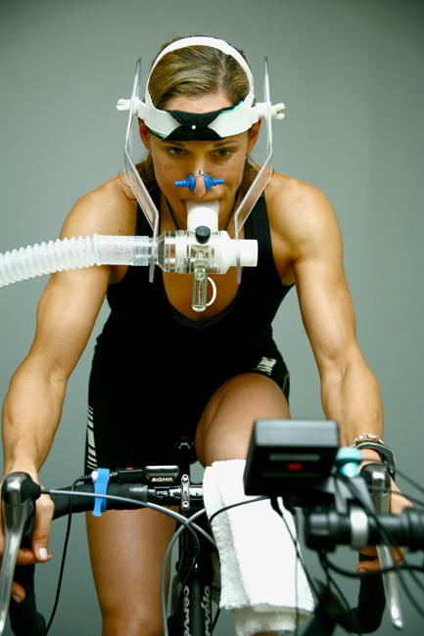
VO_{2max}
Greatest rate at which O2 is consumed during exhaustive exercise
www.cadancecycling.com

Slide 20
Chronic Aerobic Exercise
Increases cardiorespiratory fitness (VO_{2max})
(e.g. functional capacity)
  Exercise to higher maximal intensities
  Exercise longer at standard and relative submax intensity
  Less fatigue (RPE) at standard or relative submax intensity

Slide 21
↑ VO_{2max} Results From
Increased Blood Volume
  Increased venous return
  Increased SV
  Increased Q_{max}
Skeletal Muscle Adaptation
  Increased (a-v)O₂Diff
  Increased Enzymes of Aerobic Metabolism
  Increased Myoglobin

Slide 22
Chronic Aerobic Exercise
Modifies metabolic function
  ↑ fat metabolic capacity
  ↓ Lactate accumulation
Enhances efficiency
  ↓ O₂ needed for a given exercise intensity
  ↓ Cardiac work needed for a given exercise intensity

Slide 23
SUMMARY
  Chronic exposure to aerobic exercise increases cardiorespiratory fitness
  A key adaptation is increased VO2max
  Supporting adaptations include
    Increased blood volume, SV, Qmax
    Enhanced muscle metabolic function
    Improved efficiency

Slide 24
MEDIATION OF HEALTH
EFFECTS OF exercise

Slide 25
Health & fitness effects of PA are related to chronic “dose” or a change in chronic dose

Slide 26
Mechanisms Underlying Health Effects of Chronic Exercise
Muscle
  ↑ Muscle Mass
    ↑ Resting Metabolic Rate
    ↑ Fitness
  ↑ Insulin Sensitivity
    ↑ GLUT-4 Translocation
    ↓ Blood Glucose

Slide 27
Mechanisms Underlying Health Effects of Chronic Exercise
Cardiovascular System
  ↑ Cardiac Function
    ↑ Stroke Volume
    ↑ Max Cardiac Output
  ↓ Resting Blood Pressure

Slide 28
Mechanisms Underlying Health Effects of Chronic Exercise
Metabolism/Immune Function
  ↑ HDL Cholesterol
  ↓ Triglycerides
  ↓ C-Reactive Protein

Slide 29
Mechanisms Underlying Health Effects of Chronic Exercise
Skeleton
  ↑ Bone Mineral Density
G-I System
  ↓ Intestinal Transit Time

Slide 30
SUMMARY
  Health effects of chronic exercise are driven by increased caloric thru-put (energy expenditure)
  Key adaptive mechanisms:
    Increased muscle mass
    Increased insulin sensitivity
    Enhanced cardiovascular function
    Reduced resting blood pressure
    Improved blood lipid profile
    Enhance immune function
    Increased bone mineral density

Slide 31

