Slide 1
Young Investigator Grants
Things you “should” and “should not” do
Gaye Christmus MPH
Pre-award Grants Manager and Technical Editor
R. Glenn Weaver, M.Ed., Ph.D.
Associate Professor
Arnold School of Public Health
University of South Carolina
Notes:
Glenn

Slide 2
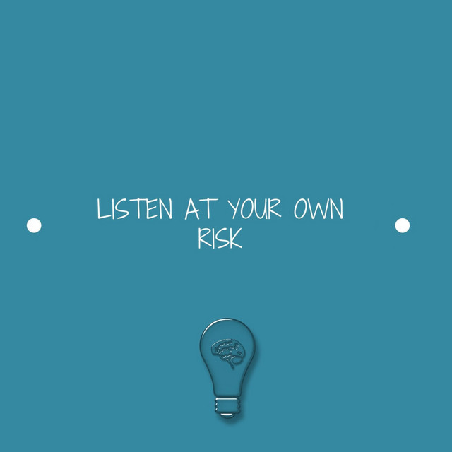
Disclaimer
Young Investigator Grants
Notes:
Glenn

Slide 3
Young Investigator Grants
Notes:
Glenn

Slide 4
Agenda
Why you should listen to us
Things you “should” and “should not” do
Questions & Answers
Young Investigator Grants
Notes:
Glenn

Slide 5
Why you “should” listen to us
And why you “should” not
Notes:
Glenn

Slide 6
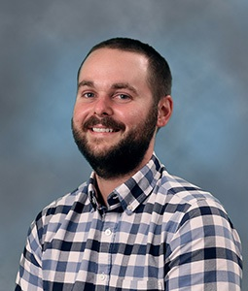
Why you should listen to us
I have secured $35,000 in internal funding
6 NIH grants as a PI totaling $4.8 million in grant funding
Project PI on an NIH COBRE ($609,543 in funding)
I am (or have been) a Co-I on an additional 5 NIH grants totaling over $9million
NIH reviewer
Young Investigator Grants
Notes:
Glenn

Slide 7
Why you should listen to me
Young Investigator Grants
Notes:
Glenn

Slide 8
Why you should listen to me
Young Investigator Grants
Notes:
Glenn

Slide 9
Why you should NOT listen to me
14%
of PI grants awarded
Young Investigator Grants

Slide 10
Why you should (and should not) listen to me
Over the past 20 years, worked with 60+ faculty members to submit 1,000+ grant applications
Over the past 5 years, helped Department of Exercise Science faculty receive 400 research grants totaling $45 million
I’ve had a lot of opportunities to observe what works and what doesn’t work in terms of submitting and receiving research grants.
BUT…
I’m not a scientist.
I’ve never submitted, much less received, a research grant as PI.
Young Investigator Grants
Notes:
Gaye

Slide 11
What you “should” do
And what you “should not” do
Notes:
Gaye

Slide 12
Plan to Play the Long Game
Getting funded by NIH, NSF, AHA, and other major funders almost never happens quickly – researchers have to be willing to play the long game
Getting funded involves time, effort, patience, frustration, (tears!) and a willingness to learn, adapt, and keep going.
And the game isn’t over once you get funded – it keeps going, and it only gets a little bit easier.
Young Investigator Grants
Notes:
Gaye

Slide 13
Submit Grant Applications
Funded principal investigators submit grant applications
Revise and resubmit
Write, write, write, write, write (pubs and grants)
Focus on one or two areas of expertise
Find multiple mechanisms that fit your expertise
Find examples (share examples)
Young Investigator Grants
Notes:
Gaye

Slide 14
Pay Attention and Play the Game
Sign up for updates from funders (Open Mike, NIH Guide for Grants and Contracts, PIVOT, etc.)
Look for funding opportunities and program announcements and read them carefully
Pay attention to policies and procedures (a lot of them won’t make sense – get over it)
Read NIH Reporter
Assisted Referral Tool (ART)
Young Investigator Grants
Notes:
Glenn

Slide 15
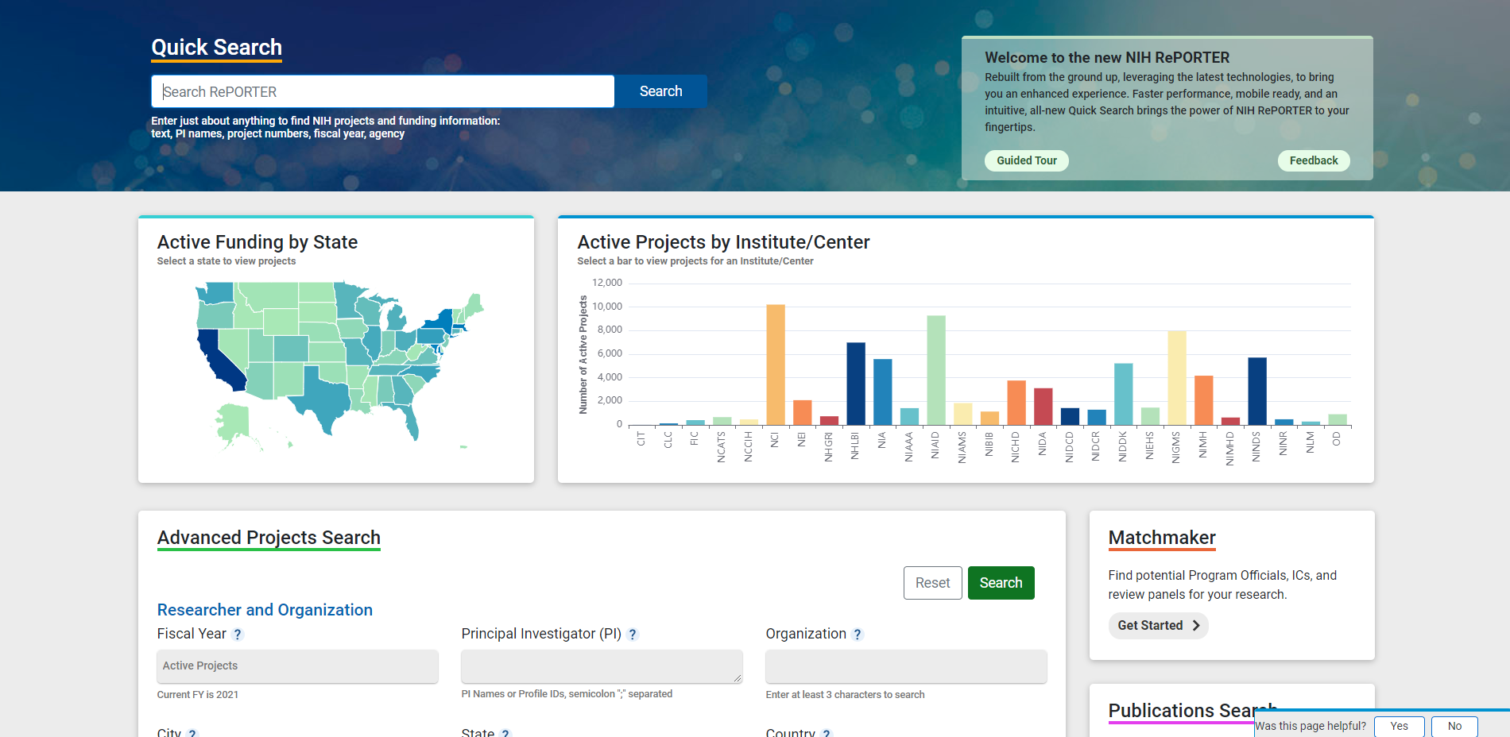
Young Investigator Grants
Notes:
Glenn

Slide 16
Young Investigator Grants
Notes:
Glenn

Slide 17
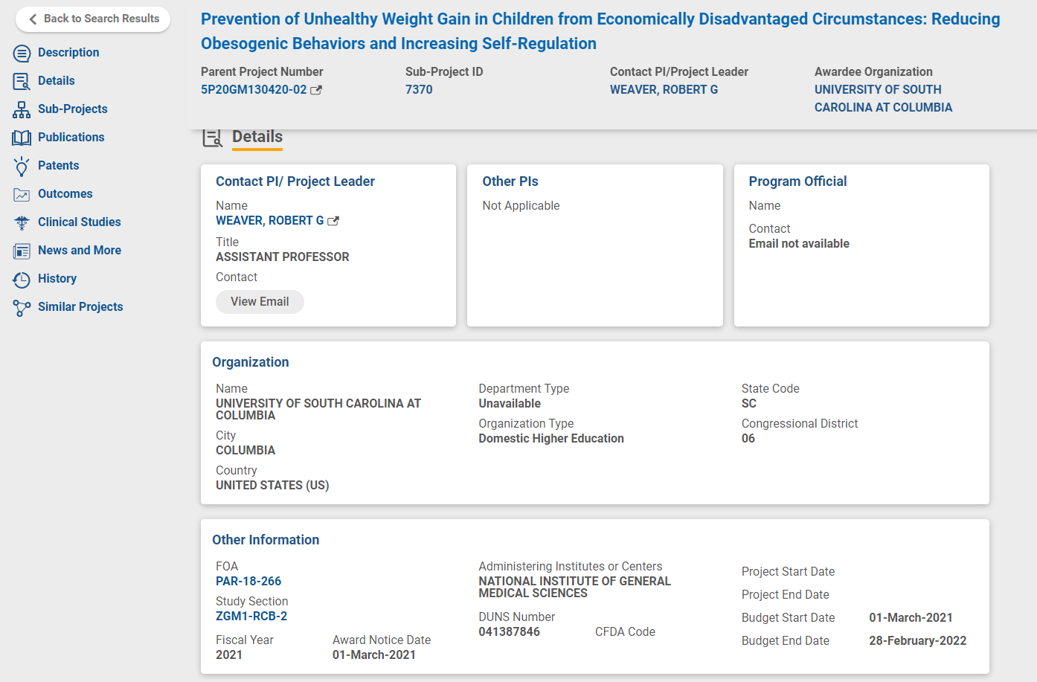
Young Investigator Grants
Notes:
Glenn

Slide 18
Start Early and Submit Early
Putting together a competitive application takes a long time – months, not weeks
This is true for every PI, but especially true if you don’t have much or any grant support in your college or department.
Submit early, because glitches and problems occur
Start working on revisions immediately after submission – anticipate the critiques and begin preparing to address them
Young Investigator Grants
Notes:
Gaye

Slide 19
Form a Team and Ask for Feedback
Find and work with people who will provide constructive criticism – and be willing to do the same for them
Not all Co-I’s will do the above (sometimes you need them anyway)
To get feedback you must start early
Not all feedback is right (you make the call)
Most funding agencies want team science
Get feedback from people who are not experts
Young Investigator Grants
Notes:
Glenn

Slide 20
Form a Team and Ask for Feedback
Young Investigator Grants
Notes:
Glenn

Slide 21
Read the Program Announcement and Guidelines and Follow Them
Successful PIs read the program announcement and do what it says!
This should be a given, but a surprising number of would-be PIs don’t follow this rule
In addition to the program announcement, know and follow the funder’s rules and guidelines. (If your department doesn’t provide grant support, this is challenging, especially with NIH.)
Young Investigator Grants
Notes:
Gaye

Slide 22
Don’t Take It Personally
Almost no one is funded the first time they submit, and even well-funded researchers submit applications that receive critical reviews.
Deal with (anticipate) reviews and criticisms from reviewers
24-hour rule
Young Investigator Grants
Notes:
Glenn

Slide 23
The entire significance section of this proposal presents information and makes assertions that are already well known and established. The proposal does not shed any new light on the problem of child obesity, the status of existing prevention programs, or novel strategies that might advance the science and practice of obesity prevention.
This is a well written proposal with many strengths and attention paid to details. Childhood obesity among individuals from low-income families is a significant public health problem. Should the proposed intervention strategy prove effective, it has the potential to mitigate disparities in OWOB prevalence.
Young Investigator Grants
Notes:
Glenn

Slide 24
The key innovation of the proposed project is the challenge it poses to the paradigm of creating new curricula to raise MVPA in PE programs. Instead, it proposes to use LET US Play principles in conjunction with diverse PE programs to raise MVPA. This makes the proposed project highly innovative.
Most PE programs already train their teachers in most of the LET US PLAY components. While teachers may not be able to implement these components, further training from a public health intervention is not likely to have lasting impacts beyond what they would have learned as undergraduates in their methods classes.
Young Investigator Grants
Notes:
Glenn

Slide 25
Learn How to Write a Compelling Research Plan
Two important things to know about your research plan:
1. It’s a marketing tool.
2. The way it’s written will make or break it, because good writing cannot overcome bad science, but bad writing can easily overcome good science.
So how can you make it compelling, interesting, and easy to review?
Keep it simple
Reviewers are very busy people. Make the review process easy for them! Also, remember that they may not be experts in your area.
You need to make it easy for them to understand and advocate for your application.
Use bullet points.
Young Investigator Grants
Notes:
Gaye

Slide 26
Young Investigator Grants
Notes:
Glenn

Slide 27
Writing Tips for a Compelling Research Plan
Follow a logical progression – lead reviewers where you want them to go.
Make it easy for them to follow the story – don’t “sneak up” on key points. Make the point, then back it up.
Use consistent terms throughout for the constructs and variables you discuss.
Use clear, direct language.
Avoid jargon and niche terms. You want reviewers to feel smart, not dumb, when they read your application.
Young Investigator Grants
Notes:
Gaye

Slide 28
Writing Tips (cont.)
Use strong verbs and active voice whenever possible – they help to create energy and enthusiasm.
Include white space.
Remember that you’re “selling” an exciting study that will advance the field. You’re not reporting on the literature or the methods you plan to use.
And one of the best ways to “sell” your study is to learn to tell the “story” of the science you’re proposing. Although story telling doesn’t come naturally to most scientists, every scientist can learn how to do it.
Young Investigator Grants
Notes:
Gaye

Slide 29
And, but, therefore
Young Investigator Grants
Notes:
Glenn

Slide 30
Questions?
Young Investigator Grants
Notes:
Gaye and Glenn

