Slide 1
Whither the Observational Study in
Physical Activity and Health Research?
PAPH Course 2022
I-Min Lee: Some methodological considerations
Bill Kohl: Some considerations on outcomes

Slide 2
Whither the Observational Study in
Physical Activity and Health Research?
Some Methodological Considerations

Slide 3
Overview
Hierarchy of research study designs
Evidence base underpinning 2018 PAG: observational studies predominate. Why? How should we view these data?
In-class exercise; break into small groups (~15 minutes): RCT result contradicts observational study result – who is correct?
Discussion of in-class exercise to apply what you have learnt
Notes:
3

Slide 4
Hierarchy of Research Study Designs
Notes:
4

Slide 5
Epidemiologic Design Strategies
STUDY DESIGNS
Descriptive
• Correlational (ecologic)
study
• Case report/series
• Cross-sectional study
Analytic
Observational Experimental
• Case-control • Clinical trial
study
• Cohort study

Slide 6
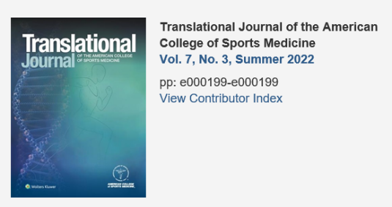
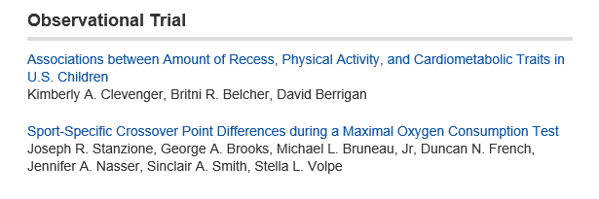
Terminology – there is no such thing as an “observational trial”. Either observational OR trial

Slide 7

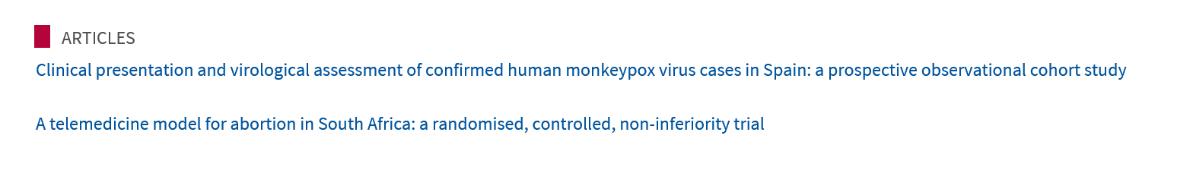
Correct terminology – either observational OR trial

Slide 8
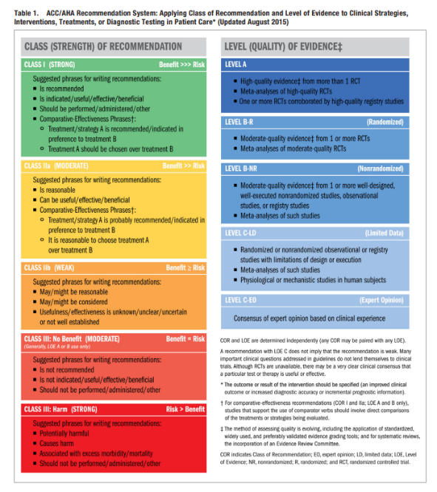
RCT
RCT
Obs
Halperin et al, Circulation 2016;133:1426-8

Slide 9
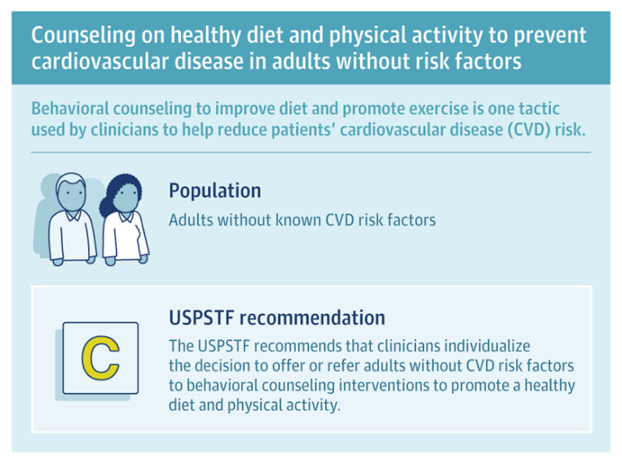
what is evidence?
JAMA 2022;328:404

Slide 10
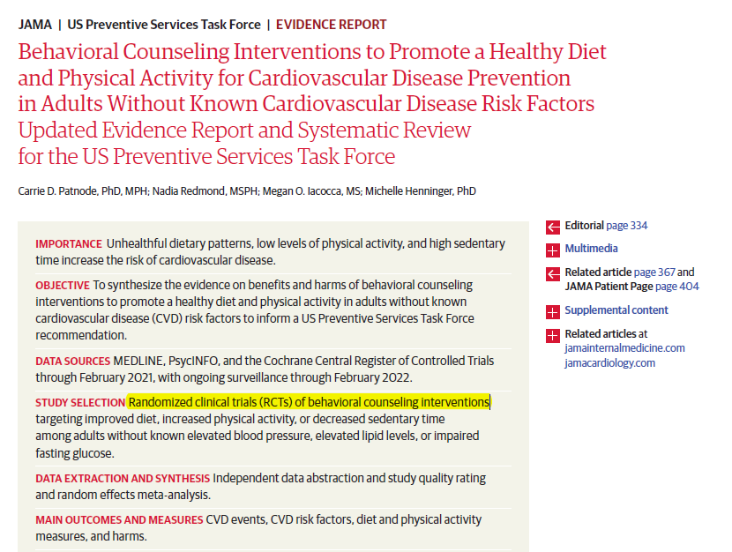
JAMA 2022;328:2;328:367-74

Slide 11
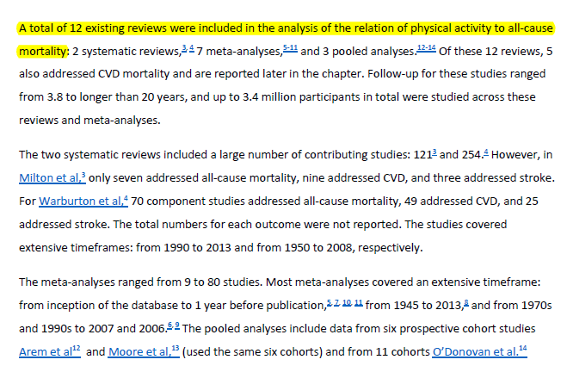
Contrast this with 2018 PA guidelines: data underpinning these guidelines primarily come from observational epidemiologic studies – e.g., for all-cause mortality, evidence was only from observational studies:

Slide 12
Why the emphasis on “weaker” data from observational studies in physical activity and health research?

Slide 13
Some Issues to Consider when Choosing Research Design
Bias (particularly confounding)
Study duration (shorter vs longer)
Participants (selectivity/generalizability)
How many “doses” of PA or SB can be investigated?
Notes:
13

Slide 14
1. Bias
RCT’s are clearly superior – randomization prevents people from choosing their activity level
Healthy habits cluster – active people smoke less, eat better, etc. We can control for confounding in analysis of observational data, but confounders may not be assessed or well measured
Notes:
14

Slide 15
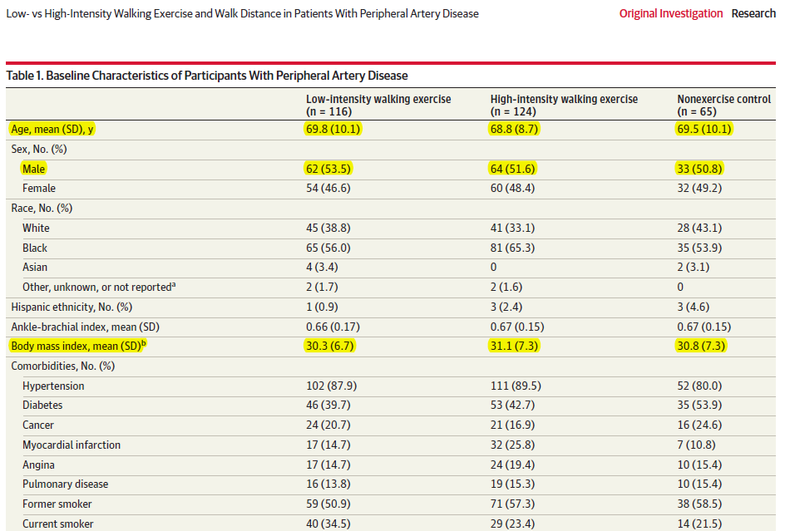
Example of balanced characteristics across intervention arms in RCT
McDermott et al, JAMA 2021;325:1266-76

Slide 16
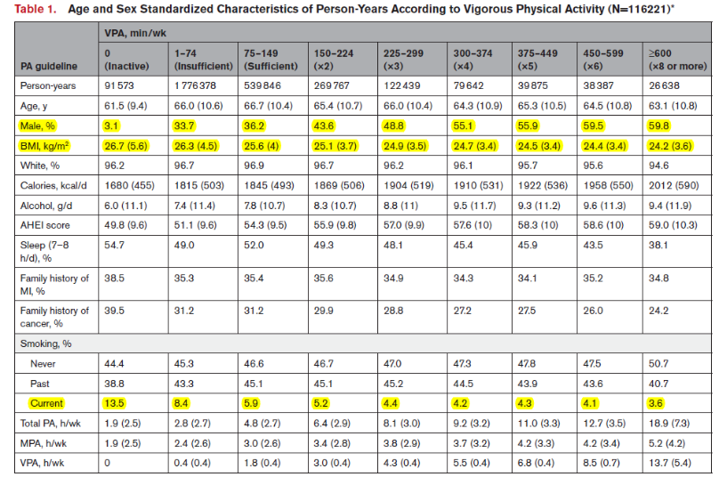
Example of unbalanced characteristics across VPA levels in observational study
Lee et al, Circ; e-pub July 12, 2022

Slide 17
2. Study Duration
Non-communicable diseases that are the leading causes of death worldwide – e.g., heart disease, cancer, type 2 diabetes – develop over a period of years to decades
Studies of these endpoints in healthy population need to be of long duration
For trial results to be valid, compliance and follow-up need to be high
But, compliance and follow-up tend to erode over time, particularly in exercise trials
Notes:
17

Slide 18
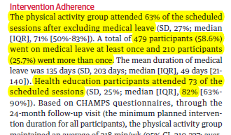
Compliance Erodes over Time
In any trial, compliance with protocol erodes over time
In exercise trials, compliance in exercise arm tends to erode more than in placebo arm
E.g., LIFE trial; 2.6 y duration
63% in exercise arm
82% in control arm
Pahor et al, JAMA 2014;311:2387-96
Notes:
18

Slide 19
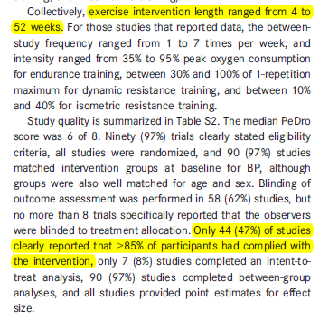
Meta-analysis of RCT’s of exercise and BP – 93 trials:
Trial durations: 4 to 52 wk
Less than half of trials had >85% of participants being compliant with exercise intervention
Cornelissen et al; JAHA 2013:2:e004473

Slide 20


Why so much emphasis on good compliance?
But only ½ PA group were compliant, while ½ control group started exercising! Your 2 arms now look like this:
Suppose you did this trial among inactive people:
PA
control
PA
control
The 2 arms are now identical – yielding useless results on the effect of PA vs control

Slide 21
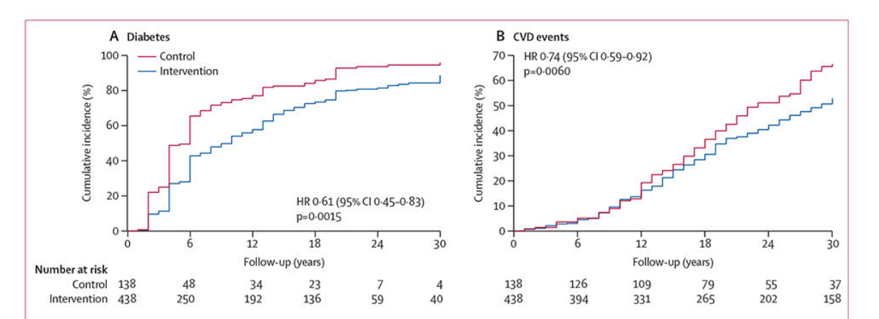
Thus, RCTs tend to be limited in duration, with subsequent observational follow-up: e.g., Da Qing Diabetes Prevention Outcome Study
Randomized component 6 y; observational f-up until year 30 for additional cases to accrue
Gong et al, Lancet Diabetes Endocrinol 2019;7:452-61

Slide 22
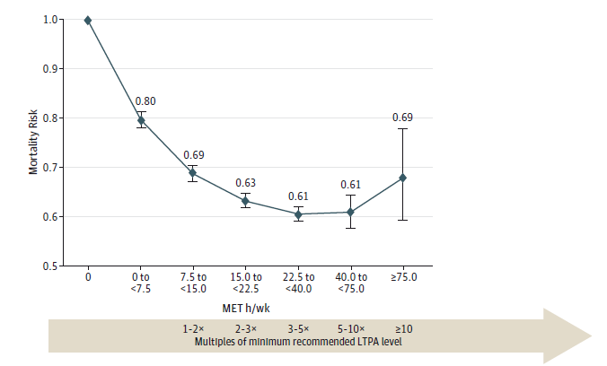
Contrast this with study duration in observational studies:
Median f-up, 14 y
N in each study, range ~14,000 to 312,000
Arem, et al; JAMA Int Med 2015;175:959-67

Slide 23
3. Selectivity of Participants
Trials require more participant burden than observational studies
Because investigators are asking participants to do something they would not have, if they were not in a trial, screening for safety issues occurs
Both these factors “weed out” people; so trial participants tend to be select
Notes:
23

Slide 24
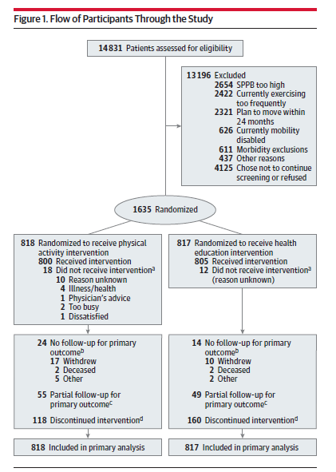
E.g., LIFE trial:
Responded to mass mailing
Among respondents, 14,831 – 8,634 ineligible (2654+2422+2321+626+611)= 6,197 eligible
Participation = 26% (1635/6197)
Trial participants tend to be very select
Pahor et al, JAMA 2014;311:2387-96

Slide 25
4. Number of “Doses” Studied
Trials are “high touch” studies – need to maintain compliance, follow-up, safety, etc.
Thus, they are high cost, making it infeasible to have many intervention arms (typically, 2: 1 intervention + control
Notes:
25

Slide 26
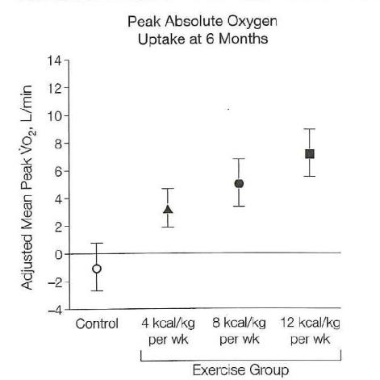
E.g. of RCT with 3 PA doses (uncommon) + control:
Outcome: Cardiorespiratory fitness
3 doses: 50%, 100%, 150% of recommended level
DREW Study (6 months – typical duration)
Church et al, JAMA 2007;297:2081-91

Slide 27
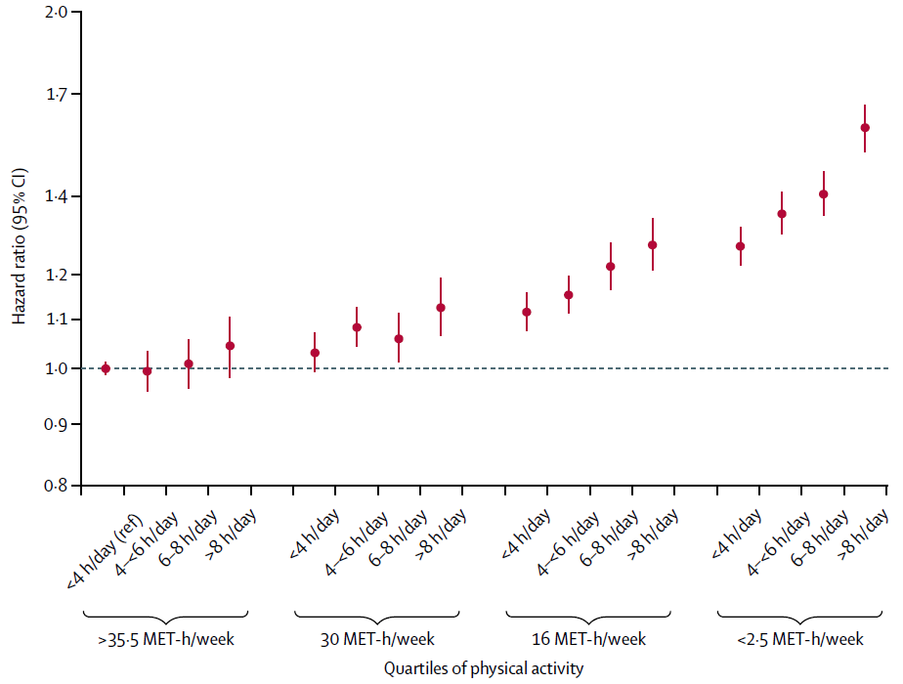
Contrast this with meta-analysis of observational studies with 16 doses of PA/SB:
Outcome: All-cause Mortality
Least active, ~5 min/d PA
Most active, ~60-75 min/d PA
Doses reflect real life
Ekelund et al, Lancet 2016;388:1302-10

Slide 28
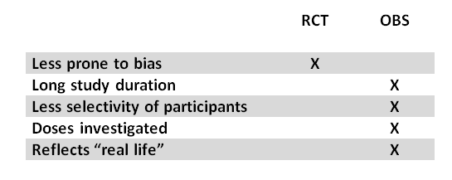
Summary – Both Study Designs Provide Complementary Evidence
X indicates the study design with the advantage

Slide 29
In Class Exercise: RCT vs OBS on PA-mortality
(15 minutes; small groups)
Does one study give the “right” answer; the other, the “wrong” answer (if yes, who is right)?
What could account for the differences?
What additional information would you like to know, in order to investigate your answers to (2) above?
Please do NOT look up the actual papers online!

Slide 30
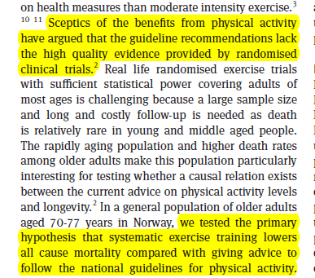
Rationale for the Generation 100 RCT
Investigators are to be applauded for ambitious trial

Slide 31

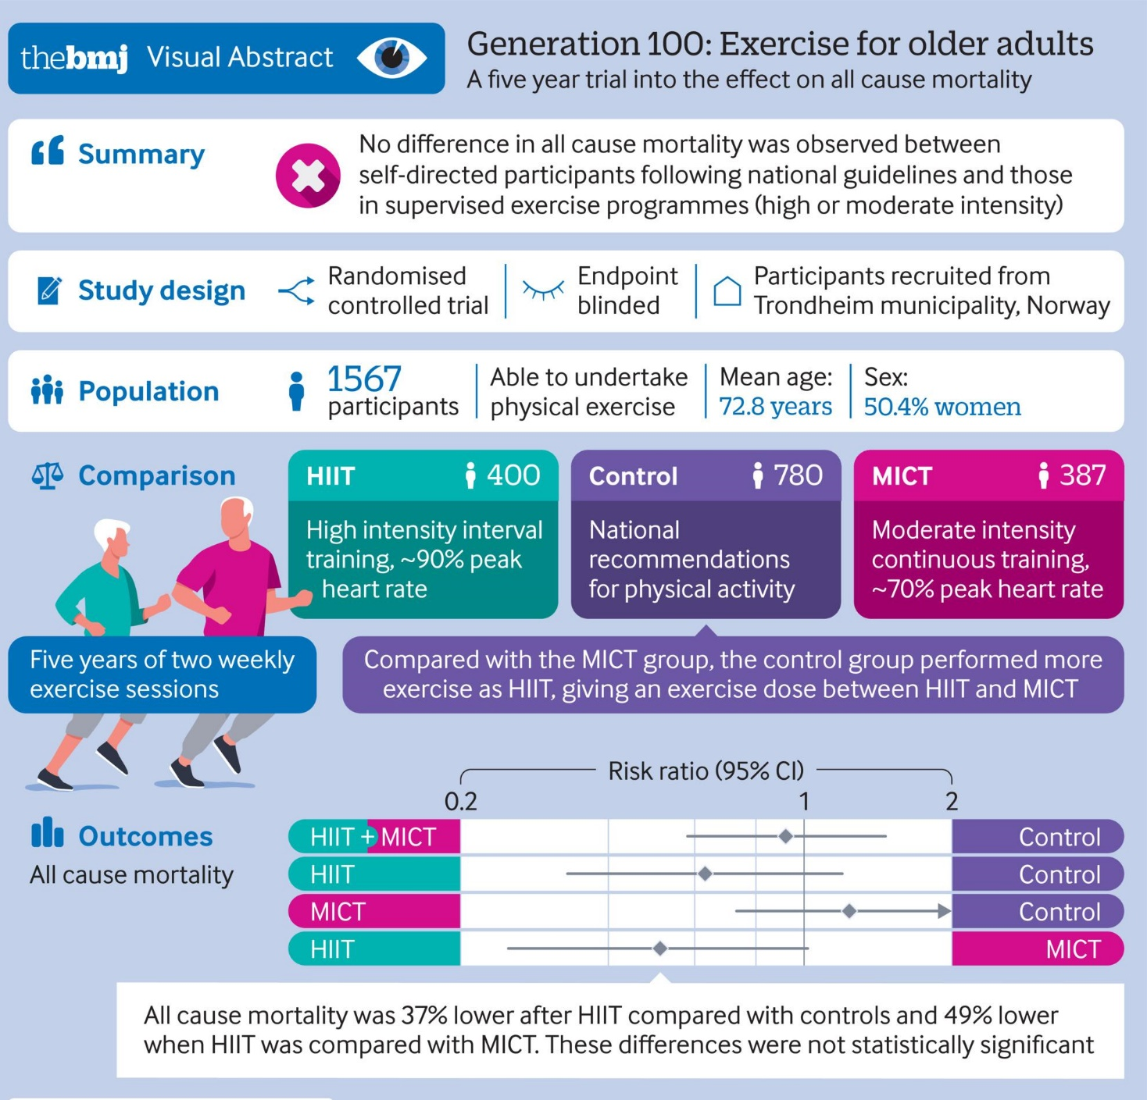
Stensvold et al, BMJ 2020;371:m3485

Slide 32

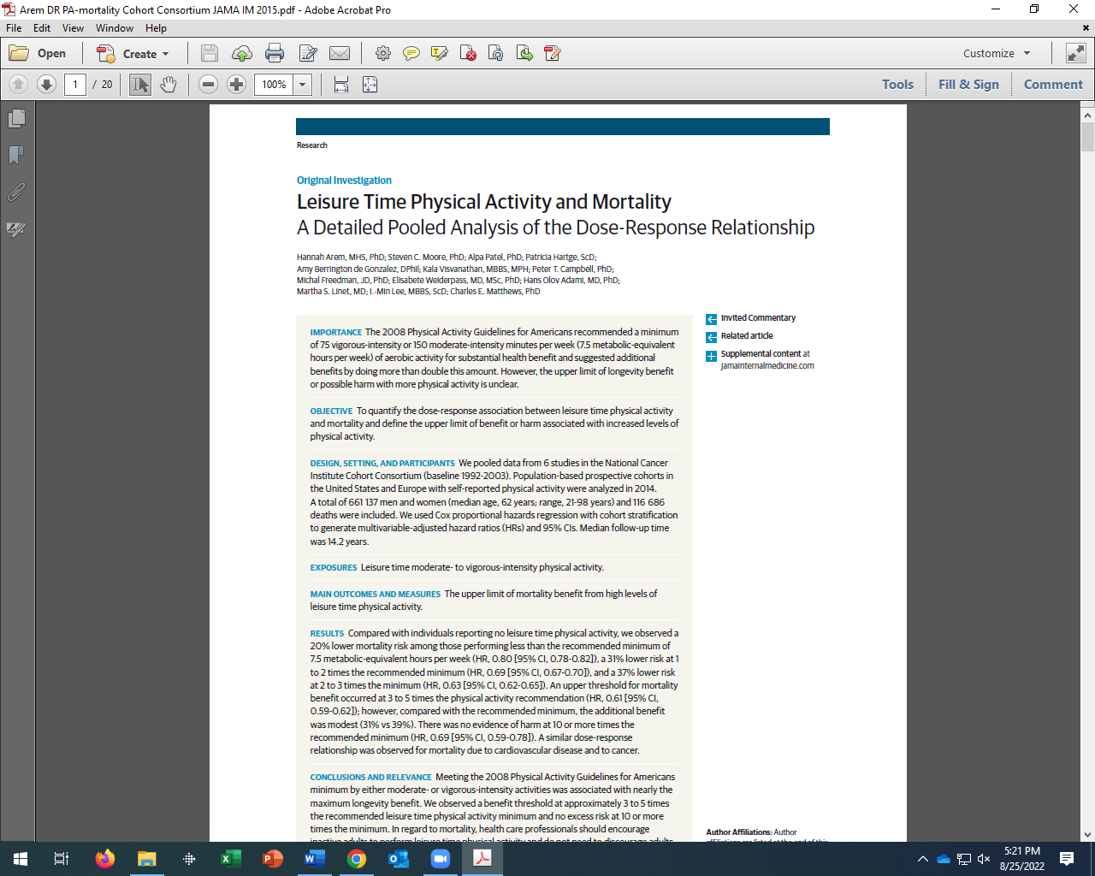
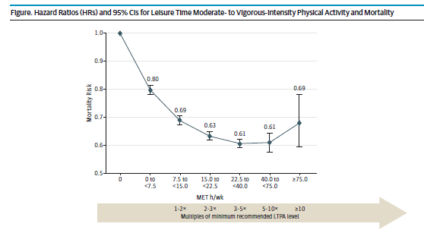
Arem, et al; JAMA Int Med 2015;175:959-67

Slide 33
Some Issues to Consider
Bias (particularly confounding)
Study duration (short vs long)
Participants (more vs less selectivity)
How many “doses” of PA or SB can be investigated?
Notes:
33

Slide 34
Generation 100 RCT: compliance declined over time in 5-y trial
Adherence to Intervention
Y1 Y3 Y5
Control 78% 70% 69%
HIIT 50% 49% 47%
MICT 63% 55% 51%
Control → HIIT
crossover 23% 22% 18%
Notes:
34

Slide 35
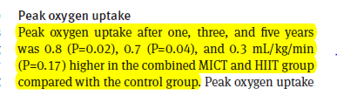
Objective, indirect assessment of compliance in exercise vs control arms

Slide 36
Generation 100 RCT: selectivity of participants
< ¼ (23.5%) of eligible persons agreed to participate
Investigators anticipated 10% cumulative mortality rate over 5 y; however, observed rate < ½ expected (4.6%) → power is limited
Participants were already very active: >90% of controls exercised ≥1/wk and >20% exercised almost daily
Thus, the findings may reflect a “ceiling” effect – in an already active population, adding HIIT or MICT may not lower mortality rates

Slide 37
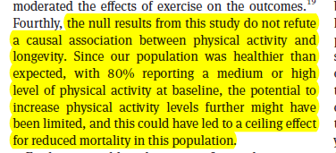
Conclusions of investigators

