Slide 1
Methodological and Practical Considerations for Assessing
Physical Activity in Health Related Research
Greg Welk, Ph.D.
Iowa State University

Slide 2
Outline
A Bit of History
Considerations for Selecting Appropriate Measures
Perspectives and Observations with PA Assessment Research
  Monitor-Based Measures
  Applications for Report-Based Measures

Slide 3
A Bit of History
My Introduction and Experiences with Activity Assessment

Slide 4
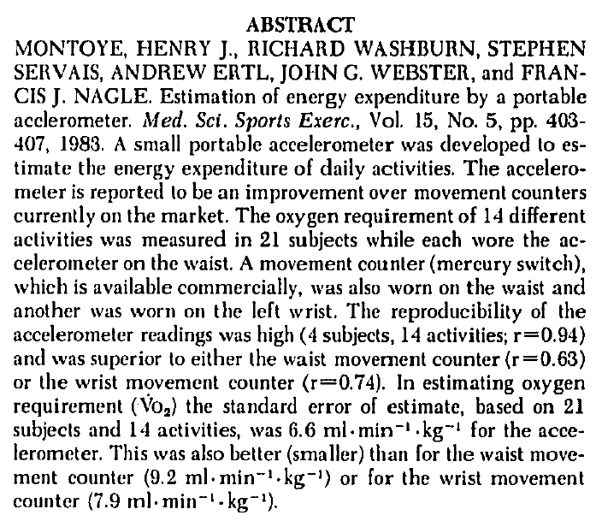
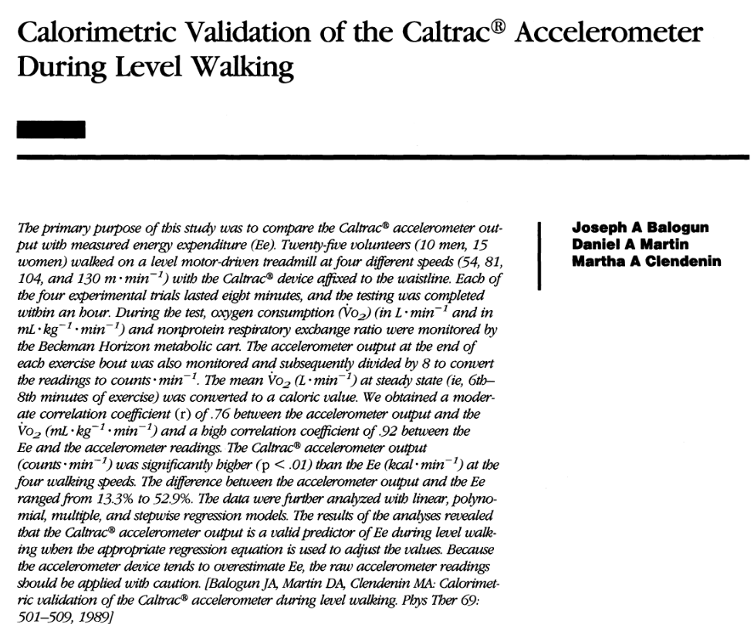
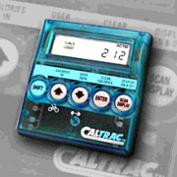
First Studies with Accelerometry
Notes:
I thought it would be useful to take a quick look back at the origins of work with accelerometry based devices. There may be other interpretations of history but I trace the roots of our work to this seminal paper by Dr. Henry Montoye. I specifically wanted to comment on this since Dr. Montoye’s grandson has maintained the family tradition and presented yesterday on some of his new work. Alex, if you are here maybe give a quick wave!
The early work led to the development of a monitor called the Caltrac. This is not the picture of the version that I worked with but it is all I could find on Google. There were other devices evolving but this is the first one that was available for purchase. My introduction to monitors came on my first meeting with my Ph.D. mentor Dr. Charles Corbin. He held one up in his office and said, have you seen one of these? Little did I know that I would still be tinkering with them today 25 years later.
The work progressed in similar ways with research building on past studies but it was a bit easier to keep up with the literature with only a few groups using them.
Many of you may look at the monitor and think that it looks pretty bulky but it was “cool” back then and participants enjoyed wearing the gadgets as they do today. If you aren’t convinced of how our perceptions change you can think back to your first cool cell phone!

Slide 5
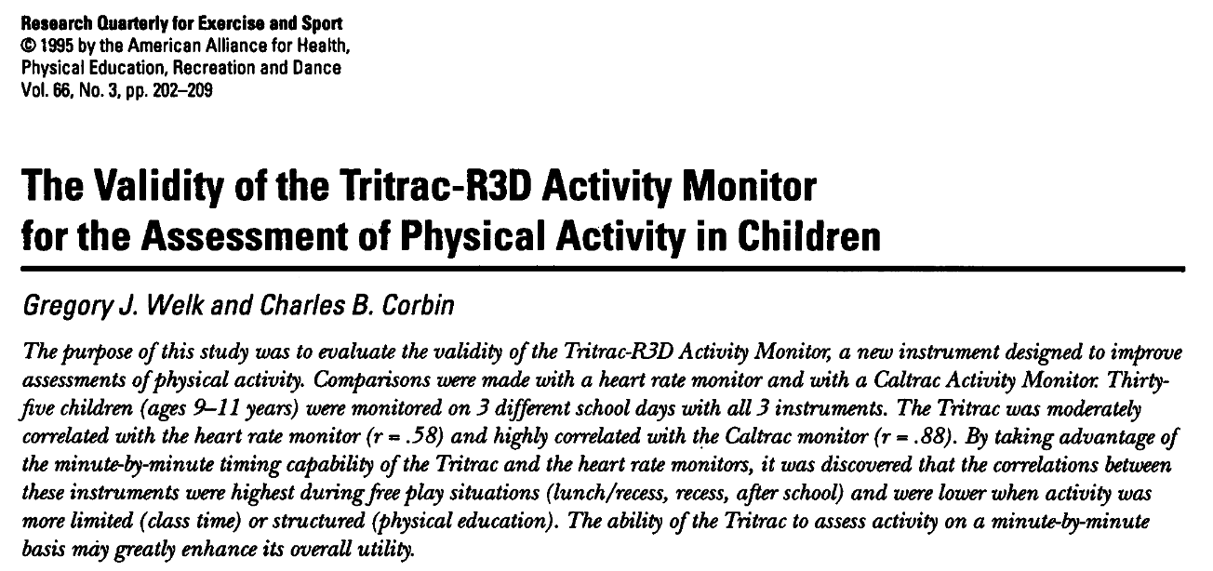
My Early Work with Activity Monitors

Slide 6
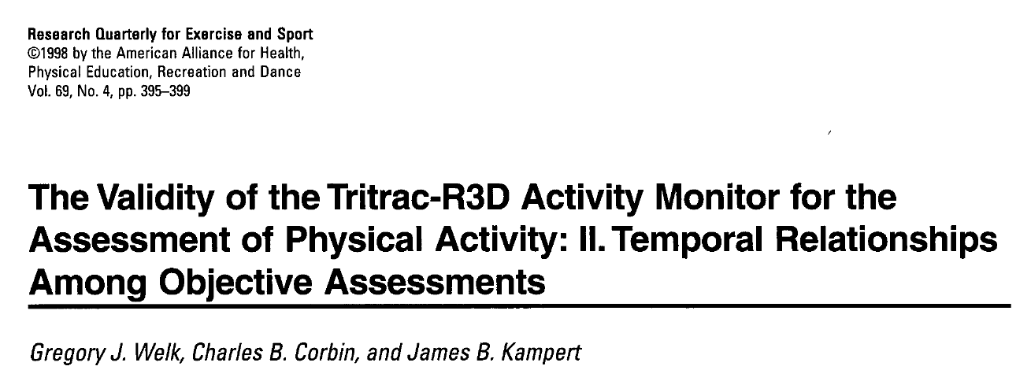
Follow up Study on Temporal Patterns
Tested the potential value of combining information from an activity monitor and a heart rate monitor

Slide 7
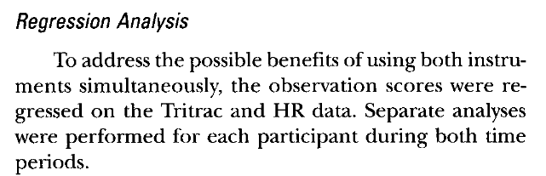
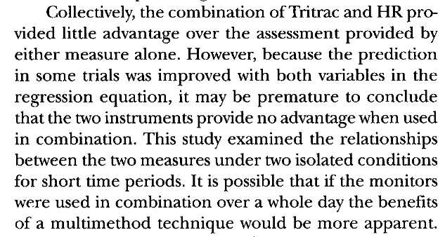
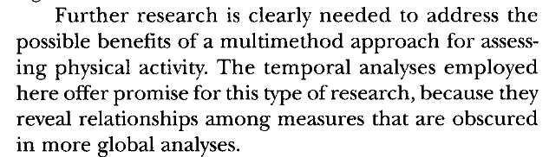

Slide 8

My History with the PAPH Course

Slide 9
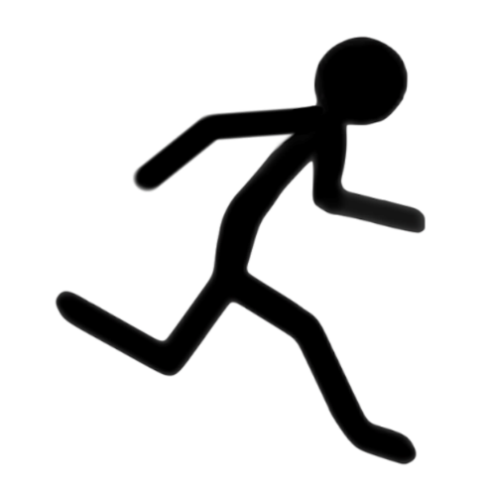
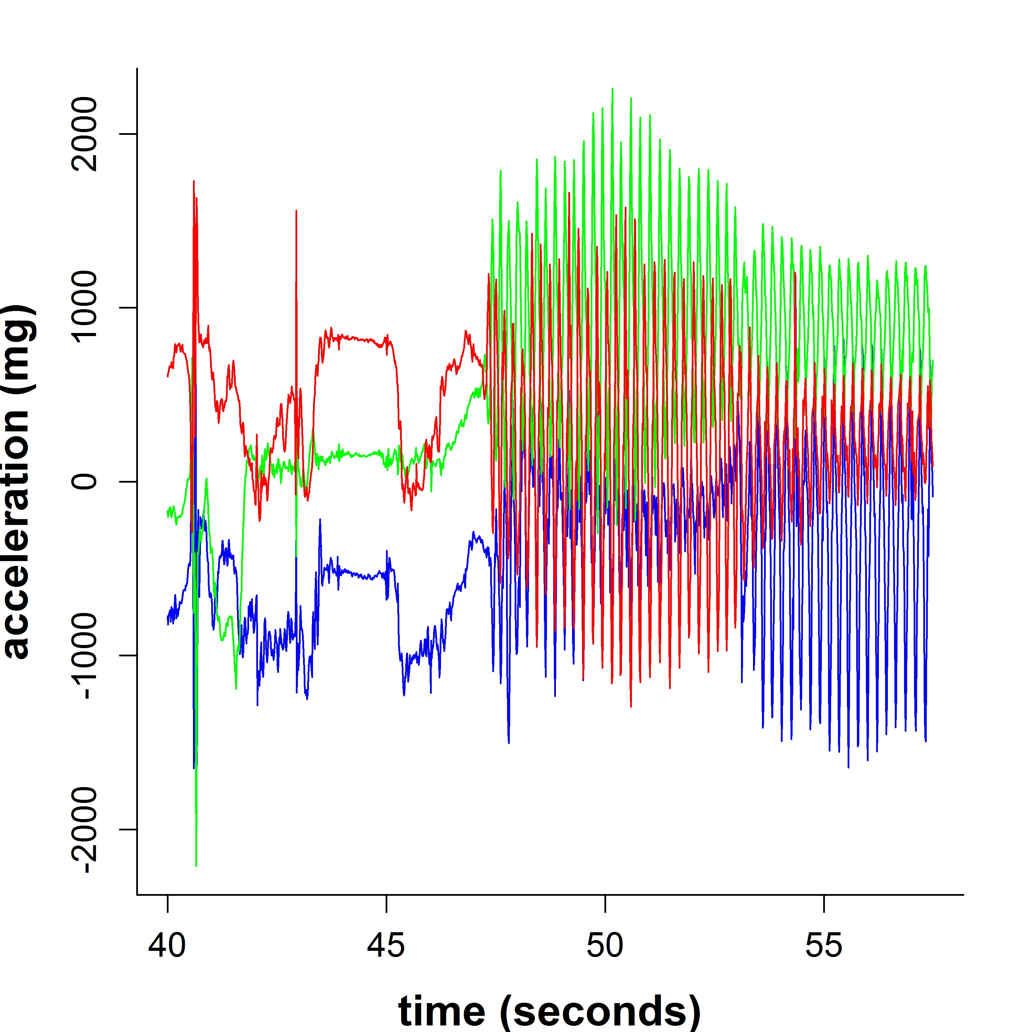
Flash Forward 25 Years!
Things are a bit more complex
1440 samples/day
(1 per minute)
8,640,000 samples/day
(100 hz)

Slide 10

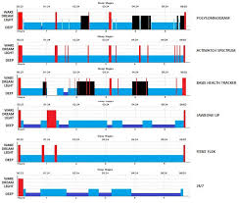

What I’ve Learned
We need to remain aware of the limitations of our methods!
The researcher stood in front of his data admiring the results with the error he couldn't see. "Oh, how impressive this is! A perfect fit!" everyone exclaimed. "What power! What patterns! The new methods are magnificent!"
The emperor stood in front of the mirror admiring the clothes he couldn't see.
"Oh, how they suit you! A perfect fit!" everyone exclaimed. "What colors! What patterns! The new clothes are magnificent!"
Hans Christian Andersen

Slide 11
Can’t We all just Agree on
Some StandardizeD Approaches and Methods?
Common Question

Slide 12
Major Consensus Conference
Objective Monitoring of Physical Activity: Closing the Gaps in the Science of Accelerometry. Med Sci Sports Exerc. 2005 November; 37(suppl):S487-S588.
Key Recommendations:
Encourage open-source technology to enhance comparability
Tap into cell phone technology
Develop core set of activities to employ in calibration studies
Avoid wrist placement

Slide 13
Another Consensus Conference
Objective Measurement of Physical Activity: Best Practices and Future Directions. Med Sci Sports Exerc. 2012 January; 44(suppl 1):S1-S89.\
Key Recommendations
“Monitor data should be collected and saved as raw signals with post-processing used for data transformation.”
“Organiz[e] multi-disciplinary teams … to develop tools, process data, and perform calibration/validation studies…”
“… discontinue development and use of cutpoint methods to define intensity categories…”

Slide 14
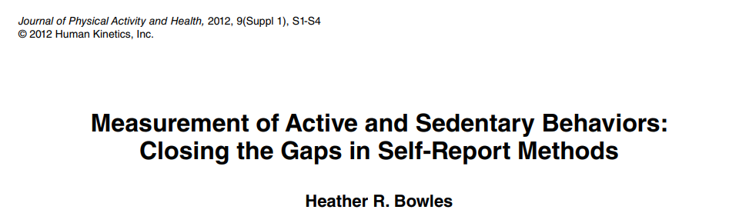
Another Important Conference
Closing the Gap in Self-Report Methods.
Journal of Physical Activity and Health, 9 (Suppl), S1-S122.

Slide 15
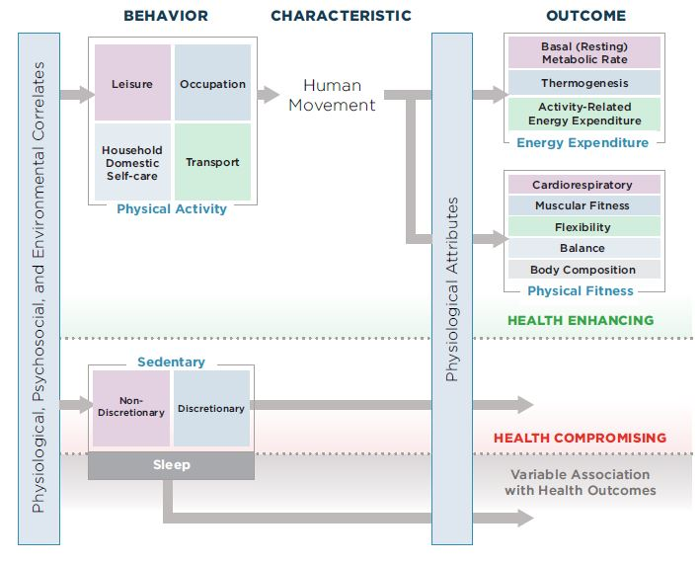
Conceptual Model of Physical Activity
Notes:
I rlly like this conceptual model of physical activity that came out of a consensus conference back in 2010. The model was published by Pettee-Gabriel, Morrow, & Woolsey, JPAH:9(suppl 1), 2012).
I like it because it depicts physical activity and sedentary behavior on the same image and describes them appropriately as health enhancing and health compromising. I also like it since it focused attention on physical activity as a behavior.
First, lets explore the different domains in more detail.
_____________________________________________________
Subsequent slides will guide user through the model.
The animations start in the upper left corner

Slide 16
Behavior
Characteristic
Consequence
Physical Activity
Physiological Attributes
Basal (or Resting) Metabolic Rate
Human
Movement
Energy
Expenditure
Thermogenesis
Activity-Related Energy Expenditure
Energy Expenditure
Cardiorespiratory
Muscular Fitness
Flexibility
….behavior that involves human movement, resulting in physiological attributes including increased energy expenditure and improved physical fitness…
(Pettee-Gabriel, 2012)
Balance
Body
Composition
Physical Fitness
Health Enhancing
Notes:
SAMPLE ANIMATION 2:
Returning to the definition of physical activity we see that the common characteristic of physical activity is “human movement” and that the consequence of this movement is energy expenditure.
However, the definition emphasizes movement that leads to increases in energy expenditure over baseline levels. This is important because most of our energy expenditure is for basal metabolism or thermogenesis.
However, it is the Activity- Related energy expenditure that contributes to the gains in physical fitness and improvements in health.

Slide 17


Multiple Domains / Settings
  Leisure-time PA
  Household / Domestic PA
  Work-related PA
  Transport-related PA
Leisure
Occupation
Physical Activity
Behavior
Household, Domestic,
Self-Care
Transport
Physical Activity
Physical activity is clearly a complex behavior
that is extremely difficult to assess
Notes:
SAMPLE ANIMATION 1:
Physical Activity is a complex behavior that is extremely difficult to assess.
There are multiple domains and settings for physical activity and each has different characteristics (animation)
Leisure Time PA
Household PA
Work Related PA
Transport-Related PA
The challenges of assessing activity are even more challenging with children due to more sporadic activity and intermittent activity patterns.

Slide 18
Two Steps Forward / One Backward?
Challenges
  Physical activity needs to be understood as a behavior
  Advanced methods are still complex to use for most people
  Continued challenges with standardization
Strategies and Opportunities
  Find good collaborators with PA assessment experience
  Network with other researchers
    Association: ISMPB (International Society for Measurement of Physical Behavior)
    Conference: ICAMPAM (International Conference for Ambulatory Monitoring of Physical Activity and Movement)
    Journal: JMPB (Journal for the Measurement of Physical Behavior):

Slide 19
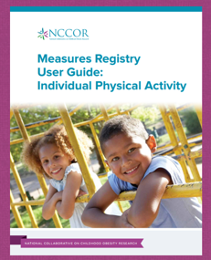
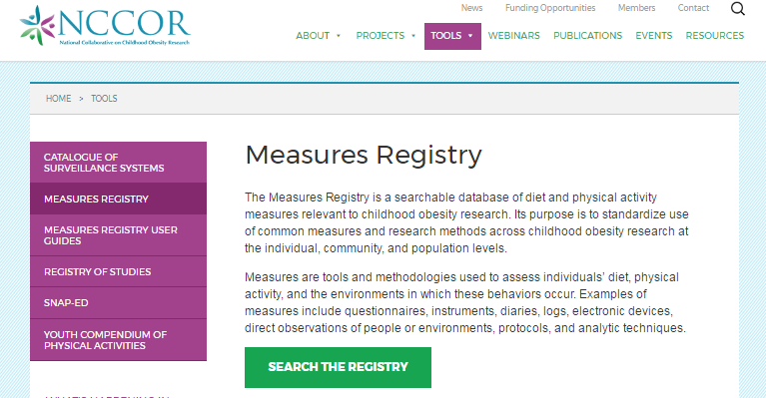
Considerations for Selecting Appropriate Measures

Slide 20
NCCOR Measures Registry
Consider resources on the NCCOR Measures Registry
  A web-based portfolio of nearly 1,400 studies on more than 100 discrete measures related to diet and physical activity.
Measures are categorized into four domains:
  Individual Diet
  Food Environment
  Individual Physical Activity
  Physical Activity Environment
NCCOR.org/measures
Notes:
David
Therefore, in order improve the capacity of researchers and practitioners to conduction research and program evaluation. NCCOR launched the Measures Registry in 2011, the Measures Registry is a web-based portfolio of nearly 1,400 studies on more than 100 discrete measures related to diet and physical activity.
Key features include:
Measure type
Number of items
Links to full text
Measures are provided if available
Study design & participant details
Validity & reliability
How to use the measure
Search and filter capabilities by:
By domain
By measure type
By age
By urbanicity

Slide 21
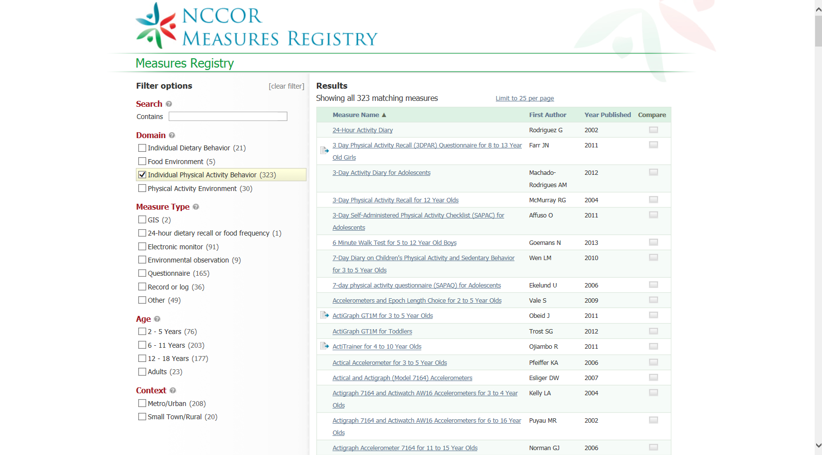
Notes:
This slide shows the hundreds of options for measures that would pop up if you were searching the Measures Registry to assess individual physical activity behaviors.
Making appropriate decisions can be difficult so it is important to provide an overview of some fundamental terminology

Slide 22
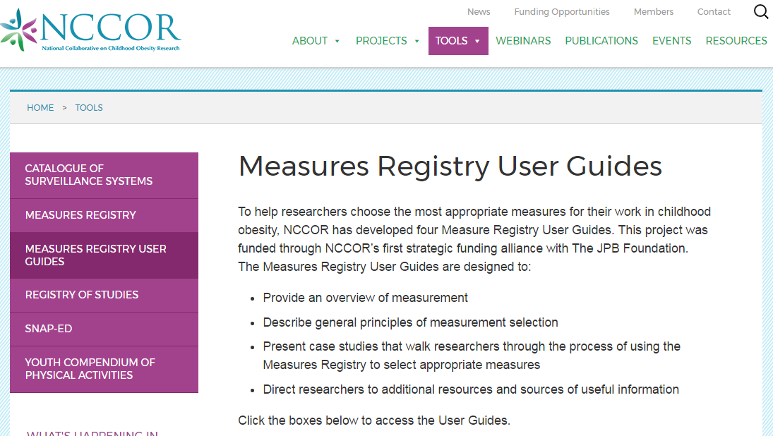
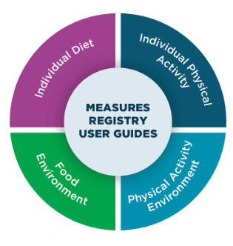
Measures Registry User Guides
http://www.nccor.org/nccor-tools/mruserguides/

Slide 23
Physical Activity and Sedentary Behavior
Report-based
Measures
Monitor-based
Measures
Accelerometers
Pedometers
HR monitors
GPS
Self-Report
Proxy Report
Diaries
Criterion Measures
Calorimetry
Observation
DLW
Notes:
The placement of physical activity and sedentary behavior in the center of the behavioral epidemiology framework is intentional since it signifies the centrality of accurate assessment methods to advance research in these areas.
The image explains that there are 3 major categories of measures but they are depicted with partially overlapping circles to illustrates the fact that the measures provide somewhat different information about physical activity.
Report-based measures include various types of self-report measures, including questionnaires, diaries, and logs.
Monitor-based measures include various measures that directly evaluate movement, including accelerometer-based activity monitors, pedometers, multi-sensor monitors, heart rate monitors, various smart phone apps, and global positioning system, or GPS, devices.
Criterion measures include the doubly labeled water technique, indirect calorimetry, and various direct-observation measures that involve direct coding of behavior, including time intensity, type, and location.
The focus of the NCCOR Measures Registry is field-based measures that are widely used in research applications. Other summaries have distinguished these types of measures as either “objective” or “subjective”, but this categorization infuses an inherent, unintentional bias. Both provide advantages for specific research applications and these are described in more detail in the actual User Guide. Additional modules will also provide additional information about each category.

Slide 24

Measures Registry Learning Modules
https://www.nccor.org/nccor-tools/measures-registry-learning-modules/

Slide 25
Perspectives on Evaluating PhYsical Activity Monitors
Examples from Monitor Validation Studies
Notes:
Abstract
The rapid progression of research in objective physical activity monitoring has opened up many new opportunities as well as new research challenges. The lines between research and consumer monitors is clearly blurring and there are new technologies emerging with smartphones and wearable sensors that will further expand possibilities for research and clinical applications. This presentation will summarize lessons learned from systematic evaluations of various activity monitoring technologies and provide guidelines for effective evaluation of new monitoring methods. Specific focus will be placed on recent evaluations of new consumer monitoring technologies and wearable sensors as well as applications of monitors for behavioral change and clinical applications.

Slide 26
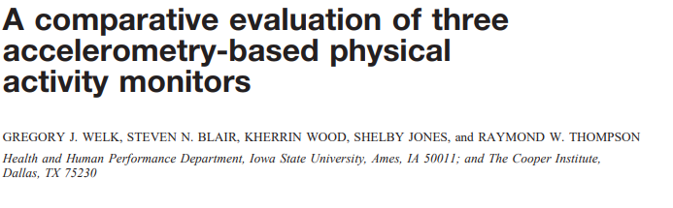
My Early Exploration of Measurement Agreement in PA Research (2000)

Slide 27
Evaluation of Prediction Equations:Treadmill Condition
Measured and Predicted MET Values for 3 Different Treadmill Paces
(Welk et al., MSSE: 32(9), S489-S498, 2000)
Notes:
This shows the MET values for the 3 monitors for 3 different treadmill paces against the metabolic cart values. The values for the CSA were remarkably close for all 3 paces
One thing, I wanted to point out though is that these relationships are based on mean data. When examining this type of data it is also important to examine individual variability in scores.

Slide 28
Evaluation of Prediction
Equations: Lifestyle activities
CSA equation was compared to measured
EE from a portable cart for various lifestyle activities
(Welk et al., MSSE: 32(9), S489-S498, 2000)

Slide 29
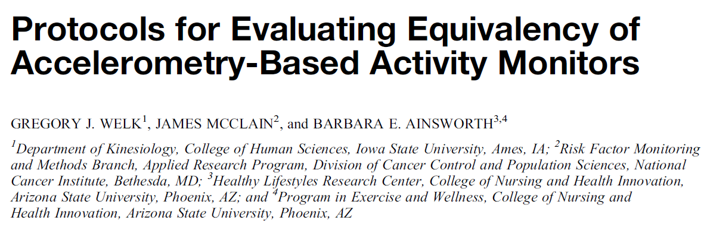
Best Practices for Validation Protocols
Standardization is needed to compare outcomes from different monitors and studies
Key Needs
  Incorporation of a range of activities and intensities
  Capturing data from a diverse population
  Comparing multiple monitors (Notion of Standard of Care)

Slide 30
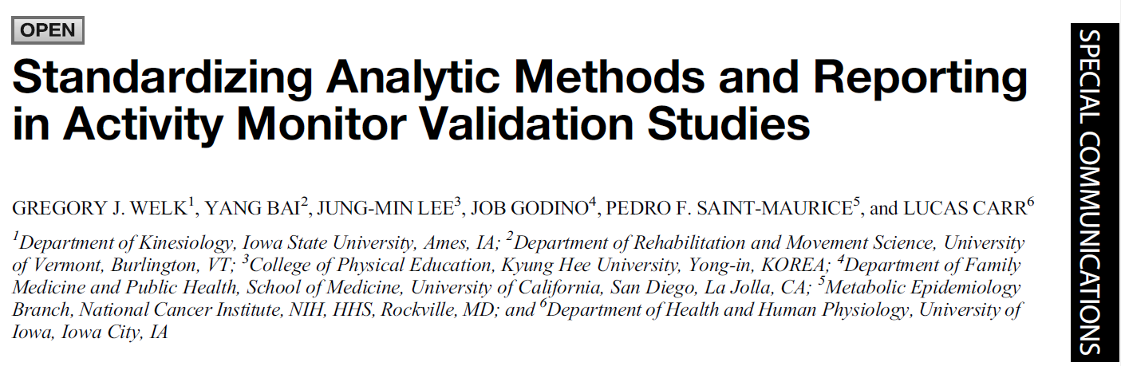
Best Practices for Analytic Methods
A major limitation in physical activity assessment research is inconsistent and inappropriate evaluation methods
Two Key Points
  Encouraged Reporting of Mean Absolute Percent Error (MAPE)
  Encouraged use of ‘equivalence testing’ to evaluate agreement

Slide 31
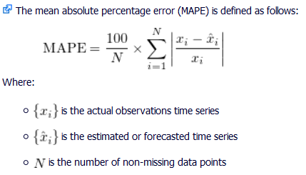
Calculation and Interpretation of MAPE
Mean Absolute Percent Error (MAPE) provides a more appropriate indicator of accuracy
MAPE is simply a mean
of the absolute differences
MAPE enables effective
comparisons across studies,
monitors, and methods.

Slide 32
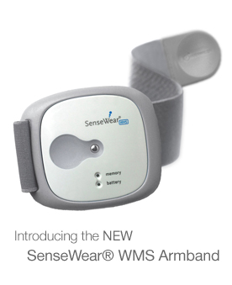
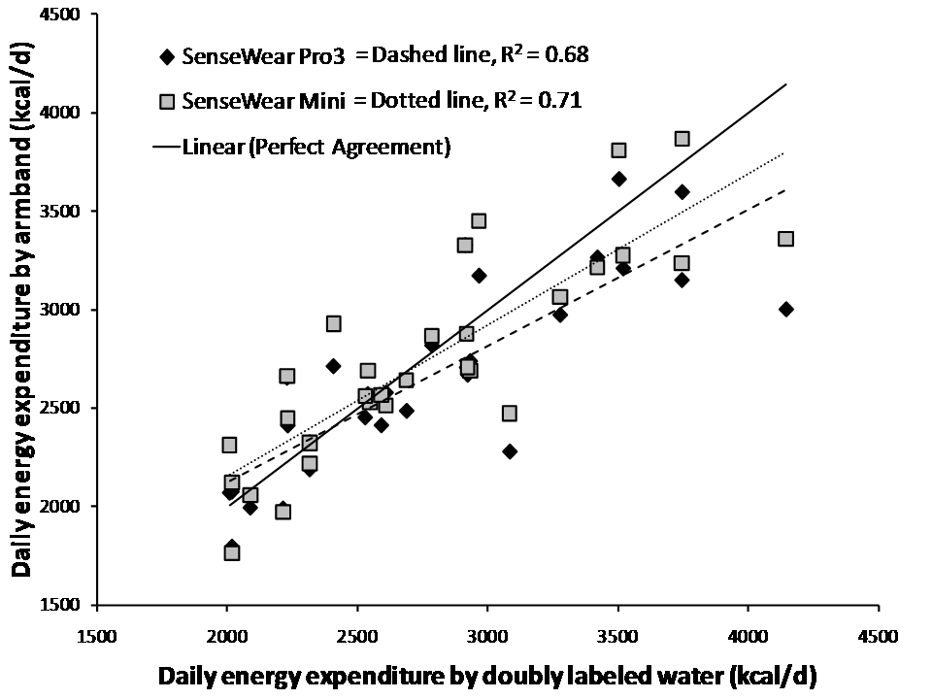
Comparison of Error and MAPE:
Sensewear DLW Studies
    Adults (Johannsen, 2010) ¹
      Total Error: 22 kcal/day
      MAPE: 8.3%
    Youth (Calabro, 2012) ²
      Total Error: 44 kcal/day
      MAPE: 11.7%
    Seniors (Calabro et al., 2010) ³
      Total Error: -21.5 kcal/day
      MAPE: 8.0%
r= 0.83
r= 0.84
¹ Johannsen DL et al. (2010) Medicine and Science in Sports and Exercise, 42(11): 2134-2140
² Calabro et al. (2013) Medicine and Science in Sports and Exercise 45(7): 1311-1322
³ Calabro et al.,(2014) European Journal of Clinical Nutrition, 1–6
Notes:
Our studies with doubly labelled water have evaluated accuracy over 2 full weeks. Average error is within about 20-40 calories. The real error (as calculated with Mean Absolute Percent Error) is about 8-12% across the 3 studies.
These error rates have been shown to be lower than other monitors so they provide good point of reference for comparison.

Slide 33
Insights and Examples from
Past Research with Monitors
Evaluation of Consumer-Based Activity Monitors
Evaluation of New Integrative Approaches with Monitors

Slide 34
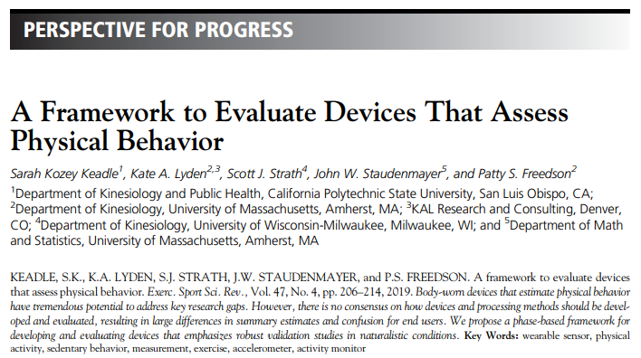
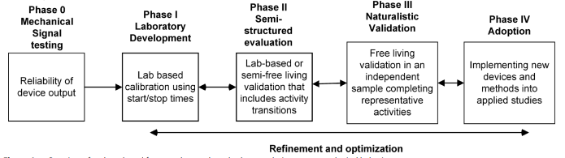
Progress Toward Standardization

Slide 35
Perspectives on Report-Based Measures of Physical Activity
Notes:
Abstract
The rapid progression of research in objective physical activity monitoring has opened up many new opportunities as well as new research challenges. The lines between research and consumer monitors is clearly blurring and there are new technologies emerging with smartphones and wearable sensors that will further expand possibilities for research and clinical applications. This presentation will summarize lessons learned from systematic evaluations of various activity monitoring technologies and provide guidelines for effective evaluation of new monitoring methods. Specific focus will be placed on recent evaluations of new consumer monitoring technologies and wearable sensors as well as applications of monitors for behavioral change and clinical applications.

Slide 36
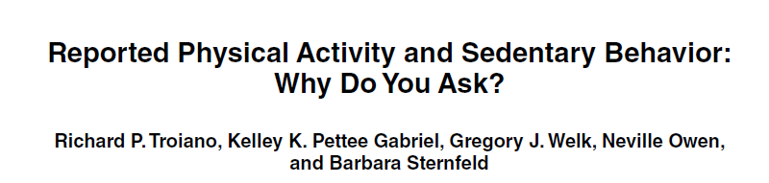
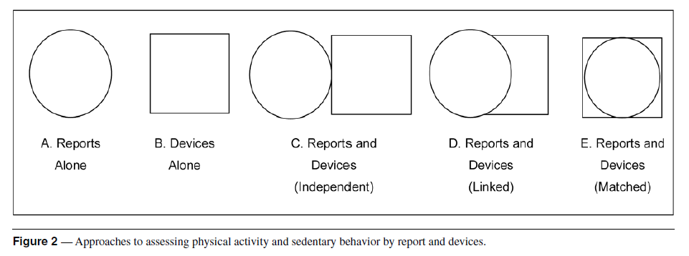
Value of Report Measures
Workshop on Measurement of Active and Sedentary Behaviors: Closing the Gaps in Self-Report Methods (2010)

Slide 37
Summary of Report – Based Measures
Report–based measures provide valuable context on physical activity behaviors
Calibration methods provide utility for anchoring or linking report-based data to monitor-based estimates.

Slide 38
Closing Thoughts?

Slide 39
Physical Activity Assessments (Finding the Right Balance)
Diaries
Diaries
Self-reports
Self-reports
Pedometers
Pedometers
HR monitors
HR monitors
Accelerometers
Accelerometers
Direct observation
Feasibility
Direct observation
DLW
Indirect
Calorimetry
DLW
Indirect
Calorimetry
Validity
Notes:
As an applied physical activity researcher I am interested in the range of different activity assessment tools and have used all of them on the list in various combinations to try to understand physical activity behavior.
The key point of the slide is that there is an inverse association between feasibility and validity of PA instruments. Monitors that are the most valid tend to not be as feasible for large scale applications. So the inherent goal is to keep shift
There is an inverse association between feasibility and validity of PA instruments

Slide 40
Thanks for your Attention
Happy to Visit More and Help with Any Questions
Greg Welk
gwelk@iastate.edu

Slide 42
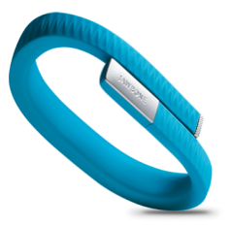
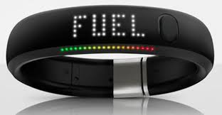
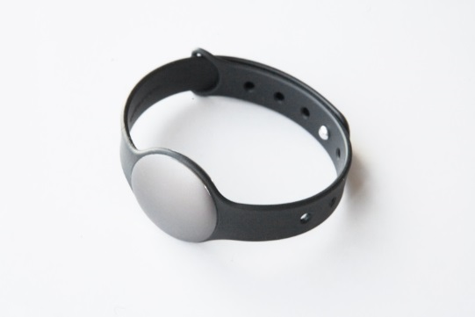
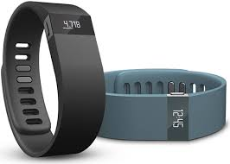
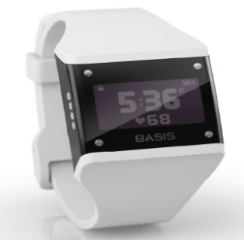
Evaluation of Consumer
Activity Monitors
Common Questions:
  Which is the best monitor
  How accurate are they?
  Can you use them in research?
Notes:
The basic questions with monitors is “do they work” and “how can they most effectively be used to promote activity”

Slide 43
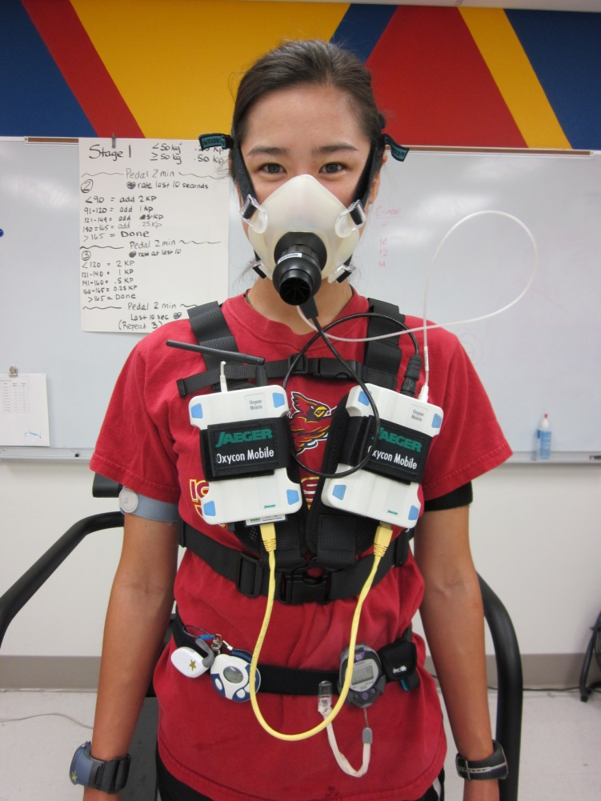
Pilot Study on Consumer Activity Monitors (2013)
BodyMedia Fit | Right Arm
BodyMedia Fit | Left Arm
Fitbit | On Right side belt
DirectLife | Chest with a necklace chain
DirectLife | On right side belt
Gruve | Left side belt
Omron | Left side belt
KAM | Right side belt
Polar HR | Chest
GPS/Foot pod | Wrist
Multiple monitors / Oxycon Mobile Criterion / Simulated Free Living Activity
Notes:
When the monitors first came out, we were as curious as anyone about whether they worked so we started studying them. We bought stock monitors and tested them in similar ways as we had done with research monitors.
This slide shows the typical arrangement with a participant wearing a variety of monitors on wrist and waist while being monitored with an Oxycon Portable Metabolic Cart. This is a nice system for this type of work since the person can walk around and move about without being connected to a cart.

Slide 44
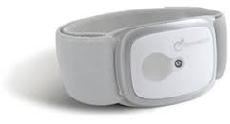
Pilot Study Results:
Mean Absolute Percent Error
Notes:
The results were somewhat surprising to us.
We found the consumer version of the Armband (Go Wear Fit) to be the most accurate with similar MAPE as our other studies but we found somewhat similar performance for other monitors.
There was a lot of variability but we decided that we needed to examine this in more detail.

Slide 45
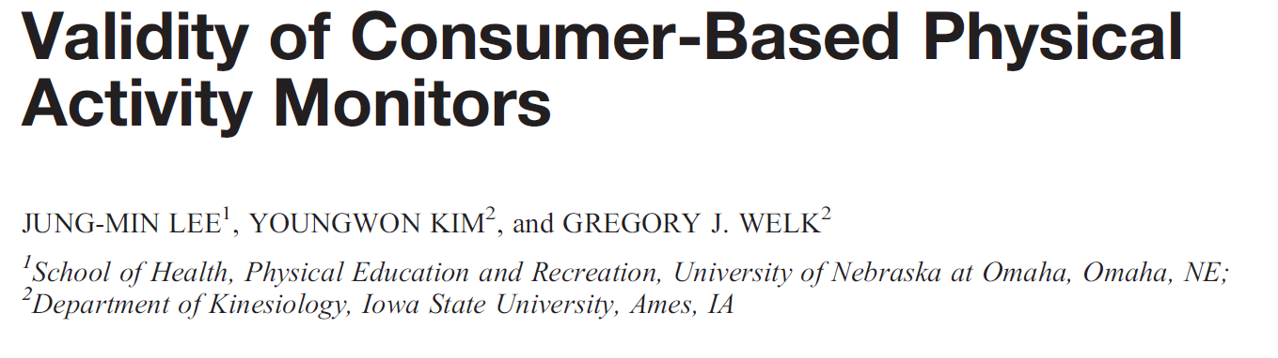
Study 1 (2015)
(Lee et al., 2015 – MSSE)
Examined accuracy of EE estimates during simulated lifestyle activities (Criterion Measure: Oxycon Mobile)
Mix of waist and wrist monitors

Slide 46
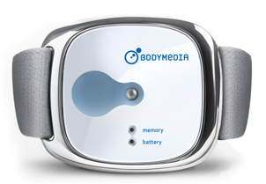
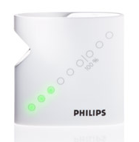
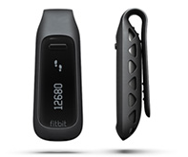
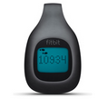
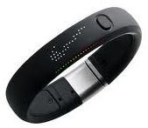
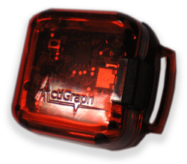
Study 1: Monitors and Design
  Participants performed an array of simulated free-living activities (lifestyle PA)
  Oxycon Mobile: Portable metabolic analyzer as the criterion measure.
  Consumer-Based Activity monitors
  1) BodyMediaFit (BMF): Research Monitor
  2) DirectLife (DL):
  3) Fitbit One (FO):
  4) Fitbit zip (FZ):
  5) Jawbone UP (JU):
  6) Nike+Fuel Band (NFB):
  7) Basis B1 Band (BB):
  8) ActiGraph (ACT): Research Monitor
Consumer Monitors
Notes:
The first study we did evaluated a number of these monitors under standardized conditions.

Slide 47
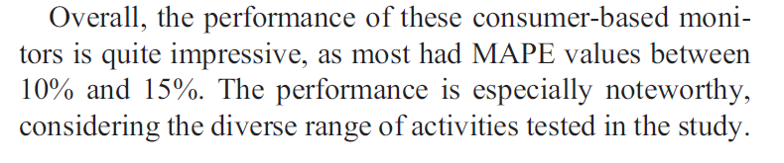
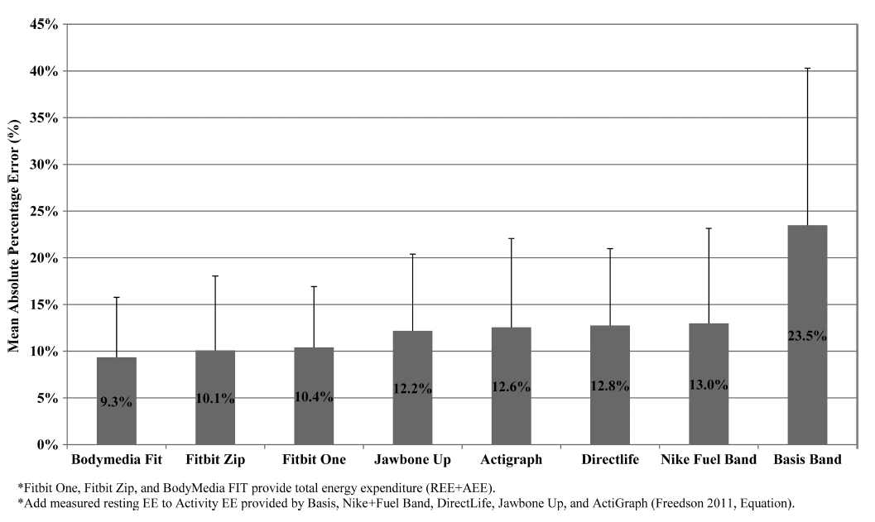
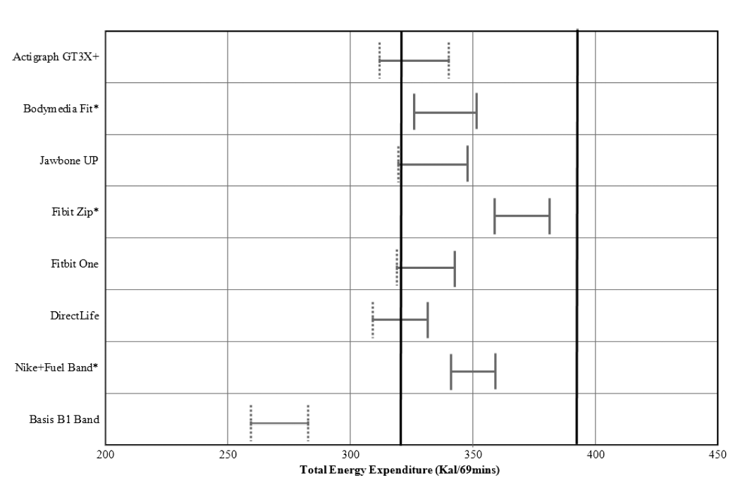
Study 1 – Results / Conclusion

Slide 48
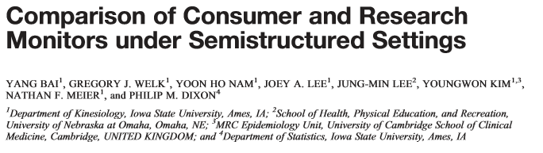
Validation Study 2 (2016)
(Bai et al., 2016 - MSSE)
Evaluated accuracy of EE estimates during a simulated sedentary and exercise protocol.
Evaluated ‘new(er)’ monitors

Slide 49
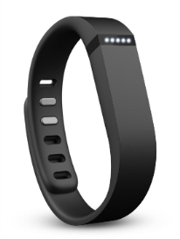
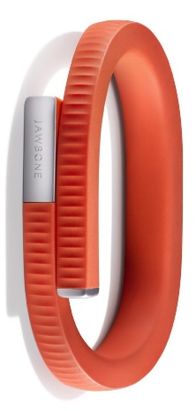
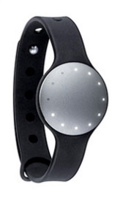
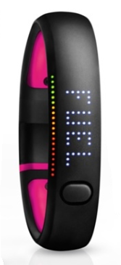
Study 2: Monitors and Design
Four Wrist Monitors
Simulated Workout Protocol
20’ sedentary activity
  Self selected (e.g. typing, writing, TV, computer, read
25’ aerobic exercise on treadmill
  Self selected speed
25’ resistance exercises
  Self selected exercises, loads, reps
Notes:
Here we changed the design a bit and tried to replicate more of a typical usage by capturing 20 minutes of sedentary time, a 25 min bout of aerobic activity and a 25 minute bout of resistance exercise.
Thus, it is simulating a typical workout a person might take after being at work for a while.

Slide 50

Study 2: Results
(Mean Absolute Percent Error)
Consumer Monitors
Notes:
This slide shows the results of this second study.
Again, the overall results showed pretty good agreement for the whole protocol

Slide 51

Study 2: Results
(Mean Absolute Percent Error – by activity)
Selected Consumer Monitors
Error rates for each specific activity were typically above 30%
Notes:
However, when we examined the error for individual activities we noted a lot higher error for individual activities. For example, the Fitbit Flex had error rates of about 30%
Now, you might wonder, how can a monitor have overall error of about 15% when the error of individual activities is consistently about 30%

Slide 52
Study 2: Results
Evaluation of Errors by Activity
 | Total Error | SB Error | AE Error | RE Error
AG3X | -11.9 (59.3) | 5.8 (21.5) | 20.5 (47.5) | -38.3 (25.4)
BMC | 35.5 (44.5) | 3.9 (6.1) | 16.3 (30.3) | 15.4 (25.9)
FBF | 20.4 (54.0) | -5.5 (22.5) | 51.9 (44.1) | -25.5 (20.6)
JU24 | -23.1 (63.5) | -11.0 (8.1) | 35.3 (58.4) | -47.2 (22.1)
MF | 72.4 (87.2) | -5.7 (7.6) | 109.5 (83.8) | -30.8 (21.7)
NFS | -42.3 (55.1) | -6.5 (7.1) | -9.2 (43.7) | -26.3 (22.9)
PL | 67.6 (152.3) | 2.2 (43.8) | 14.3 (80.8) | 48.9 (76.6)
Cancellation
of
Errors
Notes:
This explains how the errors can sometimes cancel out. The Bodymedia had low error for all activities but they were all in the same direction so somewhat added to overall error.
The other monitors tended to have error that cancelled

Slide 53





Validation Study 3 (2017)
(Bai et al., 2017
Comparison of Apple Watch and
Fitbit Charge HR
Integration of HR with accelerometer
data should theoretically improve
the accuracy
Notes:
I wanted to share one set of new analyses that is currently in review. Yang Bai is the lead author of this study as well and we compared the performance of the two leading monitors that now incorporate HR
The integration of HR should improve the estimates but this hasn’t been tested. The companies don’t really tell how they estimate EE or MVPA but the website for the Apple Watch suggests that they are using both channels / sensors.

Slide 54

Results of Study 3:
Energy Expenditure
MAPE (overall trial):
  Apple Watch: 15.2%
  FitBit Charge HR: 32.9%
Apple Watch slightly underestimated EE but approached “equivalence” while Fitbit overestimated
Error for Light and MVPA was considerably higher for FitBit than Apple Watch
Notes:
The overall results were pretty favorable for Apple Watch with about 15% error. The results for the Fitbit were not as good.
We also evaluated overall statistical equivalence and found the Apple Watch to come close to meeting the criteria while the FitBit overestimated EE

Slide 55


Summary of Consumer Monitors Research
Considerable variability in accuracy of consumer monitors
Challenges remain in using them for research or for clinical applications
Notes:
In general, there is considerable variability in accuracy of monitors
The features may limit utility for research and clinical applications.
A big challenge is that it is difficult to compare methods (BLACK BOX)

Slide 57

Example of Evaluating and Refining Processing Methods
An Example of Research with Sojourns

Slide 58



Overview of Sojourns Method
(Lyden et al., 2014, MSSE)
Looks for periods of rapid acceleration or deceleration to identify bout boundaries
Assigns MET Value from 1-1.5
Decision Tree:
Sedentary or not
Estimates METS with Neural Net
“counts” data from 3 axes in 1-sec. epochs

Slide 59
Conceptual Depiction of Sojourns
Direct Observation
Grouping Activity
By bout
Grouping Activity
By minute

Slide 60
Limitations with Sojourns
Black-box nature of neural network
Validated with a homogeneous sample of young, active, fit individuals
Potential problems with identifying bout boundaries
  If changes in intensity of activity (acceleration/deceleration) are not rapid enough to trigger the software

Slide 61

Sojourns Including Posture (SIP)
(A Multi-Sensor Adaptation to Sojourns)
Research on Refining Sojourns
  Collaboration with Dr. Laura Ellingson
Integration of ActivPAL:
  Corrects for mistakes in sedentary vs. light categorization
  Adds additional candidate bout boundaries
    Refine estimates of energy expenditure
    Improves estimates of moderate and vigorous intensity activities

Slide 62




Measures
Comparison Measures
  Actigraph
  ActivPAL
  Senswear
Criterion Measures
  Oxycon-Mobile
  Compendium

Slide 63
Met comparisons - Sedentary Time
MAPE < 20%
MAPE 20-40%
MAPE > 40%
MAPE = Mean Absolute Percent Error

Slide 64
Met comparisons – Light intensity
MAPE < 20%
MAPE 20-40%
MAPE > 40%
MAPE = Mean Absolute Percent Error

Slide 65
Met comparisons – Moderate intensity
MAPE < 20%
MAPE 20-40%
MAPE > 40%
MAPE = Mean Absolute Percent Error

Slide 66
Met comparisons – Vigorous intensity
MAPE < 20%
MAPE 20-40%
MAPE > 40%
MAPE = Mean Absolute Percent Error

Slide 67
SOJOURNS
Overall
Accuracy: 56%
Kappa: 0.41
Overall
Accuracy: 79%
Kappa: 0.71
SIP
% of measurements that were correctly classified using The Compendium as the criterion
Notes:
Kappa measures agreement between methods

Slide 68
Summary of Sojourn
Sojourn is a robust method for assessing physical activity with Actigraph data (with or without refinement)
Coding is all open-source and available in R
  Managed by Paul Hibbing and Kate Lyden
  https://cran.r-project.org/web/packages/Sojourn/index.html

Slide 70
Overview of FLASH
An Open Source Dataset with Integrated Monitor and Report Data
Notes:
Abstract
The rapid progression of research in objective physical activity monitoring has opened up many new opportunities as well as new research challenges. The lines between research and consumer monitors is clearly blurring and there are new technologies emerging with smartphones and wearable sensors that will further expand possibilities for research and clinical applications. This presentation will summarize lessons learned from systematic evaluations of various activity monitoring technologies and provide guidelines for effective evaluation of new monitoring methods. Specific focus will be placed on recent evaluations of new consumer monitoring technologies and wearable sensors as well as applications of monitors for behavioral change and clinical applications.

Slide 71

Background for FLASH Project
Built as an extension of the PAMS Project
  Physical Activity Measurement Survey NIH: 1 R01 HL91024-01A1
Capitalizing on context from ACT 24
  Value of Triangulation and Contextual
Open Access Dataset
  Hibbing et al., 2021
Notes:
Value of Triangulation
Insights from PAMS
Replicate 24 hour profiles (SWA and 24hPAR) from a representative sample of about 1500 adults – Focus on measurement error

Slide 72






Design and Measures
Convenience Sample of Adults
24 hour monitoring
  Bodymedia Sensewear (arm)
  Actigraph (wrist – both L and R)
  Actigraph (waist) Axivity (wrist)
  GENEActiv (wrist)
  ActivPAL (thigh)
Direct Observation (30-60’) - Subsample)
Self-Report: 24-hour recall with Act24

Slide 73

Value of Sensewear Data
Provides reference comparison for other methods
  Early pattern recognition approach
  Strong validation evidence for estimation of EE
Provides true
indicator
of ‘wear time’
Multi-sensor activity monitor
  3-axis accelerometer
  Heat flux
  Galvanic skin response (GSR)
  Skin temperature
  Near body ambient temperature

Slide 74
Value of Act24 Data
Provide valuable data on context of PA and SB
Provide reported data on sleep for 24hr studies
Activity | n | % Reported | MeanDuration
Walking for transportation | 421 | 69.77 | 11.56
Driving or riding in car / truck | 322 | 69.77 | 17.66
Eating a meal or snack | 267 | 85.27 | 27.88
Educational pursuits | 226 | 45.73 | 82.79
Sleeping; or in bed | 198 | 100 | 305.28
Dressing or undressing | 140 | 65.11 | 10.36
Watching TV; movies; DVDs | 133 | 52.7 | 81.50
Grooming activities | 132 | 62.79 | 17.20

Slide 75

Example of Data Integration with ACT24 Nick Lamoureux, Ph.D. student)
Measurement Agreement
  Act 24
  Sensewear
  Sojourn
Act24
SWA
Sojourn
Notes:
We have been working on a large project to evaluate measurement error in self-report and accelerometer data. Sarah shared some of the concepts for evaluating error in the webinar so I thought I would describe a bit more about the project and present some preliminary results.

Slide 76


Using Act24 to contextualize physical activity assessment error
Highest MAPE Activities
Lowest MAPE Activities

Slide 77
Summary
FLASH dataset provides a useful free-living data set linking report-based and monitor-based methods
Value
  Temporal comparisons of methods and metrics
  Insights about the context of activity
  Platform for data sharing and comparisons

Slide 79
Examples of Calibration Research with Report Measures

Slide 80


Why calibration?
% Body Fat
6 mm
Minutes of MVPA
3.5

Slide 81
Principles of Calibration
Diaries
Self-reports
Calibration and Validation of Report-Based Measures
Pedometers
HR monitors
Accelerometers
Feasibility
Calibration and Validation of Monitor-Based Measures
Direct observation
DLW
Ind. Cal.
Validity
Notes:
There is an inverse association between feasibility and validity of PA instruments

Slide 82

Overview of the Youth Activity Profile
Available online to support collection of physical activity for school-based applications
(Teachers and Researchers)
Collaborators :
Gregory Welk, Ph.D.
Pedro Saint-Maurice, Ph.D.
Phillip Dixon, Ph.D.
Yang Bai, Ph.D.
Paul Hibbing, Ph.D.
Gabriella McLoughlin, Ph.D.
Joey Lee, Ph.D.
www.youthactivityprofile.org)

Slide 83
Description of the Youth Activity Profile
The YAP is an online report tool designed to capture a profile of children’s physical activity and sedentary behaviors
The YAP can be completed by youth 3rd grade and older in 15-20 minutes
School Items (5)
Out-of-School Items (5)
Sedentary Items (5)
PA to School
PE
Recess
Lunch
PA from School
Before School
After School
Evening
Saturday
Sunday
Computer Time
TV time
Video Games
Cell Phone
Sedentary

Slide 84

1
2
3
4
5
3
5

Slide 85

Youth Activity Profile:
Calibration Process
Assessment Protocol (1 Week)
S M T W T F S
Notes:
Participants were asked to wear the SWA for 7 days, and complete the YAP once they were done with the SWA protocol. This same procedures were replicated a week later. (2nd measurement cycle).

Slide 86
Methodology: Data Processing
2. Activity during Physical Education Class
a. I didn’t have physical education
b. Almost none of the time
c. A little bit of the time
d. A moderate amount of time
e. A lot of the time
f. Almost all of the time
3. Activity during Breaks/Study Hall:
a. I didn’t have breaks
b. Almost none of the time
c. A little bit of the time
d. A moderate amount of time
e. A lot of the time
f. Almost all of the time

Slide 87

Calibration Results: School
Individual Level Agreement
In School
r = .58
The associations reflect moderate associations at the individual level.
Group Level Agreement
School Diff. = -15.6 ± 6.2 min

Slide 88





Youth Activity Profile Calibration
New Algorithms with Online Tool
www.YouthActivityProfileResearch.org

Slide 89


Summary
Calibration methods enable report-based data on the YAP to estimate time spent in MVPA and sedentary behavior
Calibration methods also provide value in adding context to monitor-based data
  Quantile regression methods were used to create population estimates of MVPA from MIMS

Slide 90


General Concept
Create Percentiles of GPAQ Data from matched sample
Quantile Regression methods (zero-inflated models)
  Link percentiles of MIMS to
  percentiles of GPAQ
  Handle issues with zeroes
  Avoids assumptions of linearity

Slide 92





Comparisons with other
‘Vital Signs’
Blood Pressure
  Many Devices
  Standard Metrics
    Systolic BP (mmHg)
    Diastolic BP (mmHg)
Physical Activity
  Many Devices
  Various Metrics
    MVPA (min)
    TEE / AEE (kcal)
    Steps
For EIM applications, compliance with PA guidelines is critical.
Indicators of EE (e.g. MetMin) offer most promise for standardization
Notes:
The key difference that complicates the

Slide 93

Considerations with WAMs
Monitor location
  Wrist is comfortable for consumers
  Wrist is not ideal for modeling PA
Differences across Monitors
  Consumer Monitors
  Research Grade Monitors
Available monitors use different sensors and different methods to provide different information in different formats with different accuracy

