Slide 1

Objective Measurement of Physical Activity:
Application and Interpretation
Or Why? How? Wazzit Mean?
Richard P. Troiano, Ph.D.

Slide 2
Session Objective
Encourage and (begin to) equip you to think about what you want/need to measure and why

Slide 3
Wherefore Today?
Why use objective measures and what do you get?
Types of objective measures (briefly)
National data (NHANES 2011-1014)
Bonus – other NHANES measures of potential interest

Slide 4
Accelerometer Cites in Scopus 1995-2020
“physical activity” OR exercise AND acceleromet*

Slide 5
National Surveillance with Devices
National Health and Nutrition Survey of Japan (pedometers) (annually since 1989)
US National Health and Nutrition Examination Survey (NHANES) 2003-2006, 2011-2014
Canadian Health Measures Surveys (2007-11)
Health Survey for England 2008
Australian National Nutrition and Physical Activity Survey (NNPAS) 2011-2012 (pedometers)
Finnish Health 2012

Slide 6
Large Cohorts with Devices
Activity and Function of the Elderly in Ulm (ActiFE Ulm)
Avon Longitudinal Study of Parents and Children (ALSPAC)
Child Heart and Health Study in England (CHASE)
European Youth Heart Study (EYHS)
German National Cohort
Identification and Prevention of Dietary- and Lifestyle-Induced Health Effects in Children and Infants (IDEFICS)
International Study of Childhood Obesity, Lifestyle and the Environment (ISCOLE)
Millennium Cohort Study
Personal and Environmental Associations with Children’s Health (PEACH)
Raine Study
Sport Physical Activity & Eating Behaviour: Environmental Determinants in Young People (SPEEDY)
UK Biobank
Women’s Health Study

Slide 7
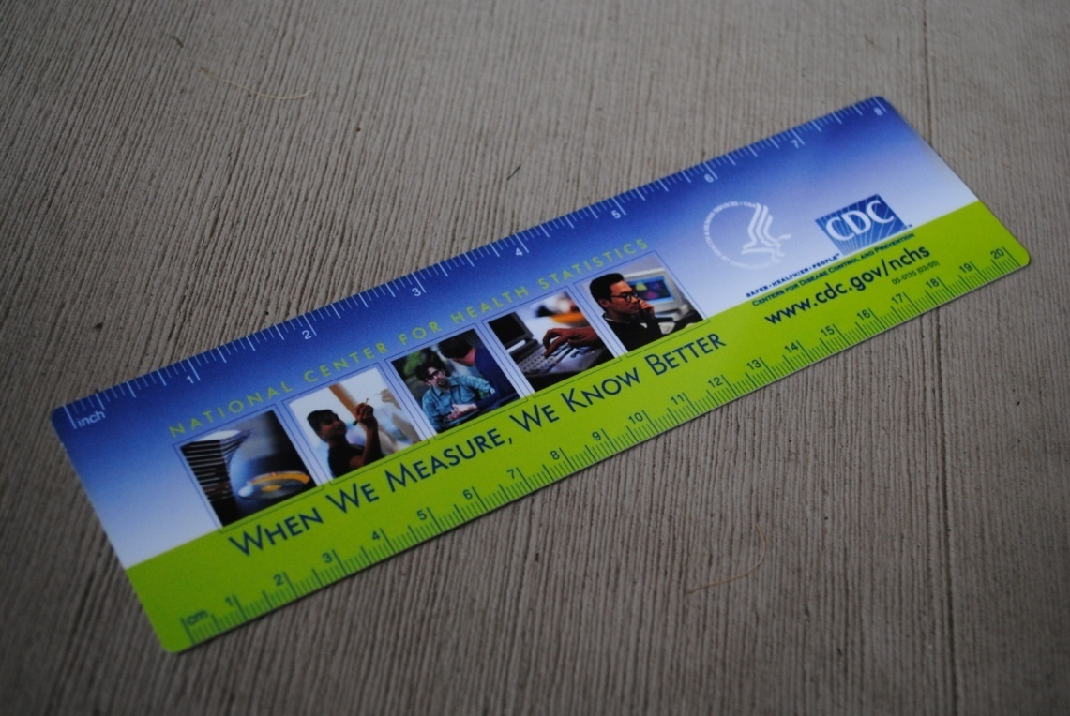
Why?

Slide 8
Accelerometer Benefits

Slide 9
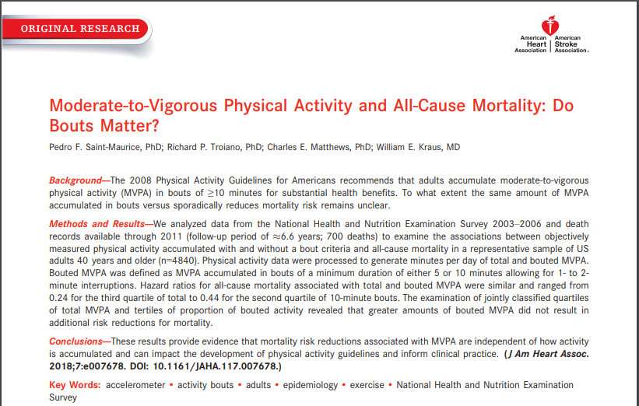
Precise Time Resolution

Slide 10
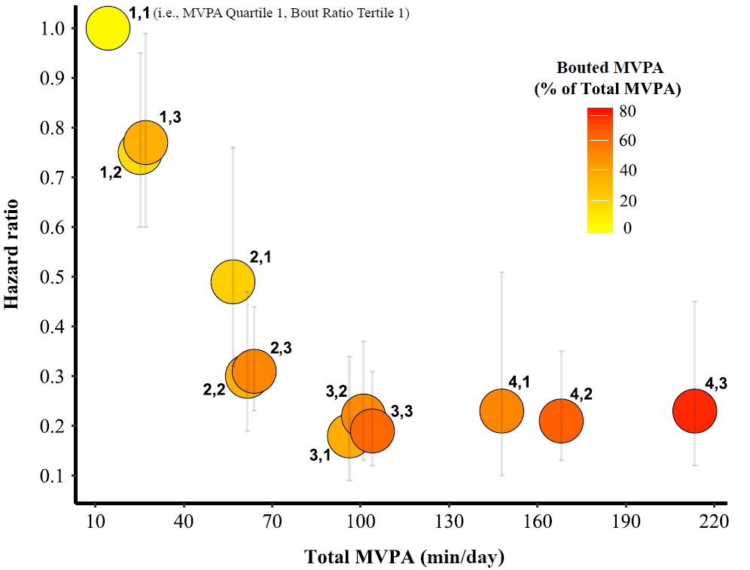
Contribution of MVPA Bouts to Mortality Benefit
> 5 min bouts,
760 cpm cutpoint
Saint-Maurice, et al. 2018. JAHA

Slide 11
Stronger Biomarker Associations
Biomarker | Self-report |  | Accelerometer
 | Beta (SE) | Adj. Wald F | Beta (SE) | Adj. Wald F
SBP | 0.01 (0.03) | 0.23 | -0.43 (0.14) | 8.89**
BMI | -0.04 (0.01) | 14.95*** | -0.77 (0.08) | 86.71****
HDL (mg/dL) | 0.10 (0.03) | 8.54** | 1.41 (0.27) | 27.77****
Glycohemoglobin | -0.004 (0.001) | 7.91** | -0.05 (0.01) | 47.11****
Glucose | 0.01 (0.07) | 0.06 | -1.67 (0.30) | 30.77****
Insulin (μU/mL) | -0.08 (0.03) | 10.15** | -1.11 (0.12) | 81.53****
** p < 0.01
*** p < 0.001
**** p < 0.0001
Minutes in bouts, Beta per 10 min unit
Atienza et al., 2011 MSSE

Slide 12
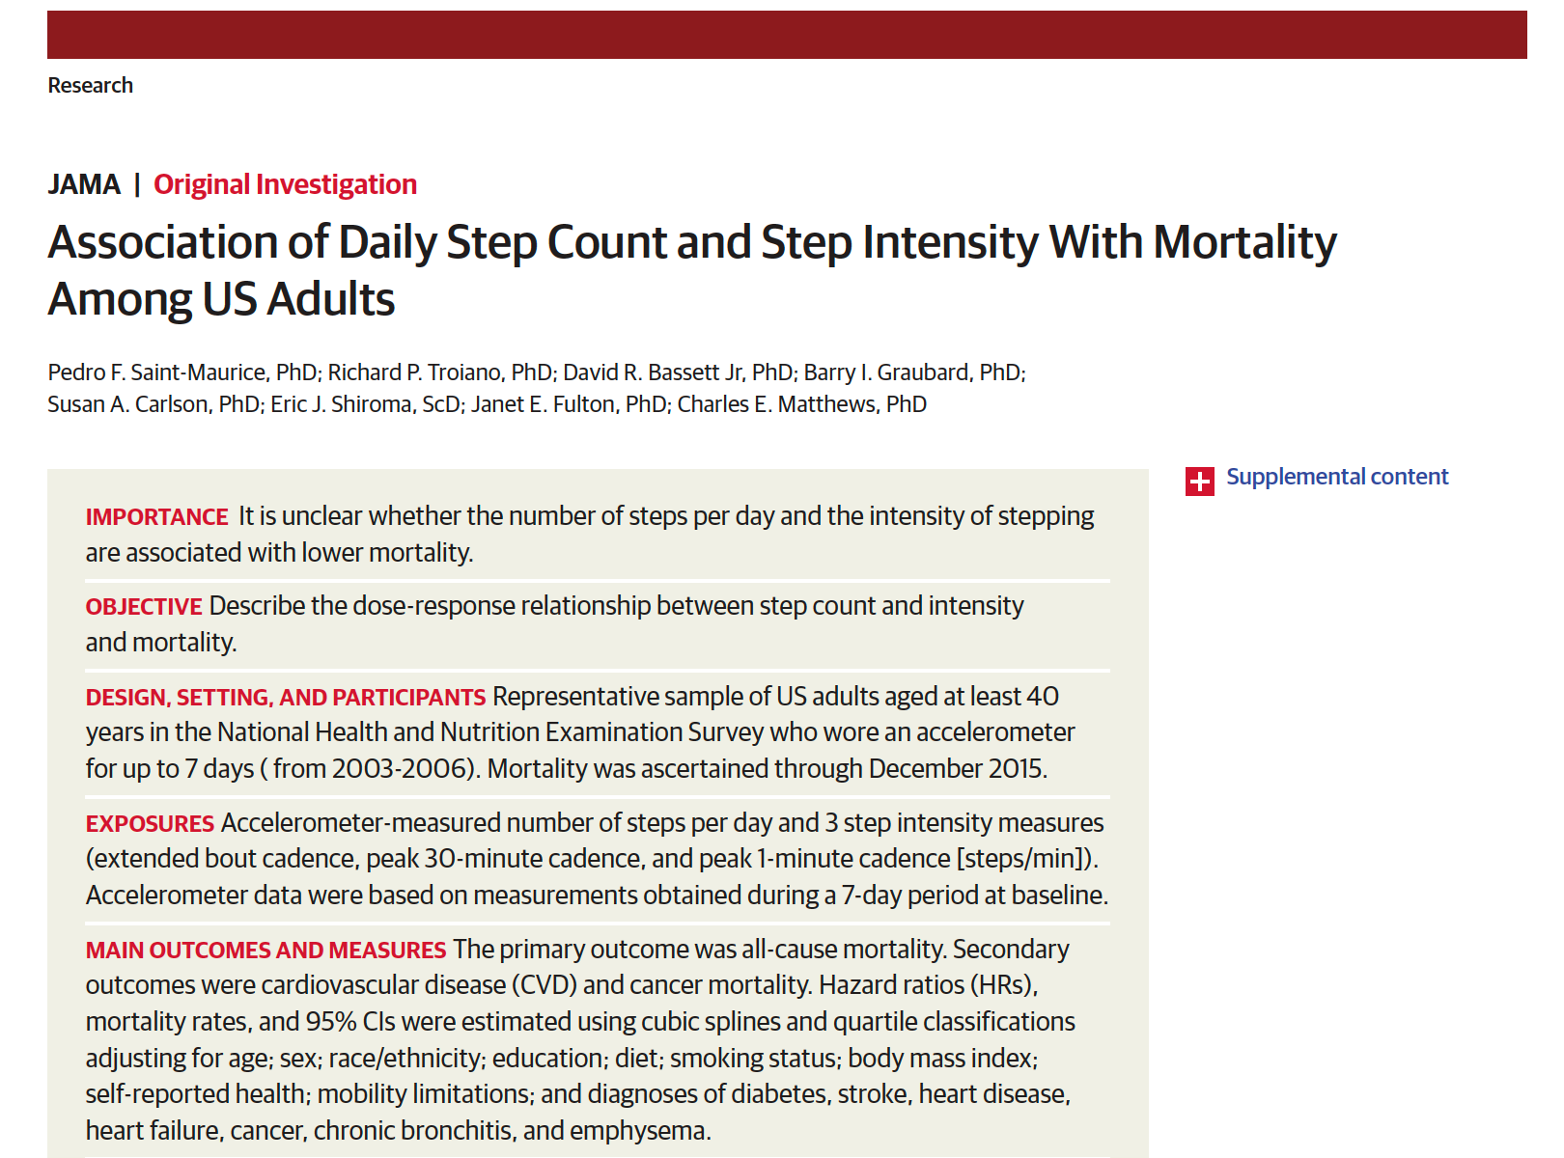
Potential to Flummox Reviewers
JAMA. 2020;323(12):1151-60

Slide 13
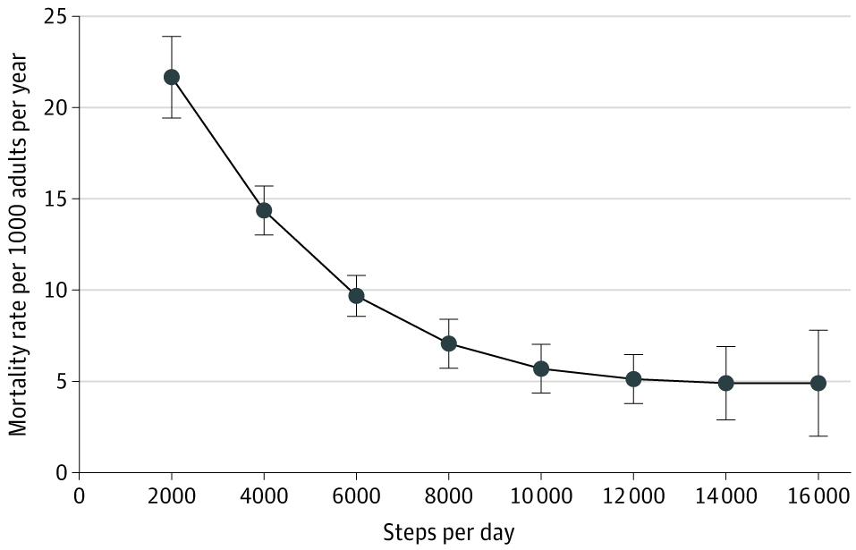
Unbelievable Mortality Reduction
Steps per Day and All-Cause Mortality in a Study of the Association of Daily Step Count and Step Intensity With Mortality Among US Adults Aged at Least 40 Years
Reviewer:
“It is not clinically plausible that an increased step count is independently associated with a 50-70% reduction in mortality risk. There is either a significant problem in the study design or analysis, or the study has a very high level of residual confounding. …”
HR = 0.49 for
8000 vs 4000 steps/d

Slide 14
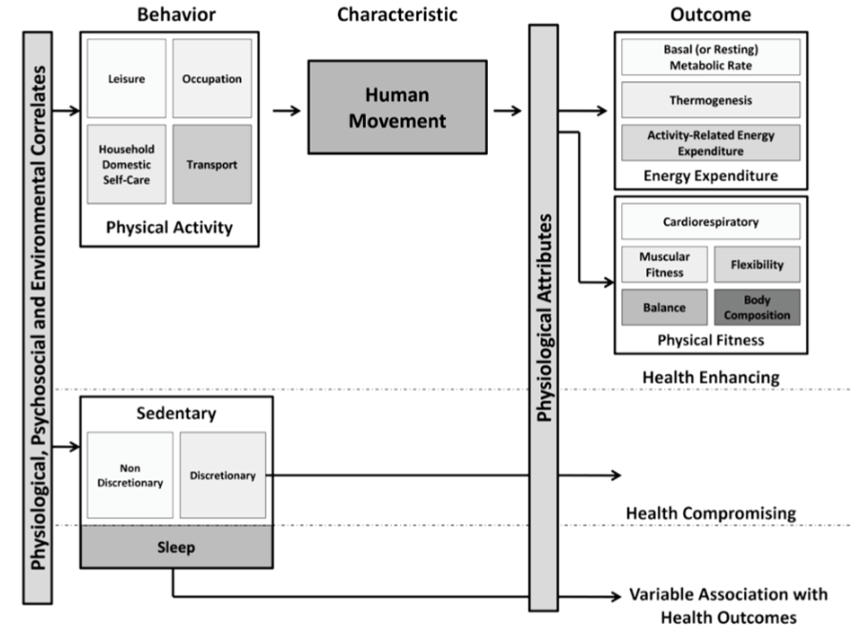
Physical Activity Conceptual Framework
Related, but not quantitatively identical
Pettee Gabriel et al., 2012 JPAH

Slide 15
PA Measures

Slide 16
Assessment Method Types
Criterion
Device-based
Self-report (Greg will address in next hour)

Slide 17
Criterion Measures
Doubly-labeled water
  Expen$ive, scarce isotope
  Requires mass spectrometry
  Provides energy expenditure, not activity
Deuterium
[Ln]
Oxygen-18
Time (days)
Direct Observation
  Previously mostly for young children, now more general use
  Investigator intensive, but video (e.g., GoPro) and scoring automation may help

Slide 18
Motion Sensors
Activity monitors
  Inexpensive (pedometer) to moderate cost (accelerometer, inclinometer)
  Removes cognitive aspect
  Includes all activity contexts
  No specific contextual information
  Primarily measures locomotor activity (at waist/leg) AND
  Misses upper body and other movements
  OR
  Measures movement of the limb on which it is attached (different issues!)

Slide 19
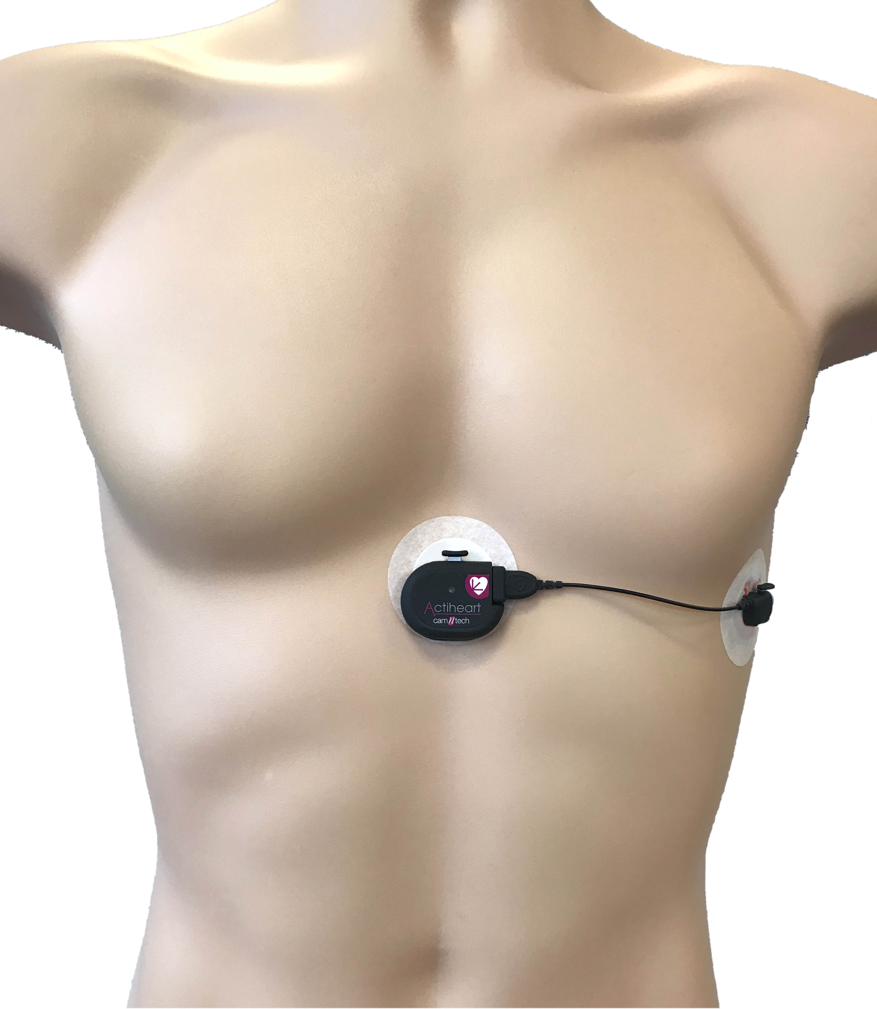
Heart Rate
Heart-rate monitors
  HR varies with intensity at moderate/vigorous levels
  Relatively unobtrusive
  Requires individual calibration for good data
  Requires extensive calibration for good individual level data
  Can measure HR
  and movement
  simultaneously

Slide 20
Expanding Device Universe

Slide 21
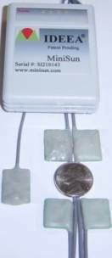
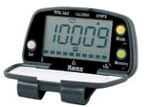
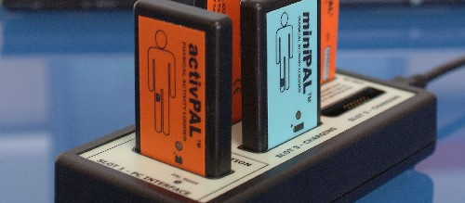
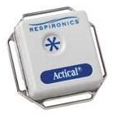
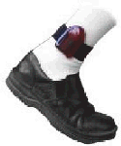
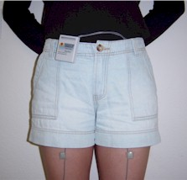
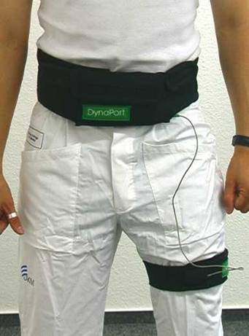
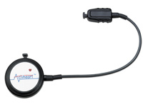
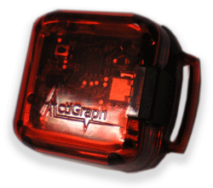
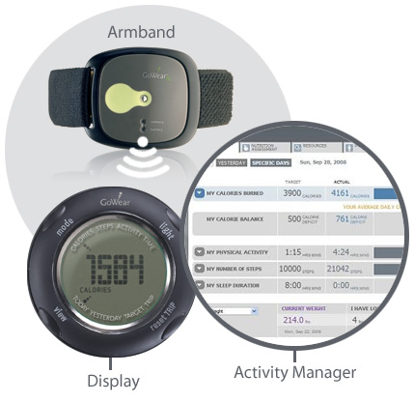
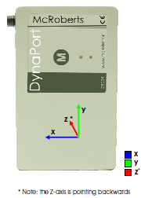
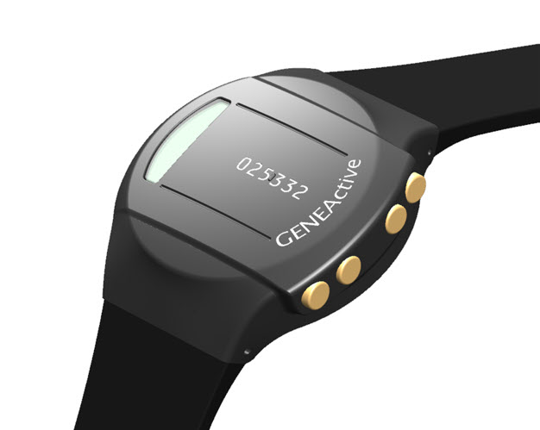
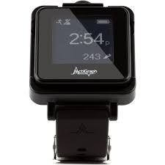
Research Instruments

Slide 22
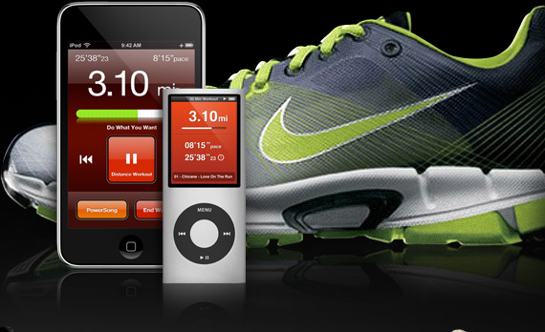
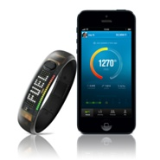
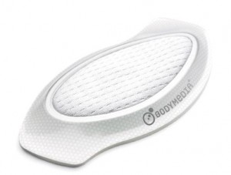
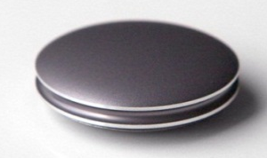
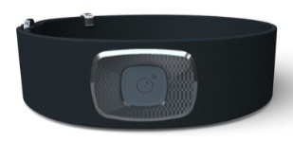

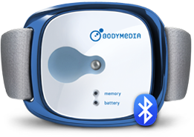
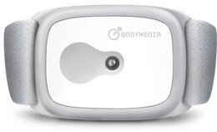
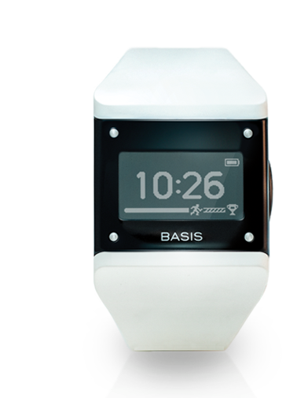
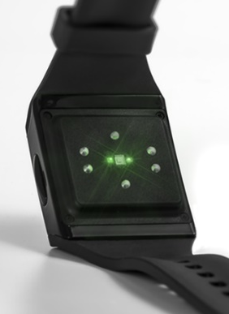
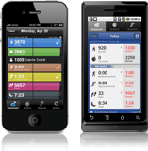
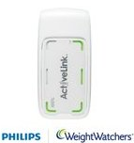
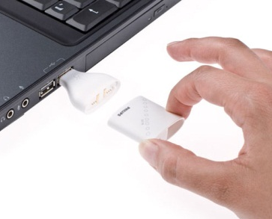
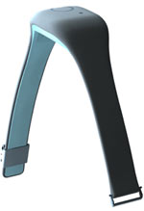

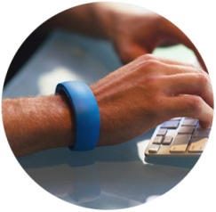
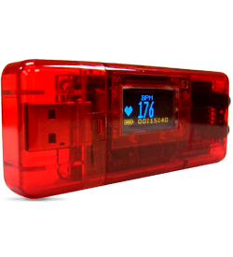
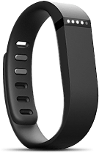
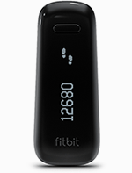
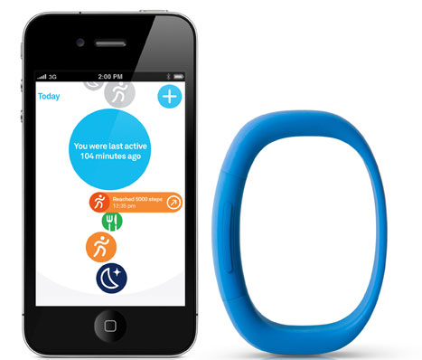
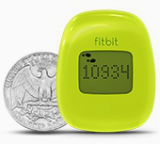
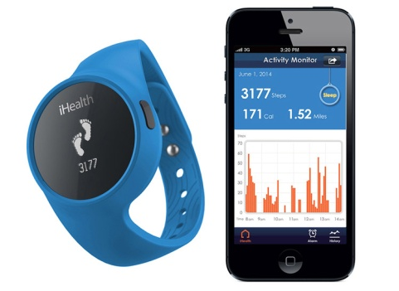


Direct Marketed Consumer Technologies

Slide 23
How Accelerometers Work

Slide 24
Accelerometer Methods
Measures body movement in terms of acceleration
  related to intensity of physical activity
  measured in 1 to 3 orthogonal planes
    anterior-posterior
    medial-lateral Relevant to waist-wear
    vertical
  Data stored or uploaded for download/analysis
  May have proprietary filtering and processing for “counts”
  Need intensity thresholds from calibration studies OR
  Algorithms to classify raw data

Slide 25
NHANES 2011-2014 Accelerometer

Slide 26
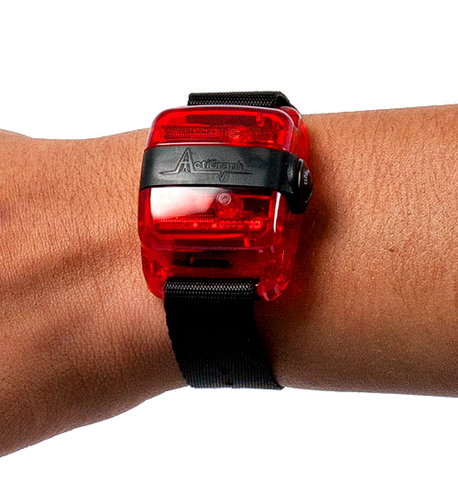
NHANES 2011-14 Protocol
Sample
  Age 6+ (3+ from 2012)
Location
  Worn on nondominant wrist
Wearing Protocol
  7+ days of continuous wear (24/7)
Actigraph GT3X+
80 Hz triaxial data
  + lux data

Slide 27
Resulting Data

Slide 28
NHANES Component Compliance and Data
Over 4 years:
  >16,000 participants agreed to wear
    ~88% of eligible examinees ages 3 years and older
  >95% of devices were returned by participants
  Analytic n=14,705 after data quality exclusions
    Females: 3,054 youth; 4,525 adults (20 y +)
    Males: 2,976 youth; 4,150 adults

Slide 29
So Much Data!
LOTS of data:
  6,912,000 data points/person/d
    ~50 million data points/person for 7 d +
    ~ 7.8 x 10¹¹ data points/4 y
  ~ 4 Tb of data with compression (csv format)
  More data than all previous NHANES combined
Summary data manageable (for 2 cycles)
  Day ~ 13 Mb
  Hour ~ 260 Mb
  Minute ~ 16 Gb

Slide 30
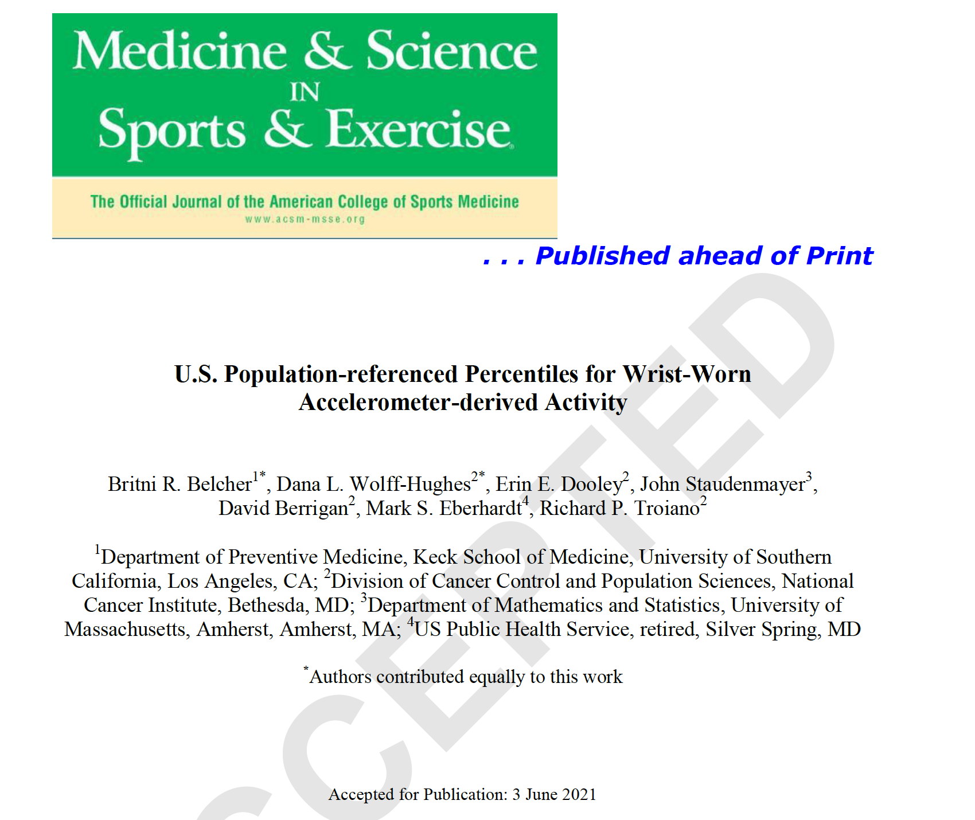
Wrist Accelerometer Reference Data

Slide 31
Curve Generation
Daily sum of Monitor Independent Motion Summary units
  Device-agnostic motion summary, like non-proprietary Actigraph counts
    Details: John et al., J Meas Phys Behav, 2019
Algorithms for wake-wear, non-wear, sleep-wear used for data quality day exclusions (nw > 5% [72 min], sleep > 17h)
Average of 1+ valid days/person (mean 4.2-6.3 valid days by sex/age group)
Generalized Additive Models for Location Scale and Shape (GAMLSS) code run in gamlss r package using Box-Cox t distribution

Slide 32
Daily MIMS-units Percentiles by Age

Slide 33
Important Points
Total daily activity metric
Represents PA from all sources, contexts, and intensities
Does not quantify PA by intensity → MIMS ≠ Actigraph counts
  No consensus on cutpoints across ages
Percentile values
Can be used to predict outcomes
Provide reference data for other studies
May apply to other device data if converted to MIMS
Wear/sleep algorithms likely to improve; misclassification at present

Slide 34
Data availability

Slide 35
Data Release
High Frequency Data
Intermediate Data
Daily Summary
Advanced
80hz Data
ftp site for download
Moderate
Minute and Hour
Counts
Website
(SAS flat file)
Basic
Daily Counts, Sleep/Wear Time
Website
(SAS flat file)
Audience
Release
Product
Data
Access

Slide 36
Other NHANES Measures

Slide 37
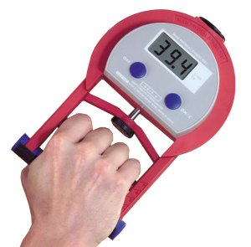
Grip Strength in NHANES 2011-14
Ages 6 +
3 trials each hand
Protocol provides proxy of total body strength
Excellent acceptance (94% completion)
Good results
  2nd and 3rd trial similar
  96% have 0-20% difference

Slide 38
National Youth Fitness Survey
Ages 3-15, target 1500 youth examined
Same locations as NHANES 2012
  Separate exam trailer
Some overlap plus unique measures with NHANES
  Screener, sample person, and family Qx.
  Dietary recall
  Height, weight, BMI
  Physical activity monitor
  Treadmill fitness test
  Grip strength

Slide 39
NYFS Exam Components
Component | Ages
Accelerometer | 3 -15 y
Treadmill | 6 -15 y
Lower body strength | 6 -15 y
Grip strength | 6 -15 y
Modified pull-up | 5 -15 y
Plank | 3 -15 y
Gross motor skills * | 3 - 5 y
* Locomotor: run, gallop, hop, leap, horizontal jump, slide
Object Control: striking a stationary ball, stationary dribble, kick, catch, overhand throw, and underhand roll.

Slide 40
Thank you
Questions and Discussion

