Slide 1
Translating Science into Policy: Putting Research into Action
Laurie Whitsel, Ph.D. FAHA
Vice President of Policy Research and Translation

Slide 2

AHA’s Mission Statement:
To be a relentless force for a world of longer, healthier lives.
Notes:
Our mission statement is relatively new and I wanted you to see it because it drives the advocacy work we do every day. There are four words I’d like to highlight.
First, we want to be a RELENTLESS FORCE for change. As we think about how we combat non-communicable disease and create environments where everyone can live healthier lives, we will need to be relentless in our approach to our work. Some of what we do has well financed, politically powerful opponents. Much of what we do depends on governments agreeing to prioritize the spending of scarce financial resources on preventing NCDs. If we are not relentless in our work, we will not succeed.
Second, we are doing this worldwide. You may not know this, but the American Heart Association is already operating in almost 90 countries around the world. Our commitment to be a catalyst for change is not just limited to the United States. We believe all people, regardless of where they live, deserve healthier lives.
Third, we are focused on creating health. Part of that is fighting disease but we want to do more. We want to create environments where everyone can live a healthy life.
Public policy advocacy is a critical pillar in our work to achieve this mission.

Slide 3

2024 Impact Goal

Slide 4



Strategic Value Proposition
The American Heart Association is a catalyst to achieving maximum impact in equitable health and well-being.
Since 1981……
From the creation of the first government affairs office in Washington in early 1980’s, the AHA has established a reputation as a credible, science and evidenced based nonpartisan resource for public officials.
4
Notes:
Our 40th anniversary year celebration for AHA advocacy

Slide 5
Strategic Policy Agenda
Priority Issues
Access to care
Increasing health insurance coverage
Medicaid expansion
Medicaid waivers
Cardiac rehabilitation
Preserve and strengthen the Affordable Care Act
Maternal Health
Health IT
Food and Nutrition
Public Health Infrastructure and Surveillance
Tobacco and Nicotine Endgame
Cardiac and Stroke Systems of Care
Preemption
Physical Activity/Active Transportation
Heart and Brain Research Funding
Non-profit Sector Issues

Slide 6

Foundation of Successful
Advocacy Campaigns
Health Equity
Decision Maker Advocacy (Lobbying)
Media Advocacy/Public Support
Science
Grassroots/Key Contact Mobilization
Resources and Fundraising
Coalition Building and Management
Policy Research and Development
Notes:
There are core components of every advocacy campaign. It’s important to note that at the American Heart Association, the foundation for all that we do is science. When we pursue policy change, we always make sure that we either have solid science to justify the change being pursued or we pursue the change so that we can get the data needed to know if the change will be successful.
At the same time, we know that we must infuse health equity in every step of the process. Far too often policy change can create greater disparities if we don’t specifically work to ensure health equity is part of our focus at each step along the way.
What are the six foundational components of every advocacy campaign?
(At the bottom) Policy development and analysis. Once we have our scientific foundation for change built, we start by developing our policy approach. This includes understanding both the substance of the policy itself and an understanding of the political environment in which we will be pursuing policy change.
Coalition building and Maintenance. Working in multisectoral collaboration is critical to achieving success because we build power and strength when working with others. Often people assume that partnerships will make the work easier but the truth is that successful partnerships take dedicated time and resources focused on ensuring the success of the partnership. But strong partnerships demonstrate the will of the community. Last December, the British Medical Journal published a paper detailing our approach to such collaboration within our Voices for Healthy Kids project which you can find online by searching for “BMJ Voices for Healthy Kids.”
Fundraising: Relationships with funders take time to develop. Developing and maintaining relationships with funders should be approached with the same level of consideration as your work with coalition partners.
Grassroots and key contacts: The development of a networks of individuals that can assist in expressing support for your campaign is not only important as a tool to persuade policy makers to support your advocacy campaign, but they can also play a key role in the successful implementation of your policy once it has passed.
Media advocacy: This includes both the traditional media and more contemporary forms of media such as social networks. Working with media is an effective way to both educate the public about your advocacy campaign and to generate momentum for change. It took us four years to pass a $1 increase in the cigarette tax in Texas. On the first day of the legislative session in year two, the headline in the Austin American Statesman declared the cigarette tax dead on the first day of the legislative session. While we didn’t expect to pass the tax this year, the headline sucked all of our momentum out of the campaign.
Decision maker advocacy: This is the direct conversations and communication you will have with policy makers. It is critical that you have people and organizations as part of your coalition that have specific expertise in working with policy makers and understand how the political process works.

Slide 7






Law and Regulation to Achieve Policy Change in Healthy Living
Pillars of Advocacy Work
Areas of Focus
Legislative/
Regulatory Policy Change
Impact
Implementation, Measurement &
Evaluation
Lobbying/Educating Policy Makers
Grassroots Engagement
Partner/Coalition Engagement
Media Advocacy
Legal Advocacy
Policy Research
Tobacco/ Nicotine Endgame
Nutrition
Physical Activity
Obesity Treatment & Prevention
Economic Incentives/Disincentives
Mass Communications
Built Environment
Systems Change
Public Spaces
Government Regulation
Guidelines/Recommendations
Surveillance
Data Modernization
Public Health Infrastructure
Settings-based policy (Healthcare, Schools, Community Workplaces, Faith-based)
Population Health/Wellbeing
Achieving Clinical/Federal Guidelines Across the Population
Equity Focus
Evidence-Base (Peer-Reviewed Research/Real World Evidence/Implementation Science)

Slide 8

Role of Policy Research
Policy Statements/Policy Guidance
Provide a voice for the American Heart Association on key policy issues
Provide a foundation for our advocacy campaigns
Translate Science Into Evidence-based, Equity Focused Strategic Policy Agenda
Rigorous process of evidence review and vetting
Approved by the Advocacy Coordinating Committee and AHA Leadership
Published in the peer-reviewed literature or in our semi-annual Policy Report
Policy Impact And Outcome Evaluation
Beginning to evaluate our impact in advocacy
Will better inform policy development

Slide 9
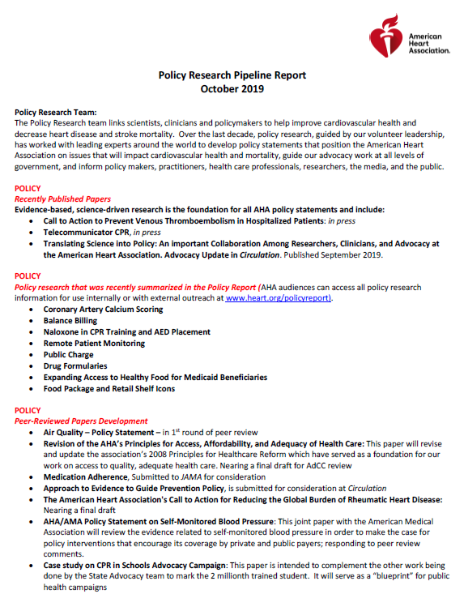
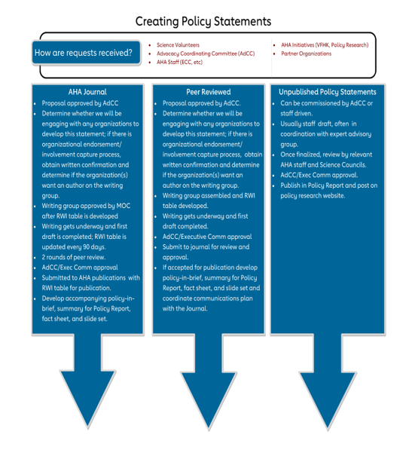


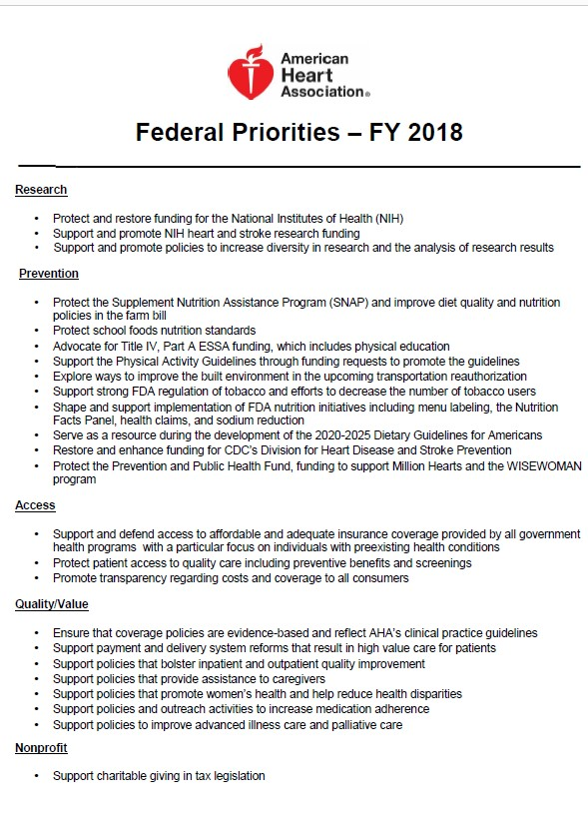
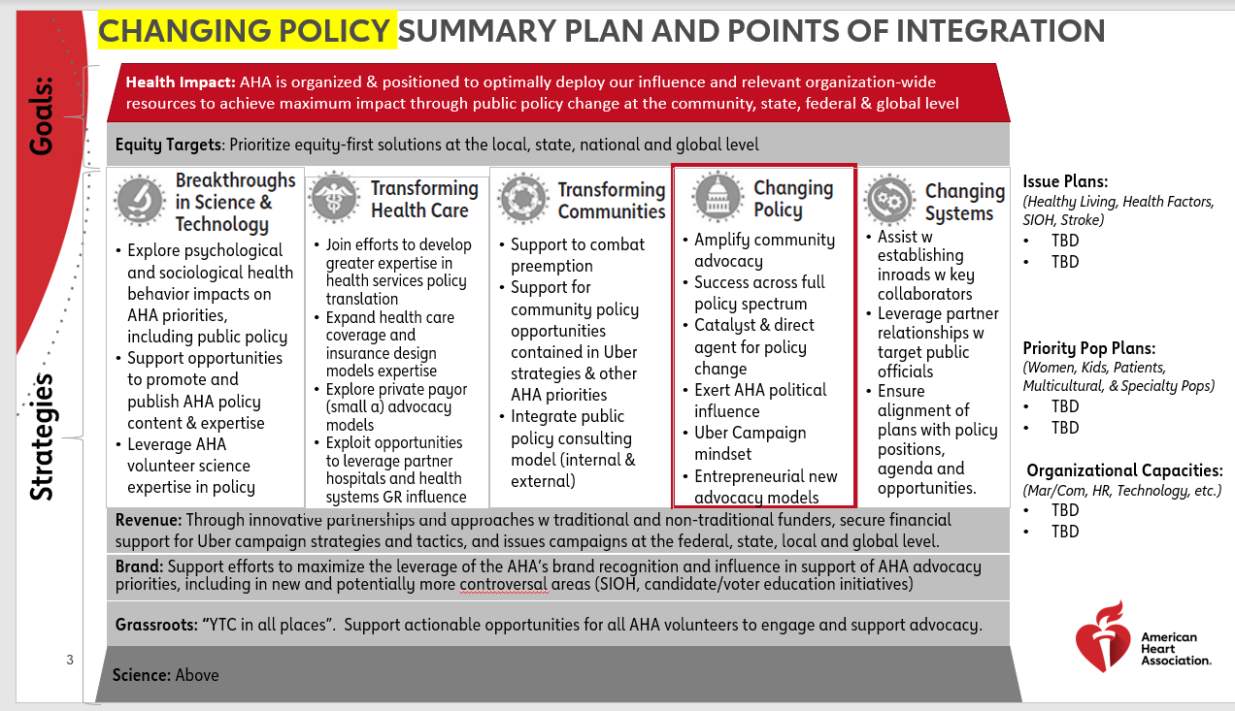
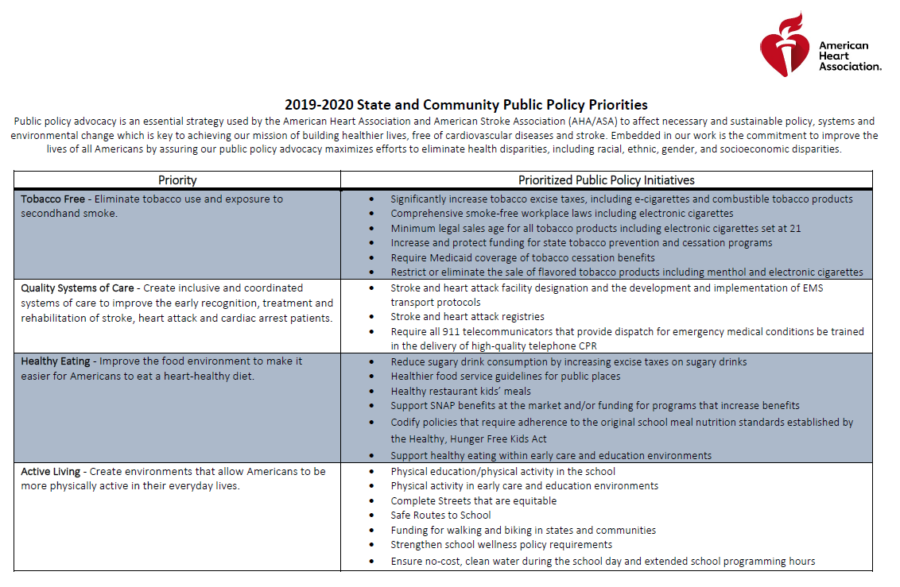
Planning, Prioritization & Tiering
(ongoing)
AHA Public Policy Agenda
(2020-2022)
AHA Science & Policy Statements
Annual Global, Federal & State/Community Priorities
(Board/AdCC Approved)
Policy Implementation and Impact Evaluation (ongoing)
2030 Strategic Plan Framework
& Health Impact Goal

Slide 10
Measuring Success in Policy
Short term outcomes
Knowledge and attitudes change
Intermediate outcomes
policy implementation
increased compliance with policy
Long term outcomes
health status change
additional policy change wins
Health Equity
Notes:
How do we measure the success of our policy change campaigns? We have a much more robust chart that looks at how we measure success but this will provide you with the highlights. It’s important to note that we must do all of this measurements within a health equity frame. In the short term – as with our sugary drink tax campaign in Vermont – we can look at knowledge and attitudes about our proposed policy change. In the intermediate term we can look at whether or not the policy change was passed and enacted and if it is enacted how it is being implemented. In Mississippi, a decade ago we celebrated the passage of a policy that required schools to teach physical education. Unfortunately, our implementation efforts were not successful and only 10% of the schools in Mississippi complied with the new law and began teaching physical education. And those schools that were in compliance were mostly the upper class and upper middle class schools around the city of Jackson. Because of the uneven implementation, the policy we passed has a strong chance of increasing disparities. Over the long term we can measure both the improvements in health in the general population and the willingness of policy makers to view policy change as a powerful tool to drive improvements in health.

Slide 11

Policy Research Pipeline Report
October 2020
Recently Published Policy Statements
Nutrition Security – May 2022
Forthcoming Policy Statements
Clinician Value-Based Payment (2022)
Data Privacy/Data Sharing (2023)
Policy Statement on Structural Racism (2023)
Heart Healthy Sustainable Cities of the Future (2023)

Slide 12
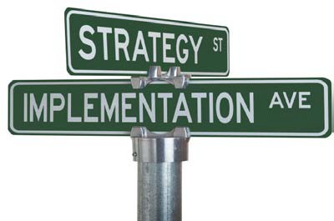
Policy Research Pipeline Report (continued)
October 2020
Policy Statements Under Development
Physical Activity Assessment, Prescription and Referral
Medical Nutrition Therapy/Healthy Food Prescription
Sustainability in the Food System and the Farm Bill
Digital Health Lexicon
Updated Telehealth Principles
Supervised Exercise Therapy for HFpEF patients
Diversity in Clinical Trials
Public Health Infrastructure
Digital Health/Digital Therapeutics
Palliative Care for HF patients

Slide 13
Physical Activity Policy Updates
Priorities
Comprehensive School Physical Activity Programs
  Multi-stakeholder input into model district and state-level policy; engagement with field staff
Complete Streets/Active Transportation Infrastructure
  Appropriations
Physical Activity Assessment, Prescription and Referral in Health Care Delivery

Slide 14



IT’S TIME TO MOVE
A historic project to make physical activity assessment, prescription, and referral a standard of care in the U.S. healthcare system.
Physical Activity Project - https://confluence.hl7.org/display/PC/Physical+Activity)
Notes:
This slide would be used for project introducing the project to new groups.

Slide 15


Slide 16

What We Do
The Alliance combines deep expertise in public policy, strategic planning, and workforce development to promote physical activity across the US population.
Through our board leadership organizations, committees, and initiatives we reach hundreds of thousands of professionals, leading organizations in physical activity, fitness, health and recreation sectors, key members of industry, policy makers, change leaders and top researchers.
We connect the strategic National Physical Activity Plan to policy and systems changes that make the most significant public health impact.
We support professionals who are focused on physical activity and health promotion, engaging them in meaningful policy and systems change and developing and issuing continuing education for professionals in public health, education, and beyond.

Slide 17
PAA Multi-Stakeholder, Multi-Pronged Action Plan
HL7®– Measure Standardization
Centers for Medicare and Medicaid Services (CMS) – Coverage Determinations
American Medical Association (AMA) - CPT codes
National Commission on Quality Assurance (NCQA) – Quality and Performance Measures
Office of the National Coordinator (ONC)/HIMSS – Linking patient generated physical activity device data to the EHR

Slide 18
Questions?

Slide 19
Laurie Whitsel, Ph.D.
National Vice President of Policy Research and Translation
American Heart Association – National Center
1150 Connecticut Avenue – Suite 300
Washington, DC 20036
Laurie.Whitsel@heart.org
724-331-4507 (C)

