Slide 1
The Movement for Movement: Equity considerations in physical activity research
Melicia C. Whitt-Glover, PhD, FACSM
Gramercy Research Group &
Council on Black Health

Slide 2
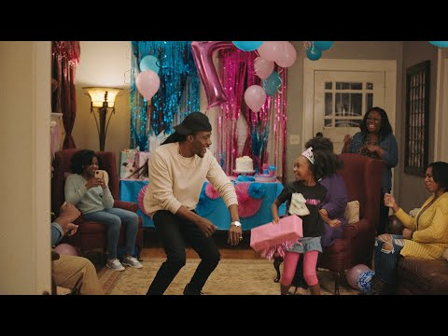

Slide 3
Equity is not only a white/non-white or gender issue….
...but many judgements are made/actions taken based on what people SEE

Slide 6
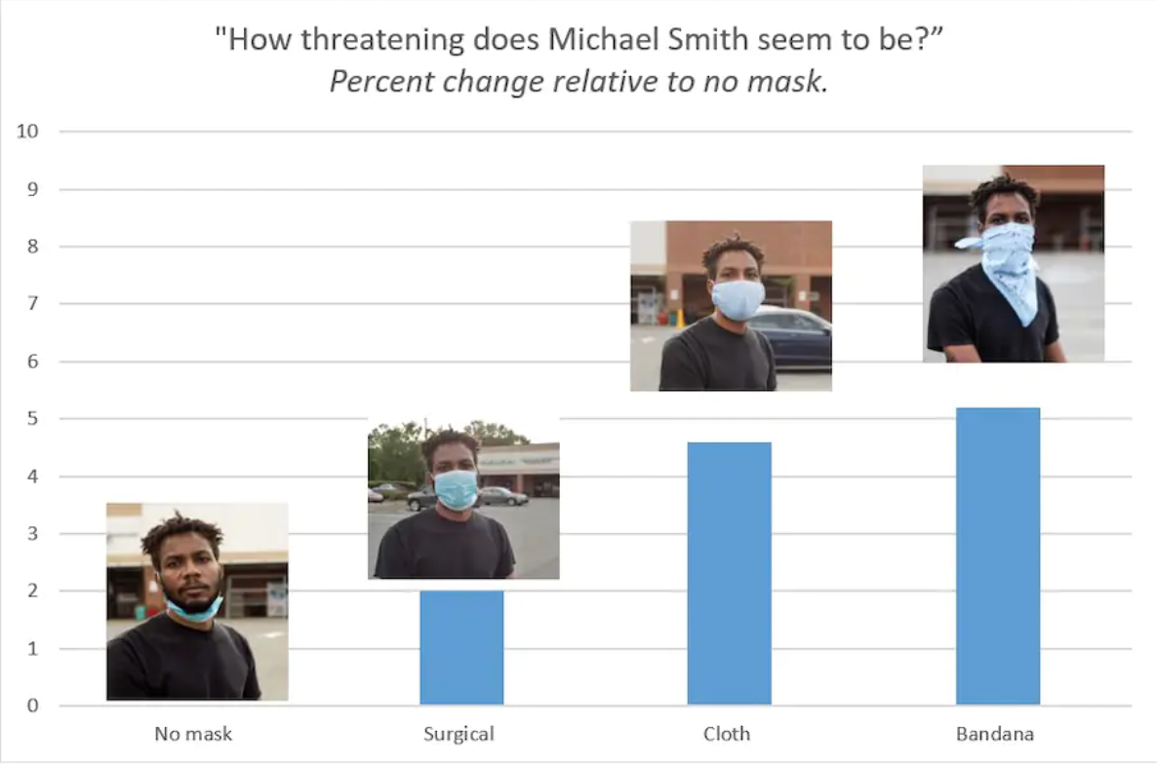
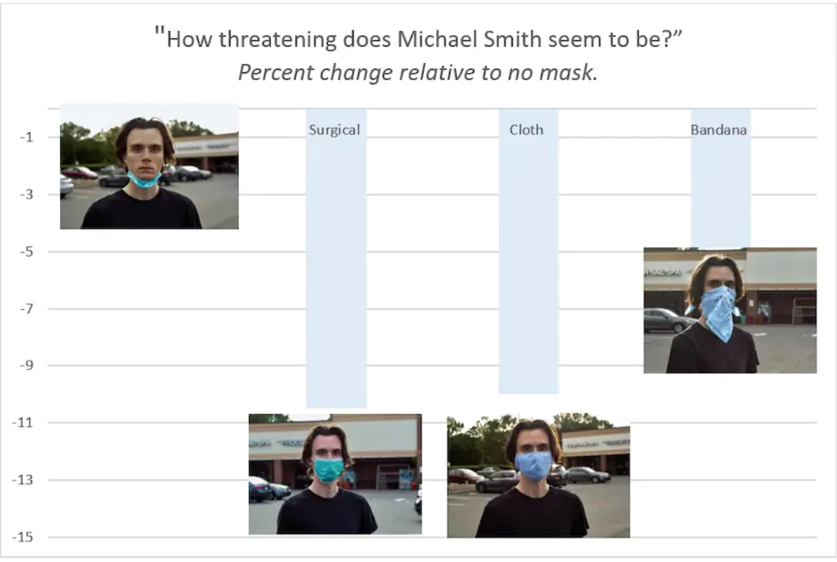
Equity in masking
Christiani et al, Masks and Racial Stereotypes in a Pandemic: The Case for Surgical Masks. Journal of Race, Ethnicity and Politics, June 2021

Slide 7
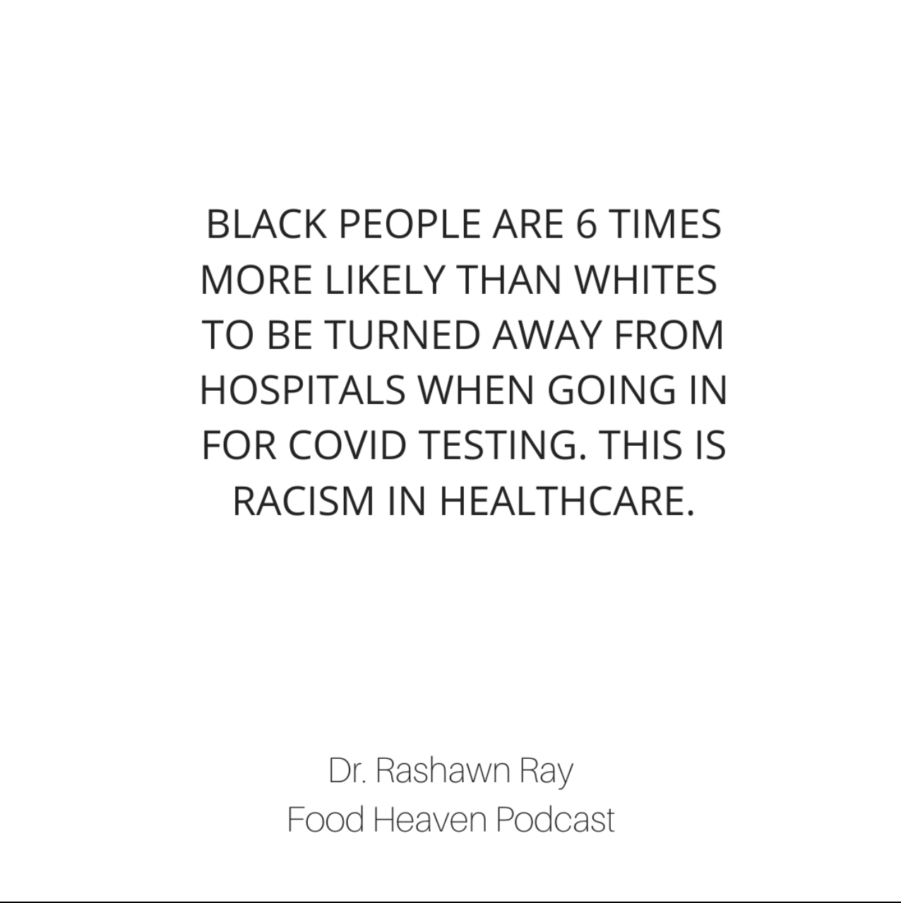

Slide 8
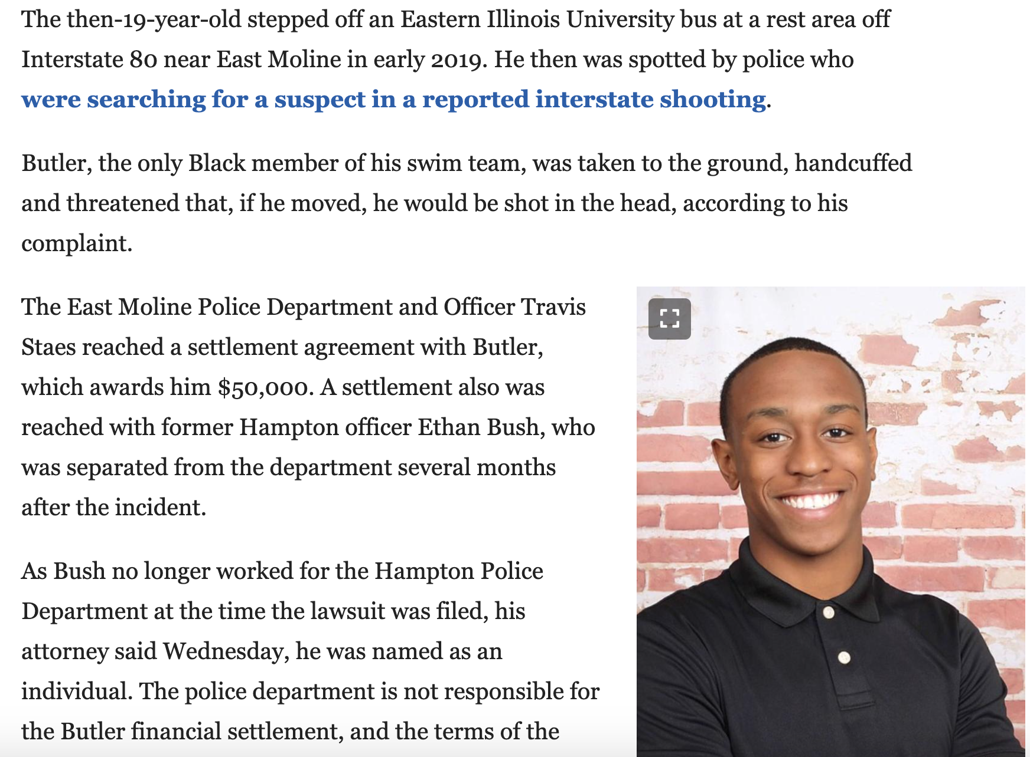
Traveling on a school trip

Slide 9
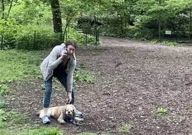
Bird watching in public spaces

Slide 10
From “awful” to ACTION!

Slide 11
Health Disparities
A particular type of health difference, closely linked with social or economic disadvantage
Adversely affects groups of people who have systematically experienced social and/or economic obstacles to health and/or a clean environment because of biases
Racial or ethnic group
Religion
Socioeconomic status
Gender
Age
Mental health
Cognitive, sensory, or physical disability
Sexual orientation
Geographic location
Other characteristics historically linked to discrimination or exclusion.
Source: http://www.minorityhealth.hhs.gov/npa/templates/browse.aspx?lvl=1&lvlid=34

Slide 12
What is health equity?
Health equity is a process of assuring optimal health for all people.
It requires:
•Valuing all individuals and populations equally
•Recognizing and rectifying historical injustices
•Providing resources according to need
Notes:
Before we move forward, I want to be sure that we are using the same terminology. Some of this might look familiar from previous NCECHW presentation or from other presentations you have seen. We define health equity, for the purposes of this work, as the process of assuring optimal health for all people. This means that no matter the race, color, age, sexual orientation, gender, income, geographic location, ability or disability status, or any other person characteristic, we are striving to ensure that each person achieves the highest level of health possible for him or her.
In order to achieve health equity, three important criteria have to be met. We have to value all individuals and populations equally. This means not assuming that some individuals have more of a right to be healthy or to have access to health or related resources than other people.
Second, we need to understand that, historically, there have been injustices that have happened that have impacted the ability of some people to have access to health or related resources. If we are striving toward health equity, we have to recognize those injustices and work toward rectifying those injustices.
Finally, we have to understand that different people have different needs and resources have to be provided based on need. Sometimes that means that resources cannot always be provided equally if we want to be sure we are being equitable.

Slide 13
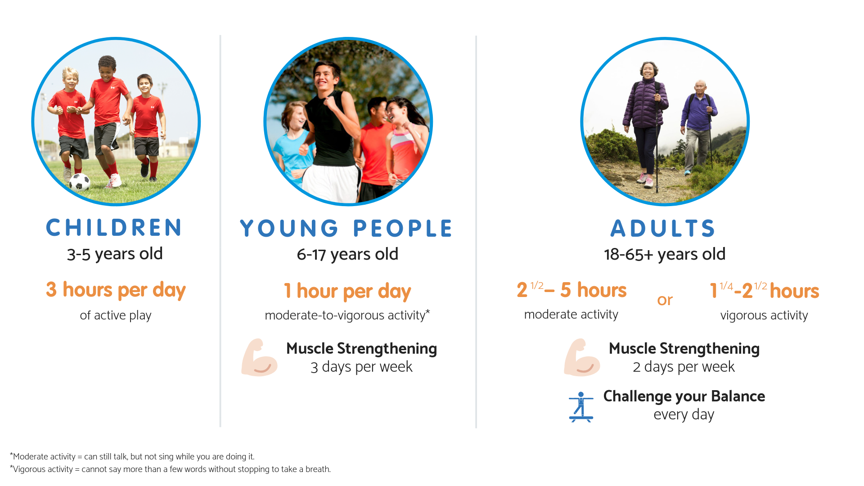
What are we trying to achieve?
Functions of daily living
Quality of life
Physiology

Slide 14
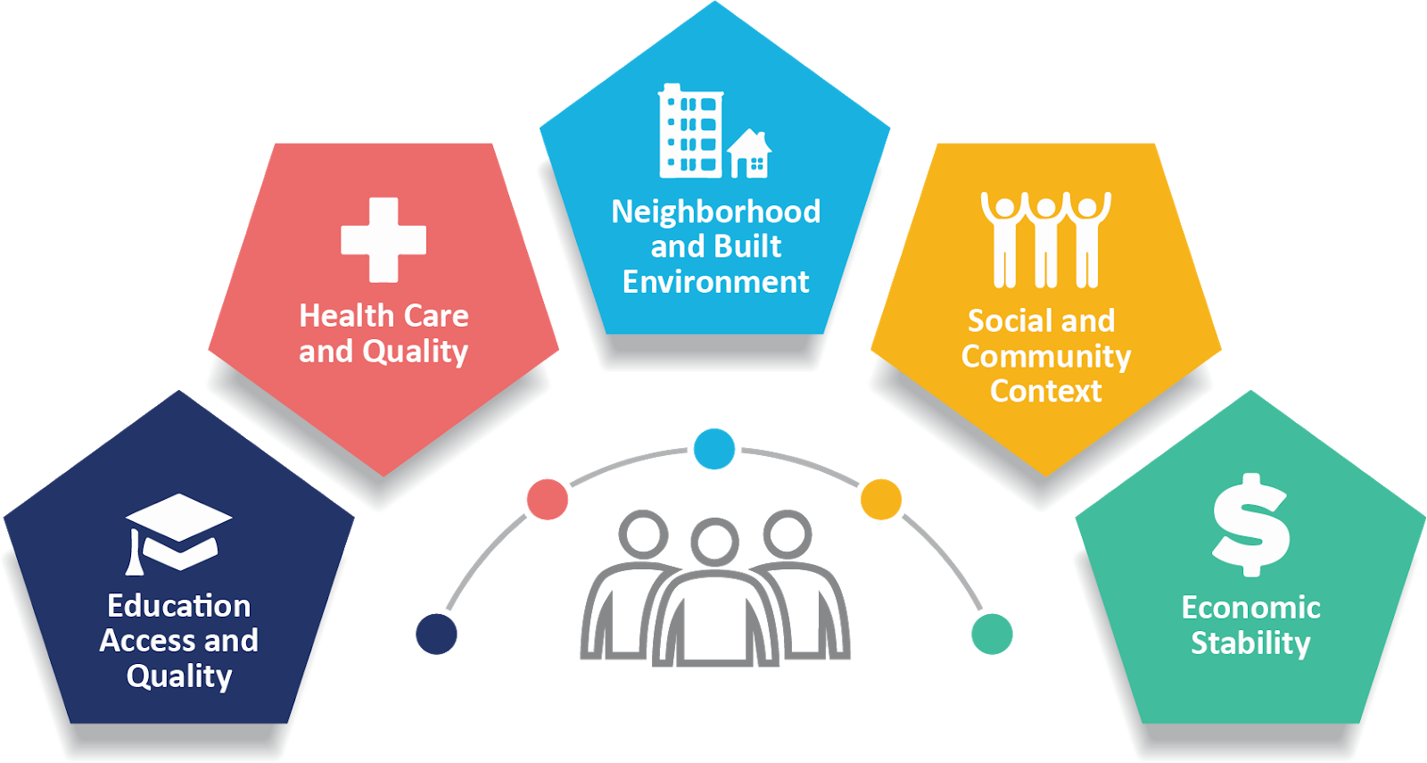
Social Determinants of Health
Notes:
Social determinants of health “are conditions in the environments in which people are born, live, learn, work, play, worship, and age that affect a wide range of health, functioning, and quality-of-life outcomes and risks.” (https://www.healthypeople.gov/2020/topics-objectives/topic/social-determinants-of-health) These conditions, which include social influences, economic status, and physical environment within the various settings can impact the decisions a person can make about their health. This includes availability of, and access to, resources; knowledge of and time to use those resources; and social and environmental norms that might impact health-related decisions.
The second picture provides a different view of the same concept. The picture shows that individual characteristics impact health. Health is also impacted by individual decisions and lifestyle factors; however, the decisions an individual makes are influenced by the people around them, the access they have to resources, a variety of factors within their local communities, and the general conditions of society. In his book, Political Determinants of Health, Daniel Dawes reminds us that all of our decisions are shaped by decision-makers and policies that drive the availability of resources, choices, etc.

Slide 15
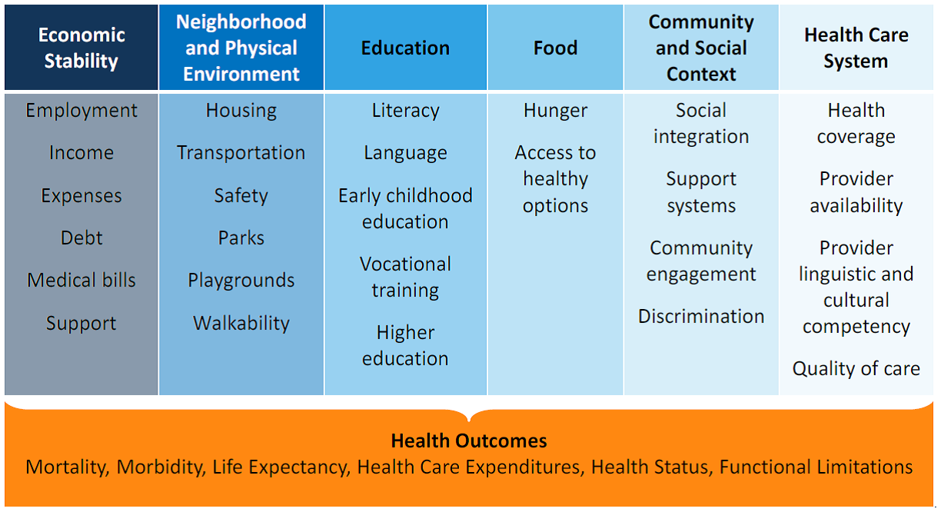

Slide 16
What is the result?

Slide 17
Coping mechanism?

Slide 18
Physical Activity Environment?

Slide 19
Having an intervention, greenway, sidewalk, bike lane, encouragement, or knowledge is not be enough
When we create opportunities for physical activity, are they for everyone?

Slide 20
If I don’t feel safe in the space…
is there still a benefit?

Slide 22
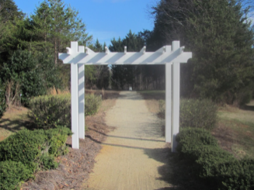
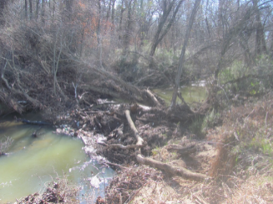
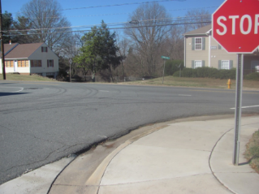
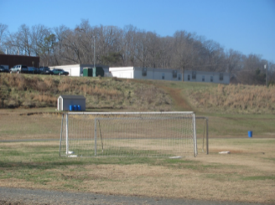
What is “walkable”?
Non-greenway schools selected based on principal perception that they were “walkable”
Post-intervention walkability assessments conducted by research staff using Neighborhood Environment Walkability Survey and qualitative methods (photographs)
Schools could be perceived as not “walkable” by those unfamiliar with route
Greenways and sidewalks available, but potential hazards are present
Greenway entrance
Creek alongside greenway
Sidewalks on one side
Hill leading to school

Slide 23
Racial bias in driver yielding behavior at crosswalks
Goddard, Tara, Kimberly Barsamian Kahn and Arlie Adkins. Racial Bias in Driver Yielding Behavior at Crosswalks. NITC-SS-733. Portland, OR: Transportation Research and Education Center (TREC), 2014.

Slide 24
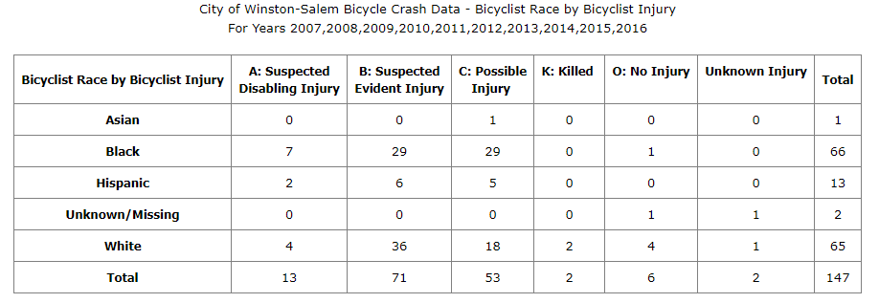
44.8% of bicyclist crash victims; 34.7% of population
68.0% of youth bicyclist crash victims

Slide 25
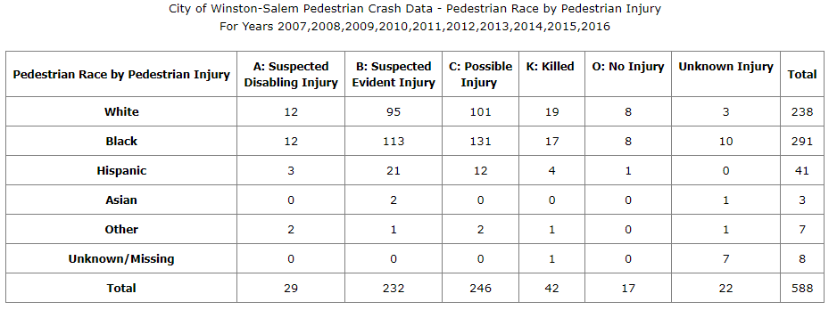
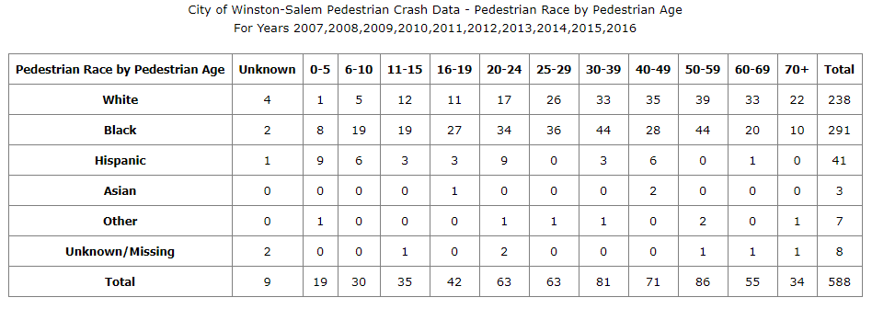
49.4% of pedestrian crash victims; 34.7% of population
45.2% of youth pedestrian crash victims

Slide 26
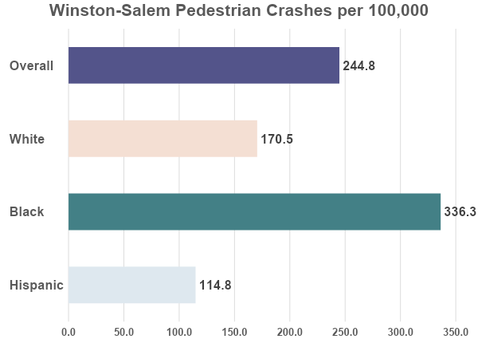

Slide 27
Closer to home

Slide 28
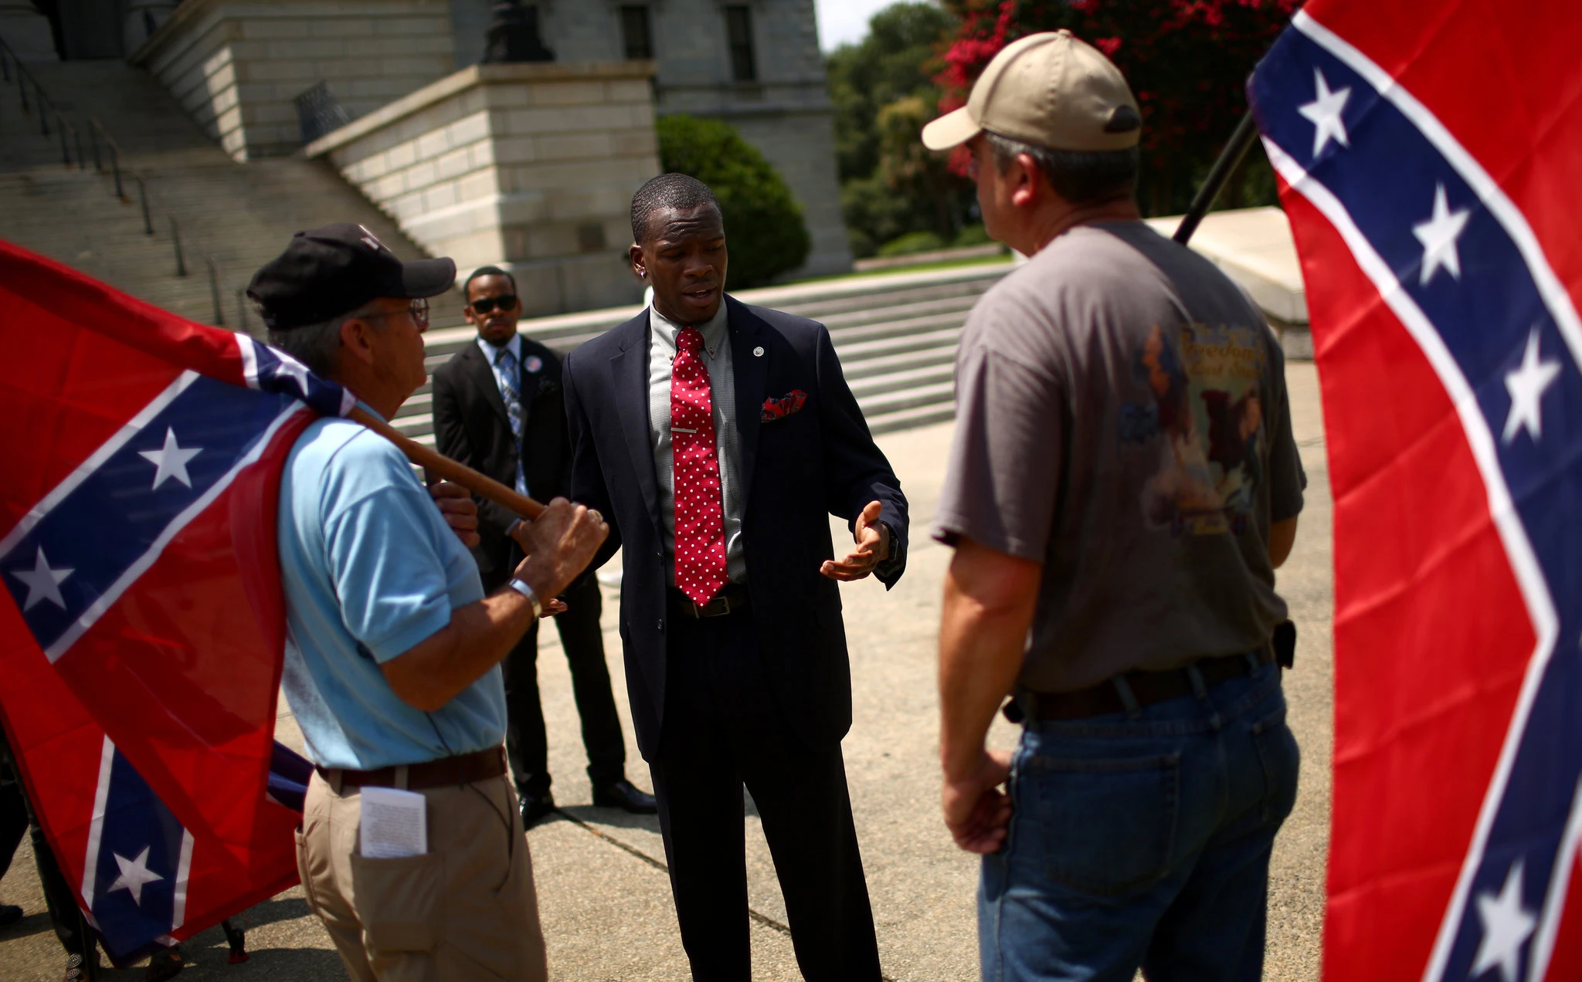
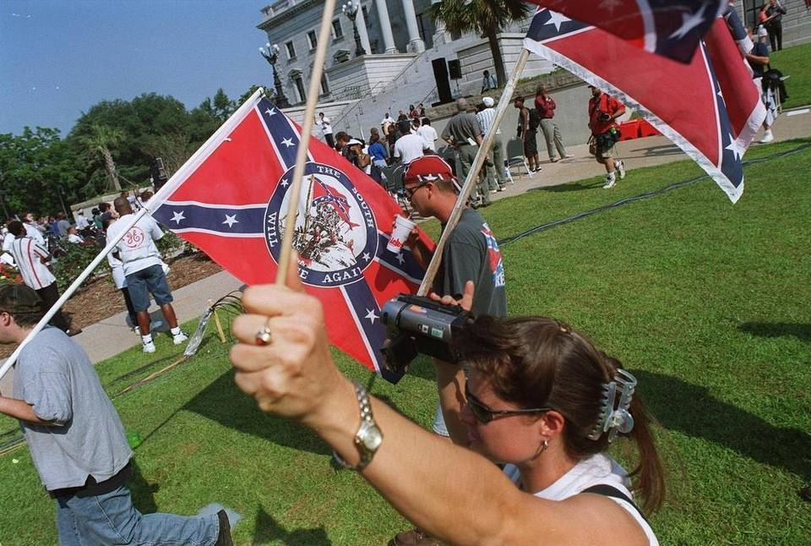
Memories of U of South Carolina

Slide 29
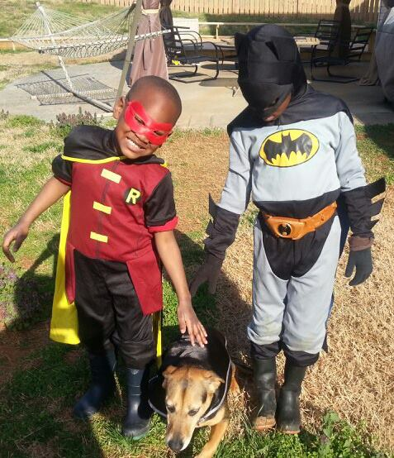
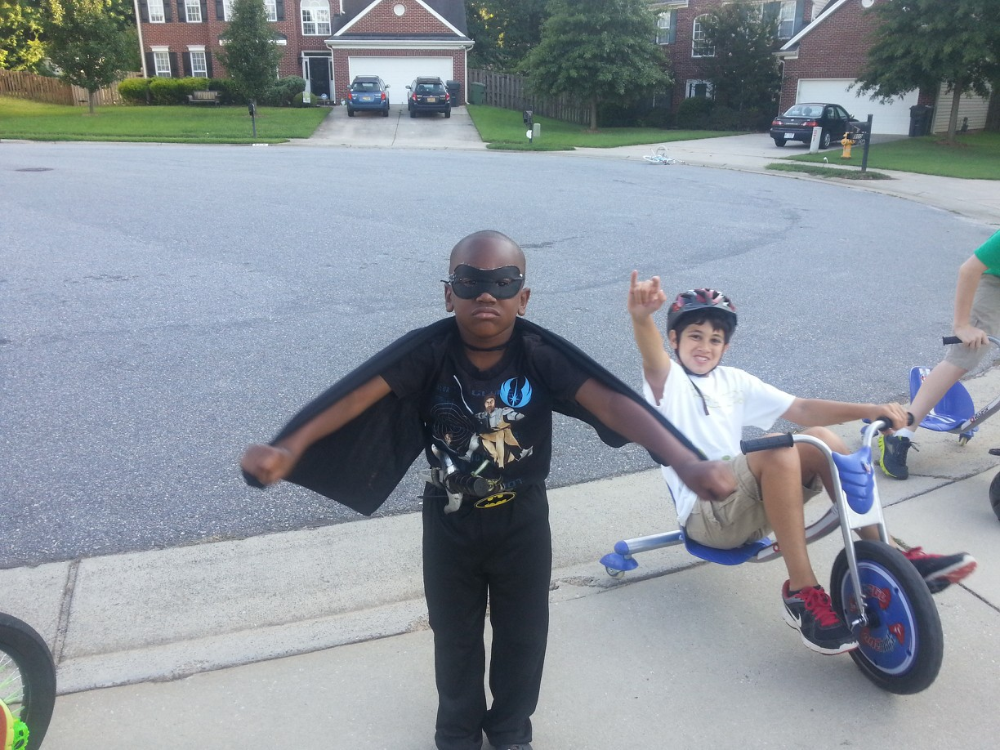
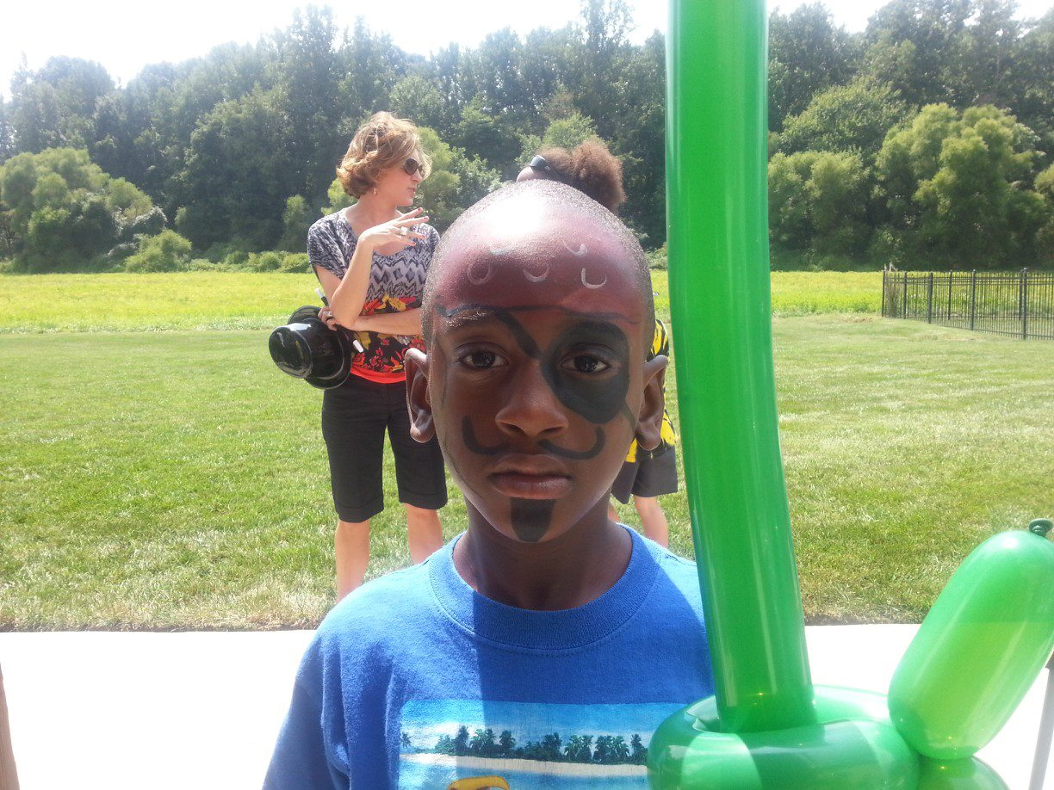
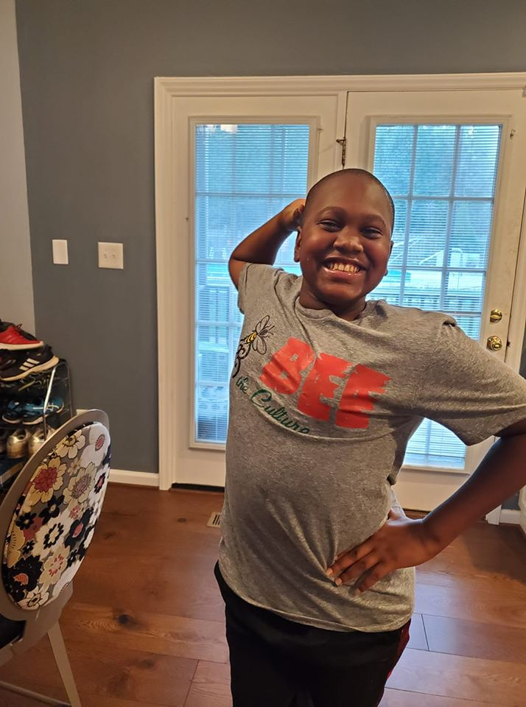
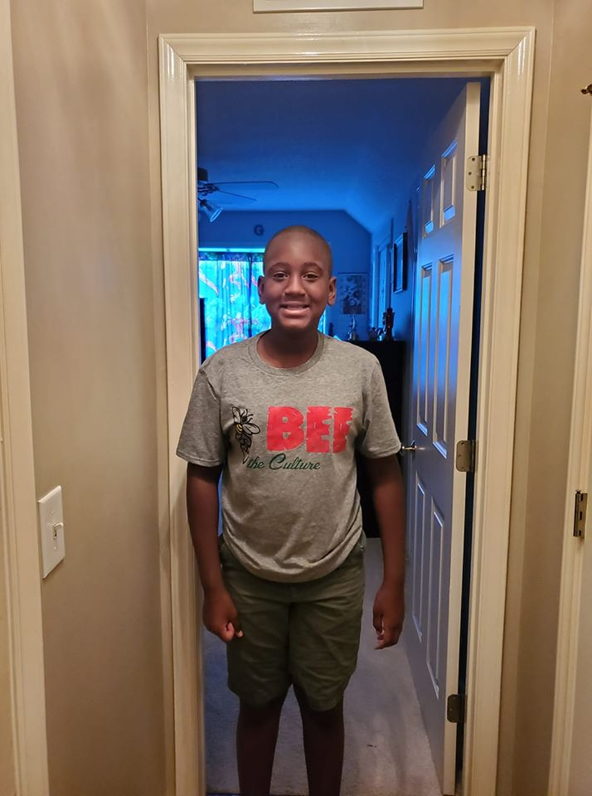
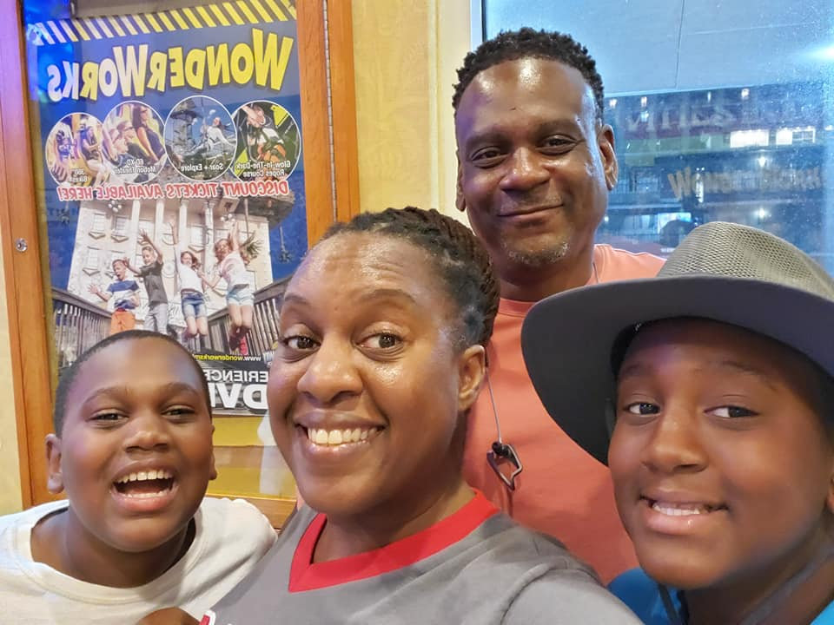
Opt outside?

Slide 30
Safety

Slide 31
How will you embed equity in physical activity research (and beyond)?

Slide 32
Do YOU see/value everyone equally?

Slide 33
What are your biases?
Ableism
Adultism
Ageism
Alloism
Classism
Cisgenderism/
transphobia
Colorism/shadeism
Colonialism
Ethnocentrism
Heterosexism
Jingoism
Lookism
Saneism
Nativism
Racism
Religious imperialism
Sexism
Sizeism
https://interrupting-oppression.tumblr.com/post/102351553722/list-of-isms

Slide 34
Understand the past...
….and the present

Slide 35
Perceptions of Clinical Trials
Illustrative Quotes
“The little bit that I know about clinical trials are that you have the two groups of people and...if it’s a condition where, it’s medication involved then one group will get a method that is not the true method or a sugar pill of some type I’ve heard and then the other group will get the real medicine.” - Stakeholder “I just finished a something. I don’t know if it was a clinical trial but I was a part of the Vital Study. I was so glad when it ended. It was five years...I haven’t seen the results yet…” - Stakeholder “Well, one I don’t take any drugs now and I don’t wanna take research where I would have to take a drug.” - Patient “They think they gone be injected and get cancer. [They think they might be injected and get cancer. Do people think that?] (Group: Yeah! Mmhmm.) [Okay. Have you ever heard of that?] Yes.” –Stakeholder “They might put, experiment on me! You know, give me something. Might make me worser. I ain’t want that. My daughter told me not to do it, too.” –Patient
Notes:
After discussing general care and cancer care, our discussions were then about clinical trials.
The experiences and perceptions of participants were mostly negative about clinical trials.

Slide 36
One Patient’s Story
Woman experiencing severe pain
Multiple tests, no cancer diagnosis
IBS diagnosis
It’s “in your head”
Prescription for acetaminophen and ibuprofen
Perforated bowel after two years, ER visit revealed cancer
“If I hadn’t gotten sick and gone to the emergency room, they probably would’ve found mine in my autopsy, type of thing. The sad part is that I had been sick for 2 years, and I’d been going to my family practice. They had sent me to a specialist, who sent me to another specialist and none of them in all of that 2 years, ever did a pet scan, which is how they found it in the emergency room. So, by the time they found it, I had gone from a 1 to a 4 (stage)...had gone through 2 years of just being in pain and them not being able to find what’s wrong. They kept telling me, “Oh, you have IBS.” Then one doctor told me, “Oh, it’s in your head.”
Notes:
TW
We wanted to share a story from a patient we interviewed. Her story details the difficulty patients sometimes have with care and cancer care.
During her interview the patient stated, “If I hadn’t gotten sick and gone to the emergency room, they probably would’ve found mine in my autopsy, type of thing. The sad part is that I had been sick for 2 years, and I’d been going to my family practice. They had sent me to a specialist, who sent me to another specialist and none of them in all of that 2 years, ever did a pet scan, which is how they found it in the emergency room. So, by the time they found it, I had gone from a 1 to a 4 (stage)...had gone through 2 years of just being in pain and them not being able to find what’s wrong. They kept telling me, “Oh, you have IBS.” Then one doctor told me, “Oh, it’s in your head.”
The patient was a woman, experiencing severe pain. She endured multiple tests that did not provide a cancer diagnosis. She was diagnosed with irritable bowel syndrome. For her pain, she was prescribed acetaminophen and ibuprofen.
After 2 years she went to the emergency room with severe pain and was diagnosed with having a perforated bowel. This diagnosis also revealed she had Stage IV cancer.
Unfortunately, there two patients who we heard very similar stories from: They had numerous appointments over a long period of time, actually years and they received various diagnoses, and were diagnosed with Stage IV cancer.
The other patient was obese and she talked about how her cousin, who was smaller in size than she was, was treated better at the same medical facilities. Another focus group participant pointed out that there are different types of bias patients can experience when receiving health care. In this case, the bias was based on her size.

Slide 37
Bird watching in public spaces

Slide 38
Funded by the Patient Centered Outcomes Research Institute (#AD-1403-11098)

Slide 39
Limited opportunities to engage

Slide 40
Keep your focus….
But shift your focus!

Slide 42
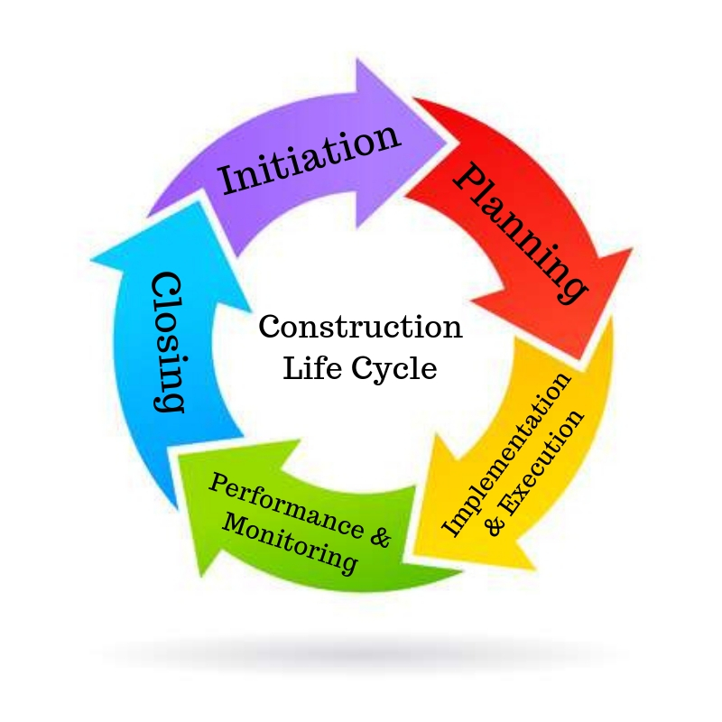
Embed Equity Throughout the Project Lifecycle
Consider
Who is included? Why?
Who is not included? Why?
What is being missed by not including them?
How can I increase inclusion and equity?
Also…
Who interprets data?
Who disseminates findings?
What narrative is being shared?
Is the narrative helpful or harmful?

Slide 43
Use your research to inform policies and systems

Slide 45
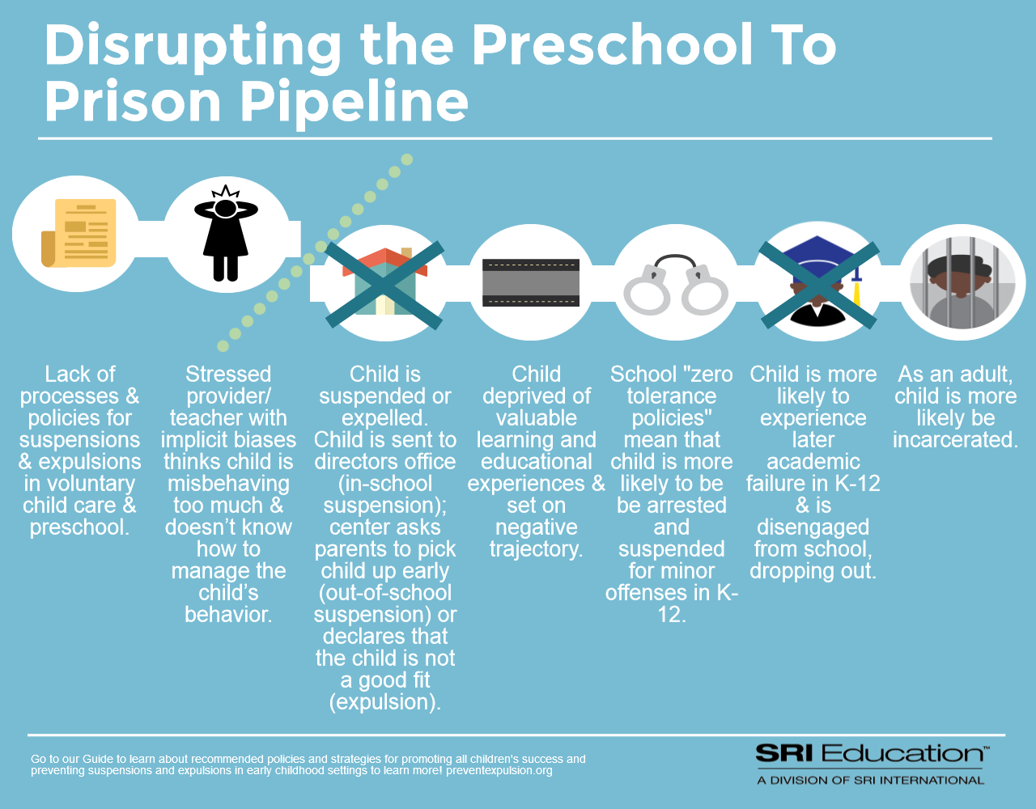

Slide 46
Focus: Disciplinary actions in early childhood education
Lessons Learned:
Identifying cross-cutting issues
National & local partner engagement
Local partner & stakeholder engagement & collaboration
Opportunities for assistance
Educating vs. lobbying
Academic/research niche
Partner capacity
PIVOT!!

Slide 47
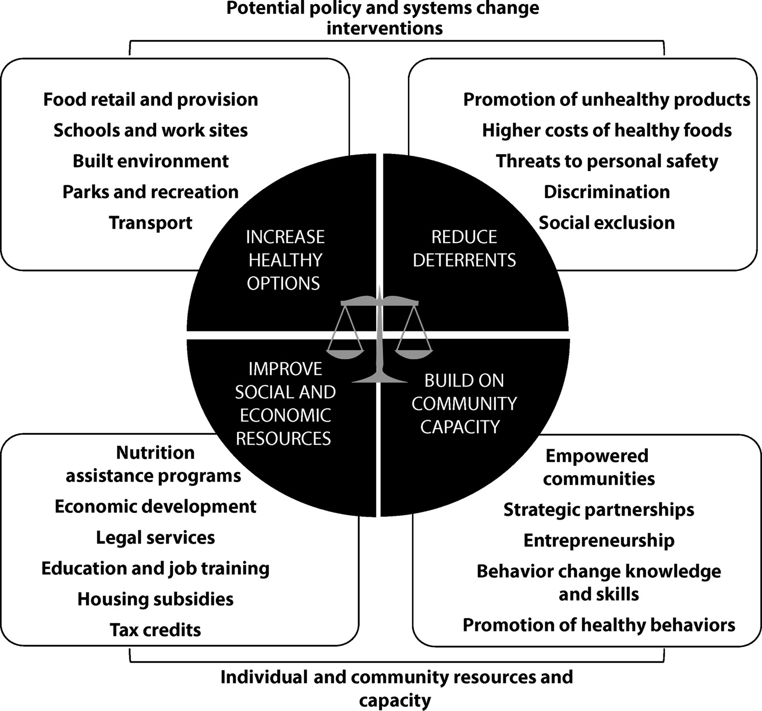
Getting to Equity in Obesity
Shiriki K. Kumanyika, “A Framework for Increasing Equity Impact in Obesity Prevention”, American Journal of Public Health 109, no. 10 (October 1, 2019): pp. 1350-1357.

Slide 48
YOUR actions can change systems
Commit to incorporating political and social determinants of health in your research and practices to SHIFT systems
Your action will change practices
Your practices will change systems
Use your privilege wisely to make a deposit into systems change

Slide 49
