Slide 1
Steps for Health
PAPH Course 2022
I-Min Lee: How clear are the data?
Bill Kraus: Translating step count recommendations into clinical practice

Slide 2
Why Steps?
Steps are an indicator of PA level
Easy to understand metric for the public; thus, useful for recommendations
Wearables are increasingly popular consumer items; they track steps

Slide 3
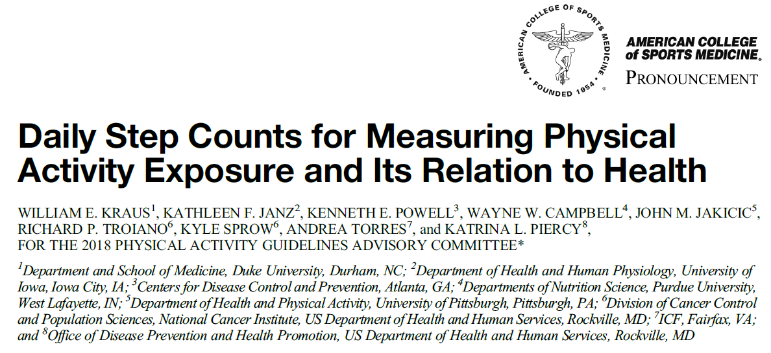
Kraus et al, MSSE 2019;51:1206-12

Slide 4
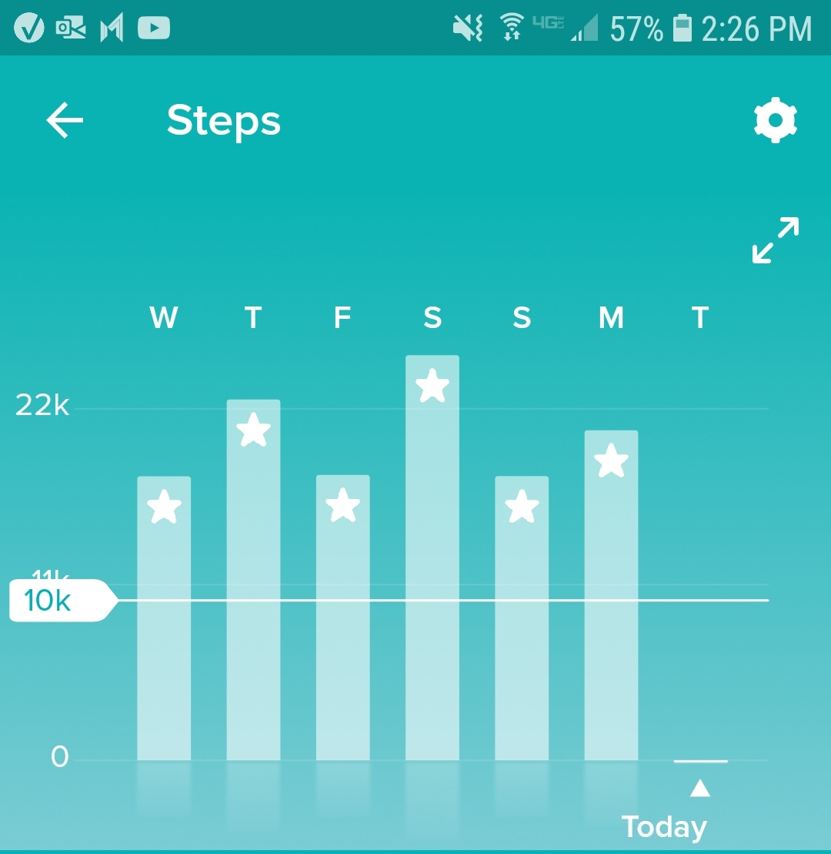
Fitbit Default Step Goal: 10K

Slide 5
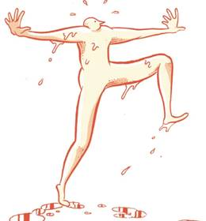
Japanese “man” = 10,000
10,000 Steps Needed?
History of 10,000 steps
Average US person takes ~4-5,000 steps/d
When put on an observed program to increase PA to level of guidelines, this requires an extra ~16,400 steps per week
16,400 extra steps per week is ~ 2,340 extra steps per day
Thus, US person could meet guidelines at ~7,000 steps/d
Jordan et al, MSSE 2005;37:1627-32

Slide 6
Issues to Consider with Step Data
How are steps measured? Wearable vs phone? Hip vs wrist (dominant / non-dominant) device? LFE (low frequency extension) filter vs no LFE?
What difference in counts across devices do we consider acceptable? (That is, for us to consider the numbers to be the “same”)
Does age matter? Does health outcome matter?
Does “quality” of steps matter? How to measure quality? E.g., slow vs fast steps; intermittent vs continuous; etc.
Notes:
6

Slide 7
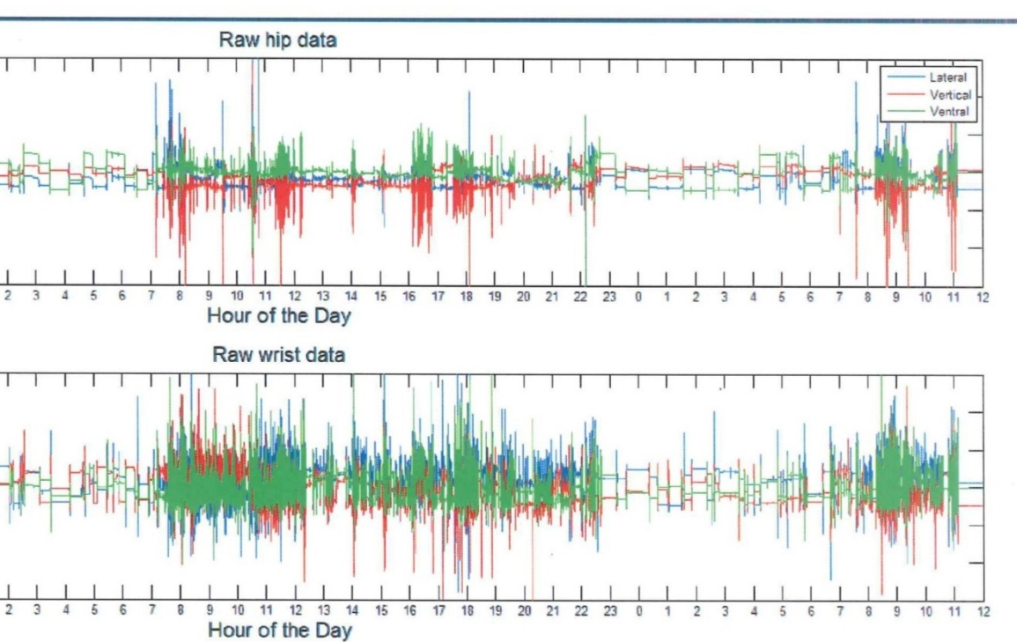
Phone/wearable does not show you (unfortunately)
But, it shows you

Slide 8
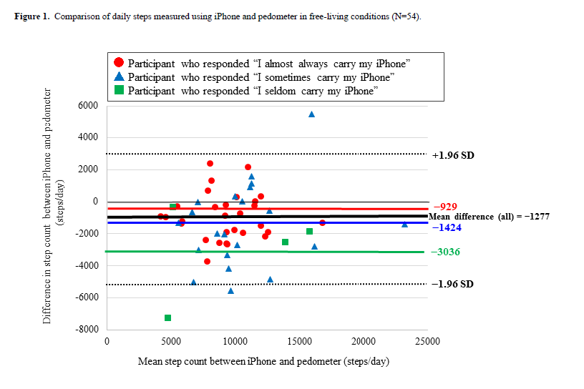
iPhone vs research pedometer
Undercount by ~3,000 steps/d
Amagasa et al, JMIR Mhealth Uhealth 2019;7:e10418

Slide 9
Hip vs wrist placement
Depending on algorithm used, wrist can over-estimate steps by a large extent – WHS example: 5,378 (hip) vs 10,107 (wrist) steps/d
Kamada et al, Gait Posture 2016;44:23-8

Slide 10
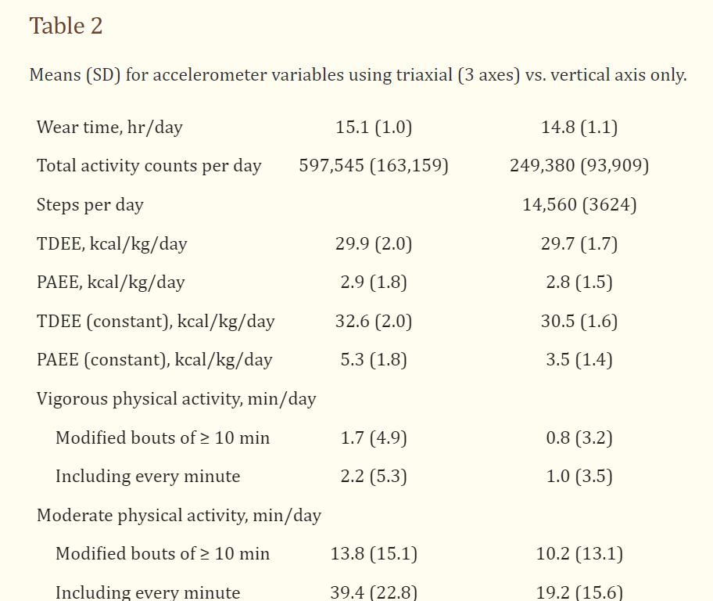
Use of LFE filter
NHS/HPFS; mean age mid-60’s
implausibly high step count: 14,560 steps/d
Chomistek et al, MSSE 2017;49:1935-44
ActiGraph has “low-frequency extension” (LFE) filter option (reduces threshold for movement detection), which is recommended for use in older populations

Slide 11
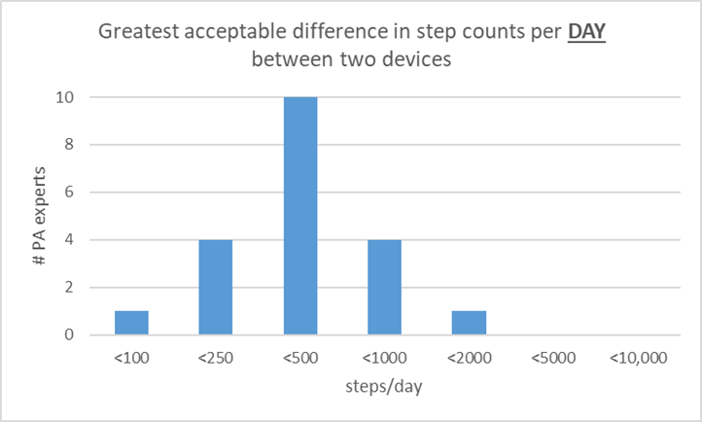
What difference is acceptable, to be considered the “same” across devices?
From Nicole Spartano; poll of investigators (n=20) doing steps research, 8/8/22

Slide 12
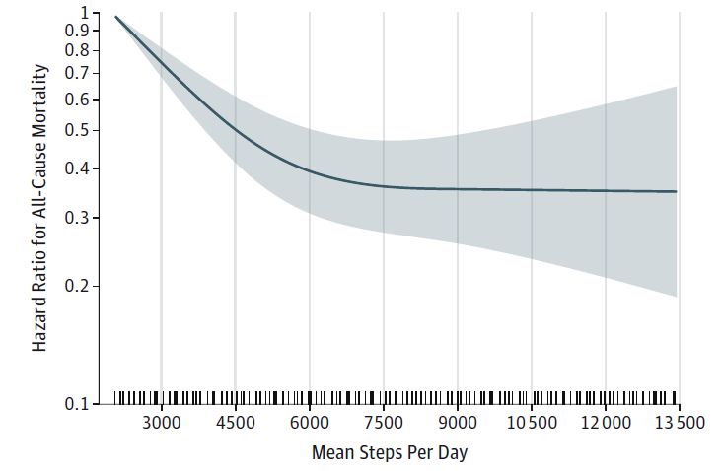
Does age matter? Women’s Health Study
Curve levels at ~7500 steps
Women’s Health Study; n ~17,000, mean age 72 y
Lee at al, JAMA Int Med 2019;179:1105-12

Slide 13
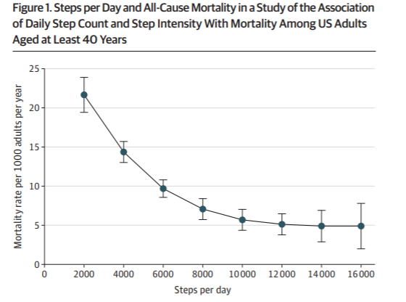
Does age matter? NHANES
Curve levels at ~11,000 steps
NHANES; n ~5,000, mean age 57 y
Saint-Maurice et al, JAMA 2020;3231151-60

Slide 14
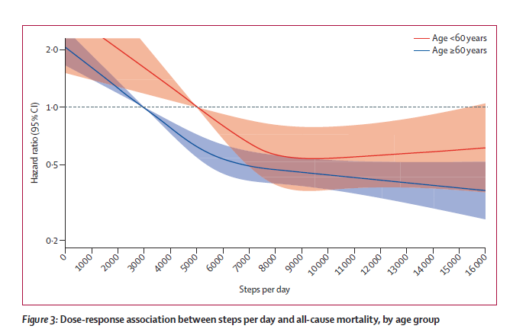
Does age matter?
Meta-analysis of 15 studies
Paluch et al, Lancet Pub Health 2022;7:e219–28

Slide 15
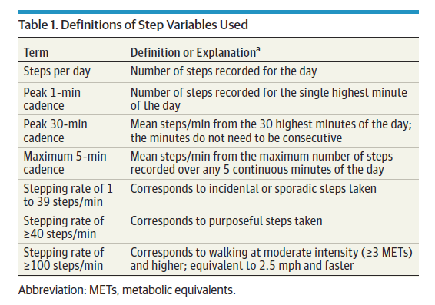
Does quality of steps matter? How to measure “quality”?
Lee at al, JAMA Int Med 2019;179:1105-12

