Slide 1



Steps for Health, Part 2
Translation to Clinical Practice
William E. Kraus
PAPH
Columbia, SC
17 Sept 2022

Slide 2
Defining the exposure targets
654, 827 Men & Women, 82,465 deaths
No lower threshold for benefit
Steep early slope
About 70% of benefit reached by 8.25 MET-hr/wk
No apparent upper threshold
No obvious best amount
No evidence of increased risk at high end
150-300 Min MPA
@ 3.3 METs
(3 miles per hour)
Moore, et al. PLOS Medicine, 2012
Attributed to WL Haskell
Notes:
Emphasize the steep early slope---anything is better than nothing, more is better than less.

Slide 3
Not Just for Mortality and CVD
150/75 min/w
300/150 min/w
600/300 min/w
Kyu HH et al. Physical activity and risk of breast cancer, colon cancer, diabetes, ischemic heart disease, and ischemic stroke events: systematic review and dose-response meta-analysis for the Global Burden of Disease Study. BMJ, 354, 2013.
Notes:
Not just mortality and heart disease. Continuous risk curves for association between physical activity and breast cancer, colon cancer, diabetes, ischemic heart disease, and ischemic stroke

Slide 4
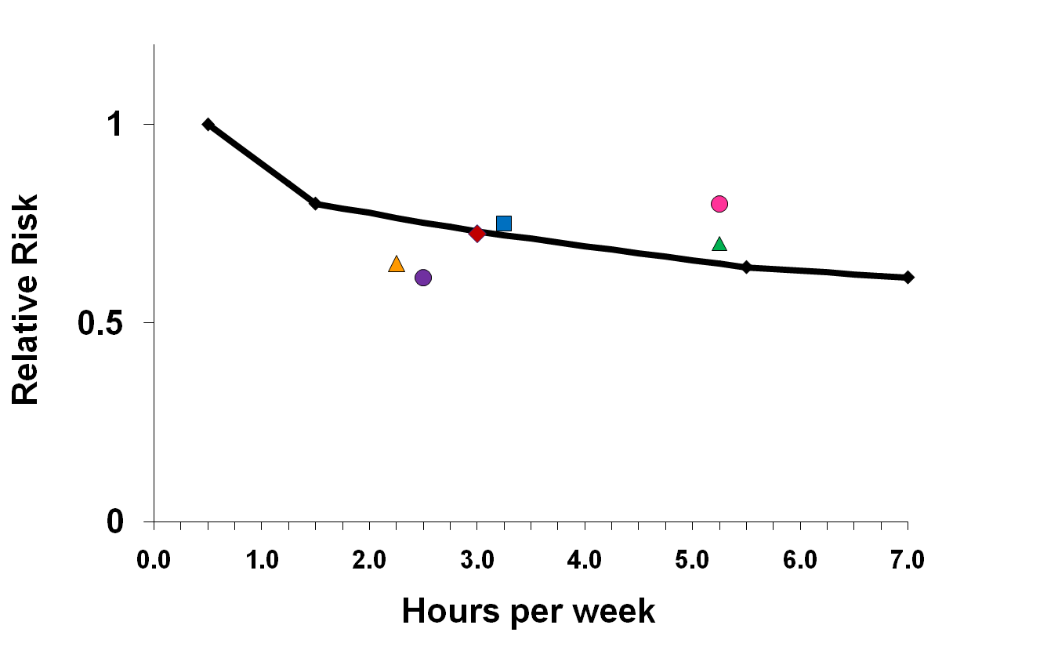
Risk of selected health events by hours/week of moderate to vigorous physical activity
all-cause mortality
depression, dementia
breast cancer
diabetes
colon cancer
hip fracture
CVD, CHD, stroke

Slide 5
Defining the exposure targets
How best to describe the amount of PA recommended by these Guidelines
Is it the minimal amount of activity to obtain health benefit?
Is it the amount of activity that provides maximal benefit?
Is it the amount of activity that provides optimal benefit?
It is a “public health target” where many adults achieve
substantial benefit – benefit for the most people
Attributed to WL Haskell

Slide 6
How do effective teams work?
PAGAC as an effective team

Slide 7
What about Steps?
Background steps—those associated with activities of daily living are about 5,000 steps per day.
Walking briskly for 10 minutes at 3.3 miles per hour requires about 1,000 steps.
This equates to between (5,000 + 2,000 =) 7,000 steps per day and (5,000 + 4,000 =) 9,000 steps per day to meet weekly physical activity guidelines.
Physical Activity Guidelines for Americans, 2nd edition: A1.1; page 116
e.g., Rick Troiano

Slide 8
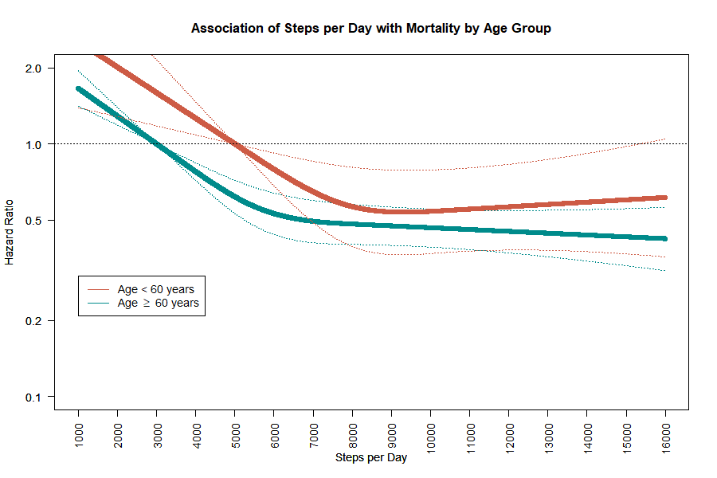


Paluch et al.
8,000-10,000
6,000-8,000

Slide 9

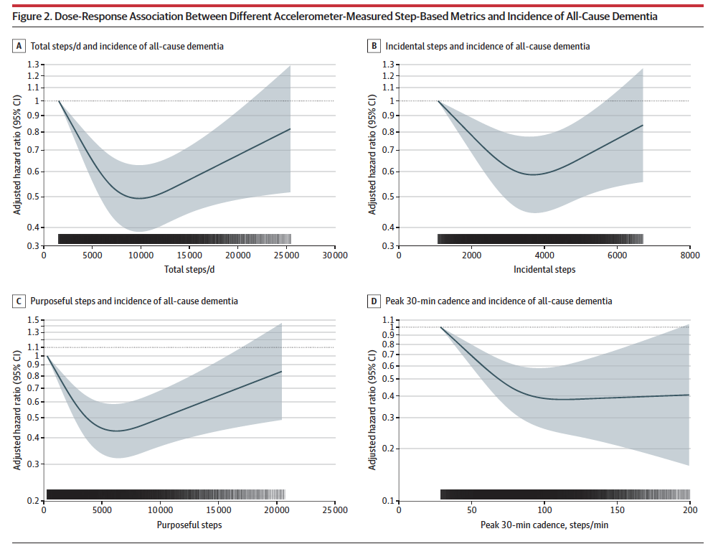

9,826
3,677
6,315

Slide 11
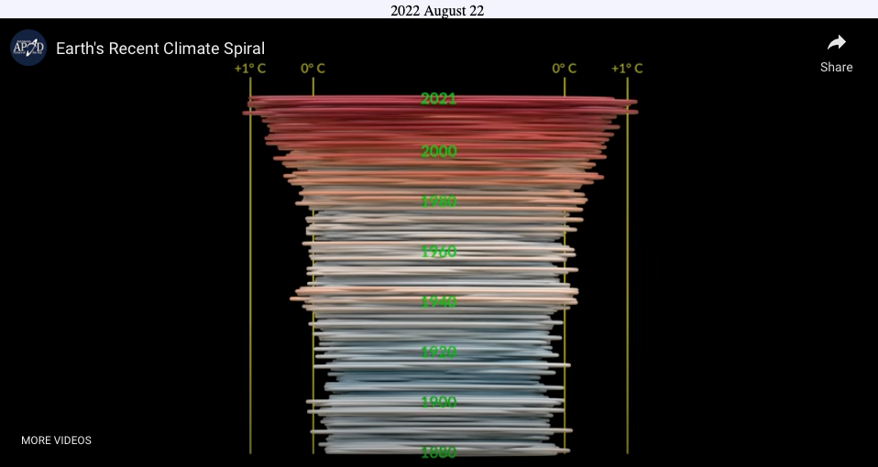
Climate since 1880
https://apod.nasa.gov/apod/ap220822.html
Notes:
Now I want to speak to you about another matter of more concern than that we have been discussing. Let’s look at this short video about the progression of Earth’s temperature since 1880.

Slide 12


Slide 13

It’s All About Climate!
The Issue of Our Time

Slide 15
Supplemental slides

Slide 16
Steps
What is the relationship between step count per day and (1) mortality (i.e., all-cause or cause-specific) and (2) disease incidence (e.g., coronary heart disease, type 2 diabetes)?
Source of evidence to answer question:
  De novo systematic review of original articles.
Notes:
Put the question you are covering on this slide and the approach to answering the question.
Approach to answering question
SR/MA/Existing Report
Combination of SR/MA/Existing report and de novo systematic review of original articles
De novo systematic review of original articles

Slide 17
Description of the Evidence
Included articles (n=9) Same Group
  4 cross sectional studies
  5 prospective longitudinal
Studies examined sub-group effects:
  Gender, age groups, ethnicity, nationality, weight status
Exposure
  Pedometer-measured steps.
Dose-response
  Addressed as narrative review, not tabulated or critiqued
Notes:
This slide could be used to summarize the evidence for original research and include information on the types of study, study duration, study location, sample size, etc.

Slide 18
NAVIGATOR
Yates (2014) used Navigator data to show change in steps per day was associated with reduce risk for cardiovascular events, specifically, a yearly 2,000 steps per day increase resulted in an 8% yearly reduction in cardiovascular event rate. Below are the data plotted for baseline steps and CVD outcomes
Yates 2014
Notes:
SC to insert key findings from their review of the evidence.

Slide 19
NAVIGATOR
Yates (2014) used Navigator data to show change in steps per day was associated with reduce risk for cardiovascular events, specifically, a yearly 2,000 steps per day increase resulted in an 8% yearly reduction in cardiovascular event rate. The dose-response appeared linear. Baseline level of steps per day was inversely associated with cardiovascular event incidence, specifically at baseline each 2000 steps per day increment was associated with a 10% lower cardiovascular event rate.
Yates 2014
Notes:
SC to insert key findings from their review of the evidence.

Slide 20
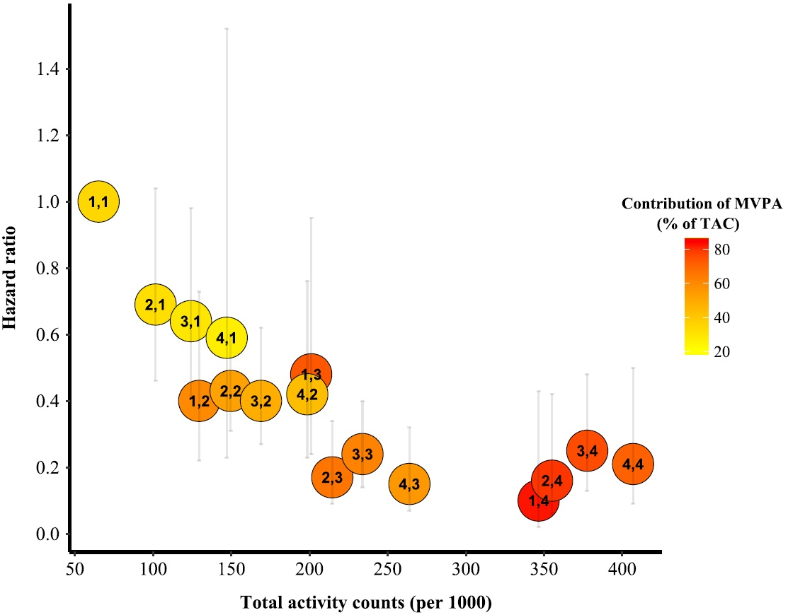
New Data
Saint-Maurice, JAHA, 2018
NHANES, 2003-2006 wave
>40 y
4840 individuals
700 deaths (31 Dec 2011)
100-759 cpm = light
≥ 760 cpm = MVPA
Notes:
SC to insert key findings from their review of the evidence.

