Slide 1
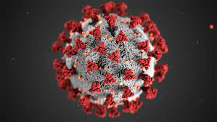
Physical Activity and COVID-19: Let’s Plan Not to Make the Same Mistakes Again
James F Sallis, PhD, FACSM
Herbert Wertheim School of Public Health,
University of California, San Diego USA
Mary MacKillop Institute for Health Research
Australian Catholic University, Melbourne
PAPH Research Course. September 2023

Slide 2
Outline
Main takeaway: Physical activity can be effective in reducing multiple harms of the pandemic, but we have not applied what we know
Pre-existing evidence on the value of physical activity for multiple pandemic-related outcomes
New evidence that physical activity can reduce severity of COVID-19 infections
Evidence is ignored and dismissed by infectious disease community
Call to action: Those of us in the PA field need to figure out how to overcome resistance to PA evidence for use in the COVID-19 pandemic—and be better prepared for the next one

Slide 3
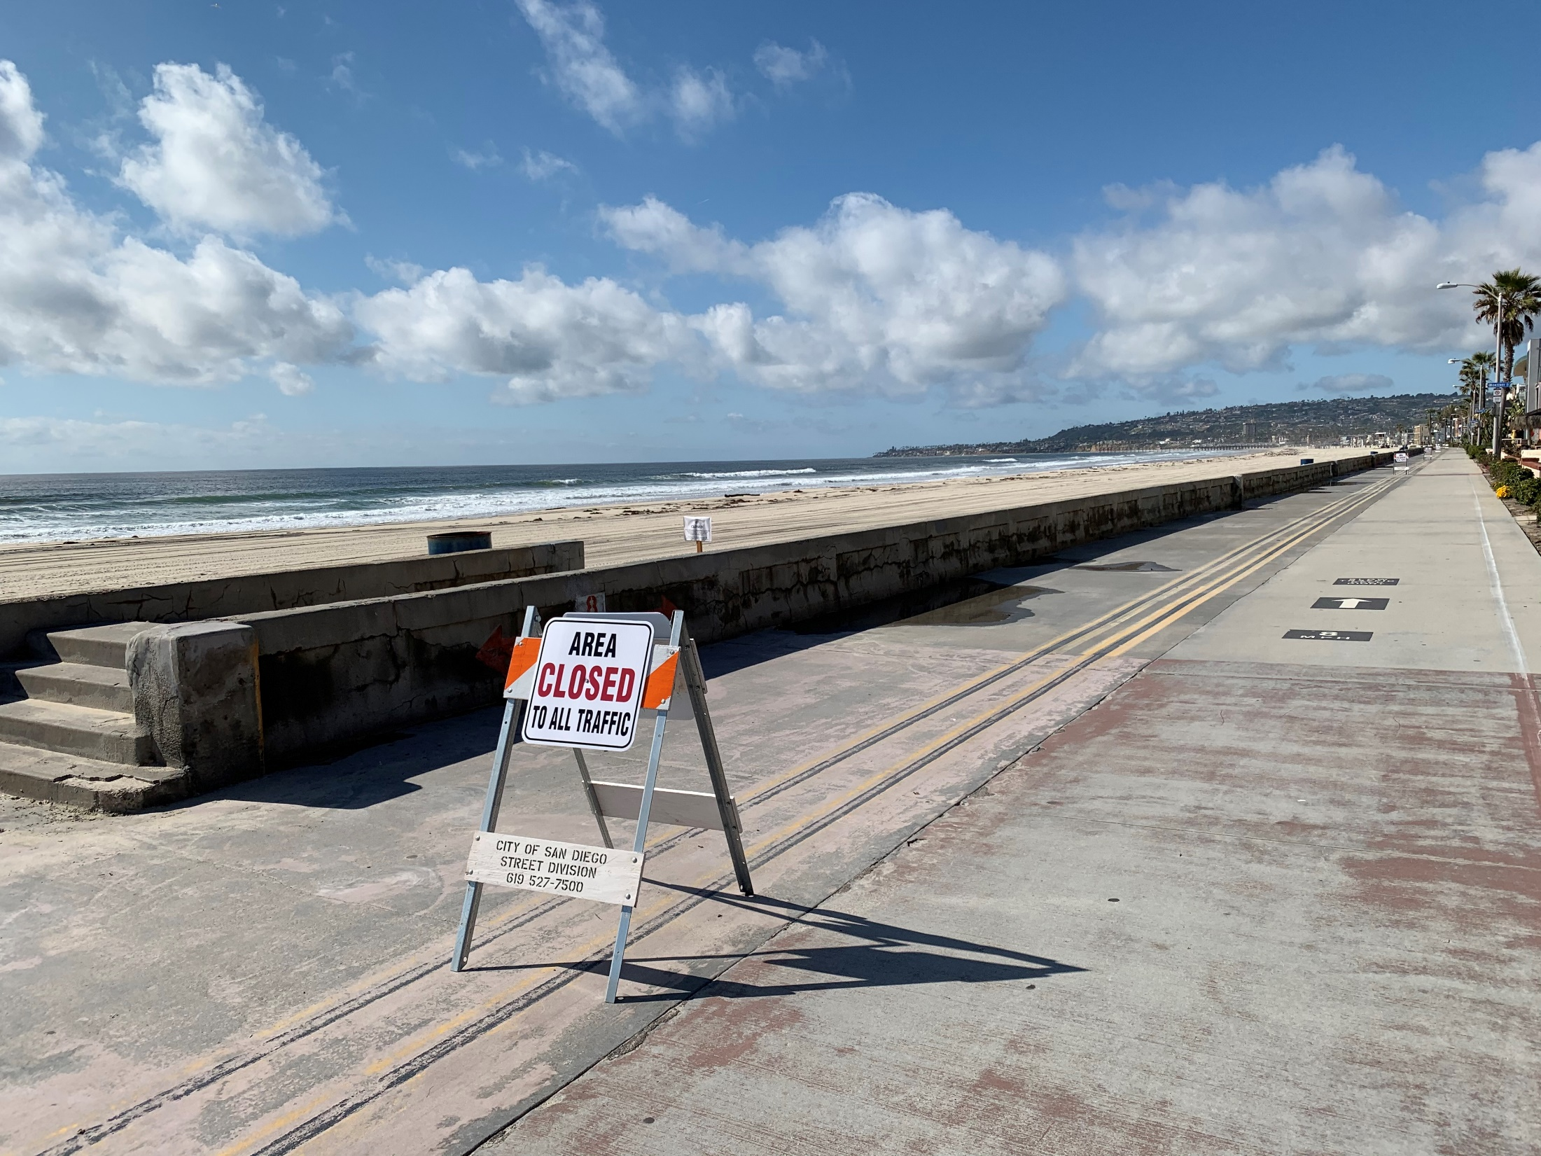
San Diego, USA
June 2020
The COVID-19 pandemic changed PA
Picture Credits: Prof. James F. Sallis, USA

Slide 4
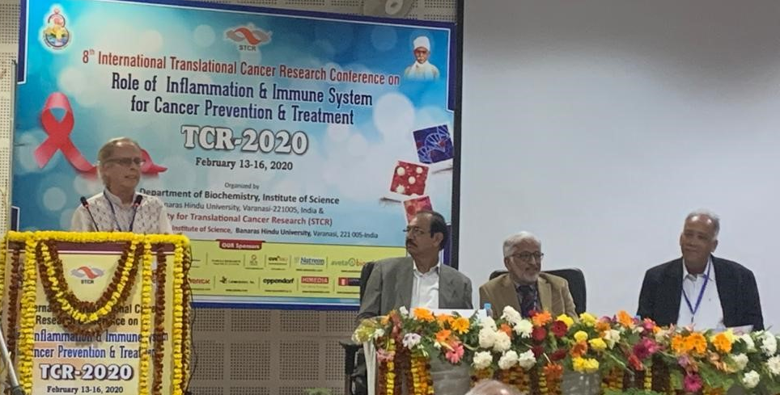
In February 2020 I gave a lecture in India on PA, immune function, inflammation, & cancer

Slide 5
Published July 2020

Slide 6
Physical Activity May Contribute to Controlling the Pandemic: Pre-existing Evidence
Moderate PA enhances immune function and reduces inflammation, so it could reduce severity of infections
Moderate PA can improve the common chronic conditions that increase risk for severe COVID-19
  About 95% of COVID-19 deaths are in people with chronic conditions
Moderate PA is one of the best stress management methods
Stress and distress create imbalances of cortisol, that negatively affect immune function and inflammation. PA rebalances cortisol
Both acute and chronic PA improve immune responses to vaccines
Note: PA produces acute effects for most of these outcomes

Slide 8
Introduction
At the start of the pandemic there were no data regarding the effect of regular physical activity (PA) on COVID-19 outcomes, even though lack of PA is a well-documented risk factor for multiple chronic diseases associated with severe COVID-19.
This study evaluated the hypothesis that consistently meeting PA guidelines prior to diagnosis is associated with more favorable COVID-19 outcomes among infected adults.

Slide 9
Participants
Conducted at Kaiser Permanente Southern California (KPSC), an integrated healthcare system serving 4.7 million residents at 15 medical centers.
Inclusion criteria
  KPSC member aged 18+ years
  Positive COVID-19 test or diagnosis between 1/1/2020 and 10/21/2020
  At least 3 outpatient visits with an Exercise Vital Sign (EVS) measure between 3/19/2018 and 3/19/2020 recorded in the Electronic Health Record (EHR)

Slide 10
Analyses
Logistic regressions estimated odds ratios (and 95% confidence intervals) for the association of EVS categories and all covariates with outcomes, with separate models for each outcome
Adjusted for demographics and all risky “underlying conditions” identified by CDC

Slide 11
Adjusted odds ratios of EVS categories with outcomes. N=48,440
EVS Comparisons | Hospitalization | Death
Inactive vs Active (ref) | 2.26 | 2.49
Inactive vs Some Activity (ref) | 1.20 | 1.32

Slide 12
Key Findings
Inactivity had higher odds ratios for all outcomes than all CDC risk factors, except age and history of transplant
Some activity (less than guidelines) provided modest protection compared to inactivity
Reported odds ratios are probably conservative because they are adjusted for numerous chronic diseases that are in the causal chain

Slide 14
Outcomes
Altmetric score of almost 9000. Picked up by 338 news outlets worldwide
Highest score to date for a BJSM article
No response at all from infectious disease community
No mention by pandemic spokespeople
No impact on pandemic control
This study was presented to the 1000+ CDC COVID task force
Justified a CDC review of the topic

Slide 15
CDC’s systematic review. Posted April 2022
Brief Summary of Findings on the Association Between Physical Inactivity and Severe COVID-19 Outcomes
By Hill, Whitfield et al.
25 studies, 15 cohort, 5 cross-sectional, 4 ecological and one case-control, reported data on physical fitness, physical inactivity or physical activity and severe COVID-19 outcomes and were included in this analysis.
The data indicate an association between increased mortality (1-12) and hospitalization (8,13-18) due to COVID1-19 infection and physical inactivity
Evidence is “consistent” and “conclusive”
https://www.cdc.gov/coronavirus/2019-ncov/downloads/clinical-care/E-Physical-Inactivity-Review.pdf

Slide 16
Outcomes
Though the review is posted on the CDC COVID-19 website, I challenge you to find it by searching
Physical inactivity was listed as an “underlying condition”
CDC and DHHS refused to issue a press release or announcement
No mention by pandemic spokespeople
No impact on pandemic control

Slide 18
Purpose and Methods
The study determined if a dose-response association was observed and between PA and COVID-19 outcomes and if associations were consistent across demographic subgroups and chronic conditions.
194,191 adults with COVID-19 diagnosis had 3 or more EVS measures prior to the pandemic.
5 categories of PA were created
Very few were vaccinated prior to May 31, 2021

Slide 20
Reference is “always active”: meeting guidelines on all EVS measures

Slide 22
Note: This paper was rejected without review by 6 mainstream medical journals

Slide 23
Ezzatvar Y, Ramírez-Vélez R, Izquierdo M, et al
Physical activity and risk of infection, severity and mortality of COVID-19: a systematic review and non-linear dose–response meta-analysis of data from 1 853 610 adults
British Journal of Sports Medicine 2022;56:1188-1193.
Sixteen studies were included. Overall, those who engaged in regular physical activity had a lower risk of infection (RR=0.89; 95% CI 0.84 to 0.95; I²=0%), hospitalisation (RR=0.64; 95% CI 0.54 to 0.76; I²=48.01%), severe COVID-19 illness (RR=0.66; 95% CI 0.58 to 0.77; I²=50.93%) and COVID-19-related death (RR=0.57; 95% CI 0.46 to 0.71; I²=26.63%) as compared with their inactive peers.
Our findings highlight the protective effects of engaging in sufficient physical activity as a public health strategy, with potential benefits to reduce the risk of severe COVID-19.

Slide 24
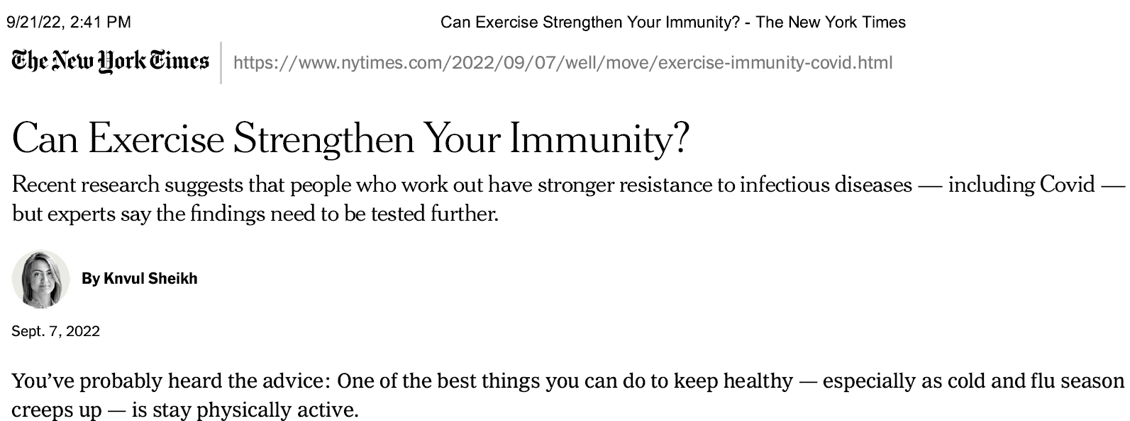

Slide 25
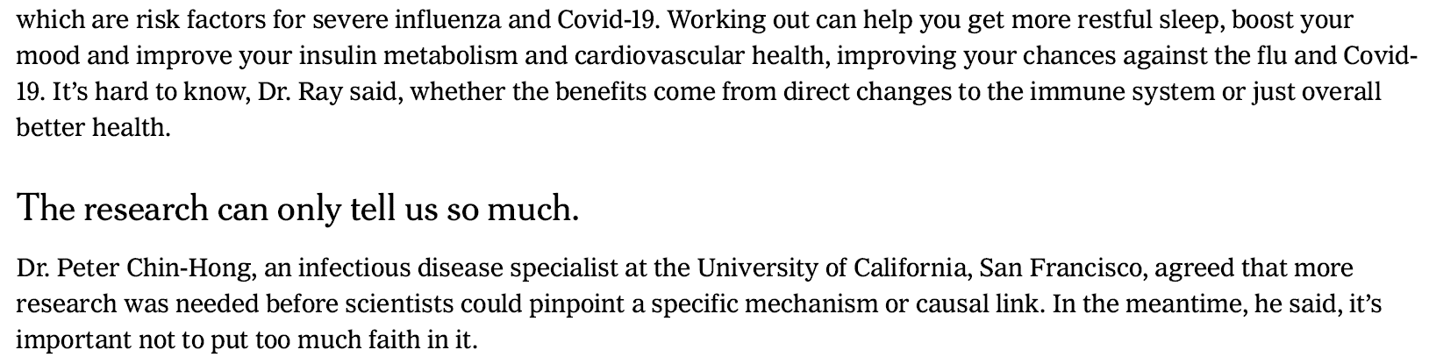
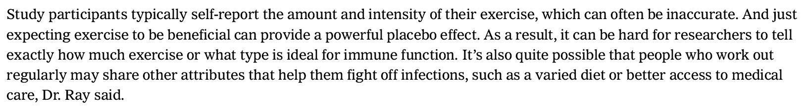
Comments from infectious disease specialists

Slide 26
Conclusions, Recommendations, Questions
Consistent findings that physical inactivity is a strong modifiable risk factor contrasts with the lack of visible efforts by US public health authorities to educate people about benefits of PA or promote PA during the pandemic.
By contrast, WHO identified inactivity as a risk factor early in the pandemic, recommended people be active, and disseminated supporting evidence.
Mitigation measures that reduce PA could be counterproductive for public health outcomes.
Why is “consistent and conclusive” evidence of PA’s benefits for COVID-19 outcomes ignored by the CDC and dismissed by infectious disease leaders?
The mental health benefits of PA have been known for decades, and COVID produced a pandemic of mental health problems. Why was PA ignored as a solution?
The Young et al results suggest PA could help reduce inequities in COVID-19 outcomes
Did failure to act on PA evidence cause public health harm?

Slide 27
How Can We Do Better Next Time?
PA assessment (e.g., EVS) should be integrated into EHRs on a routine basis to allow rapid assessment of PA as a risk factor during outbreaks. This is the main way other “underlying conditions of risk” were identified quickly in the US.
  CDC and the PA Alliance are making progress on this
PA should be incorporated into models that guide infection control decisions. Data are needed to enable PA’s inclusion.
Vaccine trials should include PA intervention conditions
How can we better communicate the PA evidence to public health and infectious disease leaders who could put it into practice?
  To answer this question we should study the perceptions of PA’s evidence, relevance, and what would be required to justify public health action

Slide 28
How Can We Do Better Next Time?
Let’s rethink the whole paradigm.
  COVID-19 was not a pandemic.
  It was a “syndemic” of multiple, interacting pandemics: COVID-19, chronic diseases, health inequities, mental health problems, physical inactivity
Let’s develop relationships with the infectious disease field to
  Collaborate on research
  Collaborate on solutions based on lessons learned (or that should be learned) from COVID-19
Planning for the next pandemic/syndemic should include a broader range of expertise (Ma and Sallis, J Gen Int Med, 2022)
  Infectious disease PLUS
  Chronic disease
  Health equity
  Mental health
  Physical activity
  communications

