Slide 1
Examples and Applications of D&I Science to PA Research
Setting
Infrastructure
Decision Makers
Implementors
Beneficiaries
Reach
Effectiveness
Maintenance
Adoption
Implementation
Sustainment
Paul Estabrooks, PhD
Professor of Health & Kinesiology
Associate Dean of Community Engagement
College of Health
University of Utah
Institutionalization
Policy Development

Slide 2

Dissemination & Implementation Science
The scientific study of the strategies and mechanisms by which scientific evidence is disseminated and implemented in community or clinical settings to improve outcomes for a specified population.
Estabrooks, 2023; Estabrooks, Brownson, Pronk, 2018; Brownson et al., 2015

Slide 3
What is D&I Science All About?
Understanding the context related to evidence-based intervention (EBI) dissemination, implementation, and sustainment.
Designing strategies to improve EBI dissemination, implementation, and sustainment that fit within a given context.
Using conceptual models or theories to map strategies to underlying mechanisms of organizational and individual change.
Documenting the relationship between strategies, mechanisms, and outcomes to produce generalizable knowledge.
Terry, 2022; Pronk & Spoonheim, 2023; Estabrooks, 2023

Slide 4
  Dissemination & Implementation Outcomes

Slide 5
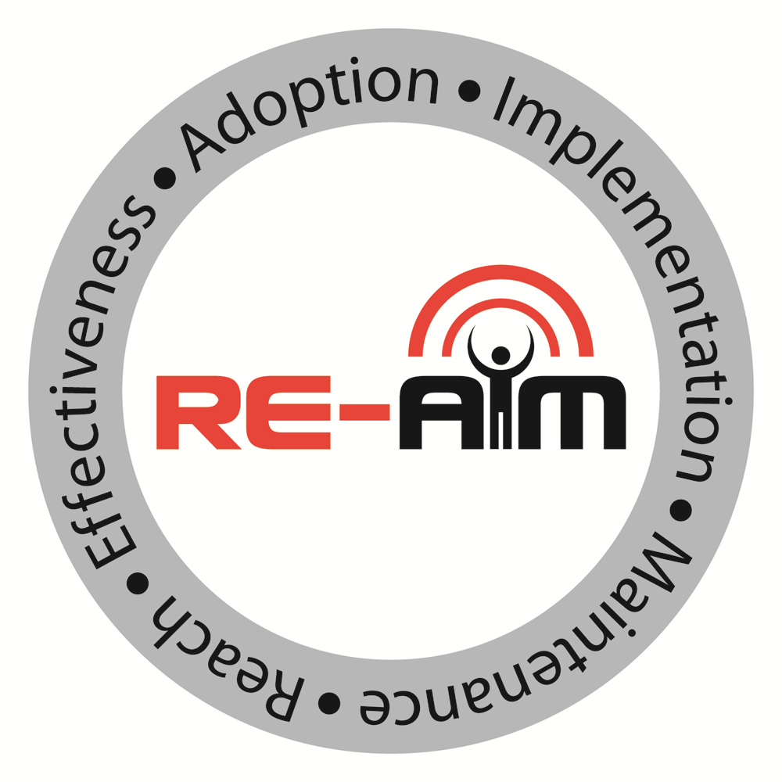
Dissemination & implementation Outcomes
  Acceptability
  Adaptation
  Adoption
  Appropriateness
  Costs
  Feasibility
  Fidelity
  Penetration
  Sustainability
Glasgow et al, 1999; Proctor et al, 2011; Reilly et al, 2020
Notes:
Start with the end in mind

Slide 6
  Multi-Leveled Context & Mechanisms

Slide 7

Multi-leveled System
External Environment
Community
Culture
Management Support
Leadership
Incentives
Communication structure
Job Descriptions
Performance Data
Infrastructure
Decision Support
Shared Goals & Cooperation
Sustainability Planning
Facilitation Processes
Adaptability
Expectation for Sustainability
Decision Makers
Competing Demands
Characteristics
Implementors
Capacity
Beliefs
Knowledge
Beneficiaries
Beneficiaries
Reach
Effectiveness
Maintenance
Implementers
Adoption
Implementation
Sustainment
Decision Makers
Institutionalization
Policy Development
Estabrooks, 2023; Feldstein & Glasgow, 2008

Slide 8
Multi-leveled Systems
External Environment
ACROSS LEVELS PERCEPTIONS OF THE EBI CONTRIBUTE TO CEDI OUTCOMES
Community
Infrastructure
Compatibility
Decision Makers
Relative Advantage
Implementors
Complexity
Beneficiaries
Observability
Reach
Effectiveness
Maintenance
Trialability
Adoption
Implementation
Sustainment
Robustness
Institutionalization
Policy Development
Estabrooks, 2023; Feldstein & Glasgow, 2008

Slide 9
  Multi-Leveled Strategies

Slide 10

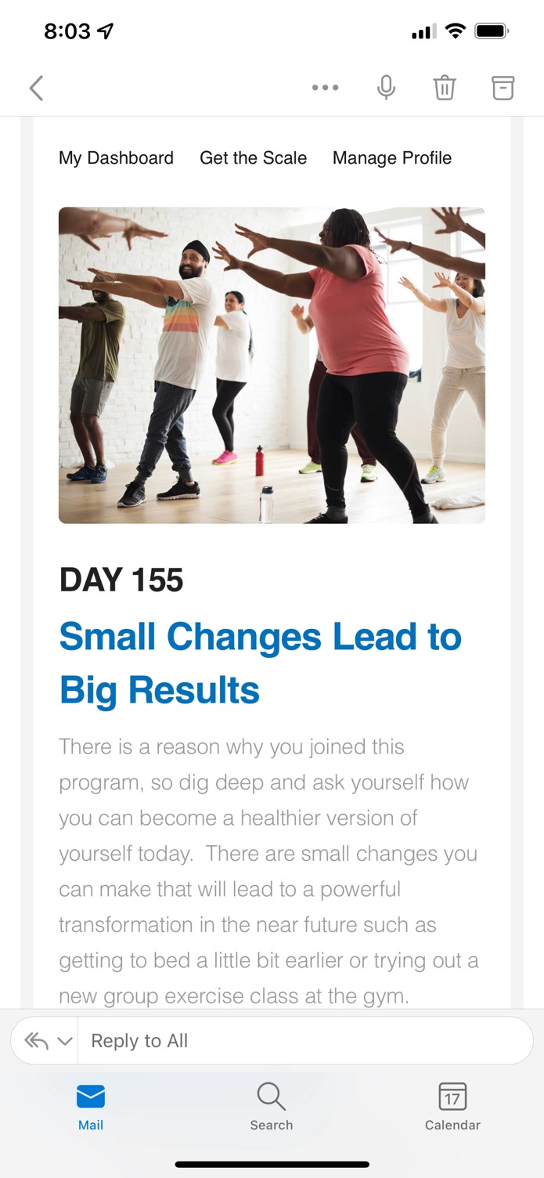
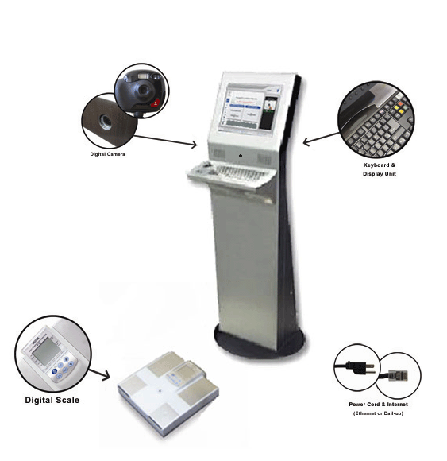
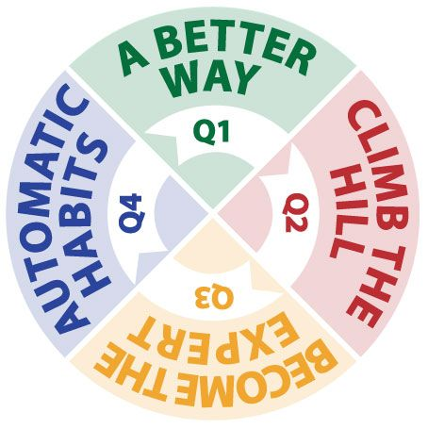
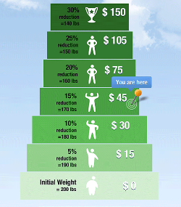


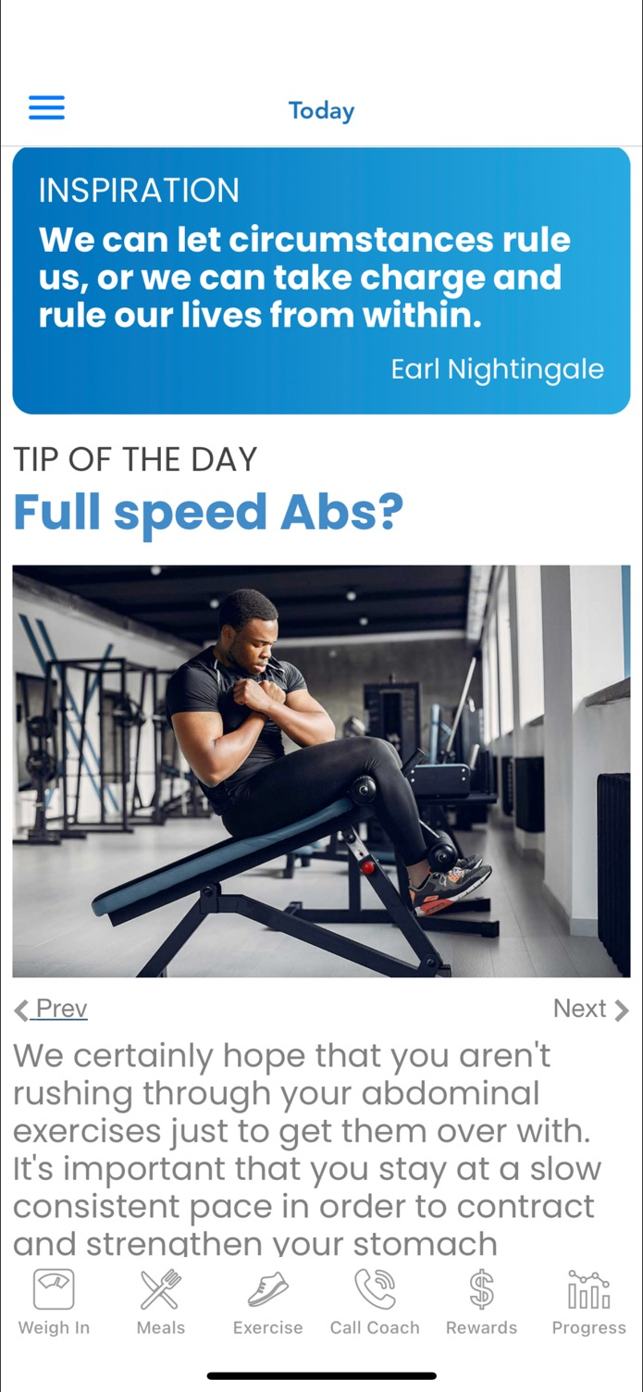
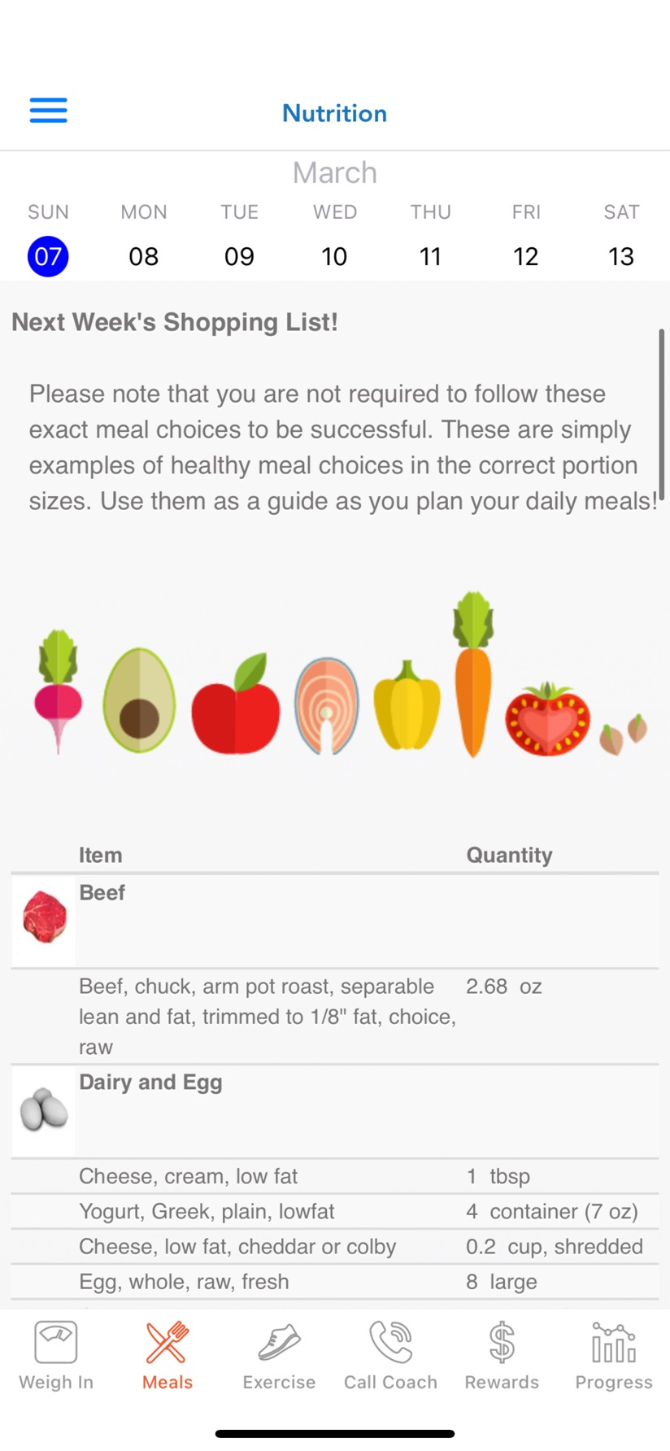
Multi-Leveled Strategies Applied to a Worksite Physical Activity, Healthful Eating, and Weight Loss EBI
Patent Pending
External
Facilitation
Incentive
Policy
EBI
Infrastructure
Almeida et al., 2015; Estabrooks et al., 2016
Notes:
10

Slide 11
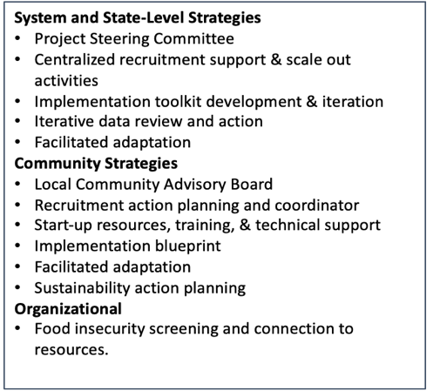







Multi-Level CEDI Strategy
Multi-Leveled Strategies Applied to An Obesity Prevention EBI for Native American Children
Key Partners
EBI
Intended Audience
Blackfeet Nation
Confederated Tribes of Warm Springs
Cheyenne River Sioux Tribe
Menominee Indian Tribe of Wisconsin
Tomayko, Adams, Estabrooks (MPI) U54 CA280812
Notes:
Addresses gap in home-based health promotion programs for AI families with young children
Year-long, monthly mailed kits
Effectiveness tested in two large trials: ~600 families, 8 communities
Current project: How best to scale-up Turtle Island Tales to interested communities?
Accepted into SNAP-Ed Toolkit of EBIs

Slide 12
Dissemination & Implementation Science:
Strategy- Outcome Examples

Slide 13
Strategy
Integrated research-practice partnership to design for dissemination & sustainability (D4DS)
Context:
Rural Midwest ↓ PA
Few resources to support physical activity promotion
Challenges with travel and the need for regular meetings
Cooperative Extension System Available and Interested in PA in rural areas
  Includes integrated training model
  Experience in program delivery
  Looking to increase impact (# of people served).
  Open to partnership
Evidence-Based
Intervention
Delivery Sites
Organization
Tested in
Cooperative Extension
Multiple Settings
Extension
Office
Critical Elements
Fit
Peer Sharing
Group feedback
Sense of Distinction
Group goal setting
Group Roles
Frequent Contact
Research Staff Delivery
Space Limits
Agents
Available Resources
Current Heath Programs
Limited Staff Time
Walk Kansas
Re-invention of
intervention retaining
critical elements but
reducing contact
Diverse Samples
Office Staff Engagement
Design Fit
Scheduling & Cost of Delivery
Demonstration
Project
*Integration of Training
Estabrooks & Glasgow, 2006; Estabrooks et al., 2008

Slide 14
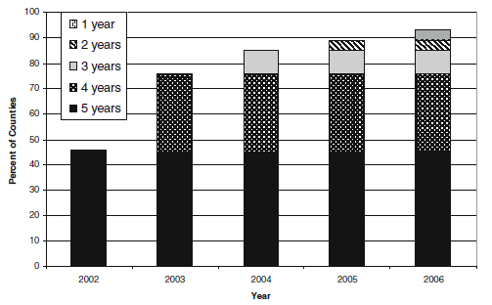

Mechanisms?
Outcomes:
Reach
Weekly minutes of moderate PA
Effectiveness
Adoption & Organizational Maintenance
Estabrooks et al., 2008

Slide 15
Strategy
Integrated research-practice partnership to design for dissemination & sustainability (D4DS)
Context:
Nurse chronic care coordinators in a regional hospital system found 68% of patients are overweight or obese
Nurses were regularly asked to provide physical activity, healthful eating, and weight management
Limited behavior change resources
Nursing leadership searching for a systematic approach
Estabrooks, Johnson, & Almeida, 2016; Estabrooks, 2023

Slide 16
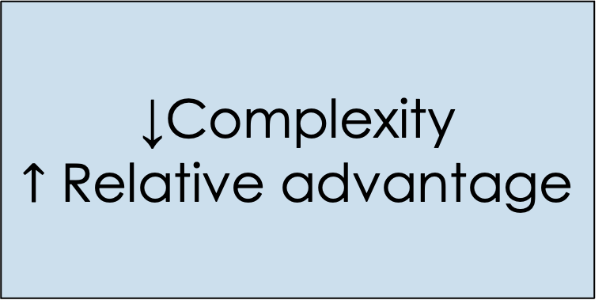
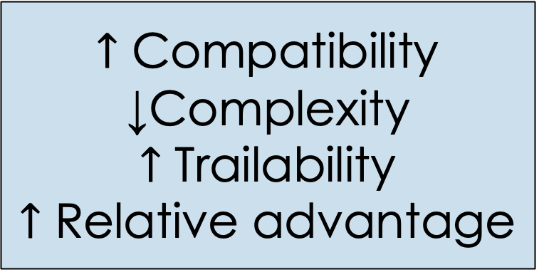
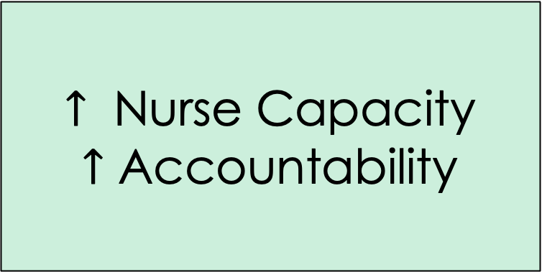
Hypothesized Mechanism of Action
Strategy
Mechanism
Outcome
Packaging intervention and ½ day CME
$↑$ Compatibility
↓Complexity
$↑$ Trailability
$↑$ Relative advantage
Adoption
# Nurses Initiate
Delivery
Electronic Medical Record Implementation Support
↓Complexity
$↑$ Relative advantage
Implementation
Fidelity to intervention protocol
Consistency
Consultee Centered Training Approach
$$↑ \text{Nurse} \text{Capacity}$$
$↑$ Accountability
Maintenance
# Nurses sustain program implementation
Regional Healthcare System
Infrastructure
Reach
Effectiveness
Maintenance
Decision Makers
Adoption
Implementation
Sustainment
Implementors
Institutionalization
Policy Development
Beneficiaries
You, 2011; Almeida et al., 2015; Estabrooks et al., 2017

Slide 17
RE-AIM Outcomes

Slide 18
Dissemination & Implementation Science:
Strategy-Mechanism-Outcome Examples

Slide 19
Strategy
Participatory D4DS
Context:
Rural & Micropolitan VA ↓ PA
Few resources to support physical activity promotion
Challenges with the need for regular meetings
Cooperative Extension System Available and Interested in PA promotion
  Includes integrated training model
  Experience in program delivery
  Looking to increase impact (# of people served).
  Open to partnership
Estabrooks et al., 2019

Slide 20

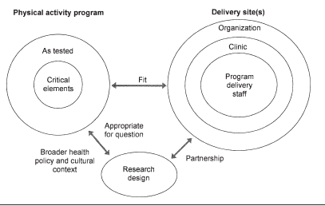

Comparing D4Ds to standard intervention development
N=56 Health Educators
Participatory Designed for Dissemination & Sustainability
Standard Development Strategy
Health Educators interested
N=36
R
Versus
ALED
N= 18
Fit Ex
N=18
Telephone Introduction
Online Training
Fit Extension
Active Living Everyday
In person training
Harden, Johnson, Almeida, Estabrooks, 2017; Johnson, Harden, Estabrooks, 2016

Slide 21
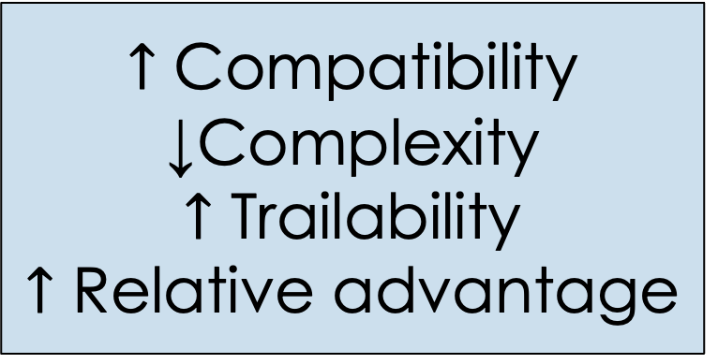
Hypothesized Mechanism of Action
Strategy
Mechanism
Outcome
Participatory D4DS
$↑$ Compatibility
↓Complexity
$↑$ Trailability
$↑$ Relative advantage
Adoption
# Agents that are trained and deliver
Quantitative, qualitative, and mixed methods approaches are needed to assess mechanisms
Cooperative Extension
Infrastructure
Reach
Effectiveness
Maintenance
Decision Makers
Adoption
Implementation
Sustainment
Implementors
Institutionalization
Policy Development
Beneficiaries
Harden, Johnson, Almeida, Estabrooks, 2017; Johnson, Harden, Estabrooks, 2016

Slide 22
Mechanism:
Relative advantage based on RE-AIM OUTCOME
*
*
*
*
* p<0.05

Slide 23
Mechanism:
Complexity and Compatibility
*
*
* p<0.05

Slide 24
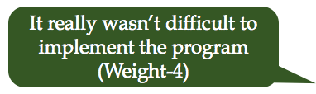

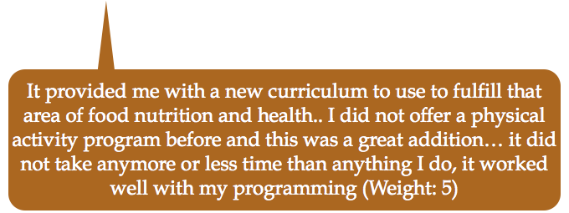
Mixed methods
Fit Ex Adopter
ALED Non-Adopter
ALED Adopter
Harden, Johnson, Almeida, Estabrooks, 2017; Johnson, Harden, Estabrooks, 2016

Slide 25
Outcome: Adoption
*
*χ²(1)=7.2, p<.01
Notes:
Each participant completed an online registration and an objective assessment of weight on a validated scale. Attrition was operationalized as completion of the 3 or 6 month weight assessment

Slide 26
Conclusion
Strategy
Mechanism of Action
Outcome
Integrated Research Practice Partnership: D4DS
Characteristics of the Intervention
Relative advantage across RE-AIM outcomes
Complexity/Ease of Use
Adoption—number and representativeness of health educators
In the context of a community program delivery system providing services to geographic areas experiencing disparities in PA, this study demonstrated the benefit of a participatory D4DS strategy to increase program adoption.
Quantitative and qualitative data support the potential mechanisms of program relative advantage, compatibility, and complexity as potential mechanisms of adoption.

Slide 27
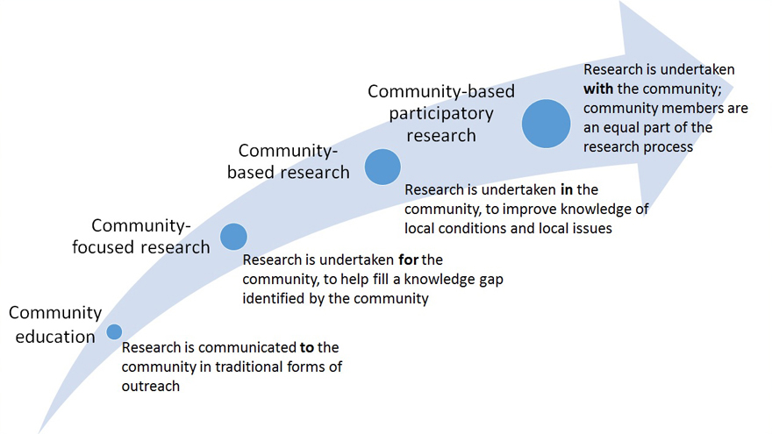
Multi-Leveled Strategies Applied to a Worksite Weight Loss EBI
Between Community-Based Research & Community-Based Participatory Research
Patent Pending
External
Facilitation
Incentive
Policy
EBI
Infrastructure
Almeida et al., 2015; Estabrooks et al., 2016
Notes:
27

Slide 28
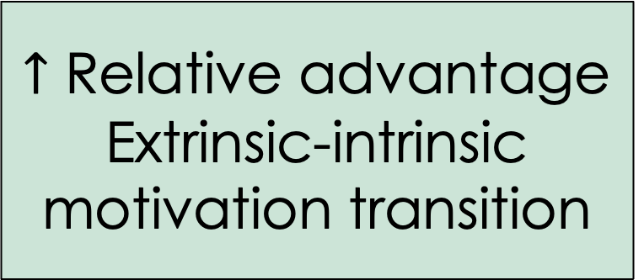
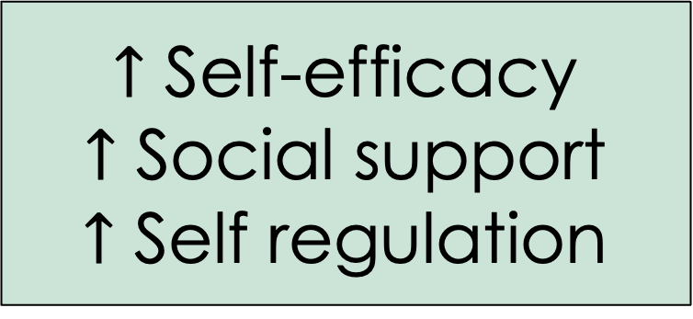
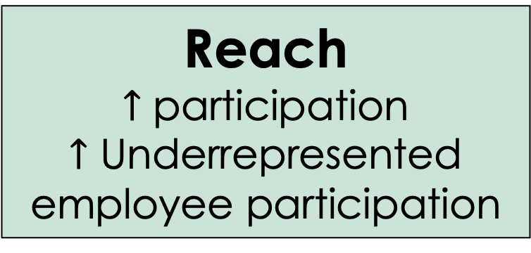
Strategy
Mechanism
Outcome
Incentive
Policy
$↑$ Relative advantage
Extrinsic-intrinsic motivation transition
Reach
$↑$ participation
$↑$ Underrepresented employee participation
Workplace
Infrastructure
Social cognitive intervention
$↑$ Self-efficacy
$↑$ Social support
$↑$ Self regulation
Effectiveness & Maintenance
↓Weight
Decision Makers
Implementors
Reach
Effectiveness
Maintenance
Beneficiaries
Adoption
Implementation
Sustainment
Institutionalization
Policy Development
You, 2011; Almeida et al., 2015; Estabrooks et al., 2016

Slide 29
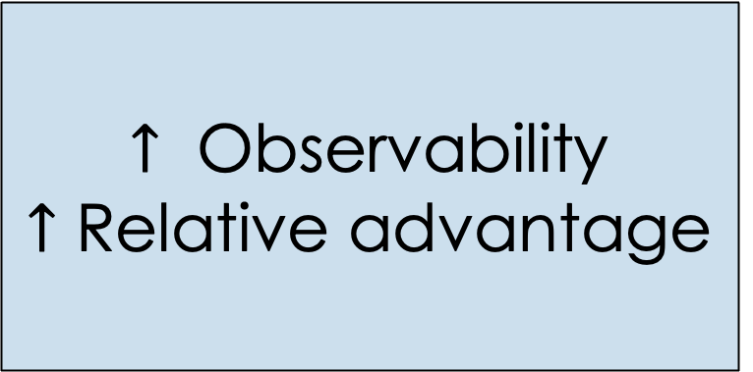
Strategy
Mechanism
Outcome
Packaging intervention using technology and external coaching
$↑$ Compatibility
↓Complexity
$↑$ Trailability
$↑$ Relative advantage
Adoption
# Worksites Initiate
Representativeness of Worksites
External Expert Facilitation
↓Complexity
$↑$ Relative advantage
Implementation
Fidelity to intervention protocol
Consistency
Audit and feedback on worksite outcomes
$$↑ \text{Observability}$$
$↑$ Relative advantage
Maintenance
# Worksites sustain program implementation
Workplace
Infrastructure
Reach
Effectiveness
Maintenance
Decision Makers
Adoption
Implementation
Sustainment
Implementors
Institutionalization
Policy Development
Beneficiaries
You, 2011; Almeida et al., 2015; Estabrooks et al., 2017

Slide 30
Results
Reach
Effectiveness
Adoption
Maintenance
Implementation
All study components were delivered as intended
Participants varied in components of the the intervention that were used from daily message reading (highest >60%) to use of daily self-reported goals (<15%).
73 Worksites contacted
28 Agreed (38%)
Reasons for decline:
None (44%),
Program would compete with other programs (n=33%)
expected internal changes (n=13%),
Study too long (n=7%),
75% of the workplaces opted to maintain the program for a second year (no cost; no incentives; no health coach)
25% of worksites expressed interest in continuing the program in it’s complete form.
Percent of overall employee population meeting 5% weight loss
n=192
n=195
n=195
n=198
n=112
n=128
n=131
n=80
You, 2011; Almeida et al., 2015; Estabrooks et al., 2017
Notes:
Start with the end in mind

Slide 31
Communicating Complexity in D&I Projects

Slide 32
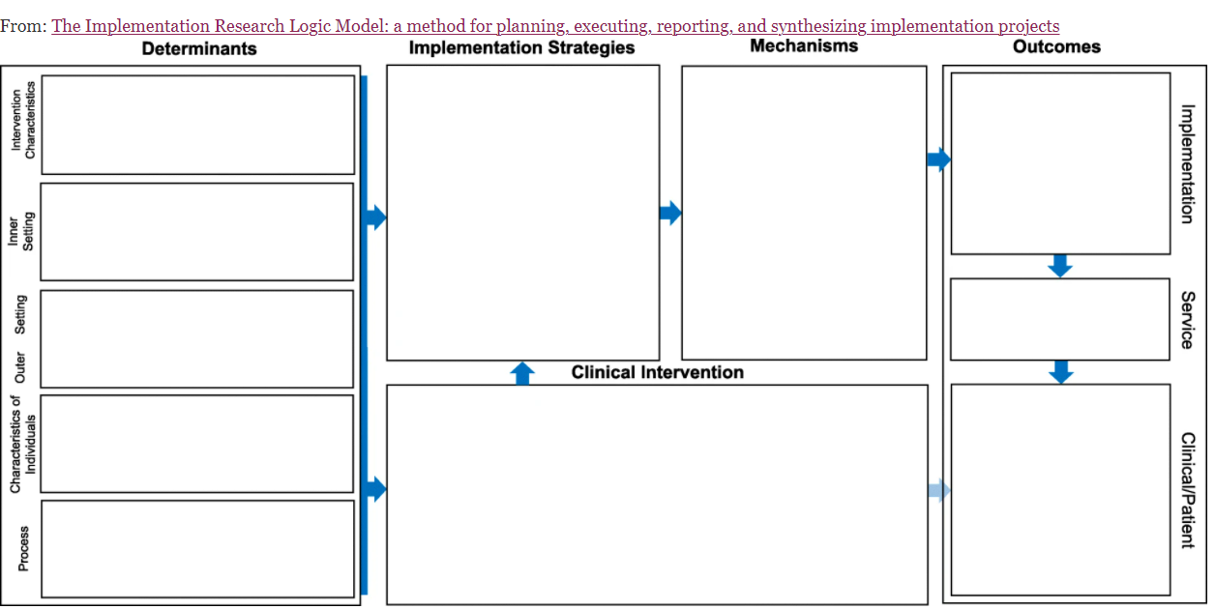
Implementation Research LoGic model
Smith, J.D., Li, D.H. & Rafferty, M.R. The Implementation Research Logic Model: a method for planning, executing, reporting, and synthesizing implementation projects. Implementation Sci 15, 84 (2020).
Paper (https://implementationscience.biomedcentral.com/articles/10.1186/s13012-020-01041-8) has great additional file examples

Slide 33
Implementation Research LoGic model: Nebraska CORD 3.0
Determinants
Implementation Strategies
Mechanisms
Outcomes
-No childhood obesity interventions in rural/micropolitan areas
-Few evidence-based approaches designed for rural implementation
+ existing adaptation of for rural/micropolitan areas
+evidence of adaptation success
+Turn-key program package
Fund & Contract (A)
Identify communities with strong partnerships across organizations and a priority to address childhood obesity.
↑ incentive for adoption (A)
Identify communities ready for implementation (A,D)
↑ mandate for adoption (A)
Adoption: (A, B, C, D, E)
Number of communities that agree to deliver BHF
Number of BHF Cohorts initiated
Innovation
↑ perceptions of the innovation (BHF); relative advantage, complexity etc. (A, B, E)
↑ recipient knowledge and self-efficacy (B, E)
Facilitation & ↑ capacity (C, D, E)
Packaged Implementation Blueprint
Building Healthy Families Online Training Resources and Program Package (B)
Referral processes (C)
Reach (BHF participants) (B,C)
Number, Proportion, Representativeness
+High rates of childhood obesity in micropolitan/rural areas
+Organizational prioritization of childhood obesity
-Limited external contextual drivers (lack of incentives; coverage)
Context
Implementation (A-E)
BHF fidelity (competence X adherence)
Cost
Action Learning Collaborative
Network weaving (D)
Consultee-centered training (E)
Sustainability action planning (F)
↑ Facilitation processes (D,E,F)
↑ Collaboration and team-work (D)
↑ systems-engagement (D, E, F)
↑receptivity to change (D, E)
Sustained changes in context, innovation perceptions, facilitation, and recipient capacity (F)
-Difficult to identify implementation team with multi-disciplinary expertise within a
single rural organization or community.
-Need for high levels of collaboration across community systems to support recruitment and implementation.
Maintenance (BHF Program) (F):
Number of communities offer 3rd Cohort
Cost
Recipients
Evidence-Based Intervention
Building Health Families Program (BHF): A adaptation of Epstein’s Traffic Light Diet for delivery in rural settings.
12 weekly, 90 minutes sessions for families; 4 Relapse prevention refresher sessions; Follow-up at 3, 6, 12 months
Core content includes physical activity, nutrition, and behavioral strategies for families.
Mechanisms
-Lack of local brokers
to support collaboration across systems
-Few opportunities for cross community partnerships or shared learning
-Lack of local process to support adoption, implementation, and sustainability.
+CAB BHF
Effectiveness
Reduced BMI z-score at 3 & 6 months
Parent weight loss at 3 & 6 months
Maintenance of effect:
BMI z-score at 12 months
Parent weight loss maintenance at 12 months
Attendance
↑ Physical activity
↑ Healthful eating
Goal Attainment
↑ Self-Regulation
Facilitation
Note: Implementation strategies are labeled alphabetically. Matching letters in Mechanisms and Outcomes columns demonstrate hypothesized pathways of strategy effects.
Hill/Heelan MPI
Notes:
Slide 4 is for publication.
Notes for CG and GP—1) review the figure to ensure the language aligns with the paper text and CDC supplement approved language. 2) fix font for consistency (currently some boxes are arial and some Calibri)

Slide 34
Multi-Leveled Strategies Applied to a Worksite Physical Activity, Healthful Eating, and Weight Loss EBI
Patent Pending
External
Facilitation
Incentive
Policy
EBI
Infrastructure
Almeida et al., 2015; Estabrooks et al., 2016
Notes:
34

Slide 35
Scaling Up through Community Engagement and Adaptation
Partnership growth over program of research and community impact.
Health system community benefit group
Local retailers: Barber/Beauty Shop
Civic Leadership
Safety-net food providers
Learning centers
Faith-based organizations
Dissemination partner
Academic partners
Notes:
1941-1914

Slide 36
Determinants
Dissemination & Implementation Strategies
Mechanisms
Outcomes
Organizational perspective
-difficult to reach a large number of participants in traditional face to face weight loss approaches
+engaged partners willing to contribute to success
Participant perspective
+Program appears feasible and acceptable
-limited access to EBWLI current delivered
-COVID 19 may reduce perceived importance of weight loss.
Develop Community-Academic Partnership & Resource Sharing Plans
Shared ownership of the adapted evidence-based intervention
↑ access to healthful foods and other community resources
Adoption:
Number and type of community partners that agree to support WAW-A
Intervention
Community led, academic facilitated adaptation process
↑ participant and organizational perspectives of the intervention
↑ cultural relevance
↑ community capacity to implement, sustain, and support EBWLIs through PSE changes
Reach
Number, Proportion, Representativeness
Organizational characteristics
+ Engaged partners across community system
+Payer, clinical and CBOs well represented
-lack of low cost EBWLI offered
Participant characteristics
-need to address obesity while acknowledging cultural beliefs about body shape and size.
-don’t engage in EBWLI at the same rate as other groups
Policy, systems, and environmental change implementation
Recipients
↑ Facilitation processes
↑ Collaboration and team-work
↑ systems-engagement
↑ receptivity to change
Sustained changes in the implementation and sustainability infrastructure
Implementation
Fidelity of enacting adaptations
Costs
Iterative evaluation of program data related to reach, effectiveness, implementation, and maintenance
Sustainability action planning
Maintenance :
Likelihood of sustained implementation after grant period
Implementation/Sustainability Infrastructure
+ Steering committee with access to real time program outcome data.
+PSE workgroup made up of organizations that can address and enact plans.
+Systems based approach with partners that have longstanding relationships.
+Resources for sustainability action planning
Evidence-Based Intervention
Mechanisms
Weigh and Win Adapted (WAW-A).
12-month technology-delivered, multi-component coaching intervention
Behavioral economics approach to increase participant reach
Core content includes physical activity, nutrition, and behavioral strategies for families.
Participation from multiple platforms
Sustained engagement due to adaptation
Transition extrinsic to intrinsic motivation for weight loss
↑ Physical activity
↑ Healthful eating
Goal setting and follow-up
↑ Self-Regulation through home scale weigh-ins
Improved awareness of, and access to, healthful foods.
Effectiveness
Reduced weight 3 & 6 months
Maintenance of effect:
Reduced weight at 12 months
-low access to healthful foods, behavior change support and spaces that encourage physical activity
+Strong food security support system willing to partner.
+strategic plan to address health disparities
External Environment
Figure #. Application of the Implementation Research Logic Model (IRLM) for this trial aligning determinants (barriers/facilitators with, DIS strategies, mechanism and outcomes aligned with REAIM/PRISM frameworks. + represents facilitators –represents barriers

Slide 37

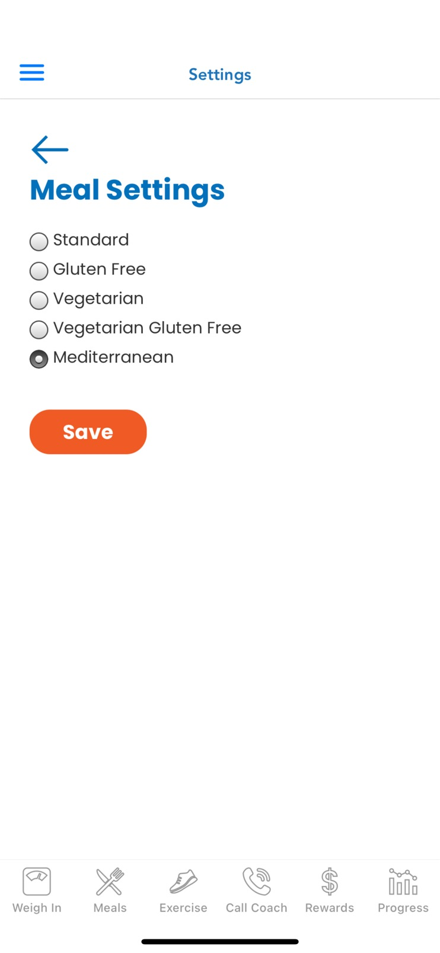


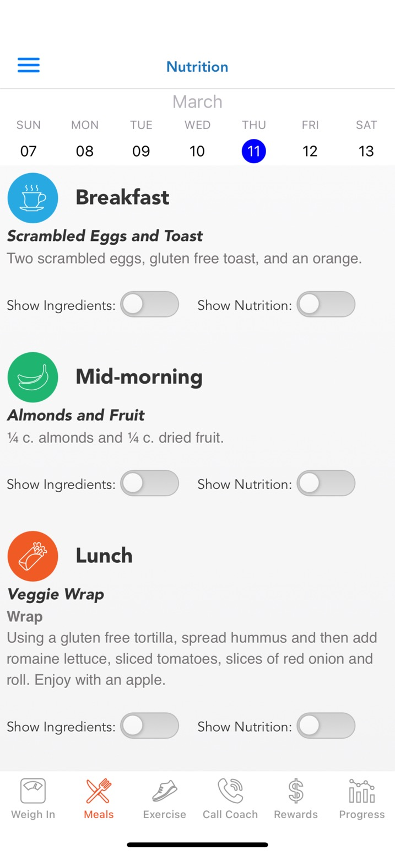
Cultural Adaptations to the EBI Application
More People That Look Like Us
Culturally Tailored Meal Plans
Notes:
1941-1914

Slide 38




Cultural Adaptations to the EBI Application & Implementation Strategies
Peers Support
Health Ambassadors
Notes:
1941-1914

Slide 39

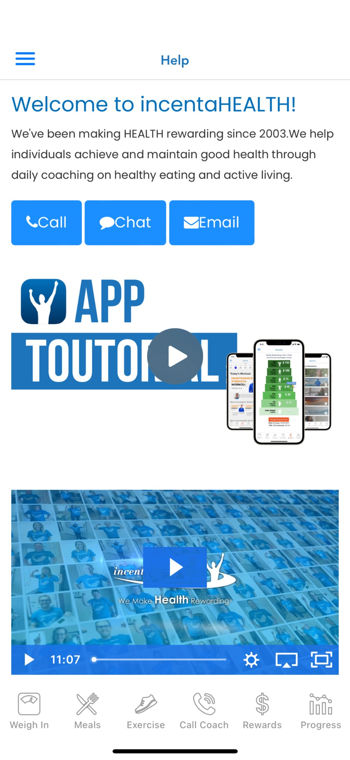

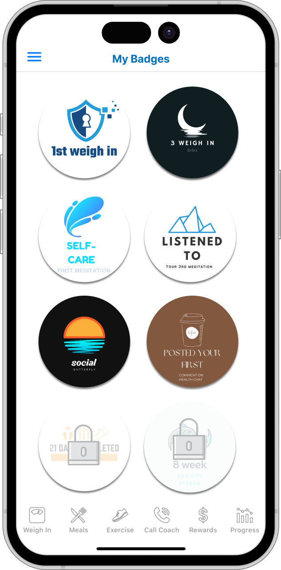
Cultural Adaptations to the EBI Application & Implementation Strategies
On Demand Video Training
Custom Notifications & Unlocking Badges
POSITIVE | To Do
1st Weigh In | Haven’t downloaded the app yet
3rd Weigh In | Missed 1st Weigh In
1st Workout | No workout for 7 days
1st Health Chat | Haven’t tried the Health Chat
5 Workouts in 2 Weeks | . . .
Notes:
1941-1914

Slide 40
MREAL Implementation Research Logic Model
Determinants
Implementation Strategies
Mechanisms
Outcomes
- Untested in schools on Mexico-U.S. border
+ existing adaptation of for youth in central Mexico
+evidence of adaptation success
+Packaged curriculum
+Existing teacher training
Expert Facilitation
Implementation fidelity review and feedback on early and core sessions.
Barrier assessment and collaborative problem-solving during preparation, early, mid, end of implementation phases.
Tailor implementation strategies to school context
Ongoing consultation.
Innovation
↑ teacher perceptions of the MREAL (e.g., relative advantage)
Recipient
↑ teacher motivation
↑ Teacher knowledge
↑ Teacher self-efficacy
↑ Teacher receptivity to change
Context
↑ Collaboration and team-work
↑ systems-engagement
Facilitation
↑ perceptions of facilitation support
Implementation
MREAL adherence to protocol (PRIMARY OUTCOME)
MREAL adherence to core components
Student Engagement with MREAL lessons
Dose (number of lessons X duration of lessons)
Sustainment of MREAL
Curriculum implementation in 2nd year of project
Cost
Cost-benefit in unit of adherence to protocol
Cost-benefit in unit of effectiveness (prevention)
Innovation
-High prevalence of narcotics and violence.
+High need for substance use prevention in region
+School interest in substance use prevention
-Teacher absenteeism
-Students exposed to substance use opportunities
Context
Standard Approach
MREAL Guided Teacher’s Manual
Practical 1-day teacher training on MREAL content and lessons.
Recipient
↑ teacher motivation
↑ Teacher knowledge
↑ Teacher self-efficacy
↑ Teacher receptivity to change
-Variable adherence to curriculum.
-Low motivation, knowledge, self-efficacy
-Limited IT skills
+Teacher champions exist
Recipients
Evidence-Based Intervention
MREAL: An efficacious intervention for students in Mexico.
12 weekly lessons, student workbook for 12–13-year-olds.
Based in bioecological framework
Focuses on culturally relevant protective factors.
Core content includes a focus on alcohol, tobacco, & other drugs use, and the use of effective drug resistance strategies (REAL; refuse, explain, avoid, leave).
1- & 2-year follow-up school level boosters
Mechanisms
↑ Attitudes related to avoidance of substance use (students).
↑ Intention to avoid substance use (students).
↑ Use of refuse, explain, avoid, and leave behavioral strategies (students).
Effectiveness (SECONDARY OUTCOME)
Prevention of alcohol
Prevention of tobacco
Prevention of other drugs use
Maintenance of effect:
24 month sustained prevention of alcohol, tobacco, & other drugs
-Limited communication with teachers
-lack of teacher progress reviews
-Lack of process to support MREAL implementation & sustainability.
+Research team history of training teachers
+Existing school staff with facilitation skills
Facilitation
Marsiglia PI
Notes:
Slide 4 is for publication.
Notes for CG and GP—1) review the figure to ensure the language aligns with the paper text and CDC supplement approved language. 2) fix font for consistency (currently some boxes are arial and some Calibri)

Slide 41
Primary Implementation Barriers |  | Implementation Strategies to Address Barriers |  | Mechanisms |  | Outcomes
No Sustainable Process to Identify and Enroll Eligible Families for Participation |  | Population Health Management with Automated Patient Text Message Outreach |  | ↑ Family Awareness of BHF ↑ Systems integration ↑ Ease of enrollment |  | ↑Reach (BHF participants) Number, Proportion, Representativeness of Low-Income Families in Rural and Micropolitan Communities
 |  |  |  | ↑ Clinical community coordination ↑ Ease of enrollment
 |  | Community Implementation Team Proactive Follow-Up
 |  |  |  | ↑ Family motivation to enroll
 |  | Repeated Opportunities for Enrollment
Lack of Availability of FHWP Materials to Support Implementation |  | Building Healthy Families Online Training Resource and Program Package |  | ↑ perceptions of the innovation ↑ recipient (community implementation team) access to resources |  | ↑ Adoption 4-8 communities that agree to, and begin, delivery of BHF
 |  | Building Healthy Families Program Kit
Variability of Potential BHF Implementation Team Expertise that could Reduce Program Effectiveness |  | Building Healthy Families Online Training Resource and Program Package |  | ↑ Implementation team capacity ↑ Implementation knowledge ↑ Implementation self-efficacy ↑ perceptions of the innovation |  | ↑ Implementation BHF fidelity and implementation quality |  | ↑ Effectiveness & Maintenance of Effects Reduced Weight Status for Family Members with Obesity
Difficulty In Convening Community Implementation Teams For Initial Training And Ongoing Support |  | Building Healthy Families Action Learning Collaborative |  | ↑ Facilitation processes ↑ Collaboration and team-work ↑ systems-engagement ↑receptivity to change Sustained ↑ in context, innovation perceptions, facilitation, and recipient capacity |  | ↑ Maintenance Sustained delivery into a second year of cohorts
Figure 3. An overview of the Building Healthy Families (BHF) implementation barrier, strategy, mechanism, & outcome pathway using iPARIHS contextual factors & RE-AIM Outcomes

Slide 42
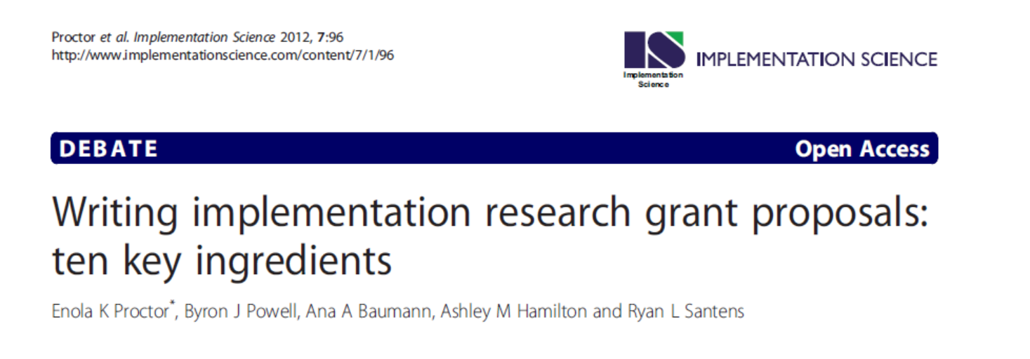
Demonstrate the gap—Evidence-based interventions exist but aren’t adopted, implemented, and sustained consistently in non-research contexts or do not reach the intended audience.
Evidence of partnering with (ubiquitous) systems that have shared priorities to fill the evidence-implementation gap.
Strongly specified the implementation strategies.
Clearly articulated measures.
Include aims that focus on (1) change in implementation outcome, (2) mechanisms of outcome change, and (3) cost evaluation.
Use rigorous mixed methods to provided better understanding of mechanisms of change.
A well articulated conceptual model/ theoretical framework.

Slide 43
Acknowledgements
National RE-AIM Collaborative: Russ Glasgow, Samantha Harden, Borsika Rabin, Marcia Ory
Weigh & Win Projects: Fabio Almeida, Todd McGuire, Keyonna King, Jamie Zoellner, Sarah Wall, The North Omaha Healthy at Home Community Member Partners (n=20!!)
Turtle Island Tales: Alex Adams, Emily Tomayko, Teresa Warne
Walk Kansas/Fit Ex: David Dzewaltowski, Mike Bradshaw, Sharolyn Jackson, Samantha Harden, Sallie Beth Johnson, Joan Wages
Care Coordinator Project: Sallie Beth Johnson, Fabio Almeida, Mark Greenawald, Care Coordination Team
MREAL: Flavio Marsiglia & ASU Team
Mountain West Family Healthy Weight Collaborative: Jennie Hill, Julie Lucero, Guillherme Del Fiol, Dave Wetter, Kola Okyemi

Slide 44
Disclosures
Margolis Foundation (Locke/Estabrooks MPI)
1R37CA252060 (Ehlers PI)
U18DP006431 CDC (Hill/Heelan MPI)
1R01CA250527 (Buman/Pereira MPI)
R56HL157218 (Stoutenberg/Trilk MPI)
1UM1TR004409-01 (Hess/Majersik MPI)
RC2 TR004391-01 (Tristani/Estabrooks MPI)
R01 NS130574 (Rajaram PI)
U54CA280812 (Project 1 Schlechter/Wetter/Estabrooks MPI; Project 2 Tomayko/Adams/Estabrooks MPI)
R03HD109639 (Maloney PI)

Slide 45

Questions

