Slide 1
Life-Course Strategies for Preventing Dementia
Loretta DiPietro, PhD, MPH

Slide 2
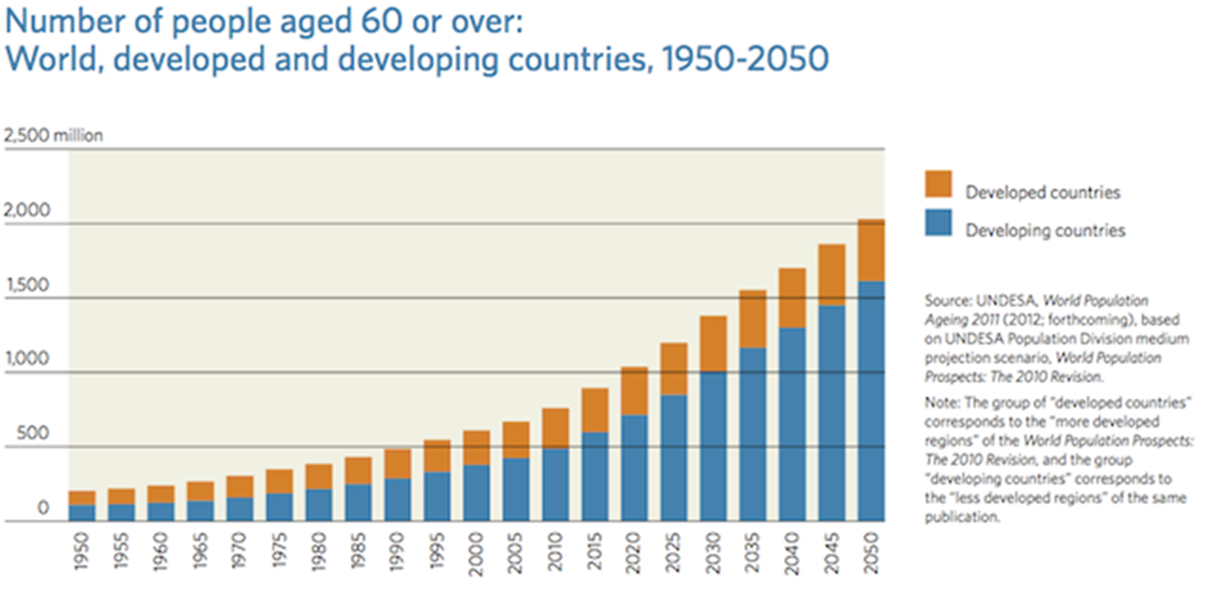
Global Aging Demographics

Slide 3
Background
Approximately 11.2% of Americans over age 65 have probable dementia and 10.6% have possible dementia according to the National Health and Aging Trends Study;
These estimates are expected to increase by 2050 and have significant implications for the health and function of older adults, as well as for their families, and the healthcare system;
Dementia significantly impairs daily functioning, with estimated costs in the United States of between $159 and $215 billion each year;

Slide 4
Dementia is a multifactorial disease
As much as 40% of dementia may be attributable to twelve modifiable risk factors:
low education current smoking
physical inactivity hypertension
obesity in mid-life diabetes
depression hearing loss
social isolation excessive alcohol use
traumatic brain injury
air pollution
Lancet Commission, 2020

Slide 5

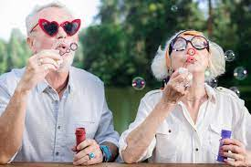

A Life Course Approach to Preventing Dementia
Early Life
Mid-Life
Later Life
Lancet Commission, 2020

Slide 6
Population attributable fractions for 12 dementia risk factors
Lancet Commission, 2020

Slide 7

Preventive Pathways
Preventing neuropathological damage;
Increasing and maintaining cognitive reserve

Slide 8
Dysregulation of metabolic, inflammatory, and oxidative pathways
Mid- Life
Later- Life
Early Life
Cardiovascular dysregulation
Inflammation
Endothelial dysfunction
Arterial stiffness
Low vascular reactivity
Increased AGE
Increased homocysteine
Mitochondrial toxicity
Neuropathology
Brain blood flow
Brain volume
Hyperphos tau
Β-amyloid_{40,42}
Obesity
Hyperglycemia
Hyperinsulinemia
Cognitive Decline
Physical inactivity
Obesity
Hypertension
Diabetes
Smoking
Alcohol

Slide 9
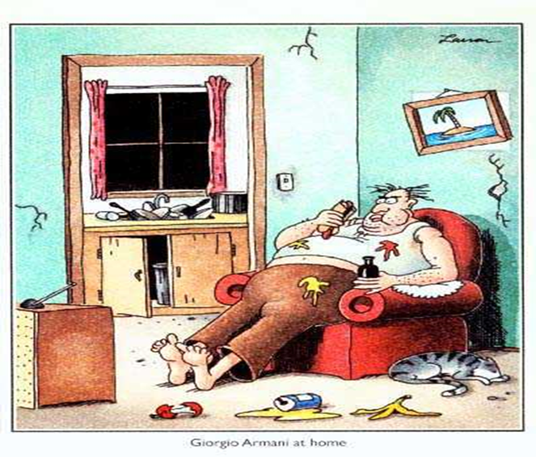
Life’s Simple 7
Smoking
Diet
Physical activity
BMI
Fasting glucose
Cholesterol
SBP/DBP
AHA, 2010

Slide 10
Association of ideal cardiovascular health at age 50 with incidence of dementia: 25 year follow-up of Whitehall II cohort study (N=7,899)
HR= 0.89 (95% CI: 0.85 to 0.95)
Sabia S, et al. BMJ 2019;366:l4414
Notes:
Remained significant even among those free of CVD over the 25 y follow-up ( 0·9, 95% CI 0·8–1·0).

Slide 11
Building and Maintaining Cognitive Reserve
Social isolation
Air pollution
Racism
Sexism
Poverty
Hearing loss
Low education
Traumatic Brain Injury
Depression
Excessive alcohol use

Slide 12

Cognitive Reserve
Educational attainment;
Occupational complexity;
Later-life engagement in cognitive-intellectual activities.

Slide 13
Association of Daily Intellectual Activities With Lower Risk of Incident Dementia Among Older Chinese Adults (N=15,582)
Prospective study of community-dwelling older adults (≥65 y) living in China;
Median follow-up time was 5 years;
Late-life intellectual activities included reading books, newspapers, or magazines; playing board games, Mahjong, or card games; and betting on horse racing.
ATC Lee, et al. JAMA Psychiatry 2018

Slide 14
Estimated ORs for Incident Dementia After Excluding
Participants Who Developed Incident Dementia Within
3 Years After Baseline (N=15,582)
Type of Leisure Activities | Model 1 |  | Model 2ª
 | OR (95% CI) | P Value | OR (95% CI) | P Value
Intellectual | 0.59 (0.50-0.68) | <.001 | 0.71 (0.60-0.84) | <.001
Social | 1.00 (0.83-1.19) | .96 | 0.97 (0.81-1.17) | .78
Other recreational | 1.50 (0.84-2.69) | .18 | 1.56 (0.86-2.81) | .14
ª Adjusted for age, sex, educational level, cardiovascular risk factors, visual and
hearing impairments, poor mobility, depression, smoking, adequate consumption of fruits and vegetables, regular physical exercise, and other types of leisure activities.
ATC Lee, et al. JAMA Psychiatry 2018
Notes:
Community-dwelling older people followed for a median of 5 years.

Slide 15
Education
Intellectual capacity gains due to education tend to plateau in late adolescence;
Reverse causation—those people with higher intellectual capacity tend to attain more education, achieve higher occupational status, and engage more in cognitive-intellectual activities.
Kremen WS, et al. PNAS. 2019;116:2021-2026

Slide 16
Vietnam Era Twin Study of Aging (VETSA) (N=1009 male veterans)
*GCA measured at age 20 and age 62 by the Armed Forces Qualification Test (AFQT)
Kremen WS, et al. PNAS. 2019;116:2021-2026
Notes:
Age 20 General Cognitive Ability (GCA) accounted for 40% of variance in the same measure in late midlife and approximately 10% of variance in each of seven cognitive domains. The other factors each accounted for <1% of the variance in cognitive outcomes.

Slide 17
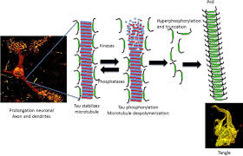
Traumatic Brain Injury
Mild TBI
  Concussion
Severe TBI
  Skull fracture
  Edema
  Brain injury
  Bleed
Hyperphosphorylated tau pathology
Notes:
The tau proteins (or τ proteins, after the Greek letter with that name) are a group of six highly soluble protein isoforms produced by alternative splicing from the gene MAPT (microtubule-associated protein tau).[5][6] They have roles primarily in maintaining the stability of microtubules in axons and are abundant in the neurons of the central nervous system (CNS)

Slide 18
Relative risk of all-cause dementia associated with mid-life TBI
Lancet Commission, 2020

Slide 19
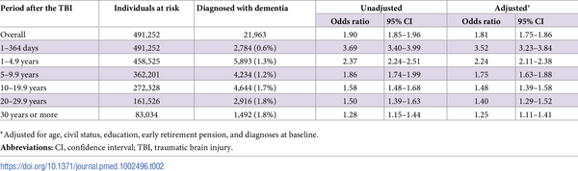
Table 2. Associations between TBI and the risk of dementia during follow-up in 491,252 Swedish citizens >50 years.
Nordström A, Nordström P (2018) Traumatic brain injury and the risk of dementia diagnosis: A nationwide cohort study. PLOS Medicine 15(1): e1002496. https://doi.org/10.1371/journal.pmed.1002496
https://journals.plos.org/plosmedicine/article?id=10.1371/journal.pmed.1002496

Slide 20
Dose Response Association between TBI and Dementia Risk
Odds Ratio
Traumatic Brain Injuries
Nordström A, Nordström P (2018)

Slide 21
N=357,558 Military Veterans
Barns DE, et al. 2018

Slide 22

Air Pollution

Slide 23
Exposure to ambient air pollution and the incidence of dementia: A population-based cohort study*
PAF=6.1%
wPAF=2.3%
*A 12-y prospective study of over 2 million Canadian-born adults 55-85 y
Chen H, et al. Environment International. 2017

Slide 24
Burden of Dementia-Specific Mortality Associated With PM_{2.5} Air Pollution in the United States
 | PAF | Total Deaths | Rate/100,000 | Age-standardized Rate/100,000
Dementia Mortality | 8.2 (6.0-13.1) | 19,852 | 6.1 | 5.1
A cohort of 4,522,160 US veterans followed up between 2006 and 2016.
The burden was particularly high in African Americans and those living in low socioeconomic communities.
Bowe B, et al. JAMA Network Open, 2019

Slide 25
Air Pollution and Dementia: a Systematic Review
Peters R. et al., J Alzheimer’s Disease. 2019

Slide 26
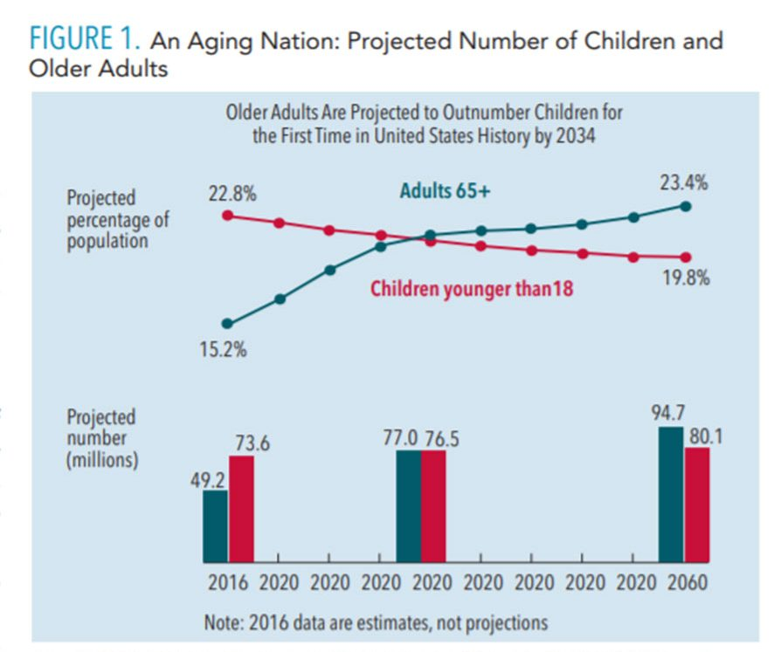
US Census, 2018

Slide 27
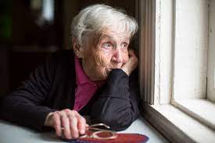
Social Isolation
25% of older adults live alone;
20% of older adults report feeling lonely;
Social isolation among older people is associated with an extra $6.7 billion in Medicare spending per year
Meals on Wheels America, 2020

Slide 28
Influence of social relationship domains and their combinations on incident dementia: a prospective cohort study (N=13,984)*
*13,984 community-dwelling Japanese older adults followed for 9.4 years.
Saito T, et al. J Epidemiol Community Health, 2018

Slide 29
Influence of social relationship domains and their combinations on incident dementia: a prospective cohort study (N=13,984)
Saito T, et al., 2018

Slide 30
Lancet Commission, 2020

Slide 31
Preventive strategies targeted toward the individual
Lancet Commission, 2020

Slide 32
Policy, Systems, Environment (PSE) Approach
Working at a more foundational level to address causes and improve environments where we live, work, learn, play, and receive health care, we can prevent many people from becoming chronically ill
Can help public health advocates create sustainable, comprehensive measures to improve public health
Policy | Systems | Environment
Written statement of organizational position, decision or course of action. (such as ordinances, resolutions, mandates, guidelines, or rules) | Changes in organizational procedures (such as personnel, resource allocation, programs) | Physical, observable changes in the built, economic, and/or social environment.
Notes:
The Lancet Commission lays out a number of strategies

Slide 33
PSE Priorities
Prioritize education across the life-span;
Create healthy food and built environments;
Create stricter laws to reduce sport-, occupational-, and transportation-related TBIs;
Create stricter air pollution regulations –especially in low-income neighborhoods;
Create stricter occupational and environmental noise pollution regulations;
Strengthen national efforts to reduce exposure to SHS – especially among children;
Create more Age-Friendly environments
Adapted from Lancet Commission, 2020

