Slide 1
Physical Activity Is a Disadvantaged Field: Fact, Not Complaint.
Let’s Discuss Solutions
James F. Sallis, Ph.D.
UC San Diego
Herbert Wertheim School of Public Health
Australian Catholic University, Melbourne
PAPH, Columbia, SC. September 17, 2022
www.drjimsallis.org

Slide 2
Outline
We all know the overwhelming evidence of numerous physical, mental, and planetary health benefits of PA
By some estimates PA is the fourth underlying cause of death in the US and worldwide
  prevalence of meeting guidelines is poor and not changing much
  PA promotion should be a public health priority
This talk is a continuation of a long-term discussion about proper funding and infrastructure for PA research and practice
  Trends in funding and support for PA research
  Trends in capacity for PA promotion practice
How can we increase the priority of PA in public health?

Slide 3

A Crystal Ball on Physical Activity and Health
James F. Sallis, Ph.D.
Presented to
First International Conference on Physical Activity and Public Health
Atlanta, GA, April 20, 2006

Slide 4
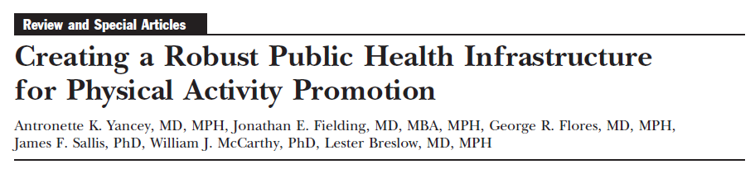
A seminal paper. Identifying critical issues. Demonstrating leadership.

Slide 5
2006 Signs of Progress, with updates:
Building Infrastructure for PA Promotion
PA Branch instituted at CDC in 1996
  Staffing has declined
PA Coordinators in all US states
PA & Public Health courses in US and internationally
Thecommunityguide.org identifies effective PA interventions
Carol White PEP programs funds PE improvements

Slide 6
2006 Signs of Progress, with updates:
Measurement & Surveillance
PA in CDC-sponsored surveillance systems
  Extensive efforts to broaden scope of PA surveillance to include the determinants of PA & more use of technology
International PA Questionnaire (IPAQ) tested in 12 countries
  Now widely used
IPAQ used in over 20 countries for first PA prevalence study with comparable measures, with 25 additional countries using GPAQ
  Over >160 countries now have national PA data
Fitness measures & accelerometers used for first time with US population sample (NHANES)
  Ineffective follow-up, with non-comparable accel measures
  Fitness measures not repeated

Slide 7
Number of Scientific Articles Found in “Web of Science”
Searches for “Physical Activity” and “Exercise” for 1995 and 2005

Slide 8
2006, with updates: There is Much More Bad News
There is no infrastructure for PA at NIH, only an occasional working group
  No change
There are only 2 PA experts at WHO headquarters
  Now there is a PA office, with strong leadership
Most U.S. states have only 1 person working on PA
  Most states have 0 now
Progress on implementing evidence-based programs seems very slow
  No change. See paper on scaling up by Reis et al in Lancet PA Series 2 (2016)

Slide 9
Number of NIH Grants in 1996 and 2005 with “Physical Activity/Exercise”
in titles. Results of a CRISP search.

Slide 10
Number of NIH Grants in 1996 and 2005 with “Physical Activity/Exercise”
or “Alcohol” in titles. Results of a CRISP search.
+7.4%
+25.7%

Slide 11
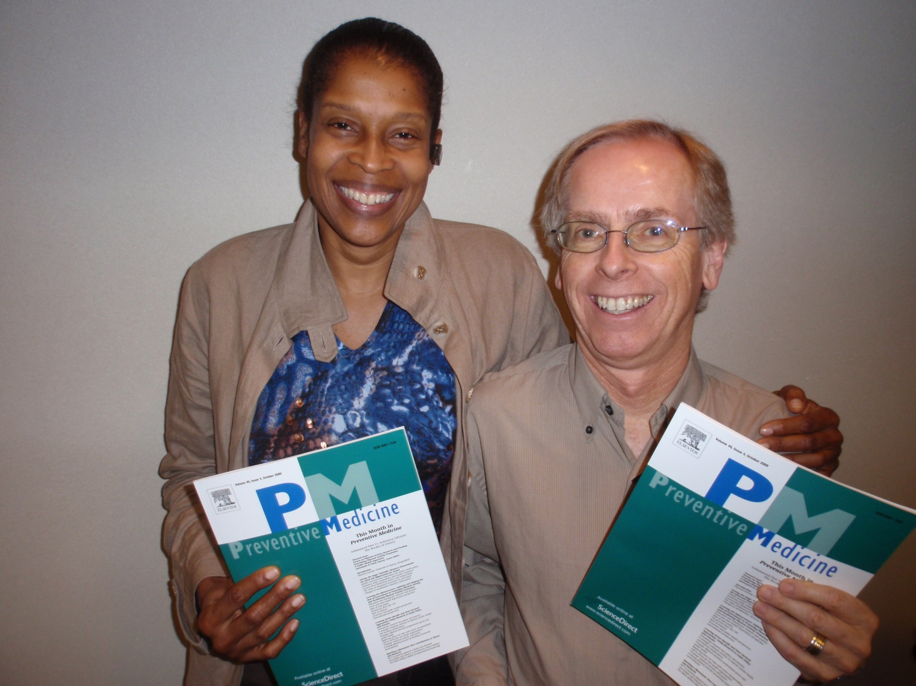
Toni Yancey and I celebrate the 2009 Preventive Medicine issue on physical activity infrastructure

Slide 12
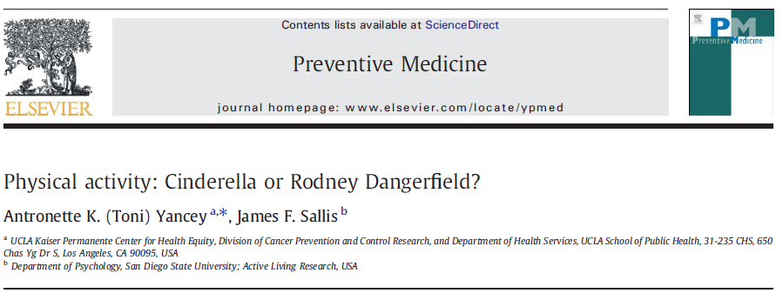
Editorial for the special issue

Slide 13
Physical Activity: Cinderella or Rodney Dangerfield? Problems Identified. Responses?
“Estimates of Funding for Various Diseases, Conditions, Research
Areas” on the NIH website February 5, 2008
[http://www.nih.gov/news/fundingresearchareas.htm].
There were 214 research areas (actually 360) for which funding
amounts were listed, but physical activity, exercise, fitness, or
sedentary behavior were not on the list.
PROGRESS

Slide 14
232,400
Notes:
Carlson, Prev Chron Dis, 2018. 8.3% of US deaths attrib to inactivity.
CDC data. Total US mortality in 2017: 2,800,000

Slide 15
Physical Activity: Cinderella or Rodney Dangerfield? Problems Identified—Responses?
Dorfman and Yancey (2009) called for an expansion of the industries
targeted by advocates to assume responsibility for their contributions to
the problem of inactivity, i.e. auto, oil, tire, highway construction,
film and TV production and distribution, and video gaming.
Little or no progress on these particular industries.
Substantial progress on research and collaboration on active transportation:
AHA published a policy and evidence rationale (Circulation)
ACSM Active Earth initiative
Conference on Health & Active Transport (Transport Research Board.
December 2019. Recording & proceedings available.)

Slide 16
Yancey & Sallis, 2009 Recommendation
A scientific infrastructure with committed and aggressive leadership is needed
NIH should establish a committee or task force with the charge of developing a comprehensive research agenda for physical activity, along with recommendations for implementing the agenda that includes a permanent and high-level “home” for PA at NIH.
  Example: Office of Nutrition Coordination
The National Physical Activity Plan recommends such an office at DHHS, but no action

Slide 17
Physical Activity in the Federal Government
DHHS Office of Disease Prevention
  No office or person with full-time attention to PA
  Office of Disease Prevention coordinated the PA Guidelines
    Thank you, Katrina Pearcy!
  President’s Council for Fitness, Sports, and Nutrition (approx. $1M budget)
CDC Division of Nutrition, Physical Activity, and Obesity
  Congressional budget has 8 funding lines for the Division
  All lines are related to nutrition or obesity topics/programs
  No dedicated budget line for PA
Physical Activity and Health Branch
  PAHB is the primary government entity responsible for PA surveillance and promotion
  In 1997, 50 states had PA Coordinators
  Now, 16 states have PA Coordinators

Slide 18
CDC Physical Activity and Health Branch:
Estimated FTEs Over Time

Slide 19
Non-Profit Sector
PA Section of APHA is only 13 years old—one of the youngest
An effort to create a PA program in the National Academy of Medicine failed to raise sufficient funds
3 small, poorly-funded PA organizations recently merged to create a larger poorly-funded PA organization
National Coalition for Promoting Physical Activity +
National Physical Activity Plan +
Physical Activity Society =
Physical Activity Alliance

Slide 20
My recommendations at the 2006 Physical Activity & Health Conference
Conduct research that will inform us how to reach physical activity goals in each country
  Dissemination & implementation research has grown
Join with other groups to build a movement for physical activity promotion
  Infrastructure for PA promotion still lacking
Become vocal & persistent advocates for effective PA interventions
Share Evidence with those who can use it
Join with others to advocate. Speak Up.
It is up to your generation to improve capacity for PA promotion. What are your ideas about how to make progress?

