Slide 1
Physical Activity Research at CDC: What do New Researchers Need to Know?
Geoffrey Whitfield, PhD
Team Lead for Epidemiology and Surveillance
Physical Activity and Health Branch

Slide 2
Agenda
“Traditional” Surveillance/Epi Data
Data Sources and Access
Example Uses:
Descriptive Epi
Analytic Epi
Ideas?
“Modernized” Physical Activity Measures
Behaviors
Environments
Policies
Ideas?

Slide 3
Data Sources and Access

Slide 4
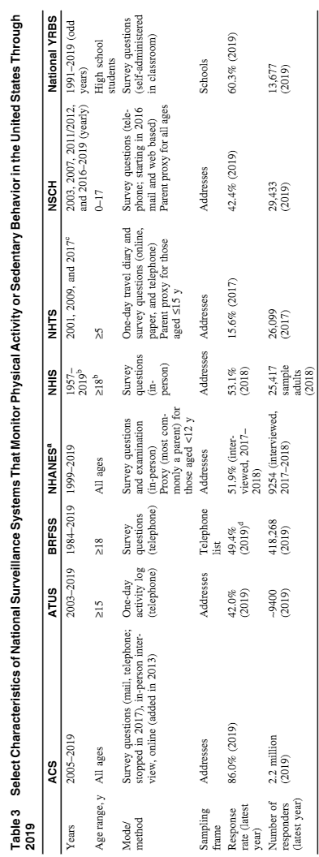

Slide 6
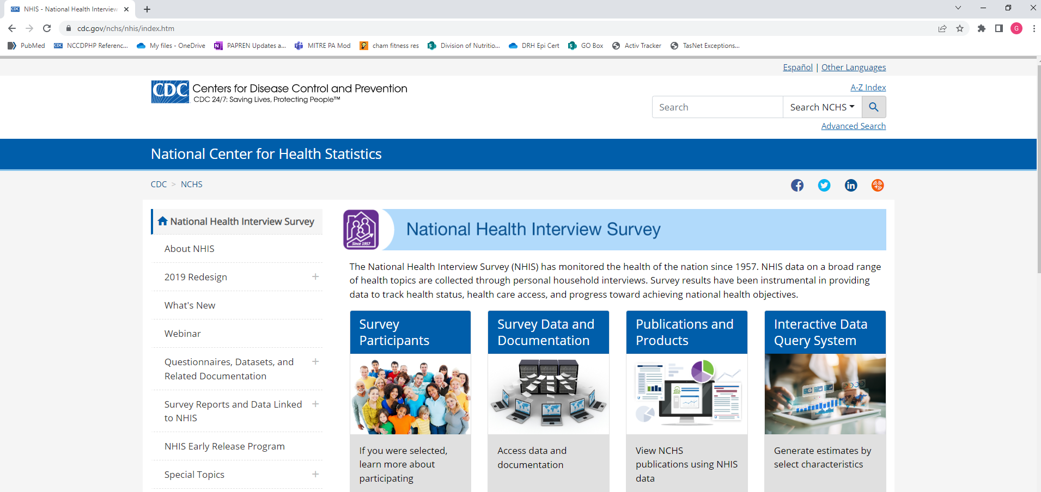
How do I get the data? – NHIS example

Slide 7
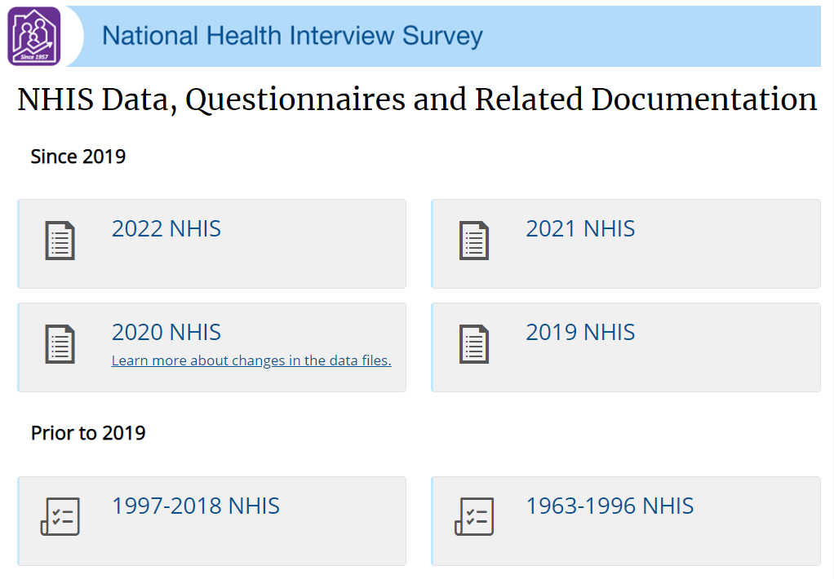

Slide 8
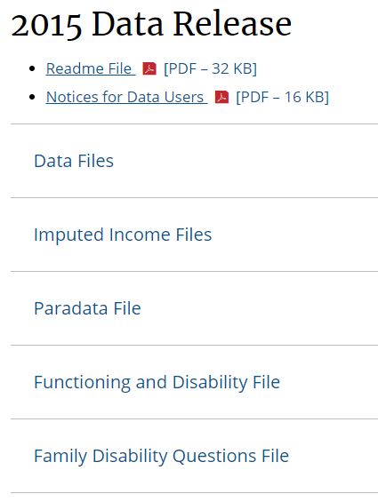
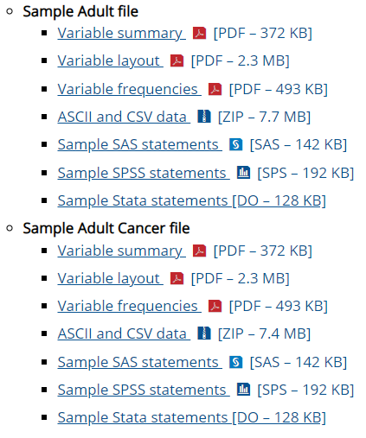

Slide 9
A built environment shout-out!

Slide 10
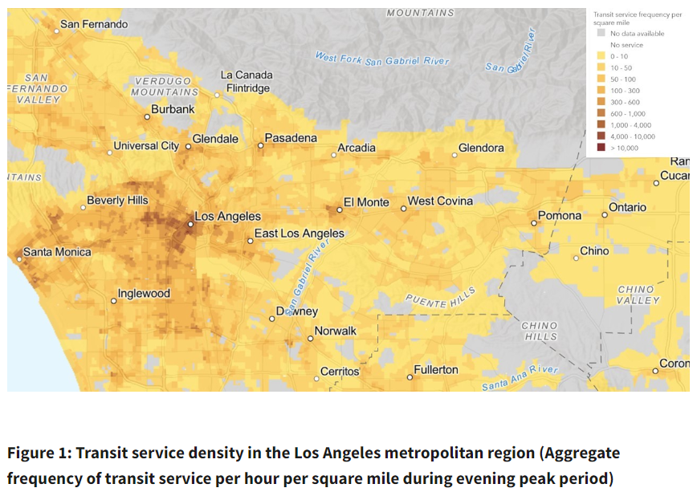

Slide 11
What can we do with the data?

Slide 12
Descriptive Epidemiology / Public Health Surveillance

Slide 13
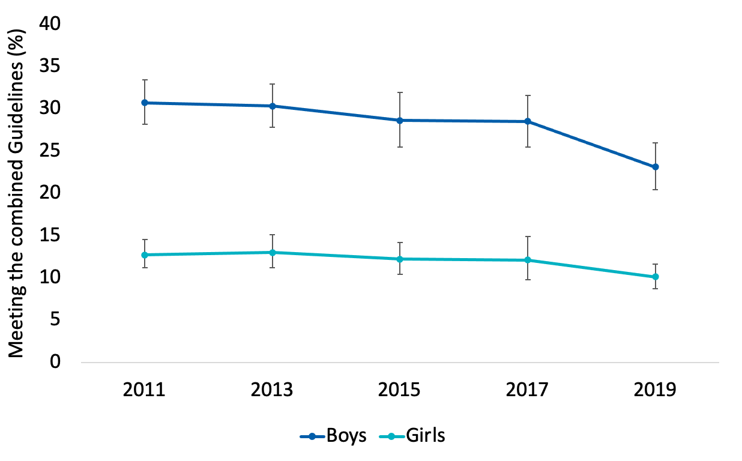
Descriptive Epi: YRBS
Survey of high school students
Every 2 years
2021 data due any day!
Notes:
The results over the past several years are concerning, with decreases among both boys and girls. The decreases were particularly evident in 2019, Before the COVID-19 pandemic, raising concerns about the potential for further decreases during the pandemic.

Slide 14
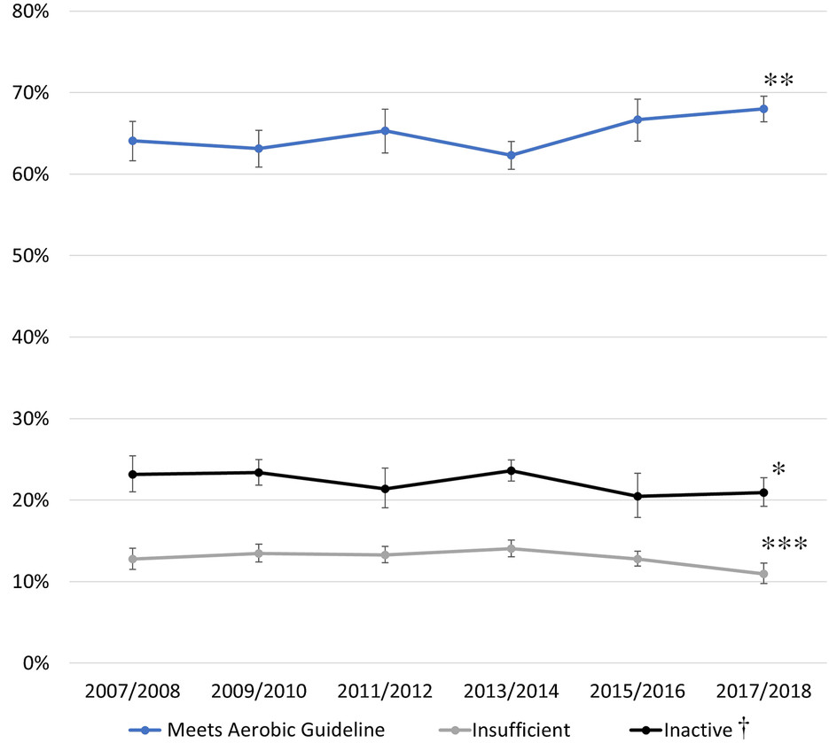
Descriptive Epi: NHANES
2-year cycles
Adults and some youth
Multi-Domain Aerobic Physical Activity
Notes:
Overall, and after bumps along the way, the proportion of adults who meet the aerobic guideline when combining all contexts has increased, from about 64% of adults in 2007/08 to about 68% in 2017/18.
Figure 1—Age-adjusted prevalence of 3 levels of multidomain physical activity participation among US adults, the National Health and Nutrition Examination Survey 2007–2018. *Significant linear trend. **Significant linear and higher-order trend. ***Significant quadratic trend.

Slide 15
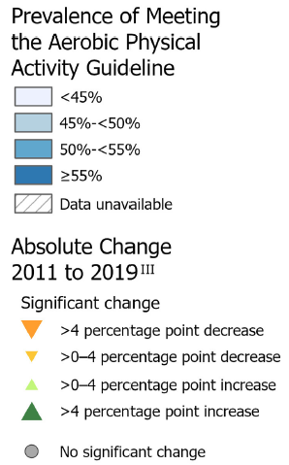
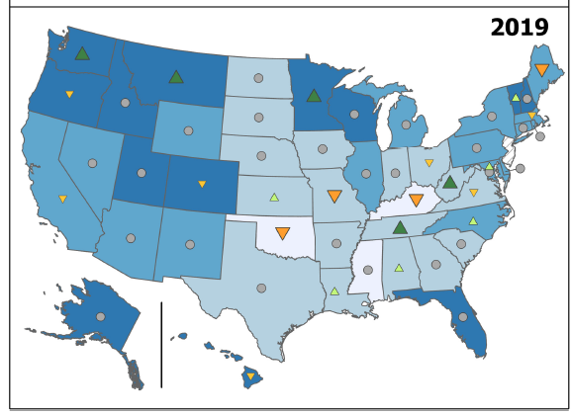
Descriptive Epi: BRFSS

Slide 16
Descriptive Epi: NHIS
Notes:
Age-adjusted prevalence of 4 levels of aerobic leisure-time physical activity among adults, National Health Interview Survey 1998–2018. *Significant linear trend. †Significant linear and higher-order trends. ‡Participants were classified into 4 levels of aerobic activity: inactive (no light- to moderate- or vigorous-intensity aerobic activity for at least 10 min); insufficiently active (some aerobic activity, but <150 moderate-intensity equivalent minutes per week); meeting the minimal guideline (150–300 moderate-intensity equivalent minutes per week); and meeting the high guideline (>300 moderate-intensity equivalent minutes per week).

Slide 17
Analytic Epi: Hypothesis Testing / Longitudinal Analyses

Slide 18
LTPA: Disparities by Race/Ethnicity and Income
Are racial and ethnic disparities in LTPA due primarily to differences in socioeconomic status?
How is participation changing over time by race/ethnicity AND income?
Test: have disparities widened, narrowed, or remained the same?

Slide 19
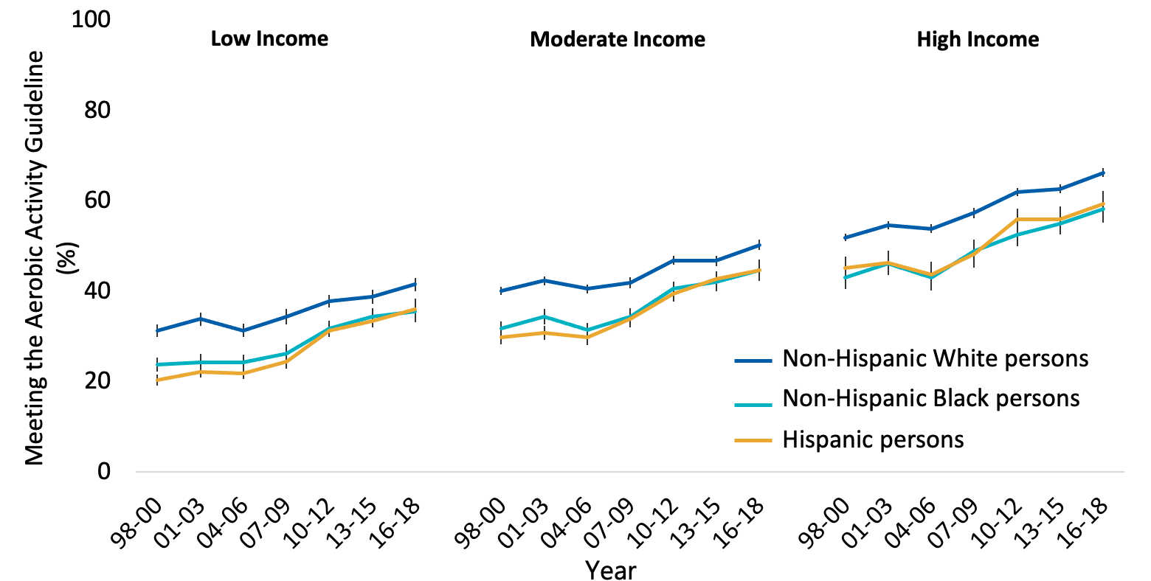
Analytic Epi: NHIS

Slide 20
Analytic Epi: NHIS
Race/Eth, Income
Square: 1998-2000
Circle: 2016-2018
*
*
Notes:
—Engaging in any aerobic activity and meeting the aerobic activity guideline estimates for the differences between non-Hispanic white and non-Hispanic black (black) and non-Hispanic white and Hispanic (Hispanic) adults at low, moderate, and high income levels. Differences between white adults and members of racial/ethnic minority groups from 1998–2000 to 2016–2018. Square indicates difference between white and racial/ethnic minority groups in 1998–2000. Circle indicates difference between white and racial/ethnic minority groups in 2016–2018. Plus indicates significant narrowing in difference (D1 − D2 > 0; [1998–2000 white – minority] − [2016–2018 white – minority] > 0). D1 indicates the difference in prevalence at the first time period (1998–2000); D2, difference in prevalence at the last time period (2016–2018).

Slide 21
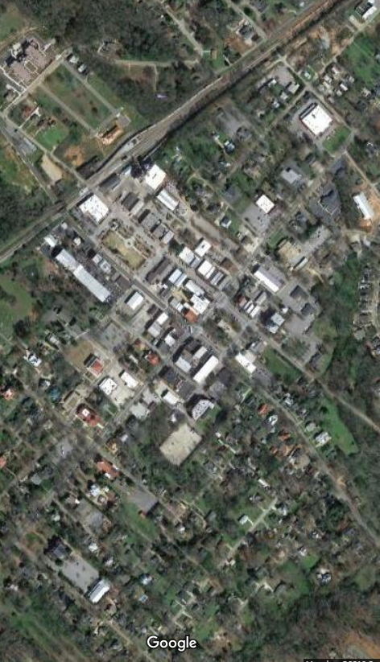
Counts – Leisure Walking
Madison, GA
Notes:
Among rural residents, the prevalence of leisure walking was progressively higher with more reported supports and destinations.

Slide 22
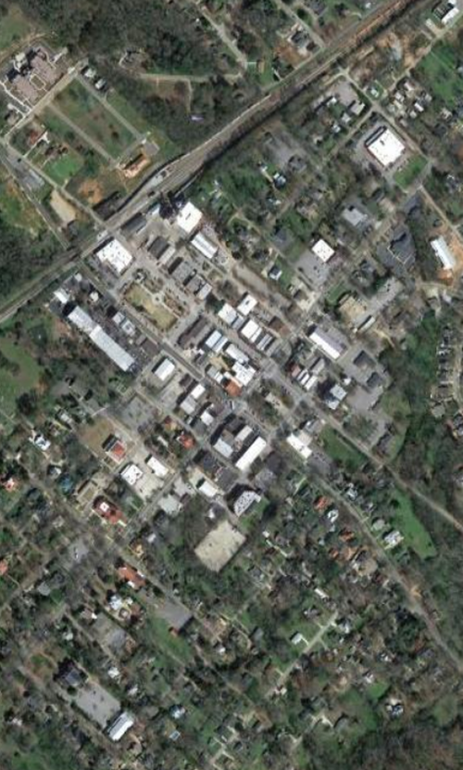
Counts – Leisure Walking
Madison, GA
Notes:
The same was true for urban residents, and the prevalence was almost identical at each count level.
**Regardless of urban/rural residence, the prevalence of walking was almost identical across counts of supports and destinations.**

Slide 23
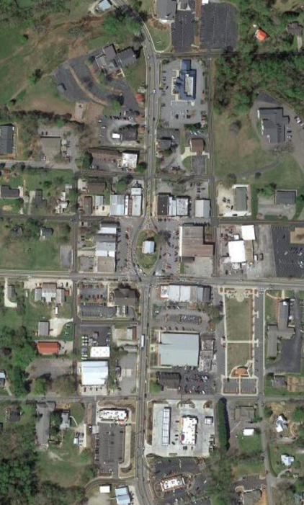
Counts – Transportation Walking
Cleveland, GA
Notes:
For transportation walking, results were similar: higher walking with higher counts.
Recall that we tended to see larger urban/rural differences for transportation walking…would the same hold here?

Slide 24
Counts – Transportation Walking
Cleveland, GA
Notes:
Not really. The prevalence of transportation walking was almost identical for urban/rural adults for each count level.
How can that be? We showed Transp walking is much lower in rural residents????????
It is because 50% of rural residents fall in the 0-1, compared to 17% of urban residents. In fact, 55% of urban residents report 4 or 5 of the significant supports and destinations.

Slide 25
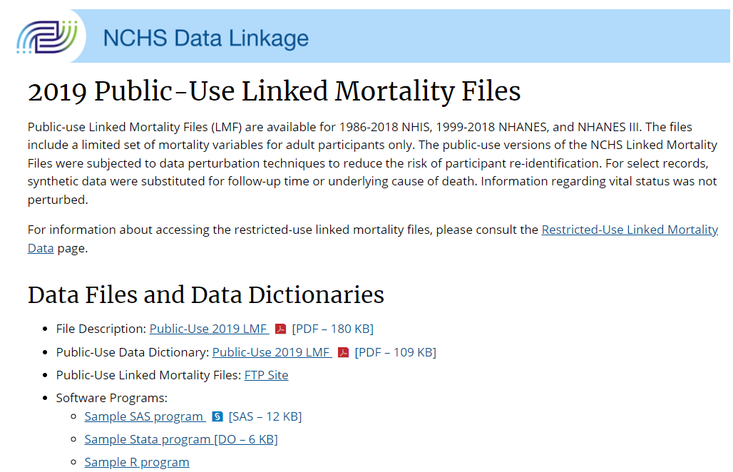
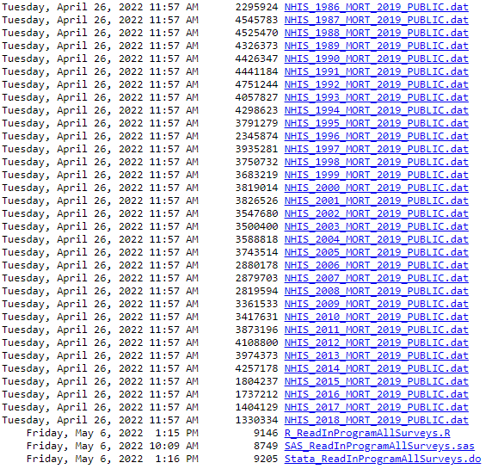
Longitudinal Analyses

Slide 26
Longitudinal Analyses: NHIS
Muscle-strengthening Activity and Mortality in Older Adults
1998-2018 NHIS
Linked to NDI through 2019
N=115K adults ≥65y
Average 7.9y follow-up
>44K deaths
The gist: LARGE, nationally-representative longitudinal dataset
FREE! (If you don’t count your income taxes ☺)
Notes:
REFINE what we know about the dose-response association between MSA and Mort, accounting for Aerobic

Slide 27
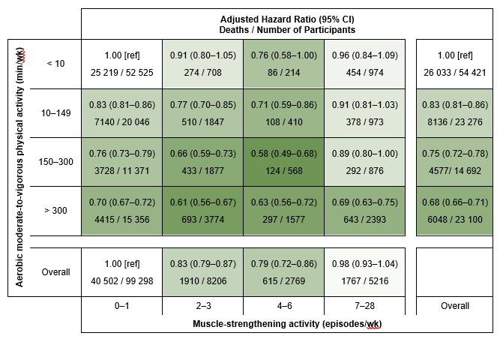
Longitudinal Analyses: NHIS
Notes:
Hazard ratios are adjusted for sex, age (continuous), self-reported race/ethnicity (Hispanic, non-Hispanic White, non-Hispanic Black, non-Hispanic other), education (less than high school, high school graduate, some college, college graduate or higher), marital status (currently married; divorced, separated, or widowed; never married; unknown), body mass index (continuous), smoking (never, former, current), alcohol consumption (never, former, current but not heavy, current heavy [previous year average > 7 drinks/week for women and > 14 drinks/week for men]), and presence of hypertension, heart disease, stroke, diabetes, cancer, chronic obstructive pulmonary disease, and asthma. Any muscle-strengthening is also adjusted for weekly minutes of aerobic moderate-to-vigorous physical activity. Any aerobic physical activity is also adjusted for weekly episodes of muscle-strengthening physical activity. Based on NHIS 1998–2018, linked to NDI 2000–2019. Deaths within two years of interview are excluded.

Slide 28
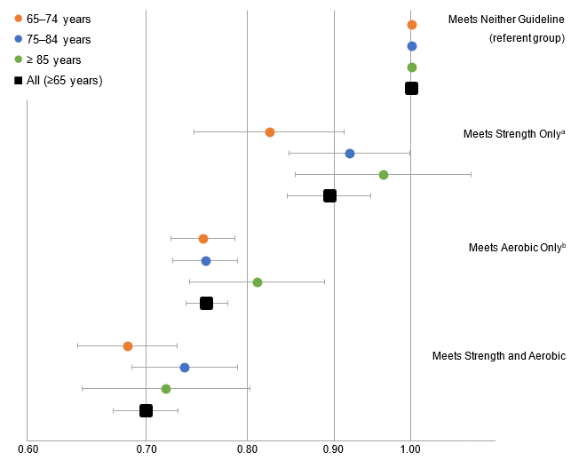
Longitudinal Analyses: NHIS
Notes:
According to the Physical Activity Guidelines, second edition. Hazard ratios are adjusted for sex, age (continuous), self-reported race/ethnicity (Hispanic, non-Hispanic White, non-Hispanic Black, non-Hispanic other), education (less than high school, high school graduate, some college, college graduate or higher), marital status (currently married; divorced, separated, or widowed; never married; unknown), body mass index (continuous), smoking (never, former, current), alcohol consumption (never, former, current but not heavy, current heavy [previous year average > 7 drinks/week for women and > 14 drinks/week for men]), and presence of heart disease, stroke, diabetes, cancer, chronic obstructive pulmonary disease, and asthma. Whiskers represent 95% CI. Plotted on a logarithmic (base 10) scale. Based on NHIS 1998–2018, linked to NDI 2000–2019. Deaths within two years of interview are excluded.
ª Muscle-strengthening activity of ≥ 2 weekly episodes..
^{b} Aerobic physical activity of ≥ 150 weekly minutes of moderate intensity, ≥ 75 weekly minutes of vigorous intensity, or equivalent combination

Slide 29
One more creative example…

Slide 30
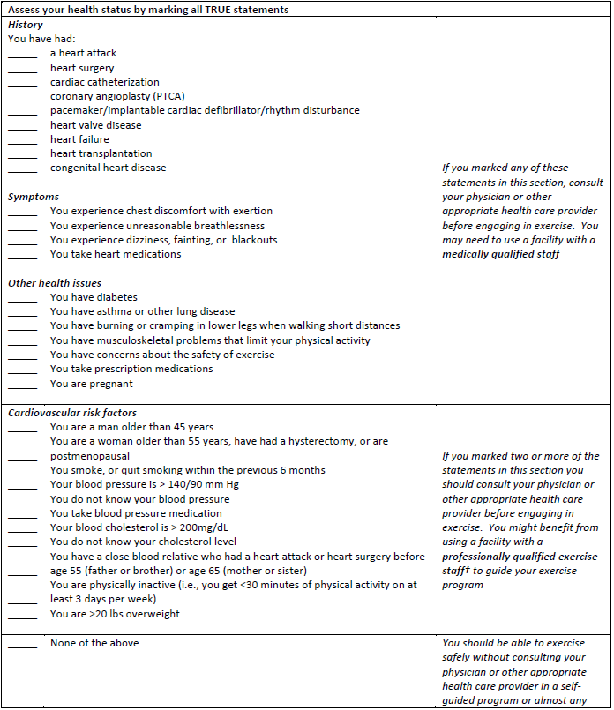
The “AAPQ”
ACSM / AHA Preparticipation Questionnaire

Slide 31
NHANES 2001-2004
Any Selection = Referral |  |  | ≥ 2 Selections = Referral
History | Symptoms | Other Health Iss | CV Risk Factors
Heart attack | CP on exertion | Diabetes | Male>45 years
Heart surgery | Undue SOB | Asthma / lung dz | Fem>55 y, hyst, menop.
Cardiac cath. | Dizzy / fainting | Claudication | Smoker or recently quit
Angioplasty | Takes heart rx | PA-limiting cond. | BP > 140/90 mmHg
Pacemaker/ICD/arry |  | Exercise safety fears | Unknown BP
Heart valve dz |  | Prescription meds | BP medication
Heart failure |  | Pregnant | Chol > 200mg/dL
Heart transplant |  |  | Unknown cholesterol
Congenital heart dz |  |  | Fam Hx early CVD
 |  |  | Inactivity
 |  |  | >20 lbs overweight

Slide 32
Proportion that would be referred based on AAPQ criteria: NHANES 2001-2004
 | Age Categories (Years)
 | 40-44 | 45-49 | 50-54 | 55-59 | 60-64 | 65-69 | 70+ | Overall
 | (n=447) | (n=393) | (n=370) | (n=268) | (n=420) | (n=348) | (n=1138) | (n=3385)
Women | 87.0 | 94.4 | 96.0 | 98.2 | 98.1 | 98.4 | 99.7 | 95.5
 | (n=447) | (n=406) | (n=386) | (n=261) | (n=384) | (n=341) | (n=1051) | (n=3276)
Men | 83.0 | 93.4 | 95.9 | 94.7 | 99.5 | 96.2 | 98.4 | 93.5

Slide 33
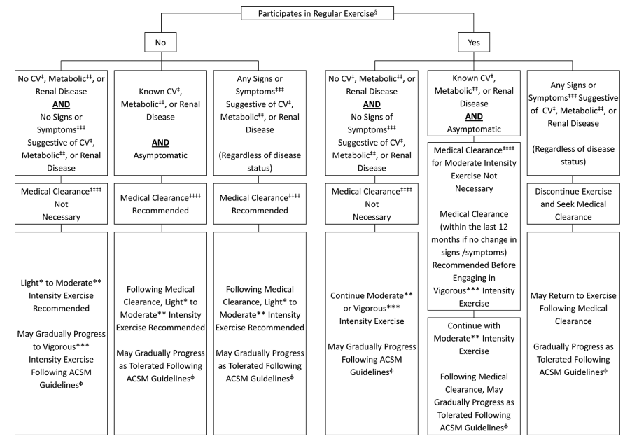

Slide 34
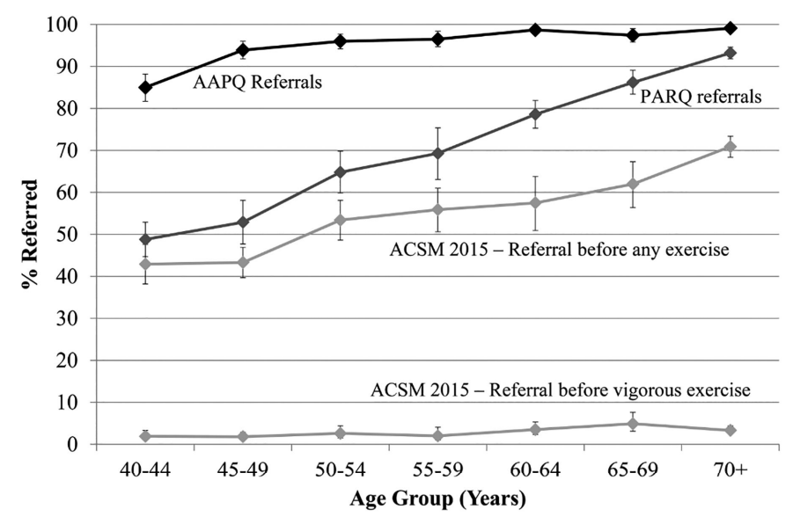

Slide 35
Research ideas
Brain Health
“Conduct appropriate analyses to examine effect modification by demographic factors. Such analytical approaches require studies that include large samples and substantial variation in sample characteristics (i.e., race/ethnicity, socioeconomic status).” pg. F3-48
“Conduct randomized controlled trials and prospective observational research on the impact of muscle-strengthening exercises (often referred to in the literature as resistance training) and other forms of physical activity (e.g., yoga, tai chi), and other modes of activity on brain health outcomes.” pg. F3-49

Slide 36
“Modernized” Physical Activity Measures

Slide 37
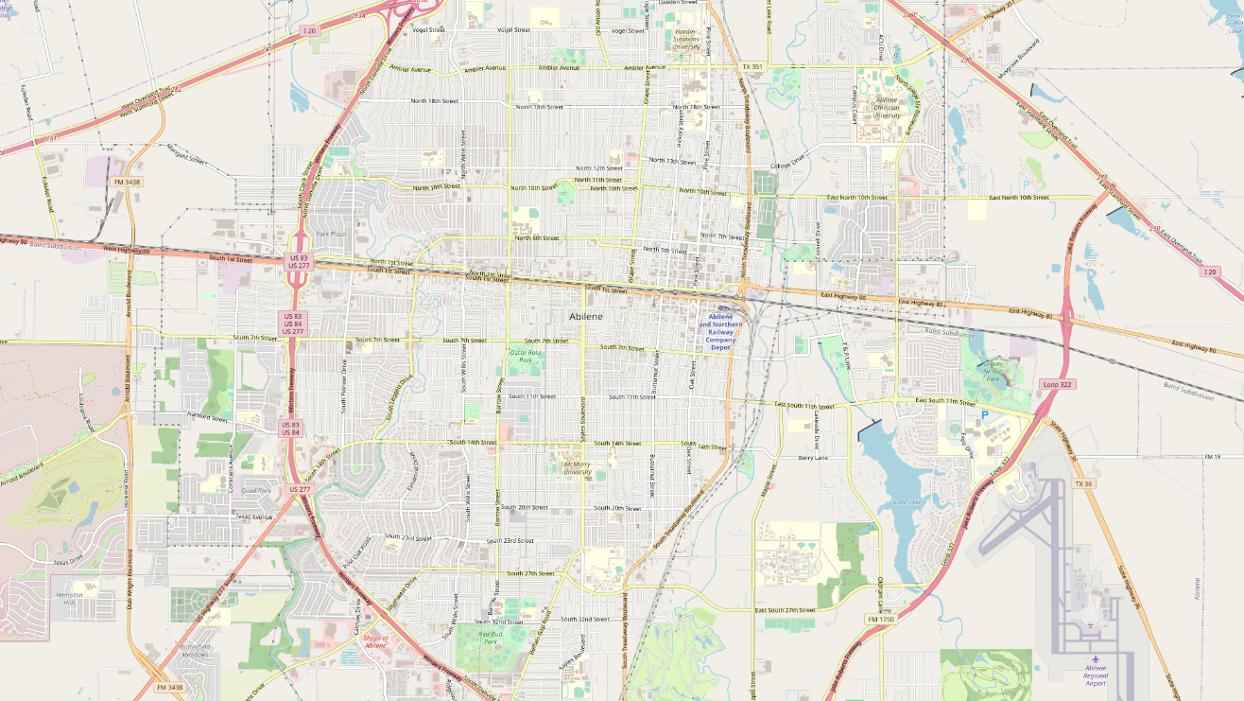
Notes:
And you might think, I know CDC provides the social vulnerability index down to the Census tract level…

Slide 38
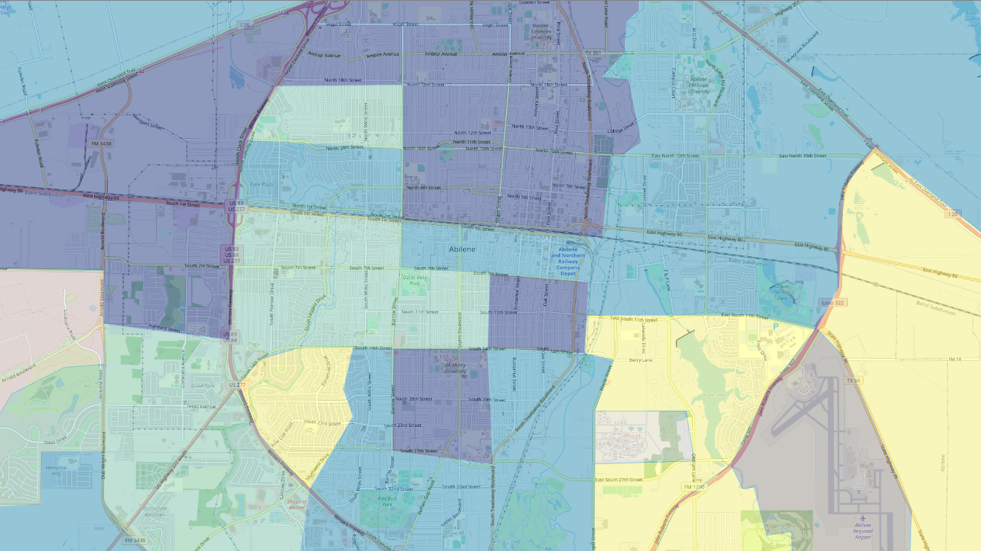
Notes:
Something like this…
Maybe they also have physical activity data at that level? Can I just ID which parts of the city are the least active?

Slide 39
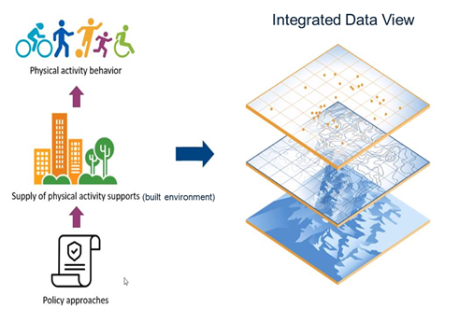
The Vision
Behaviors
Environments
Policies
Notes:
(2:25 here)
And that is really our vision… to obtain local- level data on [click through] Beh, Env, and Pol, and then have the ability to layer them on top of one another [click] to provide a more comprehensive, actionable understanding of where and how physical activity occurs in this country and how we can increase participation.

Slide 40
Where have we made progress?
Environments
Behaviors
Progress
Policies
Notes:
Where have we made the most progress?
Behaviors, then environment, and then policy is a more nascent area for us.
Tiffany gave you a deep dive into where we’ve made the most progress, actually doing preliminary investigations of convergent validity for behavioral measures.
I’ll spend the rest of my remarks summarizing what’s coming in the rest of this figure.

Slide 41
Behaviors

Slide 42
Behaviors – What do we have
National
State
County
Local
Regional
Sub-Local
Notes:
(4:30 ish here)
Walk through quickly

Slide 43
Behaviors – What is the gap?
National
State
County
Local
Regional
Sub-Local
?
Notes:
Why is the dearth of local-level data a problem? Well, it is really at the local and sub-local level that evaluation can occur. How can we know if a new piece of infrastructure increases PA? right now, it takes a one-off evaluation study to determine that. Data at this scale would make evaluation much easier and more common!
It is also at this level where we can better understand disparities in physical activity participation. We need these better measures to fully understand social vulnerability and PA participation.

Slide 44
Behaviors – How to fill the gap?
Notes:
What are we doing in this area?
[click] I’m going to stick with the theme that tiffany introduced and talk about an alternative source of cell-phone based human mobility data.

Slide 45
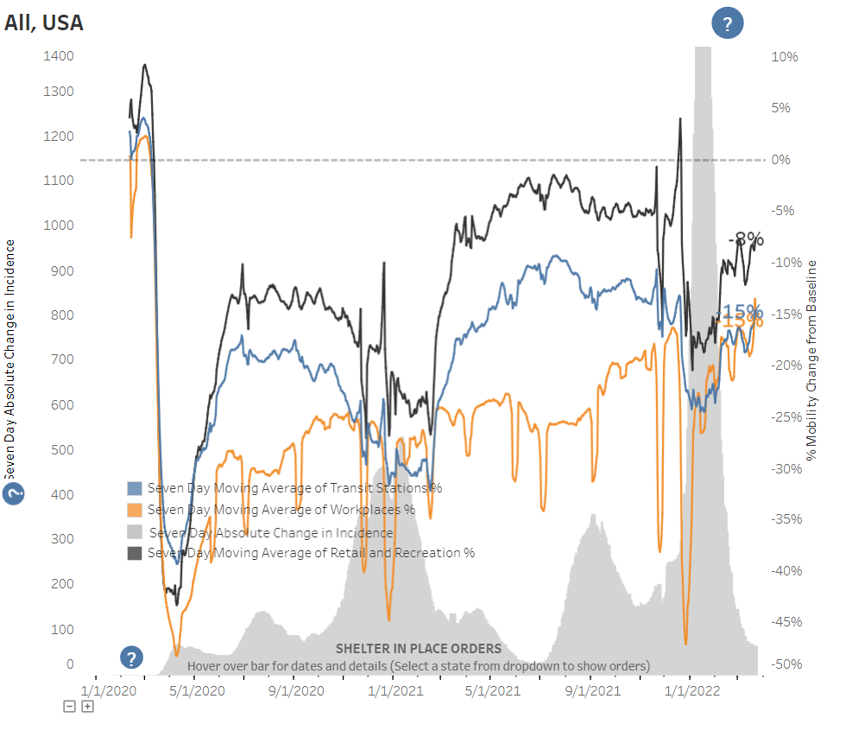

Slide 46
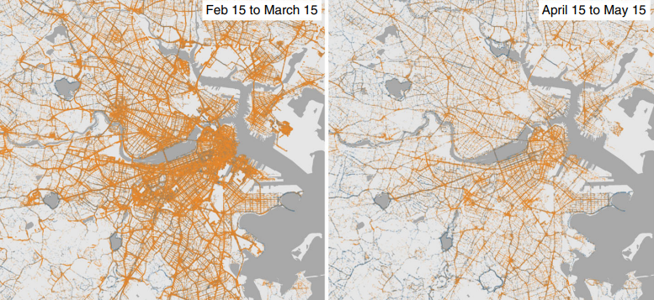
Behaviors – How to fill the gap?
Notes:
What you see here is walking volume (thickness of orange line represents walking volume) before the pandemic and [click]
Early in the pandemic, showing a clear decrease in total volume.

Slide 47
Behaviors – How to fill the gap?
Notes:
Remember what I said earlier about equity.
Hunter et al looked at change in util vs leisure walking by income quintile. You can see that leisure walking early in the pandemic increased among the most affluent, but decreased in a linear dose-response across less-affluent areas.
The same was not true for utilitarian walking.
I think this should give you an idea of the richness that can be found in these data if we are, in fact, able to harness them for PA monitoring.

Slide 48
Behaviors – Mobility data
Pros
Cons
Timely
Precise
Available for purchase, NOW!
De-identified
Not purposefully sampled
Changing sources?
Proprietary information
Privacy concerns
Computationally taxing
Innovation?
Notes:
The pros are pretty simple… they fill some gaps for us. But the cons are not inconsequential.

Slide 49
Built Environments
Notes:
Let’s shift our attention to built environments.
(9:20 ish here)

Slide 50
Environments – What do we have?
Macro-Scale
Micro-Scale
Meso-Scale
Notes:
Macro: Road/intersection density, land use mix (think of things that can be summarized at the neighborhood, county, or other areal-level)
Existing: EPA SLD and NWI, WalkScore, Census Bureau and Econ Census
Meso: Streetscape structure that sets the tone for a street (think Building structure, height, setback, tree canopy cover, building style, sidewalk width)
Existing: PAD US protected areas, tree cover indices
Micro: Specific components of the streetscape (think aesthetic touches, benches, crosswalks, refuge islands) Point locations
Existing: none

Slide 51
Environments – What is the gap?
Macro-Scale
Micro-Scale
Meso-Scale
?
Notes:
The gap? Meso scale and below.
For walking, in my opinion, the biggest gap is our lack of data on sidewalks. Walking is the most common form of PA in this country, and the sidewalk is the “basic unit of walkability”. BUT, none of our existing nation-wide walkability indices have information on sidewalk presence or absence.

Slide 52
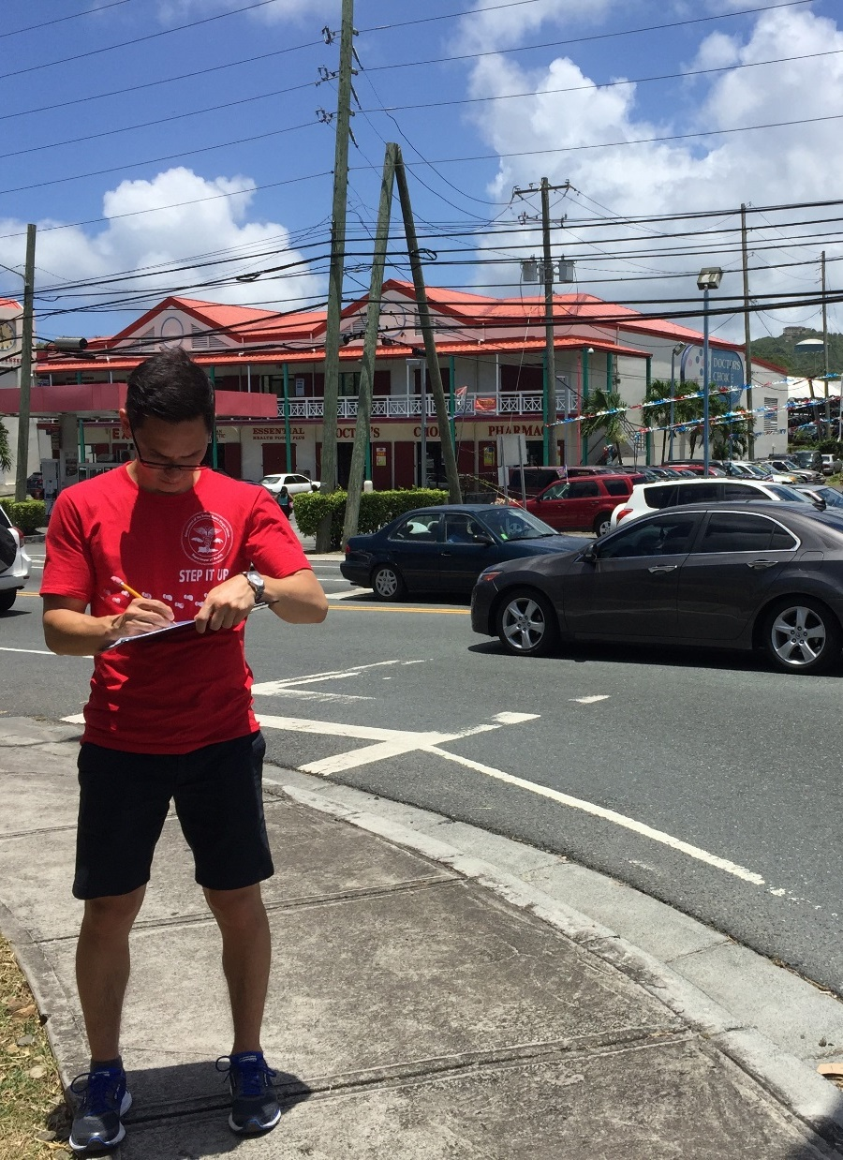
Environments – How to fill the gap?
Notes:
Well, with over 4 million miles of roads in the US, we probably cant get there through roadway audits.

Slide 53
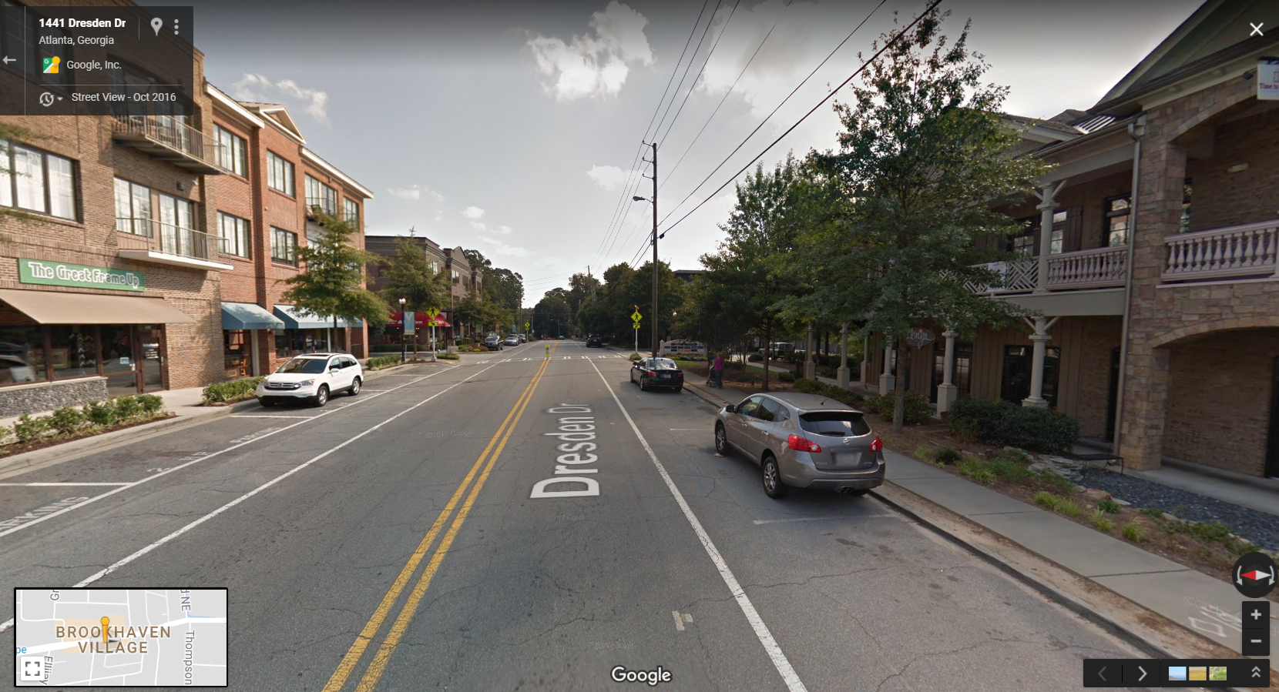
Notes:
In the US, most public roads now have some imaging available.
Given that, the path forward is PROBABLY automated image analysis. Essentially pass these images through an algorithm that identifies [CLICK] sidewalks, [Click] bike lanes, [cross walks], etc.

Slide 54
Environments – Automated image analysis
Pros
Cons
Functional algorithms
Scalable
Accuracy (improving!)
Image sources
Update frequency
Inequitable image quality
Derivative products?

Slide 55
Policies
Notes:
Lets finish with a quick look at policy surveillance. Recall that this is the newest area for us, so you’ll see a bit sparser information in this section.
(14:45 here)

Slide 56
Policies – What do we have?
Notes:
So, what DO we have?
First, at CDC, we conduct the Community Based Supports for Healthy Eating and Active Living (CBS-HEAL). This is a representative sample of municipalities (not people), from which we can estimate, for example, the % of municipalities in the US that have a bicycle and pedestrian master plan.
But, we can’t get a catalog of all the communities that have a given policy type, just the proportion.

Slide 57
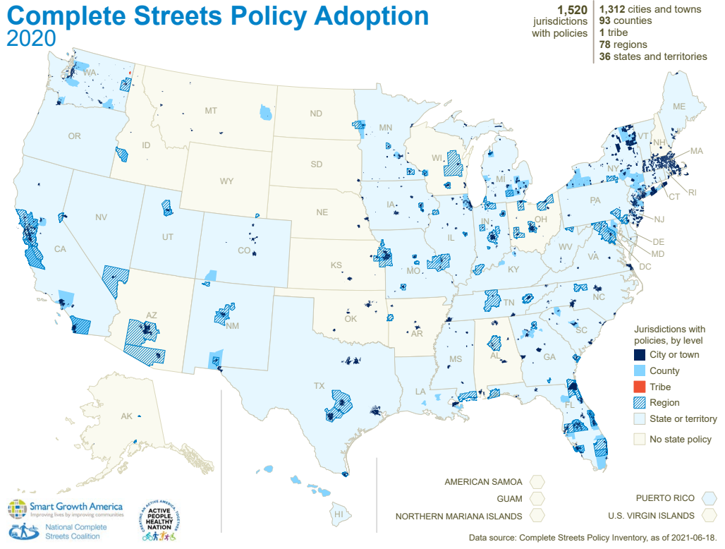
Policies – What do we have?
Notes:
On the other hand, our colleagues at Smart Growth America and the National Complete Streets coalition have a repository of every complete streets policy in the US at the state, county, region, and city level. They curate this list through both passive and active means (jurisdictions can voluntarily contribute, and SGA also monitors the internet for newly adopted policies).
This is probably the most comprehensive surveillance in the US of a PA-related policy. If you’re interested, we collaborate with SGA publicly-available maps that let you do cool things like this in presentations (every 5th year from 2000-2020):

Slide 58
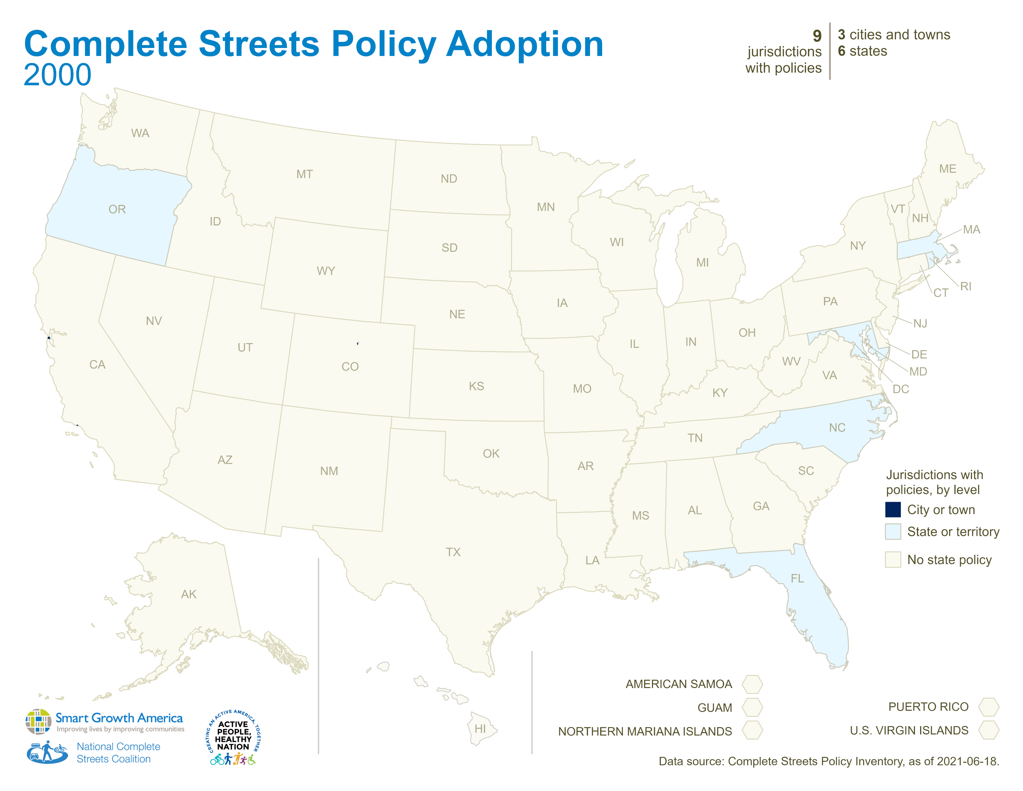

Slide 59
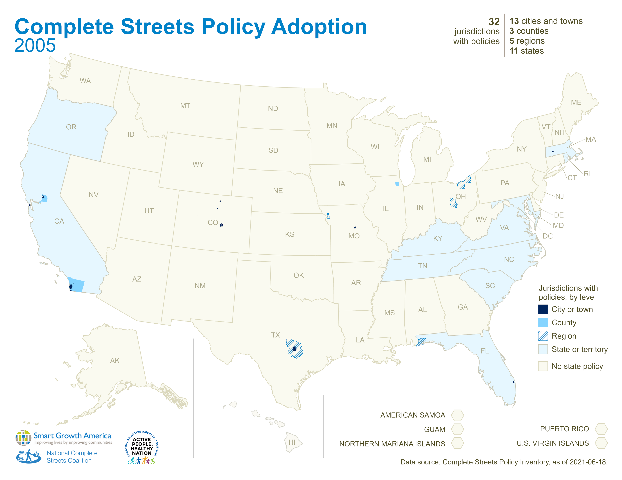

Slide 60
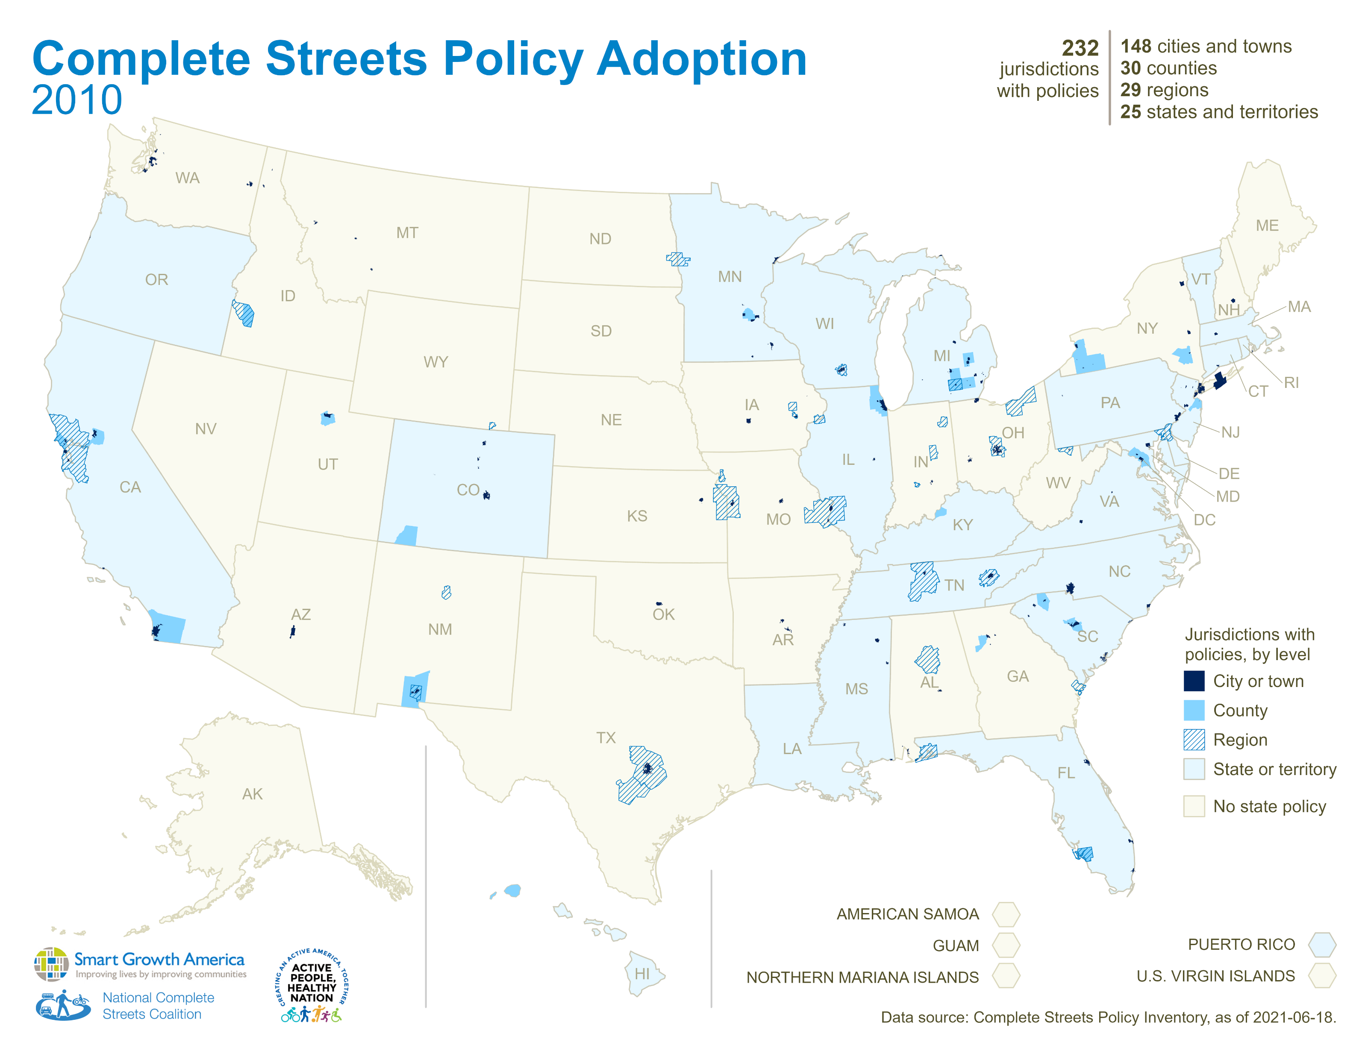

Slide 61
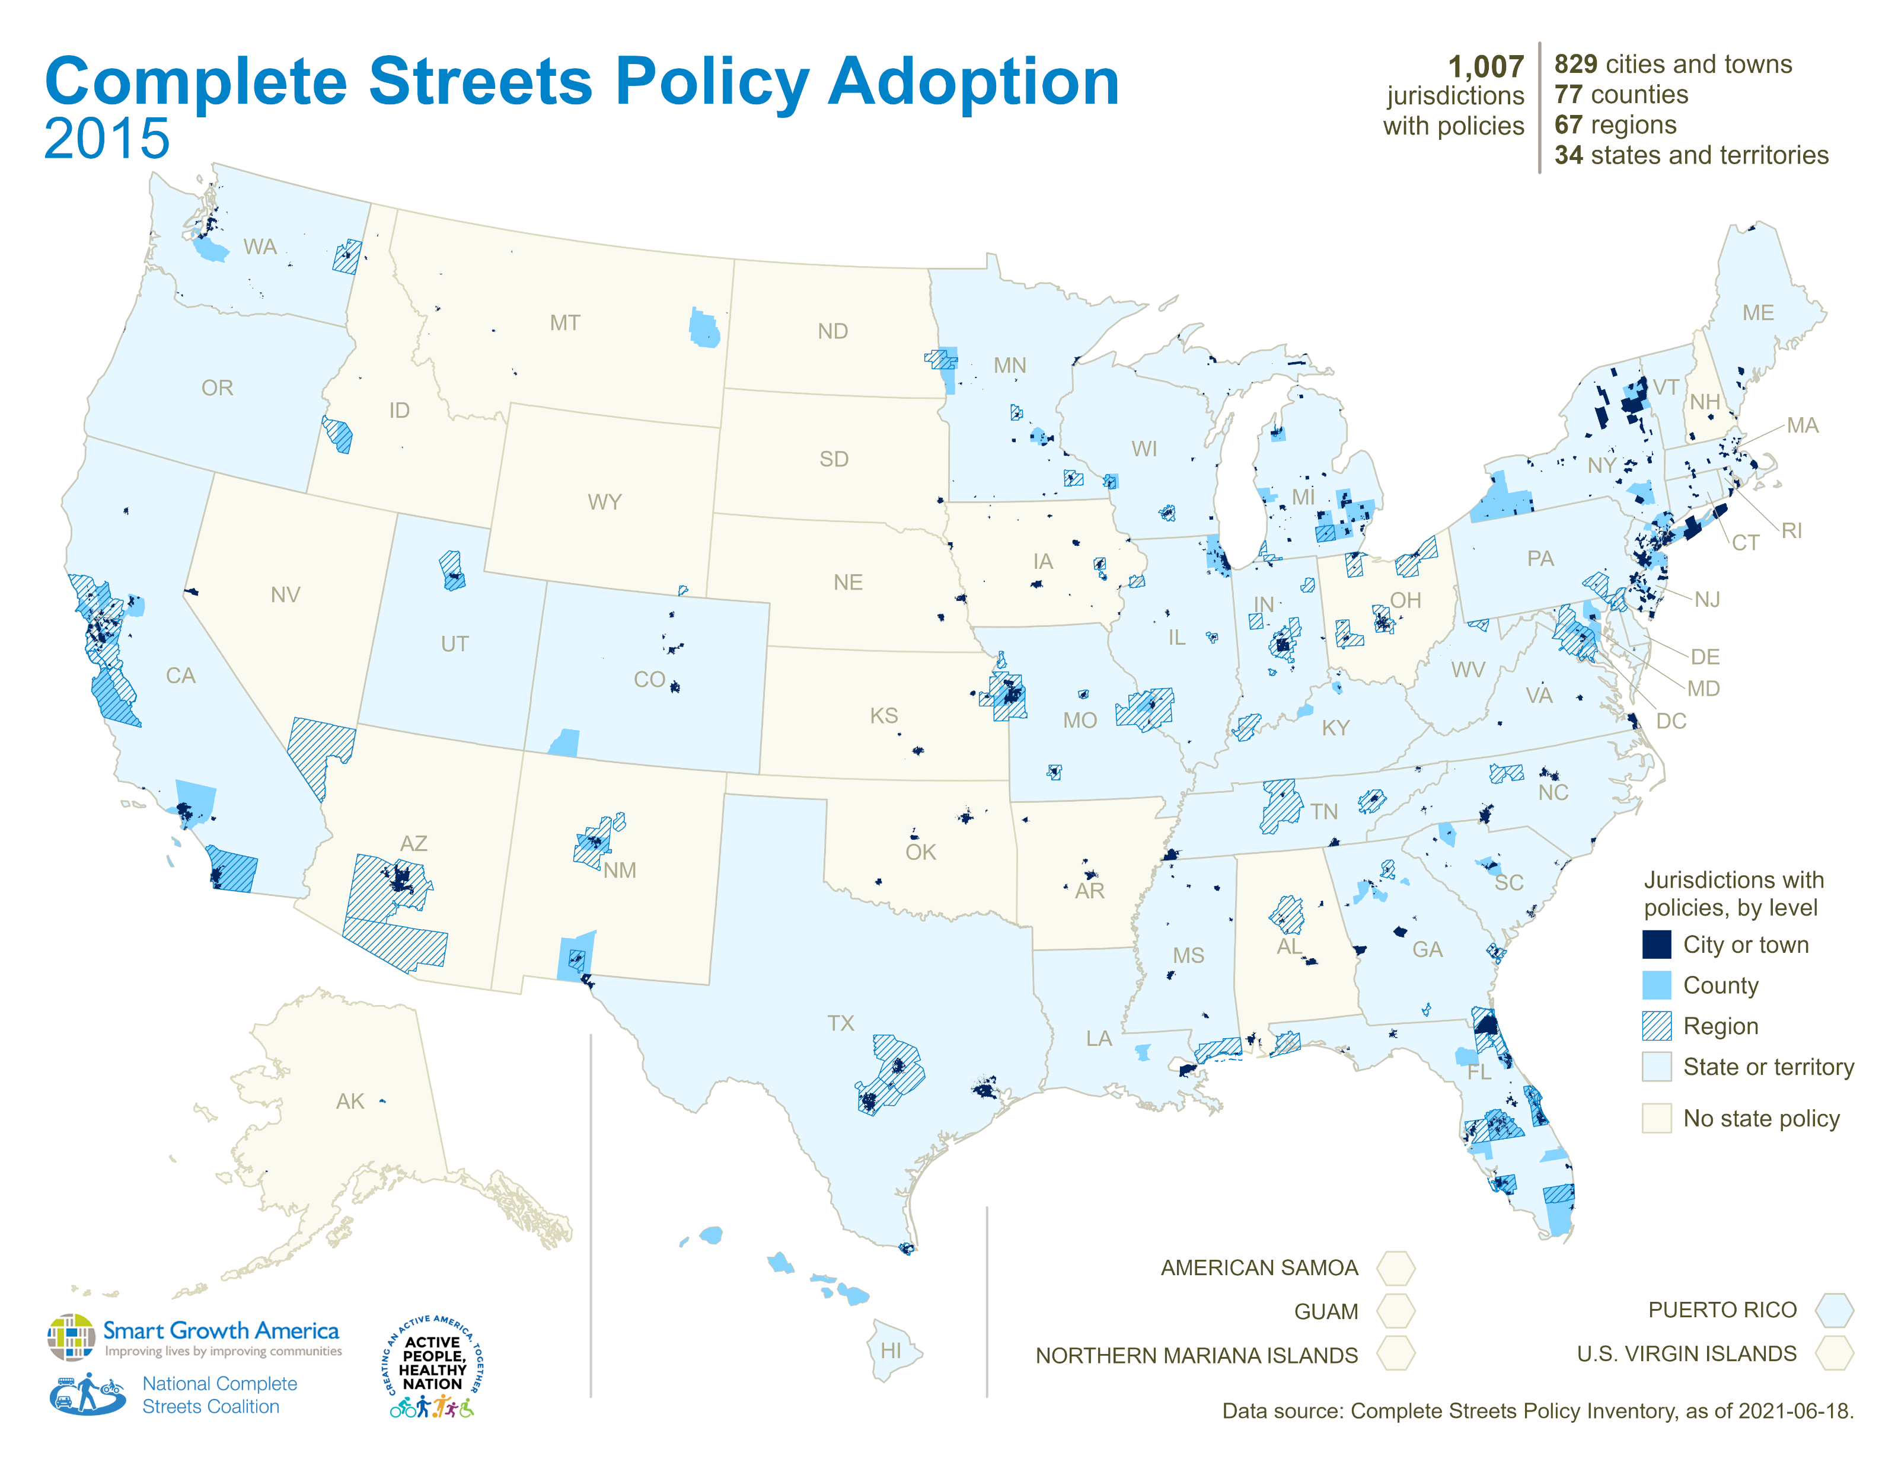

Slide 62
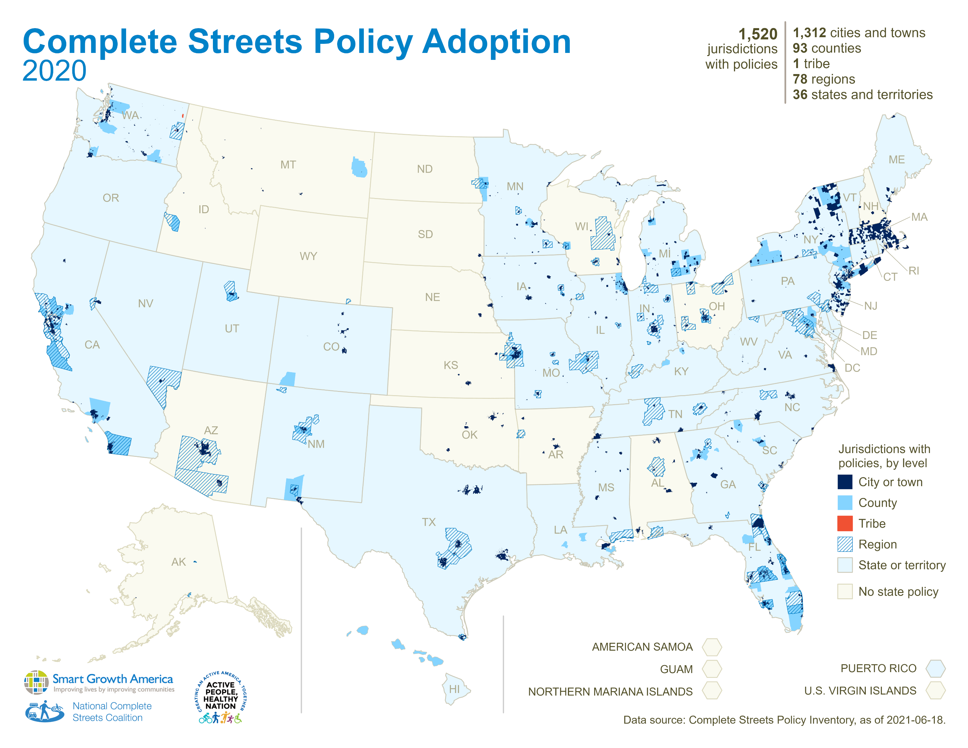

Slide 63
Policies – What are the gaps?
Geographic Specificity
Policy Quality
Policy Contents
Implementation
Notes:
So the GAPS in policy surveillance are many.
What you see here are a few gaps that would be most helpful if they were filled.
Geog specificity – local actions drive change. Local level data is needed to monitor progress
Contents – What is actually in the policy? How is it written? Are the provisions optional? Are there waivers?
Policy Quality – once you have the contents, you can rank the policy for quality – how likely is it to result in changed built environments that support PA?
Implementation – just because a policy is enacted or adopted, it does not mean the provisions will be universally implemented. (layering BE And pol data)

Slide 64
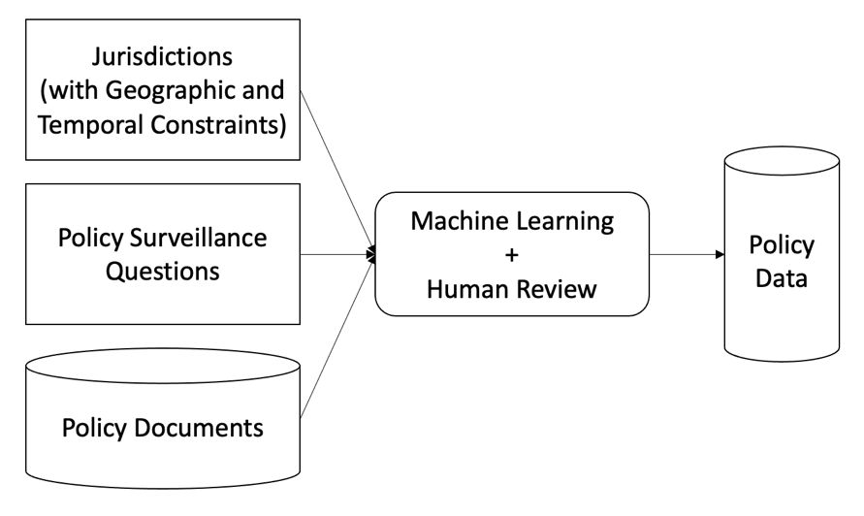
Policies – How to fill the gap?
Where do relevant documents exist and what technologies can be used to pull them into a database in a machine-readable format?
How do we find relevant documents in a legal corpus with natural language processing?
How do we identify relevant passages from legal documents that answer questions of interest?
How do we extract answers to questions?
Credit: MITRE Corporation
Notes:
As with images and the built environment, we think machine learning techniques, like natural language processing hold promise for increasing the efficiency of policy surveillance. We do not anticipate having a “one button” surveillance system where machines do everything, but they can probably do some things.
To this end, we are currently working with the MITRE corporation to conduct some experiments on making this happen. Think of these as pilot studies. The first questions are there on the screen..
Essence:
Where do the needed documents exist?
Can we find relevant documents within a given data source?
Can we find relevant passages therein?
Can we answer specific questions about the policies using NLP?

Slide 65
Policies – Partial Automation
Pros
Cons
Potential efficiencies
Scalability
Starting from scratch
May not work
Notes:
(jokingly) as you can see there are some TBDs here!

Slide 66
Thank You!
Jeff Whitfield: xdh5@cdc.gov

