Slide 1
NIH Funding
2022 PAPH Research Course
Linda Nebeling, PhD, MPH, RD
Deputy Associate Director
Behavioral Research Program
Division of Cancer Control and Population Sciences

Slide 2
NCI Extramural Divisions

Slide 3
Finding The Best Funding Opportunity Announcement
How to choose the right FOA:
http://grants.nih.gov/grants/how-to-apply-application-guide/video/choose-FOA/index.htm
Understand Funding Opportunities:
http://grants.nih.gov/grants/how-to-apply-application-guide/prepare-to-apply-and-register/understand-funding-opportunities.htm
Notes:
Receive NIH Guide Information
Weekly Update via E-mail LISTSERV - Subscribe or Unsubscribe.
RSS Format – Receive NIH Funding Opportunities in RSS (Really Simple News Syndication) format.
Twitter - Follow @NIHfunding for NIH Funding Opportunities
http://grants.nih.gov/funding/about-nih-guide-to-grants-and-contracts.htm

Slide 4
Grant Mechanisms
R03 – Small Research Grants
R21 – Exploratory/Developmental Grants
R01 – Research Projects
K-Awards @ NCI – Training Awards
R13 – Conference Grants
R15 – AREA awards
P01/P50 – Research Program Projects
U01/U54 – Cooperative Agreements
T41/T42 - SBIR/STTR – Technology Grants
http://grants.nih.gov/grants/funding/funding_program.htm
http://deainfo.nci.nih.gov/flash/awards.htm

Slide 5
Glossary - FOAs and NOSIs
Program Announcement (PA/PAR): Statement of ongoing research interest by Institute/Center
No set-aside monies (usually)
Request for Applications (RFA): Special research initiative
Set-aside monies and specially assembled review group
Notice of Special Interest (NOSI)
Succinctly highlight a specific topic of interest, for example a specific area of research or program
Direct applicants to one or more active FOAs (often parent announcements) for submission of applications for the initiative described
Administrative supplement NOSIs, too
Not generally associated with set-aside funds; gradually replacing PAs
http://grants.nih.gov/grants/guide/notice-files/NOT-OD-19-107.html
Notes:
NOSIs:
“All About Grants” Podcast on Notices of Special Interest (NOSIs):
http://nexus.od.nih.gov/all/2020/02/03/new-all-about-grants-podcast-on-notices-of-special-interest-nosis/
PAR: PA with special receipt, referral and/or review considerations
No set-aside money, often specially assembled review and special receipt dates
Request for Proposals (RFP): Call for contract proposals

Slide 6
Funding Opportunity Announcements (FOA)
FOAs may be known as program announcements, requests for applications, notices of funding availability, or solicitations
NIH advertises availability of grant support through FOAs (and NOSIs). Search for an FOA specific to your area of interest or apply using a generic parent announcement.
NIH and other HHS Agencies have Parent Announcements (also known as “generic,” “unsolicited” or "investigator-initiated") for common grant mechanisms (e.g., R01, R21).
Searching for Funding Just Got a Little Easier:
https://nexus.od.nih.gov/all/2020/02/03/searching-for-funding-just-got-a-little-easier/
Notes:
Researchers Can Find Their Next Funding Opportunity—Faster
Cancer research takes tremendous focus and time. Now, with the new
funding opportunity search‐and‐share tool on the DCCPS website, it’s
easier than ever for researchers to find a solicitation that fits their
research interest.
Visitors to the site can now search for DCCPS cancer research funding by
• Category
• Type of Research
• Due Date
• Funding Type
And with hundreds of active grants, researchers can more easily find the
right fit for their work. Encourage potential grantees to search and find a
match at http://cancercontrol.cancer.gov/funding_apply.html
DCP FOAs and grants:
http://prevention.cancer.gov/funding-and-grants

Slide 7
Gateways To Information: NIH http://grants.nih.gov/grants/oer.htm

Slide 8
Helpful Hints: Ask Yourself…..
Is the scientific idea relevant, falls within the Institute’s primary mission, or responsive to a stated area of interest?
Is it innovative, relevant and timely?
Will the results support the next steps?
What will the findings add to the research community – at – large?
Has this research been done before?
Does it target a high-risk population?

Slide 9
Planning and Developing Your Application
Use NIH’s RePORTER to identify best fit for research
Find a FOA or NOSI
Contact NIH Program Director to discuss research interest
Is this concept a priority interest in your Institute/program?
Is this FOA/NOSI still accepting applications?
Which Institute should I submit it to?
Obtain any required Prior Approval from NIH
Budget request (> $500 K direct cost/year)
Submitting application past the deadline
Notes:
Added direct cost per year

Slide 10
Actions Requiring NIH Prior Approval
NIH Prior Approval | Under the following circumstances
Additional no-cost extension, extension greater than 12 months, or late notification of initial no-cost extension | All instances.
Carryover of unobligated balances | If the NoA indicates that the recipient does not have the authority to automatically carry over unobligated balances
Change in scope | All instances
Change in status of the PD/PI or senior/key personnel named in the NoA | All instances
Change of recipient organization | All instances
Rebudgeting funds | All instances
Foreign component added to a grant to a domestic or foreign organization | All instances
https://grants.nih.gov/grants/policy/nihgps/HTML5/section_8/8.1.2_prior_approval_requirements.htm#Carryove

Slide 11
https://grants.nih.gov/grants/how-to-apply-application-guide/prepare-to-apply-and-register/understand-funding-opportunities.htm

Slide 14
Check to see if the FOA will accept clinical trial applications (clinical trial required, not allowed, or optional.) The hyperlinked question provides more details on the NIH definition of a clinical trial.

Slide 15
Application Page Limits (R01, R21, R03)
Section of Application | Page Limits (if different from FOA, FOA supersedes)
Project Summary/Abstract | 30 lines of text
Project Narrative | 3 sentences
Introduction to Resubmission and Revision Applications | 1
Specific Aims | 1
Research Strategy | R01 (12 pages) R03 & R21 (6 pages)
Biographical Sketch | 5
Page Limits | grants.nih.gov
Notes:
The title and abstract are public record. The Abstract is read most frequently.

Slide 16
https://grants.nih.gov/grants/how-to-apply-application-guide/prepare-to-apply-and-register/understand-funding-opportunities.htm

Slide 17
Identifying Whether NIH Considers Your Study to be a Clinical Trial is Crucial
It impacts whether you need to:
Respond to a clinical trial-specific FOA
Address additional review criteria specific for clinical trials
Register and report your clinical trial in ClinicalTrials.gov

Slide 18
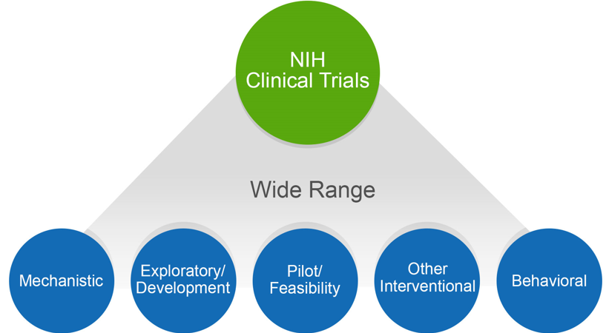
NIH Might Consider Your Human Subjects Research to be a Clinical Trial
Does your study…
Involve one or more human subjects?
Prospectively assign human subject(s) to intervention(s)?
Evaluate the effect of intervention(s) on the human subject(s)?
Have a health-related biomedical or behavioral outcome?
If “yes” to ALL of these questions, your study is considered a clinical trial
Unsure how to answer the questions? We have a tool that can help! http://grants.nih.gov/ct-decision/

Slide 19
Example FOAs (selected)
Title | Announcement Number | Expiration Date
Dissemination and Implementation Research in Health (R01 Clinical Trial Optional) | PAR 22-105** | May 8, 2025
Time-Sensitive Obesity Policy and Program Evaluation (R01 Clinical Trial Not Allowed) https://grants.nih.gov/grants/guide/pa-files/PAR-21-305.html | PAR 21-305* | Sept 11, 2024
NCCIH Multi-Site Feasibility Clinical Trials of Mind and Body Interventions (R01 Clinical Trial Required) https://grants.nih.gov/grants/guide/pa-files/PAR-21-241.html | PAR-21-241** | March 12, 2024
*Clinical trial not allowed; **Clinical trial optional

Slide 20
Example FOAs (selected)
Title | Announcement Number | Expiration Date
Environmental influences on Child Health Outcomes (ECHO) Measurement Core (U24) Clinical Trial Not Allowed https://grants.nih.gov/grants/guide/rfa-files/RFA-OD-22-020.html | RFA-OD-020* | Nov 22, 2022
Mechanisms that Impact Cancer Risk after Bariatric Surgery (R01 Clinical Trial Optional) https://grants.nih.gov/grants/guide/pa-files/PAR-21-331.html | PAR-21-331** | Sept 8, 2024
Exercise and Nutrition Interventions to Improve Cancer Treatment-Related Outcomes (ENICTO) in Cancer Survivors Consortium (U01 Clinical Trial Required) | RFA-CA-21-031 | Recently awarded
*Clinical trial not allowed; **Clinical trial optional

Slide 21
Notice of Special Interest (NOSI): Relevant Examples
Tilte | Announcement Number | Expiration Date
Notice of Special Interest (NOSI): Developing and Testing Multilevel Physical Activity Interventions to Improve Health and Well-Being | NOT-OD-21-087 https://grants.nih.gov/grants/guide/notice-files/NOT-OD-21-087.html (NOT-CA-21-065) | February 16, 2024
Reissuance of PAR-18-324, "Testing Interventions for Health-Enhancing Physical Activity (R01-Clinical Trial Optional)" as a Notice of Special Interest (NOT-OD-21-087) | NOT-OD-21-087 https://grants.nih.gov/grants/guide/notice-files/NOT-OD-21-087.html | February 16, 2024
Notice of Special Interest (NOSI): Stimulating Research to Understand and Address Hunger, Food and Nutrition Insecurity | NOT-OD-22-135 https://grants.nih.gov/grants/guide/notice-files/NOT-OD-22-135.html | November 22, 2024
Notice of Special Interest (NOSI): Fundamental Science Research on Complementary and Integrative Health Approaches, Including Natural Products or Mind and Body Interventions | NOT-AT-21-006 | Sept 8, 2024

Slide 22
Physical Activity NOSI: Relevant Examples
Tilte | Announcement Number | Expiration Date
Notice of Special Interest (NOSI): Dietary, Physical Activity, Sedentary Behavior and Sleep Assessment Methodologies Among Infants and Young Children (Birth to 5 years) through Adults | NOT-CA-21-108 https://grants.nih.gov/grants/guide/notice-files/NOT-CA-21-108.html | May 8, 2023
Notice of Special Interest (NOSI): Improving Patient Adherence to Treatment and Prevention Regimens to Promote Health | NOT-OD-21-100 https://grants.nih.gov/grants/guide/notice-files/NOT-OD-21-100.html | June 8, 2024
Notice of Special Interest (NOSI): Emerging and Existing Issues of Coronavirus Disease 2019 (COVID-19) Research Related to the Health and Well-Being of Women, Children and Individuals with Physical and/or Intellectual Disabilities | NOT-HD-22-002 https://grants.nih.gov/grants/guide/notice-files/NOT-HD-22-003.html | June 6, 2024

Slide 23
Other Relevant Omnibus type NCI FOAs
Activity Code | FOA | First Available Application Due Date
R01 | PAR-21-035 - Cancer Prevention and Control Clinical Trials Grant Program (R01 Clinical Trial Required) | June 5, 2021
R01 | PAR-21-033 – NCI's Investigator-Initiated Early Phase Clinical Trials for Cancer Treatment and Diagnosis (R01 Clinical Trial Required) | June 5, 2021
R21 | PAR-19-309 - Stimulating Innovations in Behavioral Intervention Research for Cancer Prevention and Control (R21 Clinical Trial Optional) | June 16, 2021
R03 | PAR-20-052 - NCI Small Grants Program for Cancer Research for Years 2020, 2021, and 2022 (NCI Omnibus R03 Clinical Trial Optional) | June 24, 2021
R15 | PAR-19-135 - Research Enhancement Award Program (REAP) for Health Professional Schools and Graduate Schools (R15 Clinical Trial Required) | June 25, 2021
R15 | PAR-19-133 - Academic Research Enhancement Award for Undergraduate- Focused Institutions (R15 - Clinical Trial Required) | June 25, 2021

Slide 24
Training Grants
http://www.cancer.gov/grants-training/training
http://www.cancer.gov/grants-training/training/contact

Slide 25
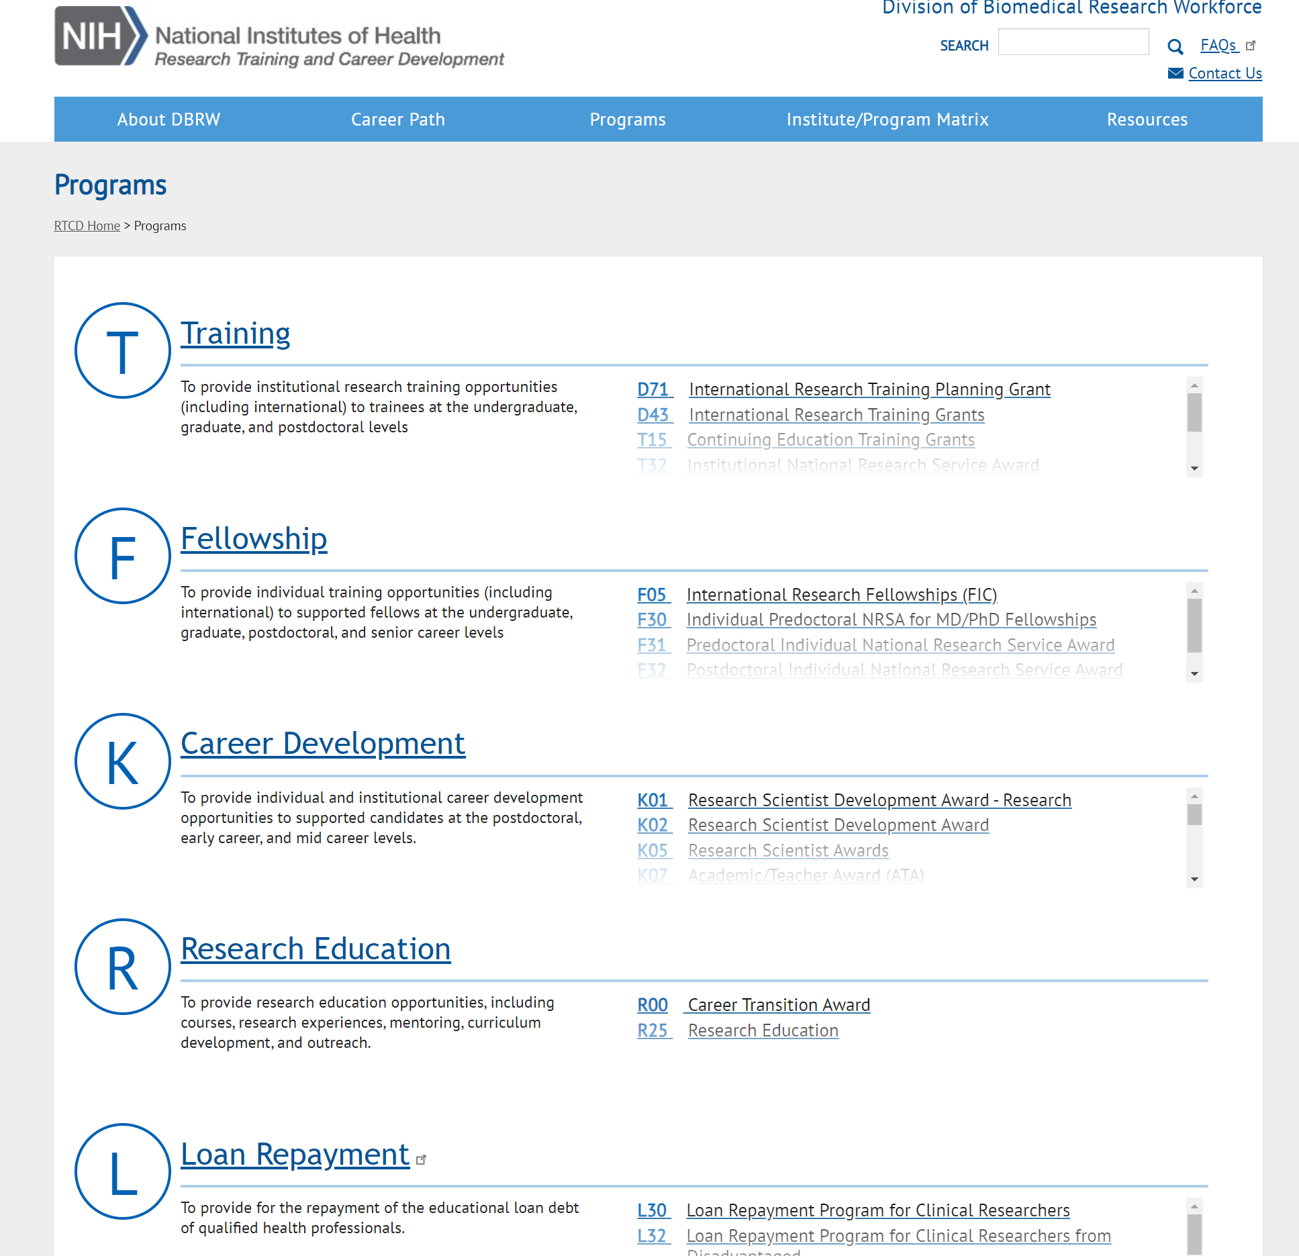
https://researchtraining.nih.gov/programs
https://researchtraining.nih.gov/programs/training-grants

Slide 26
Training Opportunities For Students And Investigators From Diverse Populations
NCI Center to Reduce Cancer Health Disparities
Diversity Training Programs
Research Supplements to Promote Diversity in Health-Related Research
http://www.cancer.gov/about-nci/organization/crchd
http://www.cancer.gov/about-nci/organization/crchd/diversity-training/cure
National Institute on Minority Health and Health Disparities Training and Career Development Grant Programs
http://www.nimhd.nih.gov/programs/extramural/training-career-dev/
Research and Training Programs at NIH Institutes
http://www.nimhd.nih.gov/resources/research-training.html

Slide 27
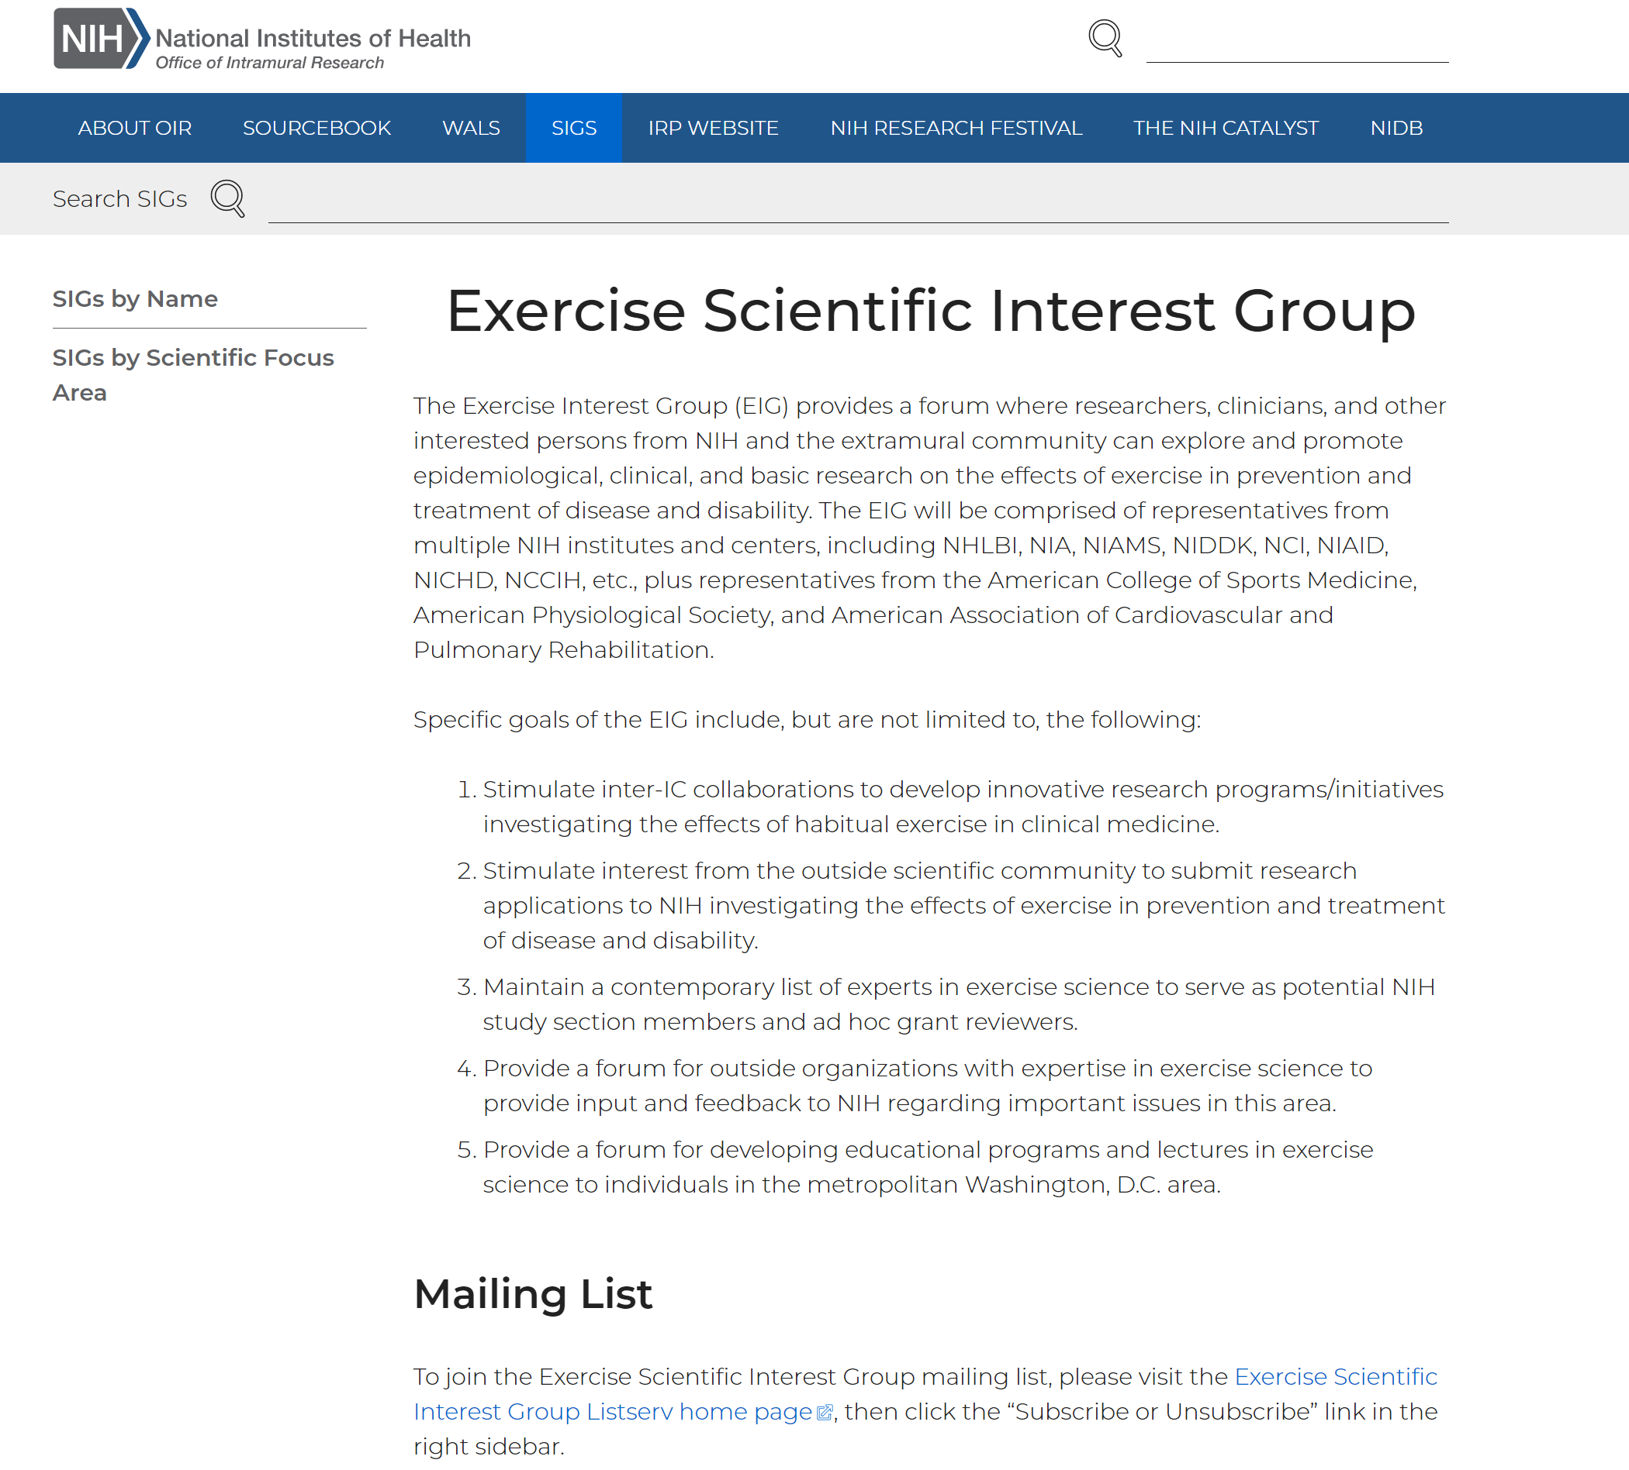
https://oir.nih.gov/sigs/exercise-scientific-interest-group

Slide 28
Sept 28, 2022
Improve food access and affordability: End hunger by making it easier for everyone — including urban, suburban, rural, and Tribal communities — to access and afford food. For example, expand eligibility for and increase participation in food assistance programs and improve transportation to places where food is available.
Integrate nutrition and health: Prioritize the role of nutrition and food security in overall health, including disease prevention and management, and ensure that our health care system addresses the nutrition needs of all people.
Empower all consumers to make and have access to healthy choices: Foster environments that enable all people to easily make informed healthy choices, increase access to healthy food, encourage healthy workplace and school policies, and invest in public messaging and education campaigns that are culturally appropriate and resonate with specific communities.
Support physical activity for all: Make it easier for people to be more physically active (in part by ensuring that everyone has access to safe places to be active), increase awareness of the benefits of physical activity, and conduct research on and measure physical activity.
Enhance nutrition and food security research: Improve nutrition metrics, data collection, and research to inform nutrition and food security policy, particularly on issues of equity, access, and disparities.
https://health.gov/our-work/nutrition-physical-activity/white-house-conference-hunger-nutrition-and-health

Slide 30
NIH Common Fund (High Risk, High Reward Research)
The Common Fund has been used to support a series of short term, exceptionally high impact, trans-NIH programs known collectively as the NIH Roadmap.
The portfolio of programs supported by the Common Fund continues to evolve to encompass a diverse set of trans-NIH programs.
http://commonfund.nih.gov/

Slide 31
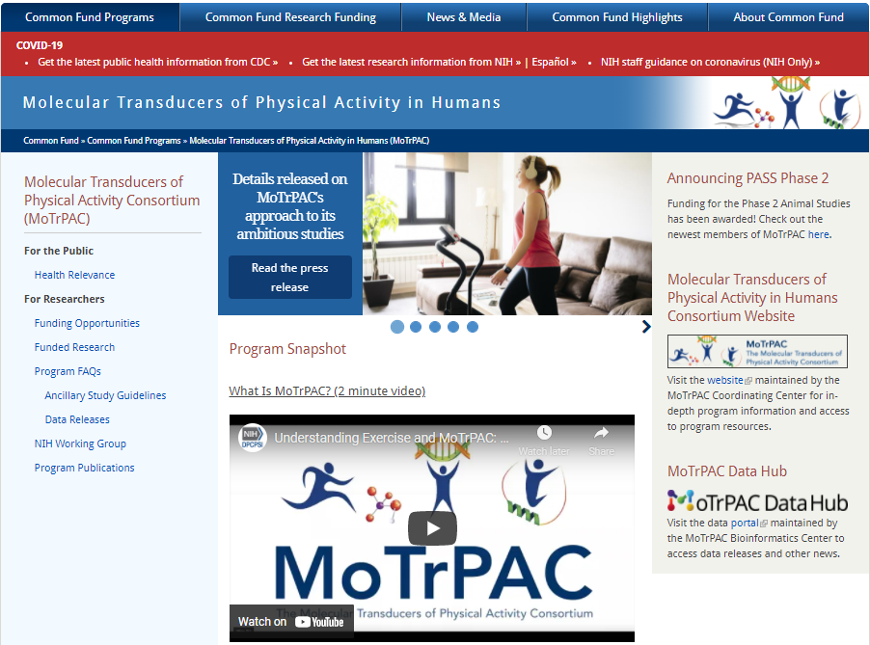
NIH Common Fund: Molecular Transducers of Physical Activity in Humans
http://commonfund.nih.gov/MolecularTransducers
http://commonfund.nih.gov/MolecularTransducers/fundedresearch
Ancillary Studies: http://www.motrpac.org/ancillarystudyguidelines.cfm

Slide 32
NIH Common Fund’s Nutrition for Precision Health, powered by the All of Us Research Program
https://commonfund.nih.gov/nutritionforprecisionhealth
Notes:
However, there's no such thing as a perfect, one-size-fits-all diet. The NPH program will build on recent advances in biomedical science including artificial intelligence (AI), microbiome research, as well as the infrastructure and large, diverse participant group of the All of Us Research Program. These advances provide unprecedented opportunities to generate new data to provide insight into personalized nutrition also referred to as precision nutrition
The goal of the NIH Common Fund’s Nutrition for Precision Health, powered by the All of Us Research Program, is to develop algorithms that predict individual responses to food and dietary patterns.
Nutrition plays an integral role in human development and in the prevention and treatment of disease.

Slide 33
ENVIRONMENTAL INFLUENCES ON CHILD HEALTH OUTCOMES (ECHO) PROGRAM
http://www.nih.gov/echo
http://www.nih.gov/echo/funding
http://echochildren.org/

Slide 34
National Collaborative on Childhood Obesity Research (NCCOR)
https://www.nccor.org/

Slide 35
https://class.cancer.gov/

Slide 36
https://cancercontrol.cancer.gov/brp/research

Slide 37
The NIH Obesity Research Task Force
https://www.obesityresearch.nih.gov/

Slide 38
Trans-NCI Obesity & Cancer Work Group
Objectives
To foster cross-divisional interests and activities in obesity and cancer
To support the development of obesity and cancer research initiatives that address high-priority areas of need and that fill gaps in NCI’s obesity and cancer portfolio
Promote communication and awareness
https://cancercontrol.cancer.gov/brp/hbrb/obesity-energy-balance/working-group
Notes:
Initiated in May 2019 with representation across NCI Co-Chairs: Linda Nebeling & Susan Czajkowski
Planning Group Members: Tanya Agurs-Collins, Laura Dwyer, Joan Becker, Olga Herren, Adaora Ezeani, Phil Daschner, Sharon Ross, Meg Zimmerman
Portfolio consultant: Gina Tesauro
Full WG meets every month; subgroups meet more frequently, as needed
Works across NIH/NCI i.e., Nutrition Research Task Force and implementation groups, NIH Obesity Research Task Force,

Slide 39
Helpful Web Sites
All About Grants Podcast
http://grants.nih.gov/podcasts/All_About_Grants/index.htm
RePORTER
http://projectreporter.nih.gov/reporter.cfm
Includes information from NIH project databases and funding records, PubMed abstracts and full-text articles, and U.S. Patent and Trademark Office Project descriptions, funding details, and research results
NIH Extramural Nexus – Monthly newsletter for the extramural community http://grants.nih.gov/grants/nexus.htm
The NCI Grants Process
http://www.cancer.gov/grants-training/grants-process
Electronic Submission of Grant Applications
http://era.nih.gov/
Funding Opportunities and Notices (NIH Guide)
http://grants.nih.gov/funding/searchguide/index.html#/
NIH searchable database of RFAs, PAs, and Guide Notices http://grants.nih.gov/funding/index.htm

Slide 41
NIH Electronic Research Administration eRA

Slide 42
Gateways To Information: Center For Scientific Review (CSR)

Slide 43
The Most Frequently Asked Questions About Peer Review
How do I determine the correct study section to submit to?
Review descriptions on CSR website
Evaluating Panel Quality in Review (ENQUIRE)
Assisted Referral Tool (ART)
Review members list
Identify needed expertise for your project
Talk to NIH program staff
How do I request a Study Section and Convey Other Information to NIH http://grants.nih.gov/grants/how-to-apply-application-guide/forms-e/general/g.600-phs-assignment-request-form.htm
What are the main comments from review?
How did my application score?
Notes:
ART- https://art.csr.nih.gov/ART/index.jsp?tabID=424017894535CD686EBE063D9F72460B11502100

Slide 44
Elements of the Summary Statement
Overall Impact Score
Percentile
Scored Review Criteria
Significance
Investigators (s)
Innovation
Approach
Environment
Notes:
Percentile is the approximate percentage of applications that received a better overall impact score from the study section during the past year. For applications reviewed in ad hoc study sections, a different base may be used to calculate percentiles.

Slide 45
Pre-Award Process
Just in Time (JIT) Information
Other support
Certification of Institutional Review Board (IRB) approval
Certification of Institutional Animal Care and Use Committee (IACUC) approval
Human subjects training certification for all key personnel
Negotiation of Competing Award
Initial peer review recommendations: Summary statement may recommend changes to the specific aims and/or budget modifications
Overlap: Ensure there is no scientific, budgetary, or commitment overlap with already funded projects
Level of effort: Ensure sufficient levels of effort are committed to support the approved project.
Budget/programmatic modification: Budget reduction if sufficient funds are not available to support project at 100 percent of the recommended level.
Notes:
JIT information must be submitted for NIH review and evaluation prior to making an award. This information may be submitted via the Just-In-Time function within the eRA Commons .

Slide 46
Post –Award Monitoring and Reporting
Annual Research Performance Progress Reports (RPPR)
Project accomplishments
Project plans for the next year
Manuscripts and publications produced
Personnel who have worked on the project
Changes to level of effort of key personnel
Actual or planned challenges or delays in the projects
Plans for resolving challenges or delays
Significant changes regarding human or animal subjects
Inclusion enrollment reports for clinical studies
https://grants.nih.gov/grants/post-award-monitoring-and-reporting.htm

Slide 47
Common Questions About the Award
Changes in Scope
Grant Rebudgeting
25% between budget categories within the total cost awarded
>25% requires NCI prior approval
Administrative supplements
noncompeting award that provides additional funding to a currently funded grant
Must be within the scope of the approved project
Request was unforeseen when the new or competing renewal application was awarded.
Grant renewal (Type 2)
Renewal applications (competing continuation) compete for funding with all other peer reviewed applications
Grant transfer requires NIH prior approval
https://www.cancer.gov/grants-training/manage-award/prior-approvals#prior-approvals; https://www.cancer.gov/grants-training/manage-award/grant-transfer;
Notes:
A change in scope is a change in the direction, aims, objectives, purposes, or type of research training, identified in the approved project.
Rebudget: The institution can rebudget between budget categories within the total costs awarded to meet unanticipated requirements, provided the expenditures:
Are within the scope of the approved project
Enhance and do not impede the successful continuation or completion of the project
Are allowable under governing regulations and policies

