Slide 1

Communication’s Place in Physical Activity Research & Practice
Brooke W. McKeever, Ph.D.
Sept. 25. 2023
Notes:
Good morning! Thank you all for being here today. I’m happy to be here to talk with you all about communication, how we can do it better, and its importance to physical activity and public health.

Slide 2




My Background and Affiliations
Notes:
First, a bit of information about my background, so you know where I am coming from... Currently, I’m a professor and Chair of the Department of Advertising & Public Relations, which is part of the College of Communication and Information Sciences at the University of Alabama. However, I just started there this summer, after 12 years in the School of Journalism and Mass Communications here at USC. I teach public relations and health communication courses and do research in those areas. My career began with a public relations agency in Chicago, and then I worked for St. Jude Children’s Research Hospital, among other organizations. In between my professional career and academia, I earned a PhD from UNC Chapel Hill and a certificate in interdisciplinary health communication. I’m also a Co-Investigator with the Prevention Research Center here, where I work with Sara Wilcox, Andy Kaczynski, and others, and I’m a Senior Research Fellow for the Arthur W. Page Center for Integrity in Public Communication at Penn State University.

Slide 3

Why am I here?
Notes:
So, why am I here? What does communications have to do with public health? Well, I am working on a book now, and as part of that research, I came across an article that had the headline you see here...
It was written in 1949. Public relations and communication have always been important in public health.

Slide 4
Presentation before APHA (Getting, 1949)
Public health objectives could be “hastened by the employment of a continuing, good public relations program (p. 1561)
Describes PR as “a science through which an organization” may secure the “public recognition and approval which is necessary to success” (p. 1561)
Notes:
As part of his presentation, Dr. Getting had the following things to say about PR and public health....

Slide 5
Presentation before APHA (Getting, 1949)
He concluded by saying, “while never before have people been as aware of health as they now are, we have still fallen short of creating proper demand for the attainment and maintenance of optimal health” (p. 1566)
Still true today?
Notes:
As you can see by this last quote, it seems like the more things change, the more they stay the same.

Slide 6
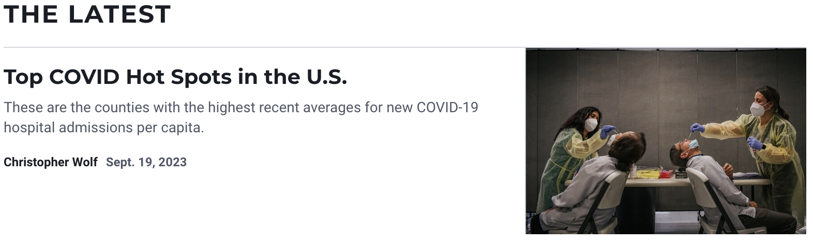
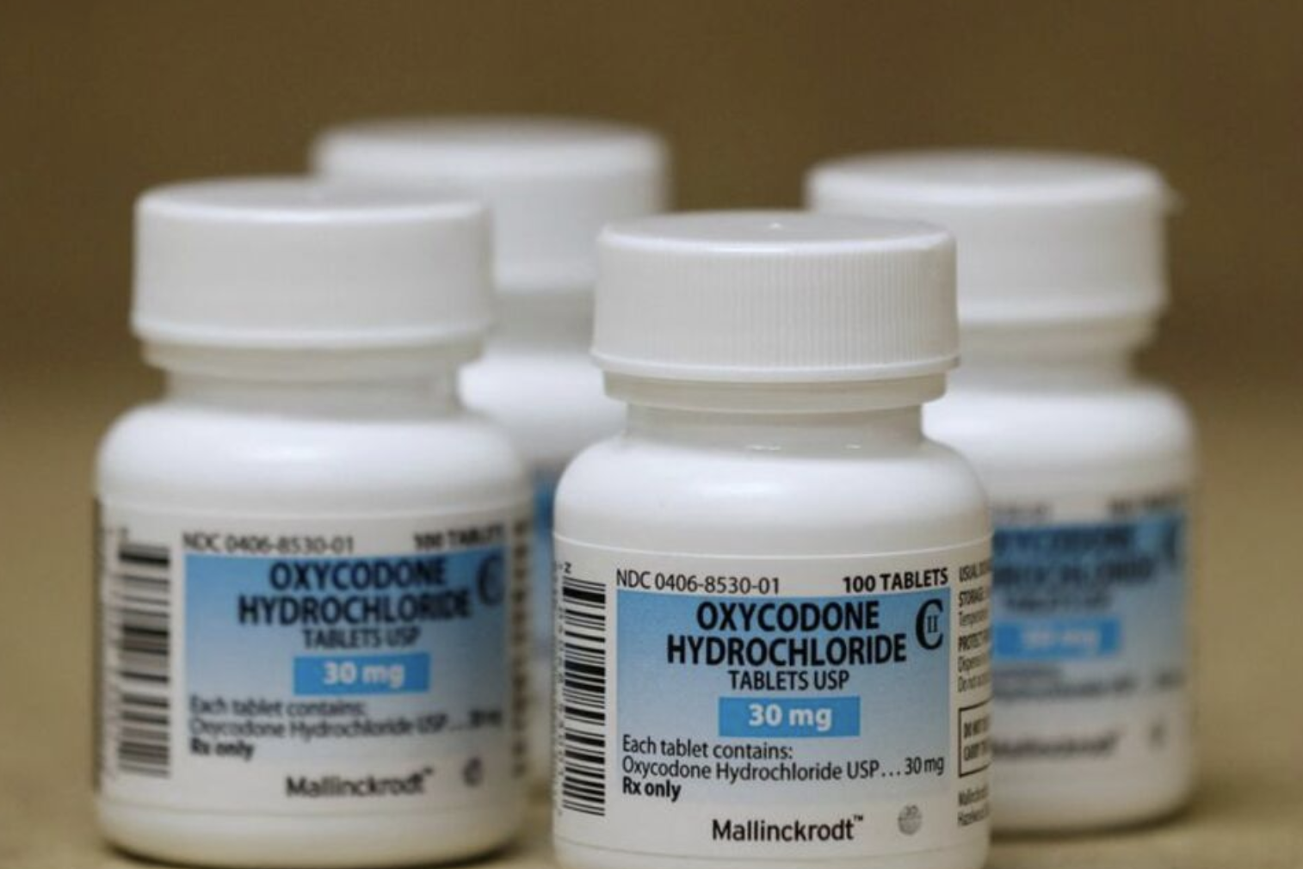

Notes:
When I think about the climate for health communication today, these are some of the issues I think about... Of course, we still have Covid. We have ongoing news with the opioid epidemic, and we have public health news related to climate change, social unrest, and various disparities. We also have more media than ever and polarized media and publics. These are challenging times to try to communicate about health issues - or anything, really.

Slide 7
Agenda:
What works in communicating about public health issues?
How can we better communicate physical activity research?
What’s needed in PA research?
Discussion
Notes:
So, what are we talking about today? Here is a basic agenda...

Slide 8
Communicating about
Public Health Issues
Media are generalists, not scientists or public health experts
They are time crunched (always)
They care about news values
Audiences have short attention spans, and we need to communicate accordingly

Slide 9
News Values
Proximity—close to home
Conflict
Bizarre/unusual
Prominence—important people involved
Timeliness
Human interest
Impact
Notes:
On the last slide, I mentioned news values... In case you are not familiar, these are some of the news values journalists use to determine what to cover. When I worked in public relations, these are the things we thought about when pitching a story on behalf of a client. This is what we all need to think of, when communicating with media or other audiences. Impact, in particular, is where communication comes in. As researchers, we need to be able to explain the impact, in lay terms, as that’s what will stand out and be remembered by people.

Slide 10
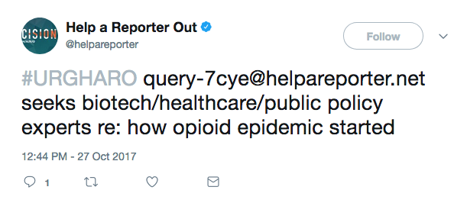
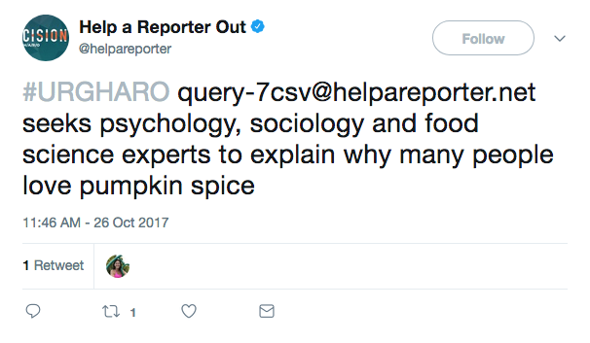
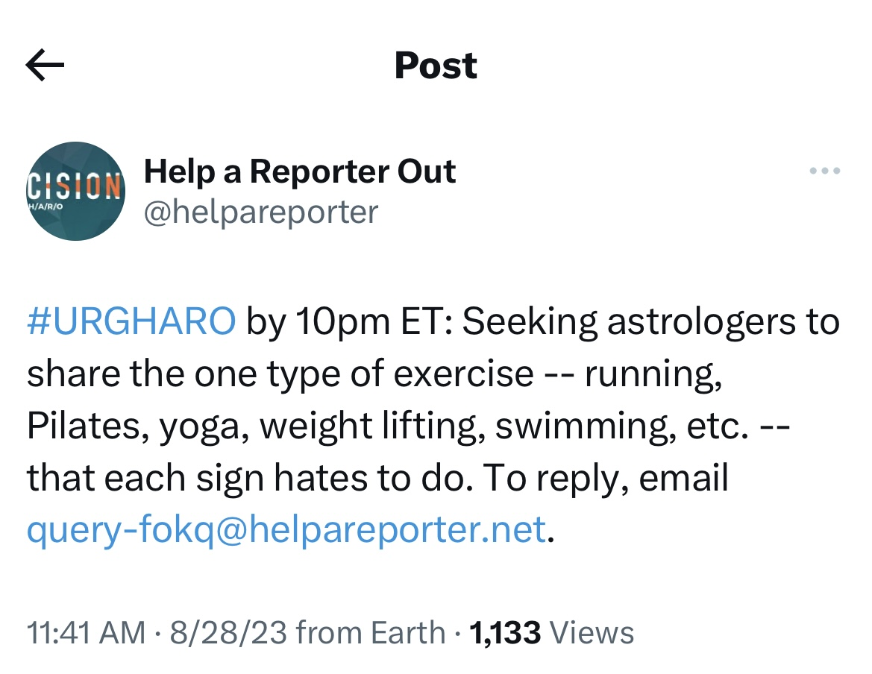
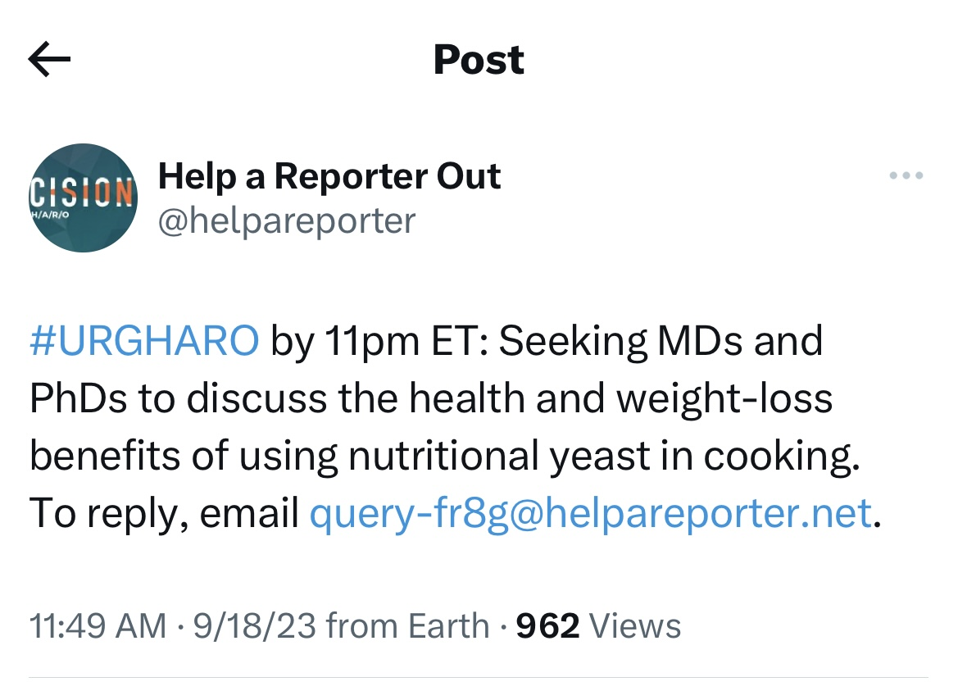
News Values in Action
Notes:
I wanted to provide a few examples of news values in action, so I went to something communications or PR practitioners use to see what reporters are working on. This is from the Twitter or X account for something called HARO or Help a Reporter Out. I pulled a few health-related examples – some of these are older than others and some are more related to this audience than others. So, the way this works is that PR practitioners can respond to these queries to get their client, or an individual, featured in the news.

Slide 11
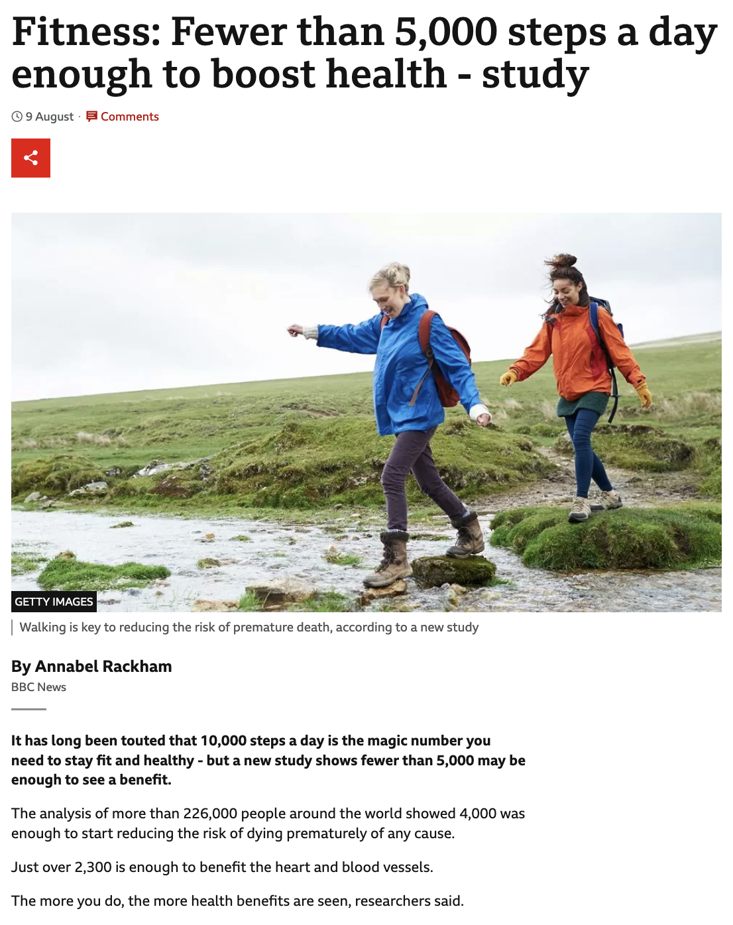
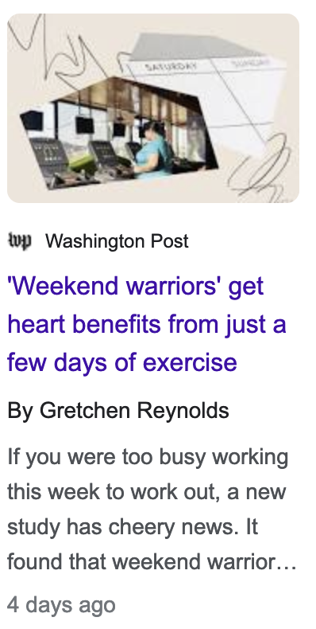
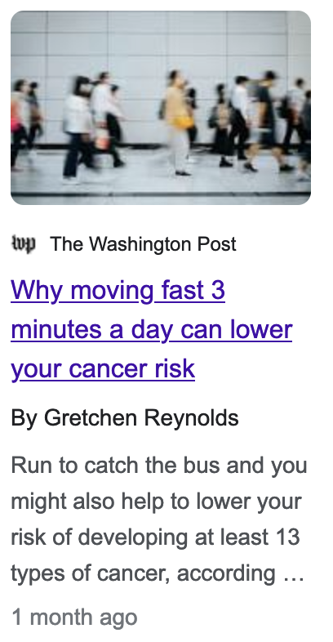
Notes:
The headlines and stories you see here are probably more relevant to this audience, and they also demonstrate some of the news values I mentioned. This headline about 5,000 steps a day being enough to boost health is unusual, because we all thought we needed 10,000 steps a day. The other headlines are written by Grethen Reynolds, who some of you may know or follow because of her writing on physical activity for the Washington Post, New York Times, and other outlets. As you can see, she leads with the point or the gist of the story, which tends to be the opposite of how we write in academia.

Slide 12
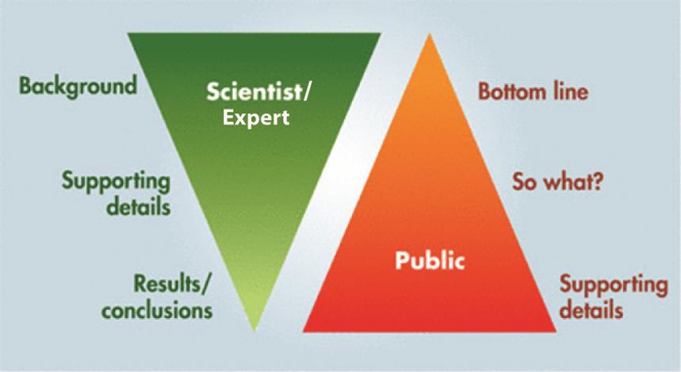
Framing your Research
Notes:
As you can see by those headlines, the key to getting health news out there is to lead with what is newsworthy.
It sounds simple, but in academia and sometimes in public health, it’s the opposite of how we communicate.
Research papers often lead with background, then they go into how the study was set up, and finally the conclusion at the end.
In communicating with the public or with media, we need to flip that—put the most newsworthy information at the top, and then if people keep reading, they can learn the details of the study.

Slide 13
Communicating your Research
Begin with the end in mind: What’s the gist, the headline, the take-away?
Describe the “so, what?” involved in your research and the implications (what does it mean for people?)
Communicate like you would to a family member; have people outside of your field review your “pitch”
Notes:
So, these tips may seem simple, but they are what I have learned and what I do when I’m communicating about research.

Slide 14
Supporting the Key Message
Then, select information that supports and connects with people:
    Relevant statistics
    Analogies or comparisons
    Personal experience/stories
    Counterintuitive facts
    Avoid jargon and minutia
Be Brief and Be Clear
Notes:
Once you know your key message, support it with evidence. In academia, we often talk about having an “elevator pitch.”
When I teach public relations, I tell my students to speak or craft messages in sound bites – things you might hear in the news.

Slide 15
Communication-related Theories & Concepts: Media Advocacy
What is media advocacy?
“the strategic use of mass media to advance public policy initiatives” related to public health (Wallack, 1994)
Notes:
As we talk about how to communicate about health issues, I want to touch on a concept that has been helpful to me in thinking about health communication. Media advocacy is way or working with and using media and communication to advance policy issues related to health. It’s been used to study changes that we have seen related to tobacco in recent years, and I think we are seeing it now with issues like gun violence.

Slide 16
Steps in the Media Advocacy Process
Setting the agenda
Framing the issue
Suggesting solutions
Notes:
In communication, when we talk about media advocacy, we talk about it in terms of two major paradigms in our field – agenda setting and framing. If we’re trying to push an issue onto the public agenda, we first have to push it onto the media’s agenda. Then we have to frame the issue as a public health issue. We saw that happen with smoking. We have seen that happen some with exercise or the lack thereof... Phrases like, “sitting is the new smoking, come to mind. Once we’ve done those first two things, we have to suggest solutions. Sometimes, we need policy solutions, like we did with smoking and tobacco.

Slide 17
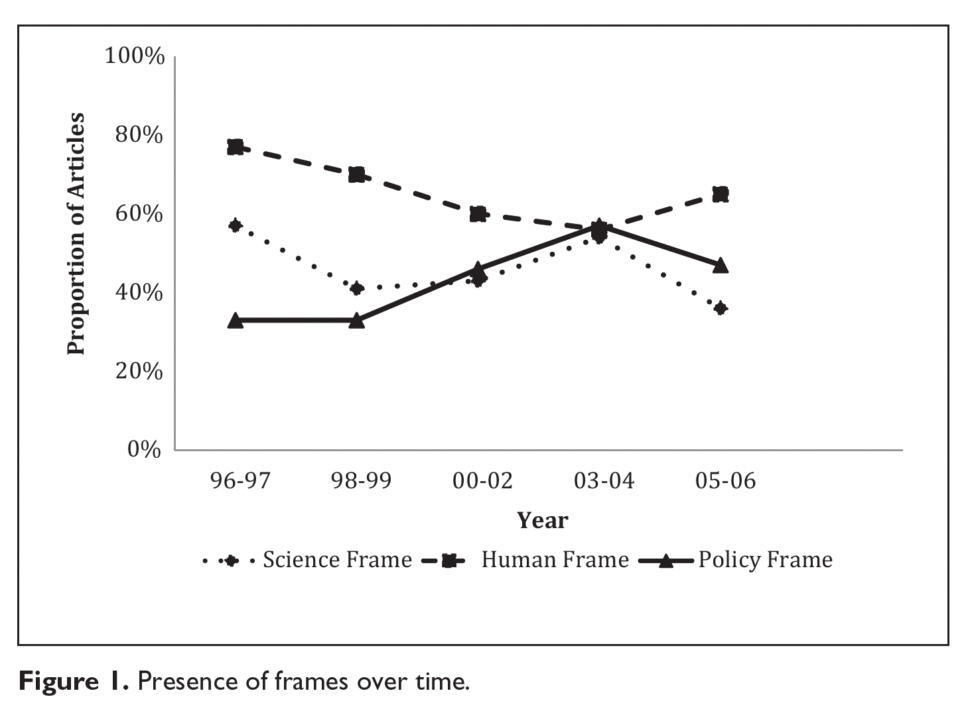
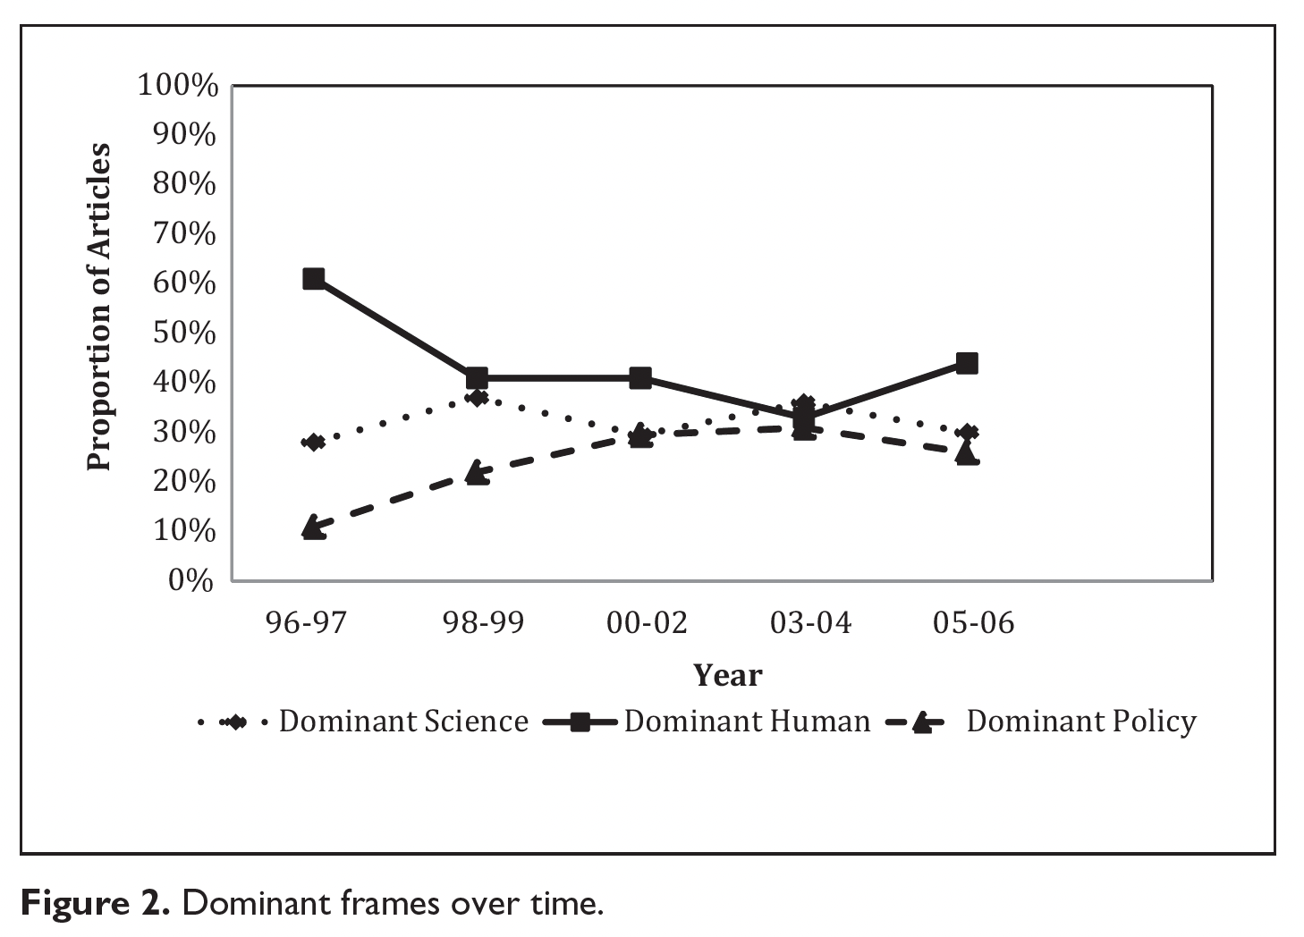
Media advocacy in action
Human frame, stories and exemplars help, along with visuals (Dixon et al., 2015; McKeever, 2013)
Notes:
17
Media advocacy is easy to talk about from a theoretical perspective, but when you look at media coverage over time, sometimes you find that the human frame, the personal stories or the examplars – stories about particular individuals - are what stick. These graphs are from something I published in Science Communication many years ago, when I looked at a decade of news coverage of autism, leading up to then President Bush signing an act that gave unprecedented funding to autism organizations and research. I also want to touch on some research that colleagues and I have done related to communicating about health issues. What I found was that “human frames” increased over time. News stories focused on individuals who had autism and the effects on families. And it was these stories – and even the people with autism – who influenced the policymakers. President Bush was quoted in some of the stories about meeting a boy with autism, and this is what influenced his decision. We also found science and policy frames in news coverage, but the human frames made the difference. Sometimes, in health and science communication, it is about telling those stories or showing how people affected by an issue could be helped by more research.

Slide 18
What else works?
Guilt and fear don’t work (not long-term anyway)
Detailed nuances don’t matter (in communicating)
Achievable goals and routines work and matter (for PA)
Stories stick
Notes:
18

Slide 19
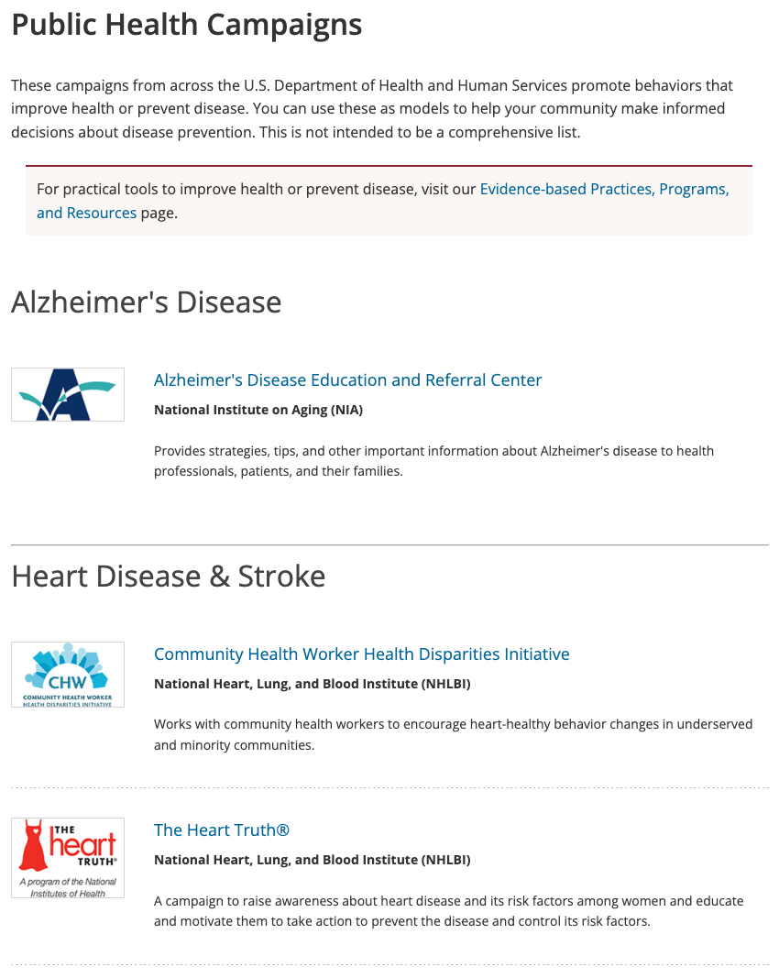
Public Health
PR/Communication Campaigns
Notes:
Now, I want to touch on a campaign that is PA-related that has done a nice job of connecting with the public over the years.

Slide 20
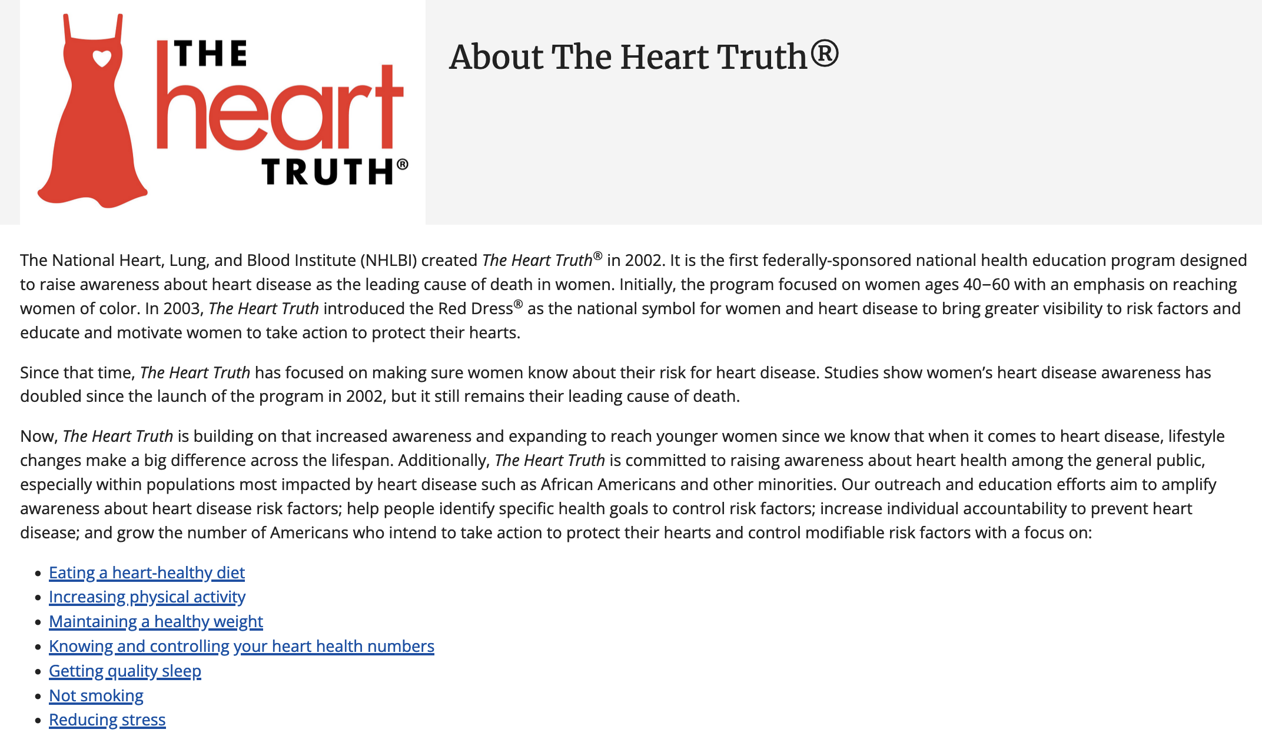
Notes:
The Heart Truth campaign is one you might be familiar with... It started with the National Heart, Lung, and Blood Institute in the early 2000s to try to raise awareness about heart disease being the #1 killer of women. You can see here, the campaign focuses on influencing women to make changes related to diet and exercise....

Slide 21
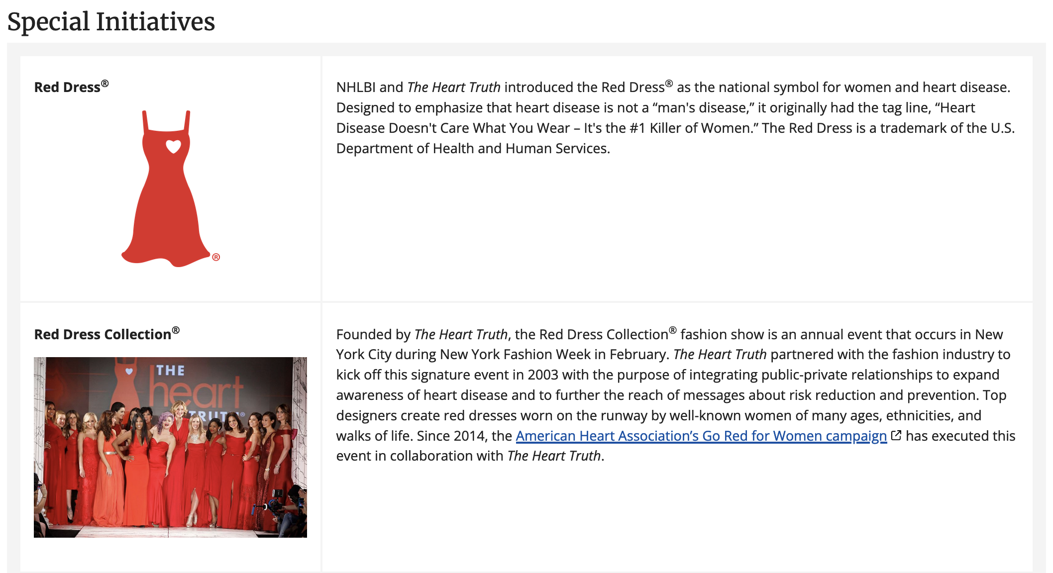
Notes:
It was created by a public relations agency called Ogilvy, and they created this red dress symbol, based on research showing that the red dress resonated with women, made them think of the heart. It was a multi-faceted campaign that included things like a Fashion Show. At one point, I saw some of these red dresses touring around the U.S. in airports... They partnered with the American Heart Association’s Go Red for Women campaign, which amplified the efforts.

Slide 22
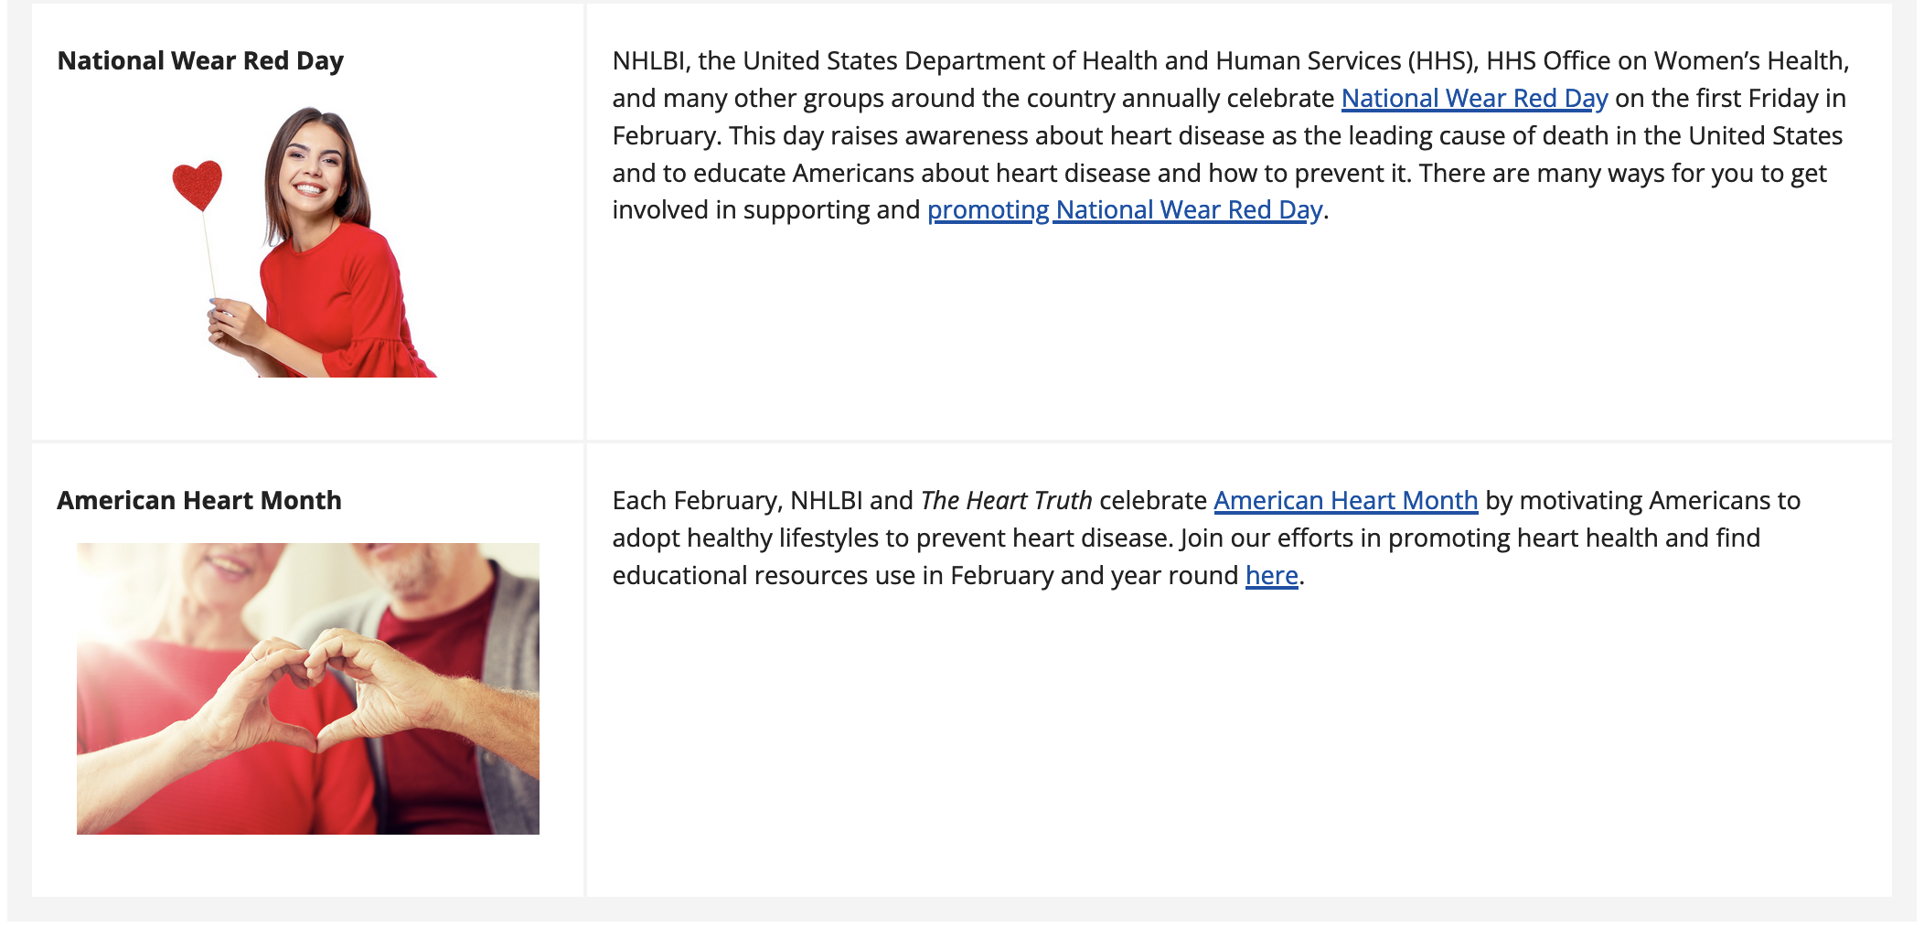
Notes:
They started a National Wear Red Day, and every February, we celebrate American Heart Month, which often coincides with stories in women’s magazines about women who made changes in their lifestyle to improve their health.

Slide 23
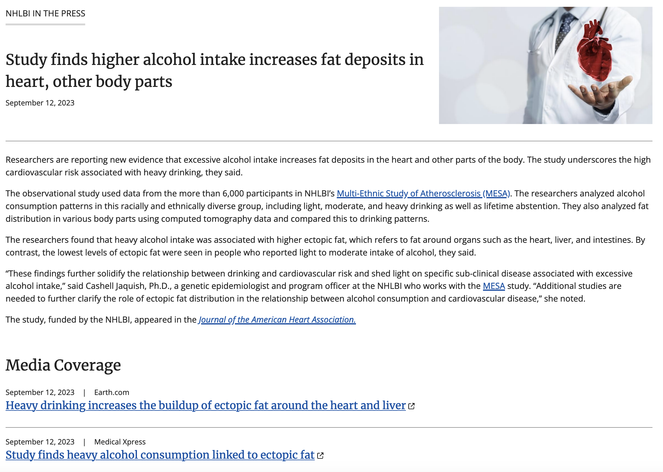
Notes:
These organizations are also good at getting research into the news. If you go on the NHLBI website, they have this recent press release about some recently published research that they sponsored, which you can see here, has been picked up by a few media outlets. Again, that headline is attention-grabbing and cuts right to the gist of the story, with supporting facts found as you read on....

Slide 24


Before and after the Heart Truth Campaign
In 2000, 34% of women knew heart disease was their #1 killer
In 2009, 68% of women knew the Red Dress symbol, up from 25% in 2005
Two-thirds said it prompts learning and risk reduction behaviors.
Notes:
As you all know, evaluation is important, when looking at health communication campaigns, and there has been some efforts to evaluate this campaign. On this slide, you see some of their early evaluation efforts. They raised awareness and according to survey results, the campaign got people thinking about changing their behaviors. Now, as the campaign has moved forward, it continues to evolve. They have developed this healthy hearts network and community subcontract program to work with local groups and with American Indian and Alaska Native communities.

Slide 25
Lessons Learned?
Strategic, creative visual helps with recognition/association
Combination of national and local initiatives/events helps with impact and longevity of campaign
Partnerships are key
Programming and Communication must evolve to fit the times

Slide 26
What’s needed in PA research?
Motivations or lack thereof?
Inertia/apathy – We need a better understanding of it
Communication can help with nudges; Psychology can help with understanding
Interdisciplinary research
Notes:
Now, when I was asked to come to this event, I reminded Russ that while I think of myself as a health communication researcher, I am not solely focused on physical activity. However, in working with the PRC and communicating on behalf of the PRC, I came up with a few observations of what might be needed in PA research, which you see here on this slide.

Slide 27
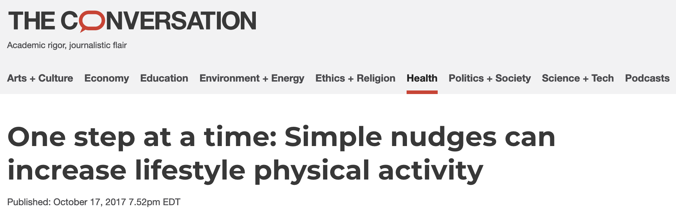
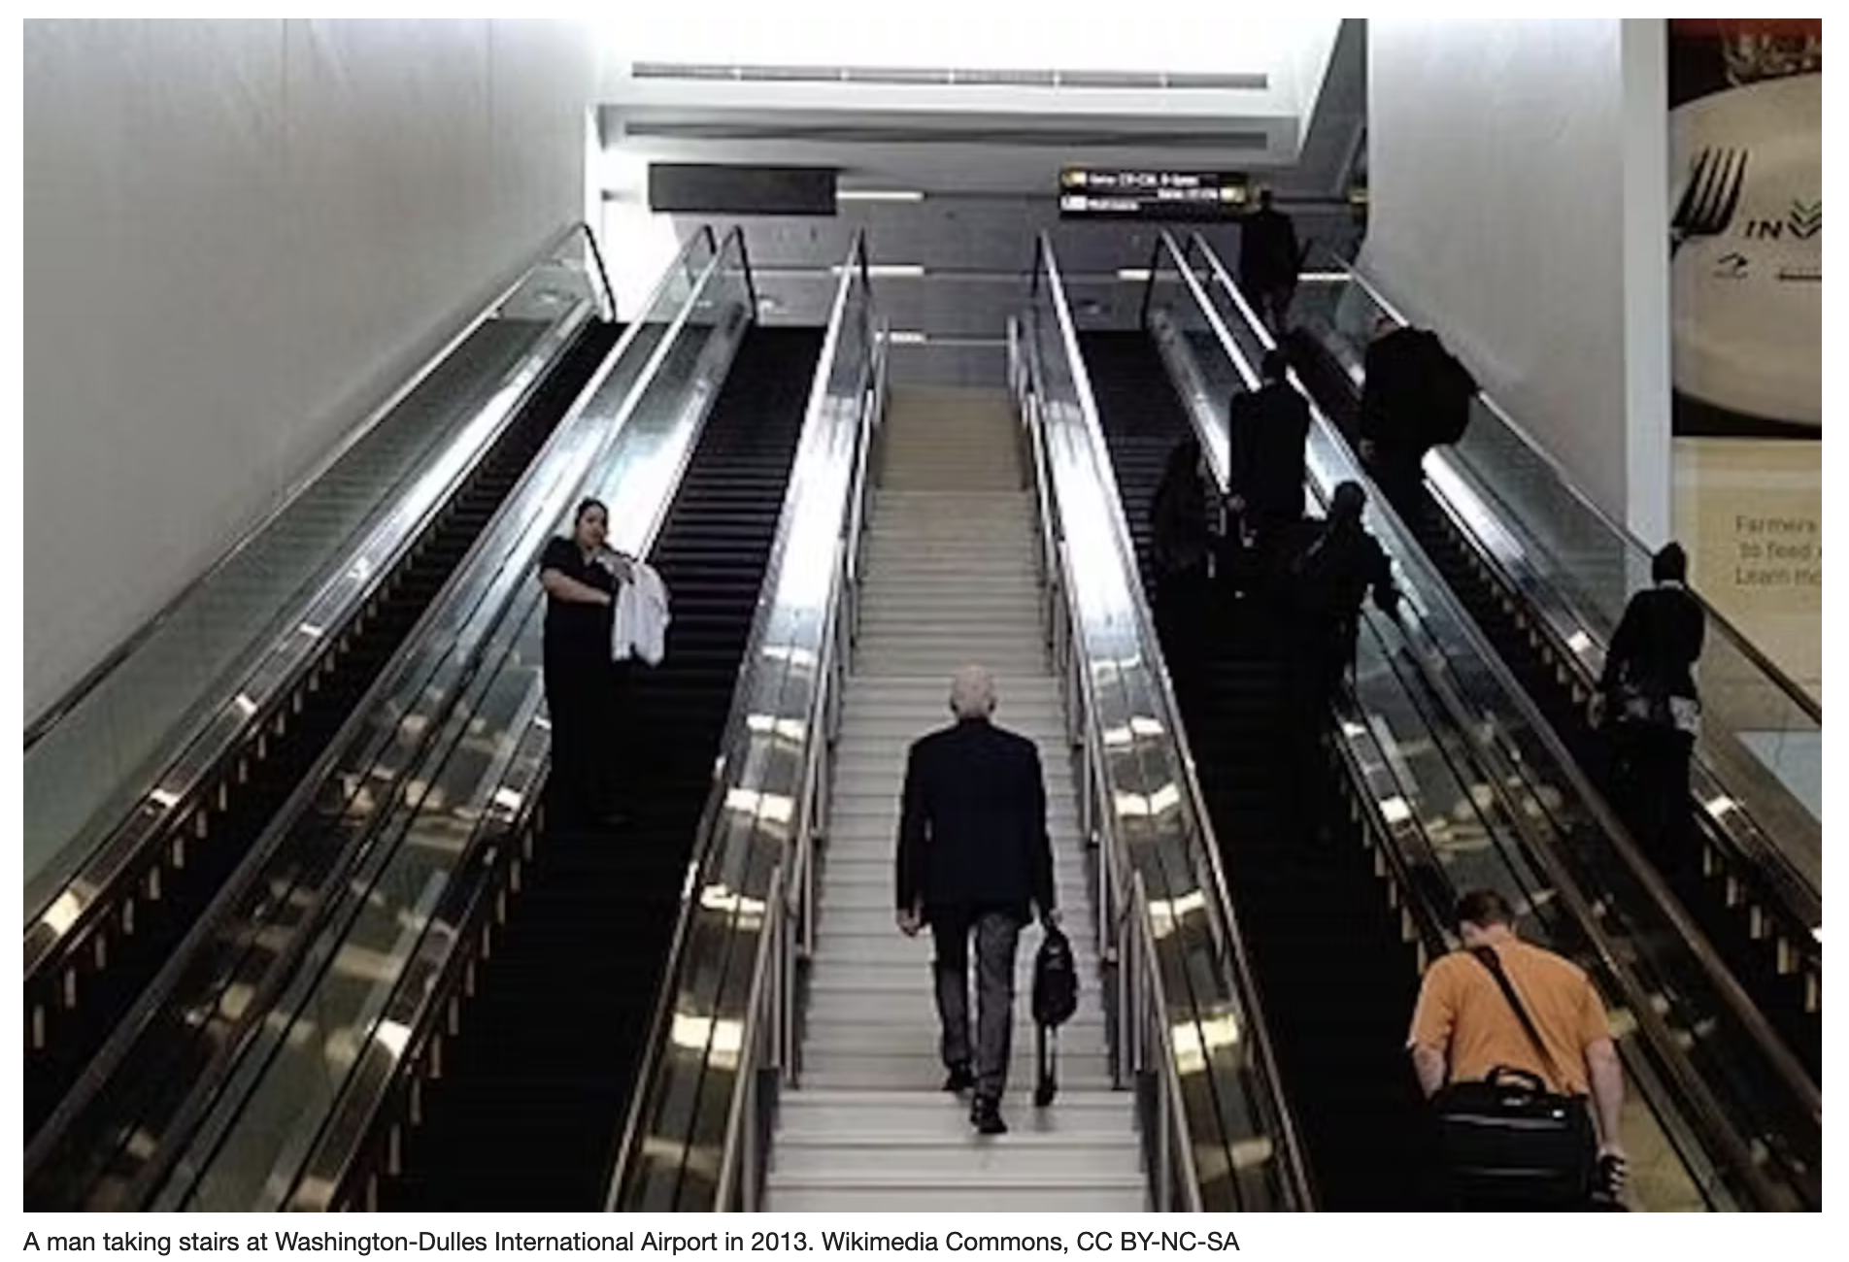

Slide 28

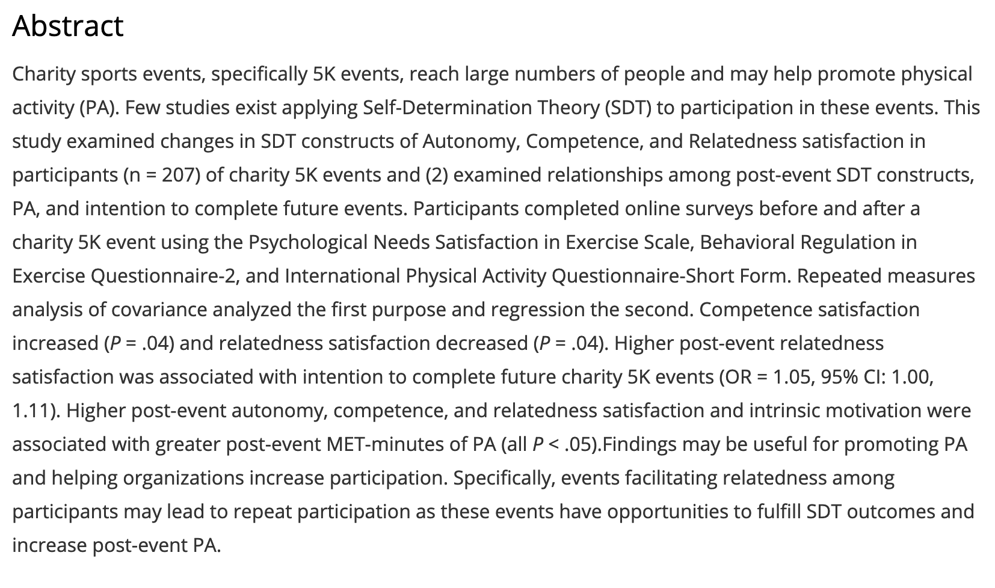

Slide 29
What’s needed in PA research?
Temptation to splice and dice – may be good for publication and for science; not so good for relevance, impact, communication
Your experiences, thoughts?

Slide 30
References:
Bernhart, J.A., Wilcox, S., McKeever, B.W., Ehlers, D.K., O’Neill, J.R. (2022). A self-determination theory application to physical activity in charity sports events. American Journal of Lifestyle Medicine.
Dixon, G. N., McKeever, B. W., Holton, A. E., Clarke, C., & Eosco, G. (2015). The power of a picture: Overcoming scientific misinformation by communicating weight-of-evidence information with visual exemplars. Journal of Communication, 65(4), 639-659.
Getting, V. A. (1949). Public relations in public health. American Journal of Public Health and the Nation's Health, 39(12), 1561–1566.
McKeever, B. W. (2013). News framing of autism: Understanding media advocacy and the combating autism act. Science Communication, 35(2), 213-240.
Wallack, L. (1994). Media advocacy: A strategy for empowering people and communities. Journal of Public Health Policy, 15, 420-436.

Slide 31
Thank You!
Discussion, Questions?
bmckeever@ua.edu; @BrookeWMcKeever

Slide 32


