Slide 1
Culture, Cultural Humility, and Effective Interventions
David X. Marquez, PhD
Professor
Interim Department Head
Department of Kinesiology and Nutrition
University of Illinois Chicago
Rush Alzheimer’s Disease Center, Rush University

Slide 2
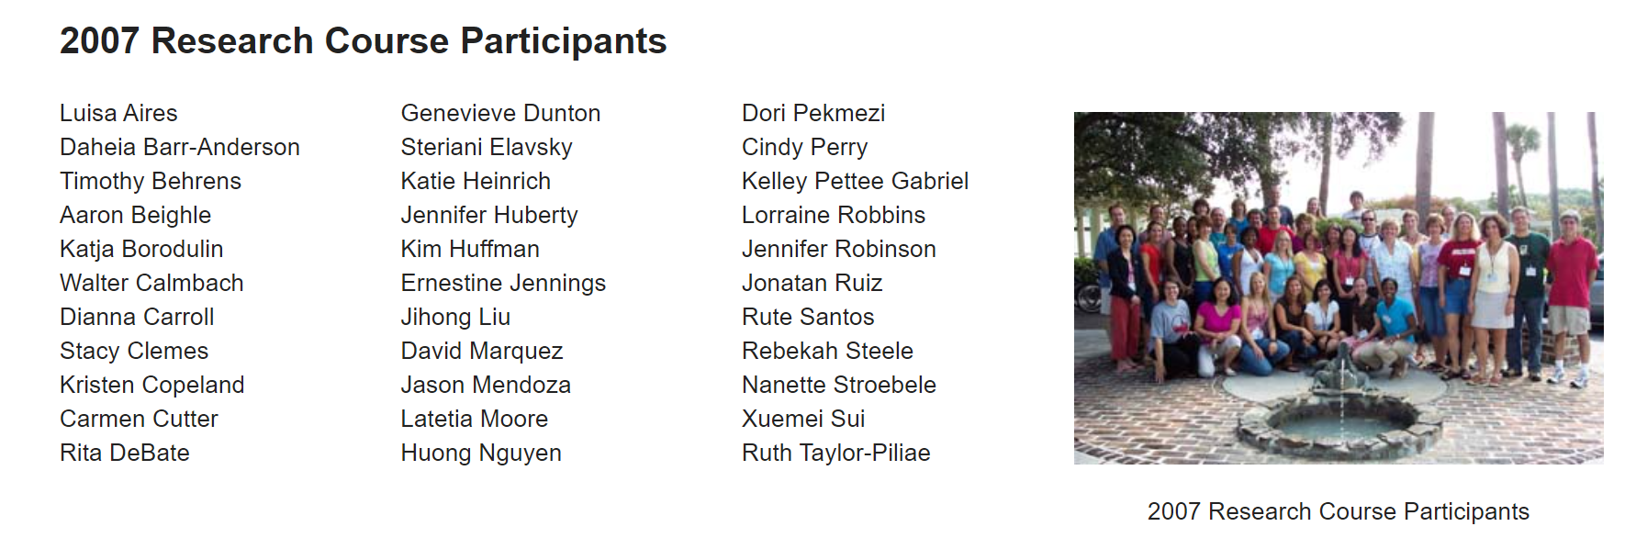
Proud PAPH Alum

Slide 3
Overview
Multicultural Orientation Framework
Cultural humility
Self-awareness
Older Latino interventions
Overcoming barriers
BAILAMOSTM
BAILA

Slide 4
Why diversity in clinical trials is important
https://recruit.ucsf.edu/diversity-research-participation-why-its-important

Slide 5
Multicultural orientation framework
Instead of using the language of competencies, the multicultural orientation framework uses the language of orientation
An orientation provides a lens through which one sees the world
One of the core pillars of a multicultural orientation is cultural humility (cultural opportunities and cultural comfort the other two)
Info on the Multicultural framework and cultural humility is from:
Hook, J.N., Davis, D., Owen, J., & DeBlaere, C. (2017). Cultural Humility: Engaging Diverse Identities in Therapy. American Psychological Association. ISBN: 978-1-4338-2777-8

Slide 6
Cultural humility
Culturally humble individuals are able to have an accurate perception of their own cultural values as well as maintain an other - oriented perspective that involves respect, lack of superiority, and attunement regarding their own cultural beliefs and values (Davis, Worthington, & Hook, 2010; Hook, Davis, Owen, Worthington, & Utsey, 2013)
The intrapersonal aspect of cultural humility captures how people are able to view themselves culturally, including their biases, strengths, limitations, areas for growth, beliefs, values, attitudes, and assumptions
The ability to incorporate feedback in a non-defensive, open stance is the hallmark of intrapersonal humility
Attune to your true feelings, be present with the thoughts that automatically enter your mind, and resist the urge to explain or defend your reactions

Slide 7
Cultural humility
The interpersonal aspect of cultural humility describes a way of being with others that is open to and curious about others’ cultural beliefs and values rather than presumptuous or arrogant (Davis et al., 2010; Hook et al., 2013)

Slide 8
Cultural Humility and Self - Awareness
We need to/should explore our own cultural identity, as well as the relationships between our cultural identity and systems of power and privilege
We define privilege as an identity in which belonging to a group or community affords you certain unearned benefits based on the power of that group to influence social institutions and social norms
Regardless of the feelings (e.g., discomfort, shame), we try to sit with our feelings, avoid the temptation to run from any negative emotions we may experience , and be mindful of how our positive emotions can fuel our motivation to do more work in this area

Slide 9
Knowledge structures Sociocultural Identity Wheel
The starting point to cultural self - awareness begins with increasing cultural knowledge and understanding about our particular cultural identities (personal, family, and sociopolitical histories that help inform the broader contexts of our cultural heritage)
Sometimes we are not aware of the privileged parts of our cultural identity because they just seem “ normal ” to us .
“White”
“Heterosexual“
“Able bodied“

Slide 10
Motivational processes
It is helpful to get in tune with our motivations about how we engage with culture in our professional and personal lives
By exploring our cultural identities and worldview, we will develop a natural tendency to be interested and curious about our cultural experiences, as well as the cultural experiences of others

Slide 11
Relational experiences
The third important part of cultural self - awareness is to understand how we experience our cultural identities in relationship to others and within society
There is also value in connecting with others through cultural dialogues
At times these dialogues can affirm our cultural self, and at other times they can push us to think differently

Slide 12
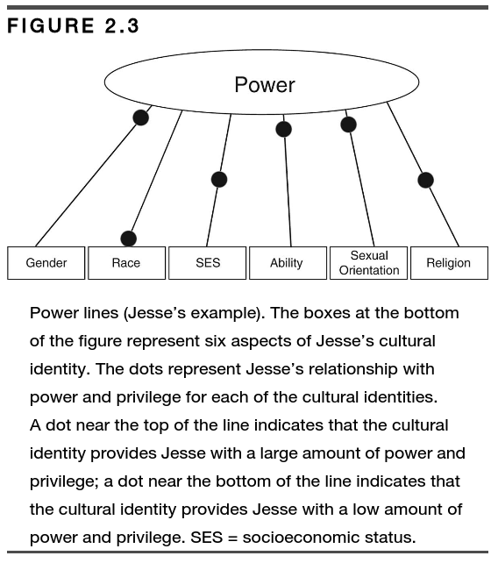
How about you?
Does a particular identity afford you a high, medium, or low amount of power and privilege?

Slide 13
Increasing comfort with cultural differences
The more we insulate ourselves from others, the more difficult it will be to feel comfortable connecting with individuals who are different from us﻿ — including our participants
Interpersonal contact with culturally different individuals can reduce prejudice and promote intergroup harmony under certain conditions (Utsey, Ponterotto, & Porter, 2008).
The Nature of Prejudice, Gordon Allport (1954)
Factors necessary for social contact to effectively reduce prejudice:
(a) equal status between members of different groups
(b) common group goals
(c) emphasis on cooperation to attain group goals
(d) support by those in a position of authority

Slide 14
Working to identify and reduce cultural biases
We want to become aware of and reduce cultural biases we hold
Cultural biases occur when you have an incorrect (e.g., overly positive or overly negative) view of a particular cultural group or issue (Pedersen, 1987)
Often cultural biases take the form of stereotypes, which are cultural views that are fixed, oversimplified, and overgeneralized (Ashmore & Del Boca, 1981)

Slide 15
Use power and privilege to work towards social justice
If you are unsure of what to do, start with offering your presence; listen and acknowledge the pain that others are experiencing
The main recommendation for action is to build relationships and connect with others who are already working in this area
Be sure to engage with humility! Do not pretend to be the expert about what has to be done; instead, spend most of your time listening to the individuals who are most affected by the issue at hand
Dive in! A main recommendation when getting started is to commit to being a regular volunteer for a set period (e.g., 6 months)

Slide 16
My experience working with Latinos: Why don’t (older) Latinos exercise?

Slide 17
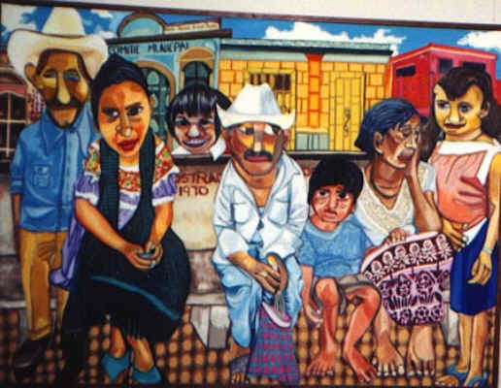
Barriers for Latinos
lack of time (care-giving/work)
importance of family (family’s needs
before women’s own needs)
no experience
racism
health concerns
lack of access and facilities (cost; no transportation)
safety concerns (afraid to walk alone, dogs)

Slide 18
Improving interventions in Latinos: Rooted in the evidence
Suggestions include:
Maintain sense of social support
Culturally relevant
Low cost
Consideration of environmental factors
Need more culturally appropriate interventions
Ickes & Sharma, 2012
Notes:
This review also confirms that we still face challenges when working with the Latino population. Some suggestions for improving future interventions include:
Maintaining sense of social support is needed
Need for longer interventions, >6months
Building on sense of culture
Culturally relevant
Low cost
Consideration of environmental factors
Interventions among Hispanic populations should build on their sense of culture and incorporate means of social support to increase physical activity levels [29]. Sense of commitment, self-efficacy, and a strong sense of group identity and cohesion were all important factors in Hispanic adults participating in the physical activity interventions
-Many interventions conducted had a focus on individual-level variables as primary outcomes, and as a result benefits achieved were lost at follow up, therefore environmental factors need to be considered in order to increase long term benefits.
-Important to realize that one size does not fit all, however having a set of guidelines will help develop develop appropriate interventions that will impact individuals and communities.

Slide 19
Dance as Physical Activity

Slide 20
HOLD UP, wait a minute! WHO IS GOING TO TRUST: -AN OUTSIDER OF THE NEIGHBORHOOD -APPARENT WHITE-LOOKING -NON-DANCER

Slide 21
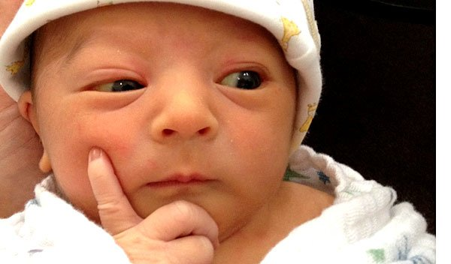
Challenge
Distrust
Older Latinos are skeptical of the research process, especially undocumented: I feel like a guinea pig
Current social climate
Fear of providing information
Need to make it/keep it personal, with cultural humility

Slide 22
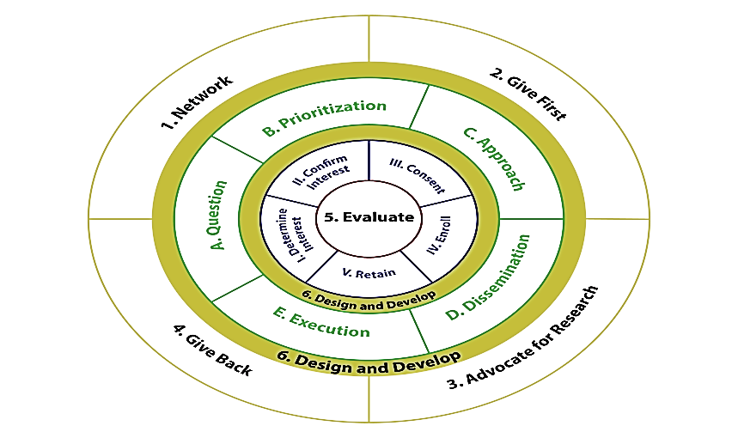
NGAGEDD Model
The NGAGEDD Model – General Premise
The NGAGEDD Model
Network
Give First
Advocate for Research
Give Back
Evaluate
Design
Develop
Outer circle represents community activities, middle circle represents participant input on research, and inner circle represents individual study activities.
Glover, Shah, et al. Under Review
Notes:
1. Network
- Build relationships with local leaders, stakeholders, & organizations
- One-on-one leader meetings & community board meetings
2. Give First
- Information transferal
- Financial support & sponsorship of activities
- Free health fair screenings & encourage memory loss evaluations
3. Advocate for Research
Culturally & linguistically compatible t materials
Presentations on research participation, AD & cognitive health, biospecimen collection, & brain autopsy
Completion of an Interest Form - interest in or potential commitment to research participation (yes, maybe, no)
4. Give Back
Dissemination of research findings
Educational programming focused on prevention, early detection, & early treatment of AD
5. Evaluate
Quantitative methods
Pre- & post-presentation surveys
Retention events where participants voice concerns re: research participation & related activities through focus groups
6. Design and Develop
Qualitative Methods (e.g., semi-structured focus groups)
Design Science Methods (e.g., design innovation sessions)
Taken together, these methodologies represent approaches to actively engage diverse stakeholders
to discuss and strategize for a solution to best meet the expressed needs of diverse communities underrepresented and understudied in aging research
to address specific issues throughout the research process
Goal: Facilitate Center research becoming more engaged and aligned with stakeholders such as participants.
Participant-Centered Research Principles:
A. Have study participant voices heard
B. Enable participants to communicate desired health research outcomes
C. Empower participants to make informed decisions on research participation
D. Participant assessment of the value of health research options
Method Innovation:
A. Introduce complementary qualitative research methodology to the Center
B. Facilitate training of researchers on making research participant-centric

Slide 23
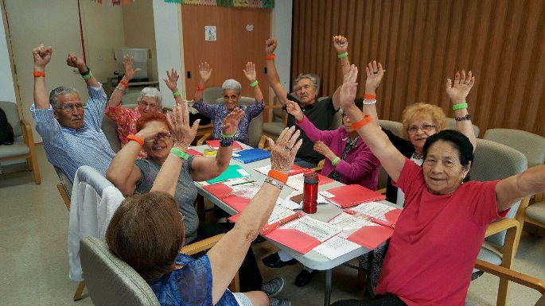
Building up the Dance research: Recognizing my positions of power…. and LACK of knowledge
Dance Instructors’ Perceptions of Dance for Older Latinos. (8/2008)
Perceptions of Dance among Older Latinos.
(5/2009- 8/2009)
BAILAMOSTM Pilot Study. (1/2010- 8/2010)
Marquez, D. X., Bustamante, E. E., Aguiñaga, S., & Hernandez, R. (2015). BAILAMOS©: Development, pilot testing, and future directions of a Latin dance program for older Latinos. Health Education & Behavior, 42(5), 604-610. doi: 10.1177/1090198114543006

Slide 24
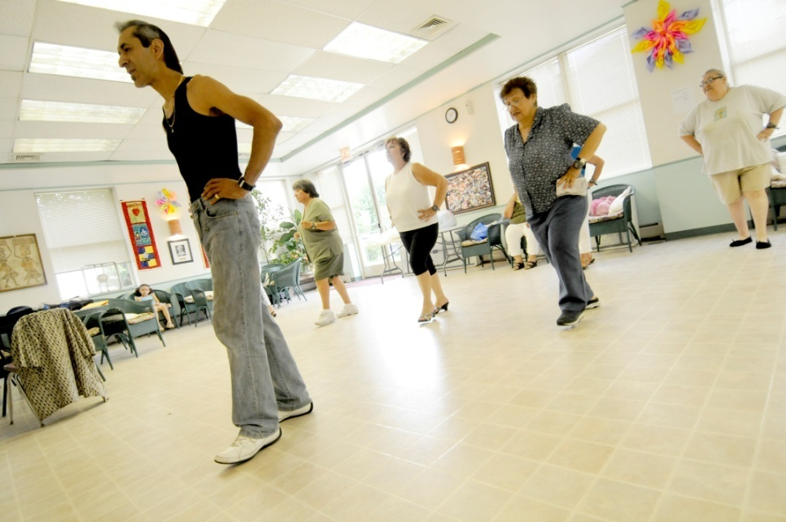
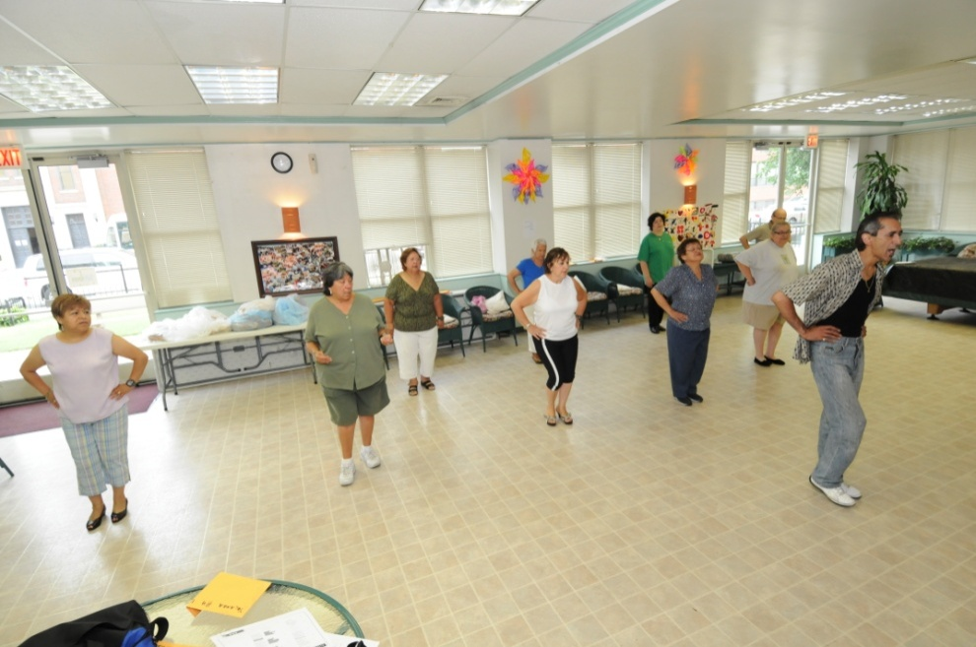
BAILAMOSTM dance program (Balance & Activity In Latinos, Addressing Mobility in Older adultS)
Age-appropriate PA for older Latinos
Challenge physically and cognitively
Enjoyable
Not hard, boring, & tedious
Marquez, D. X., Bustamante, E. E., Aguiñaga, S., & Hernandez, R. (2015). BAILAMOS©: Development, pilot testing, and future directions of a Latin dance program for older Latinos. Health Education & Behavior, 42(5), 604-610. doi: 10.1177/1090198114543006

Slide 25
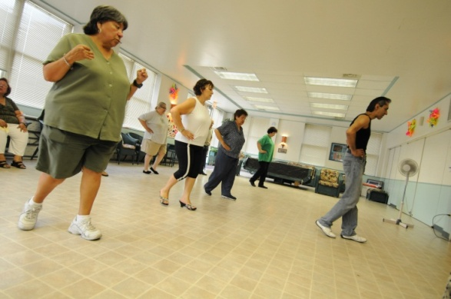
BAILAMOSTM dance program
The BAILAMOSTM dance program
4-month, 2X/week for 1 hour each
Merengue, Cha Cha Cha, Bachata, Salsa
Monthly discussion sessions
Instructed dancing (individual and partner)
Sessions of open dancing
Health education control group
University of Illinois Extension
1 day/week for two hours
Curriculum developed for older adults and in Spanish

Slide 26
Recruitment: A culturally informed, yet culturally humble approach
Presentations at Herencia Latina (Latino Club) at the senior center
Announcements at Spanish masses at Roman Catholic churches
Flyers in weekly bulletins
Stand by exits with flyers and sign-up sheets
Word of mouth
Hospitals/clinics
Flyers in mailboxes of senior housing facilities

Slide 27
BAILA: Being Active, Increasing older Latinos healthy Aging
David X. Marquez, PhD
Department of Kinesiology and Nutrition (UIC)
Michael Berbaum, PhD
Institute for Health Research and Policy (UIC)
David Buchner, MD, MPH
Department of Kinesiology and Community Health (UIUC)
Susan Hughes, PhD
School of Public Health (UIC)
Kyriakos Markides, PhD
University of Texas Medical Branch, Galveston
Edward McAuley, PhD
Department of Kinesiology and Community Health (UIUC)
JoEllen Wilbur, PhD
Rush College of Nursing
Robert Wilson, PhD
Rush Alzheimer’s Disease Center
Marquez, D.X., Wilbur, J., Hughes, S., Berbaum, M.L., Wilson, R., Buchner, D. M., & McAuley, E. (2014). B.A.I.L.A. - A Latin dance randomized controlled trial for older Spanish-speaking Latinos: Rationale, design, and methods. Contemporary Clinical Trials, 38(2), 397-408. doi: 10.1016/j.cct.2014.06.012

Slide 28
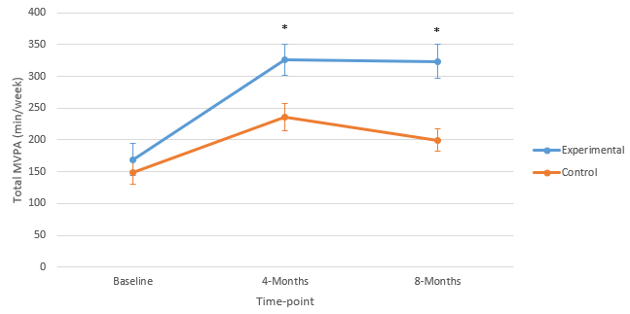
CHAMPS: Increases in MVPA, with a sustainable maintenance program
Marquez, D.X., et al. (2022).
Annals of Behavioral Medicine.
DOI: 10.1093/abm/kaac009
Notes:
The dance condition showed a significant increase in self-reported MVPA relative to control (Cohen’s d = 0.18, p = .04).
Significant differences were sustained through the secondary timepoint (month 8) in self-reported MVPA (d = 0.22, p = .03).

Slide 29
Attendance: Noting our lack of fully knowing the population
Non-scientific factor analysis of reasons people miss classes (in no particular order)
Caregiving
Out of country/state
Work status change
Health issues
Transportation
Lost interest – but don’t say that
Marquez et al., (2020). TBM;10:1566–1572; doi: 10.1093/tbm/ibz127

Slide 30
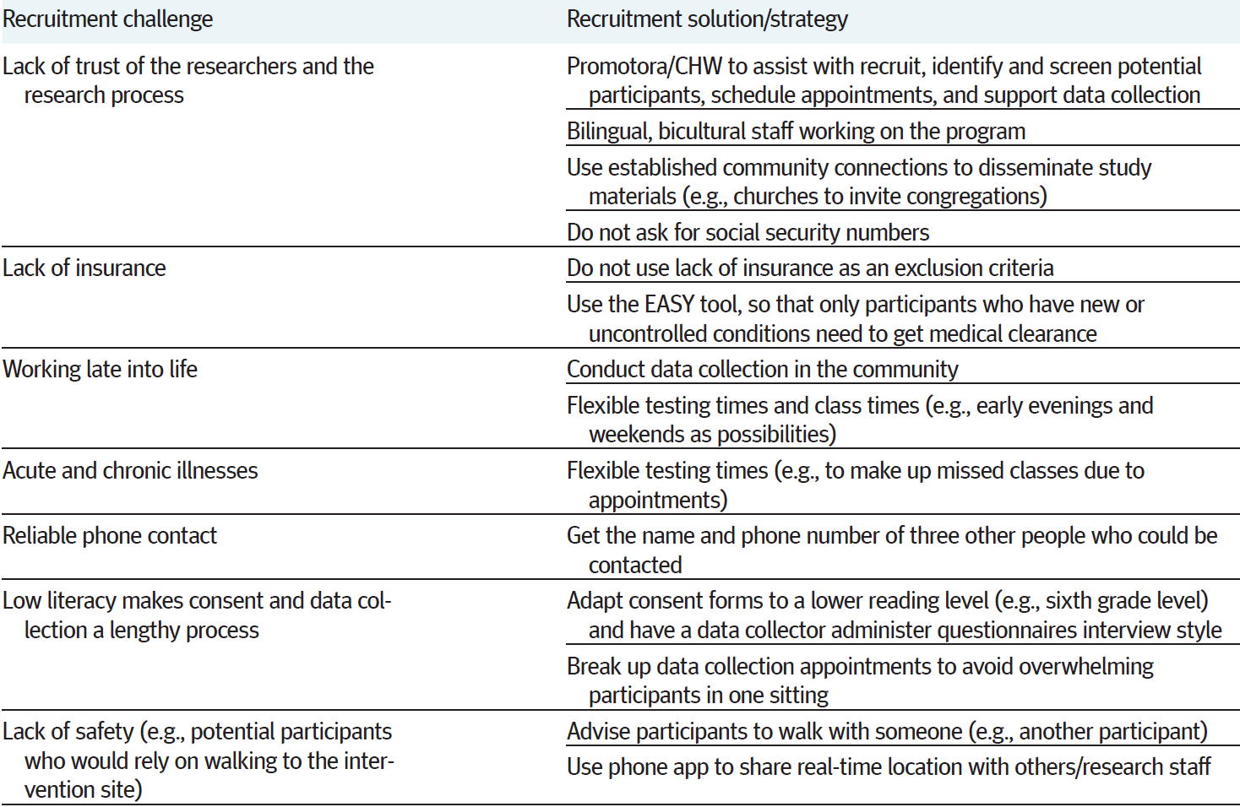
Marquez et al., (2020). TBM;10:1566–1572; doi: 10.1093/tbm/ibz127

Slide 31
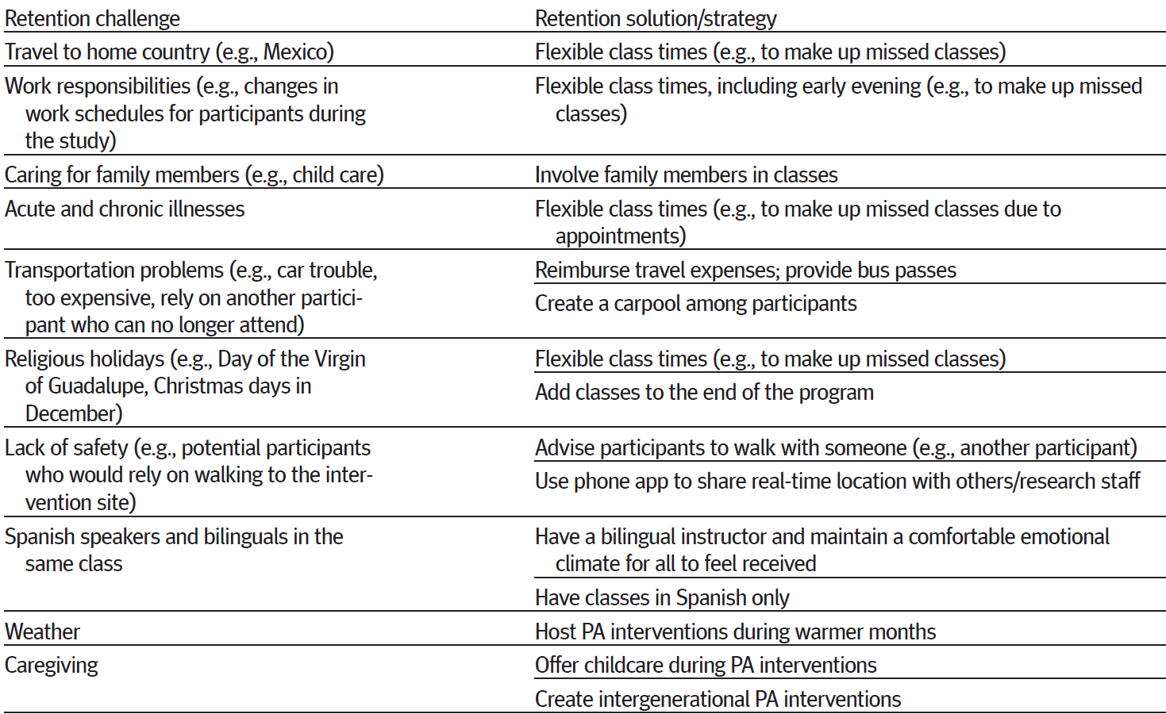
Marquez et al., (2020). TBM;10:1566–1572; doi: 10.1093/tbm/ibz127

Slide 32
Summary
Get to know the population you plan to do interventions with (not on)
Take a culturally humble approach to learning about them
Incorporate what you learn into your intervention
Find ways to extend the programs beyond grant funding

Slide 33
Acknowledgments
Hook, J.N., Davis, D., Owen, J., & DeBlaere, C. (2017). Cultural Humility: Engaging Diverse Identities in Therapy. American Psychological Association. ISBN: 978-1-4338-2777-8
Participants in all studies
Past and present BS, MS, PhD student research assistants
UIC Department of Kinesiology and Nutrition
Rush Alzheimer’s Disease Center
CDC Healthy Aging Research Network (HAN) (http://www.prc-han.org/)
Alzheimer's Association, New Investigator Research Grant to Promote Diversity (Proposal ID: 205469)
Grant Number P30AG022849 from the National Institute on Aging (UIC Roybal Center on Aging)
National Institute of Nursing Research of the NIH under Award Number R01NR013151
National Institute of Aging of NIH under Award Number 3P30AG010161-25S1
Centers for Disease Control and Prevention, USDHHS, Project Number: 10583869

