Slide 1


Slide 2


Slide 3
Whither the Observational Study in Physical Activity and Health Research?
Considerations on Exposures and Outcomes
Bill Kohl
University of Texas Health Science Center at Houston and
The University of Texas at Austin
@billkohl

Slide 4
Assumptions
Observational studies have been the foundation for the field of physical activity and health for 70+ years.
Observational study designs optimal for “lagged outcomes”.
Questions of life course and multiple exposures are only practically studied using observational studies.
Sometimes observational studies are the only tools available.
Causality can be determined with observational studies.

Slide 5
Questions…I have questions
How low can we go?
Life course and 24-hour patterns?
New and improved outcomes?

Slide 6
How Low Can We Go?

Slide 7

Volume, Intensity, and Patterns, Oh My!
2008, 2018 Physical Activity Guidelines for Americans (adults)
At least 150 minutes of physical activity that is of at least moderate intensity (> 3.0 METs) each week (7.5 MET/hrs/week)
Muscle-strengthening activities 2x/week
Move more and sit less

Slide 8
Physical Activity Intensity
1.0
3.0
6.0
METs

Slide 9
Volume, Intensity, and Patterns, Oh My!
Sedentary behavior refers to activities that do not increase energy expenditure substantially above the resting level and includes activities such as sleeping, sitting, lying down, and watching television, and other forms of screen-based entertainment.
Pate et al ESSR 2009

Slide 10
Volume, Intensity, and Patterns, Oh My!
Operationally, sedentary behavior includes activities that involve energy expenditure at the level of 1.0-1.5 metabolic equivalent units (METs).
Light intensity physical activity, which often is grouped with sedentary behavior but is in fact a distinct activity construct, involves energy expenditure at the level of 1.6-2.9 METs.
Includes activities such as slow walking, sitting and writing, cooking food, and washing dishes.
Pate et al ESSR 2009

Slide 11
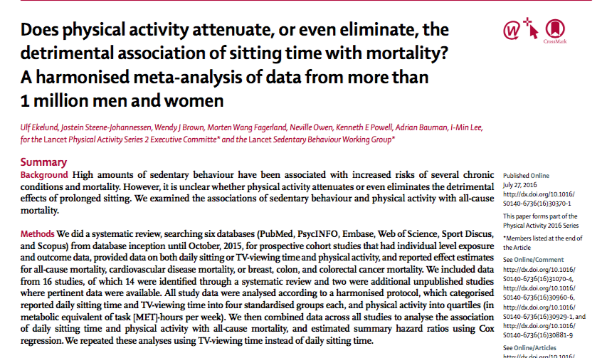

Slide 12
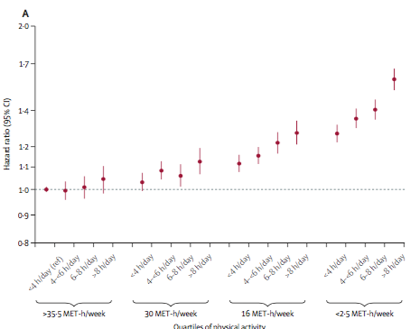

Slide 13
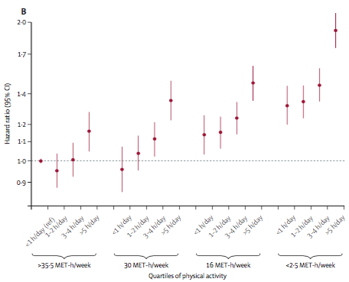

Slide 14
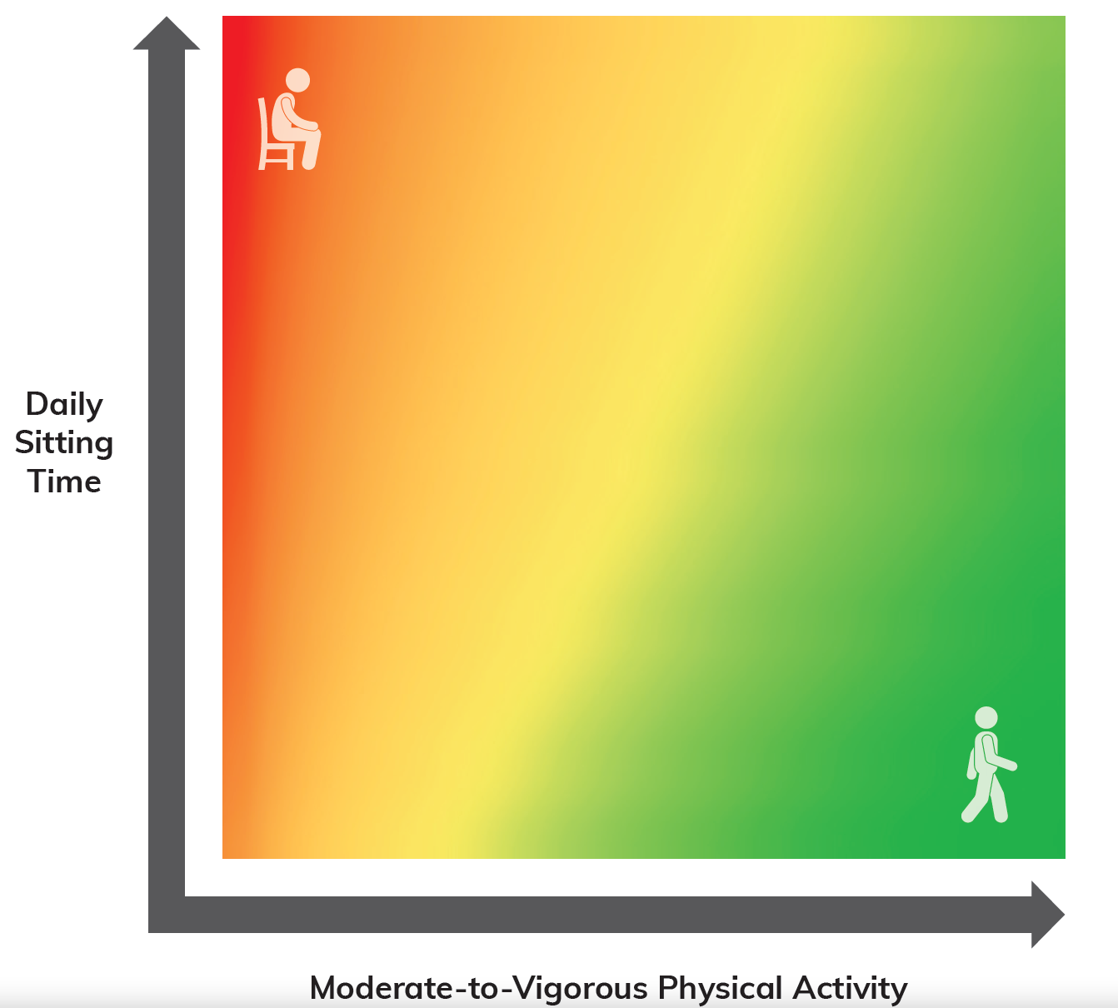

Slide 15


Slide 16
Physical Activity Intensity
1.0
3.0
6.0
METs

Slide 17
24-Hour Patterns of Physical Activity and Health Outcomes
METs
6.0
3.0
1.5
1.0
0
24
Hours

Slide 18
24-Hour Patterns of Physical Activity and Health Outcomes
METs
6.0
3.0
1.5
1.0
0
24
Hours

Slide 19
24-Hour Patterns of Physical Activity and Health Outcomes
METs
6.0
3.0
1.5
1.0
0
24
Hours

Slide 20
Exposures in Observational Studies
Should pivot to take patterns of daily physical activity into account and not use only physical activity and/or sedentary behavior dichotomy as an exposure.
Patterns may not (likely are not) equally weighted in their effects on health outcomes. Treating them as the same is not likely a good move.
Shine a light on the the health implications of light intensity physical activity activity and what can be done to develop “interventions”?

Slide 21
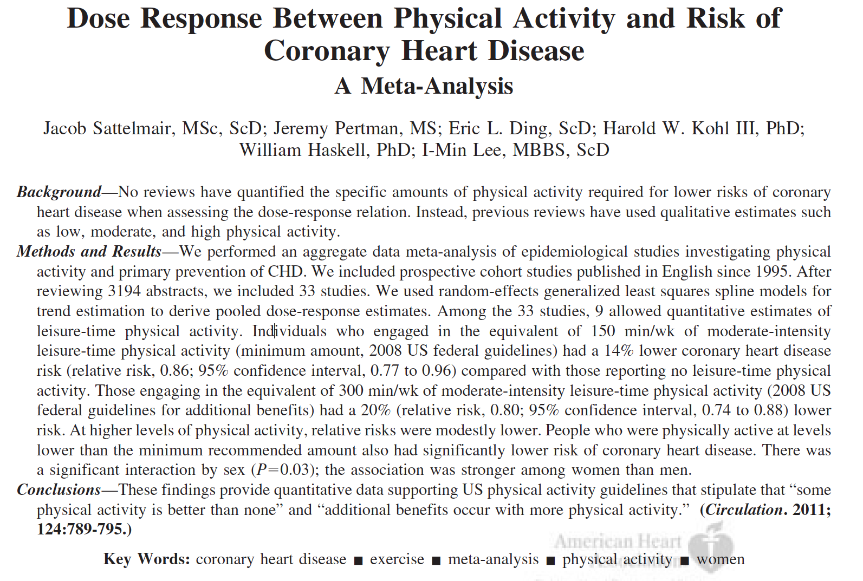


Slide 22
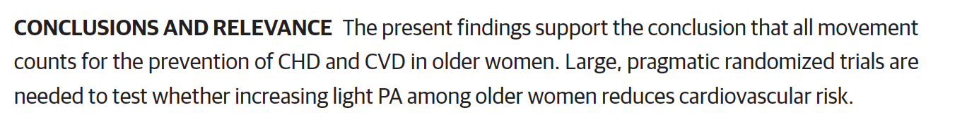

Slide 23
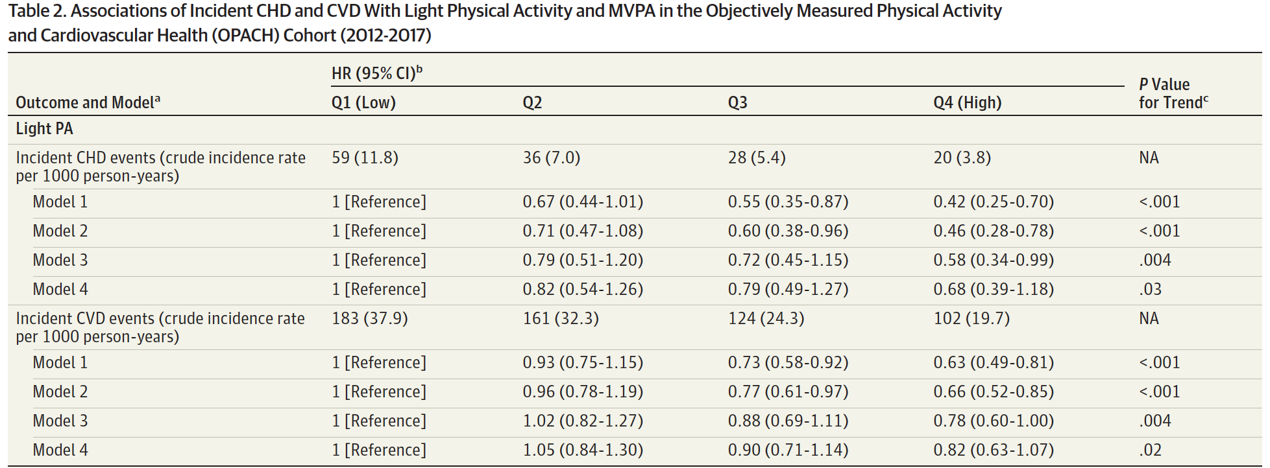

Slide 24
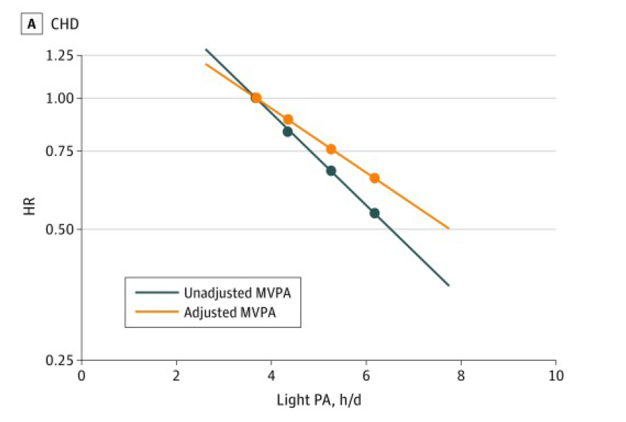

Slide 25
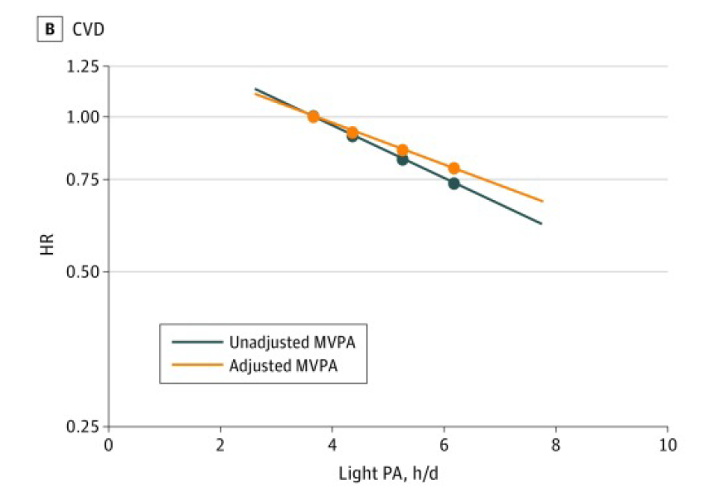

Slide 26
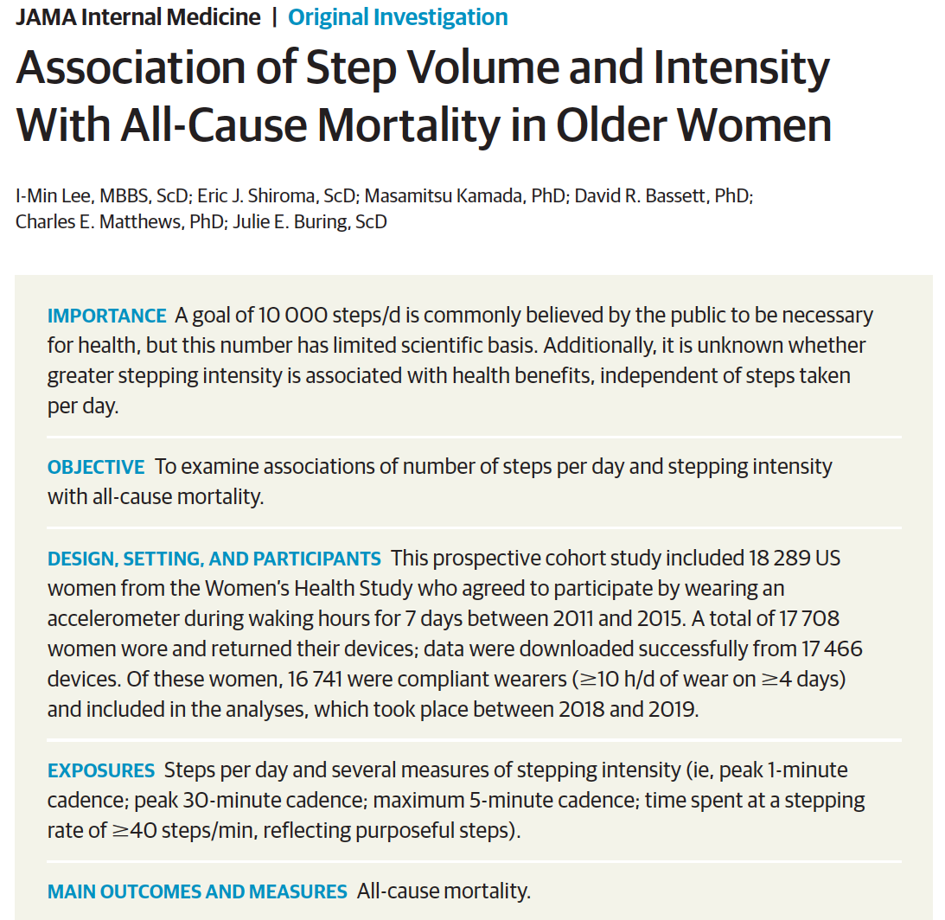

Slide 27
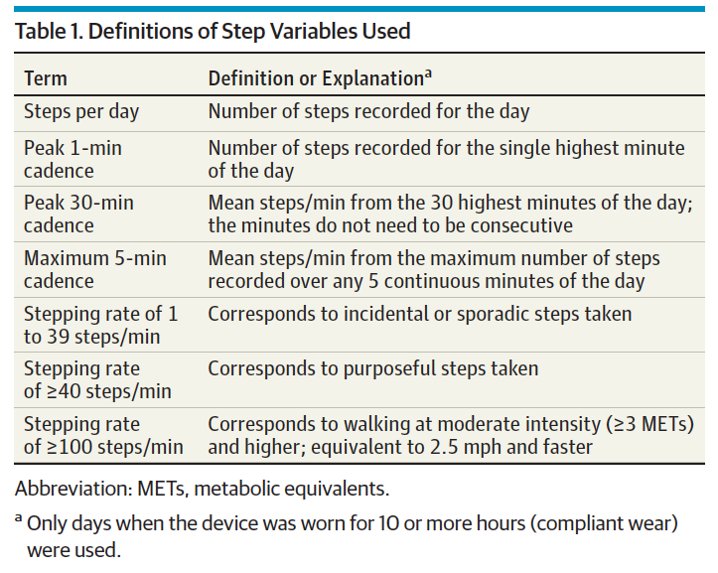


Slide 28
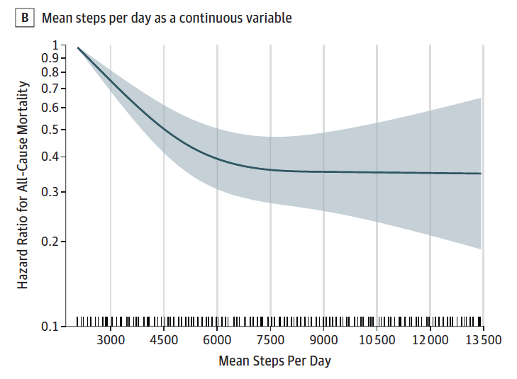

Slide 29
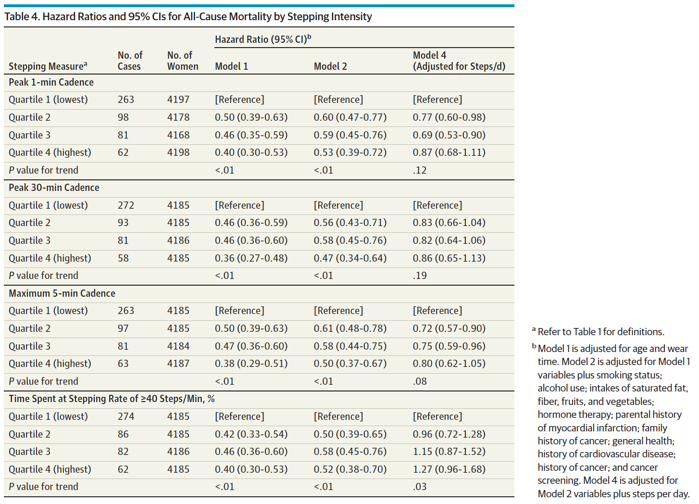

Slide 30


Slide 31
Musings about Life Course
Traditionally, focus for observational studies has been on single point estimate of exposure as it relates to future outcomes – sometimes 20+ years in the future.
Very few change in exposure studies (delta or area under the curve) – even those are a blunt instrument.
Causality / Biologic Plausibility?
Point estimates as a proxy for continuous exposures is no longer acceptable.
Think of how we live – activity cycling, changes with aging, life events, stressors, etc.

Slide 32


Slide 33
New and Improved Outcomes
Historically, observational studies began with coronary artery disease mortality and all-cause mortality as outcomes.
Evolved to CVD incidence and other NCD mortality (cancers) and diabetes mellitus incidence.
Guidelines (>150 minutes per week of at least moderate-intensity physical activity) are based on all-cause mortality as “health”.

Slide 34
Physical Activity and Health
Conceptual Framework
Health Outcomes
Physical Activity Exposure
Cardiovascular/
Respiratory Health (including CHD, PVD, Stroke)
Metabolic Health (including Diabetes Mellitus and Obesity)
Musculoskeletal Health (including Osteoporosis)
Cancers
Functional Health
All-Cause Mortality
Mental Health
Intensity
Frequency
Examples
Examples
Examples
Examples
Examples
Examples
Examples
Dyslipidemias
Blood Pressure
Hemostatic/
Coagulation Factors
Asthma
Fitness
Cardiac Function
Lung Function
Insulin Resistance
Insulin Sensitivity
Glucose uptake
Metabolic Syndrome
Overweight
Constipation
Fitness
Hormonal influences
Sleep quality
Bone mineralization
Flexibility
Strength
Balance
Maturation/
Growth
Fitness
Motor skill development
Muscle fiber
Bowel transit time
Hormonal factors
Immune Function
Linkages with other behaviors.
Quality of life
Functional independence
Balance
Pain
Fall prevention
Cognitive Function
Anxiety
Self-concept
Sleep quality
Cognition
Brain Health
Strength
Balance
Fitness
Previous Injury
Family history
Duration
Pattern
Type
Risk Factors
Caloric Expenditure
Adverse events and Risks of Physical Activity

Slide 35
Health is “a state of complete physical, mental and social well-being and not merely the absence of disease or infirmity.”
World Health Organizaton 1948

Slide 36
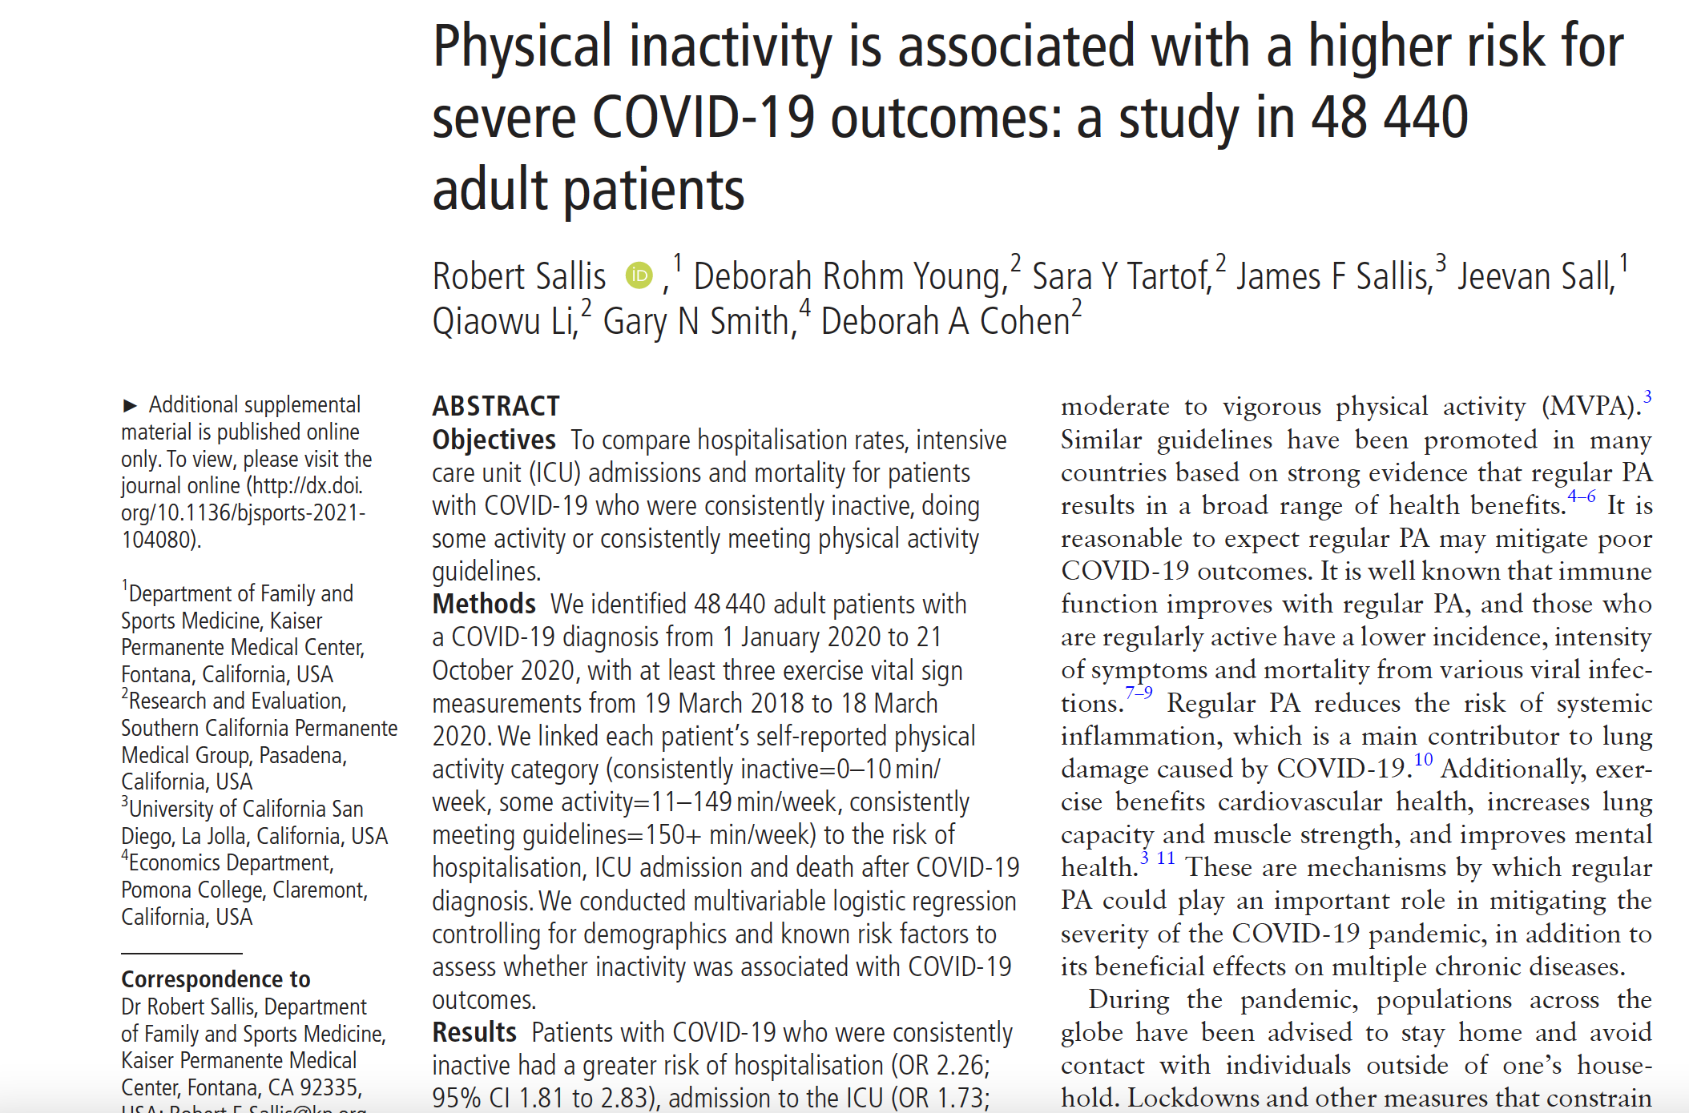
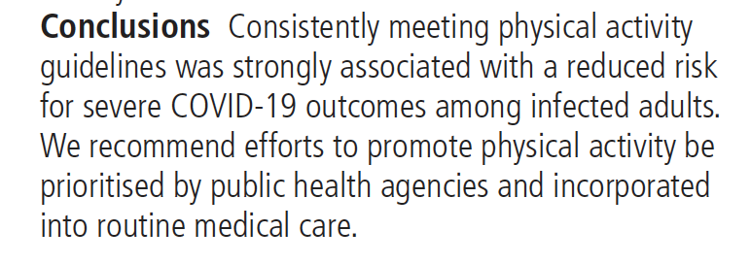

Slide 37


Slide 38
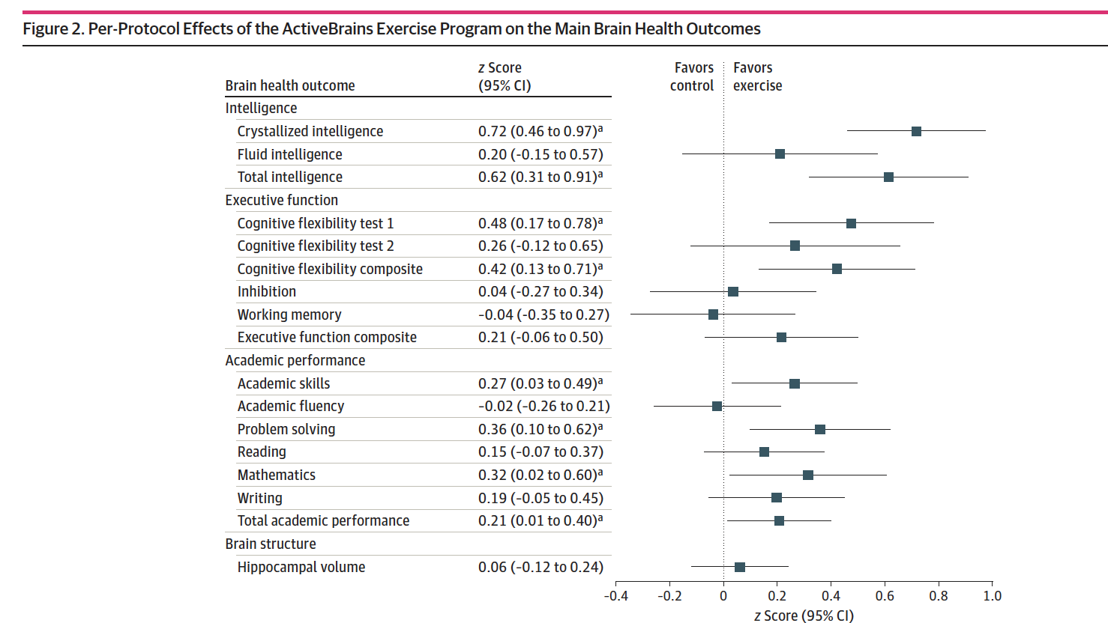

Slide 39
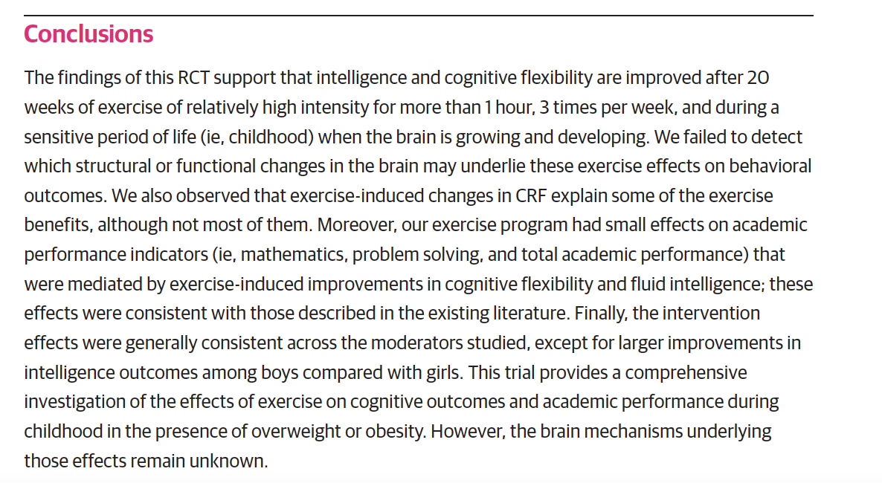

Slide 40
Summary
Observational studies should still be in the top drawer of the Physical Activity Epidemiology toolbox.
Light-intensity physical activity deserves our attention, especially for otherwise sedentary targets.
We must continue to zealously pursue novel ways to assess how people actually live instead of treating physical activity as a binary exposure.
Yuge opportunities for life-course exposures to physical activity in observational designs.
New outcomes are critical as we move into the 8th decade of physical activity and health research.

Slide 41


