Slide 1
Public Health and Physical Activity Research 101
Bill Kohl
University of Texas
School of Public Health and Department of Kinesiology and Health Education
Austin Texas
@billkohl
Columbia PAPH – September 2022

Slide 2


Slide 3
Physical Activity and Health –
Development of a Field
Environment &
Policy
Behavioral Science
Population Studies
Exercise Science
Public Health Science
1900
1953
1990

Slide 4

Physical Inactivity and Health
Osteoporosis
Prevention of Weight Gain
Diabetes Mellitus
Risk of “Disease”
CHD
Stroke
Musculoskeletal Injury
Functional Health Status
Activity

Slide 5
Public Health
The science and practice of protecting and improving the health of a community, as by preventive medicine, health education, control of communicable diseases, application of sanitary measures, and monitoring of environmental hazards.

Slide 6
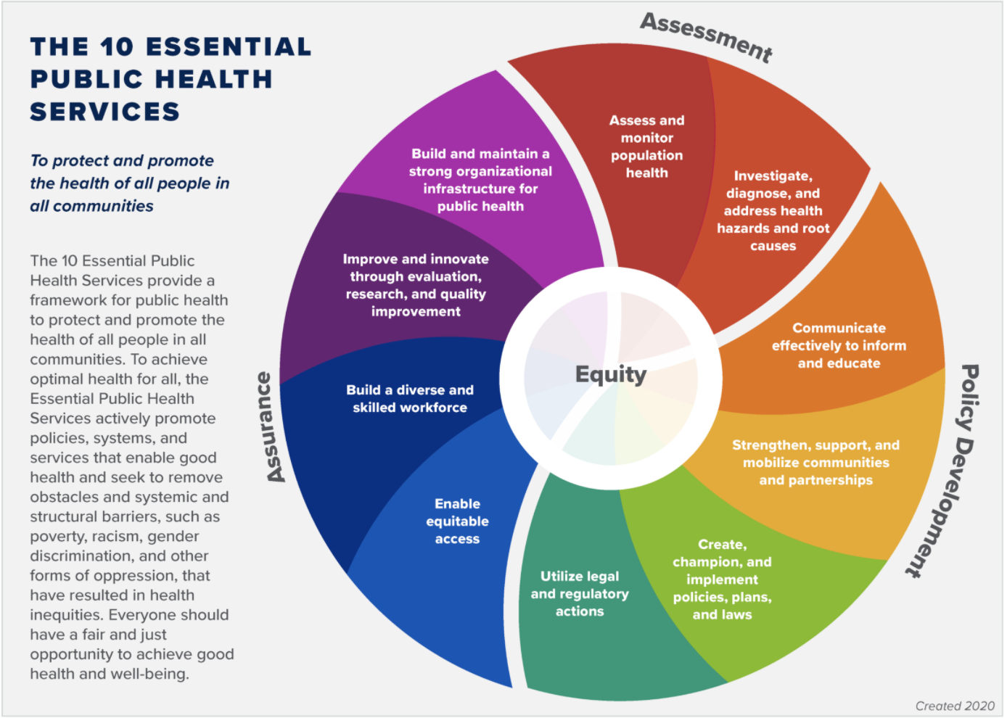
National Public Health Performance Standards Program

Slide 7
Overview of basic public health concepts
Key differences between public health and clinical research
    population versus individual perspective
Examples of public health strategies
    surveillance
    community interventions
Specific applications of physical inactivity as a public health problem.

Slide 8
Public Health versus Clinical Research
Population versus individual perspective
Major emphasis on equity / social justice
Observational studies

Slide 9


Slide 10
What causes the cases?

Slide 11
Individuals

Slide 12
High Risk Approach
Traditional medical model
Targeted intervention
Cost-effective (?)
Patient and physician motivation

Slide 13
High Risk Approach
Treats symptoms, not causes
Depends on definition of “high risk”
Difficulty identifying targets

Slide 14
What causes the incidence?

Slide 15
Populations

Slide 16
Population Approach
Identifies the underlying causes
Can alter the entire population
Interventions can change the social norm

Slide 17
Population Approach
Individuals find little (and few) benefit(s)
Disease-oriented mind-set not conducive to prevention either by patients or physicians
Low yield

Slide 18


Slide 19
Causality
Strength of Association
Consistency of Association
Specificity
Temporality
Dose – Response
Biological Plausibility

Slide 20
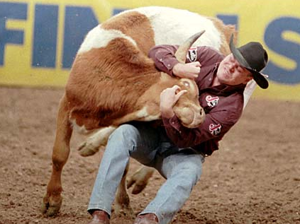

Slide 21
Public Health Strategies
Science base
Surveillance
Intervention research
  Efficacy
  Effectiveness
  Cost effectiveness

Slide 22


Public Health Strategies
Guidelines
Communications
Partnerships

Slide 23
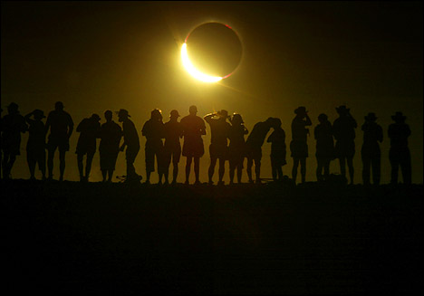

Slide 24
The Uses of Public Health Chronic Disease and Behavioral Surveillance Systems
Quantify magnitude of health problem
Describe natural history of disease
Detect “outbreaks”
Document Person, Place and Time
Test hypotheses
Evaluate intervention measures (control/prevention)
Detection of changes in health practices
Policy and planning
Adapted from Thacker, 1994

Slide 25
Information Flow in Surveillance
Case Definition
e.g., meeting Guidelines
System Modification
Reporting Sources
e.g., BRFSS
Feedback
Data Analysis
e.g., Prevalence
& trends
Program Implementation
Dissemination
& Evaluation
e.g., Reports
Policy
e.g., HP 2030 Objectives

Slide 26
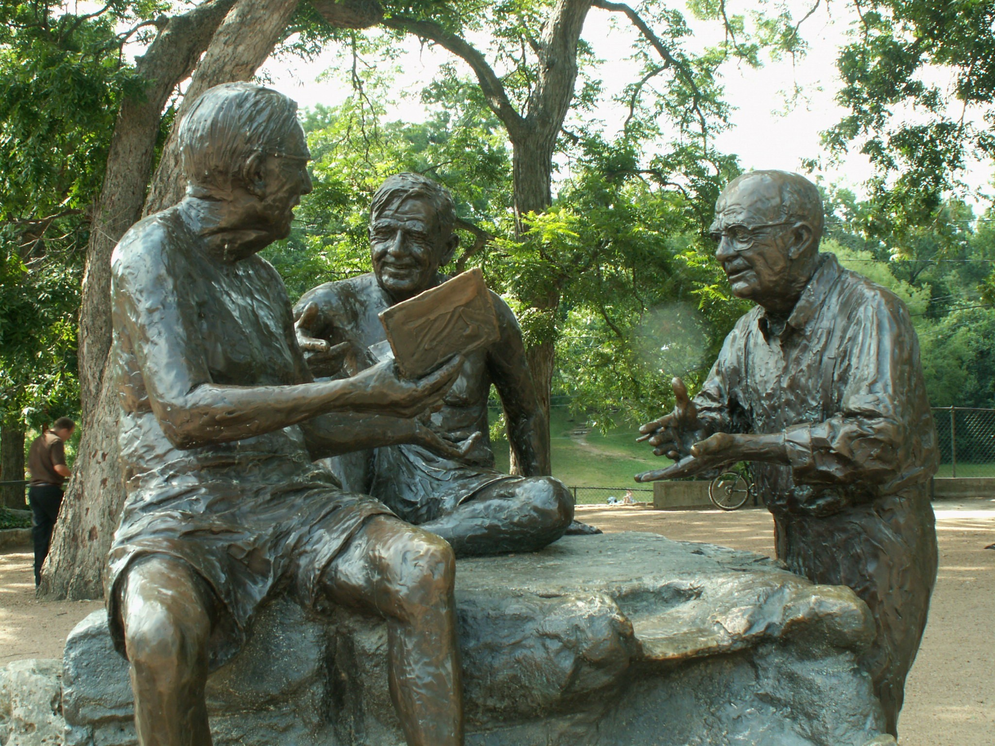

Slide 27
Public Health vs Population Health?
Public Health: What we as a society collectively do to ensure the conditions in which people can be healthy (IOM 1988).
Population Health: The health outcome of a group of individuals including the distribution and determinants of such outcomes within the group (after Kindig and Stoddard 2003).
Community Health: Hybrid that is geographically organized and emphasizes health equity and socioeconomic disparities

Slide 28

http://www.thelancet.com/series/physical-activity

Slide 29
A Public Health Problem
Importance
Prevalence and trends
Solutions

Slide 30
Population attributable fraction for major NCDs associated with physical inactivity
Lee et al Lancet 2012

Slide 31
Importance
Between 6-10% of deaths due to the world’s major NCDs is attributable to inactivity
By eliminating inactivity, >5.3 M deaths/y may be prevented
This leads to an increase of 0.68 years in the world’s life expectancy

Slide 32
A Public Health Problem
Importance
Prevalence and trends
Solutions

Slide 33

Pandemic?
“…an epidemic occurring worldwide, or over a very wide area, crossing international boundaries, and usually affecting a large number of people…”
“…the occurrence in a community or region of cases of an illness, specific health related behavior, or other health related events clearly in excess of normal expectancy…”
Last – Dictionary of Epidemiology, 4th edition

Slide 34
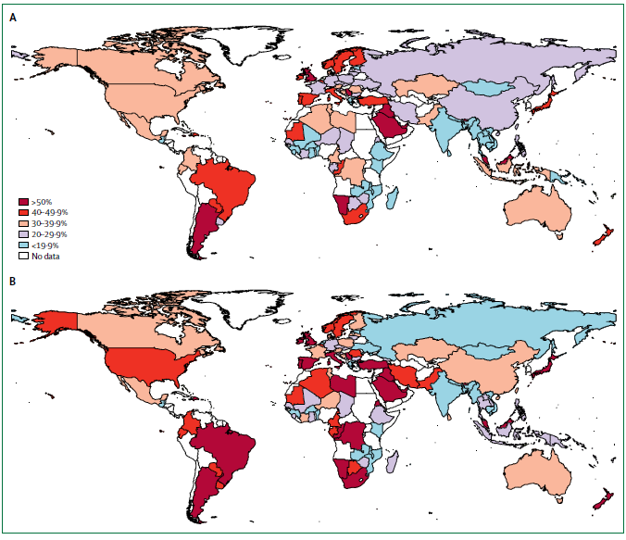
Men
Women
Adults
15+ years

Slide 35
Men
31.1%
Women
Adults
15+ years

Slide 36
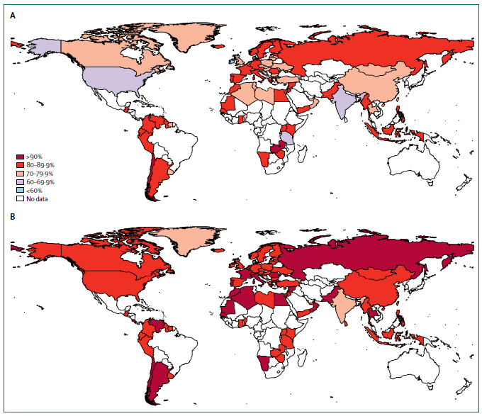
Boys
Girls
Adolescents
13-15 years

Slide 37
Boys
80.3%
Girls
Adolescents
13-15 years

Slide 38
A Public Health Problem
Importance
Prevalence and trends
Solutions

Slide 39
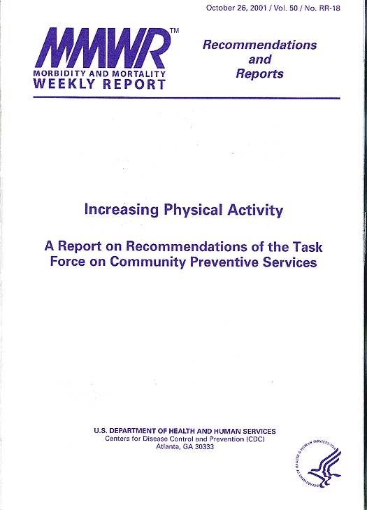
Effective Interventions to Promote
Physical Activity
Informational
  Community-wide education
  Point of decision prompts
Behavioral and social
  School-based PE
  Non-family social support
  Individually adapted behavior change
Environmental and policy
  Enhanced access with outreach

Slide 40
Effective Interventions to Promote
Physical Activity
Informational
  Community-wide education
  Point of decision prompts
Behavioral and social
  School-based PE
  Non-family social support
  Individually adapted behavior change
Environmental and policy
  Enhanced access with outreach

Slide 41
An Urgent Public Health Problem
  Prevalence and Trends
    Not meeting PA recommendations: 31%
    Prevalence: 17%
    Leisure-time PA: Increased
    Incidental, Occupational, and Transportation PA: Decreased
    Economic Shift: Low-income populations have increased NCD’s
    Urbanization: reduced occupational time PA and increased TV viewing
  Magnitude and Risk
    6-9% of all NCD deaths are attributed to inactivity
    5-5.3 million deaths/year attributed to inactivity
  Prevention and Control
    Eﬀective methods across age, social groups, countries
    Potential of Global Information and Technologies on PA
  Global Consequences
    Health
    Healthcare (Economic)
      $28-334pp: Indirect Costs
      $155-419pp: Direct Costs
    Reduced Quality of Life
  Public Health Action Priority

Slide 42
The whole concept of public health is founded on the insight that health and illness have causes or conditions that
go beyond the biology and behavior of the individual human being.
Midgley G. Systemic intervention for public health. Am J Public Health. 2006;96:466–472.

Slide 43
Behavioral Approaches to Health Behavior Change for Physical Inactivity
Behavior change theory
Behavioral Intervention
Physical Inactivity
Behavior change

Slide 44
Behavioral and Environmental Approaches to Health Behavior Change for Physical Inactivity
Behavior change theory
Behavioral Intervention
Physical Inactivity
Behavior change
Policy or Environmental change
Environmental Intervention

Slide 45
Toward a Systems Approach for Physical Inactivity
Physical Inactivity
Behavior change
Adaptation
Education
Feedback
Sport and Recreation
Competing
Actions
Behavior change theory
Health
Inhibitors
Unintended
Consequences
Workplace
Delay
Planning
Accelerants
Environment/Policy Change
Transportation
Built Environment
Strategies/Implementation
Kohl et al Lancet 2012

Slide 46
Physical Activity and Public Health Issues
How much is enough?
  Dose response issues
Measurement
Determinants
  Individual
  Community / environmental
Special populations
Disparities

Slide 47
Physical Activity and Public Health Issues
Intervention research
  Schools
  Work sites
  Health care
  Mass media
  Community
  Environment
  Policy

Slide 48
Physical Activity and Public Health Issues
Systems science approaches
Building public health programs
  Advocacy
  Mix of strategies
  Policy research/effectiveness

Slide 49


