Slide 1

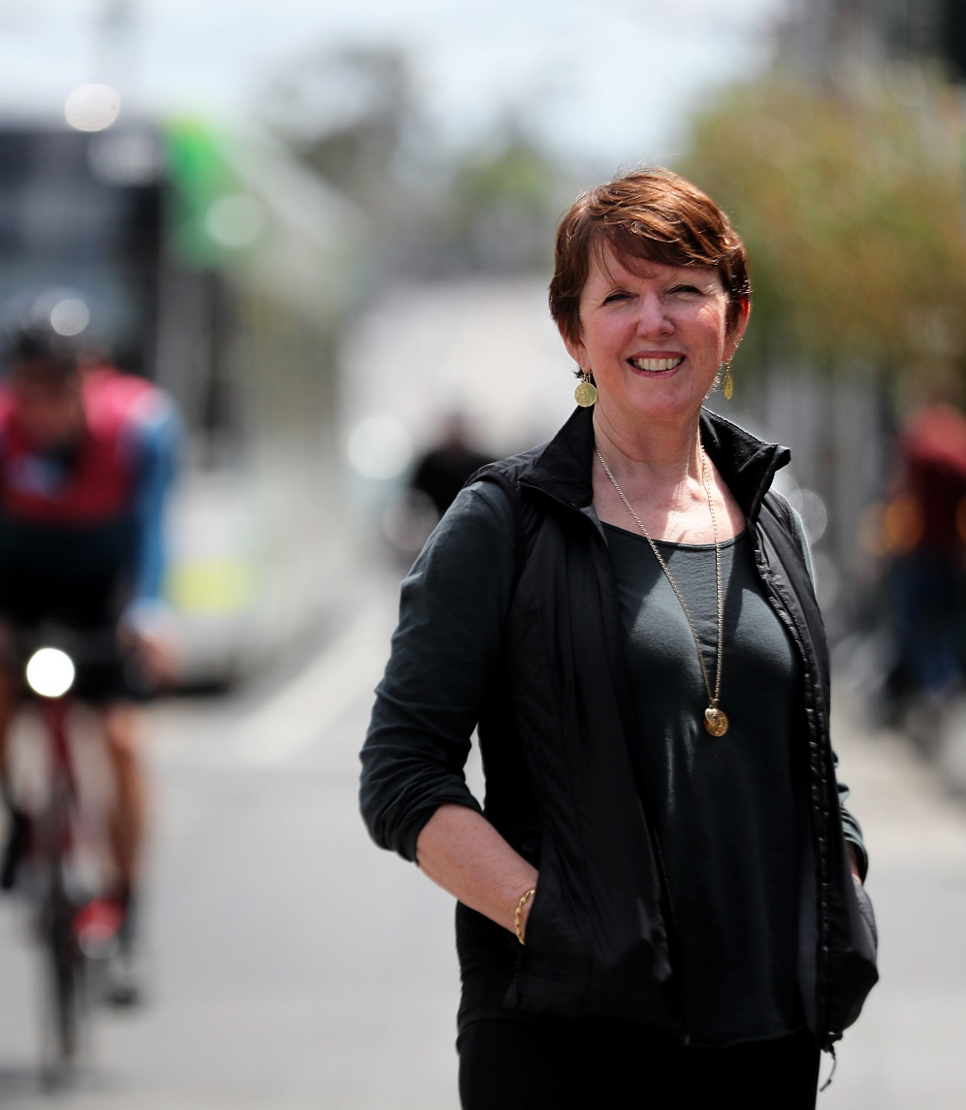
Billie Giles-Corti
The Lancet Global Health Series on urban design, transport, and health
Published May 2022
Series Leader
Distinguished Professor and Vice Chancellor’s Professorial Fellow,
Health Liveable Cities Lab, Centre for Urban Research, RMIT University
Notes:
Thank you Zoe.
Before commencing I would like to acknowledge the traditional owners of the unceded land we are meeting in Melbourne; and their elders past, present and emerging.
On behalf of the Global Healthy and Sustainable City-Indicators Collaboration, may I echo Zoe’s warm welcome to the launch of the second series on Urban Design Transport and Health and offer our sincere thanks to Zoe and The Lancet Global Health team, for their support in getting the series published and launched.

Slide 2
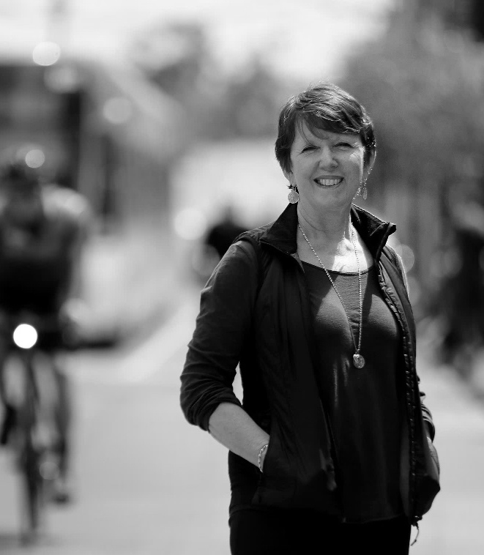
Creating healthy and sustainable cities: What gets measured gets done
Co-authors
Billie Giles-Corti, Anne Vernez Moudon, Melanie Lowe, Deepti Adlakha, Ester Cerin, Geoff Boeing, Carl Higgs, Jonathan Arundel, Shiqin Liu, Erica Hinckson, Deborah Salvo, Marc A. Adams, Hannah Badland, Alex A. Florindo, Klaus Gebel, Ruth F. Hunter, Josef Mitáš, Adewale L. Oyeyemi, Anna Puig-Ribera, Ana Queralt, Maria Paula Santos, Jasper Schipperijn, Mark Stevenson, Delfien Van Dyck, Guillem Vich, James F. Sallis
Notes:
The introductory commentary in Series two reflects on the first series published in 2016 when we proposed a set of city planning indicators of policies and interventions that could be used to benchmark and monitor progress towards creating cities that would enhance health and reduce non-communicable disease.
Our central argument in Series one was that ‘What gets measured, gets done’. T
The co-authors for this paper responded to an international call in 2018, to work on a series of paper that would provide a proof of concept that this was possible and thank you to all those who contributors and the very many funders that made this Series possible.

Slide 3
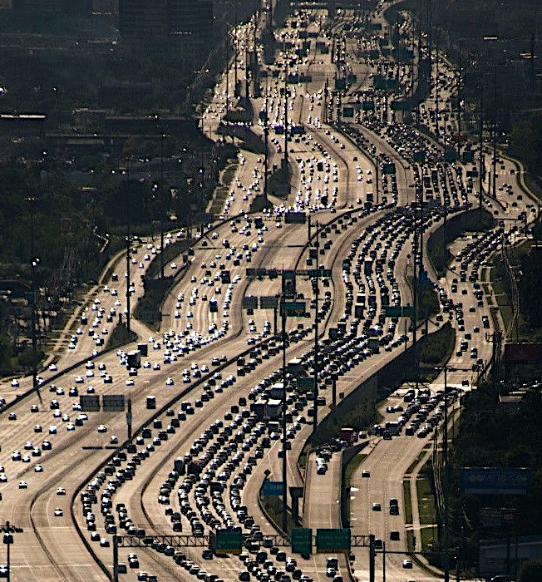
Urgency to transition to healthy and sustainable cities
Powerhouse of economy
By 2050, 70% of world’s population will live in cities
Yet when poorly planned
  Foster unhealthy and unsustainable lifestyles
  Expose residents to environmental stressors
  Cause biodiversity loss
  Widen inequities
Generate 75% global energy-related emissions
86% global CO₂ emissions from higher income countries
Notes:
However, since the first series was published the urgency to transition to healthy and sustainable cities has become palpable.
Cities are the powerhouse of economy, providing access to employment, education, amenities and opportunities. Indeed, since 2008 more than one half of the world’s population live in, and this is tipped to rise to 70% by 2050.
But when cities are poorly planned
They foster both unhealthy and unsustainable lifestyles, particularly when designed to be car-centric as shown in the image on the right
They expose residents to environmental stressors, including traffic, noise, air pollution and heat island effects
They are a major cause biodiversity loss
And they widen inequities
Cities already generate 75% global energy-related emissions (24% due to road transport), which will rise as cities grow
Yet from an equity perspective, it is important to note that 86% global CO₂ emissions from higher income countries, while it is lower income countries and lower income areas are most affected by climate change lacking infrastructure and resources to respond

Slide 4
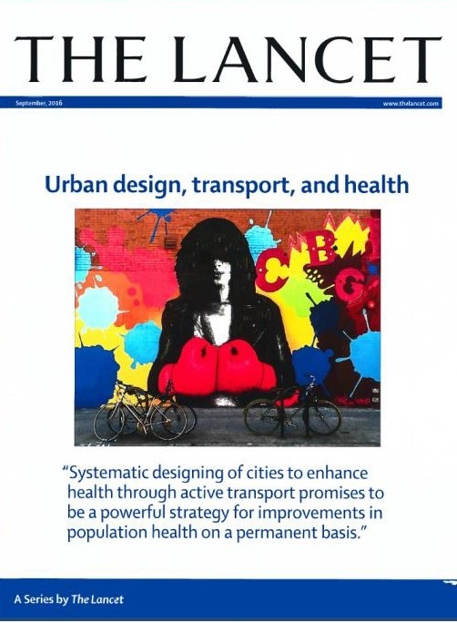
Urban system
policies
Urban & transport planning & design interventions
Transport mode &
daily living outcomes
Risk
exposures
Intermediary
outcomes
Injury &
disease outcomes
Transport mode outcomes
Transport
Private motor vehicle
Social &
health services
Public transport
Traffic
Traffic incidents
Road trauma
Regional Planning
Cycling
Education
Destination accessibility
Greenhouse
gas & particulate
matter emissions, climate change
Respiratory disease
Walking / Cycling
Air pollution
Health, wellbeing, liveability & sustainability
Employment
& economic development
Distribution of employment
Heat stress
Demand
Infectious disease
Land use
& urban design
Demand management
Attitudes & preferences
Noise
Local urban design
Social & cultural norms
Mental illness
Housing
Social isolation
Design
Mobility needs
Public open space
& recreation
Density
Daily living outcomes
Personal safety
Public safety
Distance to transit
Employment & education access
Food & health
service access
Physical inactivity
Diversity
Obesity & overweight, cardio-metabolic
risk factors
Major chronic
diseases: CVD, T2 diabetes, cancer
Social &
recreational access
Prolonged sitting
Desirability
Unhealthy diet
Notes:
In the first series on Urban Design Transport and Health, (Click) we proposed a conceptual framework for the direct and indirect pathways through which city planning decisions influence health.

Slide 5
Urban system
policies
Urban & transport planning & design interventions
Transport mode &
daily living outcomes
Risk
exposures
Intermediary
outcomes
Injury &
disease outcomes
Transport mode outcomes
Transport
8Ds
Private motor vehicle
Social &
health services
Public transport
Traffic
Traffic incidents
Road trauma
Regional Planning
Cycling
Education
Destination accessibility
Greenhouse
gas & particulate
matter emissions, climate change
Respiratory disease
Walking / Cycling
Air pollution
Health, wellbeing, liveability & sustainability
Employment
& economic development
Distribution of employment
Heat stress
Demand
Infectious disease
Land use
& urban design
Demand management
Attitudes & preferences
Noise
Local urban design
Social & cultural norms
Mental illness
Housing
Social isolation
Design
Mobility needs
Public open space
& recreation
Density
Daily living outcomes
Personal safety
Public safety
Distance to transit
Employment & education access
Food & health
service access
Physical inactivity
Diversity
Obesity & overweight, cardio-metabolic
risk factors
Major chronic
diseases: CVD, T2 diabetes, cancer
Social &
recreational access
Prolonged sitting
Desirability
Unhealthy diet
Notes:
I that (click) created eight urban and transport and design interventions: the 8Ds – 3 focused on regional planning destination accessibility, distribution of employment, demand management; and 5 focussed on local urban design: Design, density, distance to transit, diversity and desirability.

Slide 6
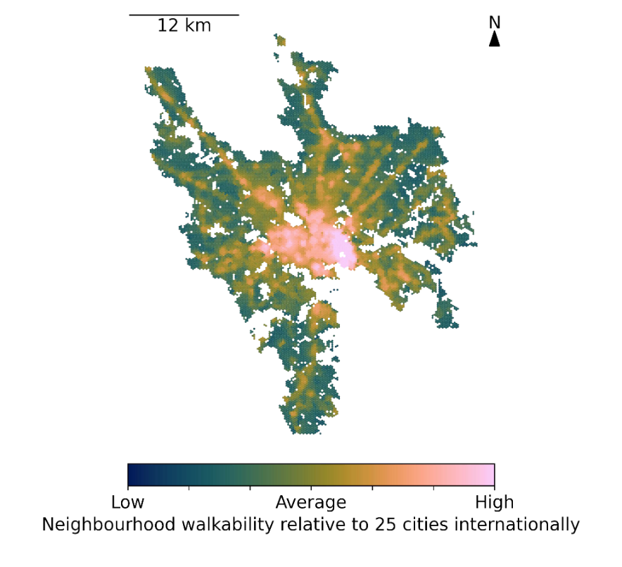
What gets measured, gets done
POLICY INDICATORS
REGIONAL URBAN & TRANSPORT INTERVENTIONS
Destination accessibility
Distribution of employment
LOCAL URBAN DESIGN INTERVENTIONS
Design
AIR POLLUTION
INTEGRATED TRANSPORT AND URBAN PLANNING
Demand management
Density
Distance to public transport
Diversity
Desirability
GOVERNMENT INVESTMENT INDICATORS
Transport infrastructure investment by mode
SPATIAL INDICATORS
LOCAL URBAN DESIGN INTERVENTIONS
Design (street connectivity)
Density
Distance to public transport
Distance to public open or green space, destinations
ADDITIONAL INDICATORS
Walkability
Distance to public open space
Notes:
;As well as spatial indicators measuring urban and transport planning and design features on the ground which reflected the lived experience of city dwellers and would enable us to identify inequities in cities.

Slide 7
Goal second Series? To facilitate development of a global system of policy and spatial indicators
Questions addressed by the second series
Is it feasible to measure policies in cities worldwide?
If so, do cities have policies to deliver healthy and sustainable cities?
Are there thresholds for urban design and transport features to achieve active and sustainable lifestyles?
Is it feasible to consistently measure spatial indicators of urban design and transport features worldwide?
If so, are there inequities in access?
What next to create healthy and sustainable cities?
Notes:
The goal of the second series was to undertake a proof of concept that would facilitate the development of a global system of policy and spatial indicators for healthy and sustainable cities; and to do that we asked a series of questions?
Is it feasible to measure policies in cities worldwide? If so, do cities have policies that will create healthy and sustainable cities?
Are there thresholds for urban design and transport features to achieve active and sustainable lifestyles?
Is it feasible to consistently measure spatial indicators of urban design and transport features worldwide?
If so, are there inequities in access to supportive environments
What next to create healthy and sustainable cities?

Slide 8
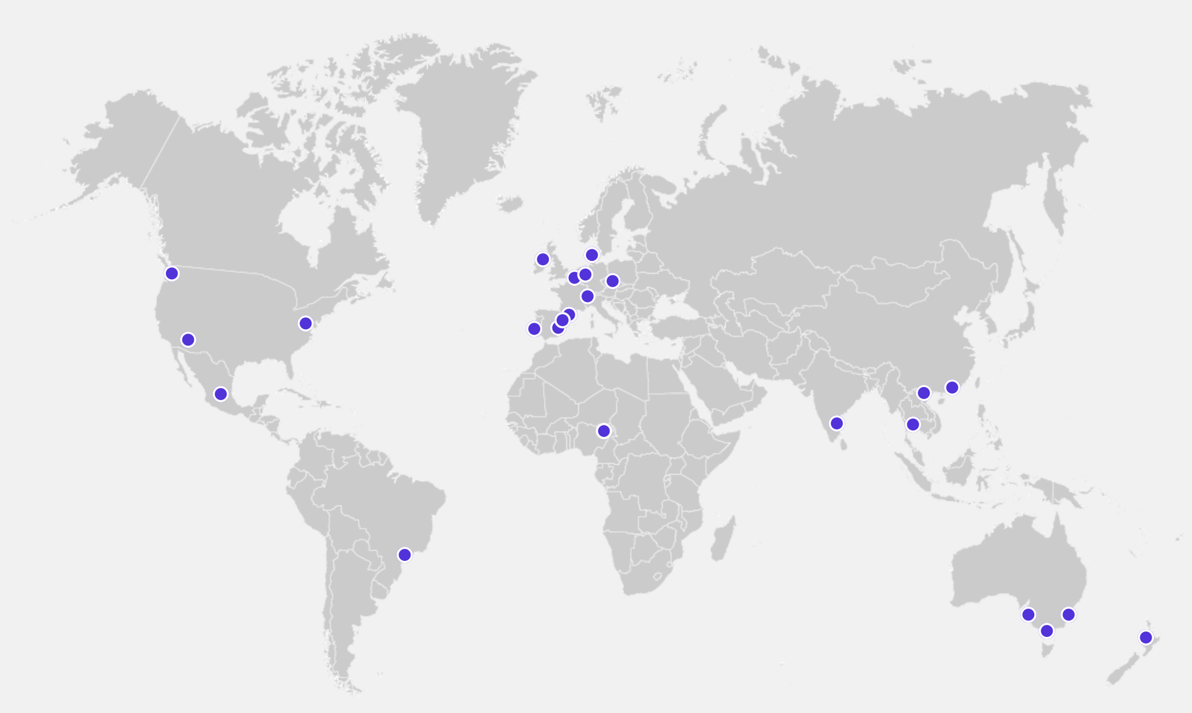
Global Healthy and Sustainable City-Indicators Collaboration
Over 80 collaborators, 25 cities, 19 countries, 6 continents
Notes:
In order to create the proof of concept that it is possible to benchmark and monitor cities, we established the Global Healthy and Sustainable Cities-Indicator Collaboration involving over 80 collaborators in 25 cities, 19 countries and 6 continents.

Slide 9

City planning policies to support health and sustainability: an international comparison of policy indicators for 25 cities
Co-authors
Melanie Lowe, Deepti Adlakha, James F Sallis, Deborah Salvo, Ester Cerin, Anne Vernez Moudon, Carl Higgs, Erica Hinckson, Jonathan Arundel, Geoff Boeing, Shiqin Liu, Perla Mansour, Klaus Gebel, Anna Puig-Ribera, Pinki Bhasin Mishra, Tamara Bozovic, Jacob Carson, Jan Dygrýn, Alex A Florindo, Thanh Phuong Ho, Hannah Hook, Ruth F Hunter, Poh-Chin Lai, Javier Molina-García, Kornsupha Nitvimol, Adewale L Oyeyemi, Carolina D G Ramos, Eugen Resendiz, Jens Troelsen, Frank Witlox, Billie Giles-Corti
Notes:
- Thanks Billie. I will be providing an overview of the first paper in the Series, entitled ‘City planning policies to support health and sustainability: an international comparison of policy indicators for 25 cities’
- I want to acknowledge all of the co-authors of this paper, who made this international policy study possible.
- I especially want to thank and acknowledge Deepti Adlakha who co-led the study.

Slide 10

City planning policies are ‘upstream’ determinants of health and sustainability
Need comprehensive policy assessment
Best-practice policy:
  Consistent with evidence on planning healthy cities
  Clear and specific actions
  Measurable and budgeted policy targets
Notes:
- As Billie had discussed, city planning policies have the power to shape urban lifestyles and environmental exposures, and are therefore crucial for health and attainment of the UN SDGs.
- Existing indicator frameworks, including the SDG indicators tend to focus on downstream outcomes, rather than assessing the quality of policies upstream
-To enable international comparisons between cities and guide city planning, we need to comprehensively and consistently assess city-level planning policies through a health lens.
- To promote health, policies should be aligned with evidence on health-enhancing city planning. They also need to have clear and specific actions, linked to measurable and budgeted policy targets that can be monitored over time.

Slide 11

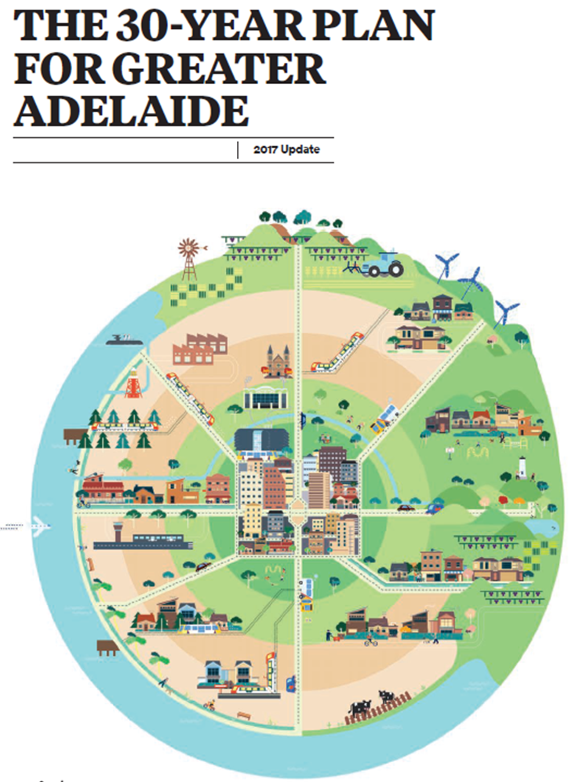

We assessed city planning policy frameworks for 25 cities across 19 countries
Do policies support creation of healthy and sustainable cities?
Local researchers and policymaker collaborators collected policy data
Indicators assessed and compared the availability and quality of policies
Notes:
So this study involved assessing city planning policies for the 25 cities: 19 cities in HICs, and 6 in MICs
We asked the fundamental question: do policy frameworks support creation of healthy and sustainable cities?
We focused on analysing policies for the whole city or majority of the metropolitan area, and included formal, publicly available government policy documents (2019).
A leadership group recruited built environment and health scholars to participate, via the International Physical Activity and Environment Network and conference presentations.
The local collaborators collected policy data, which we then used to assess and compare the availability and quality of policies across the included cities.

Slide 12

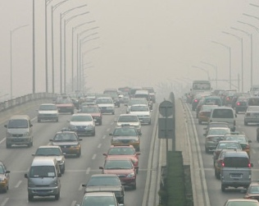


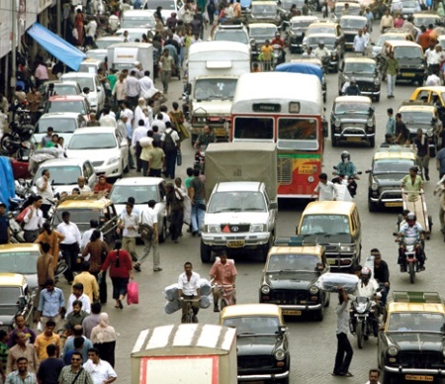
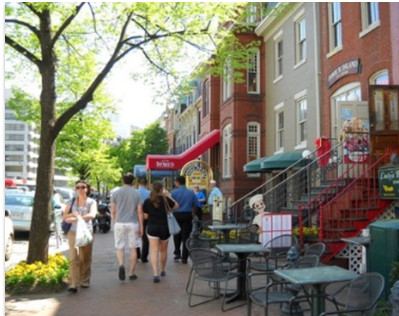

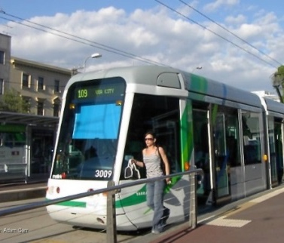
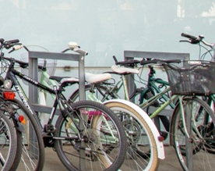
Nine city planning policy indicators from 2016 Lancet Series
Integrated planning
Air pollution
Destination accessibility
Distribution of employment
Demand management
Transport
Design
Density
Distance to Public Transport
Transport Infrastructure
Investment
Notes:
For our policy analysis, we developed measures for 9 indicators proposed in the 2016 Lancet Series
These indicators assessed policies related to: Integrated transport and land use planning; air pollution controls in land use and transport systems; destination access via public transport; distribution of employment; demand management particularly car parking restrictions; design, including street connectivity, public open space access, and pedestrian and cycling infrastructure provision and mode share; housing density to support walkability; distance to public transport; and transport infrastructure investment by mode.
This was a proof of concept study, to see whether indicators could be used to comprehensively and consistently assess and compare city planning policies for diverse cities internationally.

Slide 13
Comparison of cities:
Policy frameworks varied substantially
City | Overall score for policy presence (/24) | Overall score for policy quality¹ (/57)
Belfast, UK | 24 | 39
Valencia, Spain | 21 | 42
Sydney, Australia | 17 | 32.5
Sao Paulo, Brazil | 16.5 | 30
Cologne, Germany | 14 | 28
Auckland, New Zealand | 13.5 | 23
Baltimore, USA | 12 | 5.5
Bangkok, Thailand | 7 | 3
Maiduguri, Nigeria | 5.5 | 6
¹ assessed whether policy was aligned with consensus evidence on healthy cities and was specific and measurable
Notes:
Policy frameworks varied substantially across the 25 cities, in terms of overall scores for both policy availability and policy quality.
This slide just shows a selection of cities, highlighting the diverse scores.
Belfast had a perfect score of 24 for policy coverage across the indicator categories, followed by Valencia (21/24), then Odense and Melbourne (20/24)
For policy quality, again Valencia and Belfast, as well as Graz, had relatively high scores in terms of being specific, measurable, and consistent with evidence on planning healthy cities.
Baltimore, USA had a much lower policy quality score than other cities in high-income countries.
Cities in MICs tended to have the largest policy gaps and lower policy quality scores than HICs.
São Paulo was an outlier among cities in MICs, with a policy framework that outperformed many cities in HICs, making it a leading light for other LMICs.
As Paper 3 in this Series shows, Sao Paulo’s policy strengths may be contributing to better outcomes on-the-ground compared with other cities in MICs.

Slide 14
Policy gaps need to be addressed
Indicators | Example measures | % of 25 cities with a relevant policy
Integrated planning | Specific health-focused actions in metropolitan urban policy | 64%
 | Health Impact Assessment requirements in urban or transport policy/legislation | 16%
Air pollution | Air pollution policies related to transport planning | 80%
Destination accessibility | Requirements for public transport access to employment/ key infrastructure | 64%
Design | Public open space access requirements | 76%
Design | Street connectivity requirements | 40%
Density | Housing density requirements | 76%
Distance to PT | Public transport access requirements | 80%
Transport infrastructure investment | Information on government expenditure on infrastructure for different transport modes | 44%
Notes:
We found significant policy gaps that need to be addressed, with absence of key policies being a potential barrier to integrated planning across the full suite of transport and urban design features needed for healthy and sustainable cities.
Many cities did not have policies important for health and sustainability.
We can see here that many cities lacked policies for health impact assessment requirements, street connectivity, and information on investment in active and public transport.
While not shown here, other key policy gaps across the sample of cities, were for employment distribution, and health-focused national transport policy.

Slide 15
Absence of measurable policy targets
Difficult to monitor policy implementation and hold governments accountable
Cities in middle-income countries had fewer specific and measurable policies than in HICs
Measure | % of 25 cities with a measurable policy target
Requirements for distribution of employment | 16%
Public open space access requirements | 52%
Street connectivity requirements | 12%
Housing density requirements | 44%
Public transport access requirements | 60%
Notes:
Many cities did not have enough specific and measurable policies to support aspirations for health and sustainability.
Here we can see the percentage of cities with measurable policy targets for selected measures.
Too many policies were stated as general aims, without targets to guide implementation and help hold governments accountable.
Cities in middle-income countries generally had fewer specific and measurable policies than those in HICs
Belfast was the only city that had complete policy coverage across the indicators, but—like many other cities—had few measurable targets to achieve its ambitions.

Slide 16

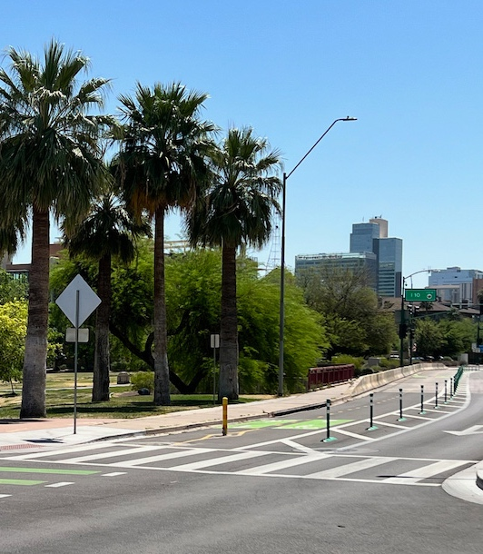
Transforming city planning policy frameworks
Policy indicators are useful for benchmarking and monitoring progress towards healthy and sustainable cities
Urgent need to strengthen city planning policies and legislation
We identified specific policy gaps and limitations that should be remedied in each city
Notes:
We showed the feasibility of systematically assessing evidence-informed policy indicators for diverse cities internationally.
Our study underlines the need to strengthen city planning policies and legislation, and that policy indicators are useful for that endeavour, by benchmarking and monitoring progress towards healthy and sustainable cities.
To help transform our cities for the better, we identified specific policy gaps and limitations that should be remedied in each city, as well as policy strengths that should to be maintained long-term.
Comparisons between cities could help civil society to advocate for reform and give policy makers the evidence needed to target policy gaps.

Slide 17

Determining thresholds for spatial urban
design and transport features that support
walking to create healthy and sustainable cities: findings from the IPEN Adult study
Co-authors
Ester Cerin, James F Sallis, Deborah Salvo, Erica Hinckson, Terry L Conway, Neville Owen, Delfien van Dyck, Melanie Lowe, Carl Higgs, Anne Vernez Moudon, Marc A Adams, Kelli L Cain, Lars Breum Christiansen, Rachel Davey, Jan Dygrýn, Lawrence D Frank, Rodrigo Reis, Olga L Sarmiento, Deepti Adlakha, Geoff Boeing, Shiqin Liu, Billie Giles-Corti

Slide 18

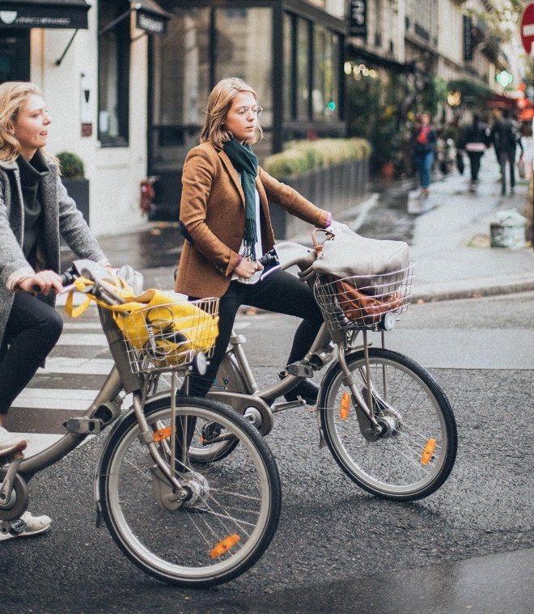

Healthy and sustainable cities: the role of physical activity
Physically active population = essential characteristic of a healthy and sustainable city
>25% is insufficiently active (do less than 150 min/week of moderate intensity physical activity as recommended by WHO)
WHO target ≥15% reduction in insufficient physical activity

Slide 19
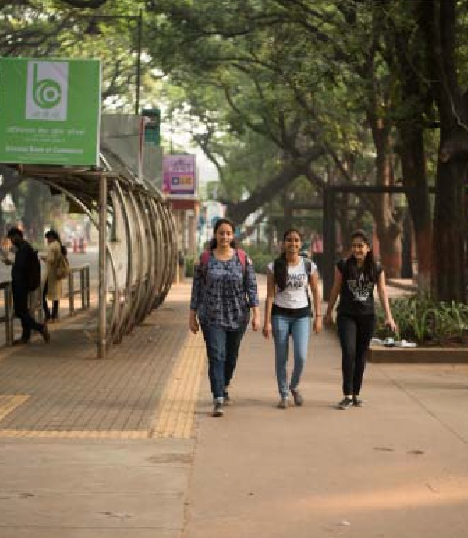
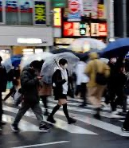

Healthy and sustainable cities: the role of walking
Walkable
neighbourhoods
Walking for transport + Walking for recreation
Reduced greenhouse
gas emissions
Increase in sufficiently physically active
Healthy & sustainable city

Slide 20

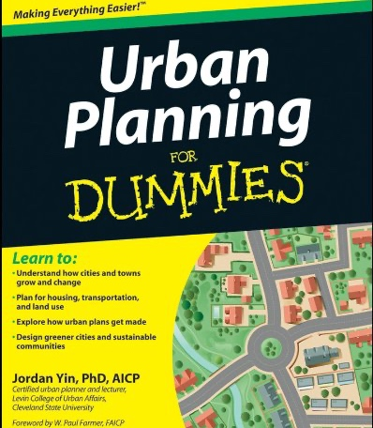


Evidence-informed quantitative targets for policies that create healthy and sustainable cities
What are the minimum thresholds for urban design and transport features associated with WHO’s target of at least 15% relative reduction in insufficient physical activity through walking?

Slide 21











Adult study
comparable
measures
10 countries
11,615
participants
18-66
years
Upper-middle
income
14 cities
Curitiba
Bogotá
Cuernavaca
Adelaide
Ghent
Olomouc
Aarhus
walking
High income
High / low walkable & SES areas
Urban design
& transport
features
Auckland,
Christchurch,
Wellington
Stoke-on-Trent
Baltimore,
Seattle
Notes:
The International Physical Activity and the Environment Network Adult (known as IPEN)
study (N=11 615; 14 cities across ten countries) provided data on local urban design and transport features linked to
walking.

Slide 22
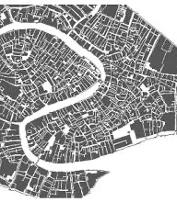

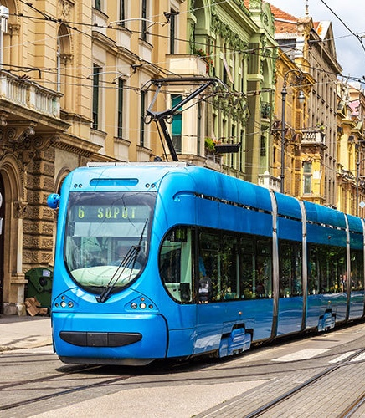
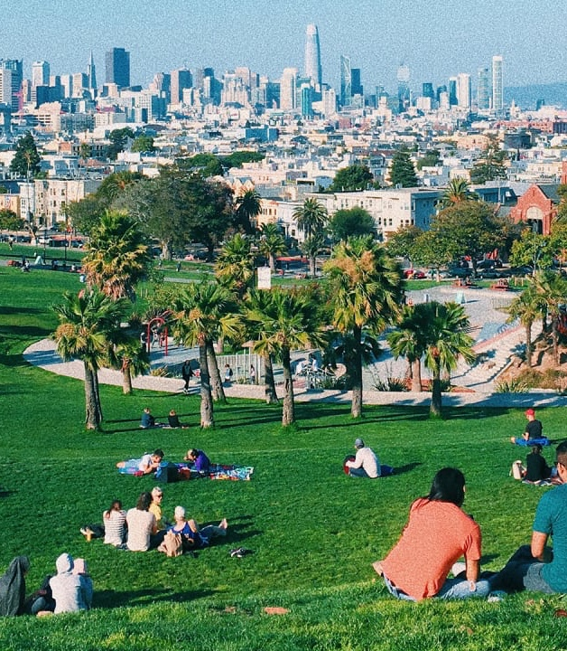
Strength and shape of (pooled) associations of …
Population density (people per km²)
Street intersection density (intersections per km²)
Public transport density (stops per km²)
Distance to nearest public transport stop (m)
Distance to nearest public park (m)
… with the odds of doing at least 150 min/week of walking for transport or recreation

Slide 23
Relationships between urban design measures and the probability of ≥150 minutes of total walking per week cont’d
Public transport density
  weak linear positive association
  OR = 1.005; 95% CI: 0.999 – 1.011; p = 0.068
  no threshold value
Distance to nearest public transport stop
  not a significant correlate
Distance to nearest public park
  linear negative association
  OR = 0.983; 95% CI: 0.972-0.993; p = 0.001
  no threshold value
Associations & thresholds did not vary by sex, age or city

Slide 24
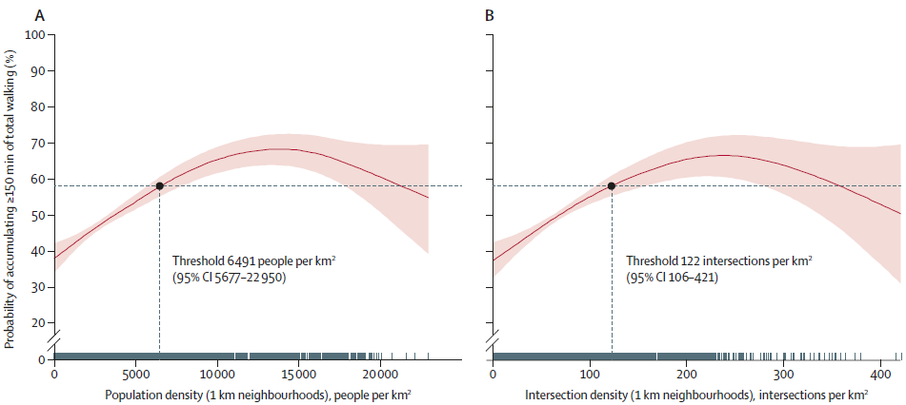
Relationships between urban design measures and the probability of ≥150 minutes of total walking per week
Dotted vertical lines show the thresholds associated with at least 58% probability of at least 150 min of total walking per week (dotted horizontal lines). Pink shading shows 95% CIs. A=population density. B=intersection density.

Slide 25


Thresholds for measurable city planning policy targets
Present
Utility of quantitative thresholds of urban design and transport features
  Evaluation of current city planning policies
  Revision of city planning policies
Thresholds feasibility
Most studied neighbourhoods would benefit from densification
“More is better”: not always the most appropriate message

Slide 26

Using open data and open-source software to develop spatial indicators of urban design and transport features for achieving healthy and sustainable cities
Co-authors
Geoff Boeing, Carl Higgs, Shiqin Liu, Billie Giles-Corti, James F Sallis, Ester Cerin, Melanie Lowe, Deepti Adlakha, Erica Hinckson, Anne Vernez Moudon, Deborah Salvo, Marc A Adams, Ligia Vizeu Barrozo, Tamara Bozovic, Xavier Delclòs-Alió, Jan Dygrýn, Sara Ferguson, Klaus Gebel, Thanh Phuong Ho, Poh-Chin Lai, Joan Carles Martori, Kornsupha Nitvimol, Ana Queralt, Jennifer D Roberts, Garba H Sambo, Jasper Schipperijn, David Vale, Nico Van de Weghe, Guillem Vich, Jonathan Arundel

Slide 27
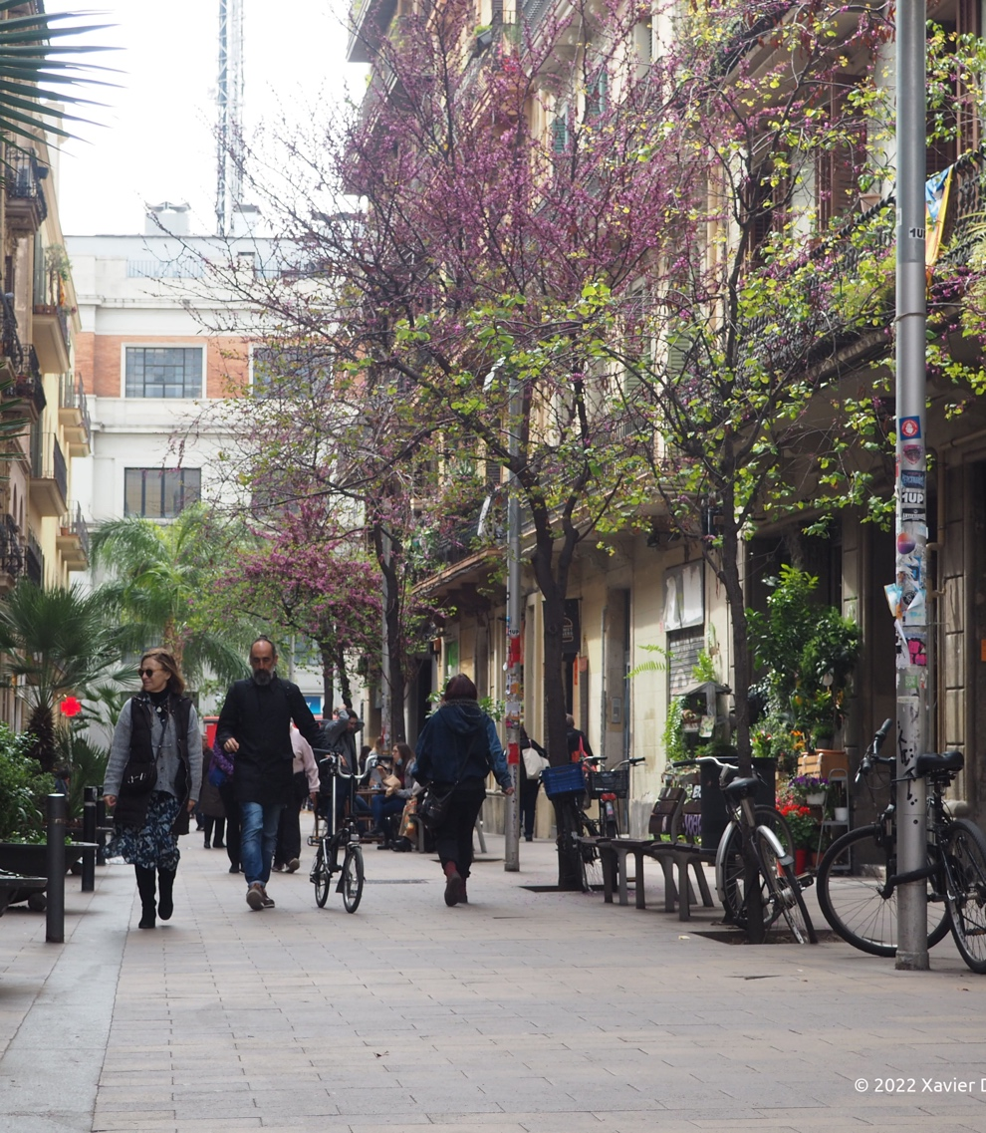
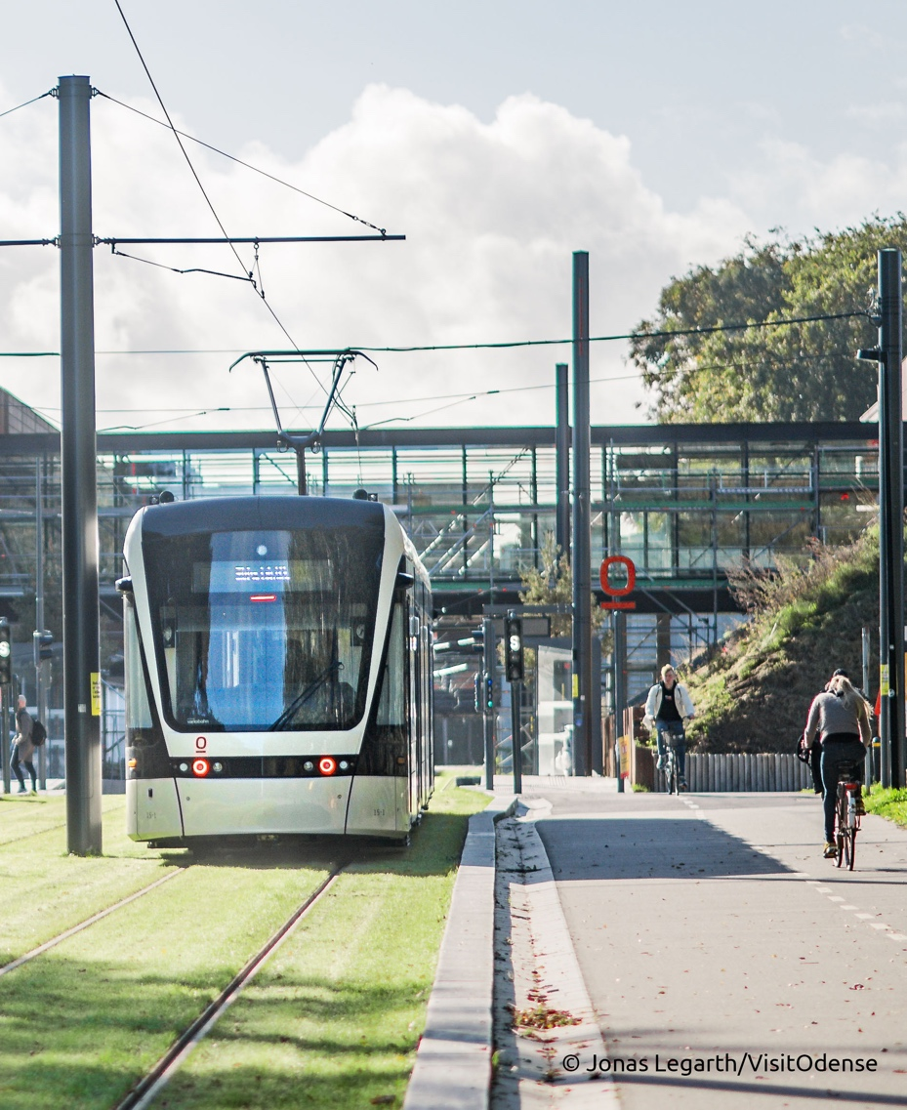
Benchmarking and monitoring cities
Global priority for sustainability and health equity
What do healthy, sustainable cities look like?
Indicators of urban design and transport features

Slide 28


A new way forward
International collaboration: data sourcing and validation
Open data
Open-source software framework

Slide 29
Indicators of urban design and transport features
Walkable catchment areas
Population and street intersection densities
Distance to nearest healthy food market
Distance to nearest convenience store
Distance to nearest public transport stop
  Any stop
  Weekday daytime service frequency <30 minutes
  Weekday daytime service frequency <20 minutes
Distance to nearest public open space entry point
  Any public open space
  Public open space >1.5 hectares
Daily living score
  Measures local access to mix of amenities
  Sum of equal-weighted binary measures
  Healthy food market, convenience store, transit within 500 m
Local walkability index
  How walkable is neighbourhood?
  Sum of equal-weighted standardized scores
  Population density, street intersection density, daily living score

Slide 30
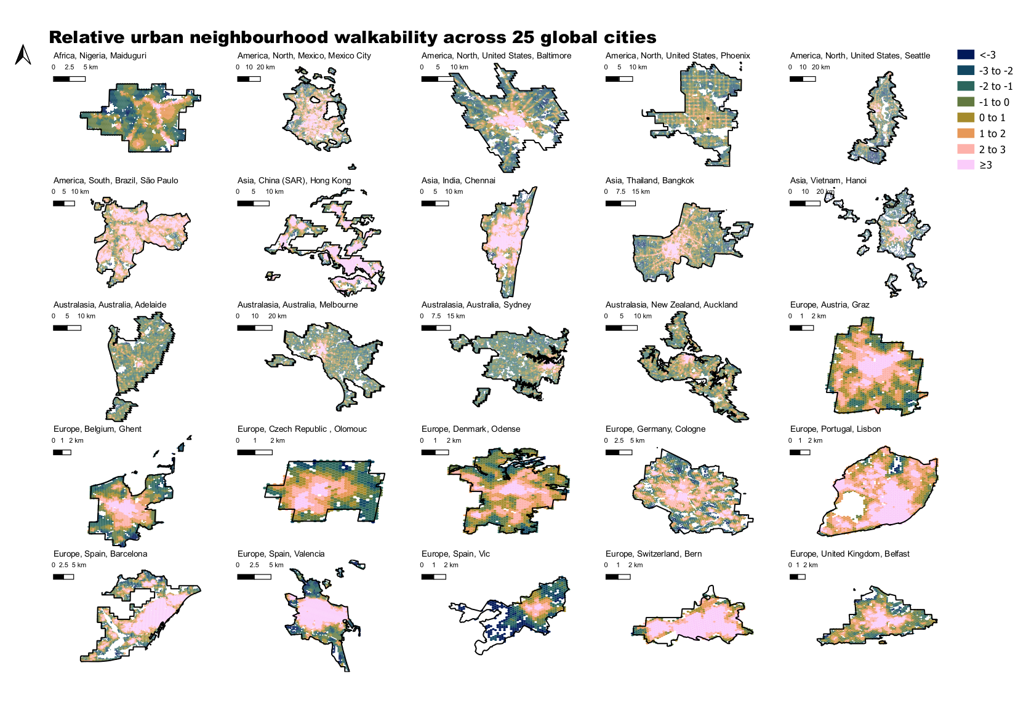

Slide 31
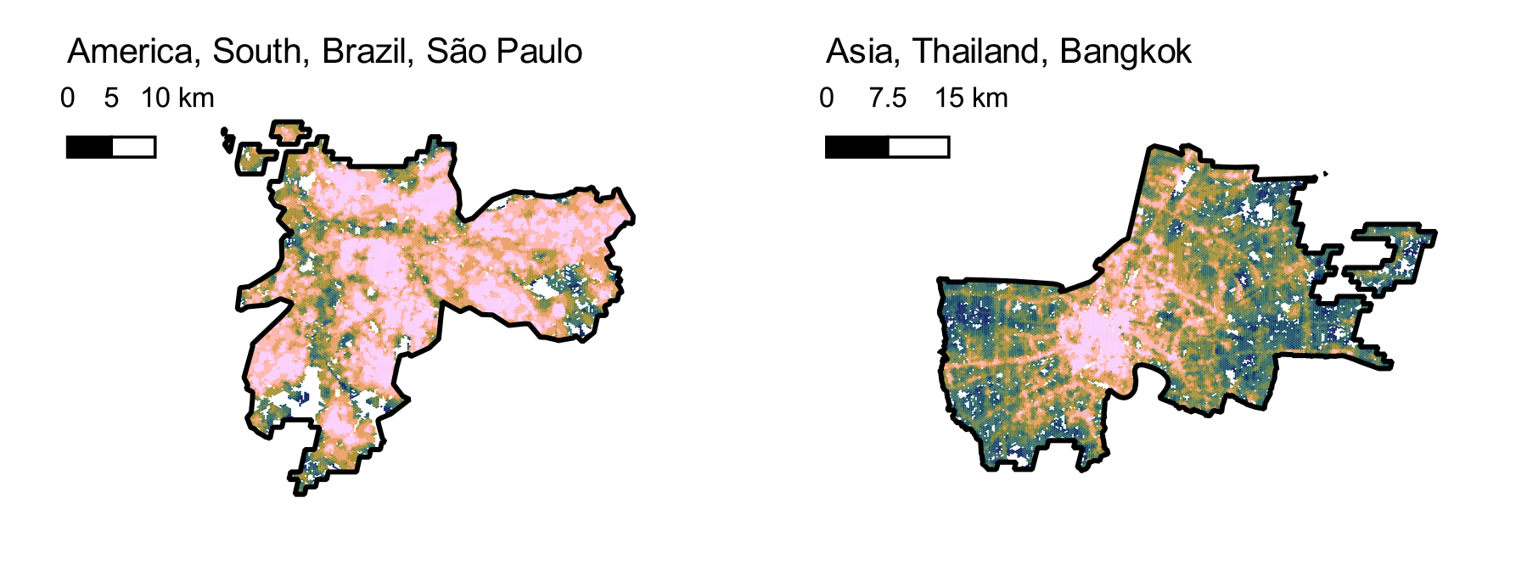

Slide 32
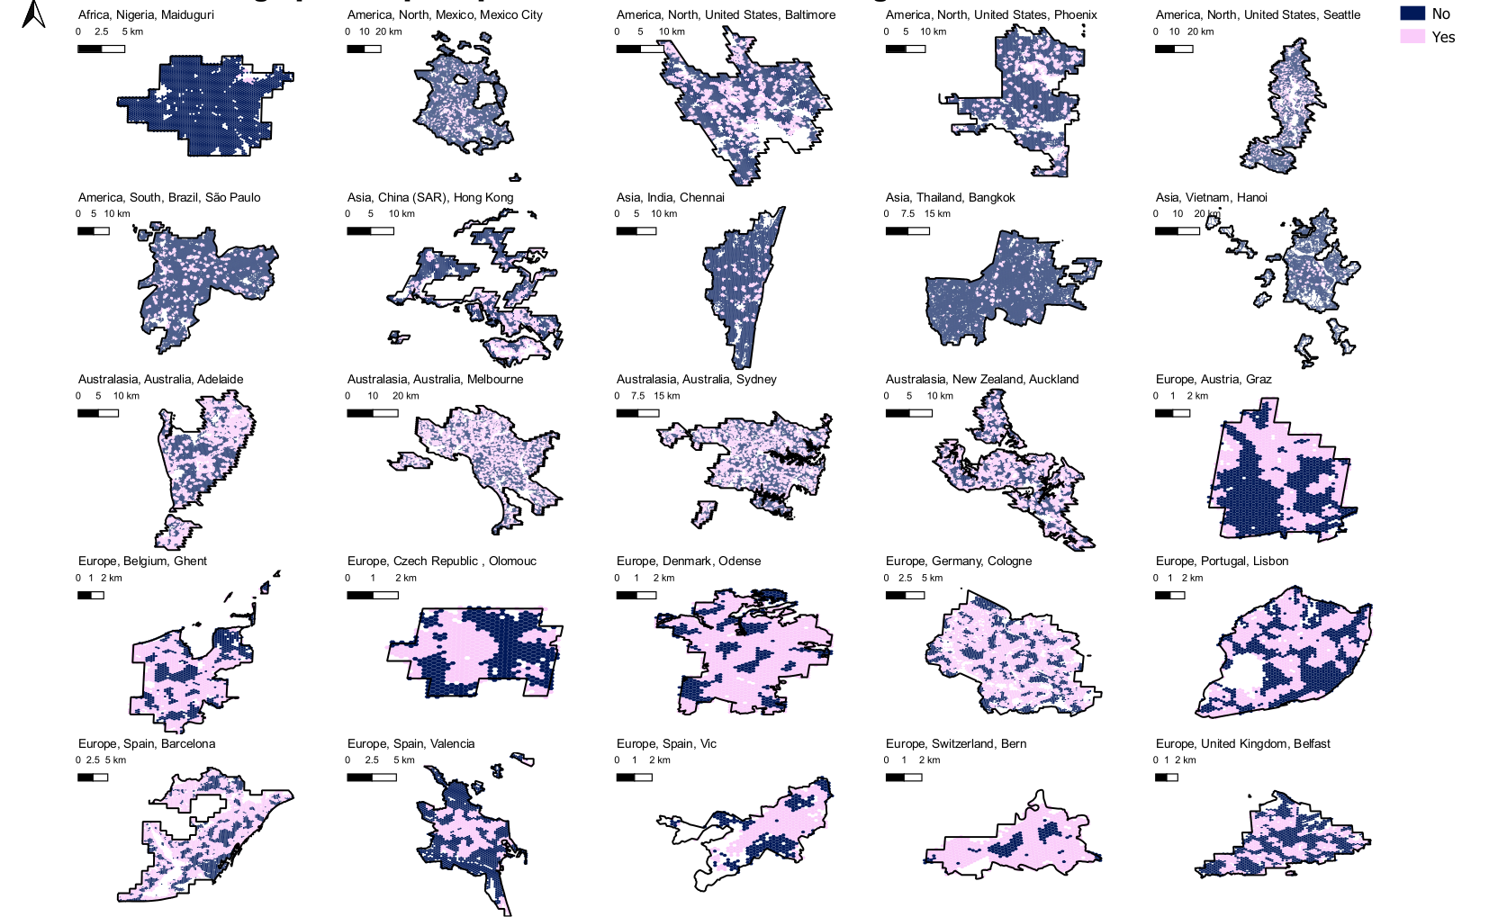
Access to large public open space within 500m across 25 global cities*
*In this map, access for urban neighbourhoods was considered achieved when at least half of the sampled walkable area was estimated to be within 500m of areas identified as public open space of size 1.5 hectares or larger

Slide 33
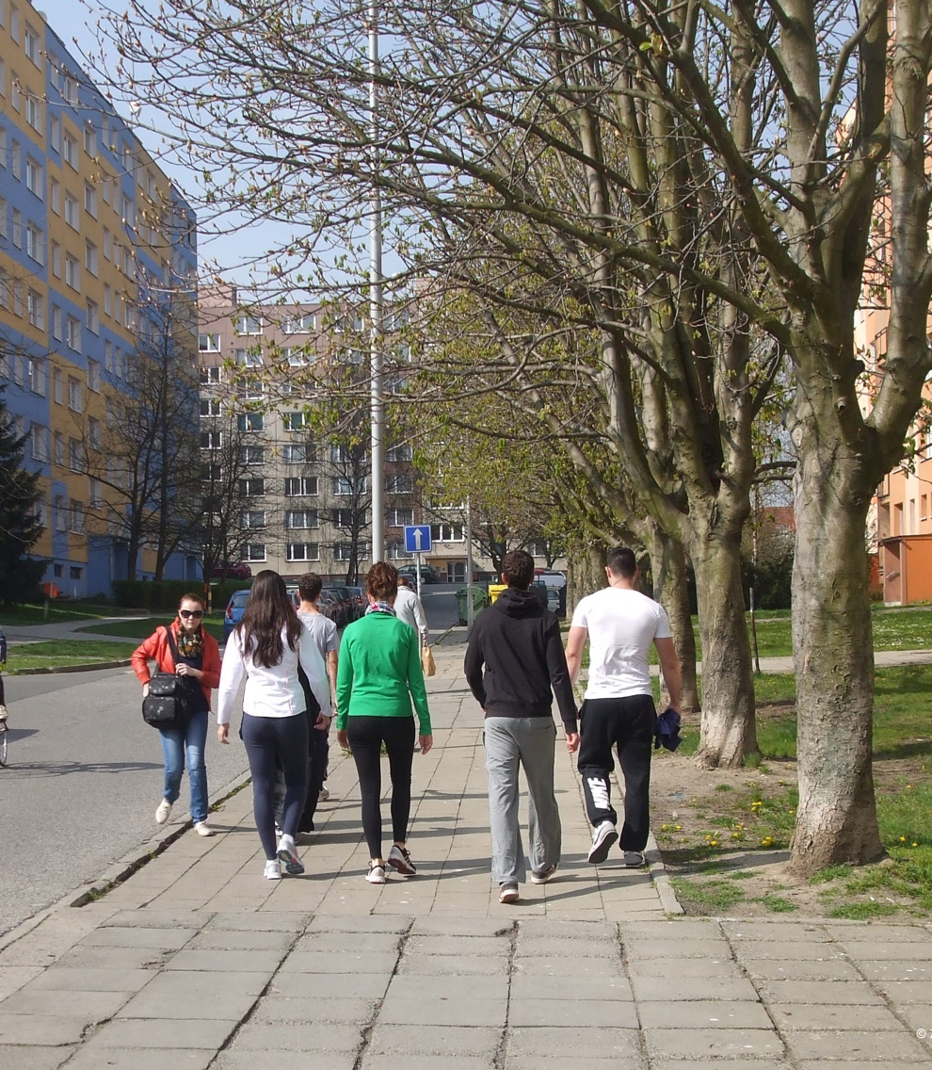
Thresholds to support active lifestyles
Thresholds from Cerin et al.
  Scenario A: 80%+ probability of walking for transport
  Scenario B: WHO target of 15%+ reduction in insufficient physical activity through walking
  What % of population met or exceeded these thresholds?
Scenario A
  Population density: 61% met threshold (and just 49% in high-income countries’ cities)
  Street intersection density: 72% met threshold
Scenario B
  Population density: 52% met threshold
  Street intersection density: 59% met threshold

Slide 34
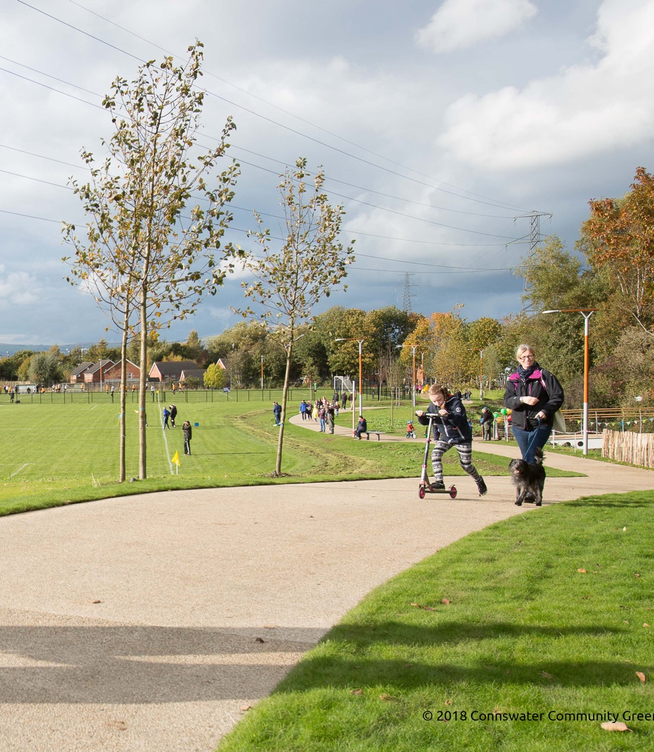
Better indicators for better cities
Many people lack access to urban design and transport features necessary for healthy, sustainable cities
Open data and open-source software for better indicators
Target evidence-based planning interventions, monitor policy effects, and harness lessons from peer cities
International effort to measure and monitor cities for health and sustainability

Slide 35
What next? Expanding our view of city planning and global health, and implementing and monitoring evidence-informed policy
Co-authors
Professor Billie Giles-Corti, Professor Emeritus Anne Vernez Moudon, Melanie Lowe, PhD, Professor Ester Cerin, Geoff Boeing, PhD, Professor Emeritus Howard Frumkin, Deborah Salvo, PhD, Sarah Foster, PhD, Alexandra Kleeman, MPH, Professor Sarah Bekessy, Thiago Hérick de Sá, PhD, Professor, Mark Nieuwenhuijsen, Carl Higgs, MPH, Professor Erica Hinckson, PhD, Associate Professor Deepti Adlakha, Jonathan Arundel, PhD, Shiqin Liu, MS, Adewale L. Oyeyemi, PhD, Kornsupha Nitvimol, MA, Professor James F. Sallis
The authors alone are responsible for the views expressed in this article and they do not necessarily represent the views, decisions, or policies of the institutions with which they are affiliated
Notes:
The final paper summarises the Series’ key findings, considered What next? and a whole of society call to action.
I would like to acknowledge my co-authors who brought context expertise that allowed us to expand our view of how city planning affects global health.

Slide 36
Series’ key findings
Feasible to measure city planning policies
Urban policies lacked measurable targets
Notes:
Working with local collaborators it IS feasible to measure city planning
While many cities express ambition to be healthy, sustainable and liveable, many lacked the city planning policies and measureable standards and targets to achieve this ambition

Slide 37
Series’ key findings
c
c
Feasible to measure city planning policies
Urban policies lacked measurable targets
Thresholds for urban design and transport features
6491 persons/km²
c
c
122 intersections/km²
c
c
Notes:
There are identify thresholds for healthy and sustainable lifestyles, and this type of research is critical because it can inform future planning standards to create healthy and sustainable cities – we need thresholds for all of the 11Ds.

Slide 38
Series’ key findings
c
c
Feasible to measure city planning policies
Urban policies lacked measurable targets
Thresholds for urban design and transport features
Feasible to create consistent spatial indicators of health-supportive environments
Substantial spatial inequities in access within and between cities
6491 persons/km²
c
c
122 intersections/km²
c
c
Notes:
We demonstrated by by working with local collaborators it IS feasible to create and validate a consistent spatial indicators of health-supportive environments – mostly using open data
This was important because it allowed us to identify, map and visualise inequities within and between cities and we hope will iinform city planners where their cities are vulnerable and require investment

Slide 39


What next?
Evidence - growing and stronger
Air pollution 4th largest risk factor for global mortality
Notes:
Since the first series on Urban Design transport and health was published in 2016, the evidence has grown, and it is now stronger. There are more longitudinal studies providing compelling evidence of the city planning impacts of chronic health.
The evidence on the impacts of air pollution has strengthened with WHO guidance that there is no safe level of exposure: Air pollution is now the 4th largest risk factor for global mortality, (click) yet we still continue to plan car centric cities, (click) with the air quality in many cities at hazardous levels.

Slide 40
What next?
Evidence - growing and stronger
Air pollution 4th largest risk factor for global mortality
Global population ageing
  Cognitive health is an emerging priority issue
    Urban and transport features linked to dementia risk factors
Notes:
The global population is ageing, with the impacts of city planning on cognitive health emerging as an additional consideration for city planning. For example, there is growing evidence that many of the urban and transport features included in the series – including air pollution – are risk factors for dementia. There are therefore growing calls for age-friendly cities protective of an ageing population.

Slide 41

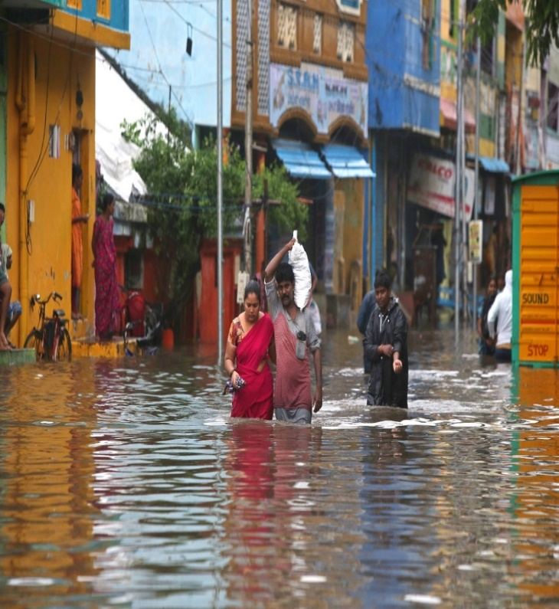
What next?
Evidence - growing and stronger
Air pollution 4th largest risk factor for global mortality
Global population ageing
  Cognitive health is an emerging priority issue
    Urban and transport features linked to dementia risk factors
Urgency for integrated city planning to mitigate and adapt to climate change is now palpable
Notes:
Yet in terms of ‘what’s next?’ the impacts of climate change is now self evident. Cities are major contributors to green house gas emissions, and the urgency for integrated city planning that mitigates and adapts to climate change is now pulpable

Slide 42
Urban system
policies
Urban & transport planning & design interventions
Transport mode &
daily living outcomes
Risk
exposures
Intermediary
outcomes
Injury &
disease outcomes
Transport mode outcomes
Transport
8Ds
Private motor vehicle
Social &
health services
Public transport
Traffic
Traffic incidents
Road trauma
Regional Planning
Cycling
Education
Destination accessibility
Greenhouse
gas & particulate
matter emissions, climate change
Respiratory disease
Walking / Cycling
Air pollution
Health, wellbeing, liveability & sustainability
Employment
& economic development
Distribution of employment
Heat stress
Demand
Infectious disease
Land use
& urban design
Demand management
Attitudes & preferences
Noise
Local urban design
Social & cultural norms
Mental illness
Housing
Social isolation
Design
Mobility needs
What next? Optimising compact 15 minute cities
Public open space
& recreation
Density
Daily living outcomes
Personal safety
Public safety
Distance to transit
Employment & education access
Food & health
service access
Physical inactivity
Diversity
Obesity & overweight, cardio-metabolic
risk factors
Major chronic
diseases: CVD, T2 diabetes, cancer
Social &
recreational access
Prolonged sitting
Desirability
Unhealthy diet
Notes:
However in Series two, we ask the question ‘What next for city planning?” with a focus on how can we optimise compact 15 minute cities to protect human, ecosystem and planetary health

Slide 43
Urban system
policies
Urban & transport planning & design interventions
Transport mode &
daily living outcomes
Risk
exposures
Intermediary outcomes and environmental change
Injury &
disease outcomes
Air quality
11Ds
Transport mode outcomes
Traffic
Traffic incidents
Road trauma
Regional Planning
Private motor vehicle
Destination accessibility
Public transport
Air pollution
Traffic congestion
Transport
Cycling
Respiratory disease
Greenhouse
gas & particulate
matter and NO₂ emissions
Climate change
Respiratory disease
Social &
health services
Distribution of employment
Noise
Climate change
Walking
Education
Demand management
Heat islands
Heat stress
Demand
Heat stress
Attitudes & preferences
Extreme weather events
Employment
& economic development
Disaster mitigation
Biodiversity loss
Extreme weather events
Sustainable development, urban liveability, ecosystem, planetary and human health and wellbeing, equity and quality of life
Social & cultural norms
Vector, water-borne and zoonotic infectious disease
Local urban design
Land use
& urban design
Design
Mobility needs
Overcrowding
Airborne Infectious disease
Housing
Density
Daily living outcomes
Social isolation
Mental illness
Destination proximity
Employment & education access
Mental illness
Public open space
& recreation
Personal safety
Distance to transit
Food & health
service access
Nature-based solutions
Physical inactivity
Major chronic
diseases: CVD, T2 diabetes, cancer, cognitive decline
Diversity
Social &
recreational access
Obesity & overweight, cardio-metabolic
risk factors
Public safety
Prolonged sitting
Desirability
Appropriate affordable housing access
Good & integrated governance
Unhealthy diet & unsafe alcohol consumption
Distributed
Urban greening access
Time spent commuting
Energy use
Notes:
To this we offer an expanded framework of the direct and indirect pathways through which city planning affects health; suggesting the need for 11 integrated urban system policies because these policies are needed to create 11 urban and transport and design interventions – from 8Ds to the 11Ds
I would like to talk you explain the rationale for their inclusion by talking you through some of the pathways

Slide 44

Call to action – global agencies, national, regional and local governments, policy-makers and practitioners
Benchmark and monitor progress in cities using policy and spatial indicators
  Use and expand tools
Transform urban governance – horizontal and vertical integration
Strengthen policy frameworks incorporating 11Ds
  Use evidence and monitor implementation
Support LMICs and disadvantaged communities
Notes:
The second series emphasizes that there are multiple converging agendas that are impacted by city planning: rising chronic disease, climate change, and biodiversity loss. There is much to do and the time to act is now. Our call to action is therefore for an urgent whole of society response
In terms of major agencies, to national, regional and local government policy makers and practitioners
We have demonstrated it is possible to create a global system of comparable policy and spatial indicators of the upstream determinants of health and we call on global agencies to support and national, regional and local governments to use and recommend the Series’ tools to develop up-stream policy and spatial indicators and to expand indicators for some of new pathways and 11Ds in our new framework: including traffic, green canopy, heat island effects
The need for integrated governance of cities is clear: horizontal governance across government, but also vertical integration of governance across all levels of government, the private sector and the community – none of this is easy, but it is nevertheless urgent
It is clear that urban policy frameworks need to be strengthened to include evidence-informed policy standards and targets that will create the healthy and sustainable cities, we know we want and need. This includes evidence-informed spatial indicators of the interventions on the ground in communities reflected in the 11Ds.
We have emphasized throughout the series, that although HIC generate 86% of greenhouse emissions, it is LMIC and low income areas that will be most impacted by climate change: there is a responsibility of agencies, governments and researchers in HIC to support LMIC to tackle city planning issues that will optimise outcomes for all global citizens

Slide 45

Carl Higgs
How can cities find out about whether their city is healthy and sustainable?
Research data scientist and PhD student, Healthy Liveable Cities Lab of the Centre for Urban Research, RMIT University

Slide 46
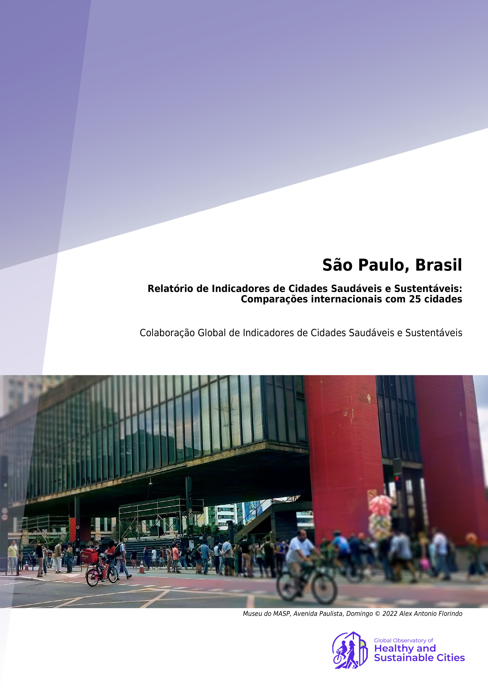
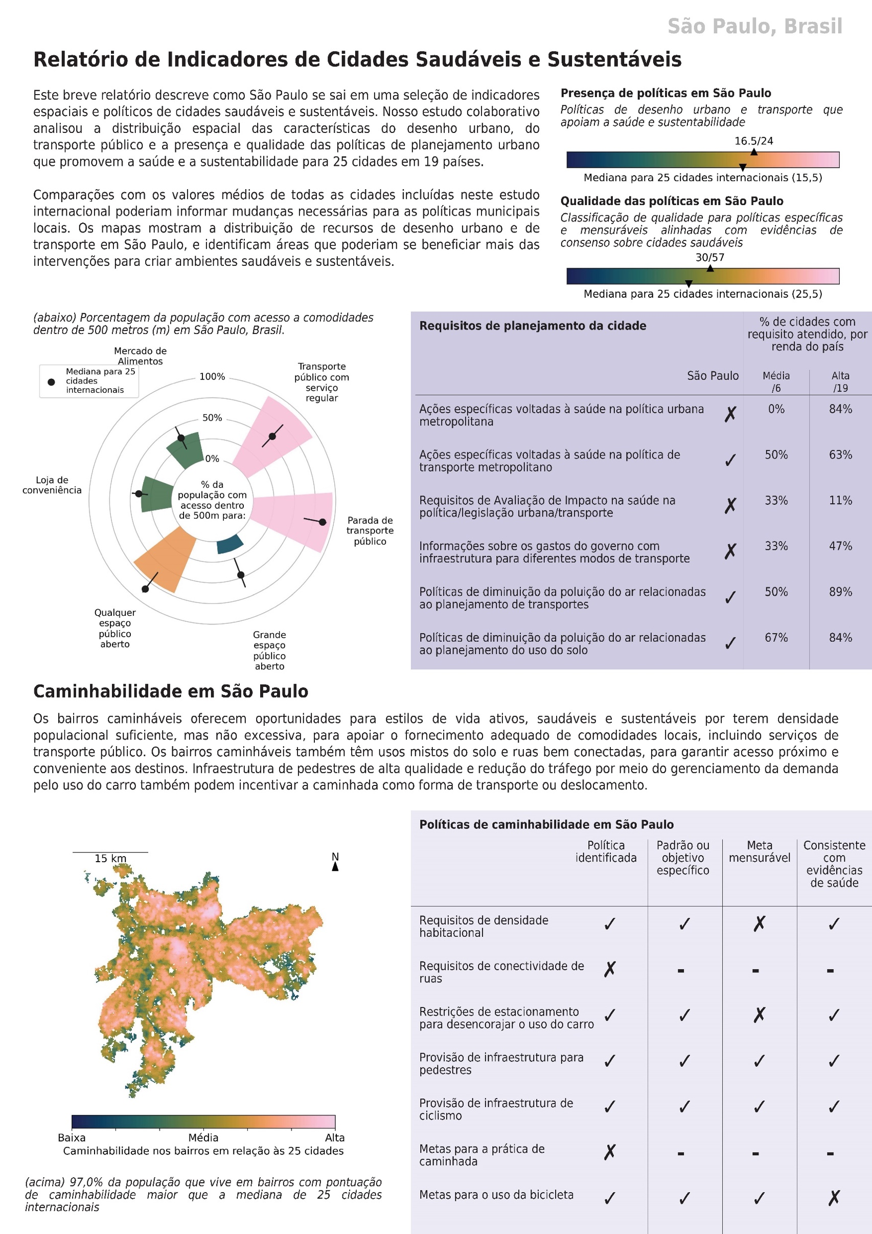
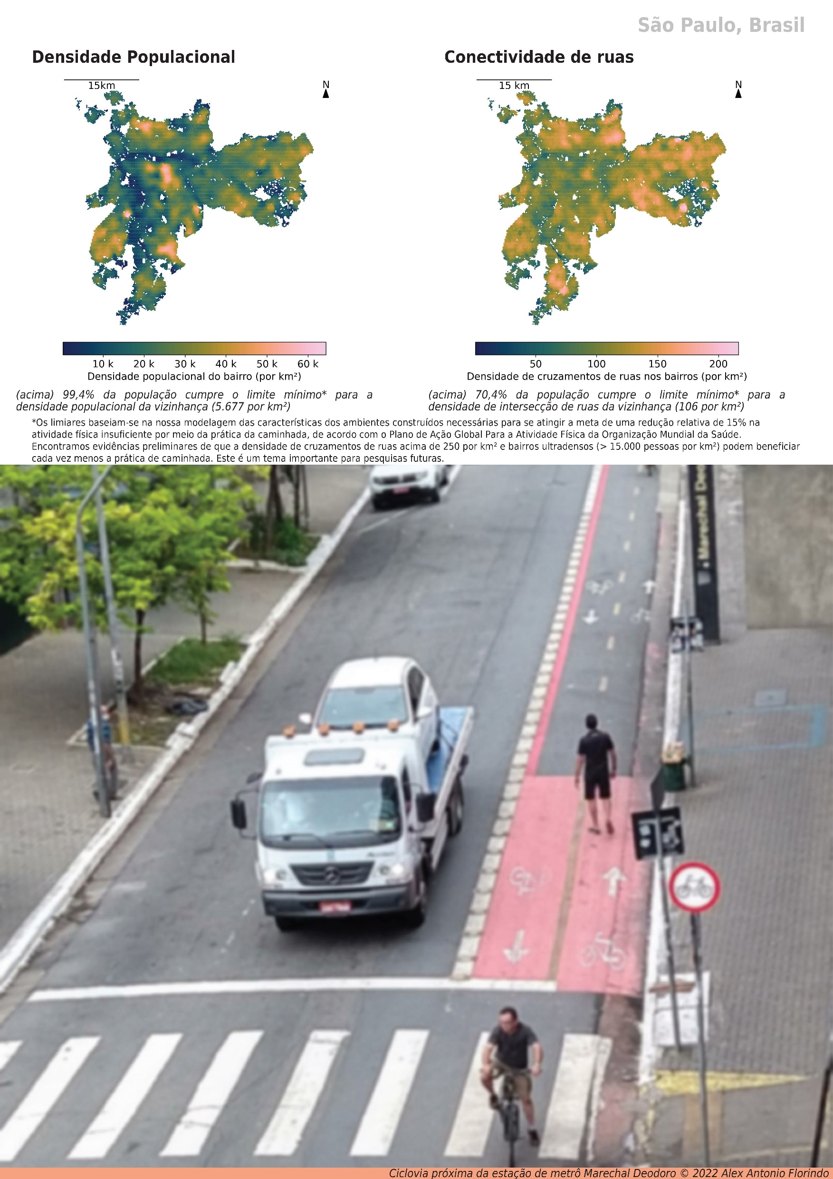
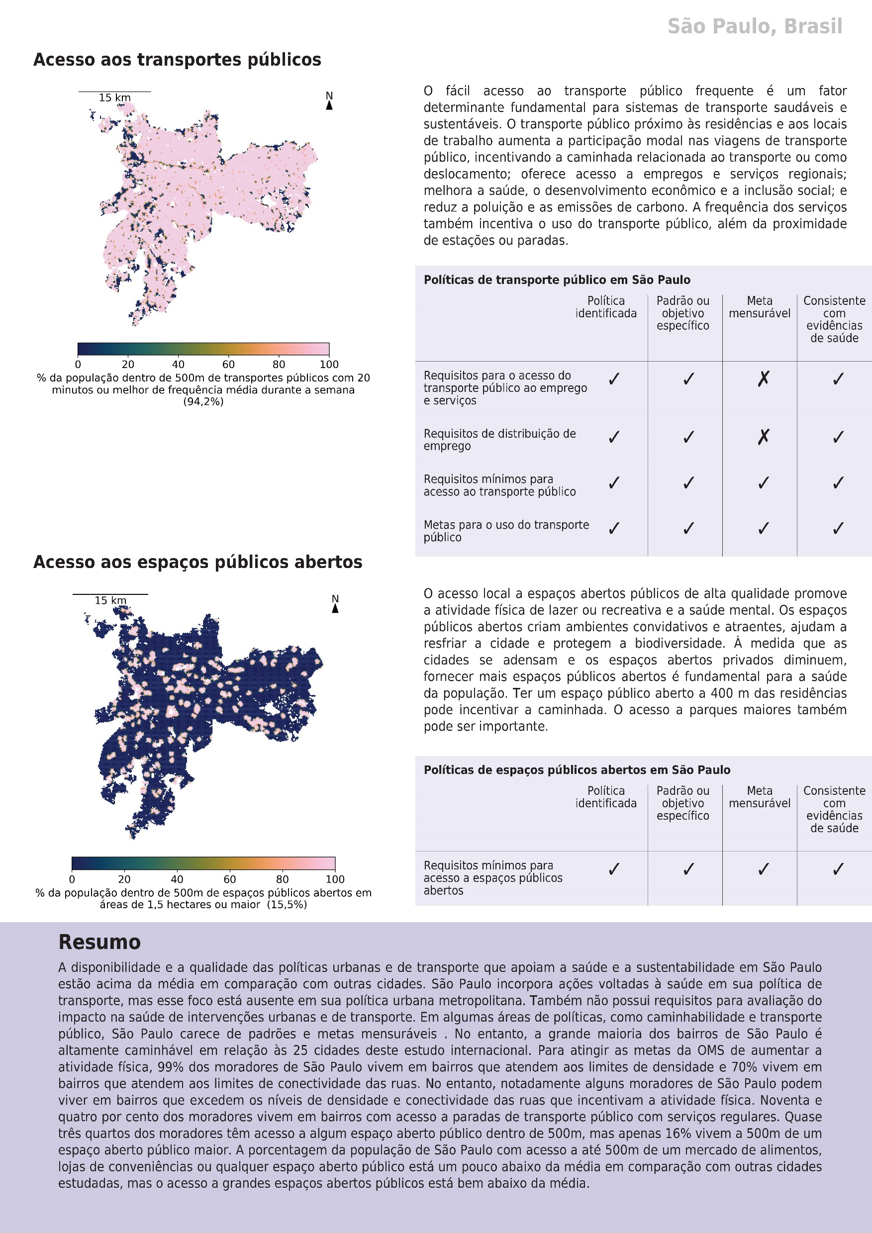
City indicator reports
Notes:
To help make our findings accessible, we created a suite of reports for each city and in multiple languages. These have been designed for local audiences whose lived experiences are shaped through their city’s transport and urban design features, and to empower decision makers with the high level information needed to enact change.
They provide a local lens for viewing the results of The Lancet Global Health Series on urban design, transport and health, concisely summarising the series’ core concepts

Slide 47
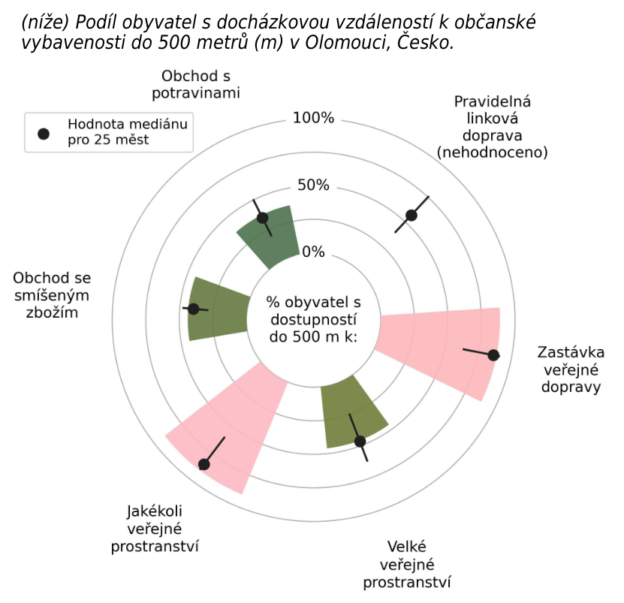
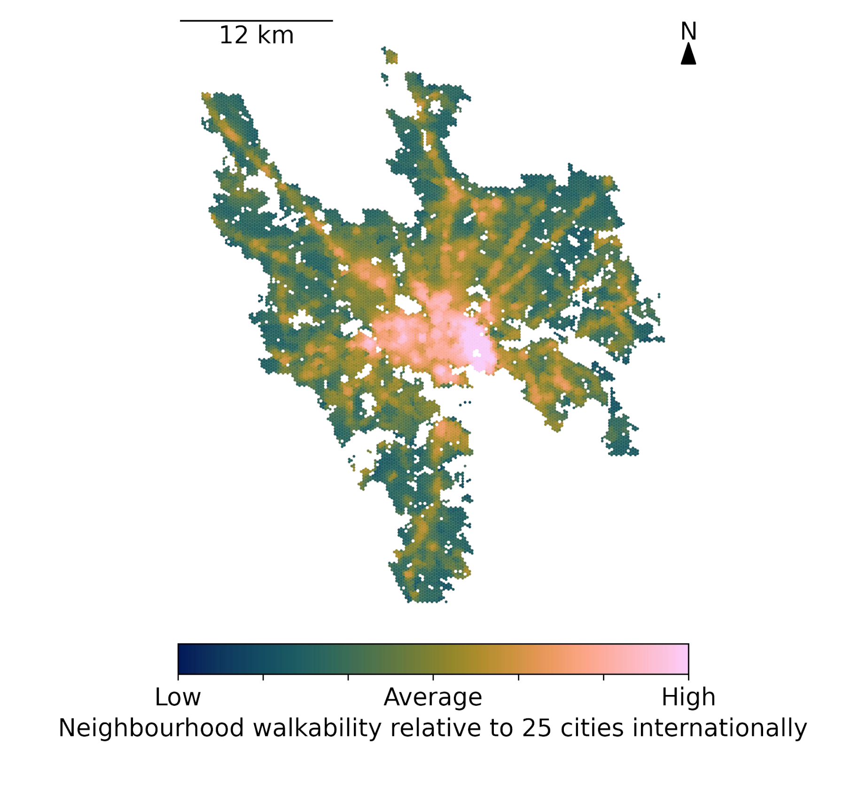
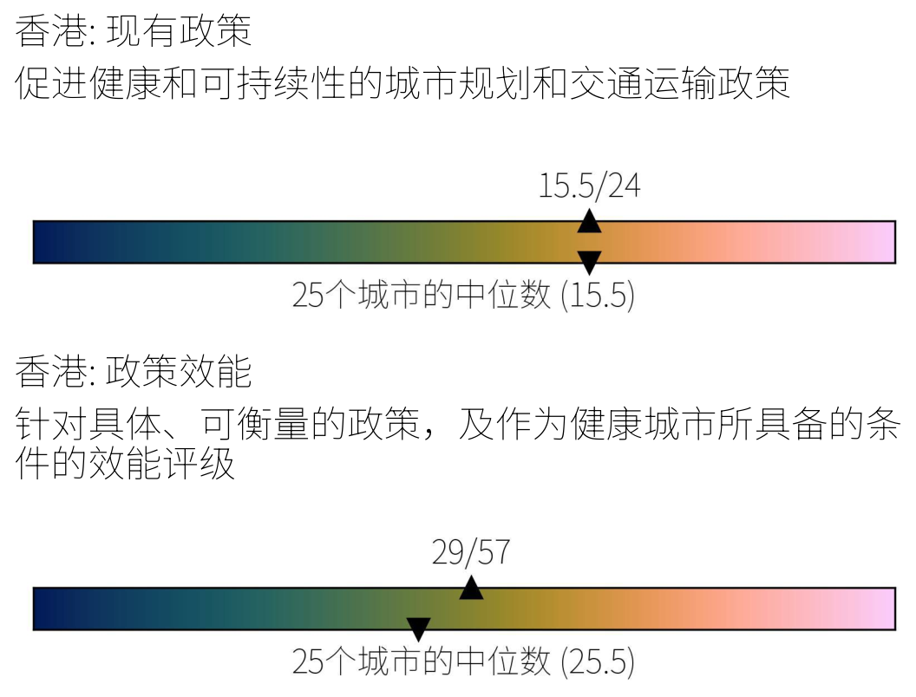
City indicator reports
Notes:
The reports also provide more detailed overviews of the spatial distribution of urban design and transport features to help identify areas that could benefit the most from interventions to create healthy and sustainable environments, such as walkability relative to the 25 cities studied.

Slide 48
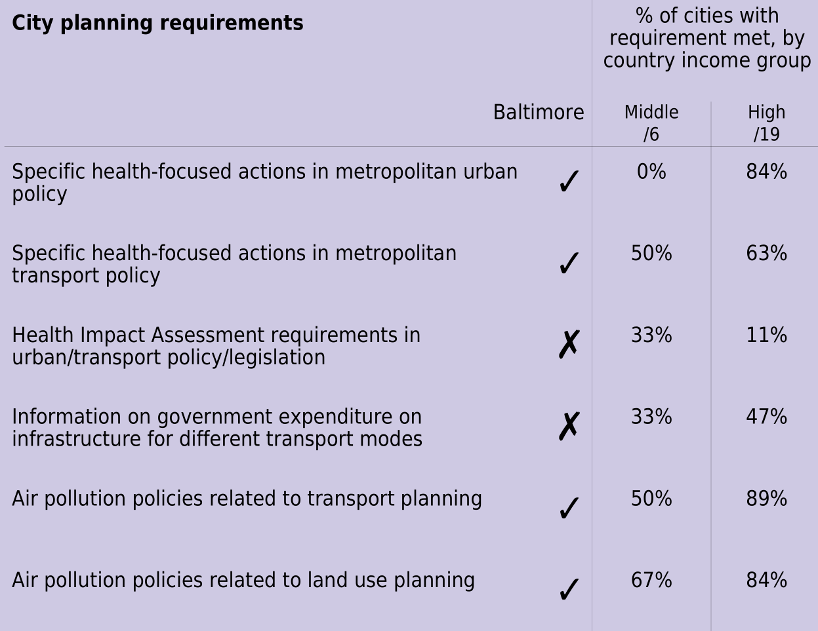
City indicator reports
Notes:
And a series of Policy checklists detail further insights that could inform changes needed for local city policies,
The city planning requirements checklist identifies whether a series of policies for achieving healthy and sustainable cities were identifiable, with a summary of the percentage of cities meeting these objectives for the cities study from middle and high income countries

Slide 49
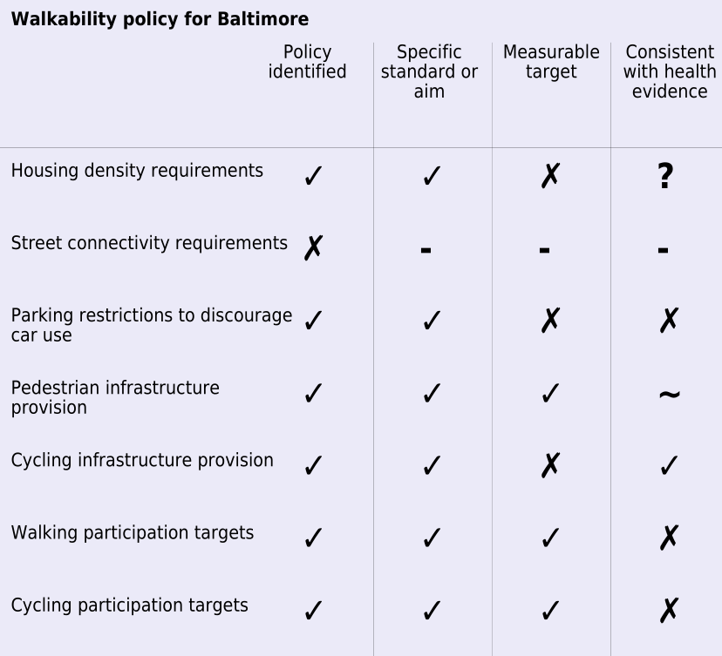
City indicator reports
Notes:
And city-specific checklists for walkability policy

Slide 50

Deborah Salvo
The Global Observatory for Healthy and Sustainable Cities website, and the 1000 Cities Challenge
Assistant Professor of public health, Brown School, Washington University
Notes:
These reports will be disseminated through the Global Observatory of Healthy & Sustainable Cities, which my colleague Professor Deborah Salvo of Washington University in St. Louis will now introduce, along with The 1000 Cities Challenge.

Slide 51

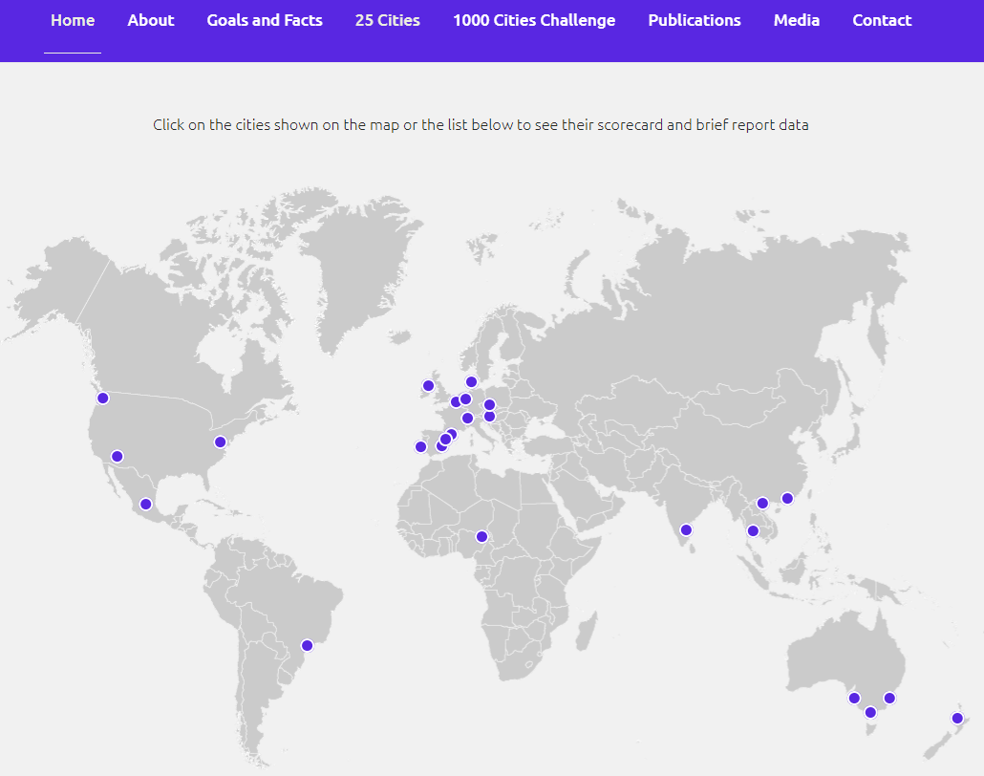
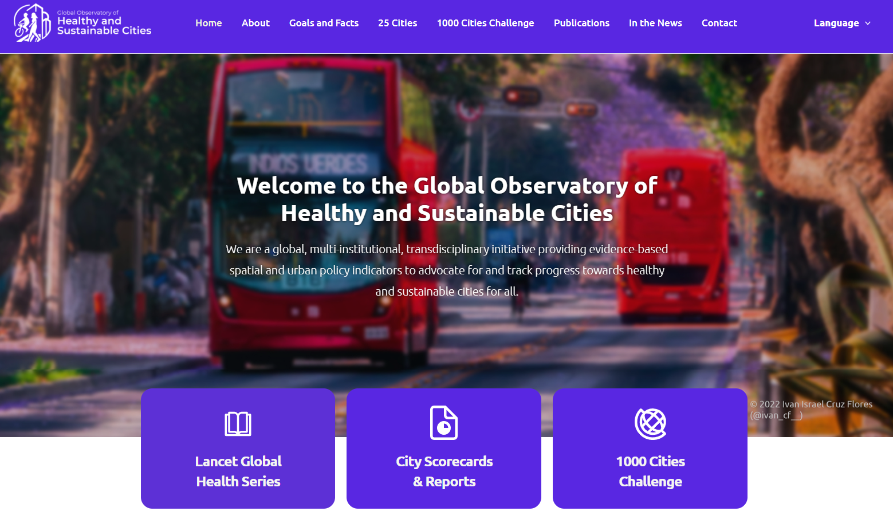
https://www.healthysustainablecities.org
Notes:
We are pleased to announce the official launch of the Global Observatory of Healthy and Sustainable Cities, consisting of a website that summarizes the work of the Healthy and Sustainable City-Indicators Collaborative, and including freely available scorecards, more extended reports, which Carl Higgs just described in the previous presentation, and all of our data and code used for our comprehensive 25 cities policy and spatial study.

Slide 52
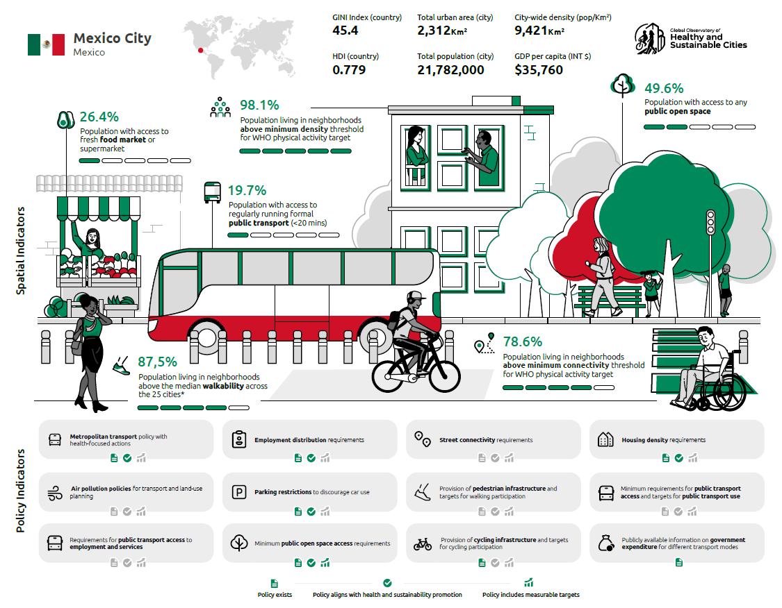
Includes scorecards and reports for
25 cities, plus open-access tools
Notes:
In addition to the reports for each of the 25 cities of our study, we provide simple to use, single-page scorecards – an infographic summarizing the key results for spatial and policy indicators for each city. This is an example of the scorecard for Mexico City, my home town. The scorecards show spatial indicators are shown in the top part of the page, along with the ilustrations you are seeing (for example, in Mexico City 49.6% of the population has access to any public open space). The policy indicators are in the bottom part, and include three simple to understand icons, representing the availability of the policy, whether the policy aligns with the promotion of health and sustainability, and whether the policy has measurable targets. For example, Mexico City has parking restrictions to discourage car use, in alignment with the promotion of health and sustainability, but has no measureable targets for thsi. These scorecards can help provide a quick, simple, high-level description of the performance of each city with respect to the evidence-informed thresholds for healthy and sustainable cities.

Slide 53

Our goal:
To provide comparable, evidence-based spatial and policy indicator data of healthy and sustainable urban design and planning for cities across the globe.
Notes:
Through the observatory, we want to encourage the scaling up of healthy and sustainable urban design and planning in cities across the globe, by:
Providing comparable data of evidence-based spatial and policy indicators for urban design, planning and policy across multiple cities of the world
We hope this will
Facilitate the establishment of urban policy and planning surveillance systems
AND Regional, country-level, and local urban goal-setting and tracking
We also hope this will
Serve As a powerful tool for local advocacy
And will encourage more global collaborative research

Slide 54

Our goal:
To provide comparable, evidence-based spatial and policy indicator data of healthy and sustainable urban design and planning for cities across the globe.
Our guiding principles:
- Open data and open science
- Interdisciplinary team science
- Global data for local impact
- Capacity building and equitable international collaborations
Notes:
Our Guiding Principles:
- Open data and open science
- Interdisciplinary team science
- Global data for local impact
- Capacity building and equitable international collaborations

Slide 55
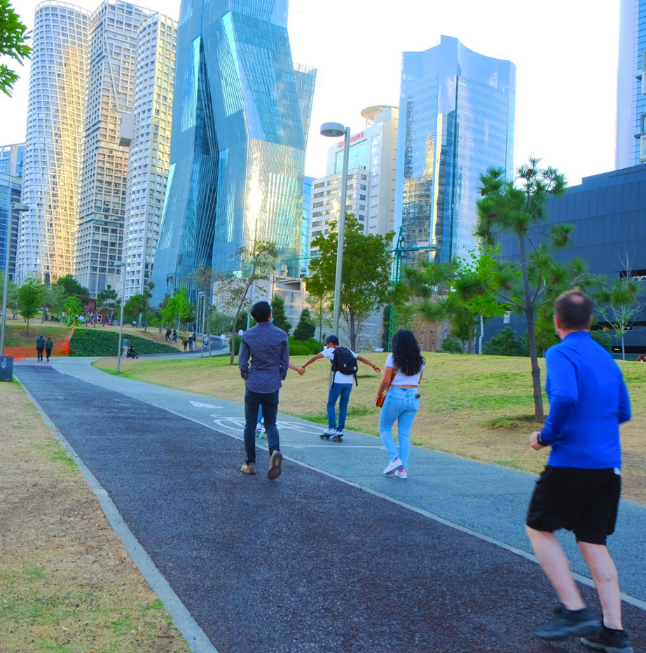
Our goal:
To provide comparable, evidence-based spatial and policy indicator data of healthy and sustainable urban design and planning for cities across the globe.
Our guiding principles:
- Open data and open science
- Interdisciplinary team science
- Global data for local impact
- Capacity building and equitable international collaborations
Our vision:
Grow to include additional indicators and comparable data for over 1000 global cities
Notes:
Our vision:
Grow to include additional indicators and comparable data for over 1000 global cities

Slide 56
Our goal:
To provide comparable, evidence-based spatial and policy indicator data of healthy and sustainable urban design and planning for cities across the globe.
Our guiding principles:
- Open data and open science
- Interdisciplinary team science
- Global data for local impact
- Capacity building and equitable international collaborations
  Join us in the 1000 cities challenge!
Our vision:
Grow to include additional indicators and comparable data for over 1000 global cities
Notes:
For this purpose, we invite all geospatial data scientists, urban health researchers, urban design and planning, citizen scientists, and policy makers from around the globe to join our initiative by helping us gather policy and spatial data from your cities, and apply our free and open access tools and code to calculate healthy and sustainable city indicators for your own cities, as well as to help us develop new indicators for this global initiative.
INTRODUCE ESTER CERIN THAT WILL FACILIATE THE PANEL.

