Slide 1

Global Physical Activity Initiatives – opportunities and challenges
Mark Tremblay, Ph.D., D.Litt. (hons), FCSEP, FACSM, FCAHS, CSEP-CEP
Senior Scientist, Children’s Hospital of Eastern Ontario Research Institute
Professor, Department of Pediatrics, University of Ottawa
President, Active Healthy Kids Global Alliance
Founder, Sedentary Behaviour Research Network
Chair, Outdoor Play Canada

Slide 2
Land Acknowledgement
Today I live, work, play and pray on the traditional unceded territory of the Algonquin Anishnaabeg People. I thank them for their oversight and stewardship of the land, water and air of this territory and commit to working with them to preserve, protect and respect these sacred resources.
Notes:
I am grateful to live, work, and play on the traditional unceded territory of the Algonquin Anishnaabeg people.

Slide 3
Overview
WHO Global Action Plan on Physical Activity
WHO Physical Activity and Sedentary Behaviour Guidelines
Active Healthy Kids Global Alliance “Global Matrix”
SUNRISE International Study
Discussion

Slide 4


Slide 5
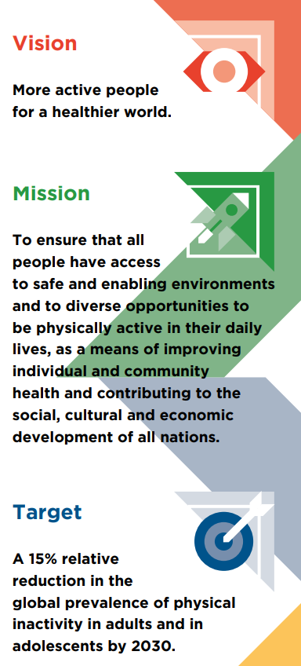

Slide 6
Guiding Principles
Human Rights Approach
Equity Across the Life Course
Evidence-based Practice
Proportional Universality
Policy Coherence and Health in all Policies
Engagement and Empowerment of Policy-makers, Peoples, Families and Communities
Multi-sectoral Partnerships

Slide 7
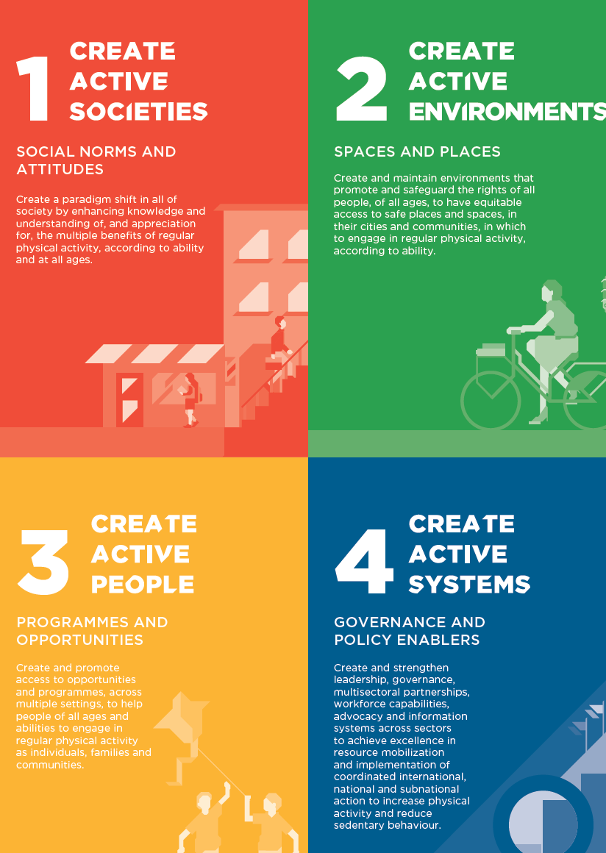

Slide 8
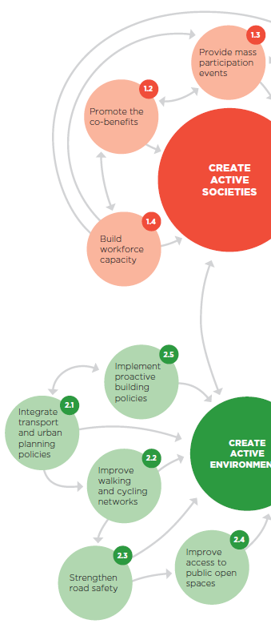
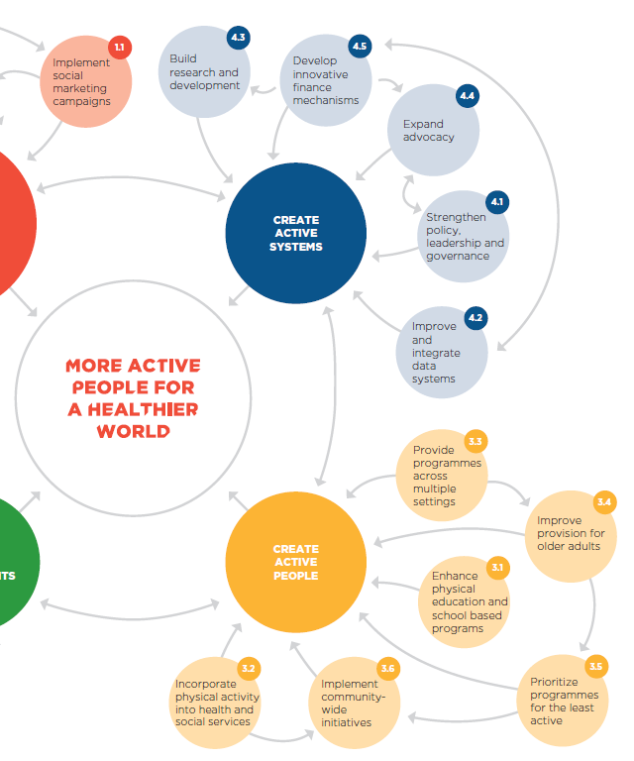

Slide 9
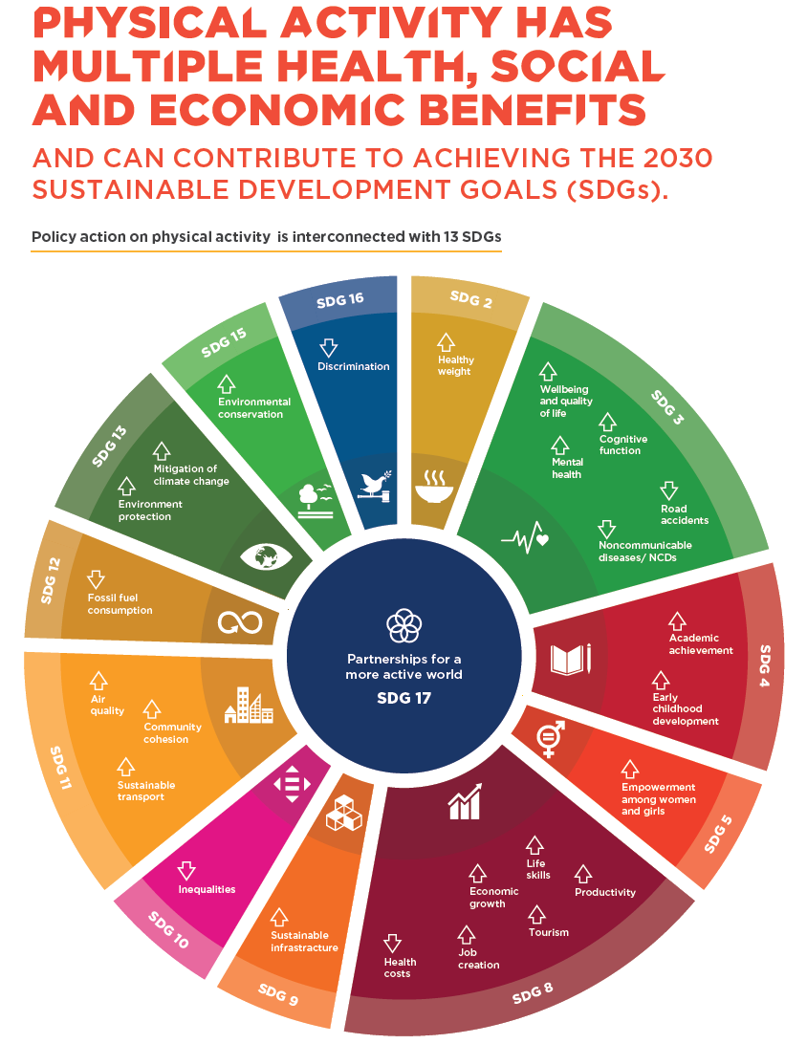

Slide 10
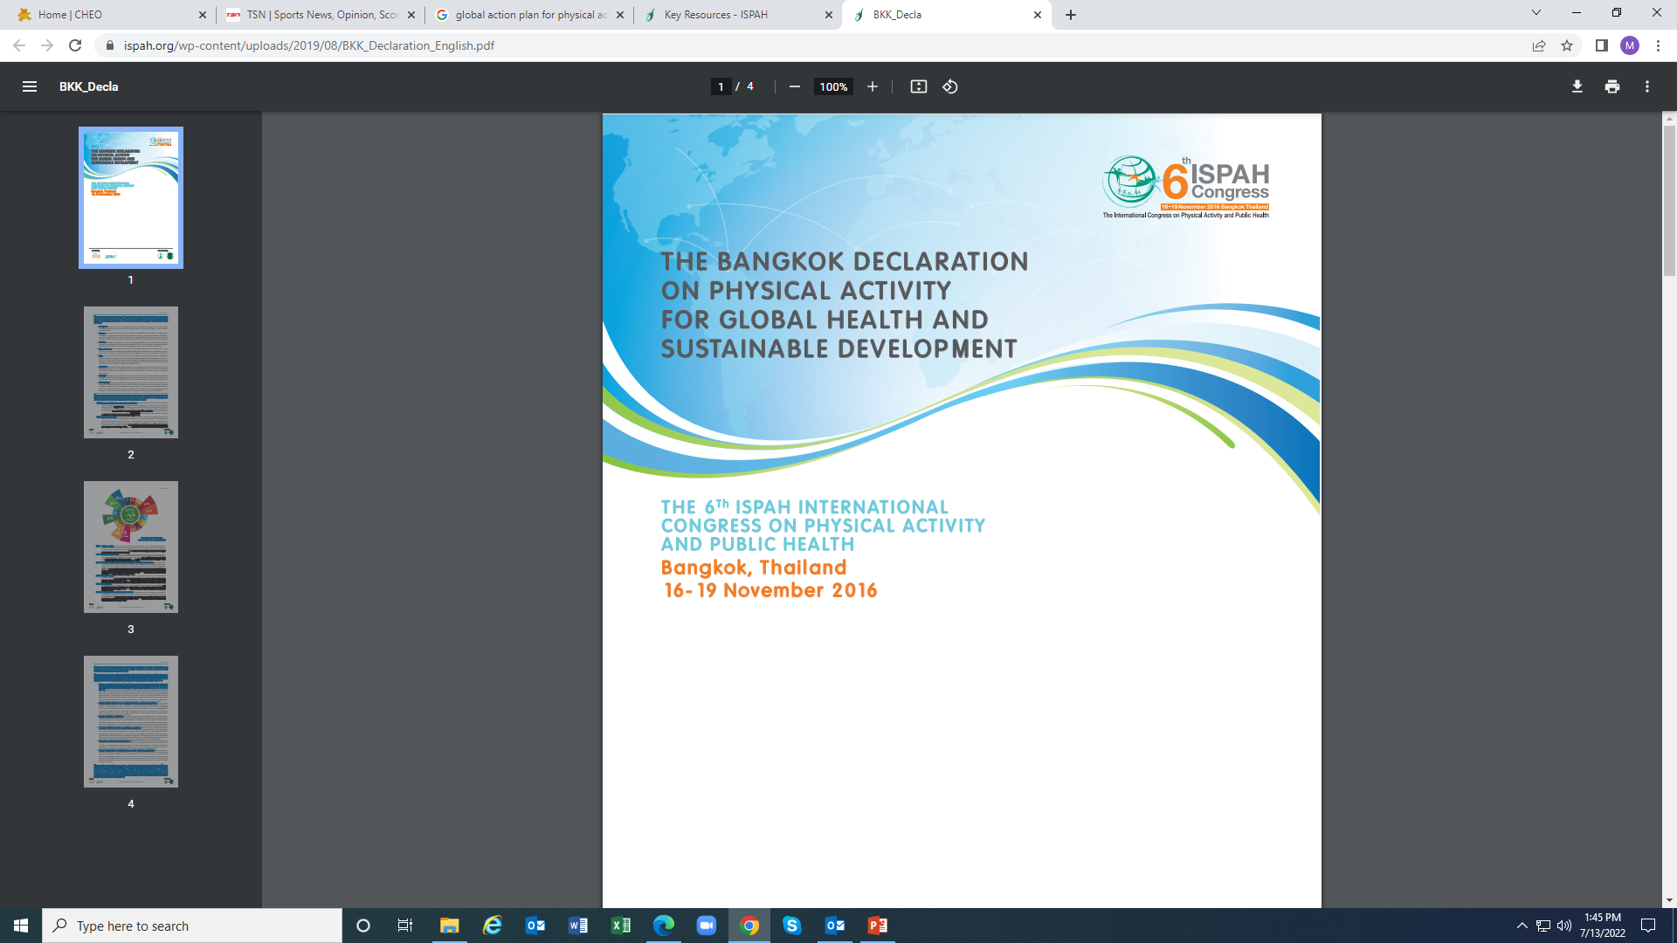

Slide 11
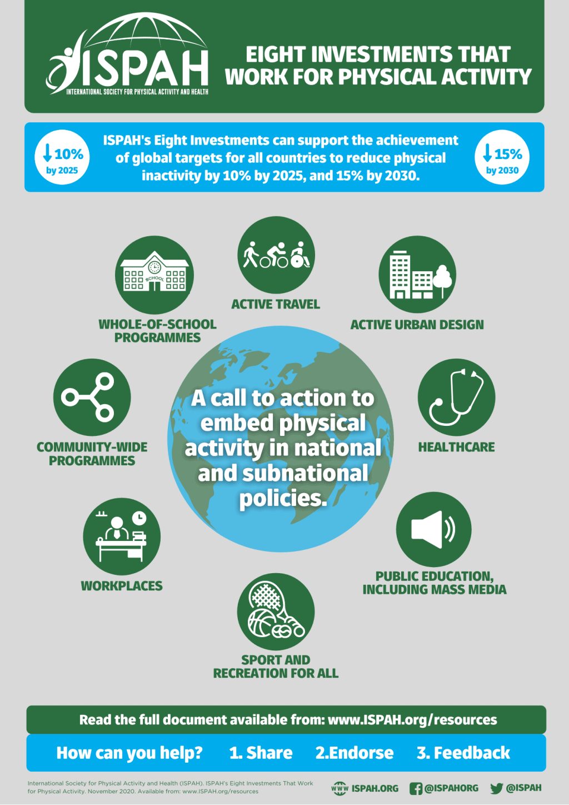

Slide 12
Lots of Opportunities!
Has the release of the GAPPA produced action? If so, is such action equitable across global regions?
Do GAPPA actions lead to achievement of SDGs?
Do the best buys work in different countries?
Do recommended approaches promote equality and equity across genders, SES, urban-rural areas, child ability/disability?
Is there evidence of adherence to the principle of proportional universality?

Slide 13

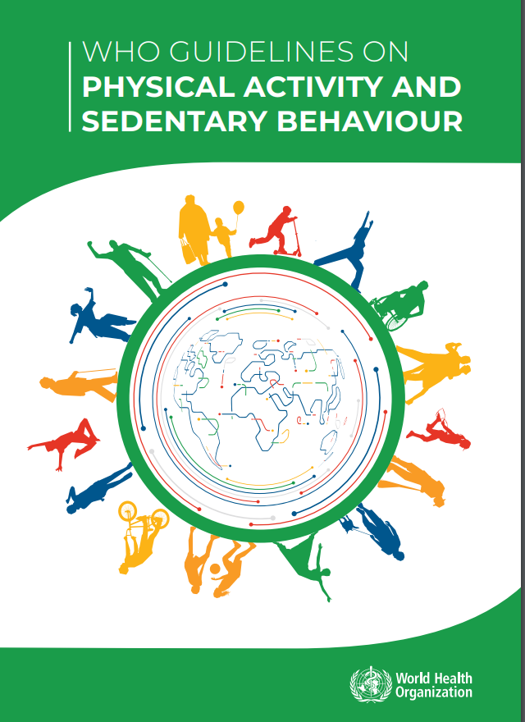
2019
2020

Slide 14
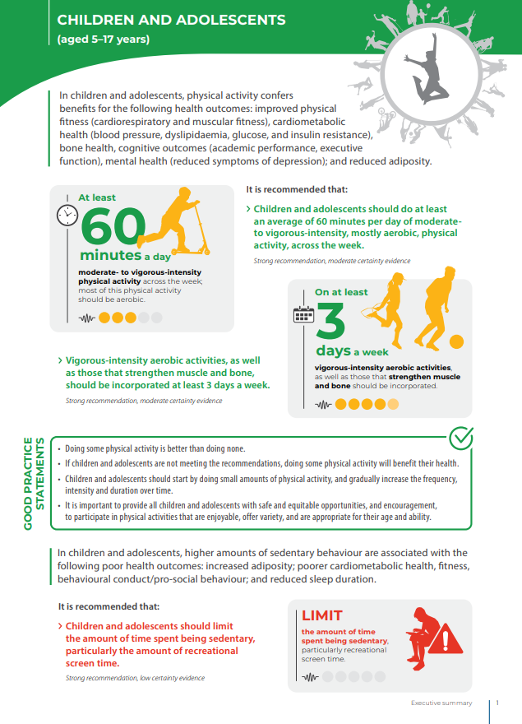

Slide 15
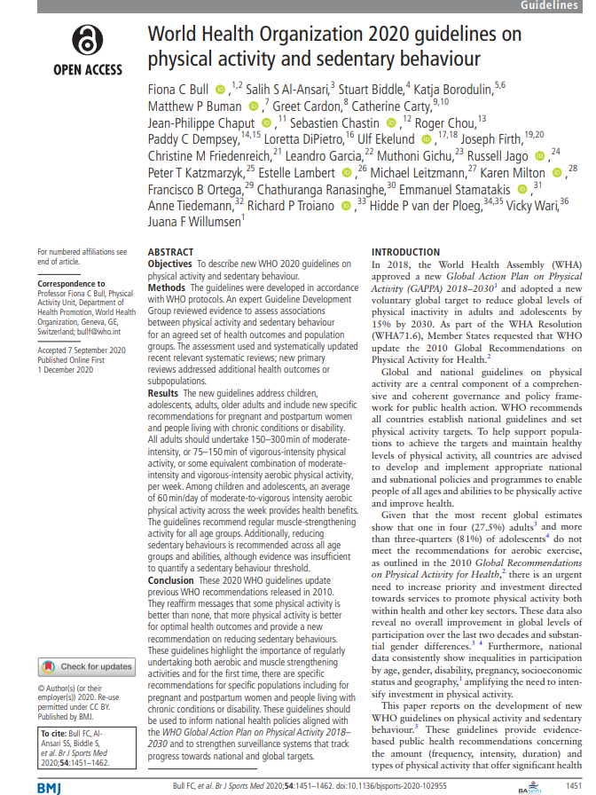

Slide 16
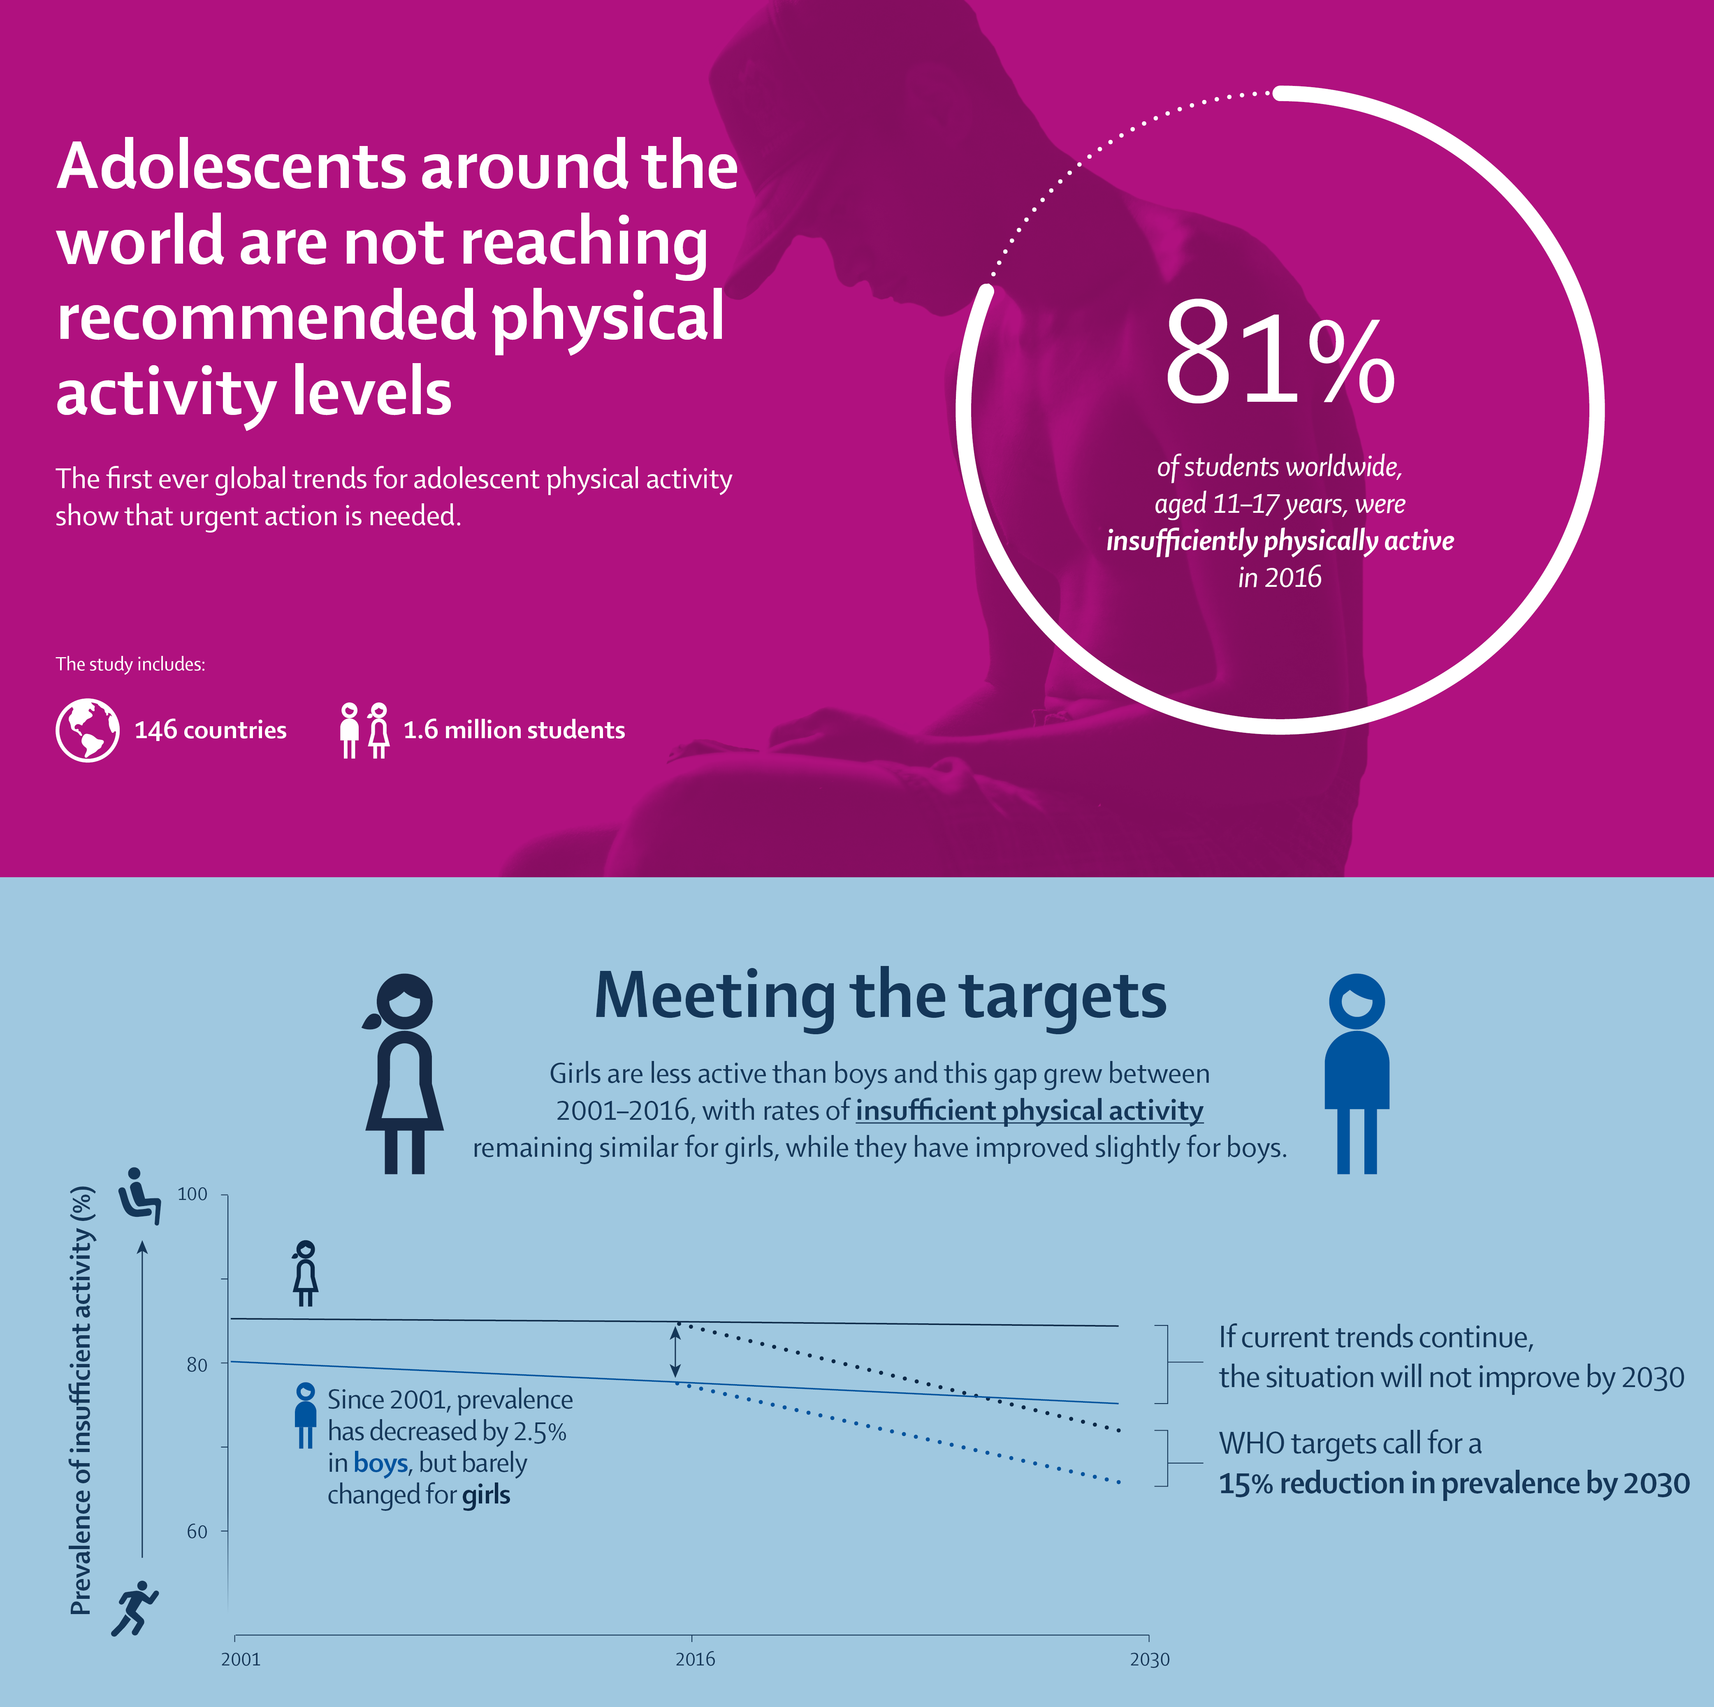
“Doing less than
60 minutes of
physical activity
on less than seven
days per week”
+ many adjustments
Guthold et al.
Lancet Child and
Adolescent Health
4(1):23-35, 2020

Slide 17
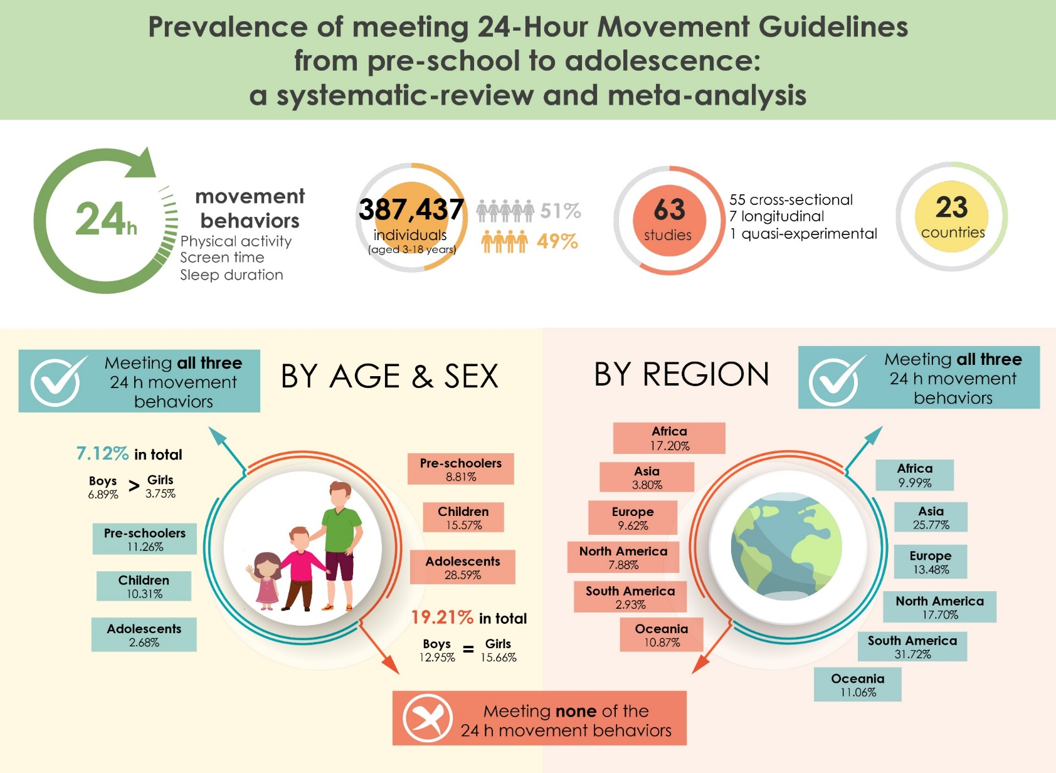
Tapia-Serrano et al. JSHS, 2022

Slide 18
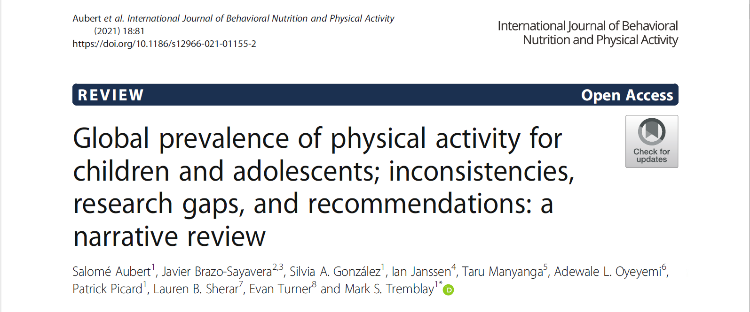

Slide 19
Extracted physical activity prevalence for 13 countries across 8 initiatives
Country | Guthold et al. (2019) 2016 estimated prevalence of physical activity activity of 11-17 years-olds (%) | Global Matrix 3.0 estimated prevalence of physical activity of 5-17 years-old (%) | 2018 HBSC Estimated prevalence of physical activity (%) |  |  | WHO country Fact Sheets estimated prevalence of physical activity of 13-15/13-17 years-old (%) | ISCOLE 2012 estimated prevalence of physical activity of 9-11 years-old (%) | ICAD estimated prevalence of physical activity of 9-10 years old (%) |  | Marques et al estimated prevalence of physical activity physical activity among 11-17 year-olds (%) | Xu et al. (2020) estimated prevalence of physical activity 0f 12-15 years-old (%)
 |  |  | Age | Boys | Girls |  |  | Boys | Girls
Australia | 11 | 20%–26% |  |  |  |  | 55.4 | 14 | 6
Brazil | 16.4 | 27%–33% |  |  |  |  | 43.9 | 7 | 2 | 12
Canada | 23.7 | 34%–39% | 11 | 37 | 30 |  | 42.6 |  |  | 25
 |  |  | 13 | 32 | 20
 |  |  | 15 | 28 | 14
China | 15.7 | <20% |  |  |  | 12.2 | 15.1
Egypt | 12.5 |  |  |  |  | 16.5 |  |  |  | 14.5 | 12.6
Estonia | 15.9 | 20%–26% | 11 | 20 | 18 |  |  | 26 | 18 | 16.4
 |  |  | 13 | 16 | 12
 |  |  | 15 | 16 | 11
Finland | 24.6 | 27%–33% | 11 | 52 | 38 |  | 61.4 |  |  | 27.9
 |  |  | 13 | 33 | 24
 |  |  | 15 | 22 | 12
Ghana | 12.5 | 47%–53% |  |  |  |  |  |  |  | 13
India | 26.1 | 27%–33% |  |  |  | 30.2 | 25
Lebanon | 17.9 | 27%–33% |  |  |  | 13.2 |  |  |  | 24.6 | 23.4
Slovenia | 20 | 80%–86% | 11 | 31 | 22 |  |  |  |  | 18.5
 |  |  | 13 | 28 | 17
 |  |  | 15 | 24 | 11
USA | 28 | 20%–26% |  |  |  |  | 26.5 | 9 | 2 | 32.3
Zimbabwe | 13.4 | 54%–59%
“For example, the USA had one of the highest levels of PA in Guthold et al. and Marques et al., [20,29] but one of the lowest levels in the Global Matrix 3.0, ISCOLE study and ICAD 1.0 [30,34,35].”

Slide 20
Inconsistencies observed across the included physical activity surveillances initiatives
  Physical activity definition: most studies/initiatives used >60 minutes/day of MPVA but lots of other definitions are used (i.e. 60 minutes/day of physical activity on 5 or more days/week)
  Data collection and analysis methods varied significantly between initiatives
  Estimated physical activity prevalence of children and adolescent for the same country varies across included initiatives
  Cross-country comparisons differs across initiatives (i.e. countries with the highest and lowest prevalence of physical activity are not the same!)

Slide 21
Surveillance Gaps
Almost no data on early years (0-4-year-olds) and children below 10 are under represented compared to adolescents (11-17-year-olds)
Almost no data available for children or youth with special needs
Less data available in low-income countries and generally lower quality (i.e. smaller sample size, older data)
Majority of the available international data was collected using self reported questionnaires vs device-based measurement

Slide 22
Lots of Opportunities!
Address data gaps!
How valid and reliable are physical activity monitoring and surveillance instruments across genders, cultures, SES, urban-rural locations, abilities/disabilities, immigrants/non-immigrants?
Do monitoring and surveillance methods capture all domains of physical activity (leisure, domestic, school, work, transportation)?
What are the consequences of informing decision-making, investments and policy alternatives when using biased data?
Same measurement issues exist for sedentary behaviours only worse!

Slide 23

www.activehealthykids.org

Slide 24
Active Healthy Kids Global Alliance
(established in 2014; incorporated in 2018)
Mission
The Active Healthy Kids Global Alliance is committed to powering the global movement to get kids moving through thought leadership, knowledge translation and mobilization, capacity building, and advocacy. This is facilitated by sustainable partnerships and cross-sectoral collaborations that enable best-practice exchanges, networking and cross-fertilization.
Vision
A world of active healthy kids.

Slide 25
History
Active Healthy Kids Canada started developing a Report Card on the Physical Activity of Children and Youth in 2005 in an effort to power the movement to get kids moving
More than 70 jurisdictions have replicated the Canadian Report Card (countries, regions, provinces/states, cities)
The Active Healthy Kids Global Alliance was established in 2014 to facilitate international comparisons among Report Card findings using a “Global Matrix” of grades
In 2018 the Active Healthy Kids Global Alliance was incorporated as a not-for-profit organization

Slide 26
Report Card Framework and Process
  The Report Card assigns letter grades to different indicators grouped into categories
  Grades are based on a synthesis and examination of current data against a benchmark
  Assessment of trends over time and the presence of disparities
  Together the indicators provide a robust and comprehensive assessment of physical activity of children and youth

Slide 27
Report Card Leadership Committee
National in scope
Cross-sectoral representation
Unbiased
Transparent
Participatory
Consensus driven
Harmonization with AHKGA

Slide 28
Global Matrix 4.0 Indicators Framework
Five behaviours
  Overall physical activity
  Organized sport and physical activity
  Active play
  Active transportation
  Sedentary behaviour
One personal characteristic – Physical Fitness
Four settings and sources of influence
  Family and peers
  School
  Community and environment
  Government

Slide 29
Benchmarks
Overall Physical Activity | Any bodily movement produced by skeletal muscles that requires energy expenditure. | % of children and youth who meet the Global Recommendations on Physical Activity for Health, which recommend that children and youth accumulate at least 60 minutes of moderate- to vigorous-intensity physical activity per day on average.
Organized Sport and Physical Activity | A subset of physical activity that is structured, goal-oriented, competitive and contest-based. | % of children and youth who participate in organized sport and/or physical activity programs.

Slide 30
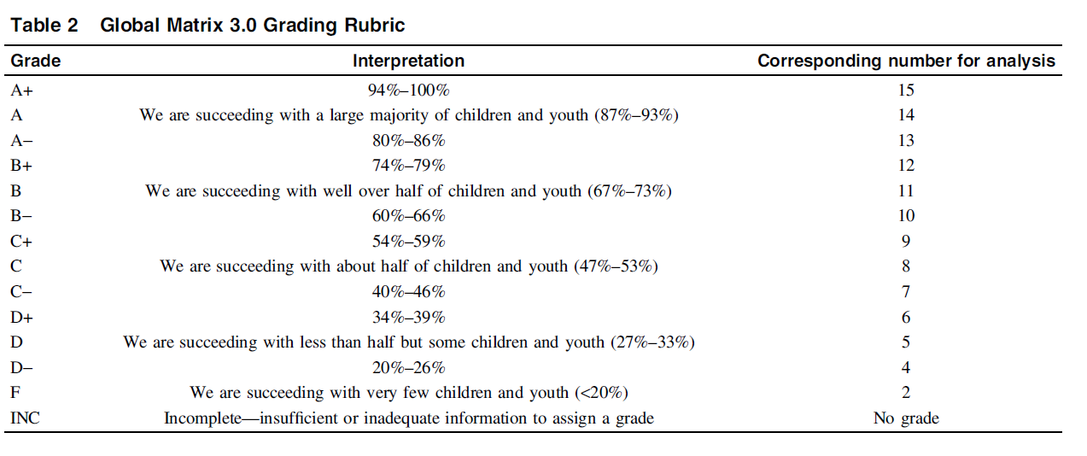
Grading Framework
Notes:
Question: Colour code?
Animation:
Table already there.
“Common benchmarks” text comes in after table ON CLICK
Fine as is.

Slide 31
Form and Format
  Report Card(s)
  Print and electronic
  Multiple languages in some countries
  Housed on Active Healthy Kids ________ website

Slide 32

The Report Card Serves as…
A public awareness mechanism and call to action through a nationwide media advocacy strategy
An accountability index for all citizens
A surveillance synthesis mechanism
An advocacy tool for physical activity leaders and organizations
A policy driver
A compass for identifying strengths, weaknesses, priorities
  Data driven policy-making
A process for identifying research and surveillance needs
A challenge to other jurisdictions to implement similar processes to allow comparisons and facilitate improvements
Notes:
32
32

Slide 33
Media Uptake
Canadian Report Card

Slide 34
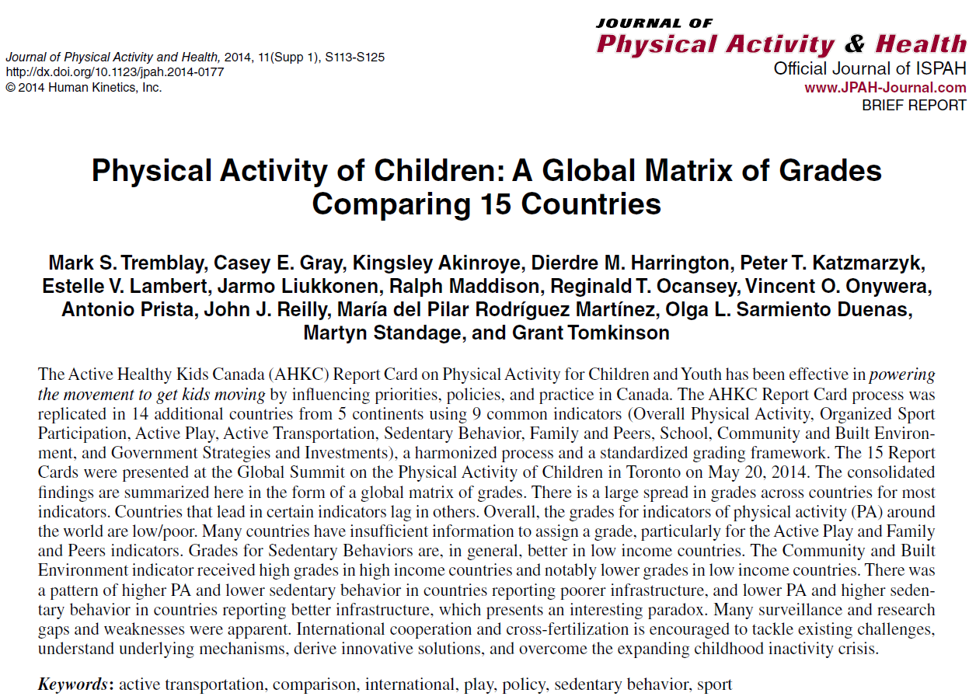
Global Matrix 1.0
2014

Slide 35
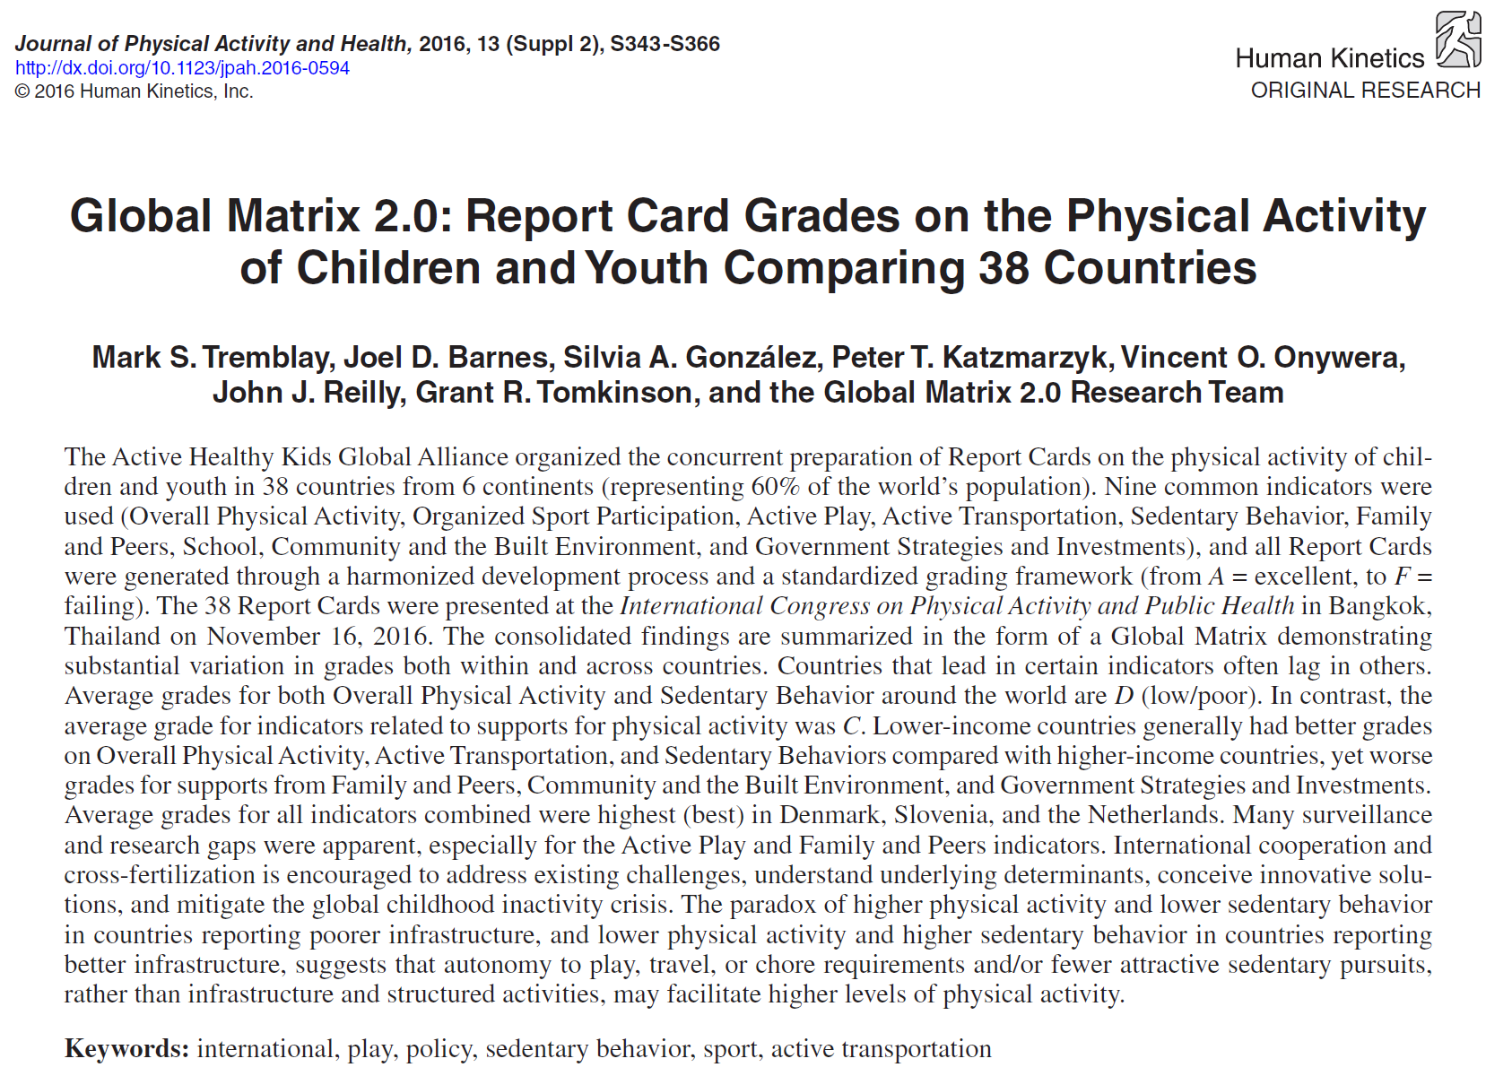
Global Matrix 2.0
2016

Slide 36
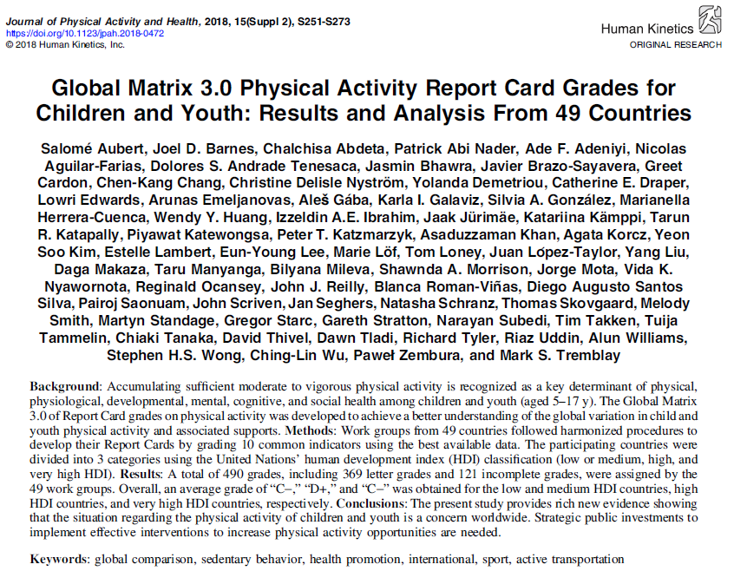
Global Matrix 3.0
2018

Slide 37
Findings – Overall Physical Activity
Benchmark: % of children and youth who meet physical activity guidelines
Data from 1,367,783 children
Global average: D
HDI variation
  low and medium HDI: C-
  high HDI: D-
  very high HDI: D-
Slovenia reported the highest grade (A-); six countries reported failing (F) grades
Only two countries (Botswana and Japan) reported INC grades
Grades were generally higher in low and medium HDI countries and a significant negative correlation was observed between HDI and overall PA grade

Slide 38
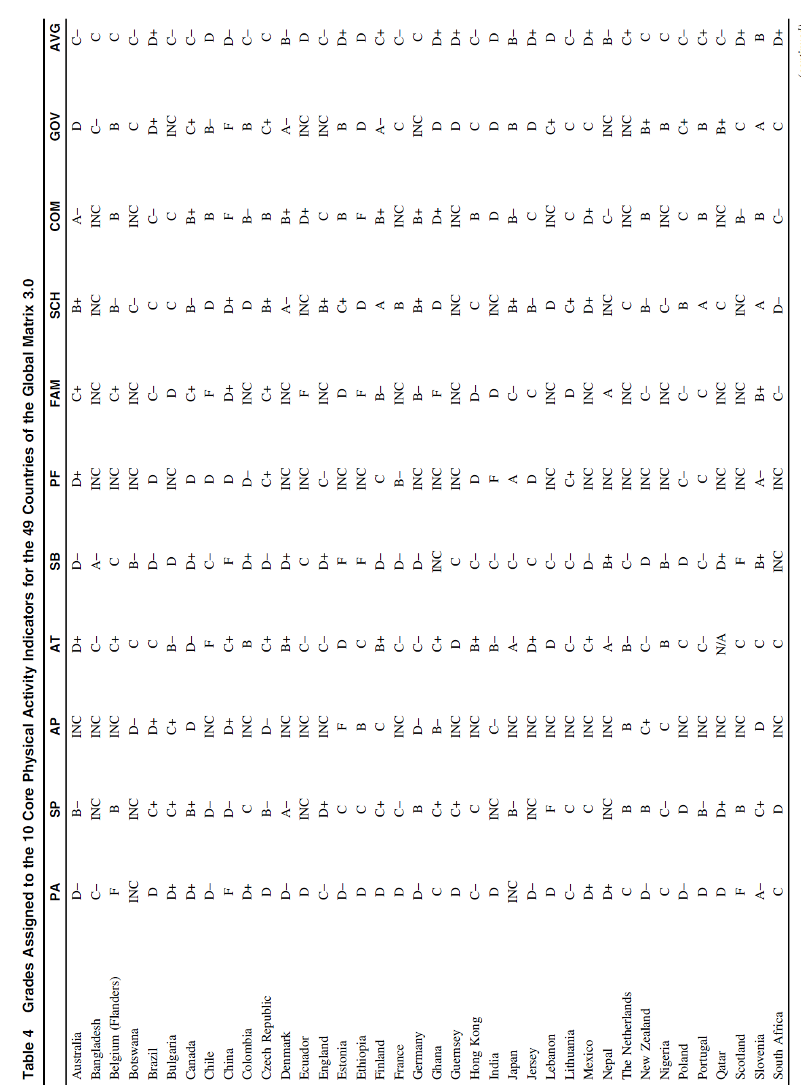
Global Matrix 3.0

Slide 39
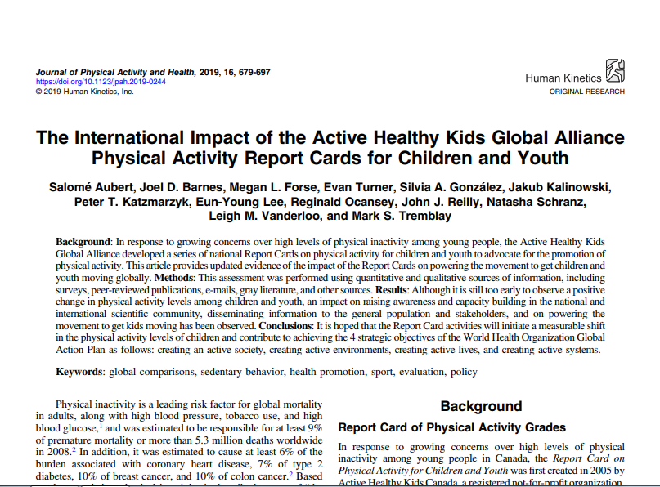
International Impact Paper

Slide 40
International Evaluation Paper

Slide 41
Number of countries participating in the
Global Matrix 1.0 (2014), 2.0 (2016),
3.0 (2018) and 4.0 (2022) sorted by country
Human Development Index

Slide 42
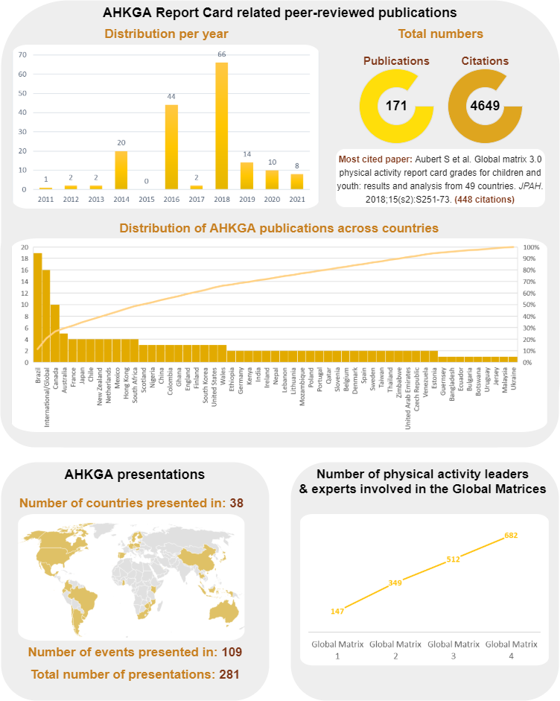

Slide 43
Lots of Opportunities!
Respect all domains of physical activity (and sedentary behaviour)
Consider measuring sources of influence (family, peers, school, community, government)
Exploit and assess cross-fertilization and capacity-building opportunities
Active Healthy Kids Global Alliance Global Matrix 4.0—A Resource for Physical Activity Researchers
  In press
  Invitation to use AHKGA information

Slide 44





Slide 45





AIMS OF SUNRISE
Assess the % of children who meet WHO Guidelines
Examine associations with health and development
Examine SDG-related correlates
Co-creation of knowledge
Notes:
less than 10% of evidence from LMICs

Slide 46
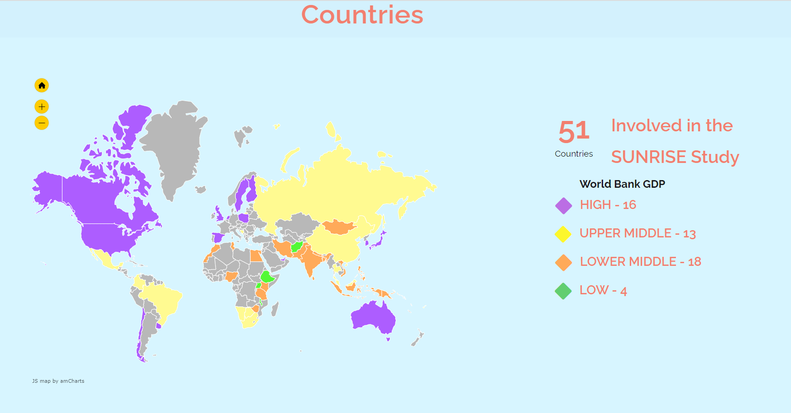
Notes:
ratio 2:1
most recent additions Egypt (Aya Ali Cairo University) and Afghanistan (Nadia Askeer JHU)

Slide 47
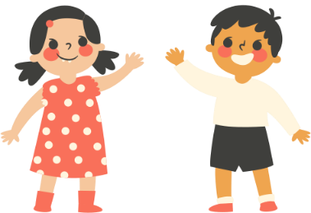


PILOT PHASE
100 children
(50 urban/50 rural)
Feasibility and acceptability of protocol
Building working relationships
Notes:
These are the aims of the pilot phase

Slide 48



MAIN STUDY
1000 children
(500 urban/500 rural)
Broadly nationally representative sample
Examine global, regional and national patterns
Advocate for needs
of children
Notes:
These are the aims of the main study.
Again, progress has been impacted as a result of COVID

Slide 49
A BRIEF HISTORY
JANUARY
2017
AUGUST 2017
JANUARY
2018
AUGUST
2018
JUNE
2019
APRIL
2022
SUNRISE conceptualization germination
First Leadership Committee
gathering in
Hong Kong
SUNRISE Pilot
studies begin
Second Leadership Committee
gathering in Wollongong
Third Leadership Committee
gathering in
Prague
First SUNRISE Annual General Meeting
Australia
Canada
Scotland
Australia
Brazil
Canada
China
Scotland
South Africa
USA
Brazil
Canada
China
Japan
PNG
South Africa
South Korea
Zimbabwe
Australia
Brazil
Canada
China
PNG
Scotland
South Africa
USA
Australia
Brazil
Canada
China
PNG
South Africa
Scotland
43 countries now involved!

Slide 50

How was the SUNRISE research agenda developed?
initial concept emerged from WHO early years 24-hour guideline development which had global leadership and input
SUNRISE International Leadership Group formed
  co-development initially with representation for all inhabited continents
  now with representation across all 8 United Nations SDG regions, an observer from UNICEF and WHO, one advisor, and a statistician and data assurance expert
Research Agenda decisions made by consensus

Slide 51
How was the SUNRISE research agenda developed?
Protocol modifications made progressively through three pilot study phases based on feasibility constraints, cultural applicability, and input from participating countries
Some constraints or limitations imposed by research ethics, research processes, and compromises between jurisdictions

Slide 52
Inherent Challenges to the Research Agenda
Remaining fluid and responsive versus ensuring comparability and consistency
Changing and advancing technology and methodologies
Unforeseen circumstances (e.g., COVID-19, armed conflicts, severe weather, strikes)
Equipment sharing and transport
Costs
Delays and timing of main study data collection

Slide 53
Lessons learned – successes and failures
Lessons learned in pilot studies helped in successfully refining the protocol and data collection methods to achieve maximum compliance
  Translation of data collection tools to local language
  Additional questions related to food habits and eating behaviour in Parent Questionnaire
  Use of local human resources as data collectors
  Use of ActiPAL discontinued for data collection due to difficulty in placing on thigh

Slide 54
Lessons learned – successes and failures
Involving caretakers/parents and stimulating children for proper use of accelerometers as well as to avoid loss
Daily telephonic reminders for good compliance
Use of iPad tasks for assessment of Executive function and training data collectors o support the children
Use of NIH toolbox instead of ASQ to assess motor skills
Addition of questions related to centre to gain more insights into the influence on movement behaviours of children

Slide 55
Lots of Opportunities!
Very little 24-hour movement behavior data on early years children – within or between countries
Assess differences across genders, cultures, SES, urban-rural locations, abilities/disabilities, immigrants/non-immigrants?
Trial interventions to address identified inequities
Compare family-based vs institutional child care
Explore mediating effects of outdoor time on movement behavior relationships with health indicators
Opportunities to explore linkages with geopolitical variation, climate and climate change

Slide 56
Lots of Challenges
Issues of global validity of surveillance methods
Uncontested generalizations
No surveillance for early years (0-4 years) or pre-adolescent schoolchildren (5-10 years)
No prevalence targets for early years (0-4 years) or pre-adolescent schoolchildren (5-10 years)
Inclusion of children with a disability or chronic disease
Representation of children living in rural areas
24-hour movement vs physical activity and/or sedentary behaviour
Different benchmarks – daily vs average day
Addition of sedentary behaviour but no specificity of amount
Tough to make things global!

