Slide 1
Issues in the Design of Randomized Controlled Dose Response Intervention Studies in PA and Health
Physical Activity and
Public Health
Columbia, SC
16 September 2022
William E. Kraus, M.D.

Slide 2
What Will I Get Out of This Talk?
If I am fortunate, three things!
What’s with this Kraus Guy?
Note Taking
Prolonged Sitting

Slide 3

Read this Book:
The Sense of Structure
George D. Gopen

Slide 4

Read this Book:
Thinking Fast and Slow
Daniel Kahneman
The grandfather of
Behavioral Economics

Slide 5

Listen to this Podcast:
Hidden Brain
Shankar Vedantum interviews
Leidy Klotz
“Do Less”
6 June 2022

Slide 6
Why Do We Need Clinical Trials?
Three studies where epidemiology has misled—one of which caused significant excess morbidity and mortality, one of which might have:
Arrhythmias and sudden cardiac death
-> CAST Trial
HRT and CVD in post-menopausal women
-> HERS, WHI Trials
Homocysteine and CVD risk
-> Folate replacement for prevention

Slide 7
Standard Components of a Good Clinical Trial
Randomized – to address unmeasured confounders at baseline
Controlled – to address effect of unmeasured confounders
Blinded – to control for treatment and measurement bias, especially in subjective measures

Slide 8
Don’t look at the slides …..
….. Behind the curtain

Slide 9
Special Considerations for Randomized Controlled Exercise or PA Clinical Trials

Slide 10
Considerations—PA Studies
What is being tested
The gender issue
When to measure what
These issues apply to population and cohort studies as well

Slide 11
Considerations (1)
What is being tested?
Intensity
Amount; over what period?
Frequency
Energy Expenditure

Slide 12
A Three Body Problem
Energy Expenditure
Duration &
Frequency
Intensity

Slide 13

STRRIDE Assessments
Domains and Tools:
Fitness Exercise testing
Body composition CT, Skinfolds
Insulin sensitivity IVGTT
Lipid profile Fasting plasma, NMR
Food intake Recall measures
hsCRP Fasting plasma, ELISA
24h
96h
2w
3 months
Ramp-up
6 months
Training
2 weeks Detraining
Low-Amount/Moderate Intensity Group
44
Low-Amount/High
Intensity Group
49
High-Amount/ High
Intensity Group
50
Control Group
50

Slide 14
STRRIDE
335 Randomized
Low-Amount/Moderate Intensity Group
73
1200 kcal/week
or 12 miles/week
at 40-55% VO₂ max
Control Group
73
Inactivity
Low-Amount/High
Intensity Group
103
1200 kcal/week
or 12 miles/week
at 65-80% VO₂ max
High-Amount/ High
Intensity Group
86
2000 kcal/week
or 20 miles/week
at 65-80% VO₂ max
24h
96h
2w
3 months
Ramp-up
6 months
Training
2 weeks Detraining

Slide 15
STRRIDE - Training Protocols
Protocol Intensity Amt Min/wk
(peak VO₂) (kcal/wk) (min per wk)
Brisk Walking 13 miles/week 1300 170
Jogging 13 miles/week 1300 120
Jogging 22 miles/week 2200 170
Inactive None None

Slide 16
STRRIDE - Training Protocols
Protocol Intensity Amount/Dose
(peak VO₂) (kcal/wk) (min per wk)
Low/Mod 40-55% 1300 170
Low/Vigor 65-80% 1300 120
High/Vigor 65-80% 2200 170
Inactive None None None
Amt
Freq
Int

Slide 17
STRRIDE II - Training Protocols
Protocol Intensity Amount Frequency
AT 65-80% VO₂ 1300kcal 3x per wk
RT 3 reps of 12-15 reps 3x per wk
AT/RT combination AT/RT 3-5x per wk
High AT 65-80% VO₂ 2200kcal 3x per wk

Slide 18
STRRIDE - Training Protocols
Intensity Amount Presc Wt. Loss
(peak VO₂) (kcal/wk)
Brisk Walking 16 miles/week None
Jogging 16 miles/week None
Brisk Walking 10 miles/week None
DPP Program 10 miles/week 7%
Diet

Slide 19
Considerations (2)
The Gender Issue

Slide 20
Energy Expenditure
Duration &
Frequency
Intensity

Slide 21
Net ∆ % VO₂ max (mL/kg/min)
Net ∆ VO2 max (L/min)
STRRIDE
STRRIDE
DREW
DREW
% VO2 max 50% 40-55% 65-80%
% VO2 max 50% 40-55% 65-80%

Slide 22
Considerations (3)
What to Measure When Relative to the Last Training Bout

Slide 23
Change S_{i} (%) with Exercise Training
120
*
#
*
#
100
80
60
*
40
20
0
-20
Inactive
Low Dose
Low Dose
High Dose
Moderate
Vigorous
Vigorous

Slide 24
6
Low/Moderate
5.5
Low/Vigorous
5
High Vigorous
4.5
ISi Units
4
3.5
3
2.5
Pre
Post
4d DT
14d DT
Time Period

Slide 25
Comparison of High Amount Vigorous at 9 months to
Low Amount Vigorous Exercise at 15 months

Slide 26












Working as a Collaborative -- MoTrPAC

Slide 27
A Few Words about MoTrPAC
Big Science
Collaborations
Work in Progress

Slide 28
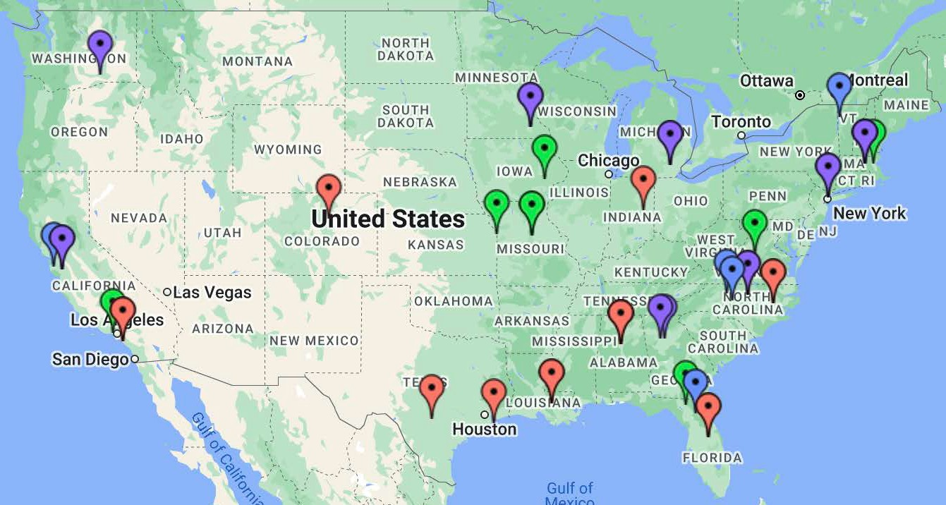
MoTrPAC Team
Coordinating Center - U of Florida, Wake Forest, U of Vermont
Bioinformatics Data Center - Stanford Chemical Analysis Sites - Broad, Duke, Emory,
Georgia Tech, Mayo Clinic, Michigan, Mount Sinai, Stanford, Pacific Northwest National Lab
Animal Sites - Iowa, Florida, Harvard, UCLA, Virginia, Kansas Med Center, Missouri
Human Clinical Centers
ExPACT - Ball State/Alabama/Florida
U of Colorado - Denver
Duke/East Carolina University
Texas (San Antonio and UTMB)
Pennington Biomedical Research Center
U of California - Irvine (Pediatric Center)

Slide 29
Reunion Slides

Slide 30
Reunion Protocol
STRRIDE I participants that finished intervention period—drop-outs not invited back.
10 years following completion invited back for CPX test, blood work, assessment of BP, lipids, FBG, FI, waist circumference and weight, PA in last three months.
Comparisons made to pre-intervention assessments.

Slide 31
Reunion Results
Inactive
Low Amount
Moderate
Low Amount
Vigorous
High Amount
Vigorous
Low Amount
Moderate
Low Amount
Vigorous
High Amount
Vigorous
Inactive
Inactive
Low Amount
Moderate
Low Amount
Vigorous
High Amount
Vigorous
Inactive
Low Amount
Moderate
Low Amount
Vigorous
High Amount
Vigorous

Slide 32
Absolute VO₂
Inactive
Low Amount
Moderate
Low Amount
Vigorous
High Amount
Vigorous

Slide 33
Mean Arterial BP
Inactive
Low Amount
Moderate
Low Amount
Vigorous
High Amount
Vigorous
Notes:
Inactive (10); LAMI (28); LAVI (35); HAVI (31). * Indicates P=0.05 versus LAMI.

Slide 34
Fasting Plasma Insulin
Inactive
Low Amount
Moderate
Low Amount
Vigorous
High Amount
Vigorous
Notes:
Inactive (10); LAMI (28); LAVI (35); HAVI (31). * Indicates P=0.05 versus LAMI.

Slide 35
Minimal Waist
Inactive
Low Amount
Moderate
Low Amount
Vigorous
High Amount
Vigorous
Notes:
Inactive (10); LAMI (28); LAVI (35); HAVI (31). * Indicates P=0.05 versus Inactive.

Slide 36
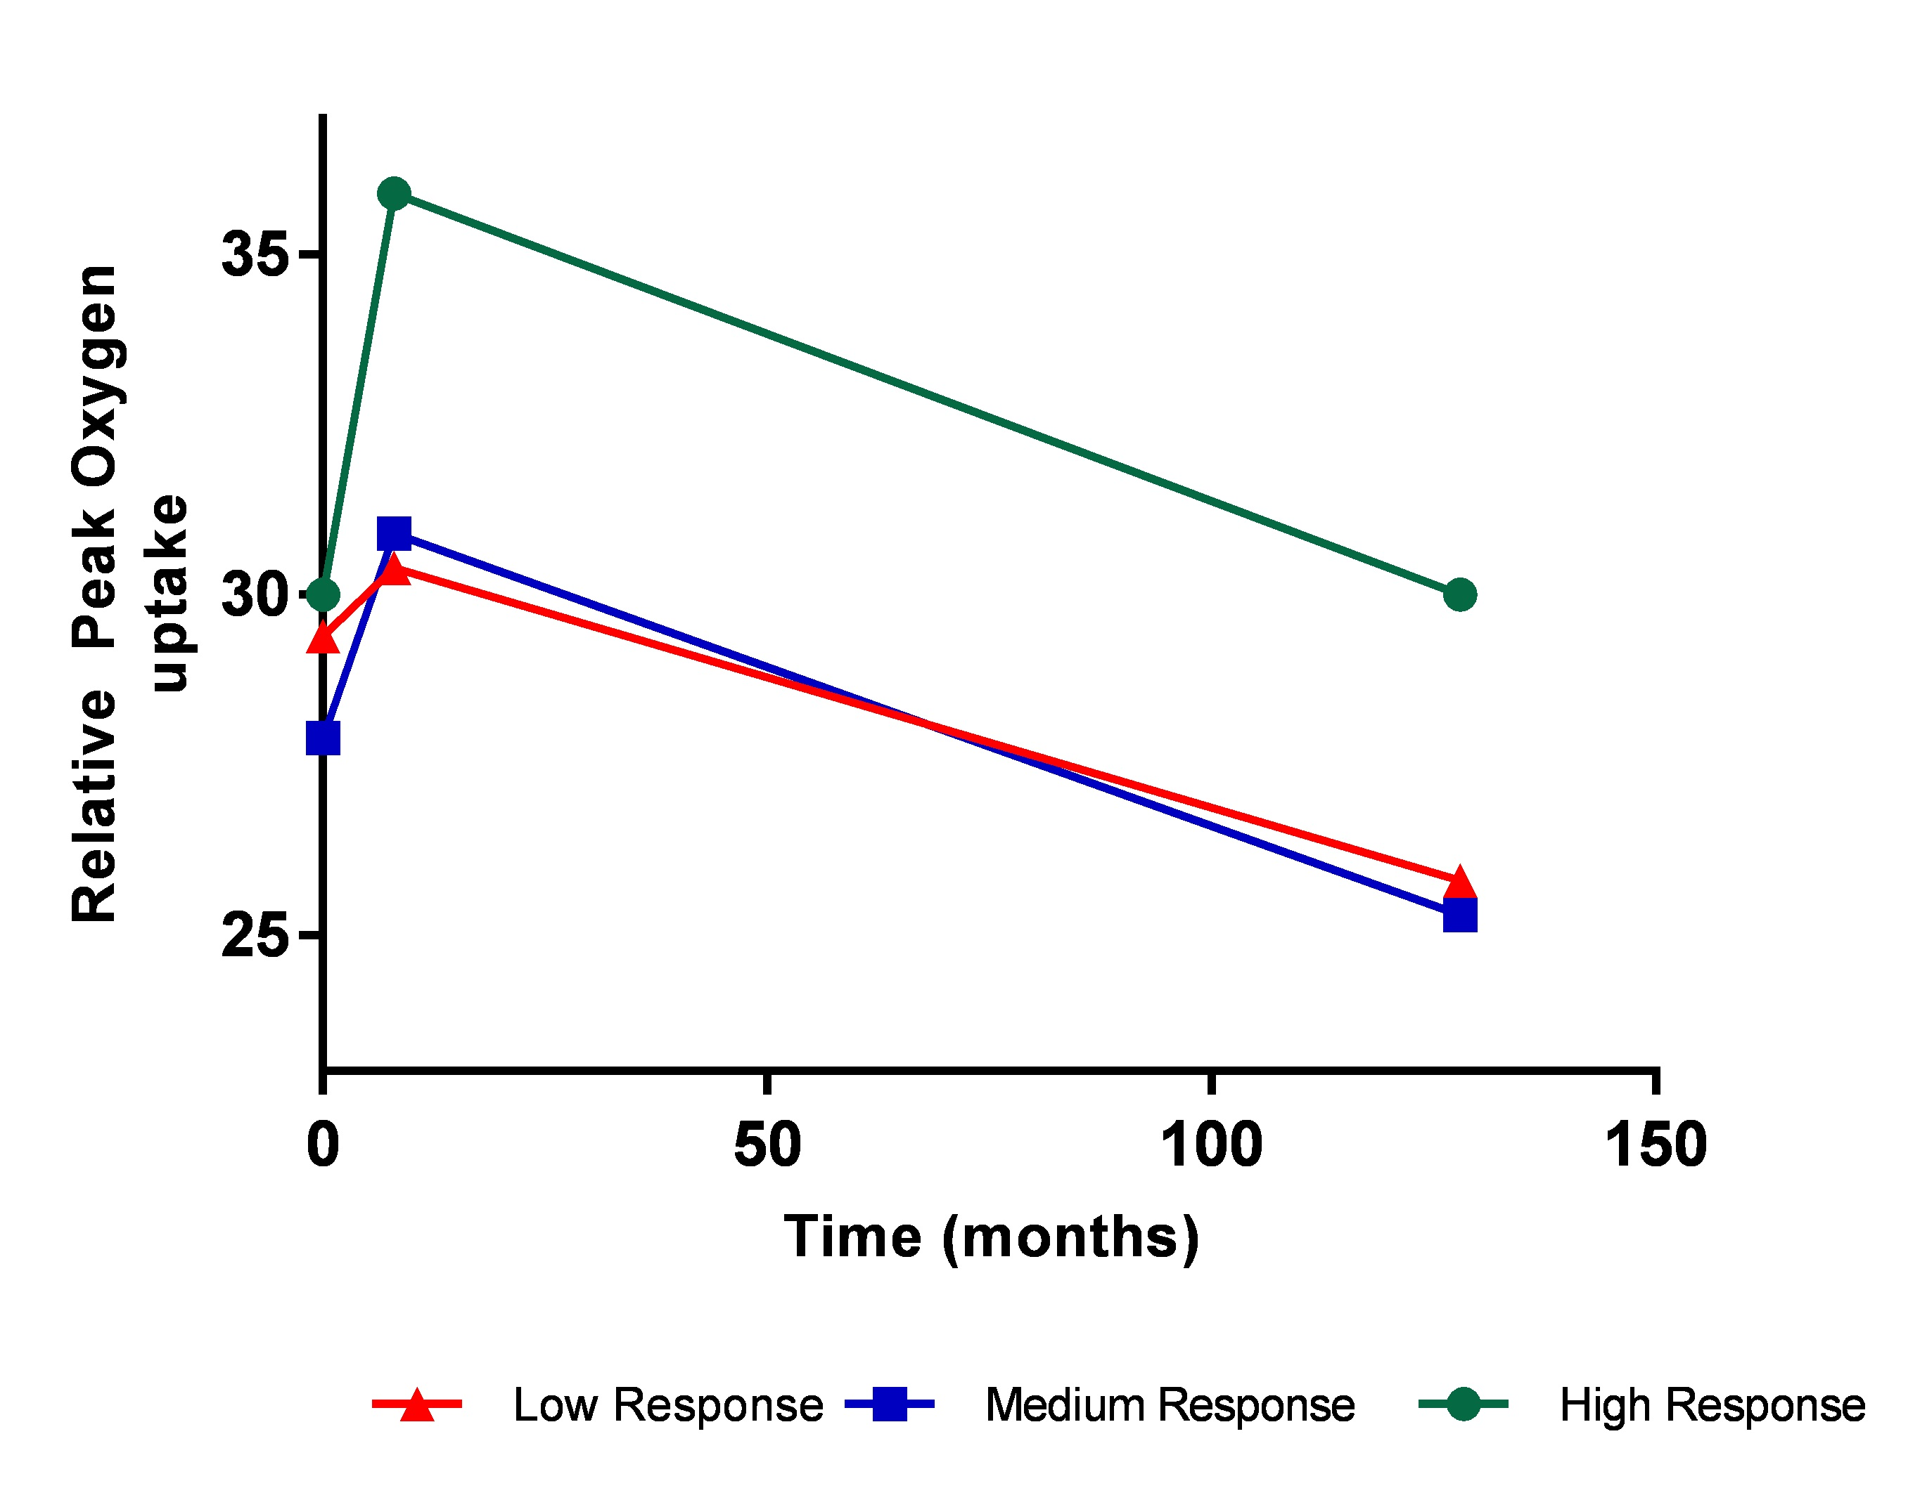
Change in Peak VO₂

Slide 38
PA at 10 Years
Exercise Sessions/Week (Last 3 Months)
Notes:
Inactive (10); LAMI (27); LAVI (34); HAVI (31)

Slide 39
PA at 10 Years
No
Yes
Exercise Sessions/Week (Last 3 Months)
Notes:
Inactive (10); LAMI (27); LAVI (34); HAVI (31)

Slide 40
Change MAP controlled PA
Δ MAP controlled for weekly PA Last 3 Mo.
Inactive
Low Amount
Moderate
Low Amount
Vigorous
High Amount
Vigorous
Notes:
Different LAMI P=0.003; 0.06

Slide 42
(Additional) Questions?

