Slide 1

Contemporary Intervention Development Frameworks for Physical Activity Researchers
David E. Conroy, PhD
The Pennsylvania State University
@conroylab | www.conroylab.com
Physical Activity & Public Health Research Course | September 24, 2023 | Columbia, SC

Slide 2
Questions asked in behavioral intervention research & development
Do people need an intervention?
What kind of intervention do they need?
What type of intervention would they accept?
Which behavior change techniques should be used?
How and where will the intervention be delivered?
Is it possible to recruit participants & deliver an intervention?
How should dosing parameters be set for each component?
Does a treatment package work?
What factors influence intervention effects?
Who responds most/least to the intervention?
How do intervention adaptations impact effects?
Is the intervention cost-effective?
Is the intervention better than the existing standard of care?

Slide 3

Interventions will likely be more impactful – and grant applications more successful – if your intervention development process is systematic and ordered rather than chaotic.
Credit: Konstantin – stock.adobe.com

Slide 4
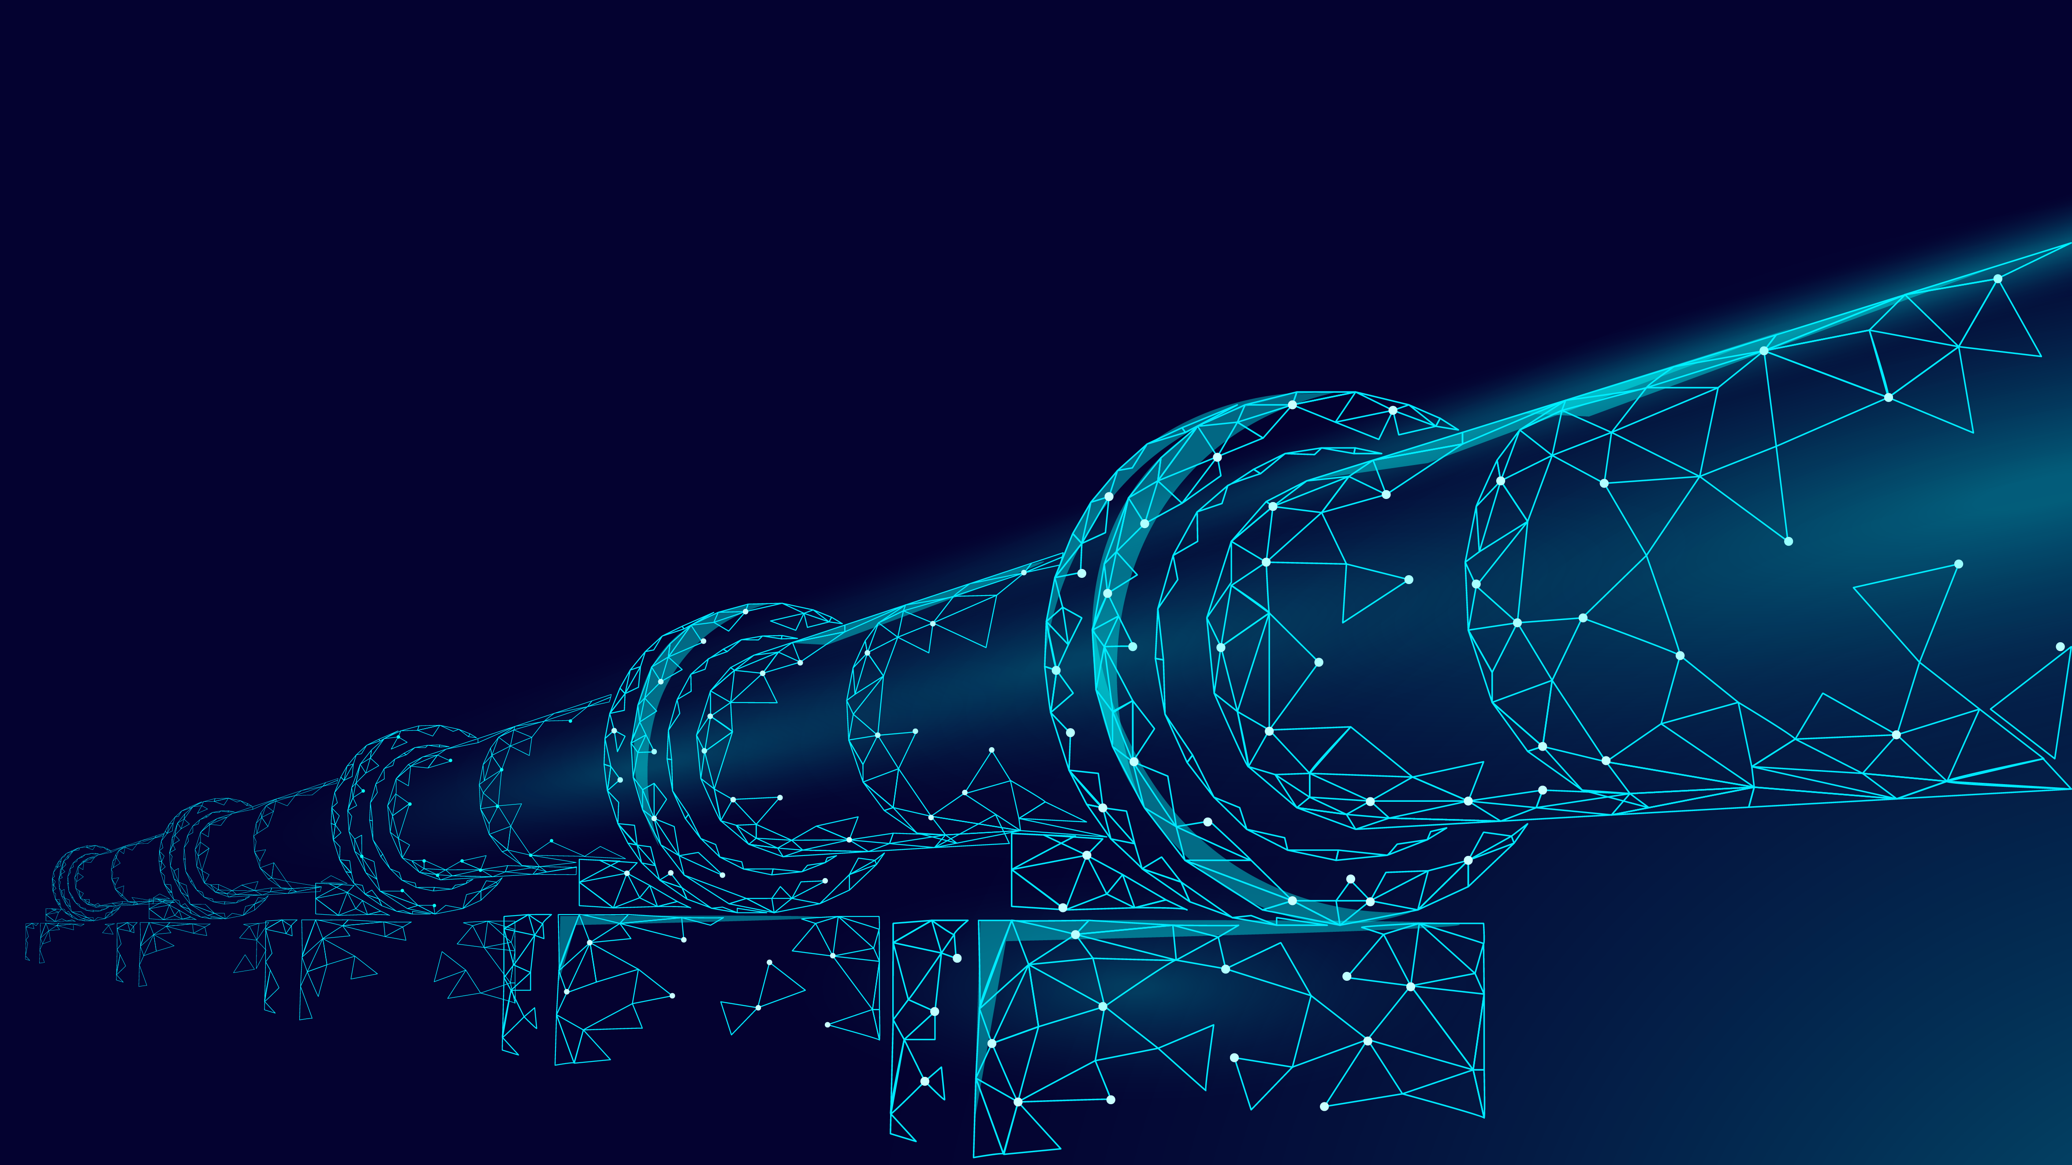
Intervention development is a long process with many steps
Credit: LuckyStep – stock.adobe.com

Slide 5
Too often, behavioral interventions have proven to be…
Unscalable
Weak or ineffective
Non-responsive to patient or stakeholder needs
Arbitrarily designed
Lagging behind basic behavioral science discoveries
Notes:
Reasons are many: lack of imagination, insufficient pilot testing leading to research generalizability bias (see Michael’s work), attraction to brute force methods

Slide 6

turn chaos and disorder…
Credit: leomalsam – stock.adobe.com

Slide 7

…into order
(& value)
Credit: Ivan Kmit – stock.adobe.com

Slide 8
Intervention development frameworks have existed for decades
PRECEDE-PROCEED (Green, 1974)
Intervention Mapping (Bartholomew Eldridge et al., 2016)
Greenwald & Cullen (1985) Five Phase Model
Flay (1986) Eight Phase Model
EVOLVE Mixed-Methods Approach (Peterson et al., 2013)
And many others…
Czajkowski & Hunter (2021) Health Psych

Slide 9

Contemporary models of intervention development are complementary
Science of Behavior Change
NIH Stage Model
Multiphase Optimization Strategy
ORBIT Framework
Credit: martialred – stock.adobe.com

Slide 10
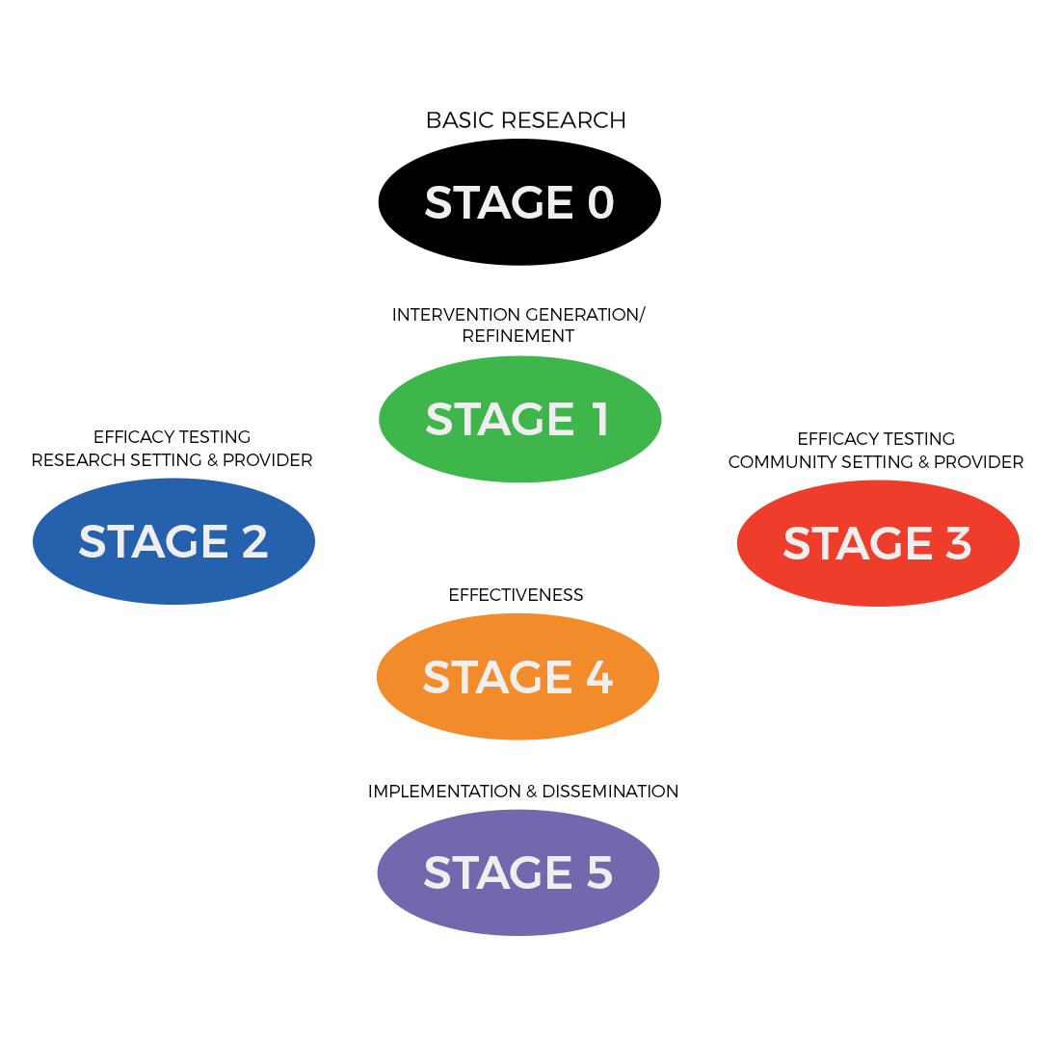
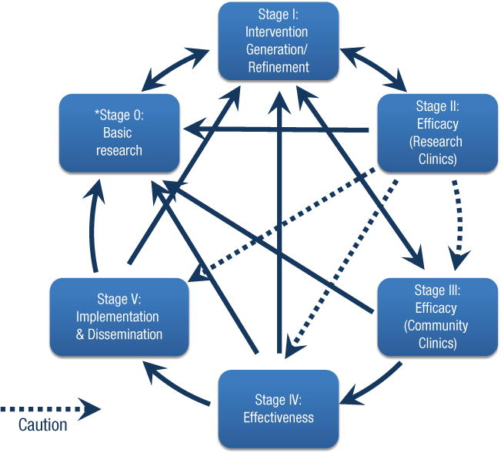
NIH Stage Model is not linear or prescriptive
Goal is to reduce the “voltage drop” from efficacy trials to widespread implementation
Address mechanisms of action in each stage
“the work is not complete until an intervention reaches its highest level of potency and is implementable with the maximum number of people in the population for which it was developed” (p. 27)
Onken et al. (2014) Clin Psych Sci

Slide 11
To learn more about the NIH Stage Model
https://www.nia.nih.gov/research/dbsr/nih-stage-model-behavioral-intervention-development
Onken, L., Carroll, K., Shoham, V., Cuthbert, B., & Riddle, M. (2014). Reenvisioning clinical science: Unifying the discipline to improve the public health. Clinical Psychological Science, 2, 22–34.
Onken, L. (2022). Implementation science at the National Institute on Aging: The principles of it, Public Policy & Aging Report, 32(1), 39-41.

Slide 12
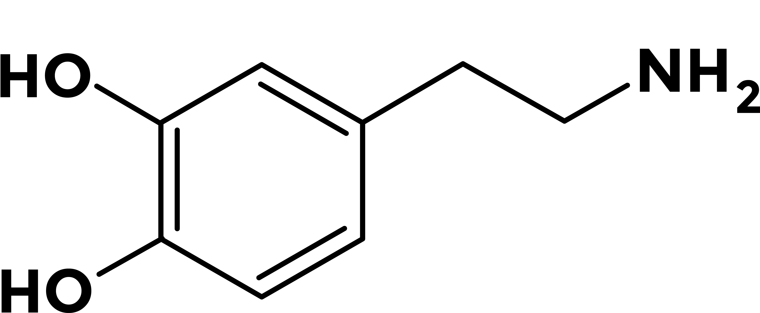


Drug development is based on an experimental medicine approach
Credit: Proxima Studio, eshana_blue, Drobot Dean – stock.adobe.com

Slide 13
SOBC method has three steps
Putative Target
target engagement
target validation
traditional efficacy test
Intervention
Behavior Change
Identify target mechanism
Measure target mechanism
  Ideally at multiple levels (self-report, behavioral, neuroimaging, biological)
Influence target mechanism
Nielsen et al. (2018) Behav Res Ther; Riddle et al. (2015) Trans Beh Med

Slide 14
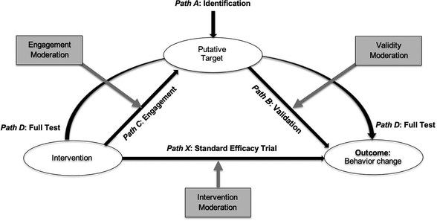
SOBC extension → Operating Conditions Framework
Rothman & Sheeran (2021) Health Psych

Slide 15
To learn more about the Science of Behavior Change (experimental medicine)
https://scienceofbehaviorchange.org/
https://commonfund.nih.gov/behaviorchange
https://www.nia.nih.gov/research/dbsr/science-behavior-change-sobc
Nielsen, L., Riddle, M., King, J.W.; NIH Science of Behavior Change Implementation Team, Aklin, W.M., Chen, W., Clark, D., Collier, E., Czajkowski, S., Esposito, L., Ferrer, R., Green, P., Hunter, C., Kehl, K., King, R., Onken, L., Simmons, J.M., Stoeckel, L., Stoney, C., Tully, L., & Weber, W. (2018). The NIH Science of Behavior Change Program: Transforming the science through a focus on mechanisms of change. Behaviour Research and Therapy, 101, 3-11. doi: 10.1016/j.brat.2017.07.002.

Slide 16
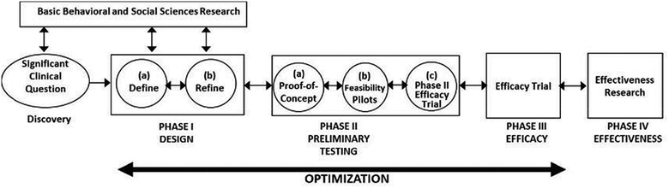
Obesity-Related Behavioral Intervention Trial Framework
Czajkowski et al. (2015) Health Psych

Slide 17
To learn more about ORBIT
https://cancercontrol.cancer.gov/brp/hbrb/translational-research
Czajkowski, S.M., Powell, L.H., Adler N., Naar-King, S., Reynolds, K.D., Hunter, C.M., Laraia, B., Olster, D.H., Perna, F.M., Peterson, J.C., Epel, E., Boyington, J.E., & Charlson, M.E. (2015). From ideas to efficacy: The ORBIT model for developing behavioral treatments for chronic diseases. Health Psychology, 34(10), 971-982. doi: 10.1037/hea0000161

Slide 18
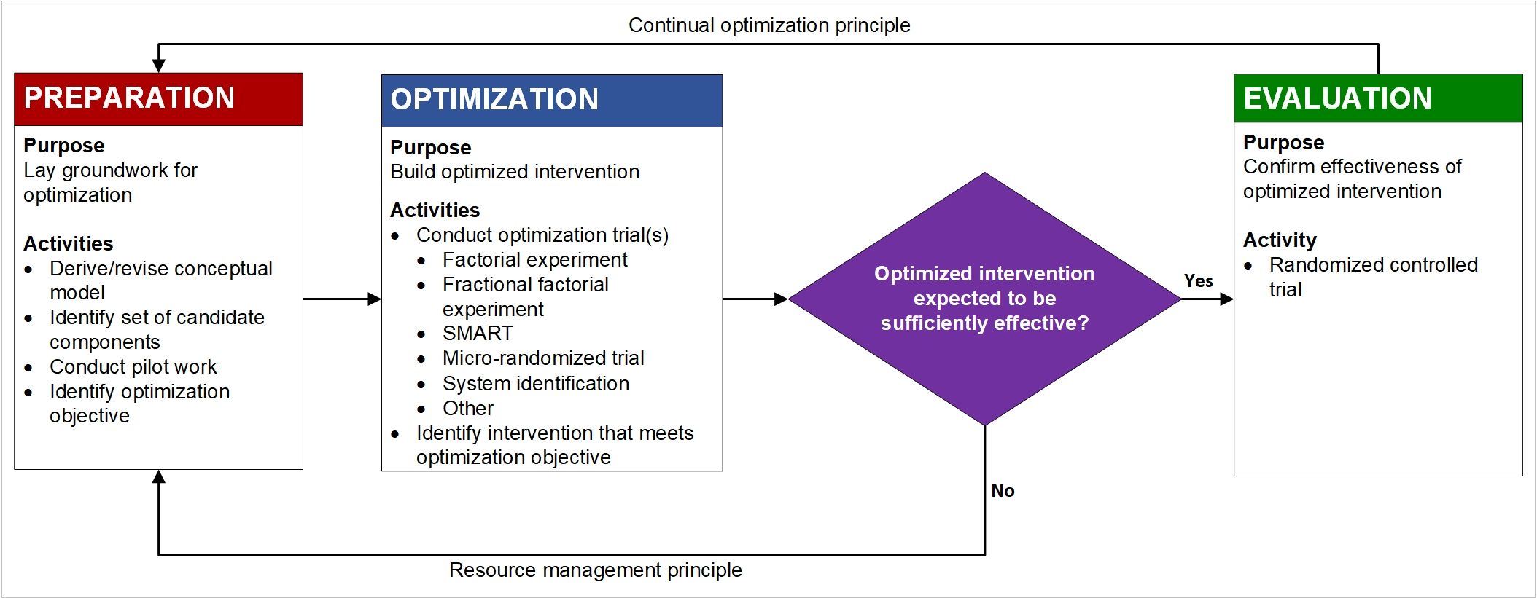
The Multiphase Optimization Strategy (MOST) has three phases
Collins (2018); Adapted for https://publichealth.nyu.edu/w/ioi/optimizing-behavioral-biobehavioral-interventions/overview

Slide 19
Guiding principles of the MOST
Resource management
Continual optimization
Limits on money, burden, time, equipment, staff, etc.
Balance cost & benefits (effects)
Impacts future scaling potential
Iterative rather than linear
Treatment packages may vary for different goals

Slide 20
MOST is a strategy, not a design
Optimize your intervention for EASE:
  Effectiveness
  Affordability
  Scalability
  Efficiency
Conventional & innovative design options
  Factorial (full or fractional) design
  Sequential multiple assignment randomized trial (SMART)
  Micro-randomized trial (MRT)
  System identification (open or closed loop)

Slide 21
What does early-phase (preparatory) intervention development work look like?
Systematic reviews
Conceptual model development
Needs assessment
Component selection
Content development
Select, test, & refine measures
Acceptability (component, content, modes, dosing)
Feasibility
Dose-finding
Proof of concept
Pilot trial

Slide 22
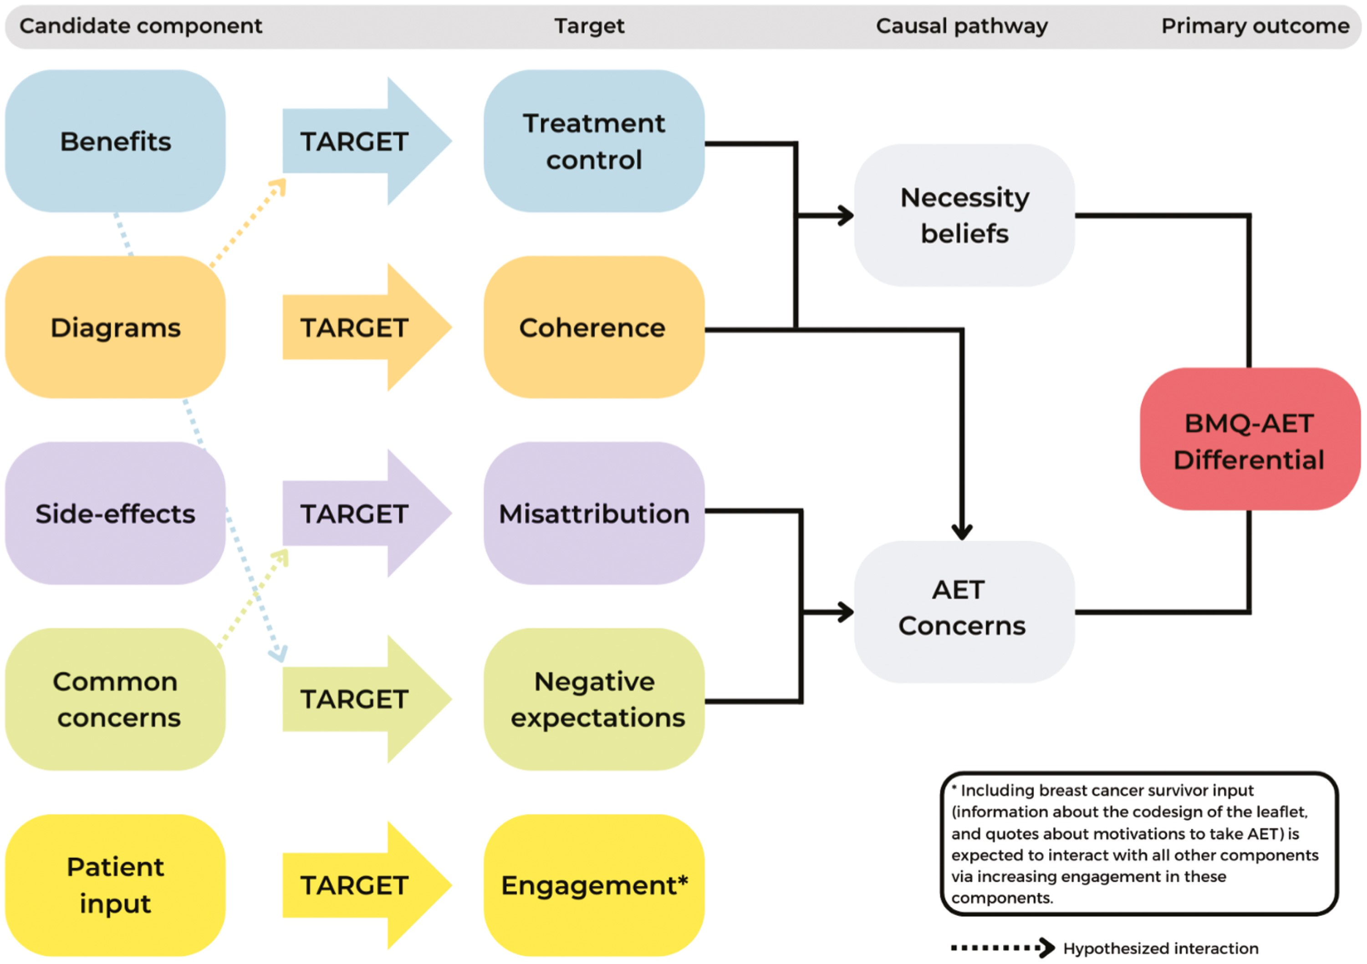
It may not be feasible to conduct a fully-powered factorial experiment to evaluate an intervention on a K award budget but…

Slide 23
To learn more about the Multiphase Optimization Strategy
Center for Advancement and Dissemination of Intervention Optimization – https://cadio.org
  Free Coursera course
  Virtual Trainings: 1/8/24-1/11/24 and 5/20/24-5/23/24
Collins, L.M. (2018). Optimization of behavioral, biobehavioral, and biomedical interventions: The multiphase optimization strategy (MOST). New York: Springer.
Collins, L.M., & Kugler, K.C. (2018). Optimization of behavioral, biobehavioral, and biomedical interventions: Advanced topics. New York: Springer.

Slide 24

Which framework is your key to scientific success & public health impact?
Credit: Real Vector – stock.adobe.com

Slide 25
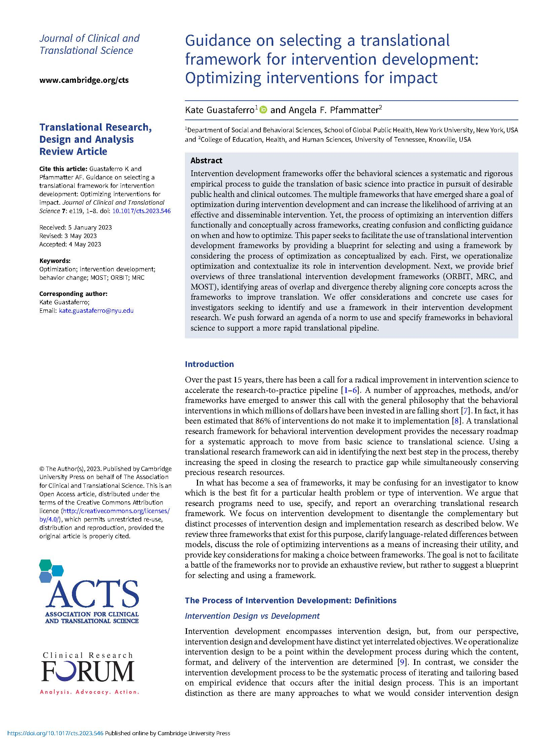
doi: 10.1017/cts.2023.546

Slide 26

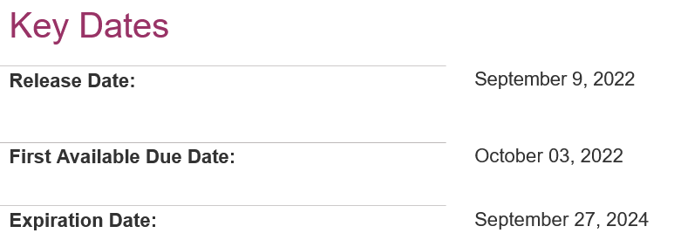
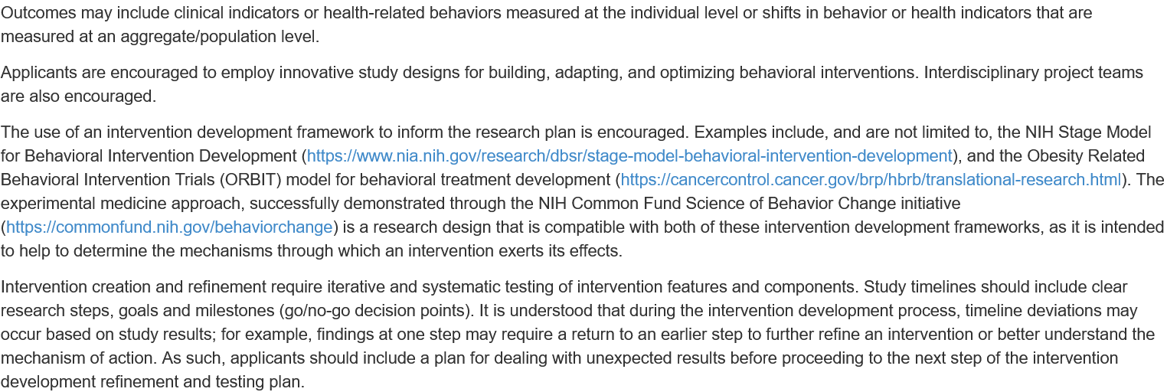

Slide 27
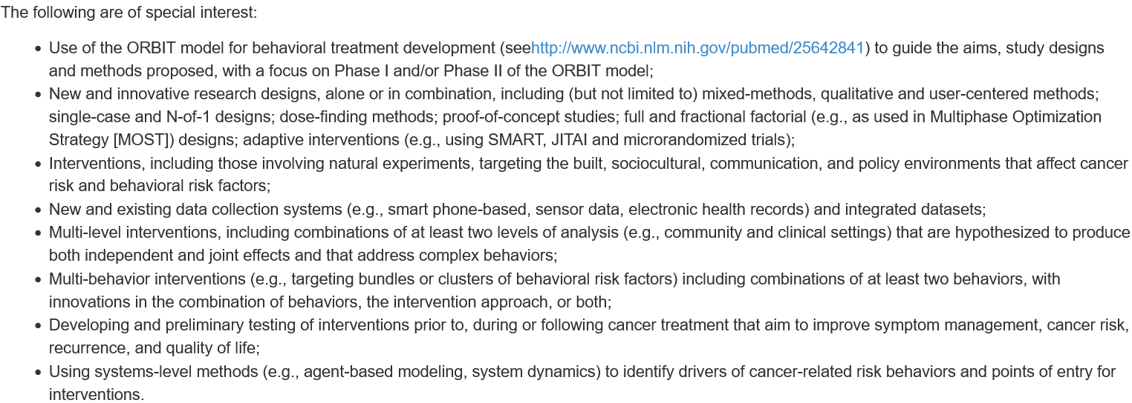

Slide 28

Credit: LeArchitecto – stock.adobe.com

Slide 29
Video resources
NIH Stage Model via YouTube
  NIA page: https://www.nia.nih.gov/research/dbsr/nih-stage-model-behavioral-intervention-development
  Achieving and Sustaining Behavior Change to Benefit Older Adults: https://www.youtube.com/watch?v=lbVRMetBdso
SOBC via SOBC
  YouTube Channel: https://www.youtube.com/channel/UCGDb2EzUBnxnScW2UnVtIIQ/about
ORBIT via SBM Behavior Change Grand Rounds
  The “Nuts and Bolts” of Developing Health-related Behavioral Interventions: Applying the ORBIT Model to Your Research: https://www.sbm.org/training/webinars (free for SBM members, $45 for non-members)
MOST via NYU’s Intervention Optimization Initiative
  Coursera course (free): https://www.coursera.org/learn/multiphase-optimization-strategy
  SBM Webinars (free for SBM members, $45 for non-members): https://www.sbm.org/training/webinars
    Applied Examples of the Preparation Phase of MOST: Preparing for Optimization
    Ideas for a Successful NIH K Application for MOST Optimization Research
    Getting Optimization Work Funded in Your Career Stage

Slide 31
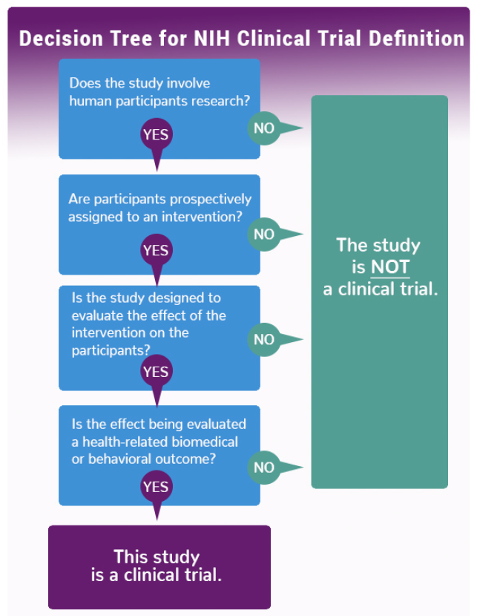
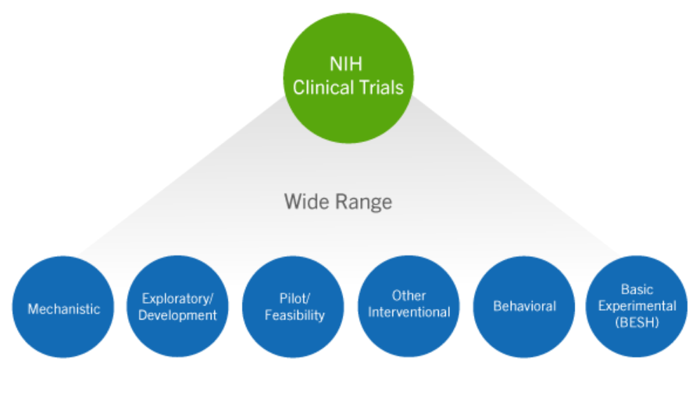
NIH definition of clinical trials
https://grants.nih.gov/policy/clinical-trials/definition.htm
https://grants.nih.gov/policy/clinical-trials/definition.htm

Slide 32
NIH definitions of Phase II/III clinical trials
Phase II Clinical Trial: An NIH defined Clinical Trial that studies the biomedical or behavioral intervention in a larger group of people (several hundred) to determine efficacy and further evaluate safety.
NIH-Defined Phase III Clinical Trial: An NIH-defined Phase III clinical trial is a broadly based prospective Phase III clinical investigation, usually involving several hundred or more human subjects, for the purpose of evaluating an experimental intervention in comparison with a standard or controlled intervention or comparing two or more existing treatments. Often the aim of such investigation is to provide evidence leading to a scientific basis for consideration of a change in health policy or standard of care. The definition includes pharmacologic, non-pharmacologic, and behavioral interventions given for disease prevention, prophylaxis, diagnosis, or therapy. Community trials and other population-based intervention trials are also included.
https://obssr.od.nih.gov/sites/obssr/files/inline-files/OBSSR-PhaseIIIDecision-Support-document-P5-508.pdf

