Slide 1
Contemporary Intervention Development Frameworks for Physical Activity Researchers
David E. Conroy, PhD
The Pennsylvania State University
@conroylab | www.conroylab.com
Physical Activity & Public Health Research Course | September 19, 2022 | Columbia, SC

Slide 2
Questions asked in behavioral intervention research & development
Do people need an intervention?
What kind of intervention do they need?
What type of intervention would they accept?
Which behavior change techniques should be used?
How and where will the intervention be delivered?
Is it possible to recruit participants & deliver an intervention?
Does the treatment package work?
What factors influence intervention effects?
Who responds most/least to the intervention?
How do intervention adaptations impact effects?
Is the intervention cost-effective?
Is the intervention better than the existing standard of care?

Slide 3
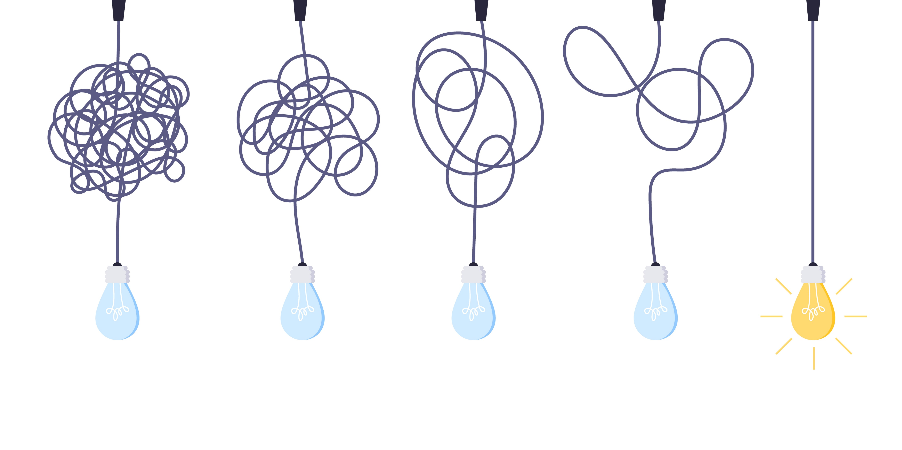
Interventions will likely be more impactful – and grant applications more successful – if your intervention development process is systematic and ordered rather than chaotic.
Credit: Konstantin – stock.adobe.com

Slide 4
turn chaos and disorder…
Credit: leomalsam – stock.adobe.com

Slide 5
…into order & value
Credit: Ivan Kmit – stock.adobe.com

Slide 6
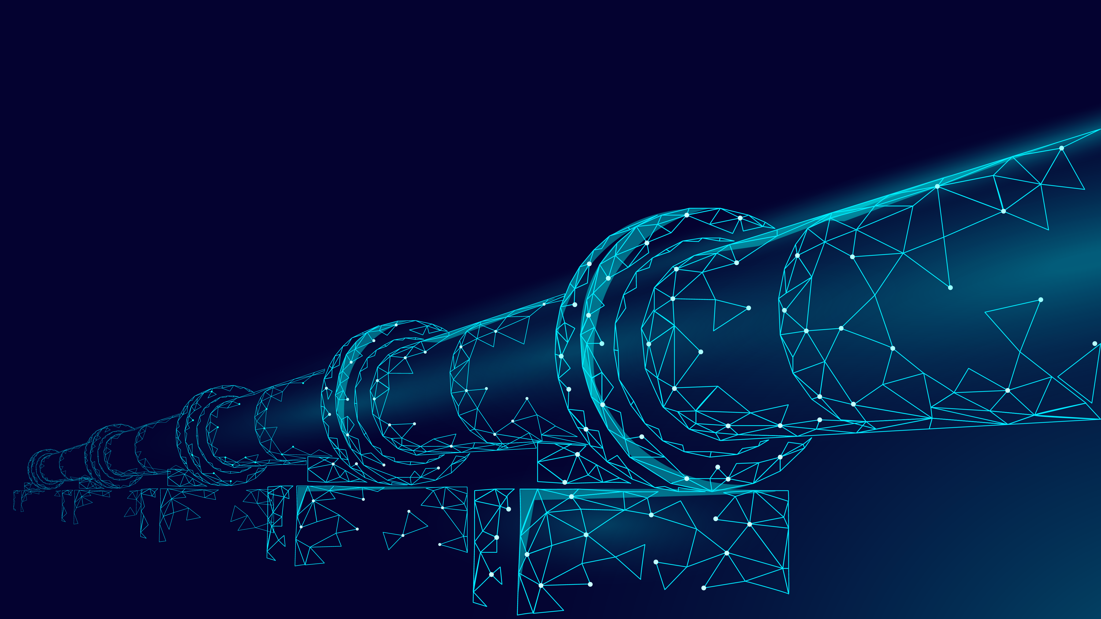
Intervention development is a long process with many steps
Credit: LuckyStep – stock.adobe.com

Slide 7
Intervention development frameworks have existed for decades
PRECEDE-PROCEED (Green, 1974)
Intervention Mapping (Bartholomew Eldridge et al., 2016)
Greenwald & Cullen (1985) Five Phase Model
Flay (1986) Eight Phase Model
EVOLVE Mixed-Methods Approach (Peterson et al., 2013)
And many others…
Czajkowski & Hunter (2021) Health Psych

Slide 8
Too often, behavioral interventions have proven to be…
Unscalable
Weak or ineffective
Non-responsive to patient or stakeholder needs
Arbitrarily designed
Lagging behind basic behavioral science discoveries

Slide 9
Contemporary models of intervention development are complementary
Science of Behavior Change
NIH Stage Model
Multiphase Optimization Strategy
ORBIT Framework
Credit: martialred – stock.adobe.com

Slide 11
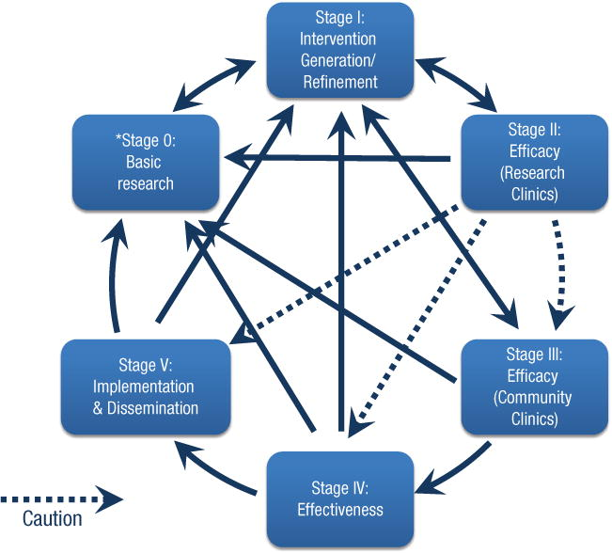
NIH Stage Model is not linear or prescriptive
Goal is to reduce the “voltage drop” from efficacy trials to widespread implementation
Address mechanisms of action in each stage
“the work is not complete until an intervention reaches its highest level of potency and is implementable with the maximum number of people in the population for which it was developed” (p. 27)
Onken et al. (2014) Clin Psych Sci

Slide 12
To learn more about the NIH Stage Model
https://www.nia.nih.gov/research/dbsr/nih-stage-model-behavioral-intervention-development
Onken, L., Carroll, K., Shoham, V., Cuthbert, B., & Riddle, M. (2014). Reenvisioning clinical science: Unifying the discipline to improve the public health. Clinical Psychological Science, 2, 22–34.
Onken, L. (2022). Implementation science at the National Institute on Aging: The principles of it, Public Policy & Aging Report, 32(1), 39-41.

Slide 13
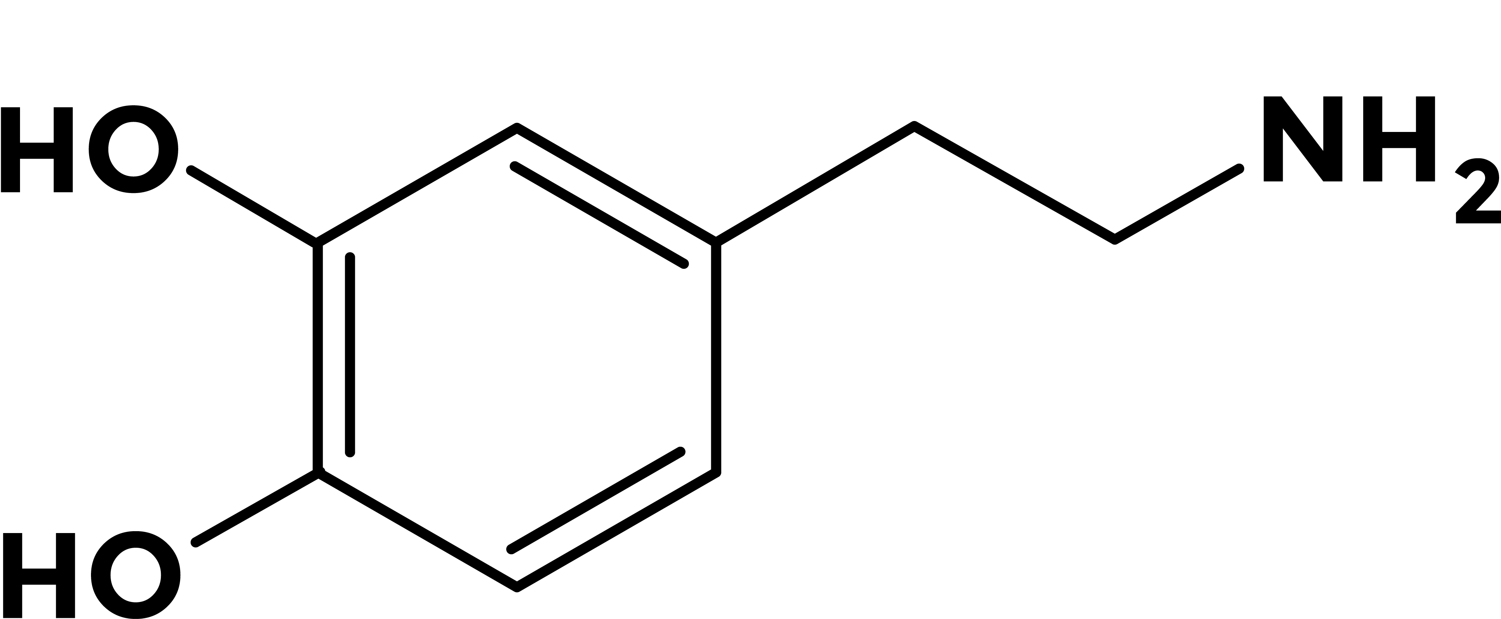
Drug development is based on an experimental medicine approach
Credit: Proxima Studio, eshana_blue, Drobot Dean – stock.adobe.com

Slide 14
SOBC method has three steps
Putative Target
target engagement
target validation
traditional efficacy test
Intervention
Behavior Change
Identify target mechanism
Measure target mechanism
Ideally at multiple levels (self-report, behavioral, neuroimaging, biological)
Influence target mechanism
Nielsen et al. (2018) Behav Res Ther; Riddle et al. (2015) Trans Beh Med

Slide 15
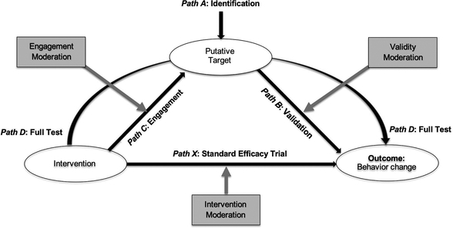
SOBC extension → Operating Conditions Framework
Rothman & Sheeran (2021) Health Psych

Slide 16
Session #2 of Virtual Interactive Seminar Series
Why Behavioral Interventions Work (or Don’t Work)
Mechanism-Focused Behavioral Science From Theory Selection to Study Design and Implementation
October 4, 2022
From 9:30 to 11:00 AM EST
The Science of Behavior Change: A Mechanism-Focused Approach to Behavior Change Research
Talea Cornelius, Ph.D., M.S.W., M.S.
Assistant Professor of Medical Sciences (in Medicine) Columbia University
In this session, Dr. Talea Cornelius will provide an overview of the Science of Behavior Change (SOBC) experimental medicine approach to developing and refining behavioral health interventions. She will discuss theory selection, mechanism-informed study design, and measurement validity, and provide online resources to facilitate mechanistic behavioral science. In addition to a lecture, this session will include a master class and hands-on practice applying the SOBC approach.
Dr. Cornelius is a trained clinical social worker, social psychologist, and biostatistician. Her research is focused on understanding health behaviors in the social context in which they are performed.
As co-investigator of the NIH-funded Science of Behavior Change Program, she leads the effort to improve the validity of measures of mechanisms that underlie behavior change in order to promote rigor in behavioral health intervention research.
Register at: https://bit.ly/3Ag5C1y

Slide 17
To learn more about the Science of Behavior Change (experimental medicine)
https://scienceofbehaviorchange.org/
https://commonfund.nih.gov/behaviorchange
https://www.nia.nih.gov/research/dbsr/science-behavior-change-sobc
Nielsen, L., Riddle, M., King, J.W.; NIH Science of Behavior Change Implementation Team, Aklin, W.M., Chen, W., Clark, D., Collier, E., Czajkowski, S., Esposito, L., Ferrer, R., Green, P., Hunter, C., Kehl, K., King, R., Onken, L., Simmons, J.M., Stoeckel, L., Stoney, C., Tully, L., & Weber, W. (2018). The NIH Science of Behavior Change Program: Transforming the science through a focus on mechanisms of change. Behaviour Research and Therapy, 101, 3-11. doi: 10.1016/j.brat.2017.07.002.

Slide 18
Obesity-Related Behavioral Intervention Trial Framework
Czajkowski et al. (2015) Health Psych

Slide 19
To learn more about ORBIT
https://cancercontrol.cancer.gov/brp/hbrb/translational-research
Czajkowski, S.M., Powell, L.H., Adler N., Naar-King, S., Reynolds, K.D., Hunter, C.M., Laraia, B., Olster, D.H., Perna, F.M., Peterson, J.C., Epel, E., Boyington, J.E., & Charlson, M.E. (2015). From ideas to efficacy: The ORBIT model for developing behavioral treatments for chronic diseases. Health Psychology, 34(10), 971-982. doi: 10.1037/hea0000161

Slide 20
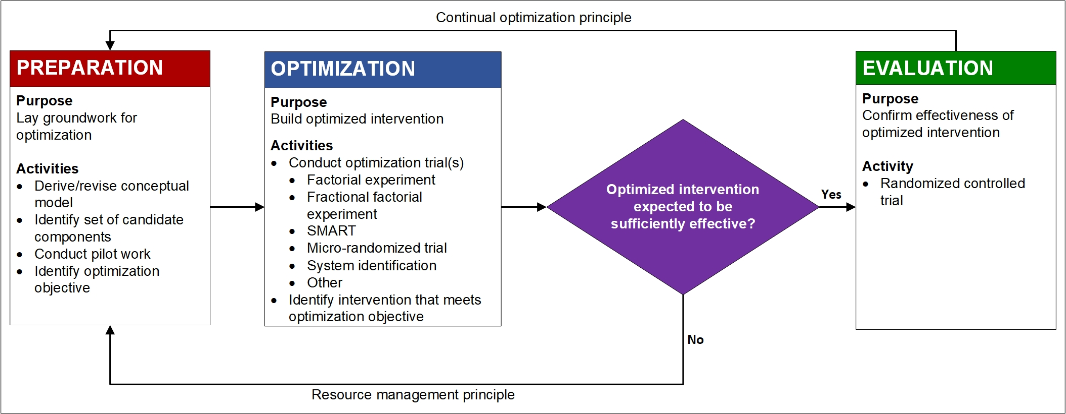
The Multiphase Optimization Strategy (MOST) has three phases
Collins (2018); Adapted for https://publichealth.nyu.edu/w/ioi/optimizing-behavioral-biobehavioral-interventions/overview

Slide 21
Guiding principles of the MOST
Resource management
Continual optimization
Limits on money, burden, time, equipment, staff, etc.
Balance cost & benefits (effects)
Impacts future scaling potential
Iterative rather than linear
Treatment packages may vary for different goals

Slide 22
MOST is a strategy, not a design
Optimize your intervention for EASE:
Effectiveness
Affordability
Scalability
Efficiency
Conventional & innovative design options
Factorial (full or fractional) design
Sequential multiple assignment randomized trial (SMART)
Micro-randomized trial (MRT)
System identification (open or closed loop)

Slide 23
What does early-phase (preparatory) intervention development work look like?
Systematic reviews
Conceptual model development
Needs assessment
Component selection
Content development
Select, test, & refine measures
Acceptability (component, content, modes, dosing)
Feasibility
Dose-finding
Proof of concept
Pilot trial

Slide 24
To learn more about the Multiphase Optimization Strategy
https://publichealth.nyu.edu/w/ioi
Collins, L.M. (2018). Optimization of behavioral, biobehavioral, and biomedical interventions: The multiphase optimization strategy (MOST). New York: Springer.
Collins, L.M., & Kugler, K.C. (2018). Optimization of behavioral, biobehavioral, and biomedical interventions: Advanced topics. New York: Springer.

Slide 25
Which framework is your key to scientific success & public health impact?
Credit: Real Vector – stock.adobe.com

Slide 26
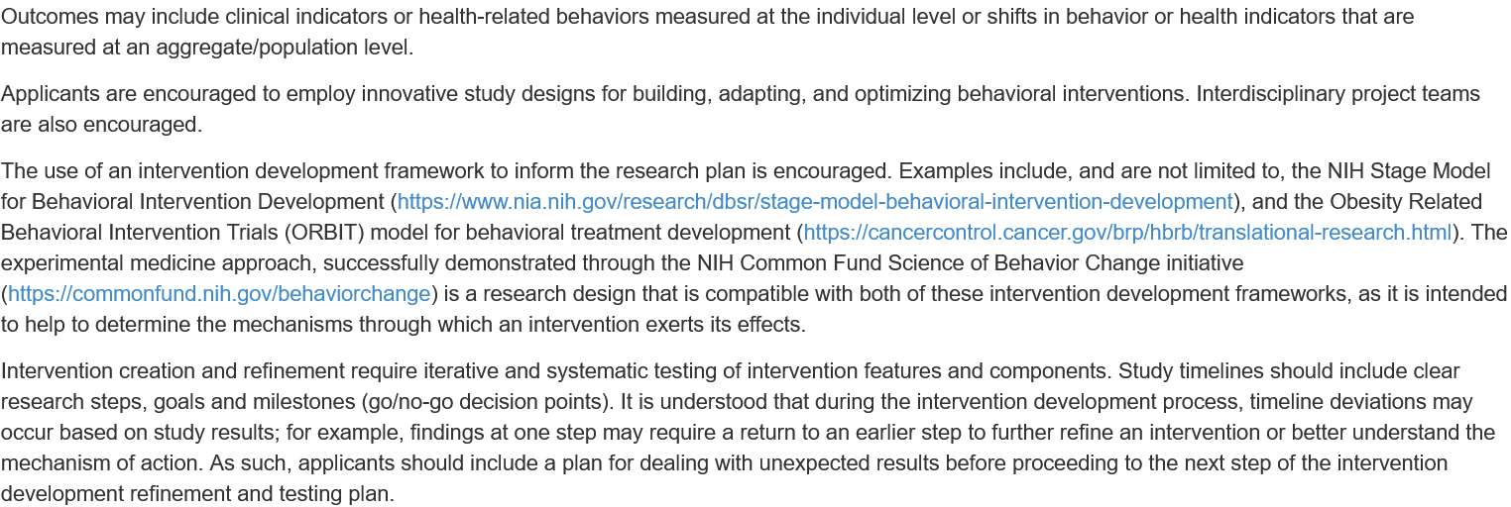

Slide 28
Credit: LeArchitecto – stock.adobe.com

Slide 29
Video resources
NIH Stage Model via YouTube
Achieving and Sustaining Behavior Change to Benefit Older Adults: https://www.youtube.com/watch?v=lbVRMetBdso
SOBC via SOBC
YouTube Channel: https://www.youtube.com/channel/UCGDb2EzUBnxnScW2UnVtIIQ/about
ORBIT via SBM Behavior Change Grand Rounds
The “Nuts and Bolts” of Developing Health-related Behavioral Interventions: Applying the ORBIT Model to Your Research: https://www.sbm.org/training/webinars (free for SBM members, $45 for non-members)
MOST via NYU’s Intervention Optimization Initiative
Coursera course (free): https://www.coursera.org/learn/multiphase-optimization-strategy
SBM Webinars (free for SBM members, $45 for non-members): https://www.sbm.org/training/webinars
Applied Examples of the Preparation Phase of MOST: Preparing for Optimization
Ideas for a Successful NIH K Application for MOST Optimization Research
Getting Optimization Work Funded in Your Career Stage

Slide 31
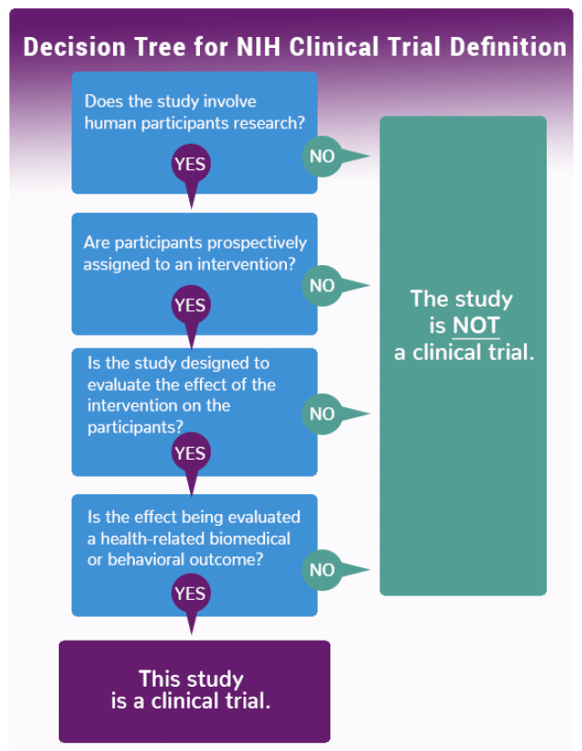
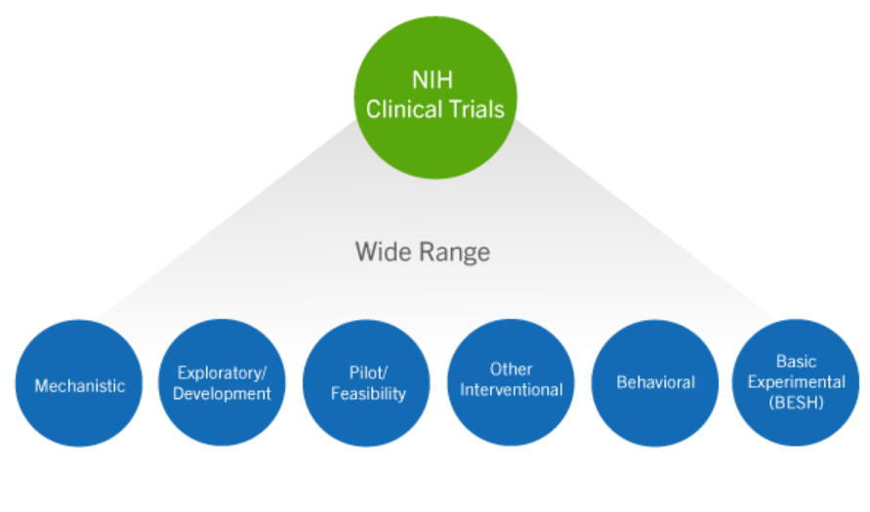
NIH definition of clinical trials
https://grants.nih.gov/policy/clinical-trials/definition.htm
https://grants.nih.gov/policy/clinical-trials/definition.htm

Slide 32
NIH definitions of Phase II/III clinical trials
Phase II Clinical Trial: An NIH defined Clinical Trial that studies the biomedical or behavioral intervention in a larger group of people (several hundred) to determine efficacy and further evaluate safety.
NIH-Defined Phase III Clinical Trial: An NIH-defined Phase III clinical trial is a broadly based prospective Phase III clinical investigation, usually involving several hundred or more human subjects, for the purpose of evaluating an experimental intervention in comparison with a standard or controlled intervention or comparing two or more existing treatments. Often the aim of such investigation is to provide evidence leading to a scientific basis for consideration of a change in health policy or standard of care. The definition includes pharmacologic, non-pharmacologic, and behavioral interventions given for disease prevention, prophylaxis, diagnosis, or therapy. Community trials and other population-based intervention trials are also included.
https://obssr.od.nih.gov/sites/obssr/files/inline-files/OBSSR-PhaseIIIDecision-Support-document-P5-508.pdf

