Slide 1
Physical Activity Policies: Zoning, Land Use and Transportation- related Policies
Jamie F. Chriqui, PhD, MHS (Twitter: @jfchriqui)
Physical Activity and Public Health Research Course
University of South Carolina
September 20, 2022
Source: https://www.pedbikeimages.org/pubdetail.cfm?picid=750

Slide 2
Presentation Overview
Brief background on zoning, land use, and public health
Overview of the longitudinal nationwide zoning study
Snapshot of findings from the longitudinal nationwide zoning study
Historical work examining associations between zoning policies and PA
Next steps and opportunities
Notes:
I will cover 4 things today

Slide 3
Zoning, Land Use, and Public Health

Slide 4
Zoning and its relationship to public health
Zoning, subdivision regulation, and building codes are exercises of the states’ police powers under the 10th Amendment
States grant authority to county/municipal governments to promote the health, safety, morals, and general welfare of their citizenry
Zoning provides a regulatory framework to address public health problems arising from urbanization
Zoning regulations are laws that divide city or county areas into districts, or zones, that specify allowable uses and, also, may specify requirements for structural improvements
Notes:
As the adage goes, all policy is local and there is almost nothing more local than zoning and land use decisions

Slide 5
Traditional zoning is based on use and density
Traditional, Euclidean zoning divides community into districts (or zones) based on use and density
For example, commercial areas, residential areas, industrial areas, etc.

Slide 6
Zoning Code Reforms
Emerged in the U.S. as a potential policy strategy to reduce sprawl and reliance on cars and increase physical activity. ¹⁻³
The reforms seek to:
Create compact development
Create pedestrian-friendly or traditional neighborhoods
Increase street connectivity
Create mixed use and higher density neighborhoods
Increase open space and alternative transportation¹⁻³
Examples of code reform zoning
Form-Based Code
Transect-Based Districts
SmartCode
New Urbanist Districts
Pedestrian-Oriented Districts or Developments (POD)
Transit-Oriented Districts or Developments (TOD)
Traditional Neighborhood Districts or Developments (TND)
Other (i.e. Smart Growth Districts)
Schilling J, Linton LS. The public health roots of zoning: In search of active living's legal genealogy. Am J Prev Med. 2005;28:96-104.
Schilling J, Mishkovsky N. Creating a Regulatory Blueprint for Healthy Community Design: A Local Government Guide to Reforming Zoning and Land Development Codes. E-43346. 2005. Washington, D.C., ICMA.
American Planning Association. Planning and Urban Design Standards. 1st ed. Hoboken, NJ: John Wiley & Sons, Inc., 2006.
Notes:
Today I’ll focus on the broad grouping of code reform and TODs
Form-based codes establish zones based on pedestrian accessibility as well as the scale and character of development.³ By allowing form based development “by right,” form-based codes legalize compact, mixed-use and walkable development that otherwise may be constrained by the community’s traditional Euclidean zoning codes.^{1-3;55;56}
Pedestrian-oriented developments/districts (PODs) are designed with an emphasis on sidewalks, street furniture, and pedestrian-centered access to building sites through mixed-use and related types of land use planning.
Similarly, transit-oriented districts (TODs) are mixed-use developments/districts located near a transit stop and core commercial areas and they mix residential, retail, office, and public uses in a walkable environment, making it convenient for residents and employees to travel by transit, bicycle, foot, or car.⁵⁸
Traditional Neighborhood Developments (TND) seek to promote dense, mixed-use neighborhoods that are pedestrian-oriented and that help to reduce sprawl by locating commercial areas in close proximity to residential areas so that residents can walk to such amenities rather than drive. TNDs typically have well-connected street systems; street furniture (e.g., benches, transit shelters, bike parking kiosks, etc.) and landscaping; and neighborhood amenities including shopping, recreational areas, restaurants, and workplaces all within ¼ of a mile or a 10-minute walk.²

Slide 7
Traditional Zoning vs. Code Reform (Smart Code or Transect-based) Zoning
Code Reform Zoning
Traditional Zoning
Source: transect.org
Notes:
This slide shows the differences in what a zoning map looks like under traditional vs. new urbanist zoning.
The SmartCode is a commercially licensed version of a form-based code that integrates New Urbanist and smart growth concepts into the Transect. The Transect is divided into 6 zones, ranging from rural (T1) to urban (T6), each with its own density and built environment characteristics. Zones T4-T6 are particularly suited for walkable and active living-oriented communities and pedestrian-oriented development as they have mixed uses; parks, plazas, and squares for recreational purposes; streets with curb cuts and tight street networks; medium-wide sidewalks; and street landscaping to provide aesthetic appeal.⁵

Slide 8
Zoning (and code reform zoning) is a policy lever or strategy for codifying the Community Preventive Services Task Force (CPSTF) recommendations (May 2017)
Recommends built environment strategies combining one or more intervention approaches to improve pedestrian or bicycle transportation systems with one or more land use and environmental design interventions based on sufficient evidence of effectiveness in increasing physical activity.
Pedestrian & Bicycle System Transportation Intervention Component
Land Use & Environment Design Intervention Component
Street pattern design and connectivity
Pedestrian infrastructure
Bicycle infrastructure
Public transit infrastructure and access
Mixed land use
Increasing residential density
Proximity to neighborhood or community destinations
Parks and recreational facility access
Notes:
Zoning and code reform zoning, in particular, are one policy tool or strategy to codify the CPSTF recommendations

Slide 9
Study Overview and Methods

Slide 10
Key Study Questions
PAPREN Applied Evaluation Project Study Questions
Has activity-supportive zoning increased nationwide over time (between 2010 and 2020)?
Have changes in activity-supportive zoning been associated with concomitant:
Increases in recreational activity or decreases in sedentary behavior
Increases in active travel to work
Reductions in pedestrian fatalities
These questions will be examined over the next 2 years
Focus of Today’s Presentation
Changes in Code Reform and Pedestrian-oriented zoning over time
Additional markers captured ONLY for 2020
PA-related markers
Inclusionary zoning/housing affordability markers

Slide 11
First of its kind longitudinal study of physical activity-supportive zoning (including code reform zoning)
 | 2010 Baseline Study (NCI R01) | 2020 Follow-Up Study (PAPREN)
Sample Frame
# Counties | 496 most populous + 4 consolidated cities | 200 most populous from 2010 sample
# Jurisdictions | 3,921 municipalities + 483 unincorporated county areas (N=4404 jurisdictions) | 2102 municipalities + 185 unincorporated county areas* (N=2287 coded to date)
# States Represented | 49 states + DC | 41 states + DC
% of US Population Covered | ~75% | 55.1%
Included Land Use Policies-Data Source(s) | Zoning codes, UDCs, form-based codes | Zoning codes, subdivision regulations, UDCs, form-based codes
Effective Date of Zoning Codes | January 2010 | January 2020
Coding Process | Zoning code audit tool developed for the project. Master’s+ trained urban planners/students coded all zoning codes using audit tool and detailed coding protocol. Regular coding meetings. | Same process using updated audit tool and protocols
Inter-coder Agreement | 90% agreement amongst coders | >90%
*there are a few jurisdictions awaiting final coding
Notes:
Included nearly all jurisdictions in the most populous counties; excludes only very small jurisdictions accounting for <1/2 of 1 percent of a counties population.
We manually compiled and reviewed the zoning code/related policies for each jurisdiction
County policies were coded and applied to unincorporated county areas
Verified zoning authority for counties through state law
For the PAPREN project, we are focused on the jurisdictions in the 200 most populous counties – longitudinally over time

Slide 12
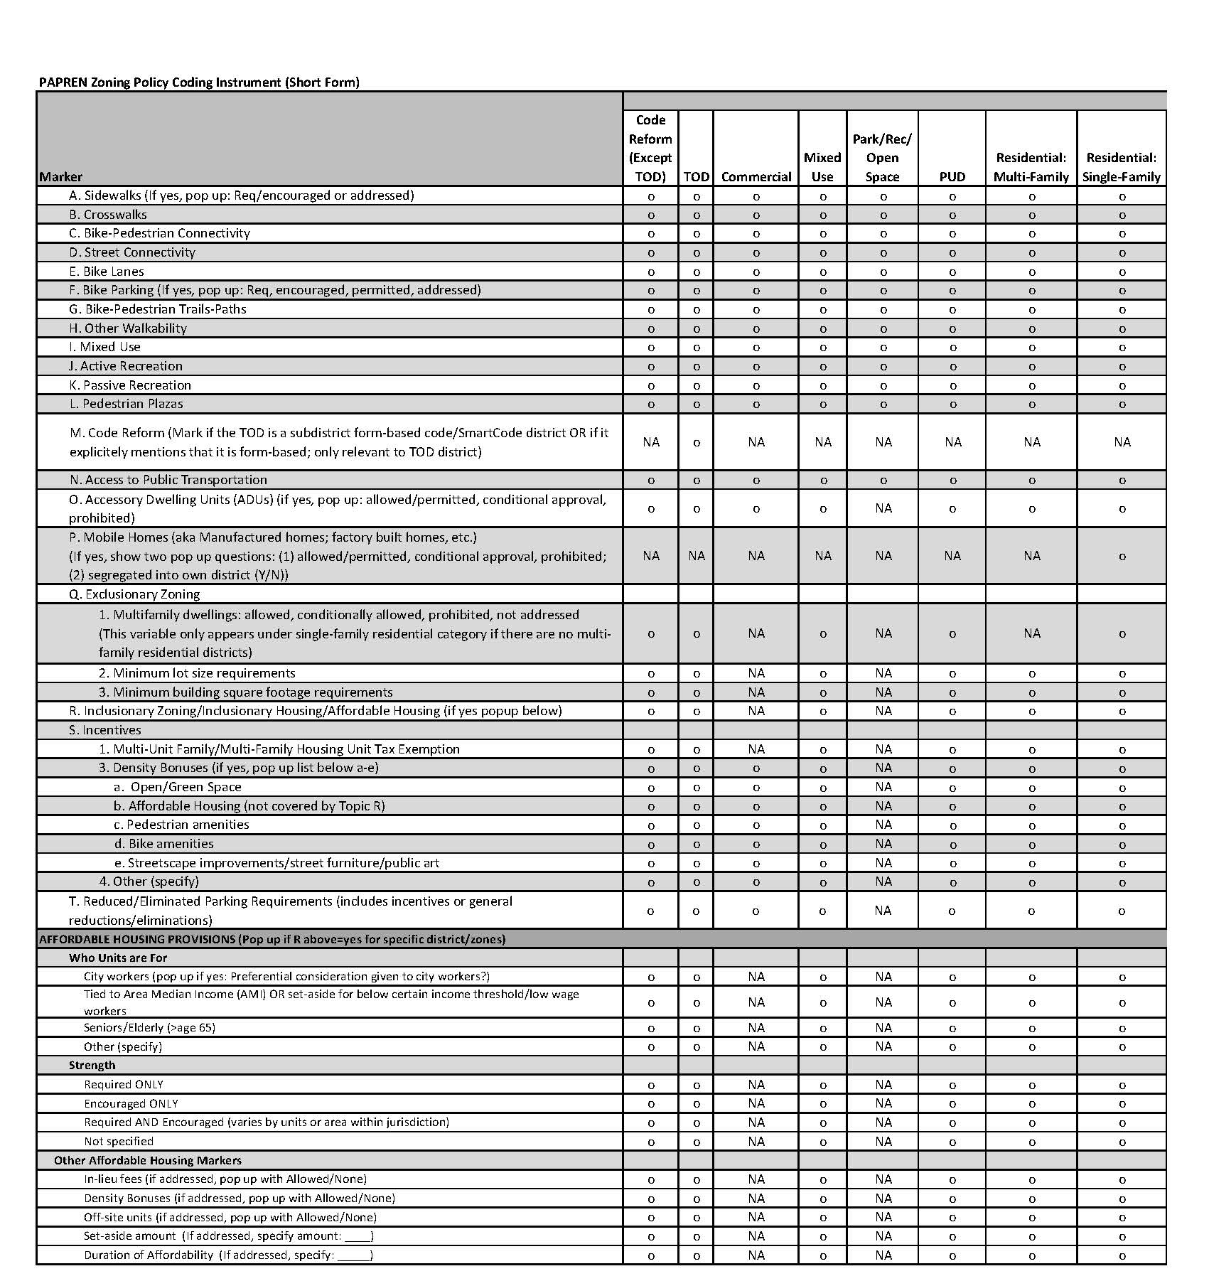
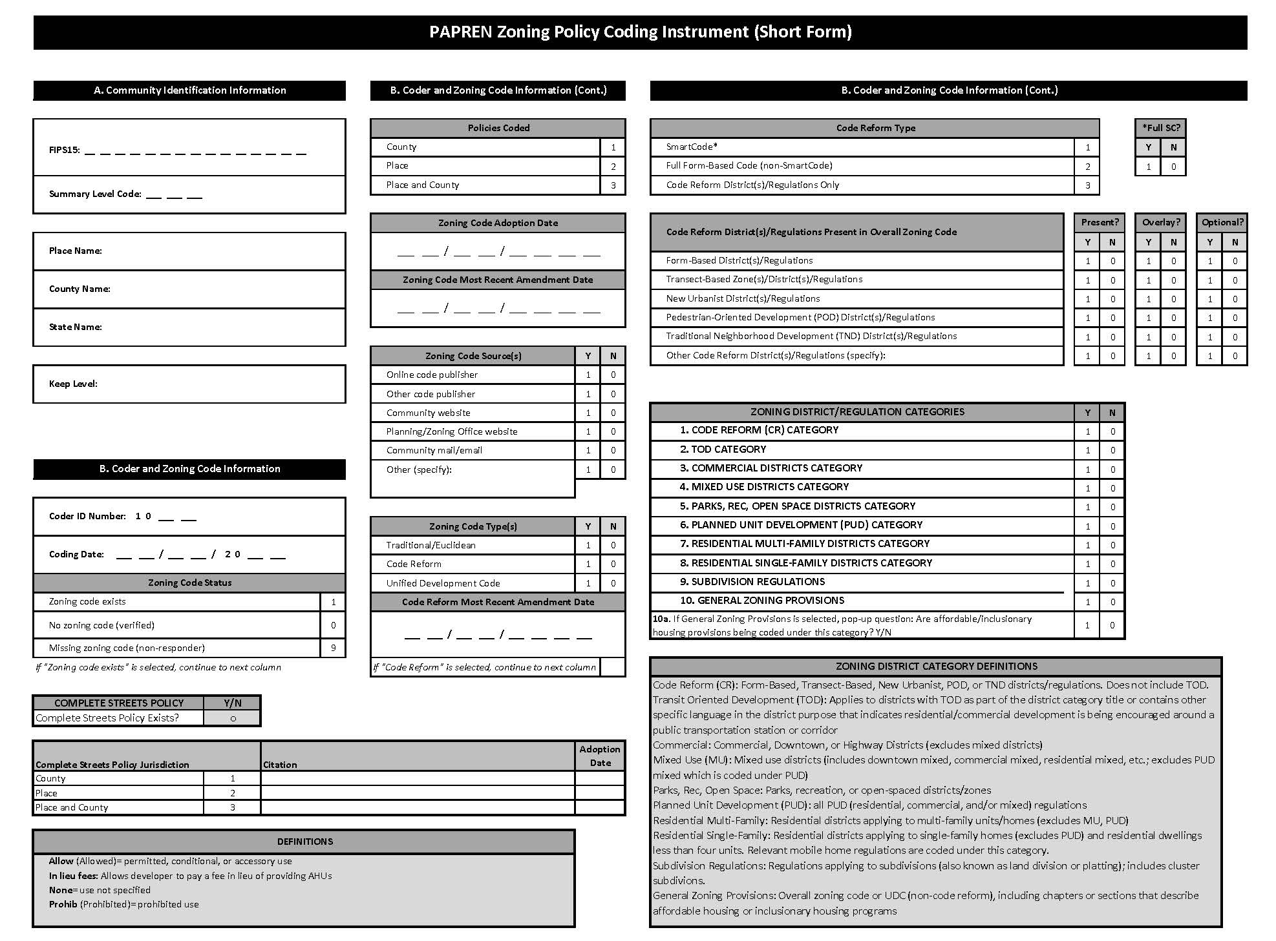
Zoning Code Audit Tool – 2020 Version
Notes:
We will share a link to the tool following the presentation
This is from the 2020 Zoning Audit tool; very similar to 2010 with some new markers for the most part
Zoom in when presenting in slideshow mode to show the markers for code reform on both page 1 and page 2
For page 1:
The tool captures the presence of traditional districts along with the presence of code reform districts.
Page 2:
For each district category including code reform, we coded the active living-oriented elements
For 2020, we have also captured a number of affordable housing related markers
For each jurisdiction, compiled yes/no indicators for each element being addressed in the jurisdiction.

Slide 13
Changes in Code Reform and Pedestrian-Oriented Zoning Over Time

Slide 14
Code reform zoning has significantly* increased over time (Longitudinal Panel; 2287 jurisdictions in 200 counties and 41 states + DC)
*All changes significant at p<.001 in both unadjusted, and adjusted models
Notes:
Just pulled out illustrative examples.
Code reform change over time also holds up in adjusted models controlling for jurisdictional characteristics and the results are essentially identical
Same for TOD Zoning –results identical in adjusted models

Slide 15
Code reform zoning is concentrated in certain areas of the country
And has become more concentrated over the past decade
Notes:
This map indicates that for the 153 counties coded thus far in 2020; code reform is more prevalent in parts of Florida, Southern California, the Seattle region, and the Philadelphia-NYC-Boston I-95 corridor. The counties in pale yellow are not significant hot spots for 2020 and the hotspots outlined in blue are new hot spots between 2010-2020 (eg Seattle region, parts of the Northeast and Florida along with the Salt Lake area).
Most of the state of Massachusetts is now a new hot spot, as are the areas in Michigan and Wisconsin.
The confidence levels for the hot spots indicate that a given county is a statistically significant hotspot - meaning that compared to distances between the locations of the entire sample of jurisdictions that contain code reform, these counties contain a number of code reform jurisdictions that are too close together to be the result of random chance.

Slide 16
Population size and region drive code reform zoning (Longitudinal Panel; 2285 jurisdictions in 200 counties and 41 states + DC)
Jurisdiction Population Size
Census Region
*In multivariable regression models adjusted for time trends, median age (older-less likely to have CR); % household no vehicle (higher %, more likely
to have CR); majority race (majority Hispanic <likely to have CR (than majority white); % urban (higher % more likely to have CR); household
poverty levels (not sig), and median household income (not sig).
Notes:
And to further illustrate what we saw with the hotspot map, we ran multivariable regression models adjusted for time trends, median age (older-less likely); % household no vehicle (higher %, more likely);
majority race (majority Hispanic <likely than majority White); % urban (higher % more likely); household poverty levels (not sig), and median household income (not sig).
Consistent with the hotspot map, we found that jurisdictions with larger population sizes and in the South and West are significantly more likely to have code reform zoning than smaller jurisdictions and those located in the MW and NE as a whole.
Due to missing data on jurisdiction characteristics only 2285 jurisdictions were included in this regression.

Slide 17
TOD zoning also is concentrated in certain areas of the country
Notes:
This map indicates that for the 153 counties coded thus far in 2020; code reform is more prevalent in parts of Florida, Southern California, the Seattle region, and the Philadelphia-NYC-Boston I-95 corridor. The counties in pale yellow are not significant hot spots for 2020 and the hotspots outlined in blue are new hot spots between 2010-2020 (eg Seattle region, parts of the Northeast and Florida along with the Salt Lake area).
Most of the state of Massachusetts is now a new hot spot, as are the areas in Michigan and Wisconsin.
The confidence levels for the hot spots indicate that a given county is a statistically significant hotspot - meaning that compared to distances between the locations of the entire sample of jurisdictions that contain code reform, these counties contain a number of code reform jurisdictions that are too close together to be the result of random chance.

Slide 18
Population size and region also drive TOD zoning (Longitudinal Panel; 2285 jurisdictions in 200 counties and 41 states + DC)
Jurisdiction Population Size
Census Region
*In multivariable regression models adjusted for time trends, median age (older-less likely to have TOD); % household no vehicle (higher %, more likely
to have TOD); majority race (majority Hispanic <likely and majority Black more likely to have TOD (than majority white); % urban (higher % more likely to
have TOD); household poverty levels (not sig), and median household income (not sig).
Notes:
And to further illustrate what we saw with the hotspot map, we ran multivariable regression models adjusted for time trends, median age (older-less likely); % household no vehicle (higher %, more likely);
majority race (majority Hispanic <likely and majority Black more likely than majority White); % urban (higher % more likely); household poverty levels (not sig), and median household income (not sig).
Consistent with the hotspot map, we found that jurisdictions with larger population sizes and in the South and West are significantly more likely to have TOD zoning than smaller jurisdictions and those located in the MW and NE as a whole.
Due to missing data on jurisdiction characteristics only 2285 jurisdictions were included in this regression.

Slide 19
Activity-supporting built environment features addressed in zoning codes have increased* over time (Longitudinal Panel; 2287 jurisdictions in 200 counties and 41 states + DC)
*p<.05 ***p<.001 in unadjusted, bivariate analyses
Notes:
Items in green boxes have seen particular emphasis in this 10-year period which is quite exciting and the advocacy work has really paid off combined with increased emphasis on health in communities

Slide 20
Code reform zoning is heavily focused on activity-supportive built environment features and such features have increased over time (Longitudinal Panel; 594 jurisdictions with code reform zoning in 182 counties and 40 states + DC)
*p<.05 in unadjusted, bivariate analyses
Notes:
This slide focuses on code reform ONLY jurisdictions. As you can see, the prevalence of most built env features is high and has increased across the board and over time

Slide 21
Jurisdictions without code reform zoning also have seen increases in activity-supportive built environment features (Longitudinal Panel; 1693 jurisdictions without code reform zoning in 184 counties and 41 states)
Note: Includes subdivision regulations
for 2020
*p<.001 in unadjusted, bivariate analyses

Slide 22
Additional PA-Markers Captured in 2020 Zoning Codes only
Marker | Any | Prevalence of Markers in Given District/Zone
 | Any | TOD | Code Reform | Mixed Use | PUD | Commercial | Residential Multi-Family | Residential Single Family
N of Jurisdictions with District/Zone | 2287 | 299 | 405 | 1016 | 1665 | 2155 | 1963 | 2190
Access to public transportation | 48% | 95% | 64% | 35% | 17% | 15% | 10% | 4%
Reduced/Eliminated Parking Requirements | 42% | 47% | 40% | 22% | 4% | 13% | 4% | 2%
Pedestrian Plazas | 51% | 57% | 72% | 44% | 19% | 21% | 8% | 4%
Density Bonuses for…
Open/Greenspace | 16% | 18% | 7% | 10% | 8% | 3% | 4% | 3%
Pedestrian Amenities | 10% | 11% | 4% | 8% | 4% | 2% | 3% | 1%
Bike amenities | 5% | 3% | 3% | 3% | 2% | 1% | 1% | 1%
Streetscape improvements | 6% | 10% | 2% | 6% | 2% | 2% | 1% | <1%
Notes:
Excluding subdivision regs
Note N for CR on this slide is less than on slide 15 b/c that combines any CR zoning including TODs

Slide 23
Examining the relationship between zoning and adult walking and inactivity

Slide 24
Zoning is associated with adult walking (Adjusted prevalence using BRFSS 2011 data)
N=153,065 adults age 18-64
* p<.05 **p<.01 ***p<.001.
Source: Chriqui et al., Env & Beh. 2016; Chriqui et al, Prev Med 2017

Slide 25
Zoning is associated with older adult (>=65) walking (Adjusted prevalence using BRFSS 2011 data)
N=60,397 adults age 65+
*p<.05 **p<.01 ***p<.001.
Source: Chriqui et al in development

Slide 26
Adjusted Prevalence of Adult Inactivity is Lower in Jurisdictions with More Activity-Friendly Zoning Provisions (BRFSS 2012 data)
N=147,517 adults age 18-64
**p<.01 ***p<.001.
Source: Leider et al., Prev Med, 2017
Notes:
All policy measures except crosswalks are significantly associated with reduced inactivity.

Slide 27
Adjusted Prevalence of Older Adult (>=65) Inactivity is Lower in Jurisdictions with More Activity-Friendly Zoning Provisions BRFSS 2012 data)
N=60,328 adults age 65+
*p<.05 **p<.01 ***p<.001.
Source: Chriqui et al in development
Notes:
All policy measures are associated with reduced inactivity among older adults.

Slide 28
Relationship between zoning and adult active travel to work

Slide 29
Association between Zoning and Adult Walking to Work
Zoning Predictor | Municipal-level ONLY |  | Municipal & Unincorporated Areas
 | Coef. | 95% CI | Coef. | 95% CI
Code Reform Zoning | 0.24 | -0.00,0.48 | 0.26* | 0.04,0.48
Sidewalks | 0.17 | -0.07,0.40 | 0.15 | -0.05,0.35
Crosswalks | 0.12 | -0.10,0.35 | 0.11 | -0.10,0.32
Bike-Ped Connectivity | 0.12 | -0.08,0.33 | 0.13 | -0.06,0.31
Street Connectivity | 0.10 | -0.08,0.29 | 0.10 | -0.07,0.27
Bike Lanes | 0.25 | -0.04,0.53 | 0.23 | -0.03,0.49
Bike Parking (street furniture) | 0.38** | 0.14,0.62 | 0.37*** | 0.15,0.58
Trails | 0.26* | 0.05,0.47 | 0.24** | 0.06,0.43
Pedestrian Plazas | 0.25* | 0.02,0.47 | 0.23* | 0.05,0.42
Mixed Use | 0.30** | 0.10,0.50 | 0.27** | 0.10,0.45
Muni models=3,914 jurisdictions covering 45% US population; Muni+Uninc models=4,393 muni+county areas covering 72% of US pop. All *p<.05 **p<.01 ***p<.001. Source: Chriqui et al., Front Public Health, 2016.
Notes:
Actual %age point increases in walking to work associated with zoning measures

Slide 30
Association between Zoning and Adult Walking OR Biking to Work
Zoning Predictor | Municipal-level ONLY |  | Municipal & Unincorporated Areas
 | Coef. | 95% CI | Coef. | 95% CI
Code Reform Zoning | 0.36* | 0.07,0.66 | 0.40** | 0.12,0.67
Sidewalks | 0.25 | -0.01,0.51 | 0.24* | 0.02,0.46
Crosswalks | 0.19 | -0.09,0.47 | 0.18 | -0.08,0.44
Bike-Ped Connectivity | 0.15 | -0.10,0.40 | 0.16 | -0.07,0.39
Street Connectivity | 0.18 | -0.04,0.41 | 0.19 | -0.02,0.39
Bike Lanes | 0.40* | 0.05,0.75 | 0.37* | 0.05,0.70
Bike Parking (street furniture) | 0.68*** | 0.39,0.97 | 0.65*** | 0.39,0.91
Trails | 0.32** | 0.09,0.56 | 0.33** | 0.12,0.53
Pedestrian Plazas | 0.34** | 0.09,0.59 | 0.34** | 0.13,0.55
Mixed Use | 0.42*** | 0.19,0.64 | 0.39*** | 0.19,0.59
Muni models=3,914 jurisdictions covering 45% US population; Muni+Uninc models=4,393 muni+county areas covering 72% of US pop. All *p<.05 **p<.01 ***p<.001. Source: Chriqui et al., Front Public Health, 2016.

Slide 31
Association between Zoning and Adult Any Active Travel to Work
Zoning Predictor | Municipal-level ONLY |  | Municipal & Unincorporated Areas
 | Coef. | 95% CI | Coef. | 95% CI
Code Reform Zoning | 0.93** | 0.24,1.62 | 1.02** | 0.38,1.65
Sidewalks | 0.29 | -0.19,0.77 | 0.38 | -0.07,0.82
Crosswalks | 0.30 | -0.28,0.87 | 0.37 | -0.16,0.91
Bike-Ped Connectivity | 0.27 | -0.24,0.78 | 0.32 | -0.13,0.78
Street Connectivity | 0.23 | -0.21,0.66 | 0.25 | -0.16,0.65
Bike Lanes | 1.05* | 0.14,1.96 | 1.00* | 0.16,1.83
Bike Parking (Street furniture) | 1.02*** | 0.49,1.55 | 1.03*** | 0.57,1.50
Trails | 0.16 | -0.29,0.61 | 0.25 | -0.13,0.63
Pedestrian Plazas | 0.61* | 0.12,1.09 | 0.65** | 0.19,1.10
Mixed Use | 0.29 | -0.08,0.66 | 0.32 | -0.01,0.66
Having code reform zoning is associated with approximately 1% more people engaging in any active travel to work (via walking, biking, or taking public transit).
Muni models=3,914 jurisdictions covering 45% US population; Muni+Uninc models=4,393 muni+county areas covering 72% of US pop. All *p<.05 **p<.01 ***p<.001. Source: Chriqui et al., Front Public Health, 2016.
Notes:
Actual %age point increases in walking to work associated with zoning measures

Slide 32
Summary of Findings
Active living-oriented zoning is associated with increased prevalence of walking and biking and decreased prevalence of inactivity among both adults age 18-64 and older adults age 65+.
Active living-oriented zoning measures (and TODs) are significantly associated with increased walking, walking/biking, and/or taking any active transportation (walking, biking, or public transportation) to work.
Results are generally similar with unincorporated areas.
Note: just associations NOT causation – longitudinal analysis underway through PAPREN

Slide 33
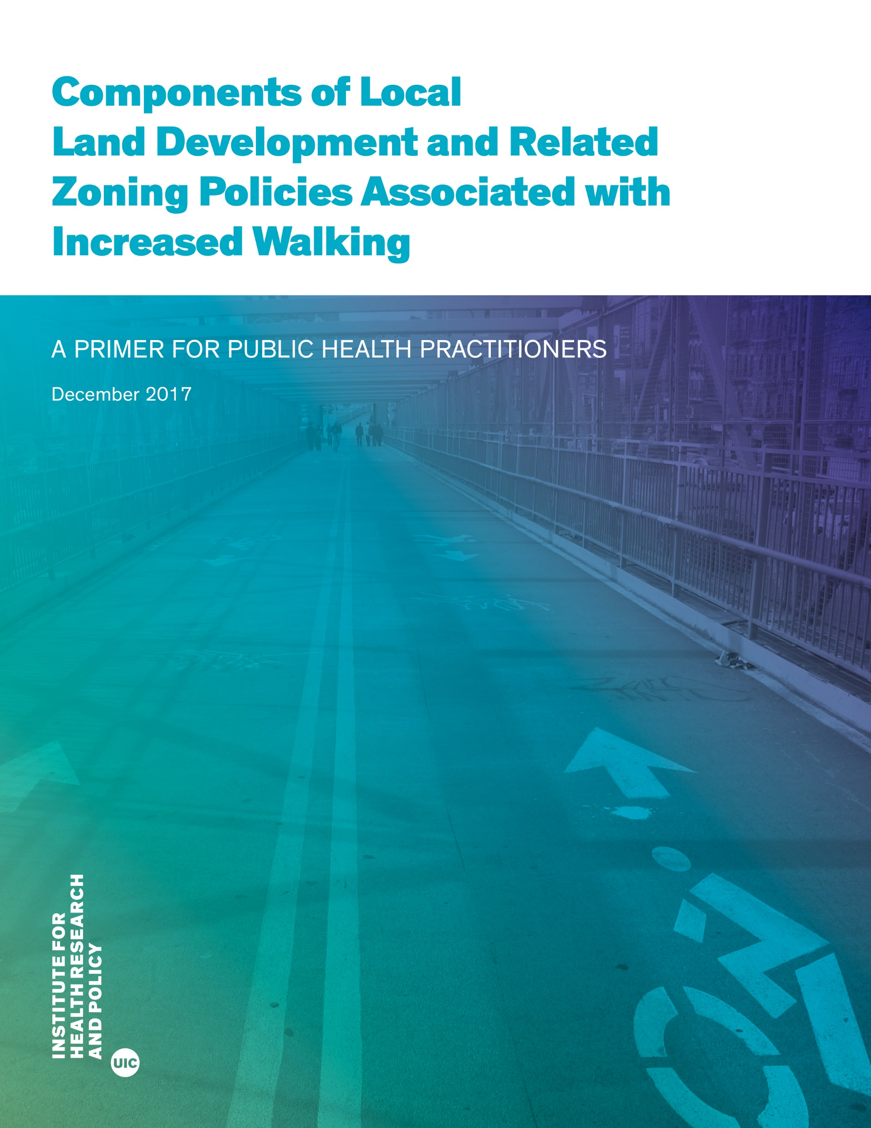
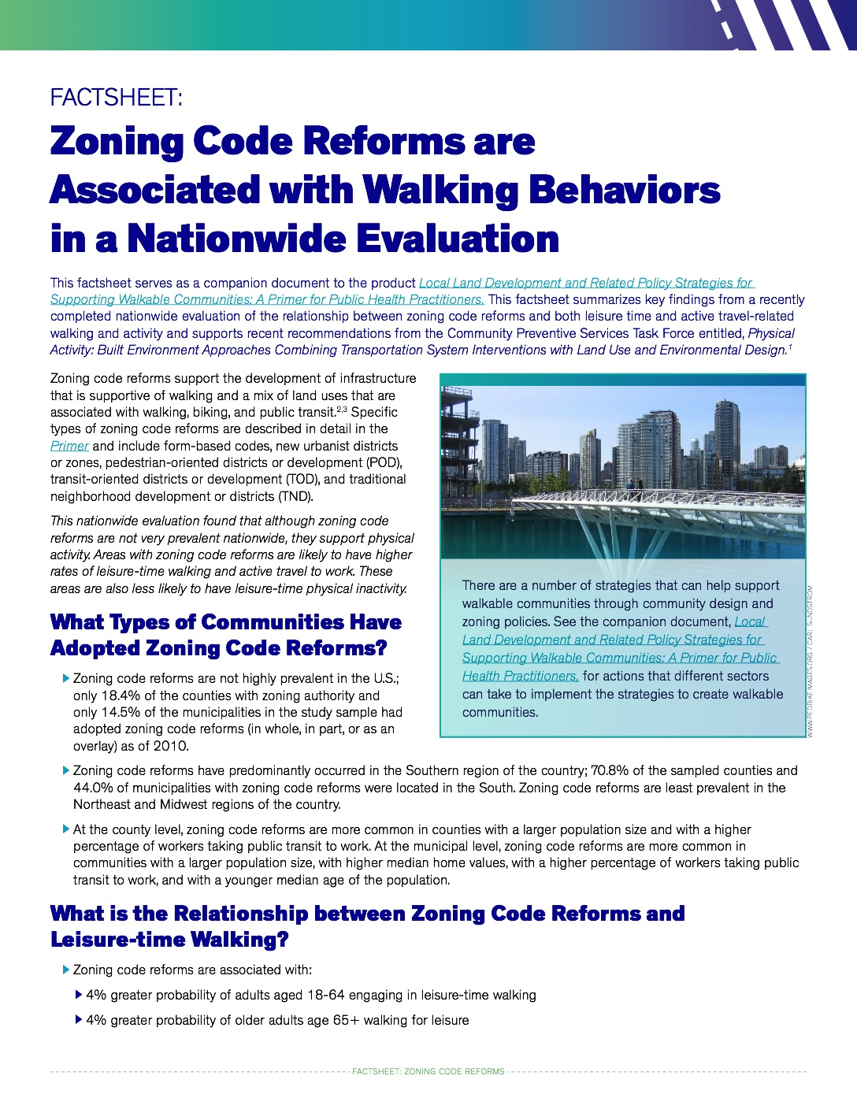
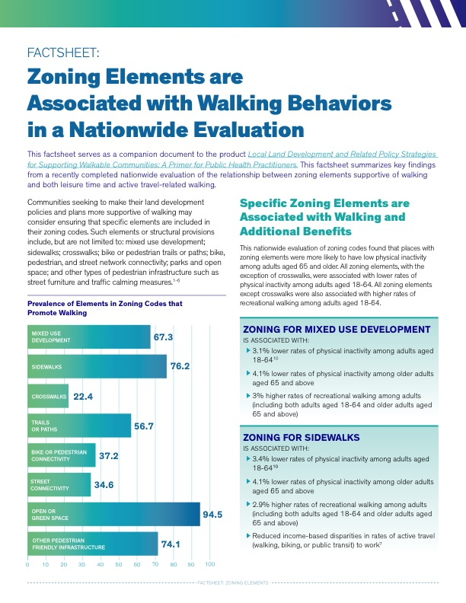
Zoning and Public Health Tools
https://ihrp.uic.edu/using-zoning-regulations-to-foster-walkable-communities-best-practices/

Slide 34
Questions

Slide 35
Contact Information
Jamie F. Chriqui, PhD. MHS
Sr. Associate Dean and Professor, Health Policy and Administration
Co- PI, CDC Physical Activity Policy Research and Evaluation Network
School of Public Health
University of Illinois at Chicago
jchriqui@uic.edu
Twitter: @jfchriqui
https://papren.org

Slide 36
Acknowledgements
Coding/Analysis Team and Co-Authors
Lindsey Realmuto, MPH, PhD cand.
Meg Fredericks, MUPP
Henry Siegel, MPH/MUPP cand.
Julien Leider, MA
Funding Acknowledgements
National Cancer Institute, National Institutes of Health (grant number R01CA158035, PI Chriqui) – baseline data
Centers for Disease Control and Prevention, Physical Activity Policy Research and Evaluation Network (PAPREN) applied research project (Cooperative Agreement Number U48DP006381, Drs. Stephenie Lemon and Jamie Chriqui, co-PIs) – updated data
The UIC Center for Clinical and Translational Science located within the Institute for Health Research and Policy at UIC (grant number UL1TR002003) provided the REDCap system which was used for policy collection and coding.
The findings and conclusions in this presentation are those of the author(s) and do not necessarily represent the official position of the NCI, the CDC, or UIC.

