Slide 1
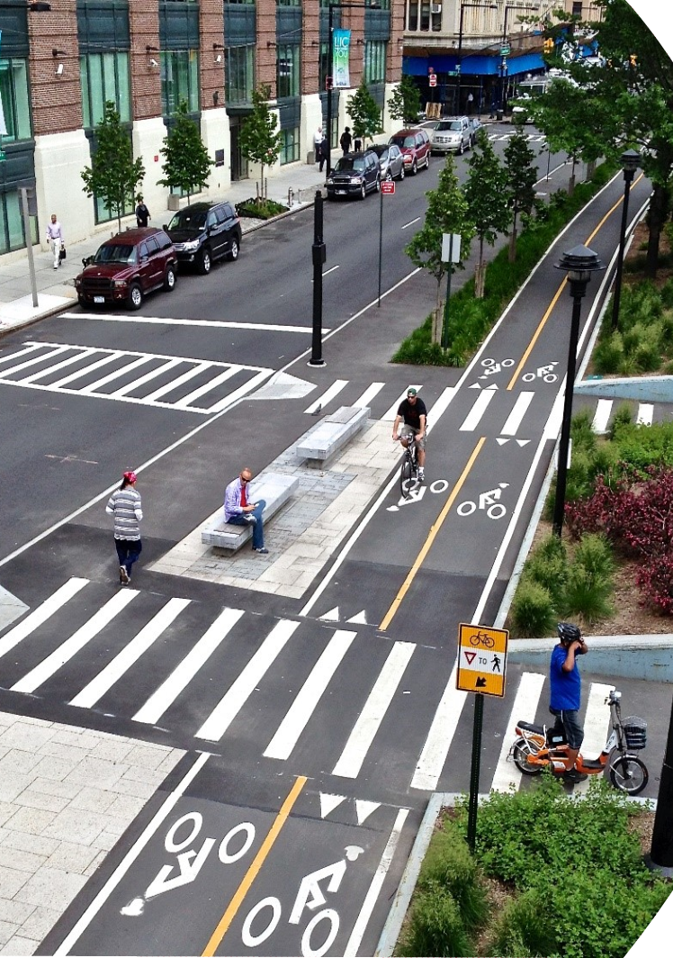
Zoning and Land Use Policy as Tools for Creating Active Communities: Rationale and Theory, Policy Approaches, and Impact
Jamie Chriqui, PhD, MHS (Twitter: @jfchriqui, @PAPREN1)
Physical Activity and Public Health Course
Theory & Practice in Planning and Zoning: A Largely Untapped Public Health and PA Opportunity
September 22, 2023

Slide 2
Acknowledgements
Coding/Analysis Team and Co-Authors
Lindsey Realmuto, MPH, PhD cand.
Meg Fredericks, MUPP
Henry Siegel, MPH/MUPP cand.
Julien Leider, MA
Funding Acknowledgements
National Cancer Institute, National Institutes of Health (grant number R01CA158035, PI Chriqui) – baseline data
Centers for Disease Control and Prevention, Physical Activity Policy Research and Evaluation Network (PAPREN) applied research project (Cooperative Agreement Number U48DP006381, Drs. Stephenie Lemon and Jamie Chriqui, co-PIs) – updated data
The UIC Center for Clinical and Translational Science located within the Institute for Health Research and Policy at UIC (grant number UL1TR002003) provided the REDCap system which was used for policy collection and coding.
The findings and conclusions in this presentation are those of the author(s) and do not necessarily represent the official position of the NCI, the CDC, or UIC.

Slide 3
Land Use, Transportation and PA and the Role of Zoning

Slide 4
Zoning is a key policy lever or strategy for codifying the Community Preventive Services Task Force (CPSTF) recommendations (Community Guide, May 2017)
The CPSTF recommends built environment strategies combining one or more intervention approaches to improve pedestrian or bicycle transportation systems with one or more land use and environmental design interventions based on sufficient evidence of effectiveness in increasing physical activity.
Pedestrian & Bicycle System Transportation Intervention Component
Land Use & Environment Design Intervention Component
Street pattern design and connectivity
Pedestrian infrastructure
Bicycle infrastructure
Public transit infrastructure and access
Mixed land use
Increasing residential density
Proximity to neighborhood or community destinations
Parks and recreational facility access
Notes:
Nearly all of these strategies are addressed through zoning, and land use decisions

Slide 5
Zoning is the key policy lever that governs land use and transportation infrastructure within a community
Exercises of the states’ police powers under the 10th Amendment
Laws that divide city or county areas into districts, or zones, that specify allowable uses or requirements for structural improvements
Includes requirements or allowable uses for things like sidewalks, trails, bike lanes, bike parking, etc.
Notes:
States grant authority to county/municipal governments to promote the health, safety, morals, and general welfare of their citizenry

Slide 6
Traditional Zoning vs. Code Reform (Smart Code or Transect-based) Zoning
Code Reform Zoning: Pedestrian-oriented by design
Traditional Zoning: Use and Density
Source: transect.org
Notes:
This slide shows the differences in what a zoning map looks like under traditional vs. new urbanist zoning.
Traditional, Euclidean zoning divides community into districts (or zones) based on use and density such as commercial, residential, mixed uses, industrial, with no overlap.
The SmartCode is a commercially licensed version of a form-based code that integrates New Urbanist and smart growth concepts into the Transect. The Transect is divided into 6 zones, ranging from rural (T1) to urban (T6), each with its own density and built environment characteristics. Zones T4-T6 are particularly suited for walkable and active living-oriented communities and pedestrian-oriented development as they have mixed uses; parks, plazas, and squares for recreational purposes; streets with curb cuts and tight street networks; medium-wide sidewalks; and street landscaping to provide aesthetic appeal.⁵

Slide 7
Zoning Code Reforms
Emerged in the U.S. as a potential policy strategy to reduce sprawl and reliance on cars and increase physical activity. ¹⁻³
The reforms seek to:
Create compact development
Create pedestrian-friendly or traditional neighborhoods
Increase street connectivity
Create mixed use and higher density neighborhoods
Increase open space and alternative transportation¹⁻³
Examples of code reform zoning
Form-Based Code
Transect-Based Districts
SmartCode
New Urbanist Districts
Pedestrian-Oriented Districts or Developments (POD)
Transit-Oriented Districts or Developments (TOD)
Traditional Neighborhood Districts or Developments (TND)
Other (i.e. Smart Growth Districts)
Schilling J, Linton LS. The public health roots of zoning: In search of active living's legal genealogy. Am J Prev Med. 2005;28:96-104.
Schilling J, Mishkovsky N. Creating a Regulatory Blueprint for Healthy Community Design: A Local Government Guide to Reforming Zoning and Land Development Codes. E-43346. 2005. Washington, D.C., ICMA.
American Planning Association. Planning and Urban Design Standards. 1st ed. Hoboken, NJ: John Wiley & Sons, Inc., 2006.
Notes:
Today I’ll focus on the broad grouping of code reform and TODs
Form-based codes establish zones based on pedestrian accessibility as well as the scale and character of development.³ By allowing form based development “by right,” form-based codes legalize compact, mixed-use and walkable development that otherwise may be constrained by the community’s traditional Euclidean zoning codes.^{1-3;55;56}
Pedestrian-oriented developments/districts (PODs) are designed with an emphasis on sidewalks, street furniture, and pedestrian-centered access to building sites through mixed-use and related types of land use planning.
Similarly, transit-oriented districts (TODs) are mixed-use developments/districts located near a transit stop and core commercial areas and they mix residential, retail, office, and public uses in a walkable environment, making it convenient for residents and employees to travel by transit, bicycle, foot, or car.⁵⁸
Traditional Neighborhood Developments (TND) seek to promote dense, mixed-use neighborhoods that are pedestrian-oriented and that help to reduce sprawl by locating commercial areas in close proximity to residential areas so that residents can walk to such amenities rather than drive. TNDs typically have well-connected street systems; street furniture (e.g., benches, transit shelters, bike parking kiosks, etc.) and landscaping; and neighborhood amenities including shopping, recreational areas, restaurants, and workplaces all within ¼ of a mile or a 10-minute walk.²

Slide 8
Additional infrastructure improvements addressed in zoning codes that may support PA
Reduced/eliminated parking requirements help to:
Preserve open space
Reduce congestion
Encourage attractive, pedestrian-friendly design
Promote transportation choices
Provide more room for new homes in dense, walkable communities that are more sustainable and livable than car-dependent communities
Sources: U.S. EPA (https://www.epa.gov/smartgrowth/parking-spacescommunity-places) ; Urban Institute’s Housing Matters (https://housingmatters.urban.org/)
Density Bonuses
Financial incentive for developers to incorporate certain design features into new developments (e.g., open space, streetscape improvements, bicycle infrastructure) in exchange for allowing them to build more units (typically vertically)
Helps to respond to community needs and interests without requiring complex approval processes

Slide 9
PA-related Elements in Zoning Codes

Slide 10
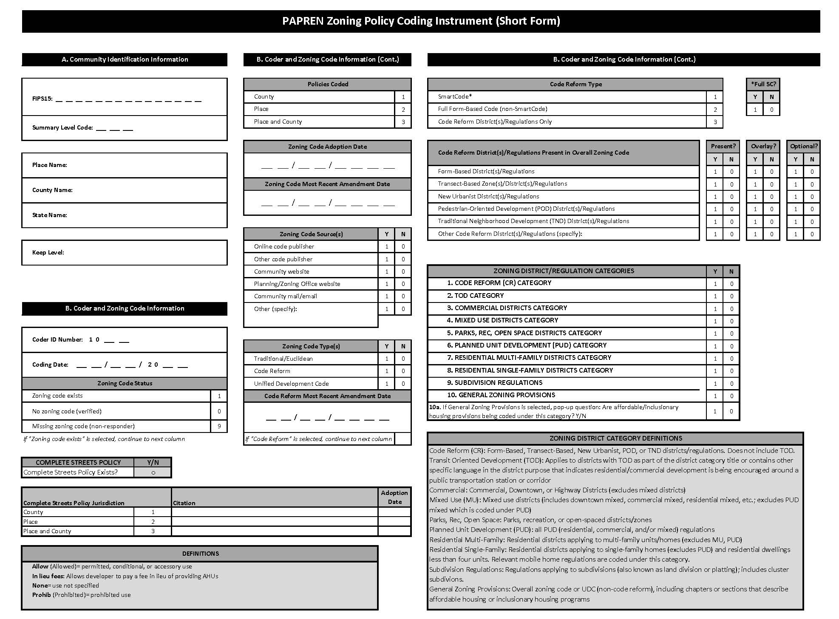
Zoning Code Audit Tool – 2020 Version
Notes:
We will share a link to the tool following the presentation
This is from the 2020 Zoning Audit tool; very similar to 2010 with some new markers for the most part
Zoom in when presenting in slideshow mode to show the markers for code reform on both page 1 and page 2
For page 1:
The tool captures the presence of traditional districts along with the presence of code reform districts.
Page 2:
For each district category including code reform, we coded the active living-oriented elements
For 2020, we have also captured a number of affordable housing related markers
For each jurisdiction, compiled yes/no indicators for each element being addressed in the jurisdiction.

Slide 11
Prevalence of Activity-Oriented Zoning Provisions in the 200 Most Populous US Counties (2297 jurisdictions)
Notes:
We have had two rounds of funding to longitudinally examine activity-oriented zoning. The first was through an NCI R01 that examined zoning codes effective as of January 2010 in over 4000 jurisdictions in the most populous 496 counties and 4 consolidated cities. Through PAPREN, we’ve been able to update the data longitudinally for zoning codes effective as of January 2020 for 2297 municipal and unincorporated county areas located within the 200 most populous counties from the original sample frame.
41 states + DC
55.1%
Zoning codes, subdivision regulations, UDCs, form-based codes

Slide 12
Longitudinal Panel Sample Characteristics (N=2297 municipal and unincorporated county areas in 41 states & DC)
Characteristic | Mean (SD)
Population size (# persons) | 73,909 (192,604); Range: 1,734 - 3,795,761 (1/3 of the jurisdictions had ≤11,336 persons)
% households in poverty | 10.31 (6.47)
Median Age (years) | 39.5 (6.2)
% occupied housing with no vehicle | 6.76 (5.79)
% living in urban area | 97.4 (9.23); Range: 0-100%
Racialized economic segregation (ICE Measure)
Quintile 1 (-0.41-0.02) | 20.03%
Quintile 2 (>0.02-0.12) | 20.03%
Quintile 3 (>0.12-0.20) | 19.98%
Quintile 4 (>0.20-0.31) | 20.03%
Quintile 5 (>0.31-0.76) | 19.94%
Region
West | 23.9%
Midwest | 27.0%
Northeast | 24.6%
South | 24.5%

Slide 13
Code reform zoning has significantly* increased over time (Longitudinal Panel; 2297 jurisdictions in 200 counties and 41 states + DC)
*All changes significant at p<.001 in both unadjusted, and adjusted models
Notes:
Just pulled out illustrative examples.
Code reform change over time also holds up in adjusted models controlling for jurisdictional characteristics and the results are essentially identical
Same for TOD Zoning –results identical in adjusted models

Slide 14
Activity-supporting built environment features addressed in zoning codes have increased* over time (Longitudinal Panel; 2297 jurisdictions in 200 counties and 41 states + DC)
***p<.001 in unadj. and adj. models

Slide 15
Activity-supporting built environment features addressed in zoning codes are more prevalent in code reform jurisdictions (Longitudinal Panel; 2297 jurisdictions in 200 counties and 41 states + DC; 2020 data)
***p<.001 in adjusted models

Slide 16
Additional PA-supportive Infrastructure Improvements are more Prevalent than PA-related Density Bonuses in Zoning Codes (2020 data only) (2297 jurisdictions in 200 counties and 41 states + DC)
Density Bonuses
Notes:
Plazas and public transit access are addressed with CPSTF

Slide 17
Most Common Factors Associated with Activity-Oriented Zoning
Larger Jurisdictions (population size)
Jurisdictions in the South
% households with no vehicle

Slide 18
What About the Relationship between Zoning and PA-related Outcomes?

Slide 19
Certain Zoning Provisions are Particularly Associated with Increased Rates of Adult Walking to Work
Zoning Predictor | Municipal-level ONLY |  | Municipal & Unincorporated Areas
 | Coef. | 95% CI | Coef. | 95% CI
Code Reform Zoning | 0.24 | -0.00,0.48 | 0.26* | 0.04,0.48
Sidewalks | 0.17 | -0.07,0.40 | 0.15 | -0.05,0.35
Crosswalks | 0.12 | -0.10,0.35 | 0.11 | -0.10,0.32
Bike-Ped Connectivity | 0.12 | -0.08,0.33 | 0.13 | -0.06,0.31
Street Connectivity | 0.10 | -0.08,0.29 | 0.10 | -0.07,0.27
Bike Lanes | 0.25 | -0.04,0.53 | 0.23 | -0.03,0.49
Bike Parking (street furniture) | 0.38** | 0.14,0.62 | 0.37*** | 0.15,0.58
Trails | 0.26* | 0.05,0.47 | 0.24** | 0.06,0.43
Pedestrian Plazas | 0.25* | 0.02,0.47 | 0.23* | 0.05,0.42
Mixed Use | 0.30** | 0.10,0.50 | 0.27** | 0.10,0.45
Muni models=3,914 jurisdictions covering 45% US population; Muni+Uninc models=4,393 muni+county areas covering 72% of US pop. All *p<.05 **p<.01 ***p<.001. Source: Chriqui et al., Front Public Health, 2016.
Notes:
Actual %age point increases in walking to work associated with zoning measures

Slide 20
Certain Zoning Provisions are Particularly Associated with Increased Rates of Adult Walking OR Biking to Work
Zoning Predictor | Municipal-level ONLY |  | Municipal & Unincorporated Areas
 | Coef. | 95% CI | Coef. | 95% CI
Code Reform Zoning | 0.36* | 0.07,0.66 | 0.40** | 0.12,0.67
Sidewalks | 0.25 | -0.01,0.51 | 0.24* | 0.02,0.46
Crosswalks | 0.19 | -0.09,0.47 | 0.18 | -0.08,0.44
Bike-Ped Connectivity | 0.15 | -0.10,0.40 | 0.16 | -0.07,0.39
Street Connectivity | 0.18 | -0.04,0.41 | 0.19 | -0.02,0.39
Bike Lanes | 0.40* | 0.05,0.75 | 0.37* | 0.05,0.70
Bike Parking (street furniture) | 0.68*** | 0.39,0.97 | 0.65*** | 0.39,0.91
Trails | 0.32** | 0.09,0.56 | 0.33** | 0.12,0.53
Pedestrian Plazas | 0.34** | 0.09,0.59 | 0.34** | 0.13,0.55
Mixed Use | 0.42*** | 0.19,0.64 | 0.39*** | 0.19,0.59
Muni models=3,914 jurisdictions covering 45% US population; Muni+Uninc models=4,393 muni+county areas covering 72% of US pop. All *p<.05 **p<.01 ***p<.001. Source: Chriqui et al., Front Public Health, 2016.
Notes:
Actual %age point increases in walking or biking to work associated with zoning measures

Slide 21
Code reform zoning is associated with more people engaging in any active travel to work
Zoning Predictor | Municipal-level ONLY |  | Municipal & Unincorporated Areas
 | Coef. | 95% CI | Coef. | 95% CI
Code Reform Zoning | 0.93** | 0.24,1.62 | 1.02** | 0.38,1.65
Sidewalks | 0.29 | -0.19,0.77 | 0.38 | -0.07,0.82
Crosswalks | 0.30 | -0.28,0.87 | 0.37 | -0.16,0.91
Bike-Ped Connectivity | 0.27 | -0.24,0.78 | 0.32 | -0.13,0.78
Street Connectivity | 0.23 | -0.21,0.66 | 0.25 | -0.16,0.65
Bike Lanes | 1.05* | 0.14,1.96 | 1.00* | 0.16,1.83
Bike Parking (Street furniture) | 1.02*** | 0.49,1.55 | 1.03*** | 0.57,1.50
Trails | 0.16 | -0.29,0.61 | 0.25 | -0.13,0.63
Pedestrian Plazas | 0.61* | 0.12,1.09 | 0.65** | 0.19,1.10
Mixed Use | 0.29 | -0.08,0.66 | 0.32 | -0.01,0.66
Having code reform zoning is associated with approximately 1% more people engaging in any active travel to work (via walking, biking, or taking public transit).
Muni models=3,914 jurisdictions covering 45% US population; Muni+Uninc models=4,393 muni+county areas covering 72% of US pop. All *p<.05 **p<.01 ***p<.001. Source: Chriqui et al., Front Public Health, 2016.
Notes:
Actual %age point increases in AT to work associated with zoning measures

Slide 22
Code reform zoning is associated with lower rates of no activity, and this association is partially mediated by walkability
Walkability
a = 0.52**
b = -0.28***
c’ = -0.14*
Code Reform Zoning
% Adults Engaging in No Leisure-Time Physical Activity
c = -0.96***
* p<.05 ** p<.01 *** p<.001
Source: Chriqui, Leider, et al. in preparation
Notes:
Walkability from EPA’s National Walkability Index, outcomes from CDC Places data

Slide 23
Activity-oriented zoning index is associated with lower rates of no activity, and this association is partially mediated by walkability
Walkability
a = 0.06*
b = -0.27***
c’ = -0.02*
Activity-Oriented Zoning
% Adults Engaging in No Leisure-Time Physical Activity
c = -0.23***
* p<.05 *** p<.001
Source: Chriqui, Leider, et al. in preparation

Slide 24
TOD zoning is associated with higher rates of active travel to work, and this association is partially mediated by walkability
Walkability
a = 1.67***
b = 0.77***
c’ = 1.28***
TOD Zoning
% Workers Engaging in Active Travel to Work
c = 2.49**
** p<.01 *** p<.001
Source: Chriqui, Leider, et al. in preparation

Slide 25
Zoning code reforms moderate the relationship between municipal-level racialized economic segregation, public transit use, and active travel (2010 zoning data only)
 | Public Transit Use |  | Active Travel
 | Odds Ratio | 95% CI | Odds Ratio | 95% CI
Associations with RES, without zoning code reform (Compared to RES Q5 – most privileged)
RES Q1 – most deprived | 0.52 | 0.35 – 0.78 | 0.31 | 0.24 – 0.40
RES Q2 | 0.36 | 0.27 – 0.49 | 0.37 | 0.30 – 0.45
RES Q3 | 0.36 | 0.28 – 0.47 | 0.44 | 0.37 – 0.53
RES Q4 | 0.48 | 0.38 – 0.60 | 0.55 | 0.47 – 0.65
Associations with zoning code reform by RES
RES Q1 | 1.72 | 1.18 – 2.52 | 1.42 | 1.12 – 1.79
RES Q2 | 2.38 | 1.69 – 3.37 | 1.69 | 1.31 – 2.18
RES Q3 | 1.53 | 1.13 – 2.08 | 1.19 | 1.00 – 1.41
RES Q4 | 1.30 | 0.89 – 1.91 | 1.26 | 1.00 – 1.58
RES Q5 | 0.90 | 0.66 – 1.22 | 0.96 | 0.75 – 1.23
Fractional logit model controlling for municipal-level median age, percent household poverty, region, walkability, percent occupied housing with no vehicle, population size, and interactions between zoning code reform and racialized economic segregation, with robust standard errors clustered on county. Bold indicates a significant association (p<.05). N=3,914 municipalities representing 45.45% of the U.S. population in 471 of the most populous counties and 2 consolidated cities located in 48 states and the District of Columbia.
Source: Serrano, Leider, Chriqui, under review
Notes:
without zoning CR, workers in jurisdictions in the more deprived quintiles were significantly less likely to engage in both PT use (Q1-Q4: OR= 0.36 – 0.52, p<0.01) and overall AT to work (Q1-Q4: OR= 0.31 – 0.55, p<0.001), when compared to the most privileged quintile. The test of moderation was significant when looking at the interactions between RES and zoning CR with both PT use and overall AT to work (p<0.05). There was no association between zoning CR and PT use for the two highest quintiles of RES, but zoning CR was positively associated with PT use for the three most deprived quintiles (OR=1.53 – 2.38, p<0.01). For overall AT to work, there was a positive association between CR zoning and AT to work for the two most deprived quintiles (OR=1.42 – 1.69, p<0.01), as well as the second most privileged quintile (OR=1.26, p<0.05).

Slide 26
Pedestrian-oriented zoning moderates the relationship between municipal-level racialized economic segregation, public transit use, and active travel (2010 zoning data only)
 | Public Transit Use |  | Active Travel
 | Odds Ratio | 95% CI | Odds Ratio | 95% CI
Associations with RES, without pedestrian-oriented zoning provisions (Ref: RES Q5)
RES Q1 – most deprived | 0.32 | 0.18 – 0.54 | 0.22 | 0.16 – 0.31
RES Q2 | 0.23 | 0.15 – 0.34 | 0.25 | 0.19 – 0.33
RES Q3 | 0.25 | 0.17 – 0.36 | 0.34 | 0.26 – 0.43
RES Q4 | 0.35 | 0.25 – 0.48 | 0.41 | 0.32 – 0.52
Associations with pedestrian-oriented zoning provisions (i.e., zoning scale score) by RES
RES Q1 | 1.10 | 1.00 – 1.21 | 1.07 | 1.01 – 1.12
RES Q2 | 1.13 | 1.05 – 1.21 | 1.09 | 1.05 – 1.14
RES Q3 | 1.05 | 0.99 – 1.12 | 1.03 | 1.00 – 1.06
RES Q4 | 1.03 | 0.96 – 1.09 | 1.04 | 1.00 – 1.08
RES Q5 | 0.91 | 0.87 – 0.96 | 0.94 | 0.90 – 0.98
Fractional logit model controlling for municipal-level median age, percent household poverty, region, walkability, percent occupied housing with no vehicle, population size, and interactions between zoning scale score and racialized economic segregation, with robust standard errors clustered on county. Bold indicates a significant association (p<.05). N=3,914 municipalities representing 45.45% of the U.S. population in 471 of the most populous counties and 2 consolidated cities located in 48 states and the District of Columbia.
Source: Serrano, Leider, Chriqui, under review
Notes:
without pedestrian-oriented zoning provisions, workers in jurisdictions in the more deprived quintiles were significantly less likely to engage in both PT use (Q1-Q4: OR= 0.23 – 0.35, p<0.001) and overall AT to work (Q1-Q4: OR= 0.22 – 0.41, p<0.001), when compared to the most privileged quintile. The test of moderation was significant when looking at interactions between the pedestrian-oriented zoning provisions and RES with both PT use and AT to work (p<0.001). In the most privileged quintile, a higher zoning scale score is negatively associated with both PT use (OR=0.91, p<0.001) and overall AT to work (OR=0.94, p<0.01). However, in the most deprived quintiles, a higher zoning scale score is positively associated with both PT use (Q2: OR=1.13, p<0.01) and AT to work (Q1-Q2: OR=1.07 – 1.09, p<0.05).

Slide 27
Opportunities and More Information

Slide 28
What opportunities exist? What else do we need to know?
Reliable data on the ground of zoning implementation in practice
Studying the process of implementation and understanding what implementation strategies WORK
Mixed methods
Having local level data on PA to examine the true relationship between zoning, the built environment (implementation), and PA-related outcomes
A lot of the data we work with nationally is limited to municipal or county level data or, when individual, only has county geocodes

Slide 29
Opportunities for Public Health Community
Public health government staff
Partner with planning, zoning, and transportation agencies when considering revising zoning codes to make a PA-orientation a priority for rezoning/new zoning efforts
Advocates
Work across sectors to advocate for PA-related zoning provisions
Work to advocate for funding to support implementation

Slide 30
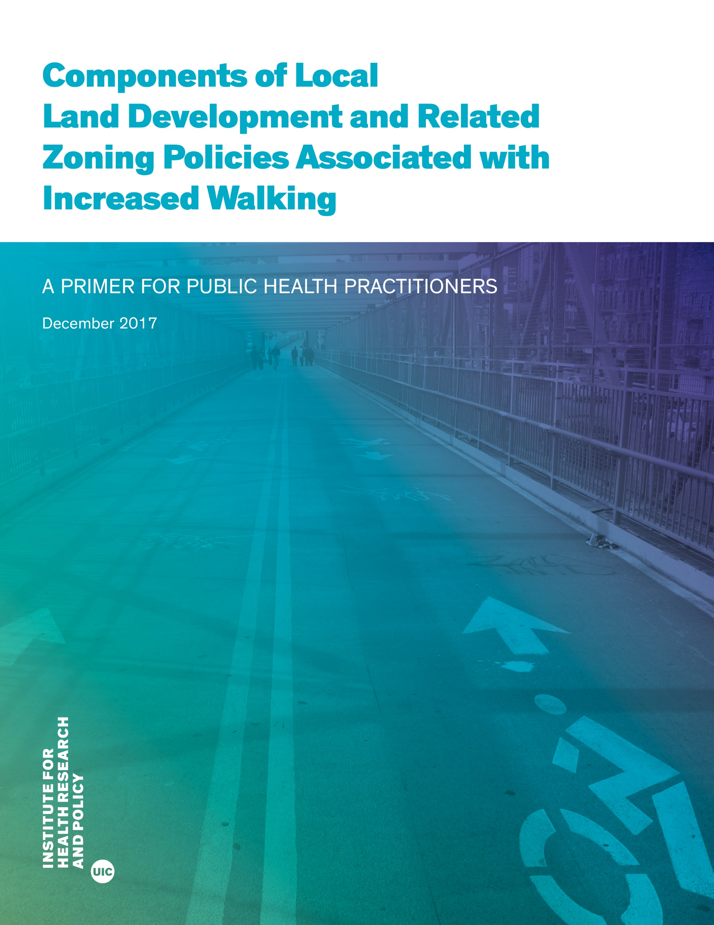
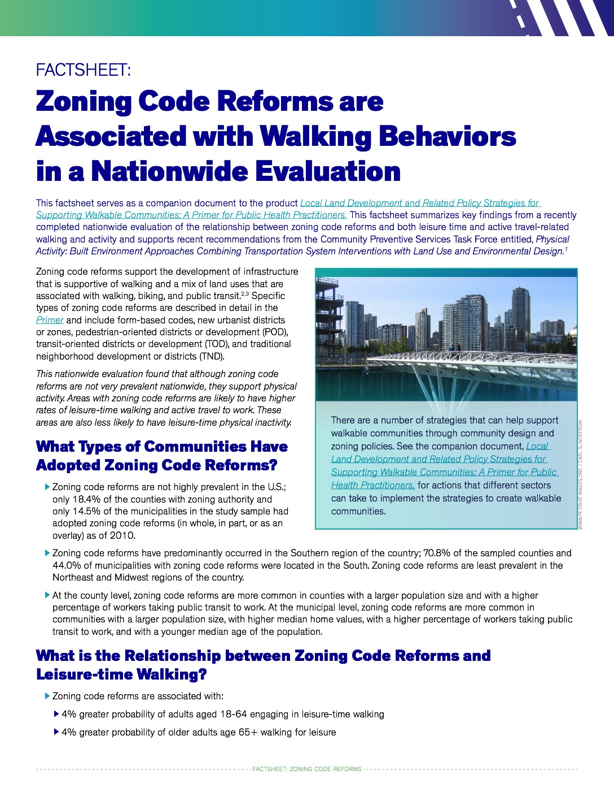
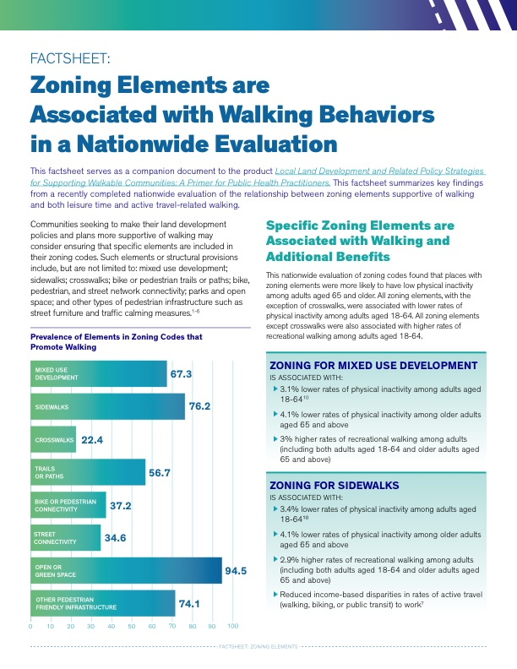
Zoning and Public Health Tools
https://ihrp.uic.edu/using-zoning-regulations-to-foster-walkable-communities-best-practices/

Slide 31
Learn More about PAPREN

Slide 32
What is PAPREN?
A CDC-funded thematic research network of the CDC Prevention Research Centers and is funded by the Physical Activity and Health Branch within DNPAO.
A key research partner of the Active People, Healthy Nation Initiative.
PAPREN is grounded in the Community Preventive Services Task Force recommendations that call for land use and transportation strategies for supporting physical activity.
PAPREN advances the evidence base and puts research into practice through collaboration across sectors with a shared vision of achieving active communities.
Includes researchers, planners, engineers, policy makers, green space managers, advocates, public health professionals and others!
We have 842 members! Great professional networking opportunity (and it’s entirely free!)
Notes:
We truly are dedicated to multi-sectoral collaboration and welcome all recipients and your colleagues to join the Network!

Slide 33
PAPREN Work Groups
Equity & Resilience
Transportation Policy & Planning
Rural Active Living
Parks & Greenspace
School Wellness
Worksite Wellness
Notes:
We have 6 work groups. Equity & Resilience is a separate group but is central to the work of all of our groups and therefore presented at the core. Next I will highlight examples of our current equity-related projects being conducted by the workgroups in Bold.

Slide 34
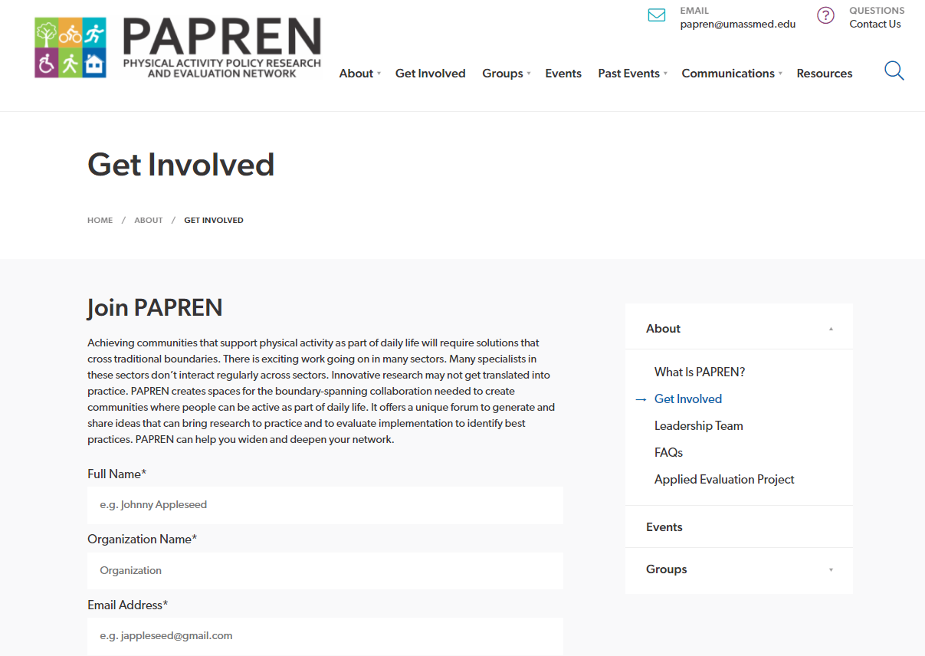
Join and Connect with Us!
Email: papren@umassmed.edu
Website: https://papren.org
@PAPREN1
Join the Network!
Join a Work Group (or 2)!
Notes:
Visit our website to sign up for the Network (to get on our email list) and/or to join a workgroup (or two)! TO join, select “Get Involved” at the top of our site. To simply receive our newsletter, scroll to the bottom of any page on our site and sign up! It’s that simple!

