Slide 7
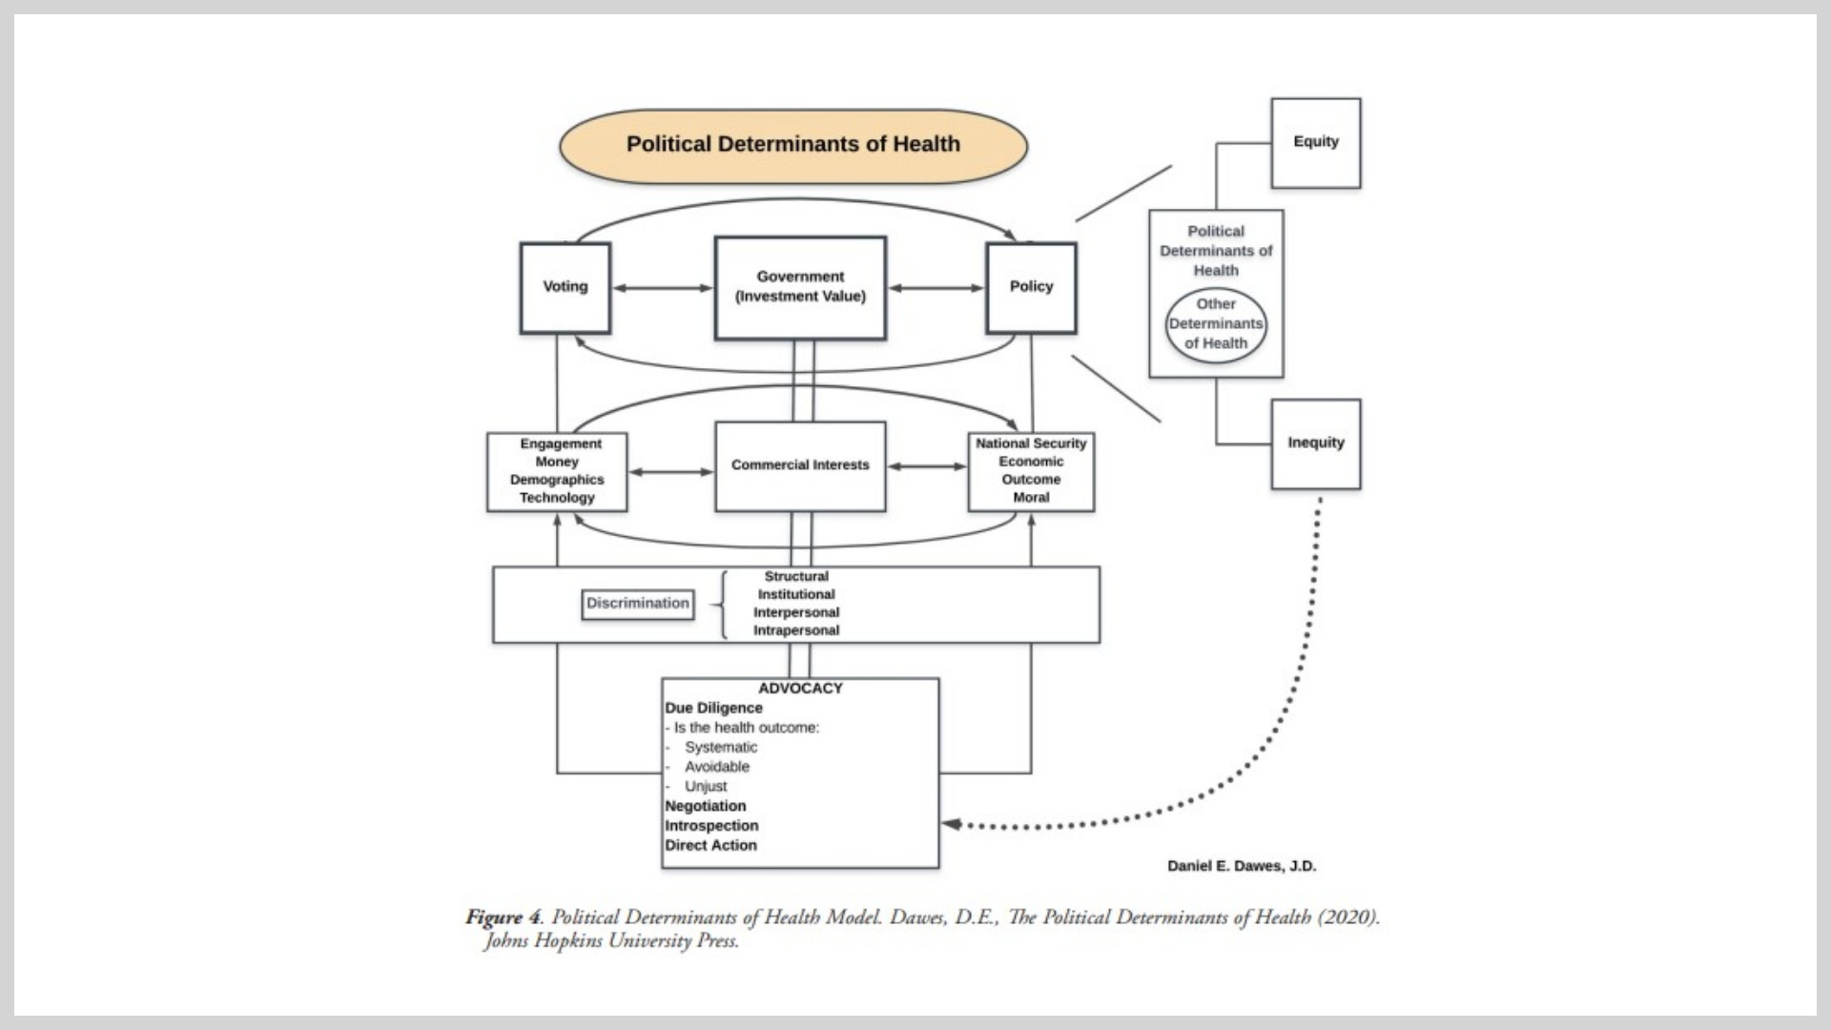
Notes:
By understanding the political determinants of health and their impact on equitable distribution of opportunities and resources and their interconnectedness with the SDOH, we will be better positioned to identify, adopt, and implement policy solutions to close the health gaps.

Slide 8
Notes:
I'll cover 4 sectors from the PA Plan: Park/rec, education, zoning and land use, and business but will particularly focus on education and zoning/land use where I collectively spend a LOT of my research brainpower studying

Slide 10
Notes:
Health can be influenced by policies in many different sectors, e.g., transportation policies can encourage physical activity (pedestrian- and bicycle- friendly community design); PE mandates in school can support students being physically active during the school day

Slide 11
Notes:
What branch are you focusing on for your projects?

Slide 14
Notes:
Add notes for self on what we found here

Slide 15
Notes:
Add notes for self on what we found here

Slide 26
Notes:
We will each BRIEFLY introduce ourselves

Slide 27
Notes:
Stephanie, remind people we are still getting things up and going and apologize that the calendar invites haven't been seamless. Until we get our calendar invites worked out from the PAPREN post and the website, please be sure to sign up for the PAPREN listserv (or to join PAPREN on our website) so you will be sent the calendar invitations.

Slide 28
Notes:
Emailed Karin about url

Slide 29
Notes:
Each work group/interest group will briefly present on their group in the next few minutes

