Slide 1
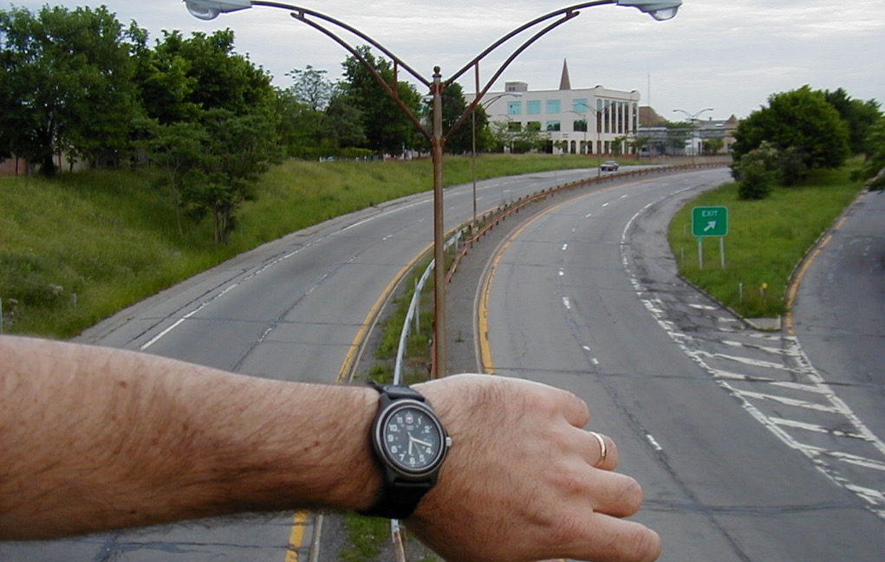

Why are you talking to us about ZONING?
It’s not even part of our jobs!
2004
Mark Fenton
Tufts University
rmfenton777@gmail.com

Slide 2
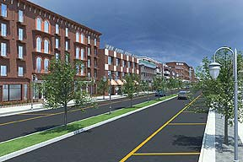
Inner Loop in-fill concept.
Rochester NY

Slide 3
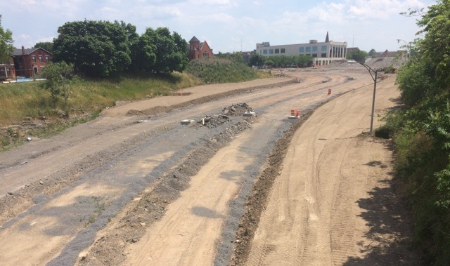
2016

Slide 4
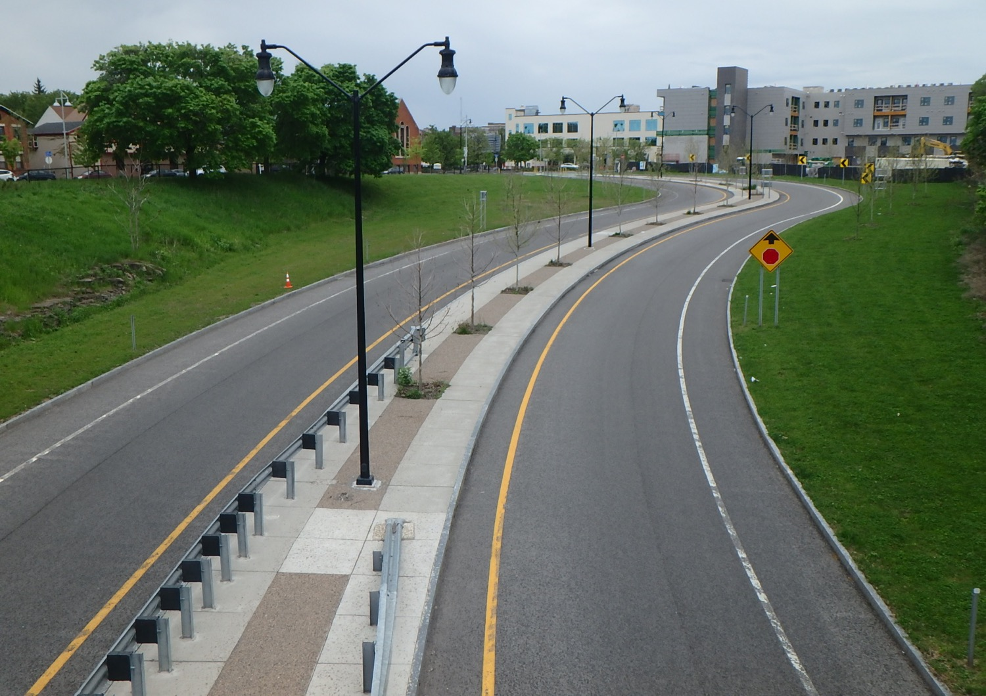
2019

Slide 5
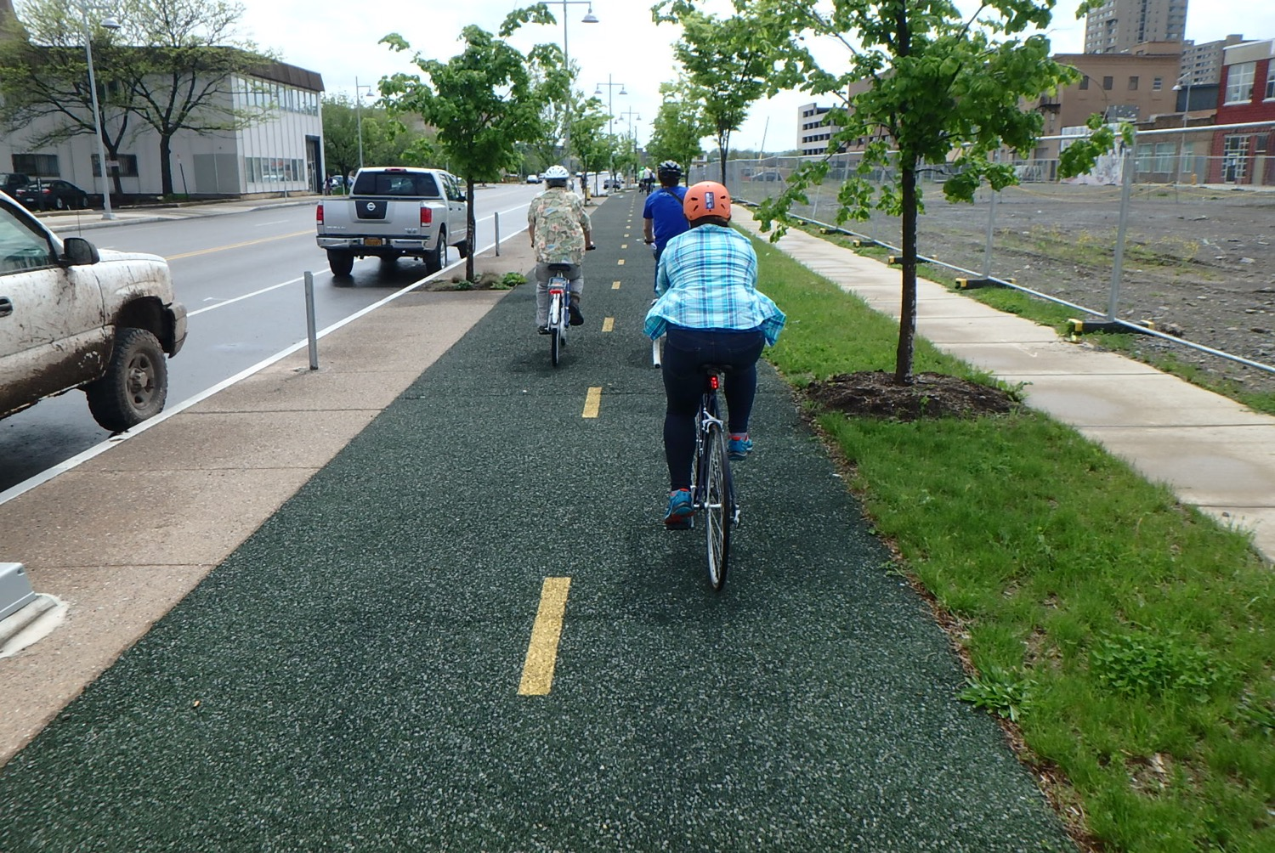

Slide 6
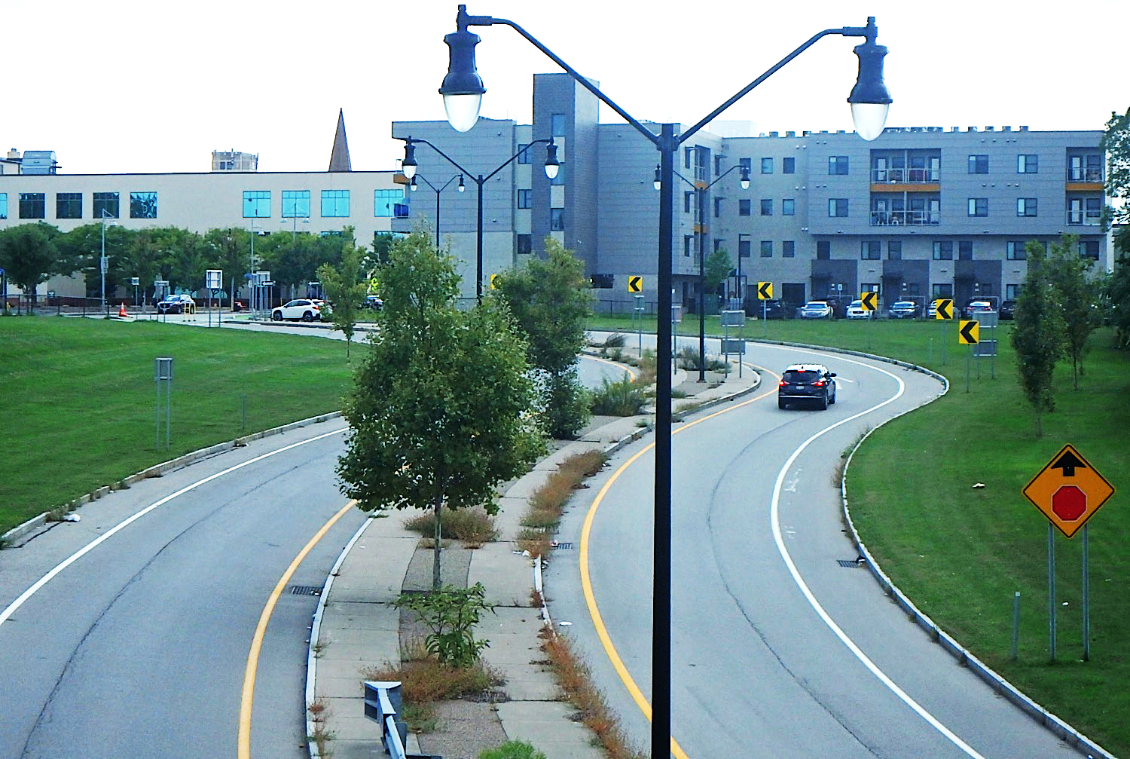
2023

Slide 7
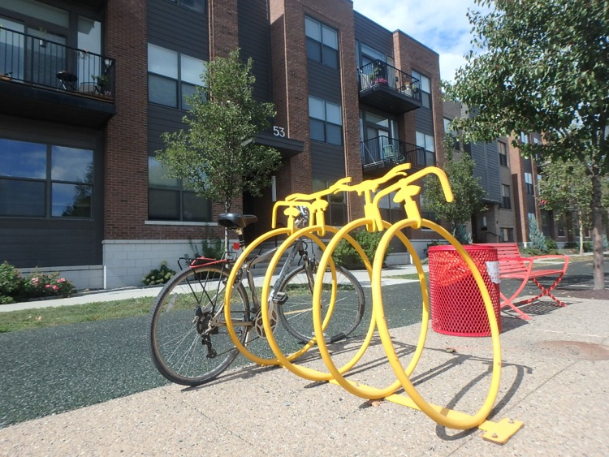
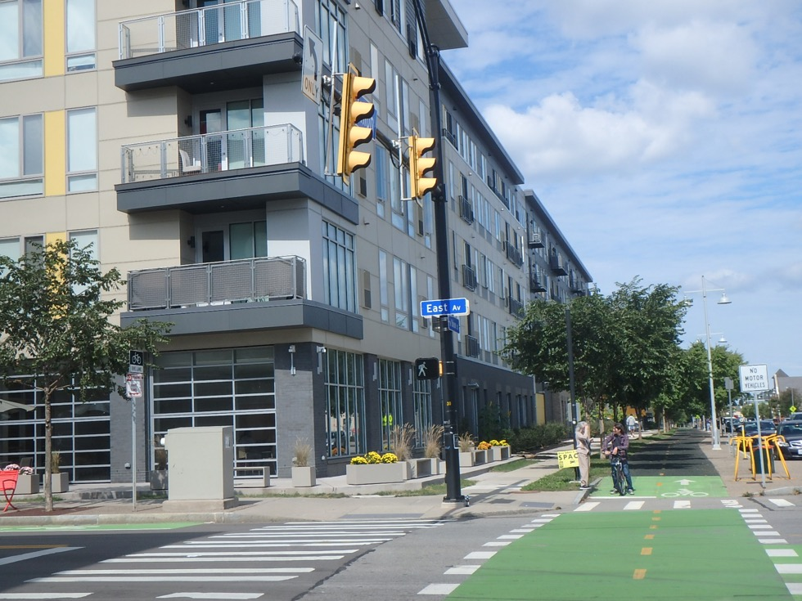
Reclaimed area zoned for mixed housing, retail, & commercial; with required bicycle & pedestrian infrastructure.
cityofrochester.gov/InnerLoopEast/

Slide 8
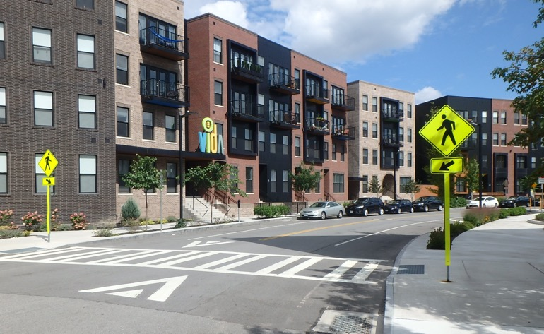
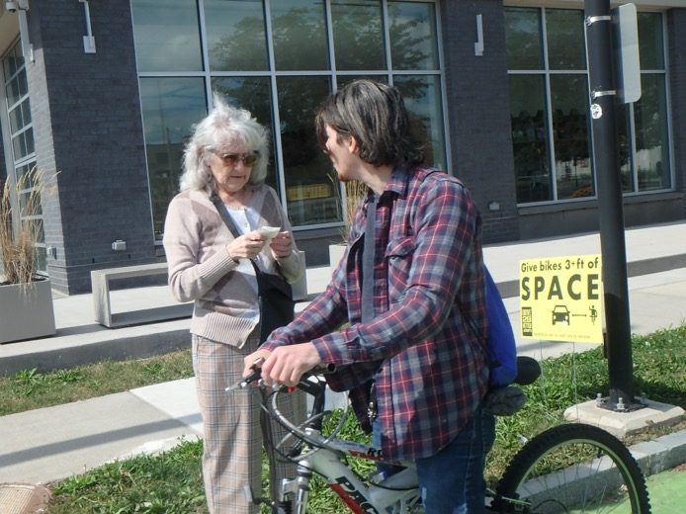
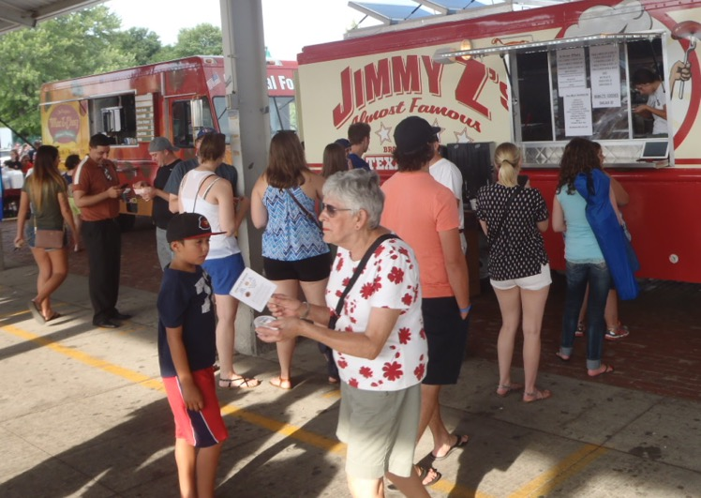
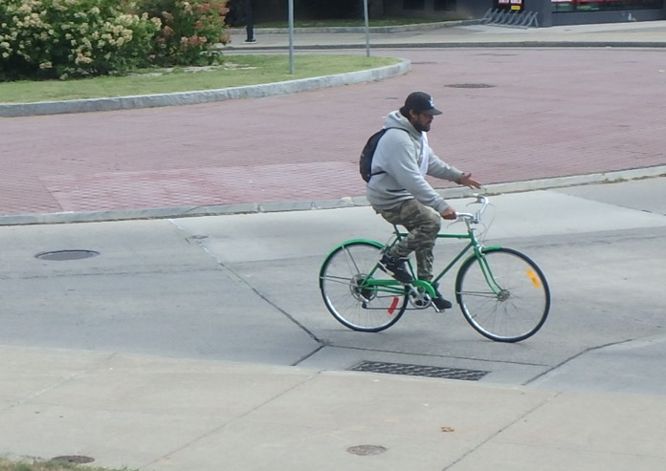

Slide 9
Supportive policies & environments for active transportation yield economic benefits . . .
Sulphur Springs TX
Greater walkability & bike-ability.
Better air quality.
Fewer vehicle miles traveled.
More small business development.
Lower building vacancy rates. >
Boosts property values, tax revenues.
More affordable housing opportunities.
Higher retail sales.
Higher employment rates.
Longer & healthier lives.
Before
After
Journal of Physical Activity & Health, 2021, 18, 1088-1096.

Slide 10
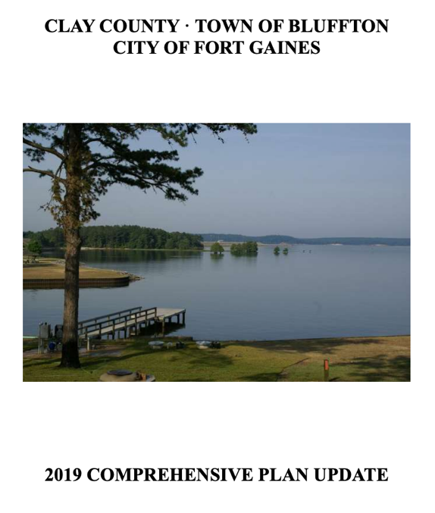
Do you know if your community has a master (growth, comprehensive, development) plan?
    No, I’m not sure.
    Yes; they don’t have one.
    Yes they have one but I’ve never looked at it.
    Yes, and I’m even a bit familiar with it (e.g. seen the executive summary).
    Yes, and I’m very familiar with our master planning document.

Slide 11
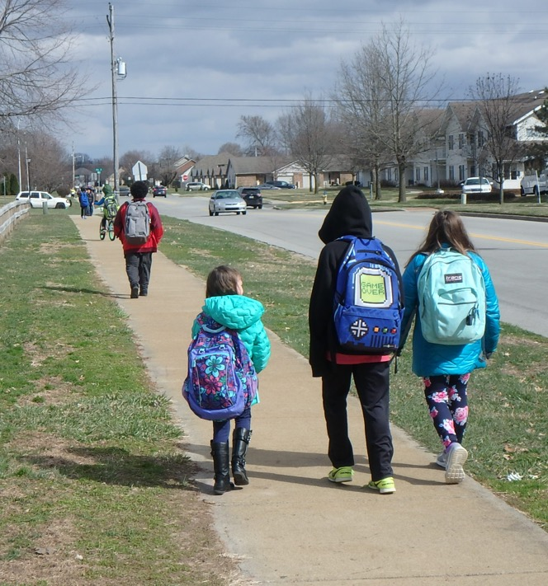
Land use, planning, & zoning
Healthy design
Planning roots in health
Opportunity areas
  Plan development
  Zoning ordinance
  Permitting practices
Creative approaches & recommendations.

Slide 12
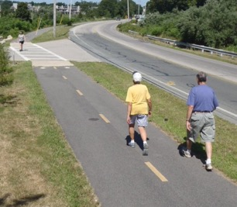
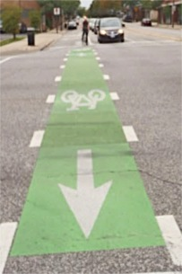
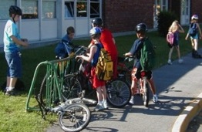
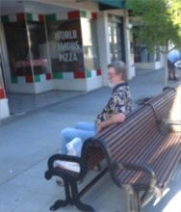
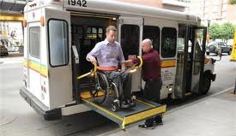
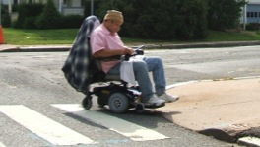
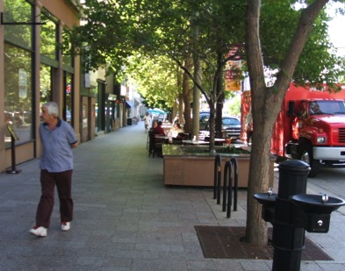
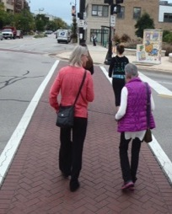
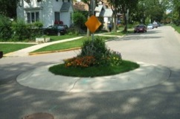
3. Four elements support active transportation
Land Use Mix
Safety & Access
Network
Site Design

Slide 13
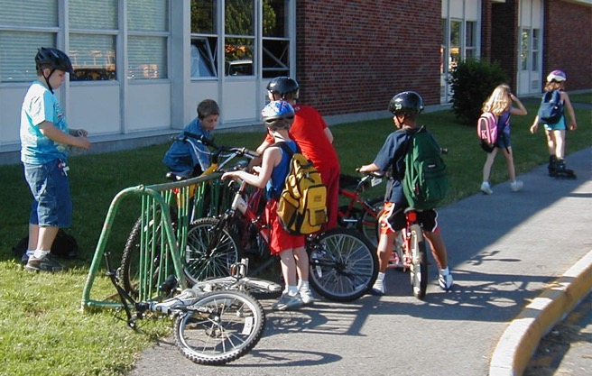
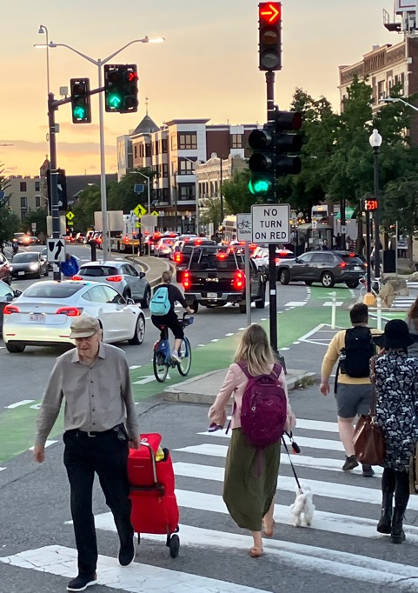
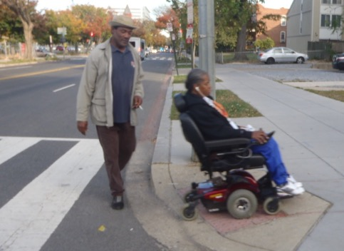
PA support occurs on three scales.
2. Linking
network of ped, bike, & transit facilities.
1. Variety of destinations in proximity.
(Circulation, 2020;142:e167–e183.)
3. Safe, functional, & accessible, & for all.

Slide 14

Key findings:
It’s never too late to start being physically active & gain major health & longevity benefits.
Regular physical activity supports older adults to live independently, improve quality of life, & reduce need for medical care.
Community leaders & policy makers can assist in increasing physical activity through support for active community design elements.
health.gov/our-work/nutrition-physical-activity/physical-activity-guidelines/
current-guidelines/midcourse-report

Slide 15
PSE strategies:
Built environment attributes:
  Walkability (e.g., residential density, land use mix, street connectivity);
  Sidewalk/curb/intersection quality control; and
  Variety, availability, & easy access to destinations, e.g. parks & recreational facilities
Impacts walking for transport, for recreation, moderate-vigorous PA, total PA, & meeting the PA Guidelines.
health.gov/our-work/nutrition-physical-activity/physical-activity-guidelines/
current-guidelines/midcourse-report

Slide 16
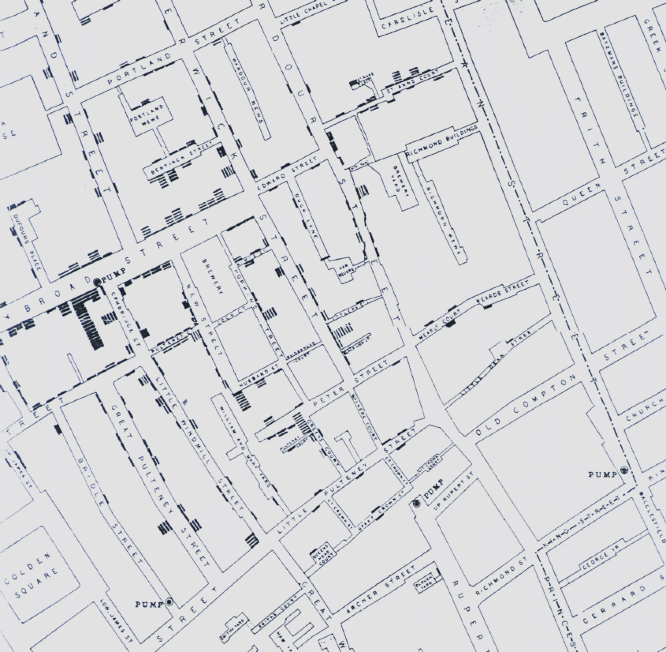
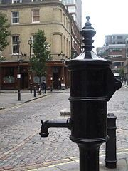
B. Environmental health roots:
Dr. John Snow – 1854 London
Mapped cholera deaths.
Suspected contaminated water as a source.
Removed Broad St. pump handle . . .
MMWR 54(34); 783; Sep. 2004

Slide 17
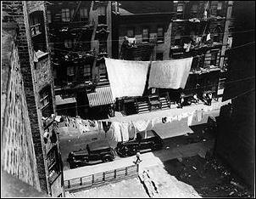

Planning: Deep roots in public health
Lowering overcrowding in tenements (which contributed to ~675,000 US deaths in the 1918 flu epidemic).
Separate “incompatible” uses & activities. (e.g. factories - homes)
  Clean water, sanitation.
  Air quality.
Provide green, open space. (Frederick Law Olmsted: Central Park & US Sanitary Comm.)
Public safety.

Slide 18
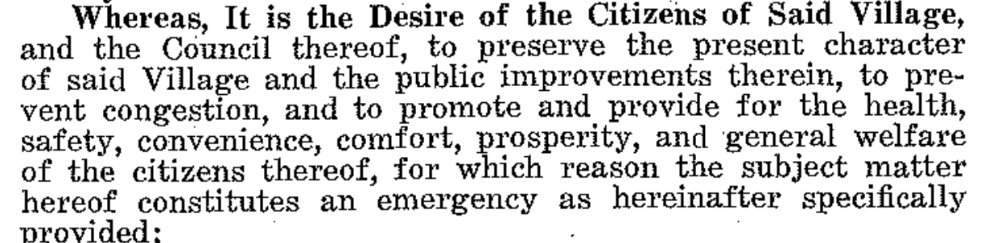
Zoning Enabling Legislation
Rules governing the subdivision, preservation, & uses of land.
For the health, safety, & welfare of residents.
Village of Euclid OH vs. Ambler Realty, 1926

Slide 19
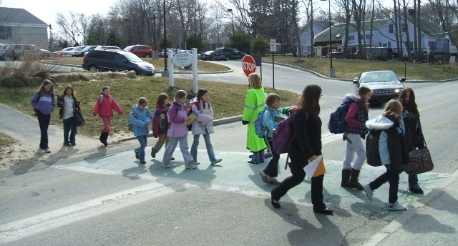
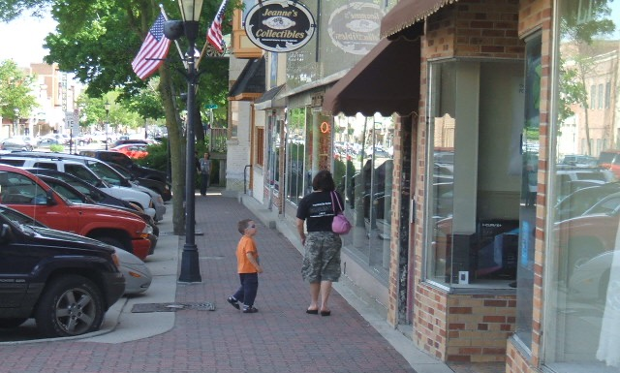
Are active routes to everyday destinations beneficial to health, safety, & welfare?
Can support active transportation, physical activity, reduced chronic disease risk & vulnerability.
Environmental health; water & air quality.
Access to essential goods & services.
Public safety; reduce crash injuries & fatalities.

Slide 20
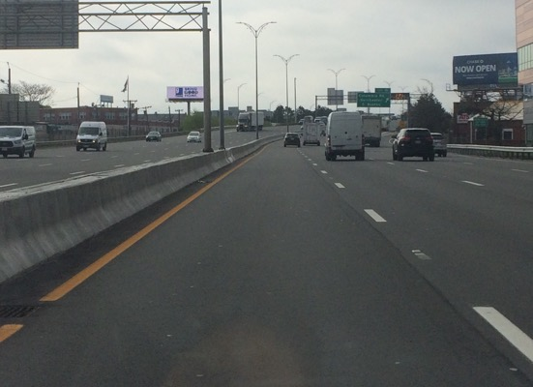
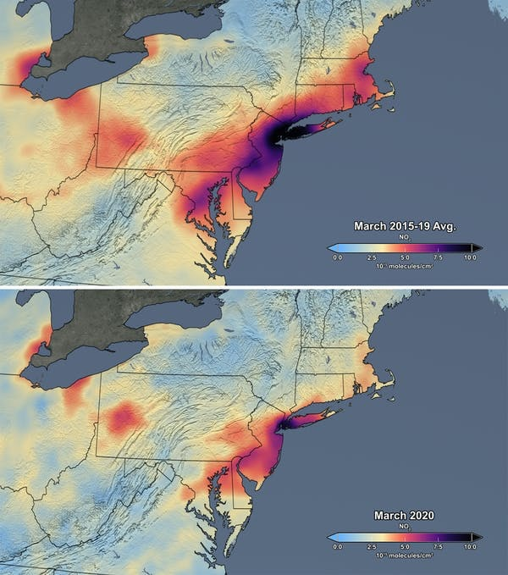
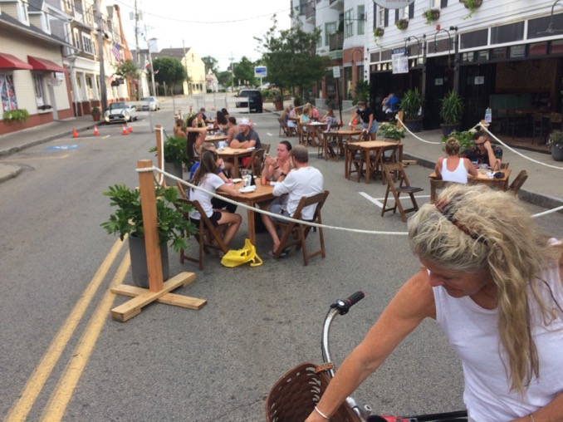
Also infectious disease;
lessons from the pandemic
  Desire for safe settings for walking, biking, outdoor activity.
  Demand for nearby essential goods & services.
  Significant air quality improvements. >

Slide 21
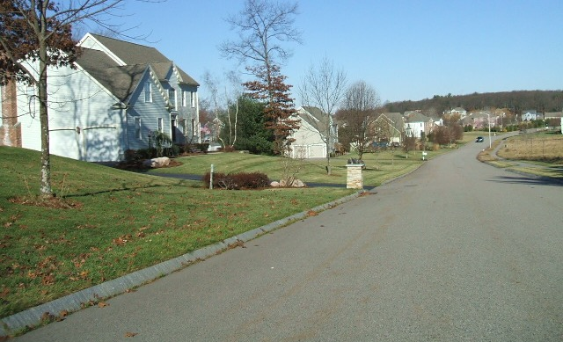
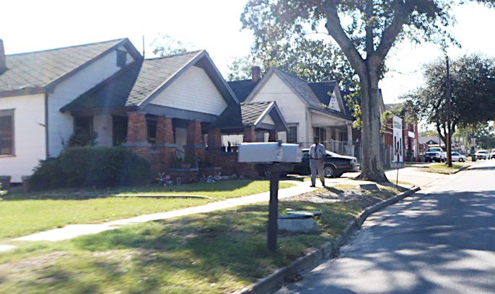
C. Three notable influence opportunities
Comprehensive planning: Community vision, goals, aspirations; social justice.
Zoning ordinance: Land uses, intensity & density, parking, landscape, etc.
  Subdivision guidelines.
  Roadway design guidelines.
Permitting practices, site plan reviews; change of use (e.g. agriculture to housing, retail); impacts; waivers.

Slide 22
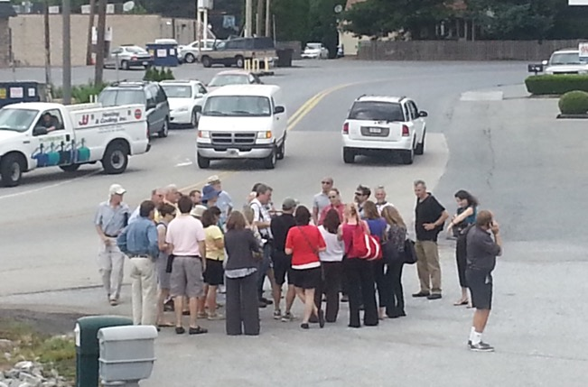
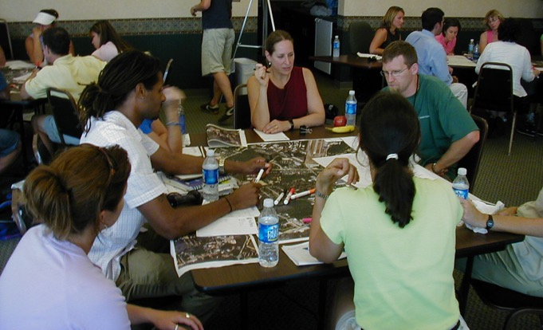
Comprehensive (Master, Growth) Plan
Opportunity to develop a vision & identify community priorities.
Substantial & diverse input & community engagement.
Not just focused on one particular project or issue.
Typical chapters, elements:
  Land use, Housing,
  Open Space, Recreation
  Transportation, Infrastructure
  Economics, Development
  History, Culture,
  Resilience, Sustainability
  Health?
Walk/Move Audit
Inclusive community input?

Slide 23
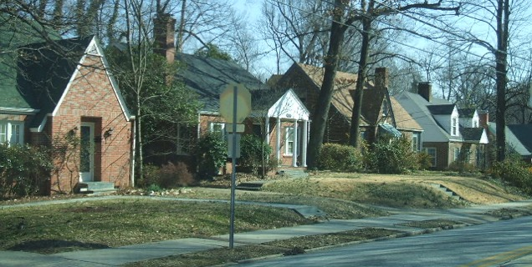
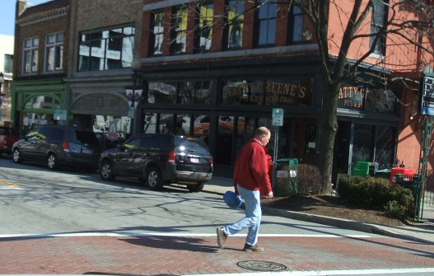
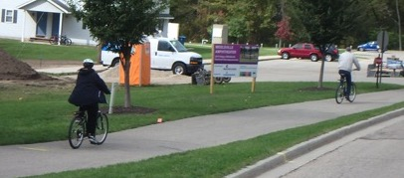
Zoning ordinance
Makes vision into law.
Land use map: Identifies areas (zones) for types of development, open, & agricultural areas.
Detailed development requirements for zones: building sizes & setbacks, utilities, roadways, parking, furnishings sidewalks.
Specific subdivision guidelines – housing mix?

Slide 24
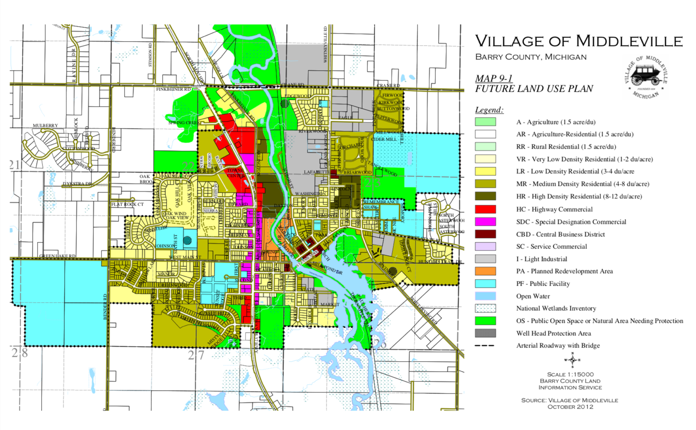
Typical Zoning Map
Illustrates ”segregated” land uses.
Likely equity impacts?

Slide 25
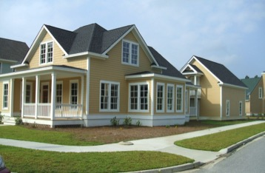
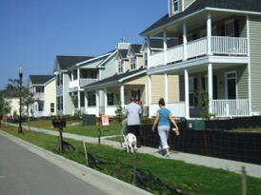
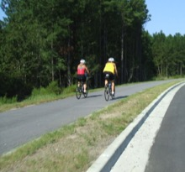
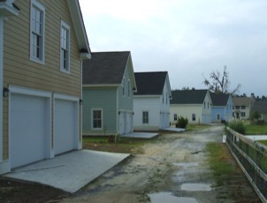
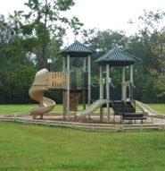
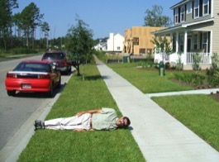
Subdivision Guidelines
Accessory dwelling units
Required sidewalk setback?
1.0 Fenton setback

Slide 26
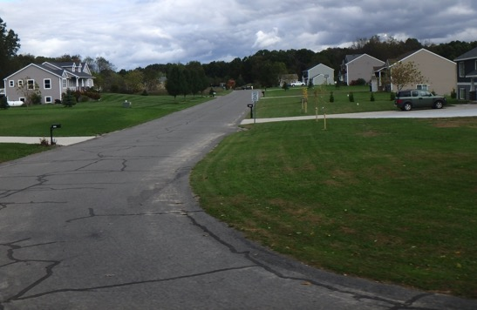

Permitting/Site Plan Review
A common question:
“Why require sidewalks if they don’t connect to anything on the main road?”
Answer:
“It may be the only way to create a network over time!

Slide 27



Current norms
Euclidian zoning; segregated land uses.
Auto-oriented. Vehicle access, big roads, parking requirements.
Building density, size, bulk, placement.
Development driven. Boards respond to applications.
Waivers, variances routinely granted.
~10 trips/day
~5 trips/day

Slide 28


How does it often happen in the real world?
Comprehensive plans. Tend to be aspirational, suggest laudatory goals; not always forged into code & practice.
Zoning ordinance. Frequently large, cumbersome documents; sometimes understood better by developers than boards. Can be tedious & costly to change/update.
Permitting practices. Many boards wish to simplify processes, not burden development with time & financial costs. Each project is a new discussion, debate.
< What we say we want.
What we permit. >

Slide 29



D. Opportunities: E.g. housing policies to anticipate & reduce gentrification, displacement; support mix & affordability ...
Washington
Inclusionary zoning (required affordable %).
Mix of rental & ownership.
Mix styles & sizes; townhomes, row houses, cottage clusters, mini-homes; shared housing.
Accessory dwelling units (e.g. garden & garage apartments).
First right of refusal for tenants.
Provide the missing middle.
Texas
South Carolina

Slide 30
Journal of Urban Health
(2023) 100:151-180

Slide 31




E.g. Columbus, IN bicycle & pedestrian plan.
The People Trail Network; “A people powered transportation network”

Slide 32


Form Based Code
Focus on building form, structure, & public realm; not land uses.
Has a regulatory plan (may include some land use restrictions.)
Provides specific regulatory requirements to make it easier for developers/builders.
Actually a faster permitting process.
Requires . . .
  More up-front community engagement
  Consensus & agreement on a vision
  More detailed plans & imagery

Slide 33
Opportunities & recommendations:
Planning . Bring public health data & social justice considerations to the forefront of process. Research: How do we create truly inclusive public engagement?
Zoning ordinances. Assure that they actually reflect the vision. Target housing affordability & variety; open space conservation; network design for active transportation. Research: Do ordinances reflect vision? Do they lead to increases in active transport? In PA attainment?
Permitting practices. Help developers & policy-makers see the growing demand & market value of “healthy” design. Research: What is most effective in shifting policy priorities? In creating systematic (not episodic) change?

Slide 34


Steps for community success . . .
Assess current status:
  Does community have any planning staff, support?
  Any existing plans?
  Existing zoning, permitting?
Help update/develop community vision w/ health.
Develop/update plan if needed; assist w/ truly inclusive engagement.
Update zoning & permitting!

Slide 35


Questions, thoughts, arguments, your own experiences?
Mark Fenton
www.markfenton.com
rmfenton777@gmail.com

Slide 37

The “housing transect” & missing middle.
* Much of suburban development has single family homes (segregated by price) and multi-family apartments, but few (or no) other housing options.

Slide 38



FBC elements – Building form standards
Size, mass, type, style, street orientation, density.
Can define districts/zones with distinct characters.

Slide 39




FBC elements – Public realm/street standards
Street design details – lanes, widths, ped & bike facilities; block length, grid connectivity.
Public space requirements – trees & plantings, impervious surface, street furnishings, shared public space.
NACTO
FHWA

Slide 40

FBC elements – Overall regulatory plan
Dictates where each building form and public realm/street design is to be applied in the community.
Is not just restricted to urban areas. Can also require low-intensity use areas, open & agricultural space.
formbasedcodes.org

Slide 41



Red-lining in home mortgages.
(Home Ownership Loan Corp.)
Austin TX, 1928 City Plan.
The Color of Law: A Forgotten History of How Our Government Segregated America (R. Rothstein)

Slide 42

People of Color are disproportionately injured and killed as pedestrians.
Age-Adjusted Pedestrian Death Rates, by Race/Ethnicity — National Vital Statistics System, United States, 2009 and 2018. MMWR 2020;69:1434.

Slide 43
People in lower-income neighborhoods are more likely to be killed as pedestrians
From: Dangerous by Design, Smart Growth America, 2021.

Slide 44



San Francisco Hwy 101
Embarcadero Freeway
1989 Loma Prieta earthquake damage!

Slide 45





San Francisco Hwy 101
Embarcadero Boulevard

