Slide 1
Grant Activities:
Significance + Innovation

Slide 2
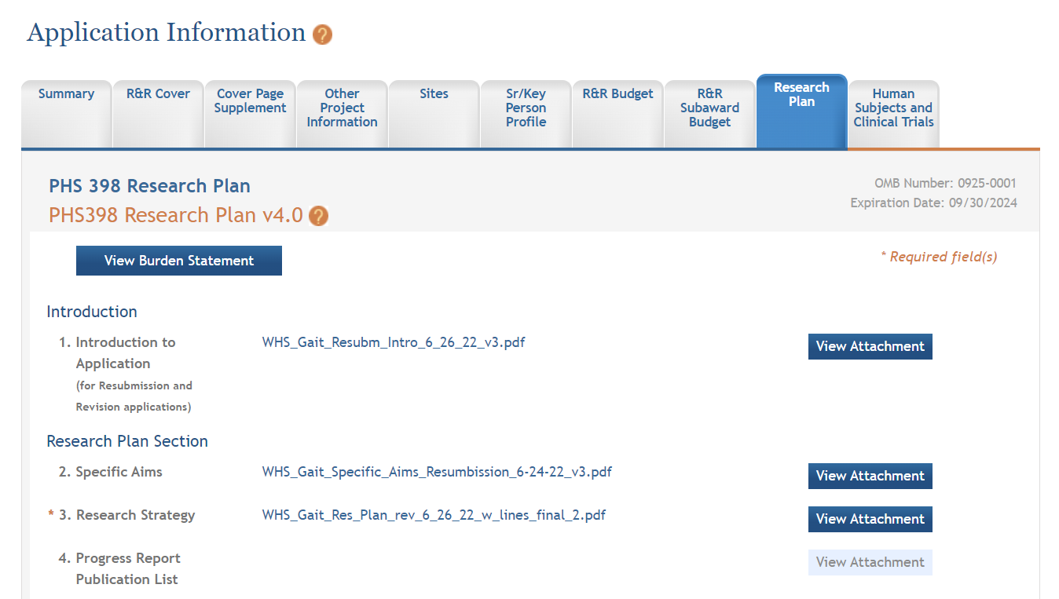
Granting agencies have their own unique formats; here is NIH example

Slide 3
Regardless of unique formats, most grant applications will have these sections, perhaps called by different terms/names (below is NIH terminology):
Specific Aims – gives reviewer “10,000 ft” view
Research Strategy – details the following:
Significance (why?)
Innovation (what is new?)
Approach (how?)

Slide 4
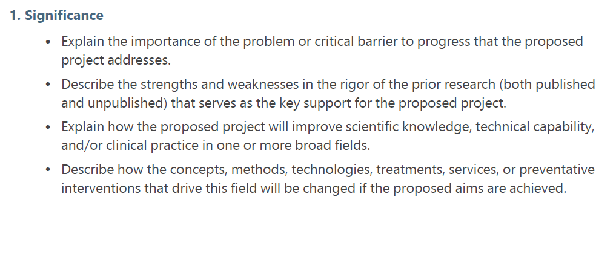
NIH description (from SF 424 guide)
Version H, October 25, 2022

Slide 5
My take
3 main sections, with sub-sections as appropriate:
Importance of the topic in your grant
How have others addressed this topic; what have they found? What is still unknown/unclear; what can you add?
At the end of your work, what will you have added and how can this be translated to practice?

Slide 6
My take
Establish a solid foundation of the problem
Why is this a problem?
Who does it affect?
What have other ix tried (address the quality and rigor of relevant literature)?
Why is a solution missing (barriers)?
What makes your solution better?
Big picture is important; don’t lose reviewer in minutiae of the weeds (i.e., avoid “study x showed… study y showed …)

Slide 7
NIH description (from SF 424 guide)
Version H, October 25, 2022

Slide 8
My take
“Innovation” – broad definition; doesn’t have to be inventing mRNA vaccine/Tesla/etc.! Rather, something new that moves status quo
What’s your new idea (could be method, technology, population, approach, etc.)?
What else is unique (e.g., unique expertise of your research team; leveraging already collected data)?
Convince reviewers of importance of proposed research plan, and your ability to pull it off

Slide 9
“Content + Package”
Content = science; you know this area better than anyone else!
Package = make it “pretty”

Slide 10
“Package”
Length has to be balanced – usually, emphasis is on “Approach” where you show exactly how you are going to carry out your research
NIH R01 typically 12 pp; I would target ~3 pp for Significance and ½ to ¾ pp for Innovation
Adjust accordingly for other mechanisms; e.g., R03/R21 6 pp
Make it pretty and easy to read; keep para short
Use figures/charts/tables well to break up flow (my “arm’s-length look” test)

Slide 11
“Package”
Make use of subheadings
Keep consistent to allow reader to follow logic – don’t mix! E.g., level 1 subheading – all underlined; level2 subheading – all italics, etc.
At end of Significance, may be useful to summarize: “Summary of gaps in knowledge”
At start of Innovation, may be useful to summarize; e.g., “The proposed study, which addresses a critical public health problem, is highly innovative with regard to science, methodology, and cost-efficiency. Innovative aspects of the proposal include the following …”

