Slide 1
Dissemination & Implementation (D&) Science: From lab to sidewalk: D&I science to improve public health Examples and Applications of D&I Science to PA Research
PAPH 2023

Slide 3
Overview
What is Dissemination and Implementation (D&I) science
Key concepts
Designing for Dissemination
Grant development considerations (throughout)
Please ask questions or bring discussion points throughout

Slide 4
Dissemination and Implementation Science
The scientific study of the strategies and mechanisms by which scientific evidence is disseminated and implemented in community or clinical settings to improve health outcomes.

Slide 5
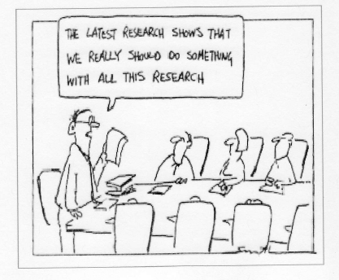
Why are you pursuing PAPH research?

Slide 6
Where are you right now?
Not familiar with D&I Science
Exploring D&I Science
Starting to apply D&I Science
Confident in D&I Science expertise
Please share a bit about your D&I Science experience

Slide 7
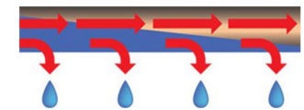
Leaky pipes
17 years
Original
research
evidence
Benefits to
patients &
populations
14% success
Original
research/
peer review
Research
synthesis
Guidelines
Implementation

Slide 8
Translation of the Diabetes Prevention Program (DPP)
Group Lifestyle Balance (community)
(n=42)
VA
(n=387)
National DPP (220 orgs
n=14,747)
Healthy eating and PA reduce risk of diabetes
DPP efficacy study
Effectiveness in YMCAs
(n=92)
Online Social Network
(n=220)
2002
2007
2009
2014
2017
2017
Epidemiology → Efficacy → Effectiveness → Dissemination & Implementation
84.1 million U.S. adults have prediabetes
Diabetes Prevention Program Research Group. NEJM, 2002. 346(6): p. 393-403.
Aziz. Implementation Science 10.1 (2015): 172
Moin, American journal of preventive medicine 53.1 (2017): 70-77.
Ely. Diabetes Care 2017;40:1331-1341

Slide 9
Dissemination and Implementation Science
The scientific study of the strategies and mechanisms by which scientific evidence is disseminated and implemented in community or clinical settings to improve health outcomes.

Slide 10
Improve public health
CONTEXT
Implementation Outcomes
Feasibility
Fidelity
Penetration
Acceptability
Sustainability
Uptake
Costs
The Core of Implementation Science
Patient Outcomes
Clinical/health status
Health behaviors
Satisfaction
The Usual
What?
Evidence-based interventions
How?
Implementation Strategies
CONTEXT
CONTEXT
CONTEXT
Proctor, Enola K., et al. "Implementation research in mental health services: an emerging science with conceptual, methodological, and training challenges." Administration and Policy in Mental Health and Mental Health Services Research 36.1 (2009): 24-34. June 8, 2016

Slide 11
Some key terms
Dissemination and implementation research intends to bridge the gap between research, practice, and policy by building a knowledge base about how health information, effective interventions, and new clinical practices, guidelines, and policies are communicated and integrated for public health and health care service use in specific settings.
Dissemination research is defined as the scientific study of the targeted distribution of information and intervention materials to a specific public health, clinical practice, or policy audience. The intent is to understand how best to communicate and integrate knowledge and the associated evidence-based interventions.
Implementation research is defined as the scientific study of the use of strategies to adopt and integrate evidence-based health interventions into clinical and community settings to improve individual outcomes and benefit population health.
PAR-22-105: Dissemination and Implementation Research in Health (R01 Clinical Trial Optional) (https://grants.nih.gov/grants/guide/pa-files/par-22-105.html)

Slide 12
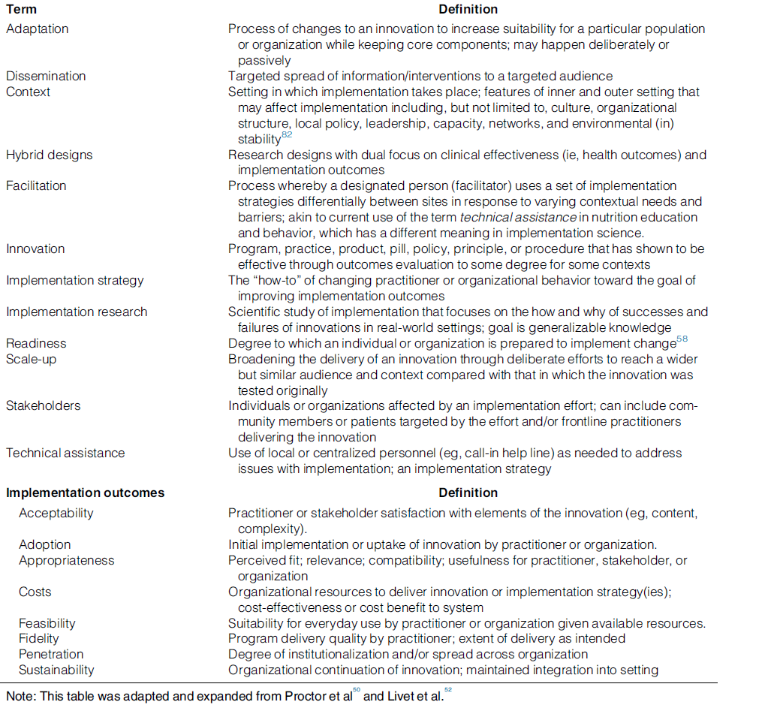
Swindle T, Curran GM, Johnson SL. Implementation Science and Nutrition Education and Behavior: Opportunities for Integration. J Nutr Educ Behav. 2019 Jun;51(6):763-774.e1. doi: 10.1016/j.jneb.2019.03.001.

Slide 13
Multiple-levels of Context
CONTEXT
Policy
Community
CONTEXT
Interpersonal
CONTEXT
Individual
CONTEXT

Slide 14
Multiple-levels of Context
CONTEXT
Community/Policy
Organization
CONTEXT
Provider
CONTEXT
Intervention
CONTEXT

Slide 15
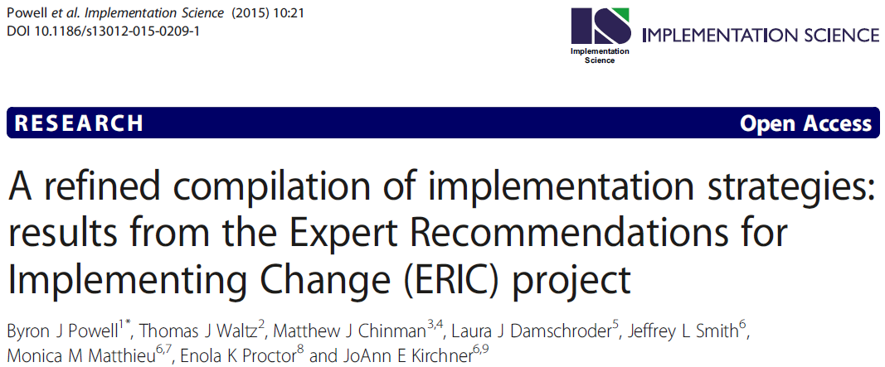
CONTEXT
Implementation Outcomes
Feasibility
Fidelity
Penetration
Acceptability
Sustainability
Uptake
Costs
Patient Outcomes
Clinical/health status
Health behaviors
Satisfaction
What?
Evidence-based interventions
How?
Implementation Strategies
CONTEXT
CONTEXT
CONTEXT

Slide 16
Swindle T, Curran GM, Johnson SL. Implementation Science and Nutrition Education and Behavior: Opportunities for Integration. J Nutr Educ Behav. 2019 Jun;51(6):763-774.e1. doi: 10.1016/j.jneb.2019.03.001.

Slide 17
Swindle T, Curran GM, Johnson SL. Implementation Science and Nutrition Education and Behavior: Opportunities for Integration. J Nutr Educ Behav. 2019 Jun;51(6):763-774.e1. doi: 10.1016/j.jneb.2019.03.001.

Slide 18
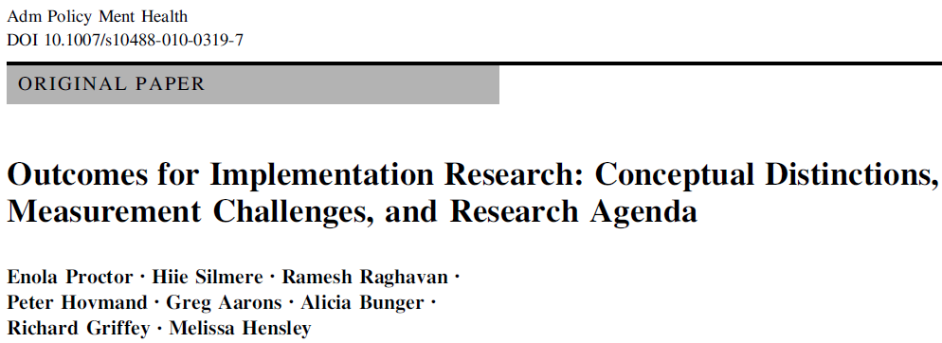
CONTEXT
Implementation Outcomes
Feasibility
Fidelity
Penetration
Acceptability
Sustainability
Uptake
Costs
Patient Outcomes
Clinical/health status
Health behaviors
Satisfaction
What?
Evidence-based interventions
How?
Implementation Strategies
CONTEXT
CONTEXT
CONTEXT
Proctor, Enola K., et al. "Implementation research in mental health services: an emerging science with conceptual, methodological, and training challenges." Administration and Policy in Mental Health and Mental Health Services Research 36.1 (2009): 24-34. June 8, 2016

Slide 19
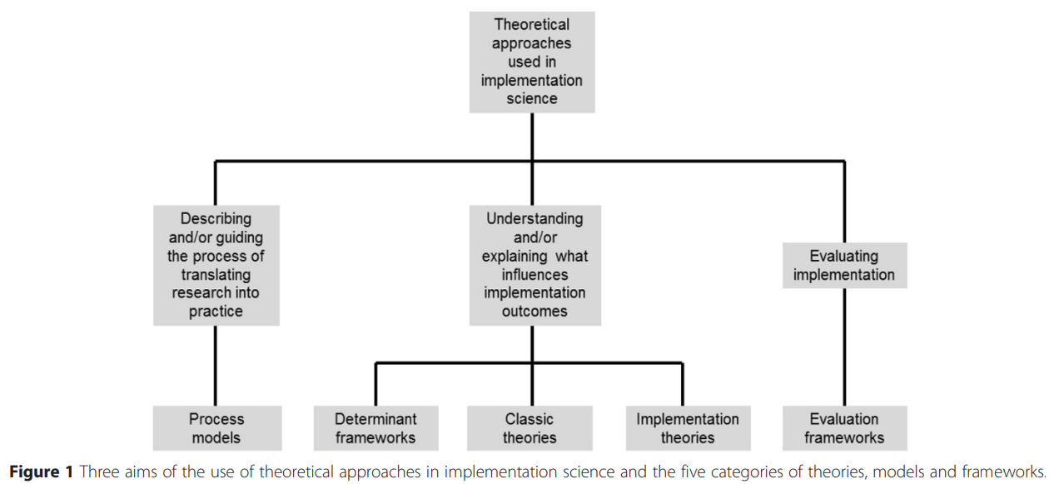
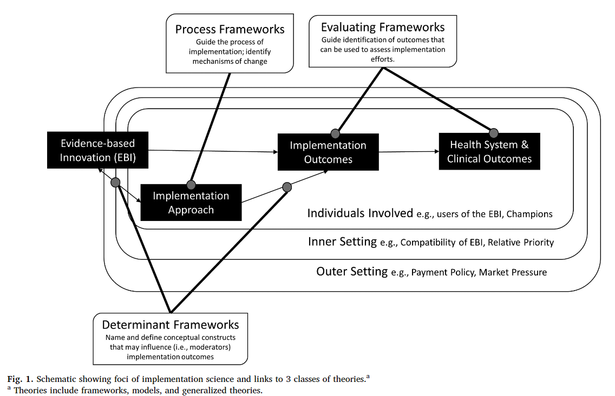
Theories, Models, and Frameworks in D&I Science
D&I Models Webtool: https://dissemination‐implementation.org
T-CaST: Theory, Model, and Framework Comparison & Selection Tool: https://impsci.tracs.unc.edu/tcast/
Nilsen, P. Making sense of implementation theories, models and frameworks. Implementation Sci 10, 53 (2015). https://doi.org/10.1186/s13012-015-0242-0
Moullin, J.C., Dickson, K.S., Stadnick, N.A. et al. Ten recommendations for using implementation frameworks in research and practice. Implement Sci Commun 1, 42 (2020). https://doi.org/10.1186/s43058-020-00023-7
Damschroder, Laura J. "Clarity out of chaos: use of theory in implementation research." Psychiatry research 283 (2020): 112461.

Slide 20
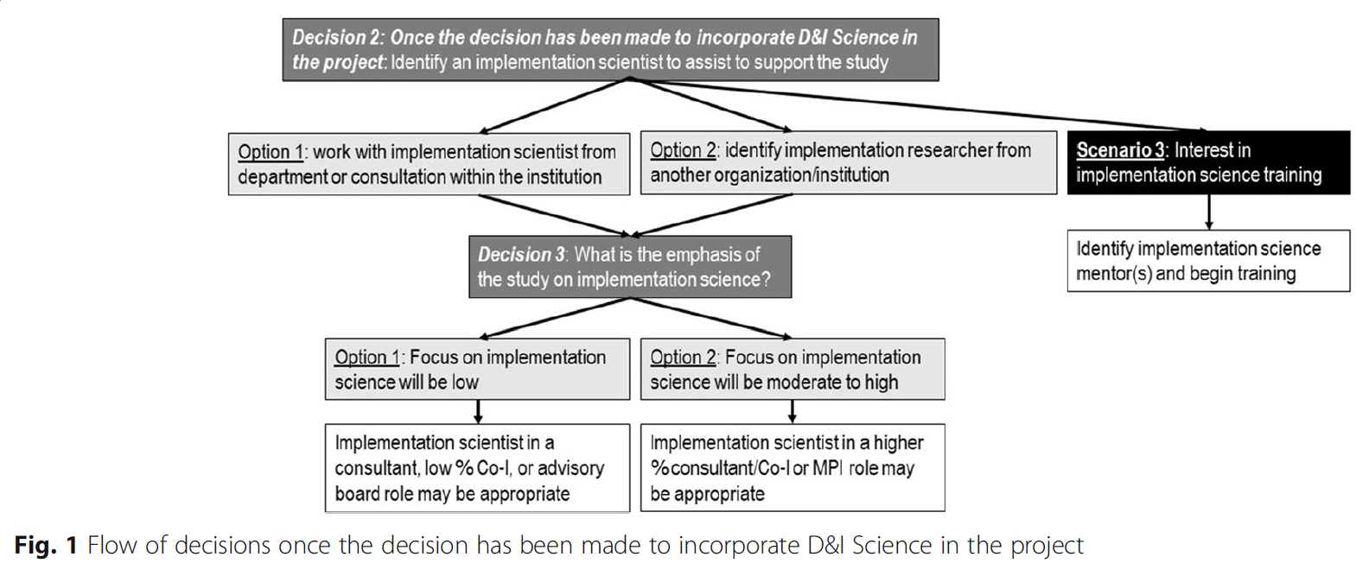
How can I incorporate D&I in my research agenda (and do I want to)?
Tabak, R.G., Bauman, A. & Holtrop, J.S. Roles dissemination and implementation scientists can play in supporting research teams. Implement Sci Commun 2, 9 (2021). https://doi.org/10.1186/s43058-020-00107-4

Slide 21
Activity: Where is the focus of your research?
Fig. 1. The Integrative Framework of Dissemination, Implementation, and Translation (IFDIT).
Leppin, A., et al. (2020). Situating dissemination and implementation sciences within and across the translational research spectrum. J Clin Transl Sci, 4(3), 152-158.

Slide 22
Notes:
Leppin, A., et al. (2020). Situating dissemination and implementation sciences within and across the translational research spectrum. J Clin Transl Sci, 4(3), 152-158.

Slide 23
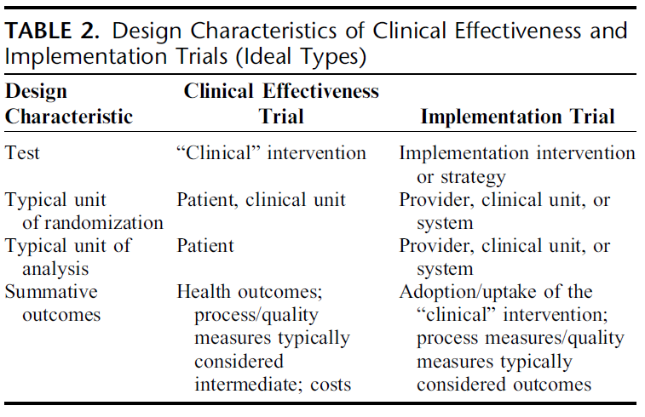
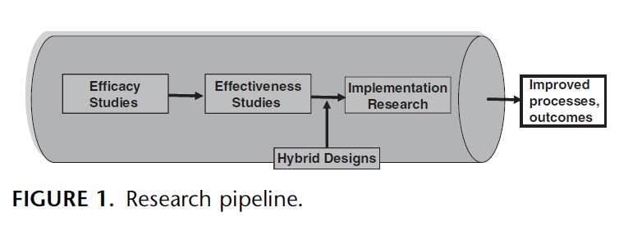
Hybrid Studies
Clinical Effectiveness Research
Implementation Research
Hybrid Type 1
Hybrid Type 2
Hybrid Type 3
Curran GM, et al. Effectiveness-implementation hybrid designs: combining elements of clinical effectiveness and implementation research to enhance public health impact. Med Care. 2012 Mar;50(3):217-26. doi: 10.1097/MLR.0b013e3182408812
Adapted from: Landsverk J, Brown CH, Smith JD, et al. Design and Analysis in Dissemination and Implementation Research. In: Brownson RC, Colditz GA, Proctor EK, eds. Dissemination and Implementation Research in Health: Translating Science to Practice. 2nd ed. New York: Oxford University Press; 2017:201-227.

Slide 24
What is Designing for dissemination and sustainability (D4DS)?
It is beginning with the end in mind.
D4DS refers to a way of ensuring that “the product” (interventions, policy, evidence) of our work solves a problem and fits the context in which it is intended to be adopted.
D4DS focuses on engaging partners in design to ultimately increase adoption, sustainability, and impact on health and health equity.
Notes:
provides a map for how to do research in ways that increase the chance that the products of research can and will be used by those who are expected to benefit.
By emphasizing the importance of starting with the end in mind —asking, who will use the products of research and what outcomes do they care about?— we discover early in our work where to focus our research efforts.
From the early product concept, to the product features and content, to how we get the word out, we evaluate "fit to context" —Is it useful? Is it equitable? Is it potentially sustainable? Do people like it? Are we successfully messaging to the right people about the availability of the product?
Engages partners through this process allows us to design appropriately and provides the opportunity to adjust and adapt along the way, rather than waiting until a product has been fully developed and tested before discovering that it simply will not work in the real world.

Slide 25
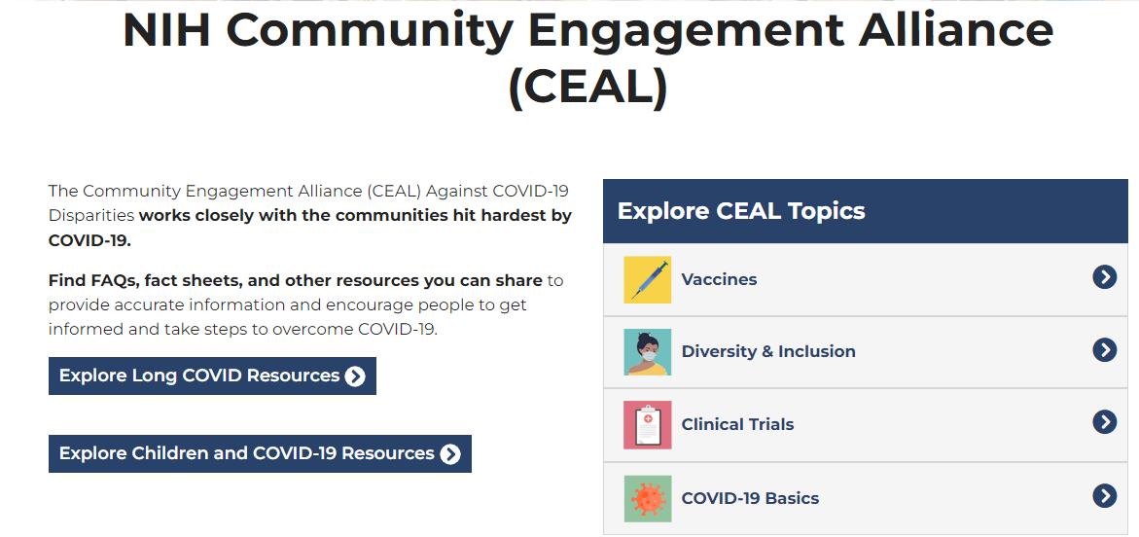
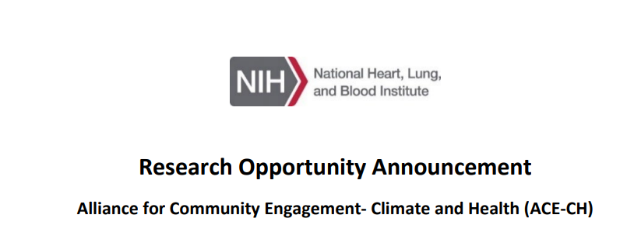
Funders are demanding …
Partner engagement
Plans for dissemination
https://covid19community.nih.gov/

Slide 26
Who is the D4DS Planner for?
Teams conducting health-related research
Academics (e.g., researchers, students, project managers)
Practitioners (e.g., clinicians, public health practitioners)
Community partners
Ideally in the beginning phases of their project.
Notes:
provides a map for how to do research in ways that increase the chance that the products of research can and will be used by those who are expected to benefit.
By emphasizing the importance of starting with the end in mind —asking, who will use the products of research and what outcomes do they care about?— we discover early in our work where to focus our research efforts.
From the early product concept, to the product features and content, to how we get the word out, we evaluate "fit to context" —Is it useful? Is it equitable? Is it potentially sustainable? Do people like it? Are we successfully messaging to the right people about the availability of the product?
Engages partners through this process allows us to design appropriately and provides the opportunity to adjust and adapt along the way, rather than waiting until a product has been fully developed and tested before discovering that it simply will not work in the real world.

Slide 27
Coming soon: will go live in December 2023
Notes:
This is home page– there are two key components of this tool:
1) Education hub and 2) the planner.

Slide 28
Notes:
In this users login in, set-up a project– telling us key things about it and invite team members to work with them on the steps of the d4ds process.

Slide 29
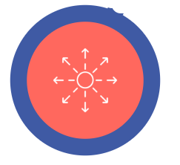
Action Items
Confirm & Co-design Your Product
Identify Partners
Develop Dissemination Plan
Empathize &
Outline the Problem
Plan for Sustainability
Understand
the Context
Evaluate Iteratively
Notes:
In this users login in, set-up a project– telling us key things about it and invite team members to work with them on the steps of the d4ds process.

Slide 30
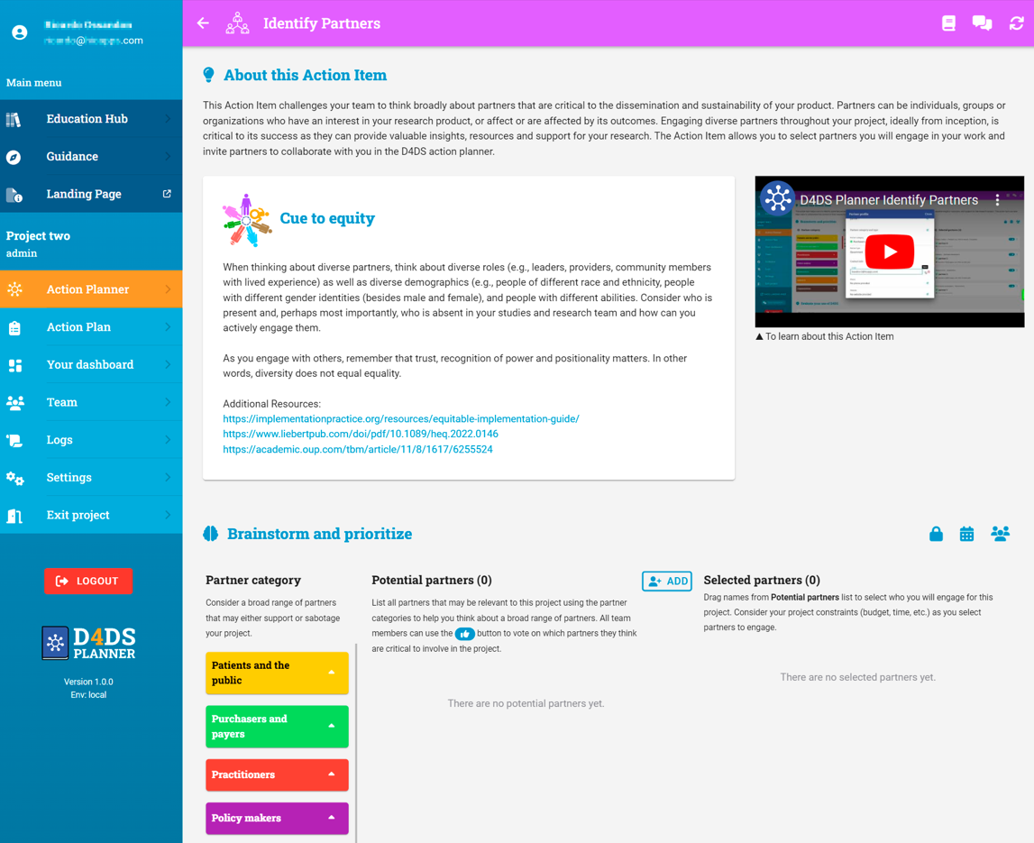
Notes:
Each item has–
About this action item
Video introduction
Cue to Equity
An interactive activity
Evaluating your completion of the action item
Dive deeper– key resources

Slide 31
So many to thank!
Ross Brownson, Debra Haire-Joshu, Stephanie Mazzucca, Enola Proctor, Cindy Schwarz, Allie Phad, Maura Kepper, Dianne Ward, many more…
Washington University Network for D&I Research (WUNDIR)

Slide 32
What do you think?
Questions?
Examples?

Slide 33
Resources

Slide 34
NIH D&I Funding Opportunities
PAR-22-105: Dissemination and Implementation Research in Health (R01 Clinical Trial Optional) (https://grants.nih.gov/grants/guide/pa-files/par-22-105.html)
PAR-22-106: Dissemination and Implementation Research in Health (R03 Clinical Trial Not Allowed) (https://grants.nih.gov/grants/guide/pa-files/PAR-22-106.html)
PAR-22-109: Dissemination and Implementation Research in Health (R21 Clinical Trial Optional) (https://grants.nih.gov/grants/guide/pa-files/PAR-22-109.html)

Slide 35
General D&I resources
Washington University in St. Louis - Toolkits
Intro to D&I, Formulating Aims, Understanding Barriers & Facilitators for Successful Implementation, Identifying Research Outcomes, + more
https://implementationresearch.wustl.edu/support-your-research/toolkits/
National Cancer Institute - Implementation Science Resources
https://cancercontrol.cancer.gov/is
https://cancercontrol.cancer.gov/is/tools/research-tools
University of Washington - Implementation Science Resource Hub
https://impsciuw.org/
Training Institute for Dissemination and Implementation Research in Cancer (TIDIRC): OpenAccess
https://cancercontrol.cancer.gov/is/training-education/training-in-cancer/TIDIRC-open-access
Advancing Health Equity Through Implementation Science: Bibliography and Resources
https://consortiumforcanceris.org/files/Health_Equity_and_Implementation_Science_Bibliography_508.pdf
Resources for Stakeholder & Community Engagement
https://cancercontrol.cancer.gov/sites/default/files/2021-08/CCIS_Engagement-Bibliography_080931_508.pdf

Slide 36
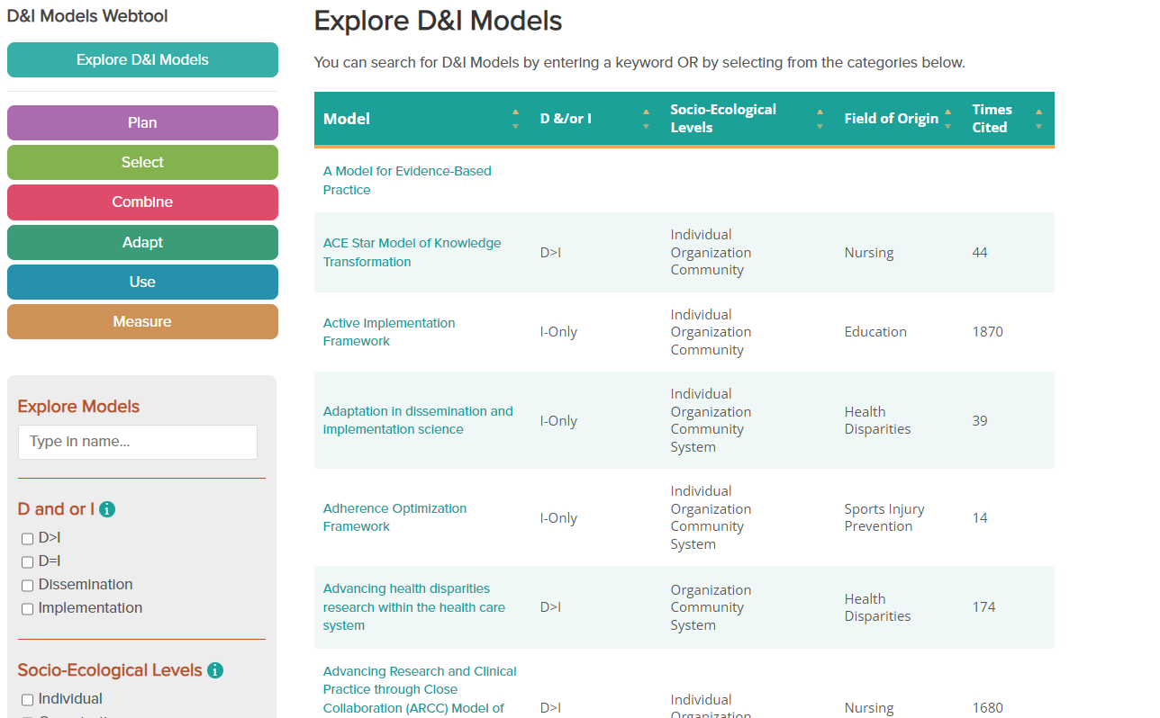
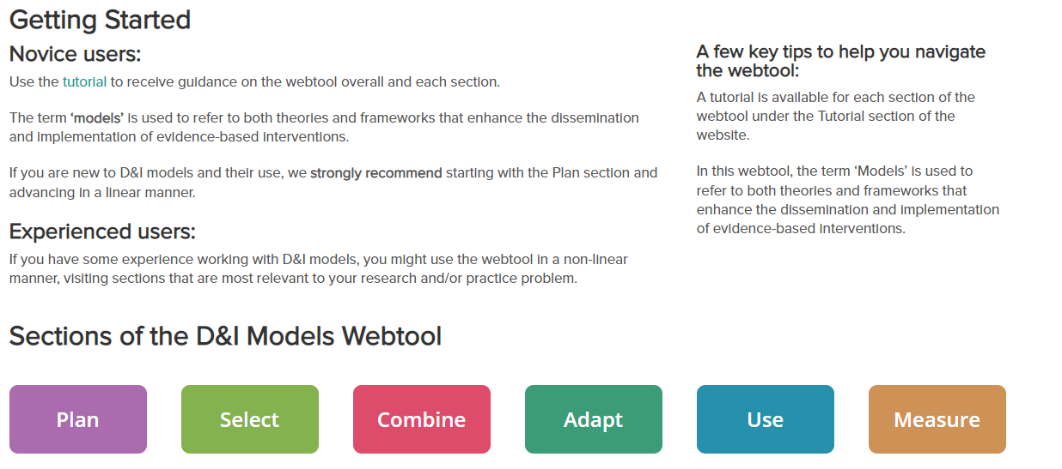
Theories, Models, and Frameworks Resources
Searchable website: https://dissemination-implementation.org/
Video: https://www.youtube.com/watch?v=EV8bfXJ75zM&t=397s
Notes:
Mitchell SA, Fisher CA, Hastings CE, Silverman LB, Wallen GR. A Thematic Analysis of Theoretical Models for Translational Science in Nursing: Mapping the Field. Nurs Outlook 2010;58(6):287-300

Slide 37
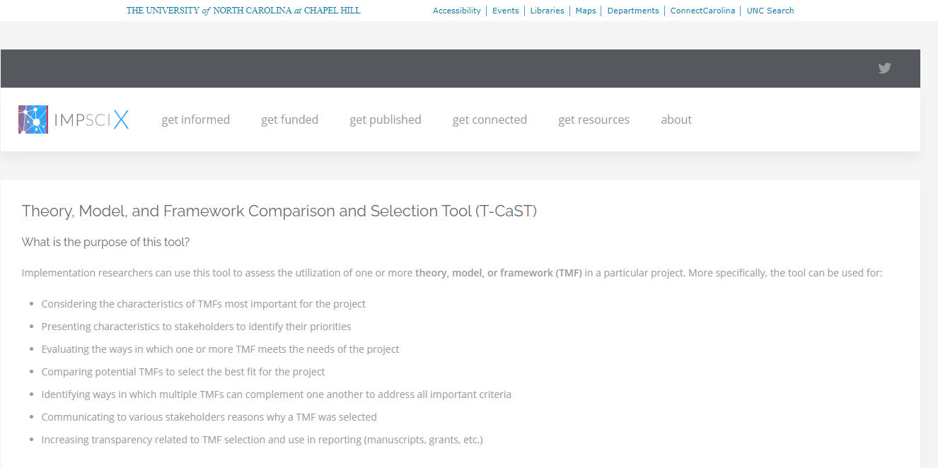
Theories, Models, and Frameworks Resources
https://impsci.tracs.unc.edu/tcast/
Birken, SA., et al. Implementation Science 13.1 (2018): 143.

Slide 38
Study designs for D&I science
Curran GM, et al. Effectiveness-implementation hybrid designs: combining elements of clinical effectiveness and implementation research to enhance public health impact. Med Care. 2012 Mar;50(3):217-26. doi: 10.1097/MLR.0b013e3182408812.
Mazzucca S, et al. Variation in Research Designs Used to Test the Effectiveness of Dissemination and Implementation Strategies: A Review. Front Public Health. 2018 Feb 19;6:32. doi: 10.3389/fpubh.2018.00032.
Esp Figure 3
Landsverk J, et al. Design and Analysis in Dissemination and Implementation Research. In: Brownson RC, Colditz GA, Proctor EK, eds. Dissemination and Implementation Research in Health: Translating Science to Practice. 2nd ed. New York: Oxford University Press; 2017:201-227.
Hwang S, et al. Designs and methods for implementation research: Advancing the mission of the CTSA program. J Clin Transl Sci. 2020 Mar 4;4(3):159-167. doi: 10.1017/cts.2020.16.
Videos
https://www.youtube.com/watch?v=Vn1npEkuhqw
https://www.youtube.com/watch?v=dvscLyHrd-k
PRECIS-2 (next slide)

Slide 39
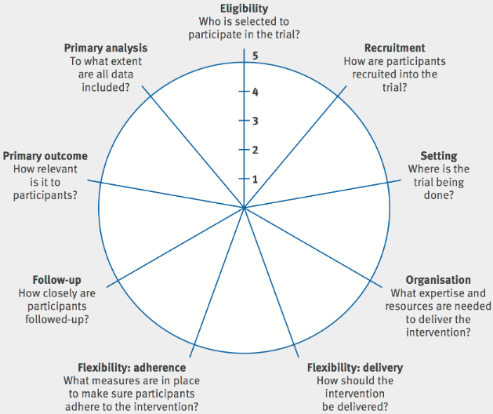
PRECIS – PRagmatic Explanatory Continuum Indicator Summary
Tool to help trialists designing clinical trials consider where they would like their trial to be on the pragmatic/ explanatory continuum
https://www.precis-2.org/
Loudon et al. The PRECIS-2 tool: designing trials that are fit for purpose BMJ 2015; 350 :h2147
Norton, W.E. et al. Designing provider-focused implementation trials with purpose and intent: introducing the PRECIS-2-PS tool. Implementation Sci 16, 7 (2021).

Slide 40
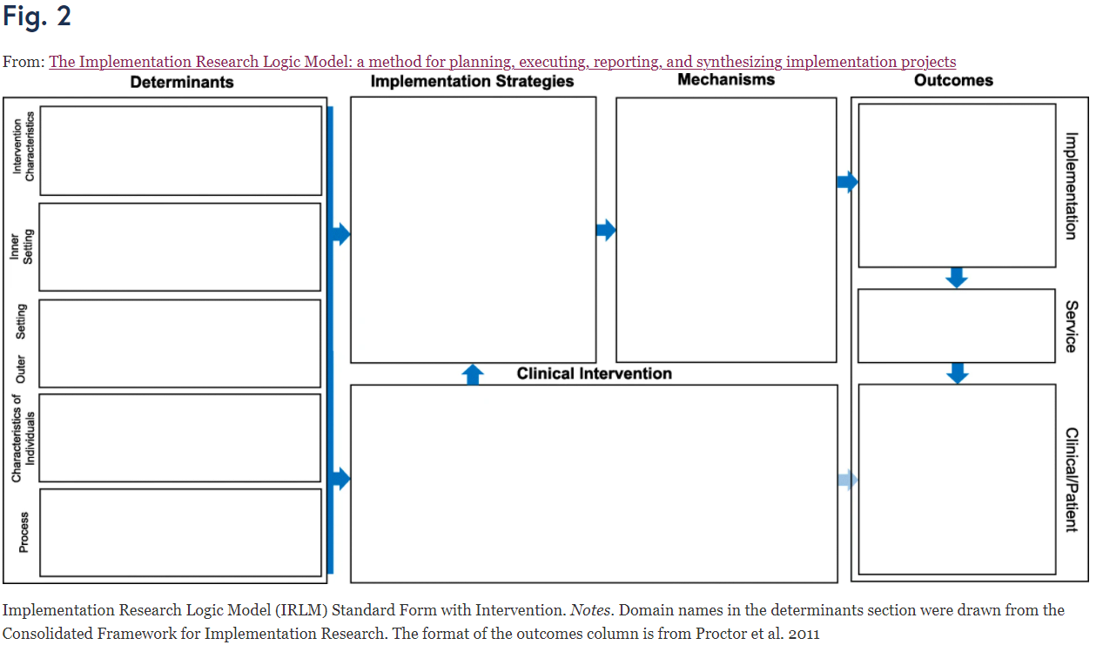
Implementation Research Logic Model
Smith, J.D., Li, D.H. & Rafferty, M.R. The Implementation Research Logic Model: a method for planning, executing, reporting, and synthesizing implementation projects. Implementation Sci 15, 84 (2020).
Paper (https://implementationscience.biomedcentral.com/articles/10.1186/s13012-020-01041-8) has great additional file examples

Slide 41
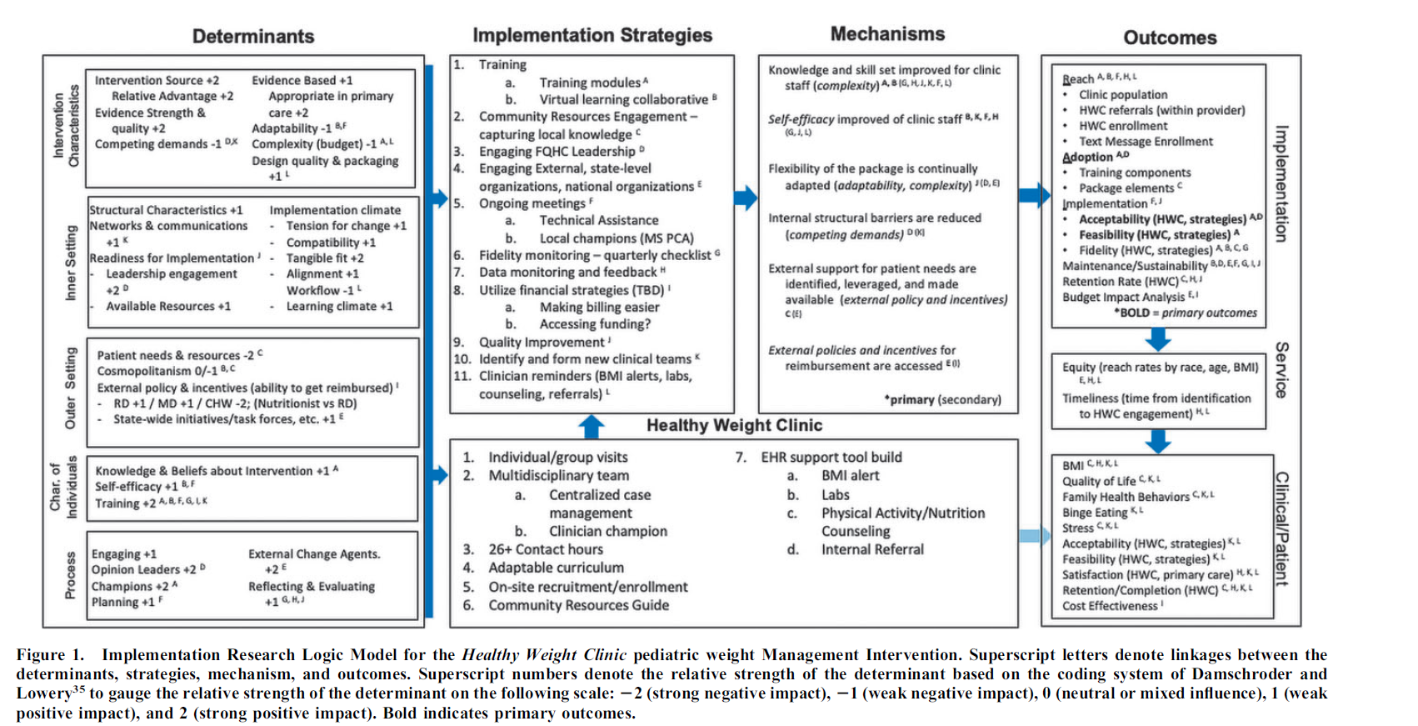
Lauren Fiechtner, Ines Castro, Sujata G. Ayala, Desiree Sierra Velez, Jeanne Lindros, Meghan Perkins, Alison Baker, Jeremiah Salmon, Vincent Biggs, Gerri Cannon-Smith, Justin D. Smith, Meg Simione, Steven L. Gortmaker, and Elsie M. Taveras.Childhood Obesity.Sep 2021.S-48-S-54.http://doi.org/10.1089/chi.2021.0177

Slide 42
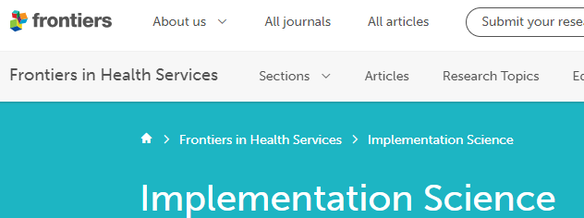
Journals
https://implementationsciencecomms.biomedcentral.com/
https://implementationscience.biomedcentral.com/
https://www.frontiersin.org/journals/health-services/sections/implementation-science
https://journals.sagepub.com/home/irp

Slide 43
Textbooks

