Slide 1
CDC Physical Activity and Health Program
Ken Rose, Chief, Physical Activity and Health Branch
Division of Nutrition, Physical Activity, and Obesity National Center for Chronic Disease Prevention and Health Promotion U.S. Centers for Disease Control and Prevention Di

Slide 2
Centers for Disease Control and Prevention

Slide 3
National Center for Chronic Disease Prevention and Health Promotion

Slide 4
Previous PA-Focused Notice of Funding Opportunities (N=13)
 | 2008 | 2009 | 2010 | 2011 | 2012 | 2013 | 2014 | 2015 | 2016 | 2017 | 2018 | 2019 | 2020 | 2021 | 2022 | 2023
805
912 (CPPW)
1103 (CTG)
1305
1422
1416 (HOP)
1417 (PICH)
1419 (REACH)
1421 (GHWIC)
1807 (SPAN)
1809 (HOP)
1813 (REACH)
1903 (GHWIC)
Funded by the Prevention and Public Health Fund, part of the Affordable Care Act.
Notes:
Here are our historical investments in physical activity going back to 2008 with funding for states through State Nutrition, Physical Activity and Obesity Programs.
There have been large community investments focused on increasing access to PA and improving community design through CPPW, CTG, and PICH. CPPW was funded by the American Recovery and Reinvestment Act (ARRA) ($450 million) and the Affordable Care Act ($30 million). An estimated 45.2 million Americans now have increased access to physical activity opportunities in recreational facilities, churches, businesses, schools, and other community settings as a result of CPPW.
Under 1305 and 1422, we provided funding to states to promote adoption of physical activity in ECE and worksites and create or enhance access to places for physical activity with focus on walking combined with informational outreach.
We have also supported tribes and Urban Indian Organizations to implement evidenced-informed and culturally-adapted policy, system, and environmental changes (PSE) to prevent obesity.
I will talk more about current funding through SPAN, HOP, and REACH in upcoming slides.

Slide 5
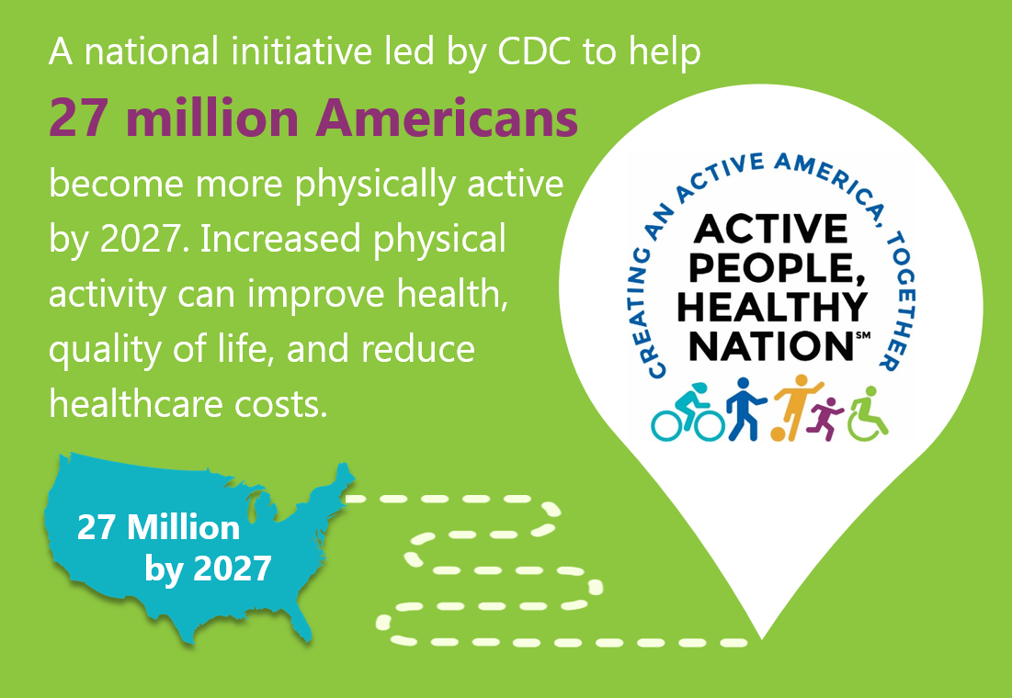
Physical Activity is a Need to Do not a Nice to Do

Slide 6
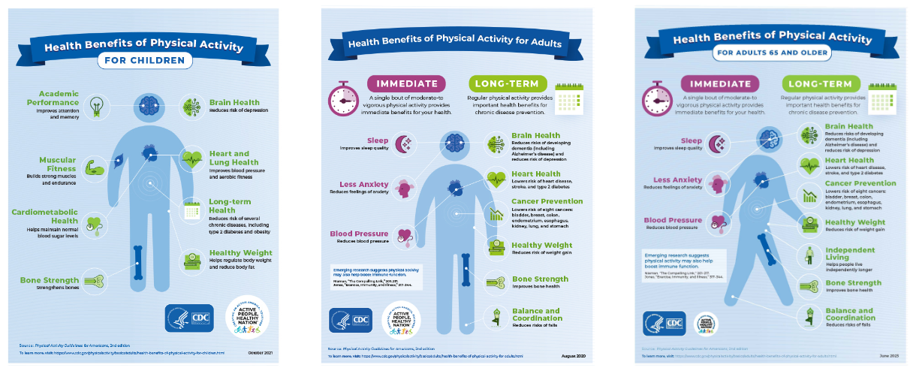

Slide 7
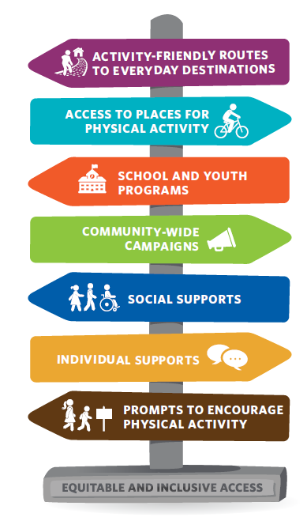
Strategies That Work to Promote Physical Activity
To learn more about the strategies, visit:
Community Preventive Services Task Force Finding for Physical Activity (www.thecommunityguide.org)
Physical Activity Guidelines for Americans, 2nd edition (Chapter 8) Community Strategies, Centers for Disease Control and Prevention, 201 (www.cdc.gov/PhysicalActivity)
Notes:
Supporting this movement are seven strategies that CDC has identified with scientific evidence of effectiveness. All of these strategies should support health equity. CDC’s funding with you supports activity-friendly routes to everyday destinations. We focus on this strategy because activity-friendly routes to everyday destinations solve two of the most common barriers people report. I don’t have enough time to be active and I don’t have safe places to be active. By making physical activity options safer and more convenient, this strategy supports an important step to help people integrate physical activity into their daily lives.

Slide 8
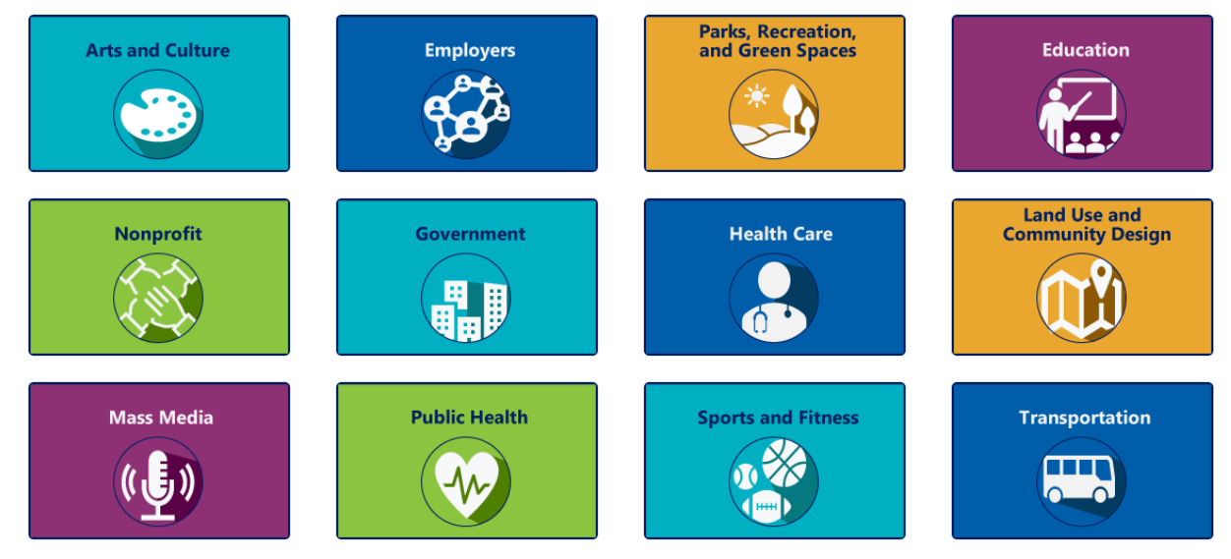
Everyone Can Be Involved! What’s Your Role?
https://www.cdc.gov/physicalactivity/activepeoplehealthynation/everyone-can-be-involved/index.html

Slide 9
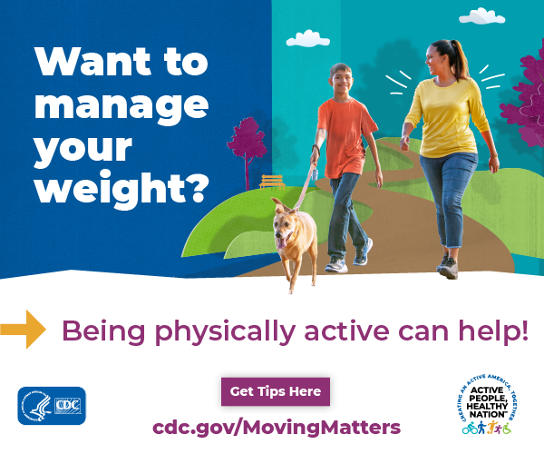
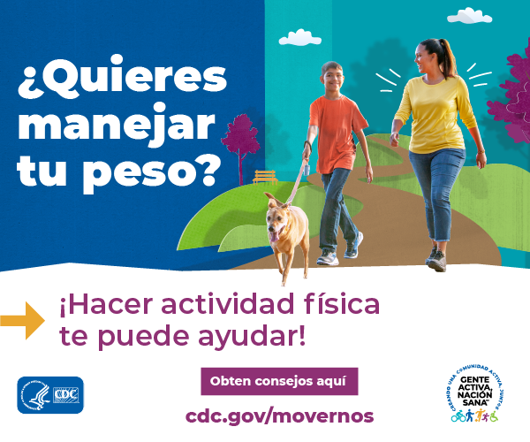
Moving Matters

Slide 10
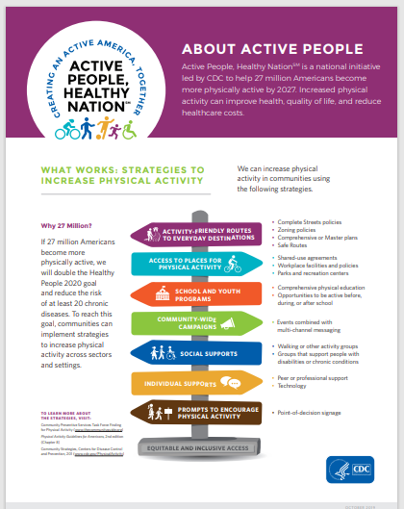
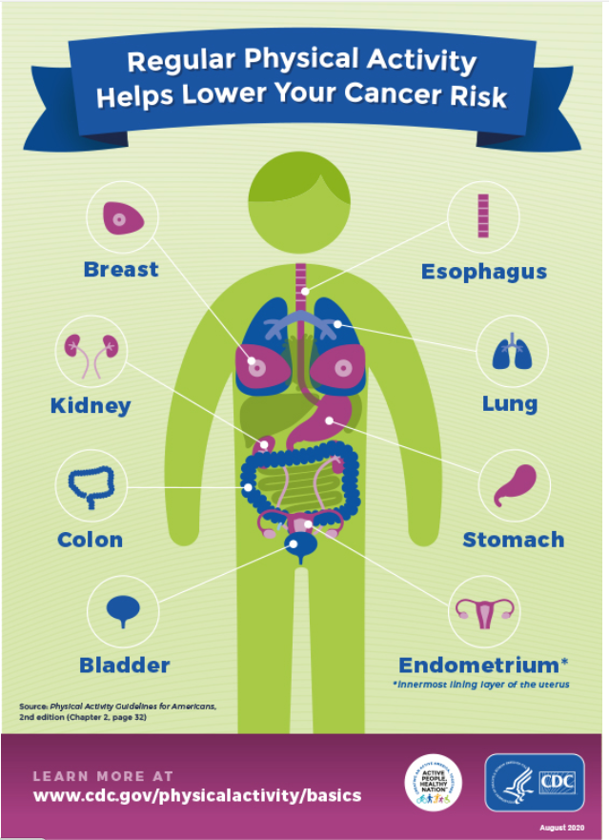
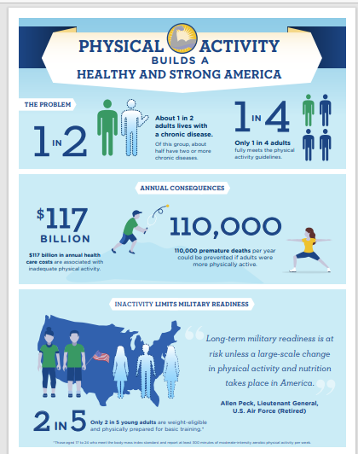
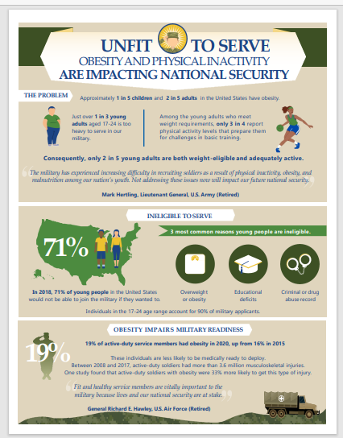
Fact Sheets, PPTs, Media Materials

Slide 11
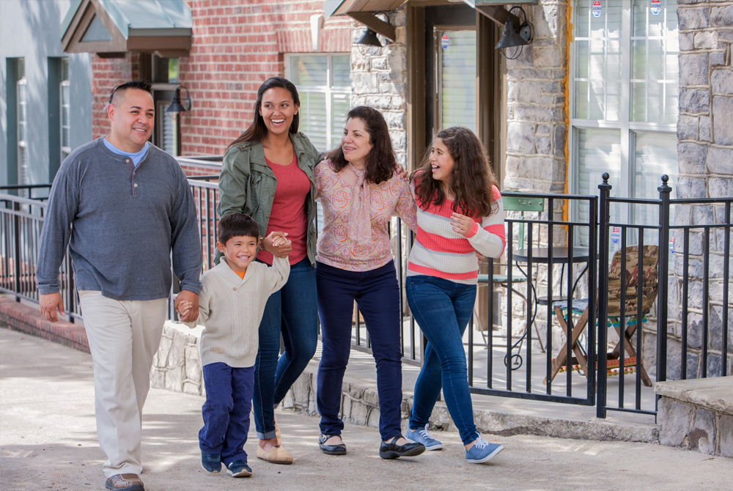
Activity-Friendly Routes to Everyday
Destinations
Combine interventions from two major categories
Pedestrian or Bicycle Transportation Systems
Land Use and Environmental Design
Photo available from the State and Community Health Media Center: https://nccd.cdc.gov/schmc/apps/overview.aspx
https://www.cdc.gov/physicalactivity/community-strategies/beactive/visual-guide.html

Slide 12
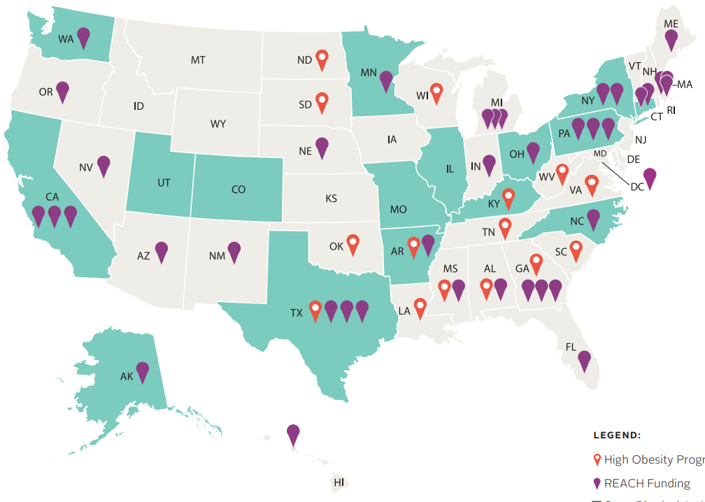
DNPAO’s Funded Program Recipients
State Physical Activity and Nutrition Program (SPAN)
16 state and local recipients strengthening efforts to implement interventions that support healthy nutrition, safe and accessible physical activity, and breastfeeding
High Obesity Program (HOP)
15 land grant universities leveraging community extension services to increase access to healthier foods and opportunities for physical activity in counties that have more than 40% of adults with obesity
Racial and Ethnic Approaches to Community Health (REACH) Program
40 organizations aiming to improve health, prevent chronic diseases, and reduce health disparities among racial and ethnic populations with the highest risk, or burden, of chronic disease
https://www.cdc.gov/nccdphp/dnpao/state-local-programs/index.html
12

Slide 13
SPAN – Illinois Public Health Institute
Notes:
Link: https://vimeo.com/624662910 (2:36)

Slide 14
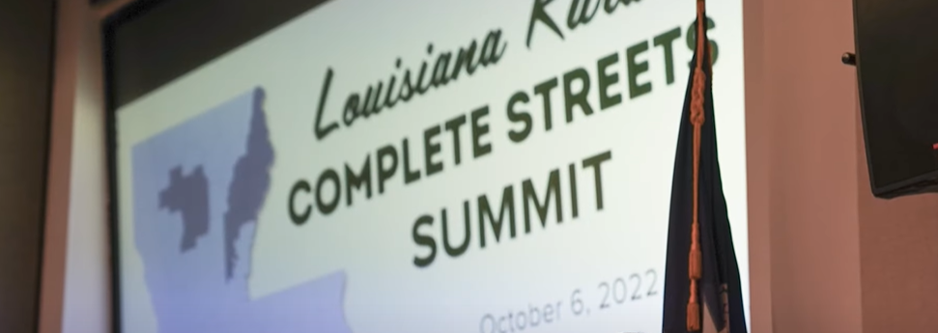
HOP – Louisiana State University
(279) Removing Red Tape for Complete Streets Projects in Small Rural Communities - YouTube

Slide 15
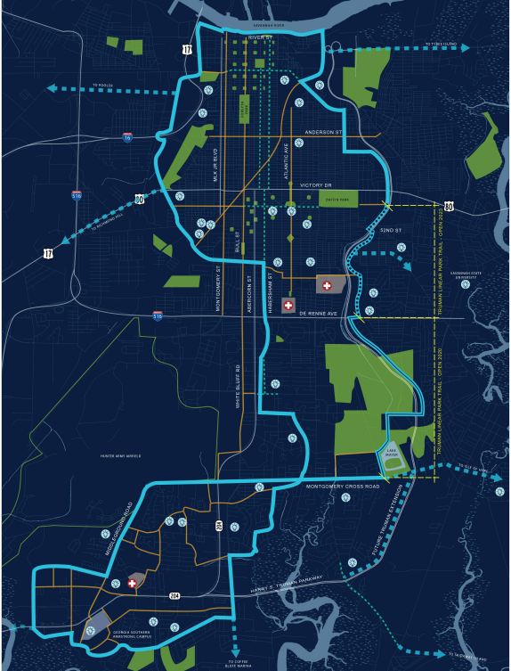
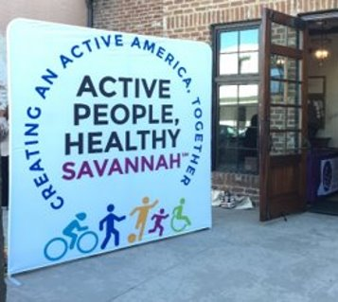
REACH – Healthy Savannah/YMCA of Coastal Georgia
Notes:
Tide to Town, Savannah’s Urban Trail System, is a planned 30-mile network of walking and biking trails connecting all of Savannah’s neighborhoods. In addition to serving a critical transportation function by offering activity friendly routes to everyday destinations, Tide to Town will provide safe, protected, and accessible spaces for all people to engage in physical activity.
The first two phases of Tide to Town are complete. The Truman Linear Park Trail opened in November 2020, followed by the Police Memorial Trail in November 2021.
In December 2021, the City of Savannah showed its support for Tide to Town by allocating $4 million in SPLOST funding and earmarking an additional $3 million for the trail network. Construction of three more phases of the trail network is planned for 2022, with significant progress to follow in the years to come.
With funding from REACH, Healthy Savannah supports education, outreach, and development of Tide To Town, with a focus on access for low-income neighborhoods and schools.

Slide 16
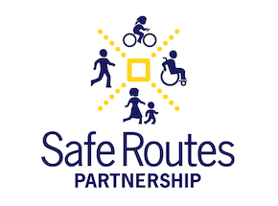
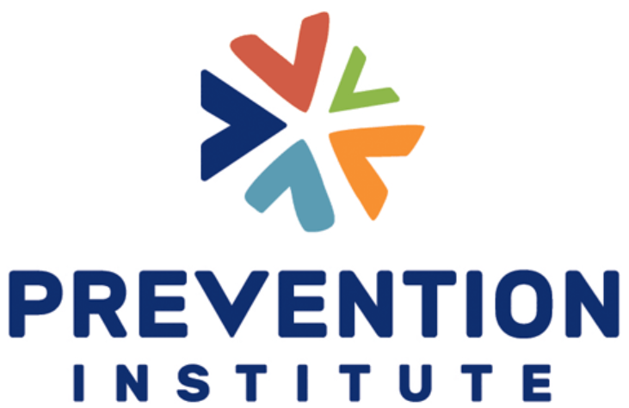
DNPAO’s Funded Partners
Notes:
We fund a network of NGOs to support and expand state and local cross-sectoral coalitions and create community action plans.

Slide 17
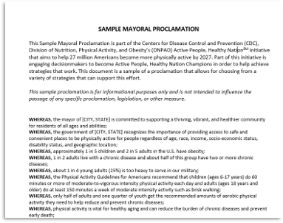
Active People, Healthy Nation Champions

Slide 18
Community Change Grants
Notes:
The Community Change Grants program supports the growing network of advocates, organizations, and agencies working to advance walkability. Grants are awarded to innovative, engaging, and inclusive programs and projects that create change and opportunity for walking and movement at the community level. Applications are open from September 15-Septmeber 30.

Slide 19
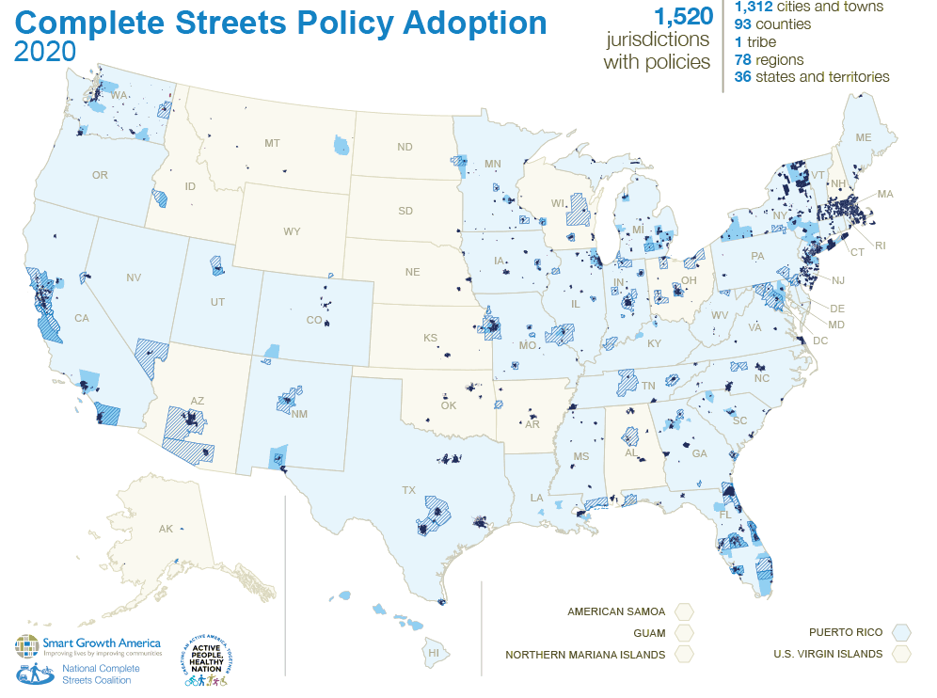
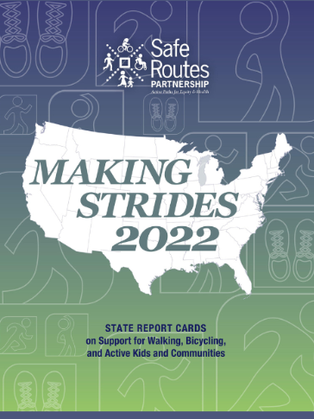
Data for Action

Slide 20
Walkability Action Institutes

Slide 21
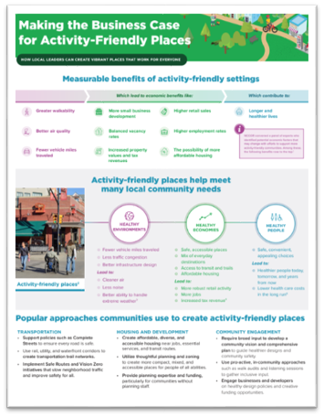
Addressing Barriers/Impactful Science: NCCOR Economic Benefits of Active Communities

Slide 22
Physical Activity Policy, Research and Evaluation Network (PAPREN)
Is a CDC-funded thematic research network of the CDC Prevention Research Centers and is funded by the Physical Activity and Health Branch.
PAPREN Work Groups develop and lead specific projects that focus on priority topic areas related to physical activity policy and the built environment activities.
A key research partner of the Active People, Healthy Nation Initiative.
PAPREN is grounded in the Community Preventive Services Task Force recommendations, especially the one that calls for transportation combined with built environment and land use interventions for supporting physical activity.
PAPREN advances the evidence base and puts research into practice through collaboration across sectors with a shared vision of achieving active communities.
Includes researchers, planners, engineers, policy makers, green space managers, advocates, physical activity and public health professionals and others!
Notes:
PAPREN is a Thematic Research Network. The Coordinating Center for PAPREN is a joint effort between the University of Massachusetts – Medical School, Prevention Research Center in Worcester MA, and the Policy, Practice, and Prevention Research Center at the University of Illinois at Chicago. Leadership includes Dr. Stephenie Lemon, at UMASS Medical Center and Dr. Jamie Chiriqui with the University of Illinois – Chicago. The primary role of the Coordinating Center is to build a vibrant Network by maintaining active communications among researchers and practitioners around a common theme … supporting network Work Groups … and making new tools and other resources available to the network. In addition to being a research network
PAPREN Work Groups develop and lead specific projects that focus on priority topic areas related to physical activity policy and the built environment, consistent with PAHB’s mission.
PAPREN is a key research partner of the Active People, Healthy Nation Initiative.
PAPREN activities are grounded in the Community Preventive Services Task Force recommendations, especially the one that calls for transportation systems combined with built environment and land use interventions for supporting physical activity.
PAPREN advances the evidence base and puts research into practice through collaboration across sectors with a shared vision of achieving active communities.
Researchers and practitioners, who affiliate with PAPREN may include colleagues from multiple sectors such as planners, engineers, policy makers, green space managers, advocates, public health professionals and others!

Slide 23
PAPREN Work Groups
Equity & Resilience
Transportation Policy & Planning
Rural Active Living
Parks & Greenspace
School Wellness
Worksite Wellness
Notes:
PAPREN has 6 work groups. Equity & Resilience is a separate group but is central to the work of all the work groups and therefore presented at the core of this graphic
The 5 other workgroups focus on Transportation Policy and Planning, Rural Active Living, Parks and Greenspaces, School Wellness, Worksite Wellness.

Slide 24
Understanding and Addressing Barriers: Anti-Displacement Strategies

Slide 25
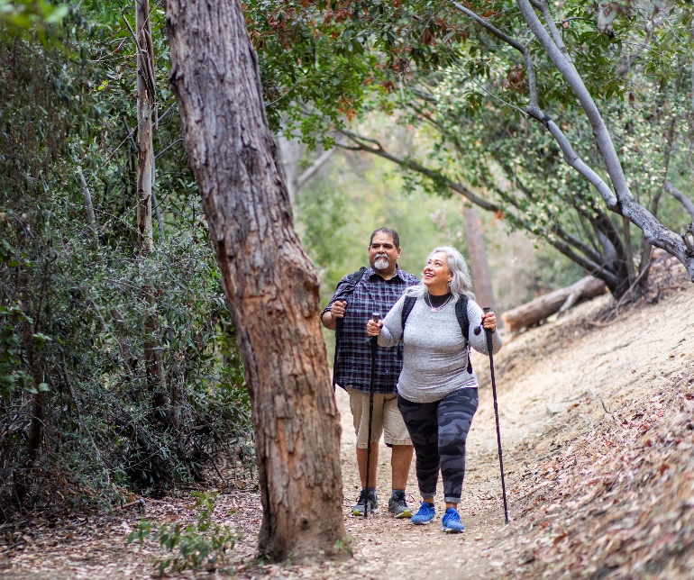
Access to Places for Physical Activity
Parks, Trails, and Greenway Interventions to Increase Physical Activity
Park, trail, and greenway infrastructure improvements
Additional interventions
Community engagement
Public awareness
Programming
Enhanced access
https://www.thecommunityguide.org/findings/physical-activity-park-trail-greenway-infrastructure-interventions-combined-additional-interventions
Notes:
The Community Guide recently added a recommendation for improving park, trail, and greenway infrastructure to increase physical activity and park use, when combined with additional interventions to increase community engagement, public awareness, programming, and enhanced access.
And the Community Preventive Services Task Force is currently weighing evidence for a recommendation on the economic benefits of parks.

Slide 26
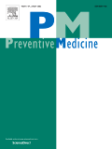
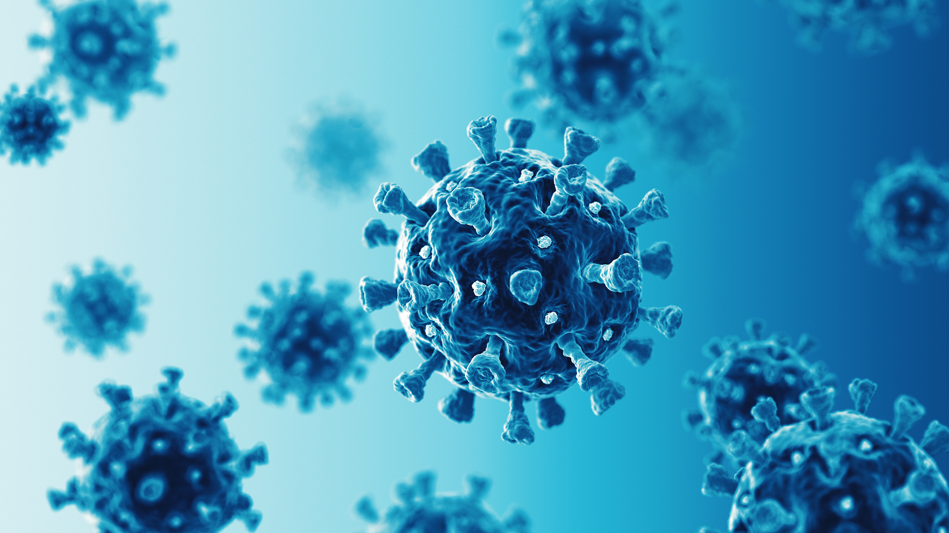
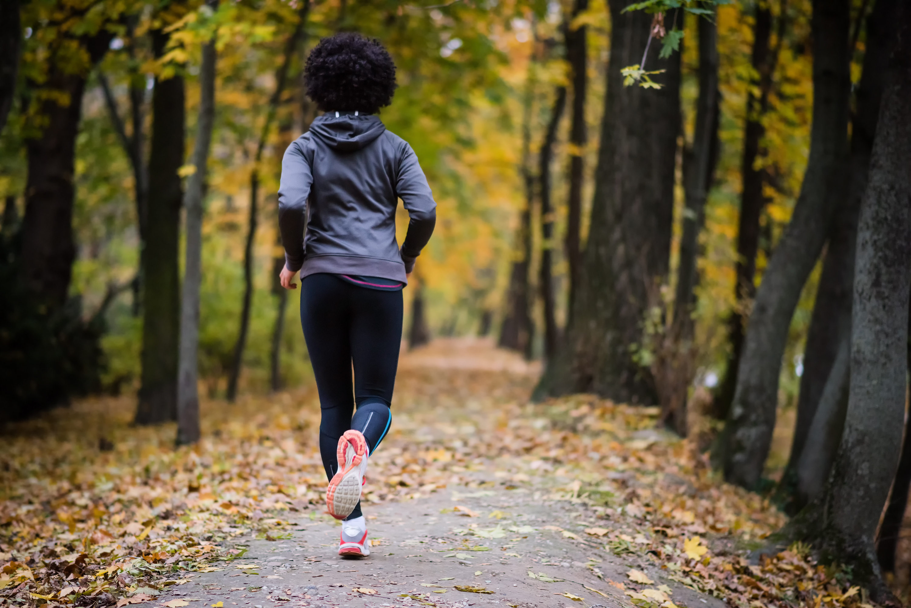
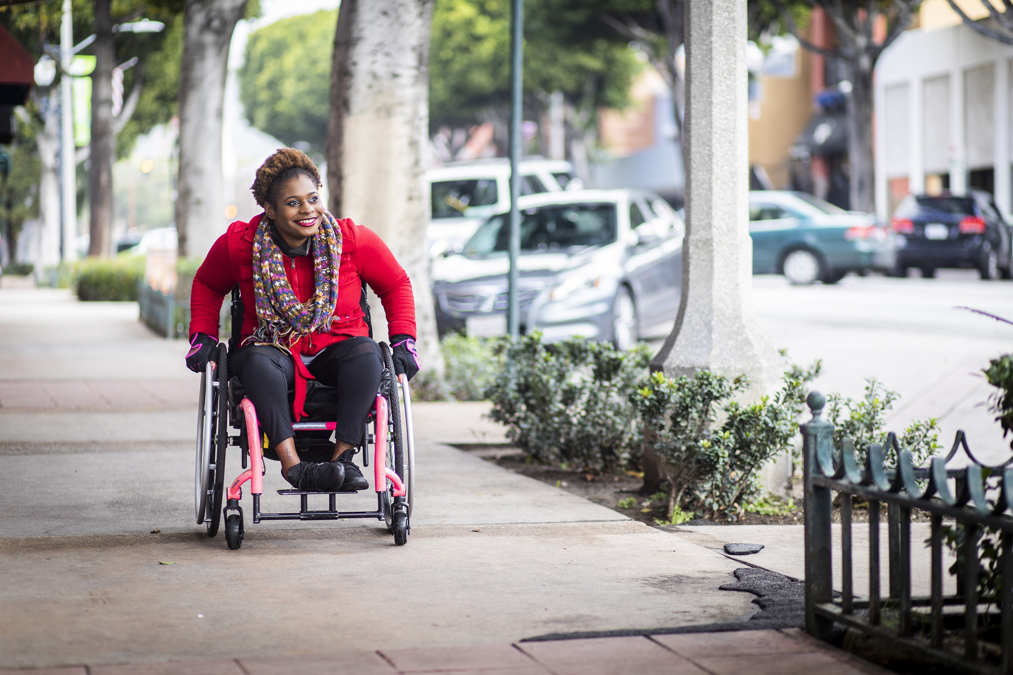
New Research
Observation of and intention to use new places and changed spaces for physical activity during the COVID-19 pandemic - United States, June 2021
Bryant J Webber ¹, Katherine L Irani ², John D Omura ³, Geoffrey P Whitfield ²
Approximately 1 in 4 adults reported discovering new places or changed spaces to support physical activity during the COVID-19 pandemic, and most intended to use these features.
Notes:
Published in
The COVID-19 pandemic prompted built environment changes throughout the United States. They assessed the prevalence of new places and changed spaces for physical activity as observed by US adults and their intentions to use them using data from SummerStyles.
Overall, 25.0% of US adults reported discovering new places for physical activity, and 25.3% reported changes to streets and outdoor spaces. Intention to use new places and changed spaces exceeded 50% among all sociodemographic and geographic subgroups. Among those reporting changes, adults who were physically inactive compared to those who were sufficiently active had similar intentions to use new places (PR = 0.83; 95% CI = 0.63, 1.10) and changed spaces (PR = 0.90; 95% CI = 0.69, 1.17). Approximately 1 in 4 adults reported discovering new places or changed spaces to support physical activity during the COVID-19 pandemic, and most intended to use these features. Expanding access to such supportive environments may help promote physical activity participation.

Slide 27
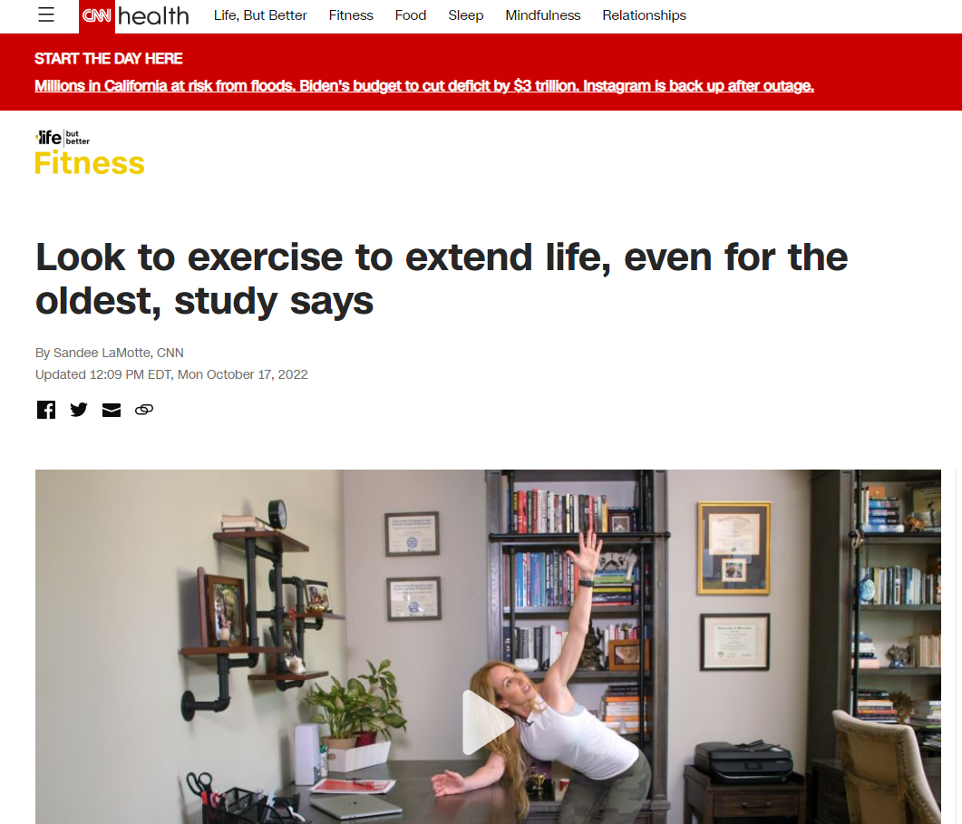
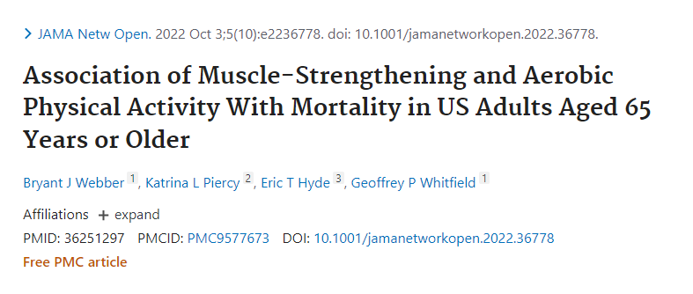
Impactful Science: Muscle Strengthening and Aerobic PA in Older Adults

Slide 28
Impactful Science: Physical Activity and Military Readiness

Slide 29
Physical Activity and Infectious Disease

Slide 30
Physical Activity and Infectious Disease
One recent study showed that meeting guidelines for aerobic and muscle-strengthening physical activity cut the risk of death from flu and pneumonia by half. Leisure-time physical activity and mortality from influenza and pneumonia: a cohort study of 577 909 US adults | British Journal of Sports Medicine (bmj.com).
A CDC systematic review of 25 studies showed that physical activity can protect people against severe COVID-19 outcomes. Brief Summary of Findings on the Association Between Physical Inactivity and Severe COVID-19 Outcomes (PDF).
As flu season approaches, CDC recommends everyone 6 months and older get a flu vaccine. Getting regular physical activity and enough sleep may also help protect you. New research showed that only about 9% of adults report doing all three of these. Joint Prevalence of Influenza Preventive Behaviors Among Adults-United States, 2020 - PubMed (nih.gov)
So get your vaccines… and do your physical activity…

Slide 31
Impactful Science: COVID and Physical Inactivity Systematic Review

Slide 32
New Funded Recipients
Missouri
St. Louis Integrated Health Network St. Louis $700k REACH; University of Missouri, Kansas City $700k REACH; Missouri Department of Health and Senior Services $800k SPAN; University of Missouri (Columbia) New Madrid, Mississippi, Scott, Stoddard, Ripley, Wayne, Howell, Wright, Crawford, and Washington Counties $700k HOP
Hawaii
University of Hawaii: USAPI: Guam, Republic of the Marshall Islands, Republic of Palau, Federated States of Micronesia $1 M REACH
Minneapolis
Asian Media Access: Phillips neighborhood in Minneapolis and the West Side Neighborhood in St. Paul $1 M REACH; City of Minneapolis, MN $1M REACH
South Carolina
LiveWell Greenville Greenville County $1M REACH; Clemson University (Clemson) Marlboro, Dillon, Marion, Darlington, Florence, Lee, Orangeburg, Allendale, Bamberg, and Hampton Counies $700k Racial and Ethnic Approaches to Community Health (REACH), 2023 – 2028 | DNPAO | CDC; State Physical Activity and Nutrition (SPAN) Program, 2023 - 2028 | DNPAO | CDC; High Obesity Program 2023-2028 | DNPAO | CDC

Slide 33
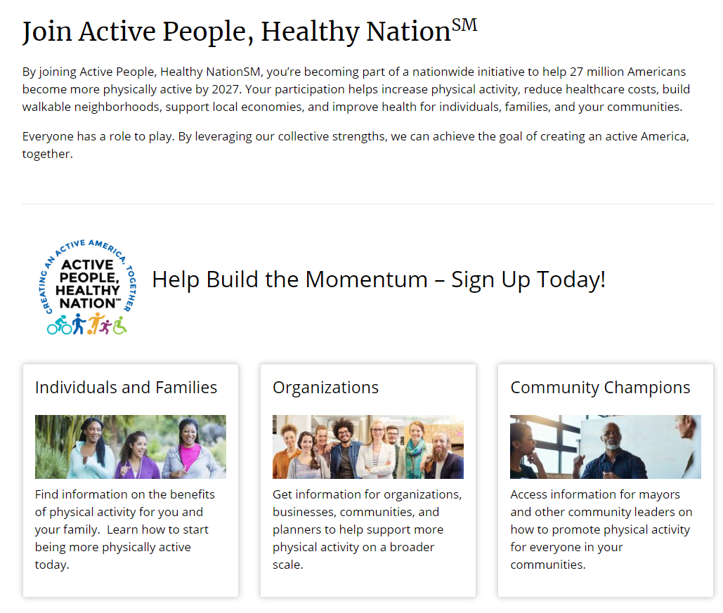
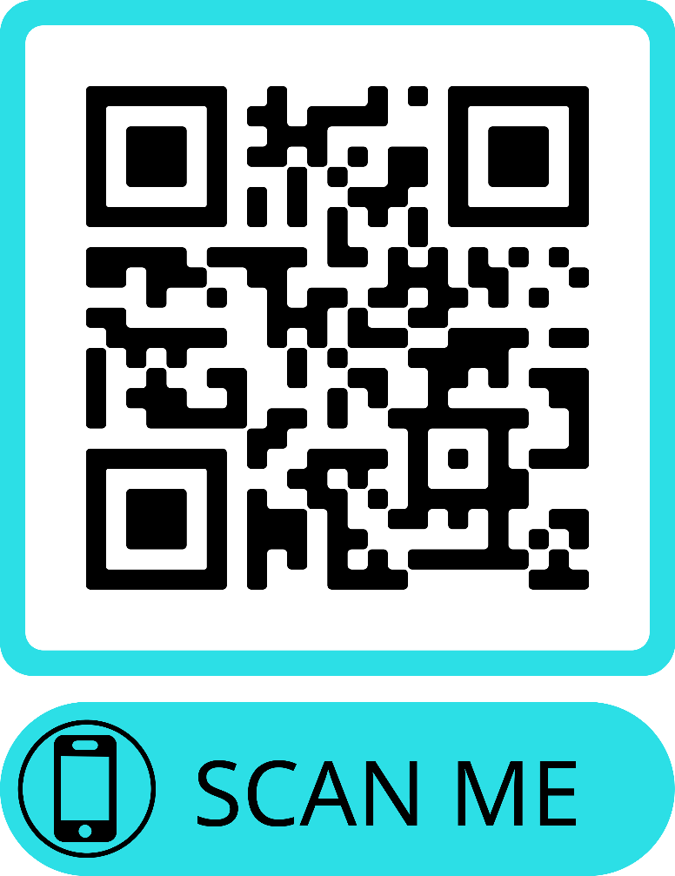
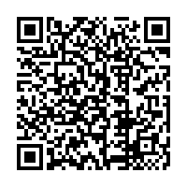
Join today!
v
https://www.cdc.gov/physicalactivity/activepeoplehealthynation/join-active-people-healthy-nation
Notes:
Join today if you haven’t already.

