Slide 1
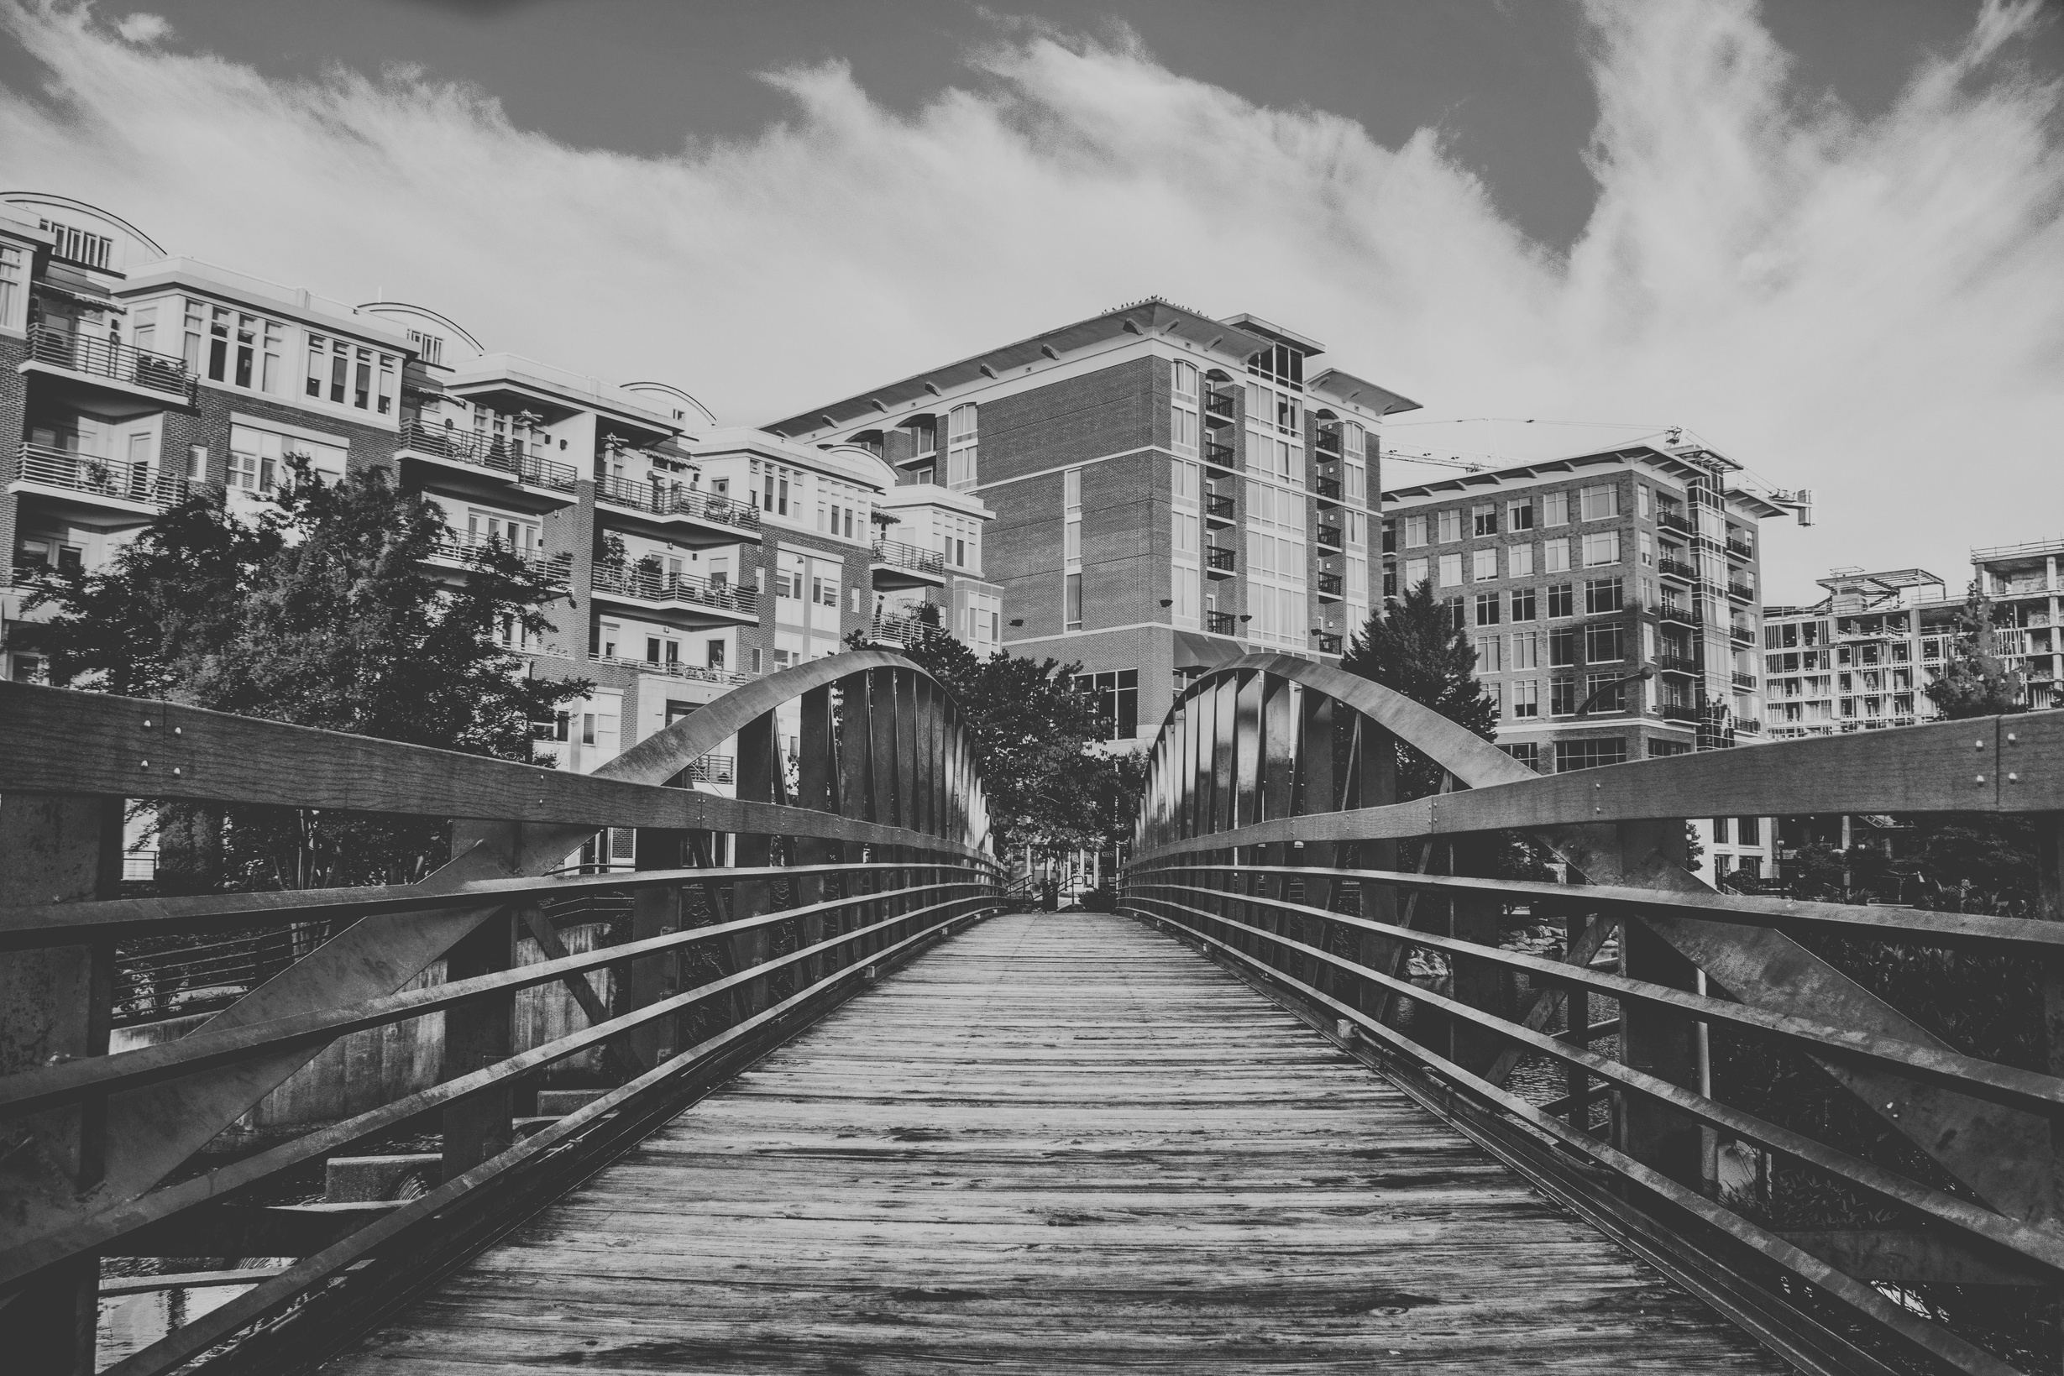

Bridging access to healthy eating and active living

Slide 2

WHAT WE DO
Amplify
Community
Power
Advocate
for Health
Equity
Advance
Community
Collaboration
We engage those who are most impacted by societal inequities in the process of planning and making healthy food and physical activity accessible and sustainable for all.
We work to build support systems and infrastructure that allow individuals and families to move towards food security, active lifestyles, and overall wellbeing.
We facilitate collaboration between organizations and community members so everyone can share their expertise, perspectives, and resources while addressing health disparities.

Slide 3
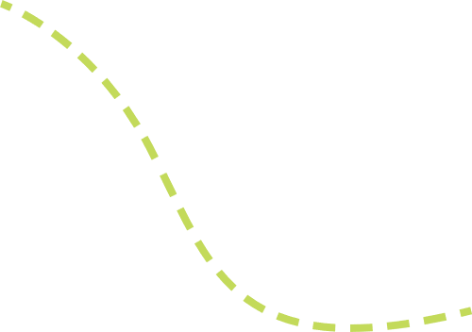

2011: Born to mitigate childhood obesity
2023: Community Power, Health Equity, Collaboration
2019: Strategic planning to map systems & find new focus
Creation &
Evolution
2014: Federal grant sparked initial growth & focus
Pandemic: move away from sector work, Equity

Slide 4

HEAL Board of Directors
LiveWell Greenville Board of Directors
Structure
Backbone Support
Food Security Coalition
Health Equity Coalition
Active Living Coalition
Customer Service Lead

Slide 5
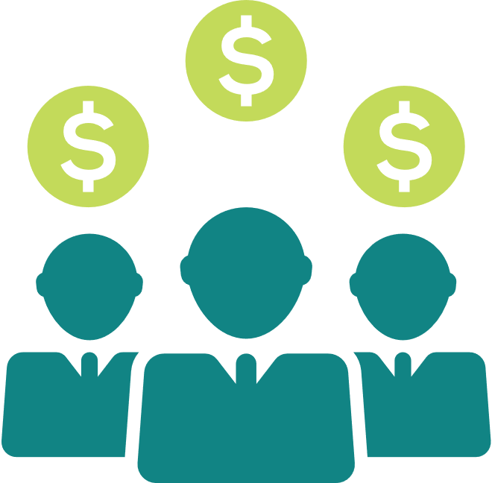



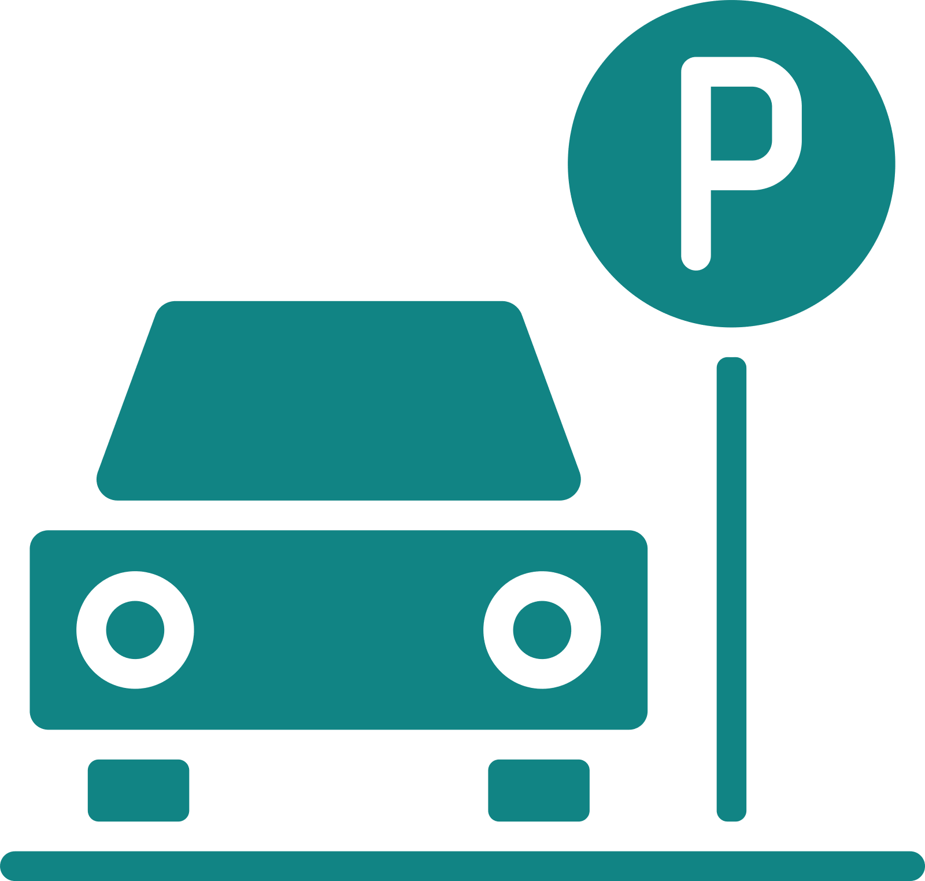












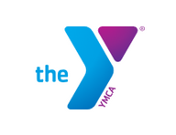




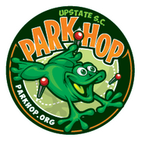





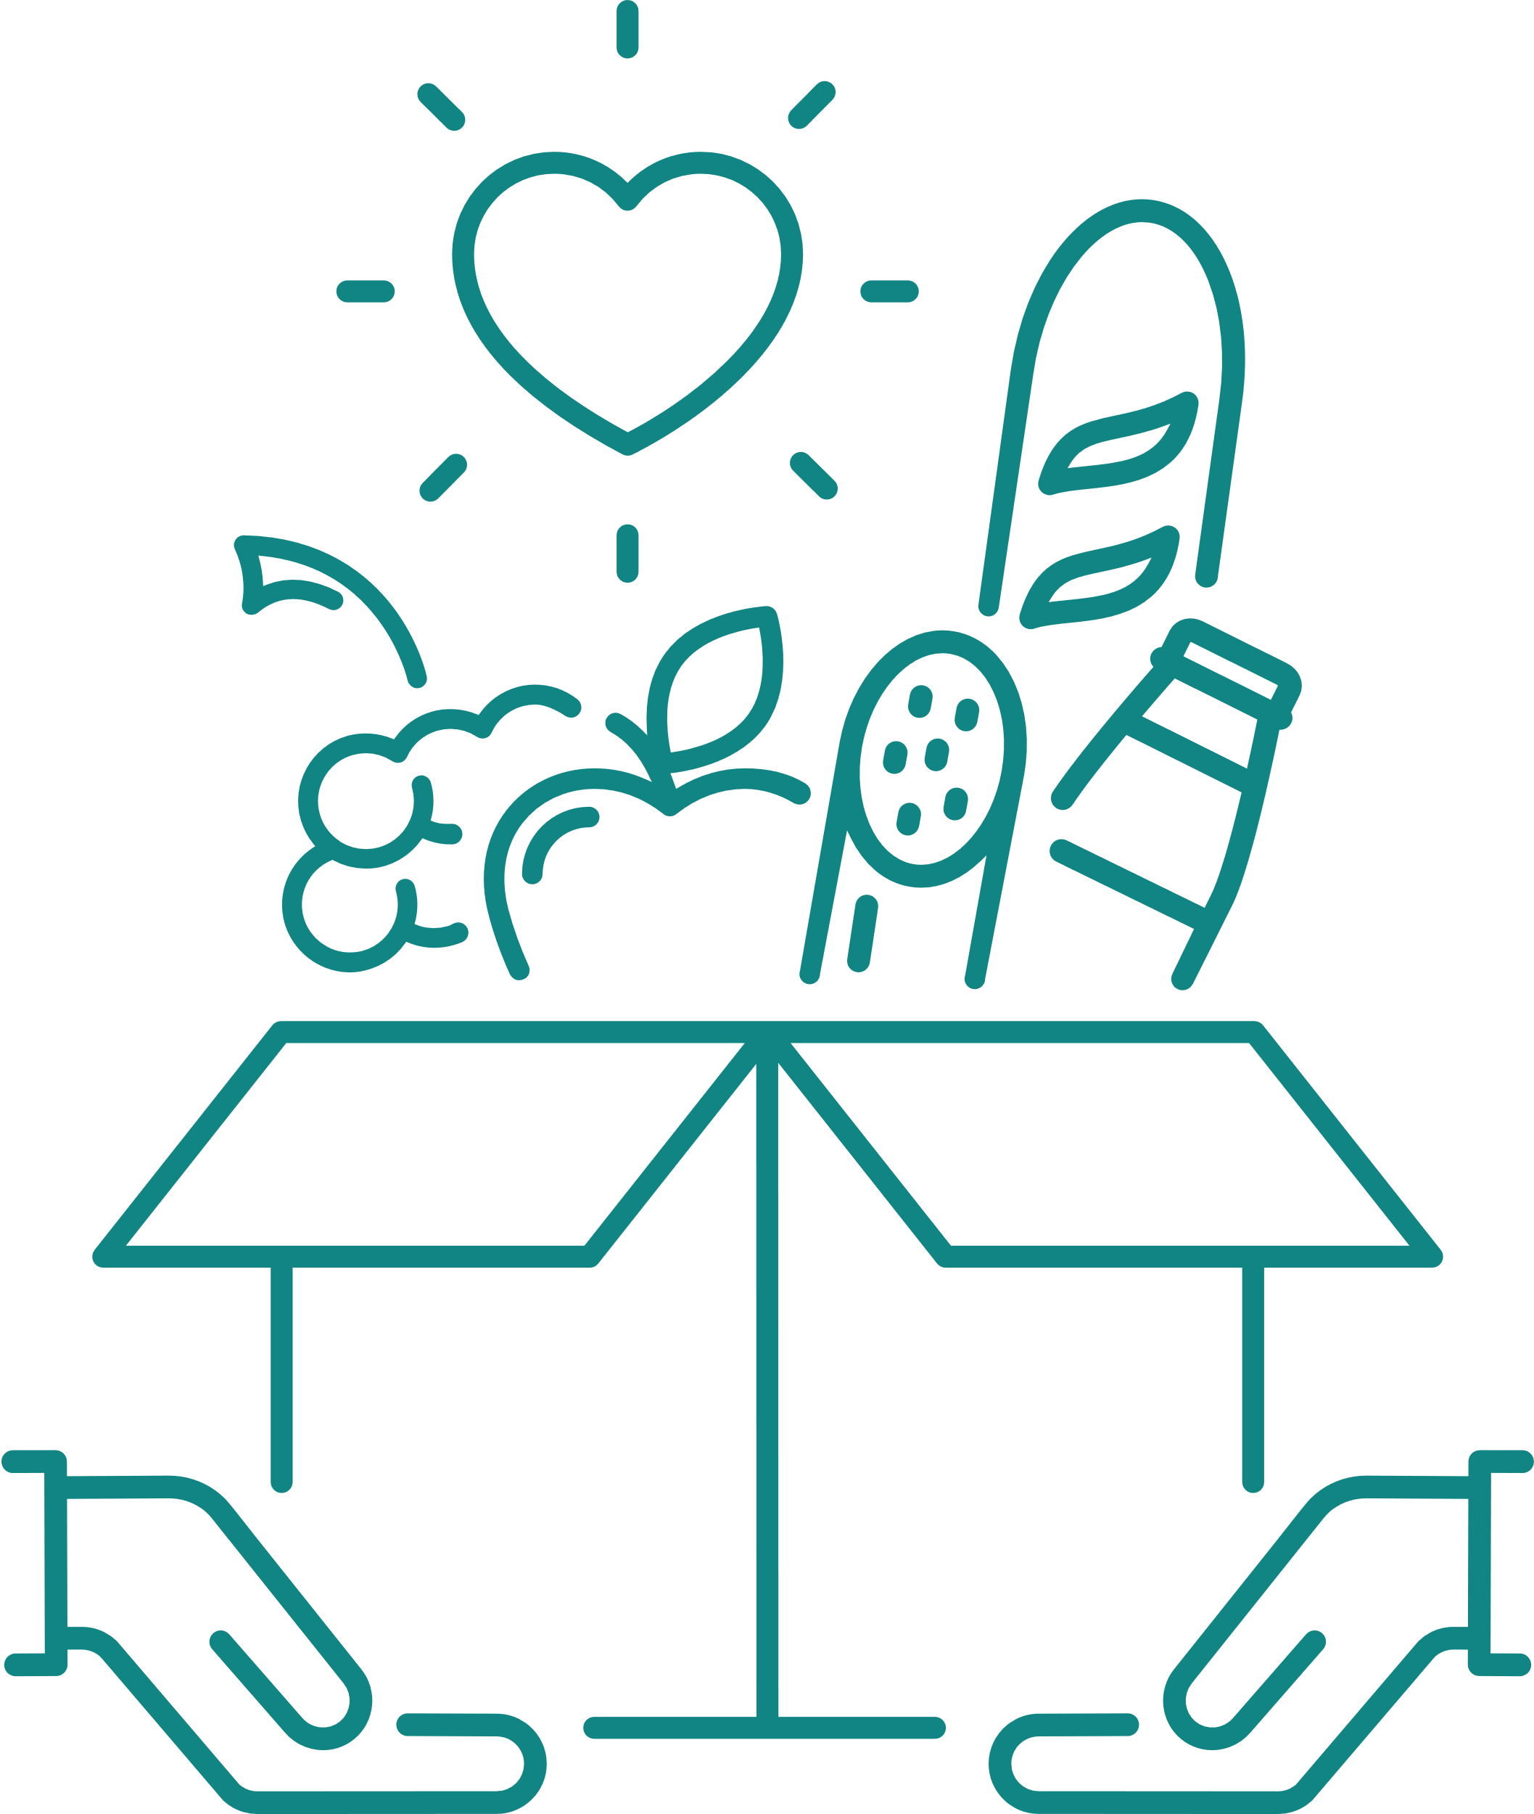








Slide 6
Partner Support & Individual Giving
8%
Foundation Grants
34%
Funding & Support
Government Grants
58%

Slide 7



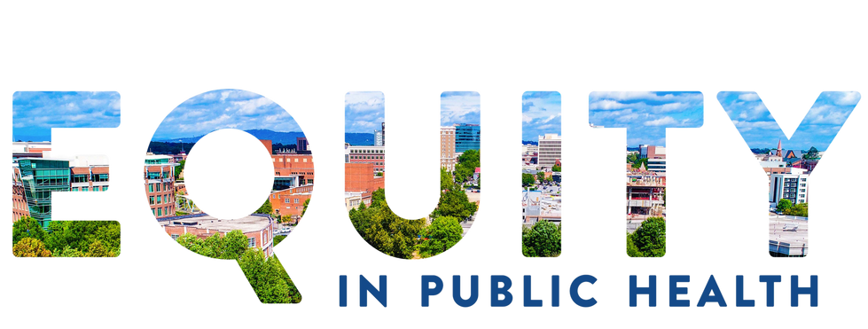
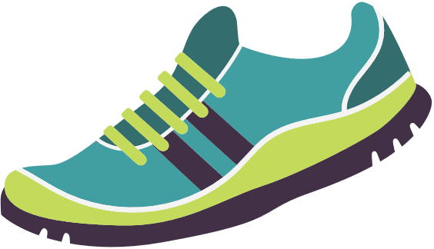

HOW WE ORGANIZE OUR WORK
Backpack Programs
EPHI Advisory Board
People, Parks, & Power
Food Is Medicine
Urban Agriculture +
Food Forests
Open Community Use
Food Pantry Infrastructure
Transportation
Park Hop
Food Security Coalition
Active Living
Coaliton
Community Food Resource Guide
Formula Bank
Outdoor Play & Learning
Advocacy
Summer Break Cafe
Community Engagement
Complete Streets

Slide 8
Active Living Goals
Programming for ALL
Maximize Resources
Build Connectivity
Increase knowledge and availability of active living programming and activities that accommodate the specific needs of the communities they serve.
  Age 14+ programming
  Program Guide
  Survey for program need
  Community Resource Guide
Increase the number of safe, convenient, and inclusive places for physical activity by maximizing the use of existing outdoor facilities and infrastructure.
  Open Community Use practice/policy
  Explore Mixed Use Spaces
  Map Resources
Increase activity-friendly routes to everyday destinations connected by safer and more accessible pedestrian, bicycle, or transit transportation networks.
  Support local advoacy groups
  Safe Routes to School & Work
  Complete Streets Policy
  Tourist Tax/Penny Tax

Slide 9
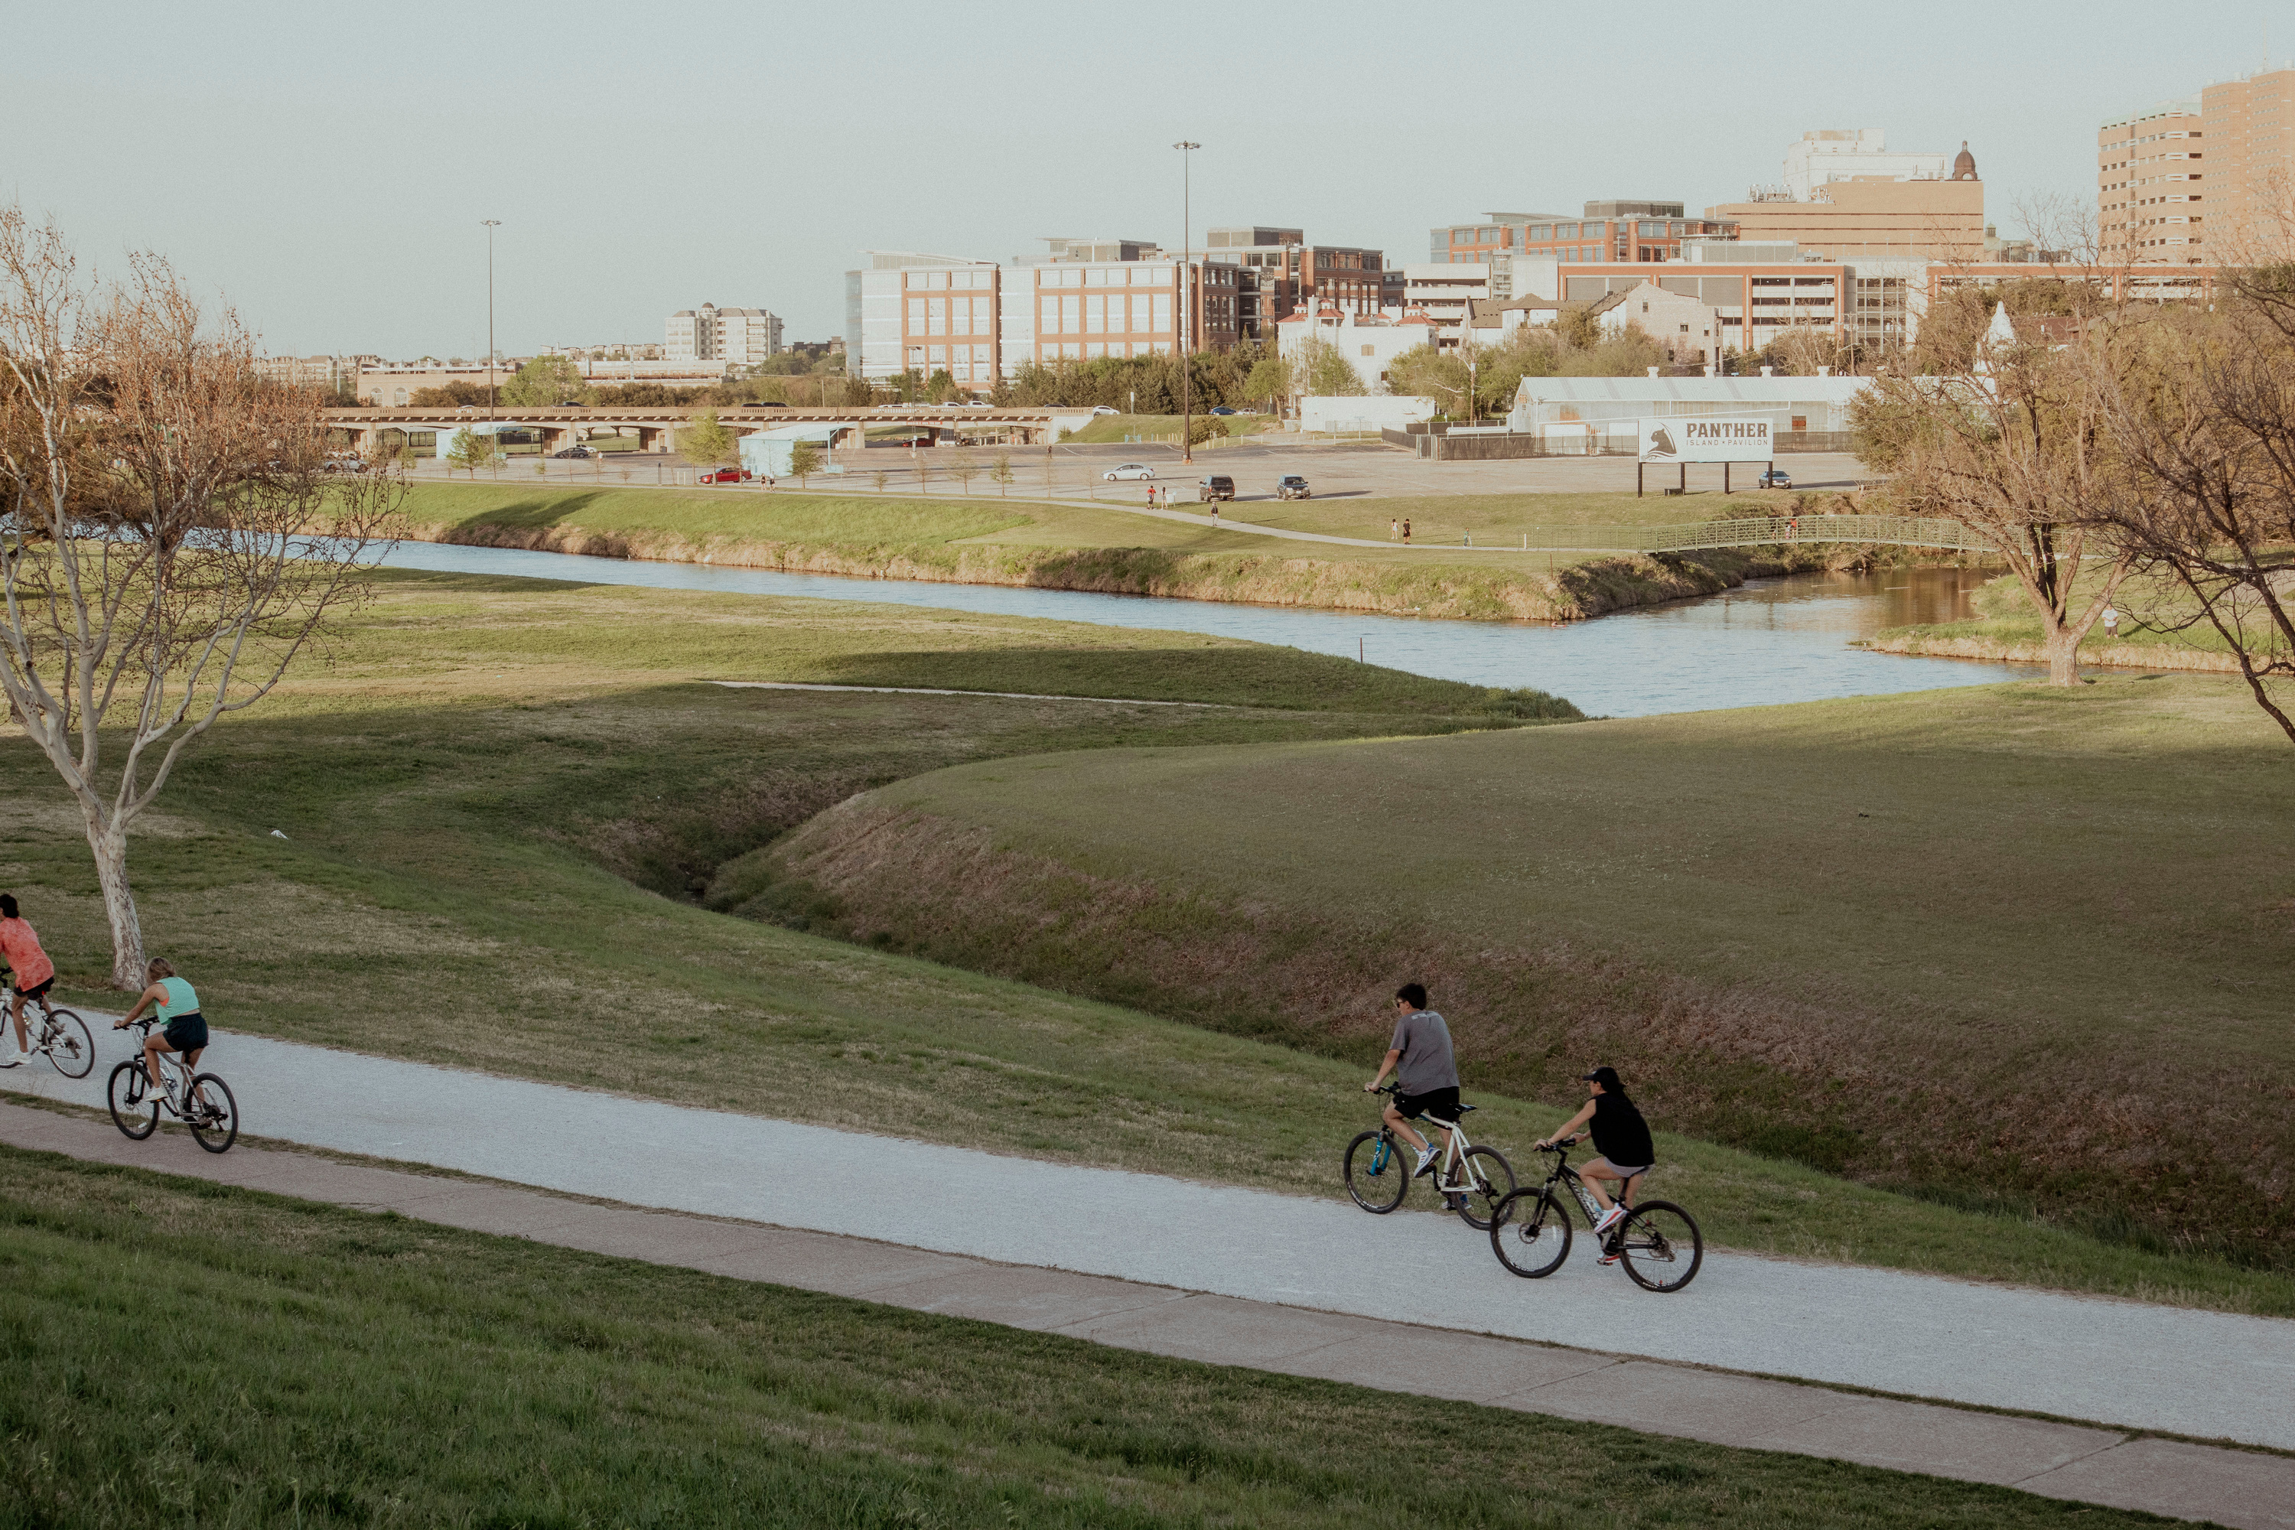
Our
Impact
Started the Active Living Coalition in 2023, a collective group of community members and organization representatives that will work together to create environments where ALL can achieve an active lifestyle.
Participated in the creation of the Healthy Neighborhoods Environment resources map, which tracks and measures the accessibility of physical activity spaces across GVL.
Started the Park Hop program, which provides free scavenger hunts and summer-long fun in parks across the Upstate. Over 1,000 participants in 2023.
Connected with Greenville County Schools to advocate for the practice of Open Community Use at all 40+ elementary schools in the county, increasing places where residents can be active.
Partnered with Bike Walk Greenville and Greenville County to make connections from the White Horse Road area to the Swamp Rabbit Trial, increasing Safe Routes to Work through a new Bike Route.
Amplifying community voice through LiveWell’s third resident advisory board, the Health Equity Action Leaders Board focused on shifting the systems and policies that perpetuate inequities in GVL.

Slide 10


Sabrina Smith
Thank
you!
ssmith@livewellgreenville.org
livewellgreenville.org
@livewellgreenville

