Slide 1
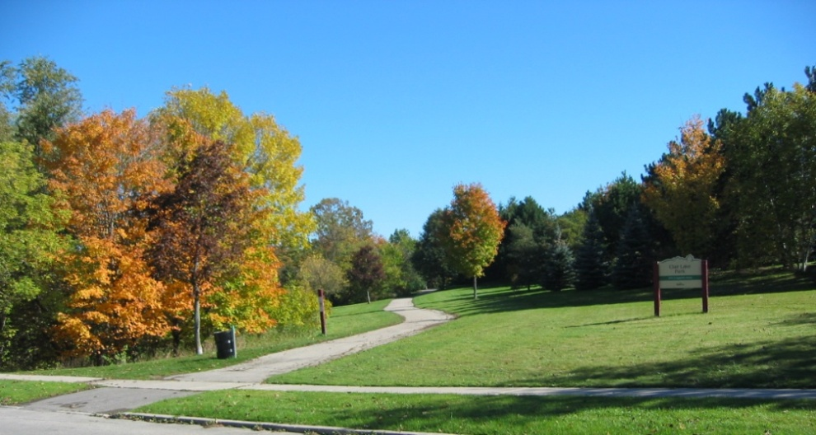
Built Environment and Physical Activity: Emerging Research Opportunities to Promote Environmental Justice and Community Health
Andrew T. Kaczynski, PhD
Department of Health Promotion, Education and Behavior
Prevention Research Center
Arnold School of Public Health
University of South Carolina
1

Slide 2
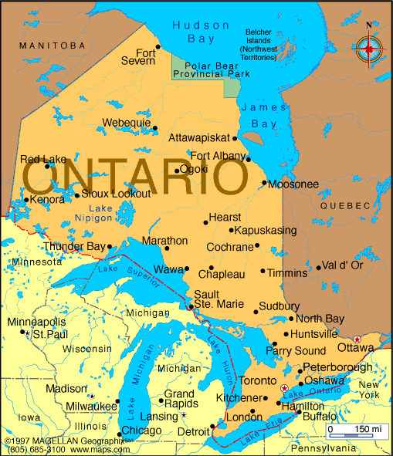

Just a bit about Andy …
Originally from Southwestern Ontario
PhD from the Faculty of Applied Health Sciences at the University of Waterloo
3.5 years at Kansas State University
10+ years at University of South Carolina
Director, Built Environment and Community Health (BEACH) Laboratory (www.beachlab.sc.edu)
Dad, tennis player, and craft beer lover
PAPH Research Course Graduate 2008!

Slide 3
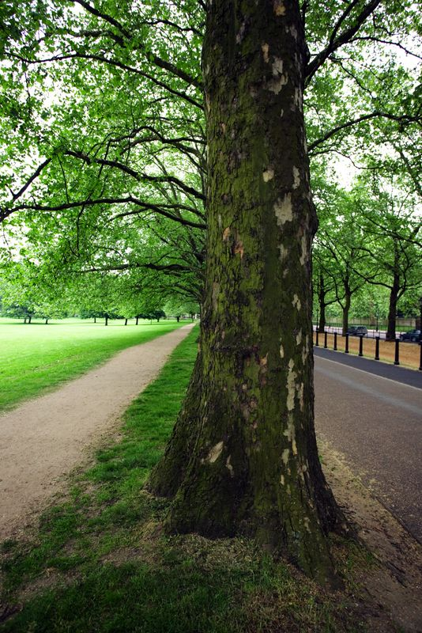
Presentation Outline
Overview of the built environment, environmental justice and physical activity
Methods for researching the built environment and physical activity
Research opportunities
  Questions and discussion
Notes:
PHS 635
3

Slide 4
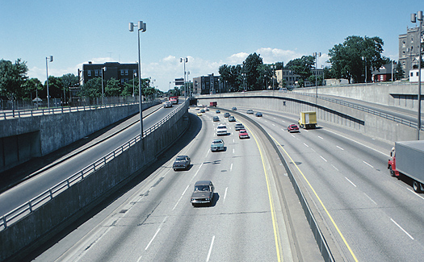
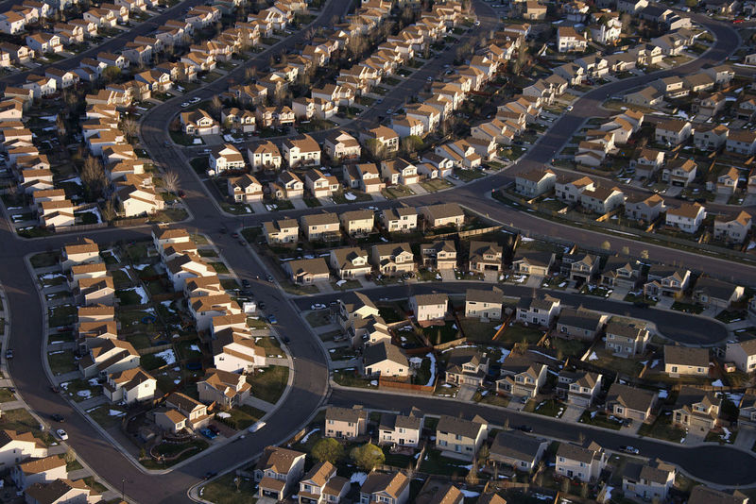
Built Environment and Health
“Most of the communities where Americans live are important contributors to current public health problems. Simultaneously, they can also be the source of important solutions to these problems”.
Frank, L. D., Engelke, P. O., & Schmid, T. L. (2003). Health and community design: The impact of the built environment on physical activity. Washington, DC: Island Press.
Notes:
PHS 635
4

Slide 5
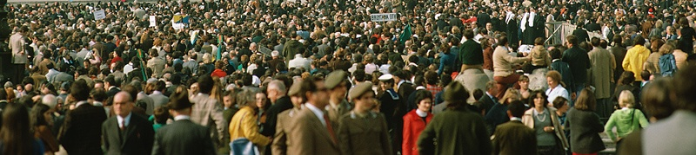
Why Target the Built Environment?
Large numbers of people affected
Relatively permanent effects
Impacts active living behaviors, not just exercise-related physical activity
More strongly related to moderate than vigorous physical activity
Endorsements from IOM, CDC, AHA, AMA, AAP, etc.
Sallis, J. F., Cervero, R., Ascher, W. W., Henderson, K., Kraft, M.K., & Kerr, J. (2006). An ecological approach to creating active living communities. Annual Review of Public Health, 27, 297-322.
Notes:
PHS 635
5

Slide 6
Environmental Justice¹
According to the U.S. Environmental Protection Agency, EJ involves:
  fair treatment and meaningful involvement of all people regardless of race, colour, national origin, or income with respect to the development, implementation, and enforcement of environmental laws, regulations,
  and policies
  everyone enjoys the same degree of protection from environmental and health hazards and equal access to the decision-making process to have
  a healthy environment in which to live, learn, and work
Deprivation Amplification²
Persons with fewer personal resources that support physical activity and healthy eating (e.g., income, knowledge, etc.) tend to reside in areas that are more deprived of neighborhood physical activity and nutrition resources (e.g., sidewalks, park, grocery stores)
Taylor, W.C., Poston, W.S.C., Jones, L., & Kraft, M.K. (2006). Environmental justice: Obesity, physical activity, and health eating. Journal of Physical Activity and Health, 3(S1), 30-54.
2. Macintyre, S. (2007). Deprivation amplification revisited: Or, is it always true that poorer places have poorer access to resources for healthy diets and physical activity? International Journal of Behavioural Nutrition and Physical Activity, 4(32), 32-38.
Notes:
PHS 635
6

Slide 7
Presentation Outline
Overview of the built environment and physical activity
Methods for researching the built environment and physical activity
Research opportunities
  Questions and discussion
Notes:
PHS 635
7

Slide 8

Methods for Measuring the Built Environment
The primary methods used to measure characteristics of the built environment that may be related to physical activity include:
  Perceptions of residents (e.g., surveys)
  Direct observation (e.g., audits)
  Geographic databases (e.g., GIS)
Brownson, R.C., Hoehner, C.M., Day, K., Forsyth, A., & Sallis, J.F. (2009). Measuring the built environment for phsyical activity: state of the science. American Journal of Preventive Medicine, 3(4 suppl), S99-123.
Notes:
PHS 635
8

Slide 9
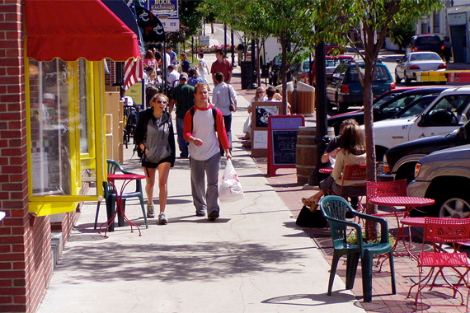
Neighborhood Environment Walkability Scale (NEWS)
One of the first and most widely used self-report measures for assessing neighborhood walkability perceptions
In the abbreviated version, seven dimensions assessed using 56 questions:
  residential density
  land use mix – diversity
  land use mix – access
  street connectivity
  walking/cycling facilities
  aesthetics
  safety
Adequate to good test-retest reliability and validity
Numerous other studies since reporting NEWS adaptations and properties
Saelens, B.E., Sallis, J.F., Black, J.B., & Chen, D. (2003). Neighborhood-based differences in physical activity: An environmental scale evaluation. American Journal of Public Health, 93(9), 1552-1558.
Notes:
PHS 635
9

Slide 10
NEWS and Neighborhood-Based Physical Activity
NEWS used to collect neighborhood perceptions data from 585 residents
of four neighborhoods; also measured neighborhood moderate-intensity PA
People reporting some PA in their neighborhood had more positive perceptions on most dimensions than people reporting no PA in their neighborhood (see graph)
However, NEWS scores not different between those reporting some neighborhood PA and those reporting a lot
Neighborhood gets people “off the couch”?
Kaczynski, A.T. (2010). Neighborhood walkability perceptions: Associations with amount of neighborhood-based physical activity by intensity and purpose. Journal of Physical Activity and Health, 7, 3-10.
Notes:
PHS 635
10

Slide 11
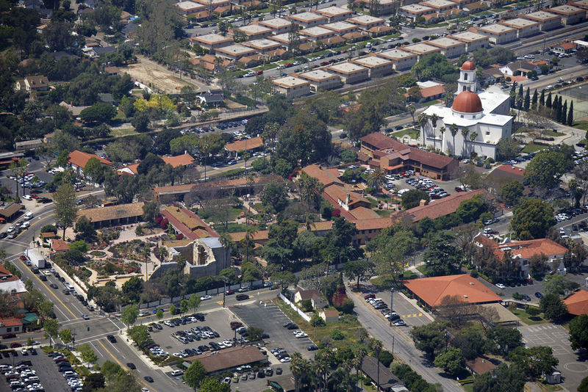
Microscale Audit of Pedestrian Streetscapes (MAPS) tool
Tool developed in three metropolitan areas (Baltimore, MD/Washington, DC, San Diego, CA, and Seattle, WA) and included neighborhoods representing a wide range of urban design and incomes to assess details of streetscapes considered relevant for physical activity
Multiple versions designed for researchers (MAPS-Full), researchers and advanced practitioners (MAPS-Abbreviated), and community members (MAPS-Mini)
Four sections of the tool: overall route, street segments (defined as the area between crossings), crossings, and cul-de-sacs
Microscale factors are collected, such as road crossing features, presence of trees, bicycle lanes, curbs, and characteristics of the social environment (e.g., stray dogs, graffiti, trash)
MAPS items and subscales predominantly demonstrated moderate to excellent reliability
Millstein, R.A., Cain, K.L., Sallis, J.F. et al. (2013). Development, scoring, and reliability of the Microscale Audit of Pedestrian Streetscapes (MAPS). BMC Public Health 13, 403.

Slide 12
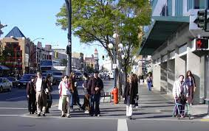
Microscale Audit of Pedestrian Streetscapes (MAPS) tool
Examined associations of microscale attributes with multiple physical activity (PA) measures across four age groups – children, adolescents, adults, older adults
3,677 participants in San Diego, Seattle, and Baltimore
Walking/biking for transport and leisure PA were measured with surveys; objective PA measured with accelerometers
Microscale attributes were consistently found to be associated with walking or biking for transport
Overall aesthetics was negatively associated with walking for transportation for adults/older adults
  Overall aesthetics was positively associated with leisure time PA of children and adults
Cain, K.L., Millstein, R.A., Sallis, J.F., Conway, T.L., Gavand, K.A., Frank, L.D., Saelens, B.E., Geremia, C.M., Chapman, J., Adams, M.A., Glanz, K., King, A.C. (2014). Contribution of Streetscape Audits to Explanation of Physical Activity in Four Age Groups Based on the Microscale Audit of Pedestrian Streetscapes (MAPS), Social Science & Medicine, 116, 82-92
Notes:
PHS 635
12
Include link to tool

Slide 13
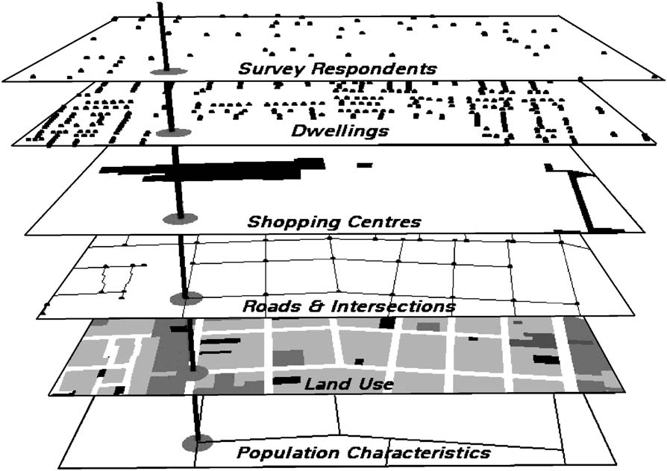
Geographic Information Systems (GIS)
GIS are a bundle of software programs combining mapping and database tools
A GIS runs off ‘shape’ files composed of multiple layers of individual features
Layers can be:
  Points (e.g., homes, stores, centers of parks)
  Lines (e.g., streets, rivers)
  Polygons (e.g., parks, parcels of land)
All features within a layer are ‘stored’ in an attribute table (like an Excel worksheet) with common geographic coordinates
Leslie, E., Coffee, N., Frank, L., Owen, N., Bauman, A., & Hugo, G. (2007). Walkability of local communities: Using geographic information systems to objectively assess relevant environmental attributes. Health & Place, 13(1), 111-122.
Notes:
PHS 635
13

Slide 14
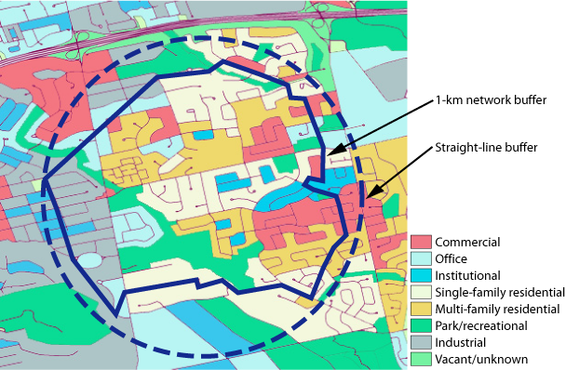
Geographic Information Systems (GIS)
Common applications of GIS in built environment research include:
  calculating distance between environmental features (e.g., home to nearest grocery store or park)
  relating features and behavior (e.g., comparing physical activity in neighborhoods with differing land use patterns)
  overlaying data about two or more neighborhood characteristics (e.g., junk food consumption and convenience store access)
  seeing if an outcome is spatially clustered (e.g., obesity)
Notes:
PHS 635
14

Slide 15
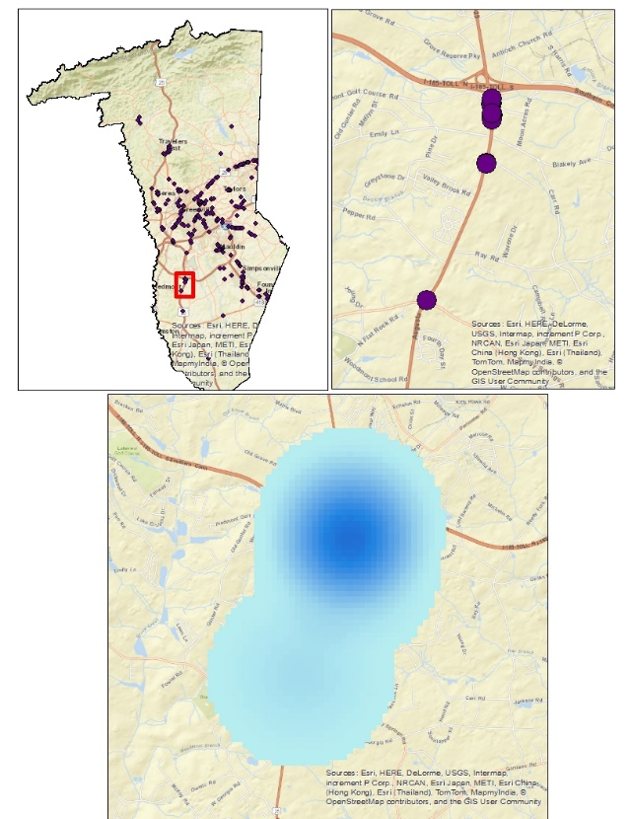
Multicomponent Obesogenic Built Environment Measure for Youth
Development of a unique methodology to quantify the obesogenic built environment for youth; used to examine the association between youth obesity, race/ethnicity, socioeconomic status, and level of urbanization
Data collected from Greenville County, SC
  3rd, 4th, and 5th grade youth BMI, SES, and home address
  Demographic data for block groups
Park data collected via the Community Park Audit Tool and scored by summing sub-components from the tool
  Food environment developed from geocoded listings of food stores and restaurants from SC DHEC and InfoUSA
  Utilized kernel density measures to transform data points to a raster surface
Hughey, S. M., Kaczynski, A. T., Porter, D. E., Hibbert, J., Turner-McGrievy, G., & Liu, J. (2019). Development and testing of a multicomponent obesogenic built environment measure for youth using kernel density estimations. Health & Place, 56, 174–183.
Notes:
PHS 635
15

Slide 16
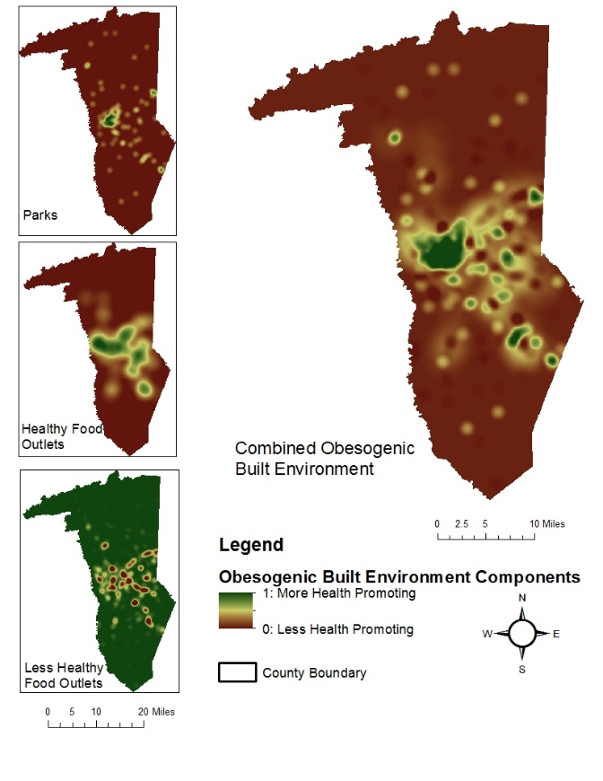
Multicomponent Obesogenic Built Environment Measure for Youth
Obesogenic environments quantified into three components: Parks, Healthy Food Outlets, and Less Healthy Food Outlets
Weighted so that both PA and nutrition each comprised 50% of the total score
Multilevel linear regression to test for associations between BE and sociodemographic and BMI scores
Supportive BE was associated with lower weight status among youth (β = −0.25, p < 0.05)
Hughey, S. M., Kaczynski, A. T., Porter, D. E., Hibbert, J., Turner-McGrievy, G., & Liu, J. (2019). Development and testing of a multicomponent obesogenic built environment measure for youth using kernel density estimations. Health & Place, 56, 174–183.
Notes:
PHS 635
16

Slide 17
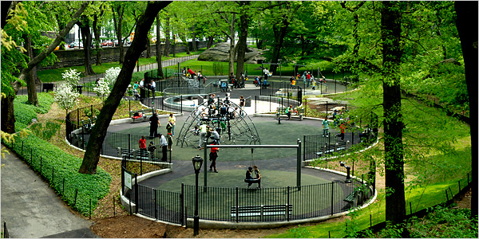
GPS & Greenspace Use in Children’s Physical Activity
How much of children’s physical activity occurs within different types of urban greenspace and how does this activity contribute to total levels of non-school PA?
Both GPS and accelerometer data collected from adolescents in Bristol, UK
Majority of activity took place indoors, with 26.4% (weekday evening) & 17.6% (weekend) of MVPA occurring outdoors and within Bristol
Larger percentage of outdoor MVPA took place in greenspaces on the weekend and the percentage of outdoor MVPA within parks was also higher on the weekend (except sport areas)
  Some children are particularly high users of greenspace for play and PA; therefore, greenspace use may be an important contributor to overall PA levels
Lachowycz, K., Jones, A.P., Page, A.S., Wheeler, B.W., & Cooper, A.R. (2012). What can global positioning systems tell us about the contribution of different types of urban greenspace to children’s physical activity? Health & Place, 18, 586-594.

Slide 18
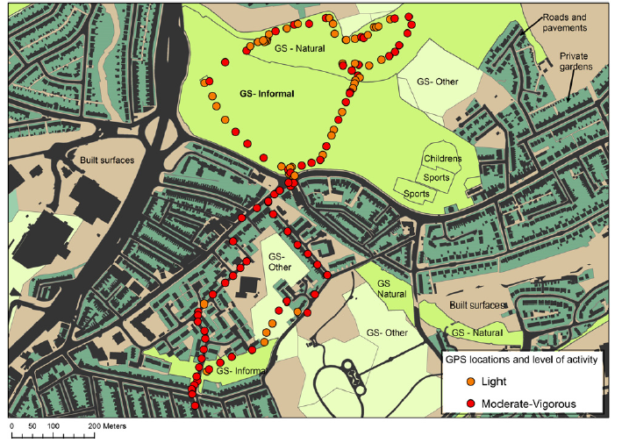
Lachowycz, K., Jones, A.P., Page, A.S., Wheeler, B.W., & Cooper, A.R. (2012). What can global positioning systems tell us about the contribution of different types of urban greenspace to children’s physical activity? Health & Place, 18, 586-594.

Slide 19
Presentation Outline
Overview of the built environment and physical activity
Methods for researching the built environment and physical activity
Research opportunities
  Leveraging technology
  Engaging citizens
  Analyzing big data
  Environmental surveillance
  Taking advantage of natural experiments
  Questions and discussion
Notes:
PHS 635
19

Slide 20
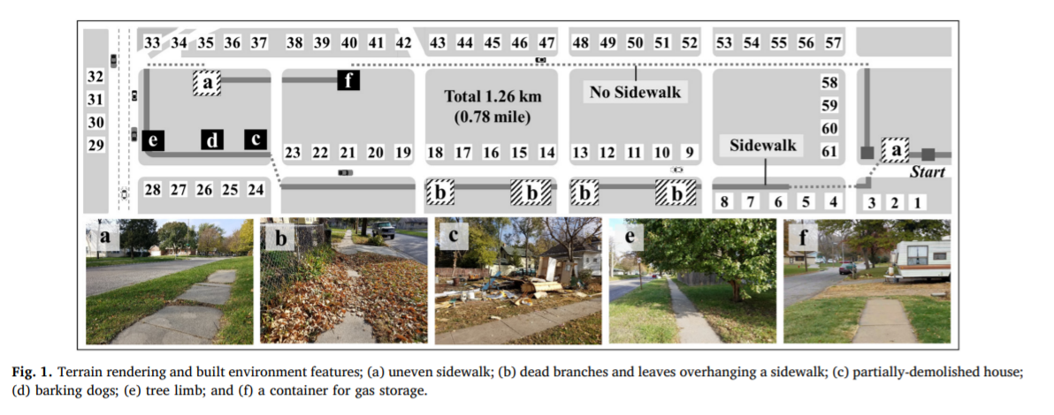
Influence of BE Features on Pedestrian Physiological Responses
Tested a novel approach to assess conditions of walkable environments using body responses
  Also examined the association between built environment and PA
Physiological data – gait stability, gait acceleration, relative heart rate
30 individuals (15 men, 15 women) in Lincoln NE
  Walked a street segment with monitors (smartphone, IMU sensor, and physiological response collector)
  Subjective ratings of street segments on walkability features
Significant positive relationships between physiological responses and built environment features and subjective ratings
Kim, J., Ahn, C. R., & Nam, Y. (2019). The influence of built environment features on crowdsourced physiological responses of pedestrians in neighborhoods. Computers, Environment and Urban Systems, 75, 161–169.

Slide 21
Presentation Outline
Overview of the built environment and physical activity
Methods for researching the built environment and physical activity
Research opportunities
  Leveraging technology
  Engaging citizens
  Analyzing big data
  Environmental surveillance
  Taking advantage of natural experiments
  Questions and discussion
Notes:
PHS 635
21

Slide 22
Harnessing Technology and Citizen Science to Support Active Neighborhoods
Pilot test of the Nuestra Voz (Our Voice) approach in Cuernavaca, Mexico with adults and adolescents
  Involved neighborhood residents acting as “citizen scientists” to systematically gather information on barriers and facilitators to PA using the Discovery Tool
  Goal was to examine acceptability and feasibility of the citizen scientist approach
32 adults, 9 adolescents participated as citizen scientists
  Responded to surveys that assessed sociodemographic information, self-efficacy for using the Discovery Tool, NEWS-A, and acceptability of using the Discovery Tool
Overall self-efficacy for using the Discovery Tool was higher among adolescents than adults (9.3 vs. 7.7, p < 0.01)
Rated five of the nine acceptability survey items with an average of 4.0 or higher out of 5.0
  Engagement and acceptability of the approach were highest in neighborhoods characterized by low SES and low walkability
Rosas, L. G., Salvo, D., Winter, S. J., Cortes, D., Rivera, J., Rodriguez, N. M., & King, A. C. (2016). Harnessing Technology and Citizen Science to Support Neighborhoods that Promote Active Living in Mexico. Journal of Urban Health, 93(6), 953–973.

Slide 23
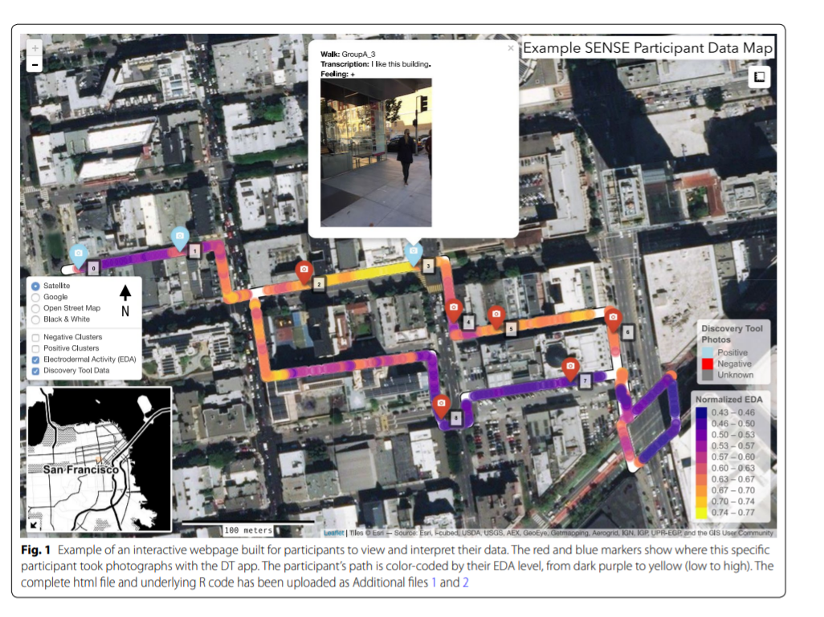
Stress experiences in neighborhood and social environments (SENSE): Integrating the quantified self with citizen science
Aimed to determine the initial feasibility and utility of adding biometric sensor data to the built environment data collected with the Discovery Tool app to collect photos and audio narratives of the built environment that contributed to or detracted from well-being
14 adults (8 women, 6 men) in San Francisco participated in a 20-25 minute walk utilizing the Discovery Tool; biometric data (e.g., BP, HR, skin temperature) collected via electrodermal activity monitor (EDA)
Geospatial technology identified that positively rated image clusters represented 4.3% of the route, while negative image clusters represented 2.7% of the route
  Average participant EDA levels observed inside a positive cluster were significantly higher than those observed elsewhere
Chrisinger, B.W., & King, A.C. (2018). Stress experiences in neighborhood and social environments (SENSE): a pilot study to integrate the quantified self with citizen science to improve the built environment and health. Int J Health Geogr 17, 17.

Slide 24
Presentation Outline
Overview of the built environment and physical activity
Methods for researching the built environment and physical activity
Research opportunities
  Leveraging technology
  Engaging citizens
  Analyzing big data
  Environmental surveillance
  Taking advantage of natural experiments
  Questions and discussion
Notes:
PHS 635
24

Slide 25
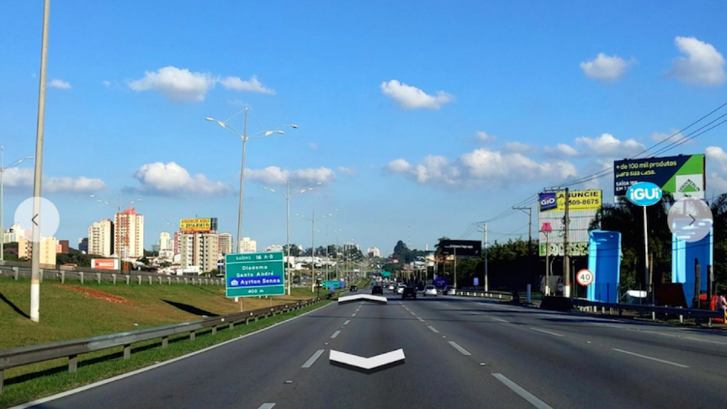
Deriving Built Environment Indicators with Google Street View
Examined associations between select neighborhood built environment indicators and health outcomes, at the state level
  BE Indicators: crosswalks, non-single family homes, single lane roads, visible wires
  12 health outcomes, including obesity/overweight, diabetes, PA, premature mortality
31,247,167 images collected from Google Street View
Health outcome data obtained from CDC
BE indicators aggregated into 3 tertiles
More crosswalks predicted lower levels of obesity among adults and children
Non-single family homes related to decreased diabetes and premature mortality
Phan, L., Yu, W., Keralis, J. M., Mukhija, K., Dwivedi, P., Brunisholz, K. D., … Nguyen, Q. C. (2020). Google Street View Derived Built Environment Indicators and Associations with State-Level Obesity, Physical Activity, and Chronic Disease Mortality in the United States. International Journal of Environmental Research and Public Health, 17(10), 3659.

Slide 26
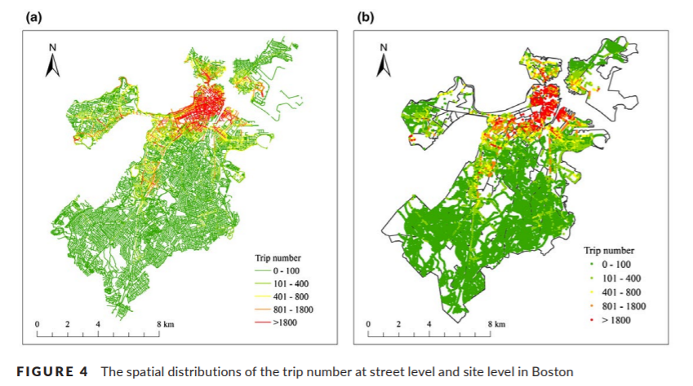
Association between Streetscapes and Human Walking Activities using Google Street View and Human Trajectory Data
Investigated the interaction between walking behaviors and physical characteristics of the environment in Boston (street canyons and visibility of greenery)
Data collected via smartphone data for walking behaviors and Google Street View (Walk Score and OpenStreetMap data also used)
Data from 6,000 anonymous users (300,000+ trips)
Street greenery and enclosure of street canyons were significantly associated with walking behaviors
Associations between walking behaviors and streetscape variables varied by land use types
Li, X., Santi, P., Courtney, T. K., Verma, S. K., & Ratti, C. (2018). Investigating the association between streetscapes and human walking activities using Google Street View and human trajectory data. Transactions in GIS, 22(4), 1029–1044.

Slide 27
Presentation Outline
Overview of the built environment and physical activity
Methods for researching the built environment and physical activity
Research opportunities
  Leveraging technology
  Engaging citizens
  Analyzing big data
  Environmental surveillance
  Taking advantage of natural experiments
  Questions and discussion
Notes:
PHS 635
27

Slide 28
Development of a Childhood Obesogenic Environment Index
No large-scale measures exist characterizing environments that pose a risk for obesity
Are such environments worse in rural areas?
Funded by HRSA/Federal Office of Rural Health Policy
Project objectives:
  Develop an obesogenic environment index score for all U.S. counties
  Explore differences in obesogenic environment scores by factors such as region, rurality, income, etc.
Kaczynski, A.T., Eberth, J.M., Stowe, E.W., Wende, M.E., Liese, A.D., McLain, A.C., Breneman, C.B., & Josey, M.J. (2020). Development of a national childhood obesogenic environment index in the United States: Differences by region and rurality. International Journal of Behavioral Nutrition and Physical Activity, 17: 83.

Slide 29
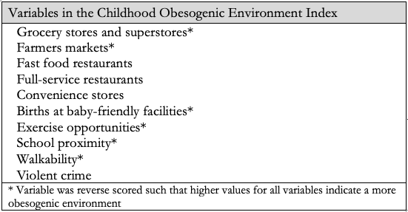
Developing a County-Level Obesogenic Environment Index
Comprehensive search of review articles (n=20) that summarized associations between the environment and its impact on nutrition, physical activity, and overweight/obesity levels in youth
Experts (n=12) provided ratings and input on 24 identified variables with respect to importance, potential data sources, etc.
Extensive discussion and expertise of project team to refine variable list
Data obtained for all counties (n=3148) from USDA, County Health Rankings, etc.
Total obesogenic environment index score generated by calculating the average percentile for all 10 variables.

Slide 30
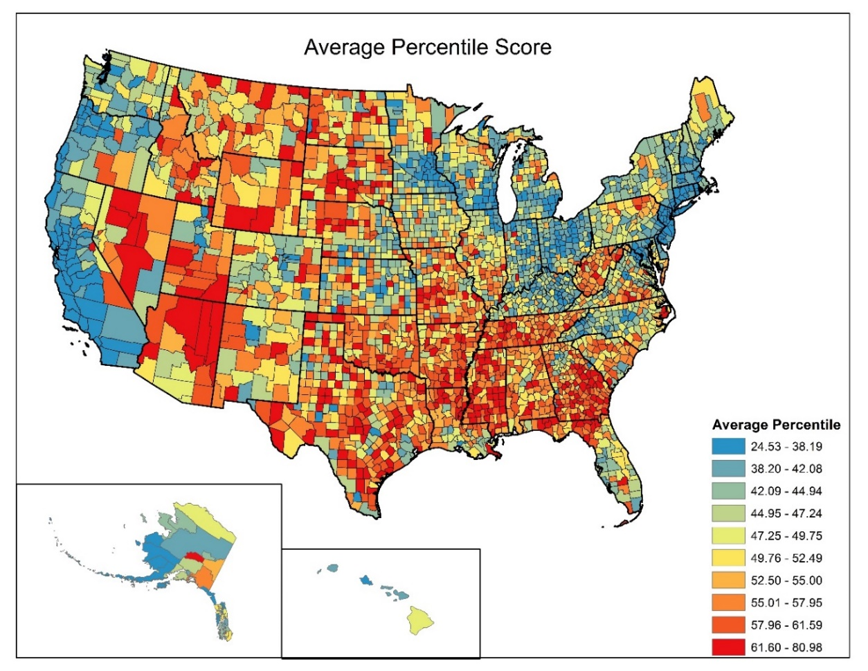
Kaczynski, A.T., Eberth, J.M., Stowe, E.W., Wende, M.E., Liese, A.D., McLain, A.C., Breneman, C.B., & Josey, M.J. (2020). Development of a national childhood obesogenic environment index in the United States: Differences by region and rurality. International Journal of Behavioral Nutrition and Physical Activity, 17: 83.

Slide 31
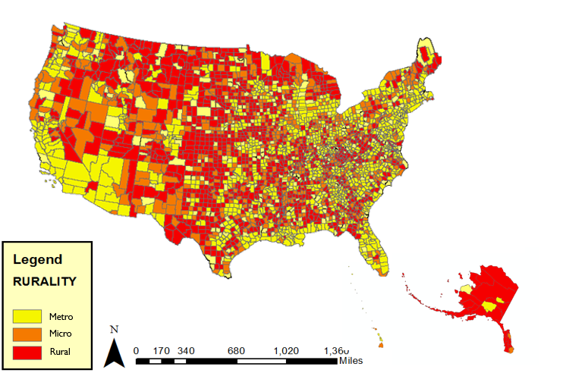
Rurality of United States Counties

Slide 32
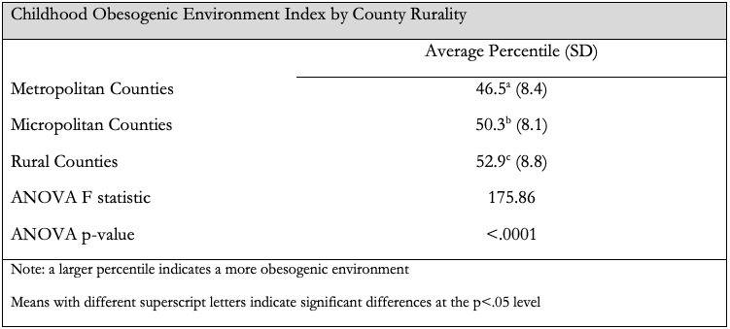
Urban-rural differences in obesogenic environment scores
Kaczynski, A.T., Eberth, J.M., Stowe, E.W., Wende, M.E., Liese, A.D., McLain, A.C., Breneman, C.B., & Josey, M.J. (2020). Development of a national childhood obesogenic environment index in the United States: Differences by region and rurality. International Journal of Behavioral Nutrition and Physical Activity, 17: 83.

Slide 33
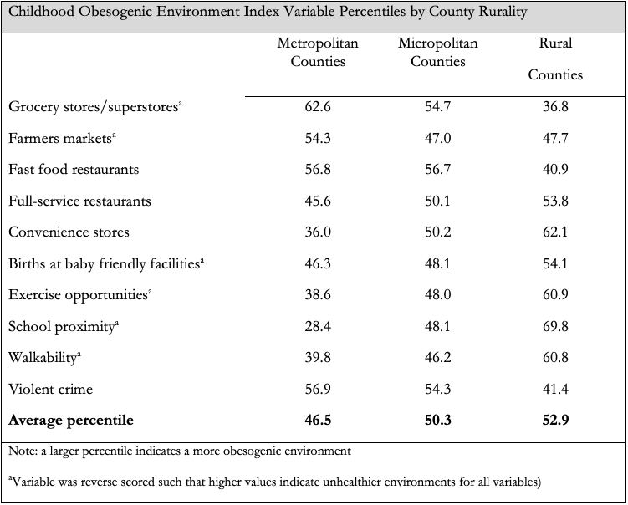

Slide 34
Regions of the United States

Slide 35
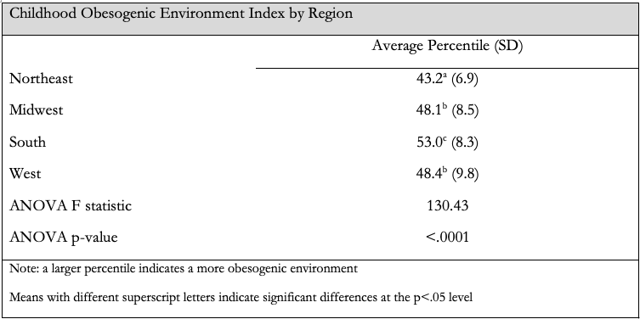
Differences by U.S. region in obesogenic environment scores
Kaczynski, A.T., Eberth, J.M., Stowe, E.W., Wende, M.E., Liese, A.D., McLain, A.C., Breneman, C.B., & Josey, M.J. (2020). Development of a national childhood obesogenic environment index in the United States: Differences by region and rurality. International Journal of Behavioral Nutrition and Physical Activity, 17: 83.

Slide 36
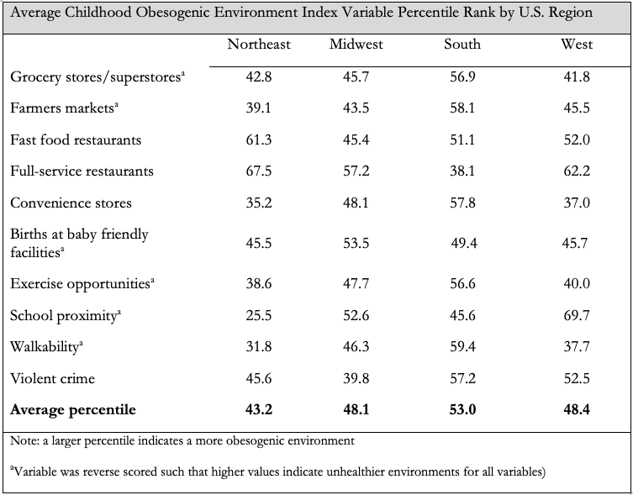

Slide 37
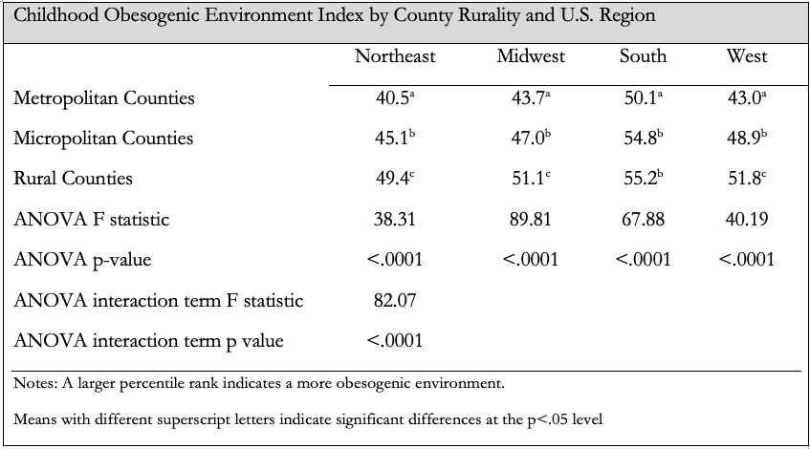
Obesogenic Environment Differences by Rurality AND Region

Slide 38
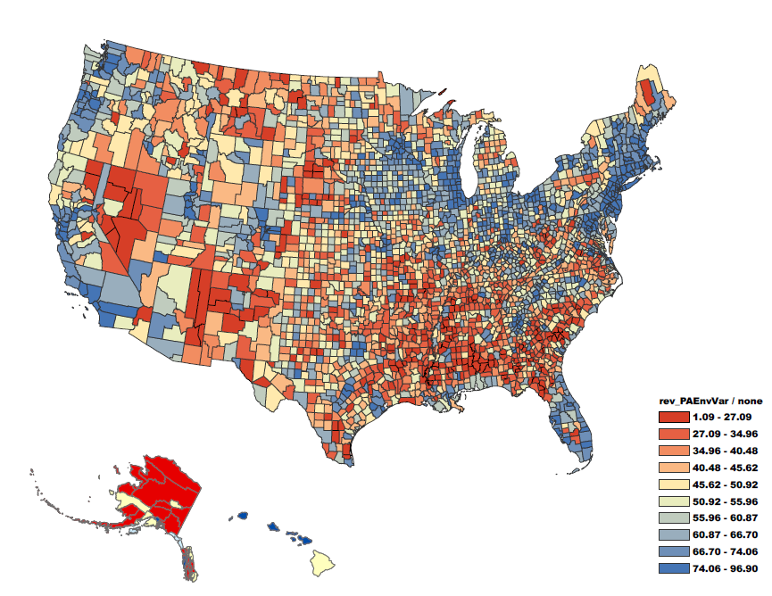

Physical Activity Environment
Physical Activity Environment Percentiles
Red = worse
Blue = better

Slide 39
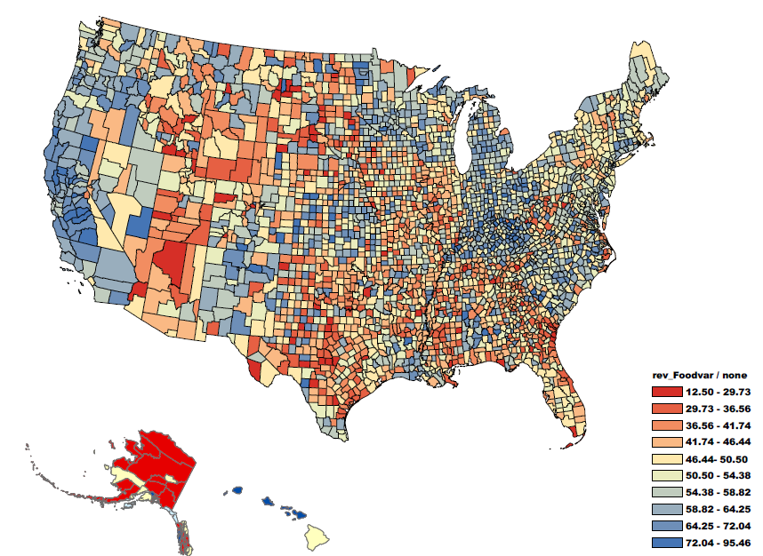
Food Environment
Food Environment Percentiles
Red = worse
Blue = better

Slide 40
Presentation Outline
Overview of the built environment and physical activity
Methods for researching the built environment and physical activity
Research opportunities
  Leveraging technology
  Engaging citizens
  Analyzing big data
  Environmental surveillance
  Taking advantage of natural experiments
  Questions and discussion
Notes:
PHS 635
40

Slide 41
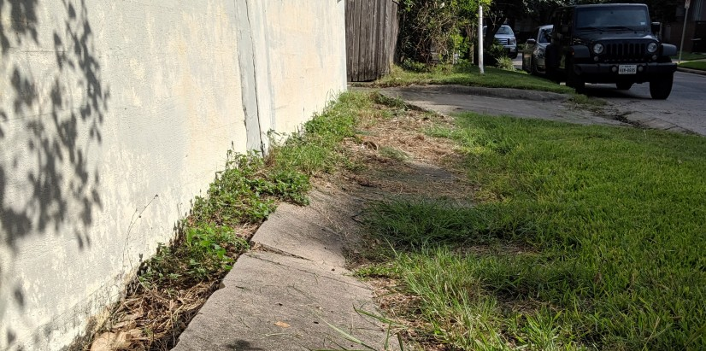
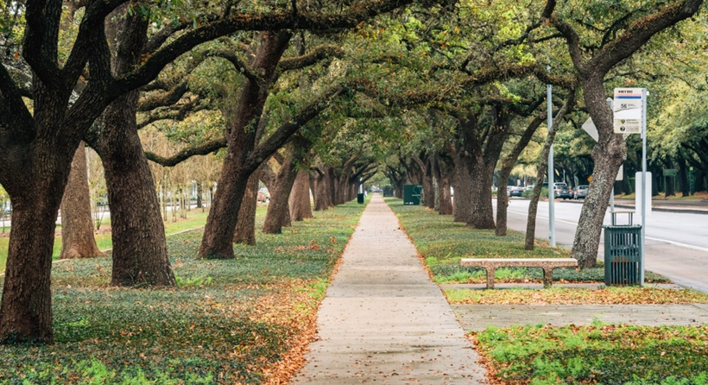
If You Build It, Will They Come? Sidewalk Improvements and PA
Examined changes in self-reported and accelerometer-derived PA associated with living near recently improved sidewalks
TRAIN Study: prospective cohort study to evaluate the effect of public light rail transit use and PA in Houston (n=430)
Data collected via S-MAQ, accelerometers, and sidewalk infrastructure improvements by City of Houston via ArcGIS
Living near (within 250m of) two sidewalk improvements was associated with 1.6x more minutes per week of transport walking and leisure-time PA compared to those not living near a sidewalk improvement (p<0.05)
Knell, G., Durand, C. P., Shuval, K., Kohl, H. W., 3rd, Salvo, D., Olyuomi, A., & Gabriel, K. P. (2018). If You Build It, Will They Come? A Quasi-experiment of Sidewalk Improvements and Physical Activity. Translational Journal of the American College of Sports Medicine, 3(9), 66–71.

Slide 42
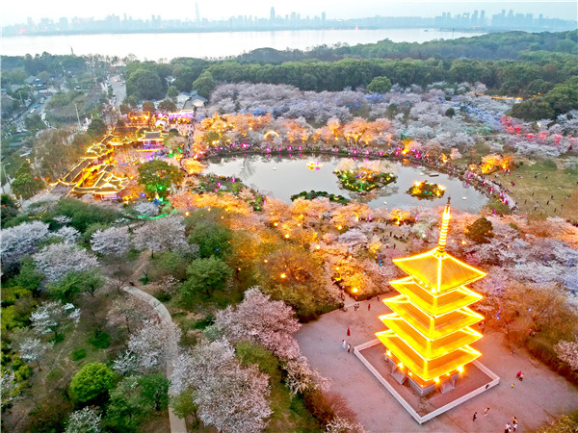
Dose-Response Effect of a Large-Scale Greenway Intervention on PA
Explored the impact on physical activity of the East Lake greenway constructed in 2016-17 in Wuhan, China
1020 participants residing varying distances from greenway in 2016 and 2019
  Baseline survey and follow up survey of PA behaviors
  Exposed group defined as those who lived 0-1 km or 1-2 km from greenway; additional buffers of 2-3, 3-4, and 4-5 km groups identified
Analyzed effect of greenway on MVPA and overall PA by distance
Greenway had positive effects on both MVPA and overall PA (MET-minutes/week) after controlling for individual and neighborhood covariates
  Effects of the greenway decreased as distance from greenway increased
Xie, B., Lu, Y., Wu, L., & An, Z. (2021). Dose-response effect of a large-scale greenway intervention on physical activities: The first natural experimental study in China. Health & Place, 67, 102502.

Slide 43
Presentation Outline
Overview of the built environment and physical activity
Methods for researching the built environment and physical activity
Research opportunities
  Questions and discussion
Notes:
PHS 635
43

Slide 44
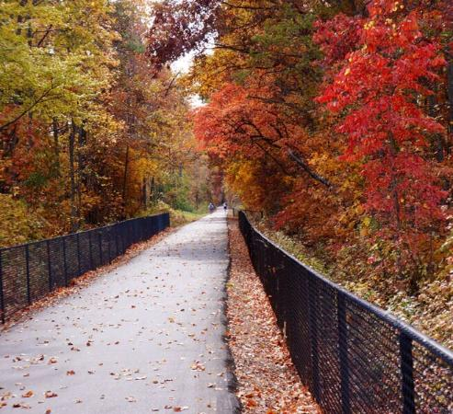
Discussion
What are some ways you are (or could) incorporate environmental factors into your research on PA and health?
What are some emerging opportunities you perceive in the field of environment and PA?
What are some ways you are (or could) incorporate technology and/or citizens into your research on PA and health?
How do we ensure that emerging research considers environmental justice?
Notes:
PHS 635
44
Include link to tool

Slide 45
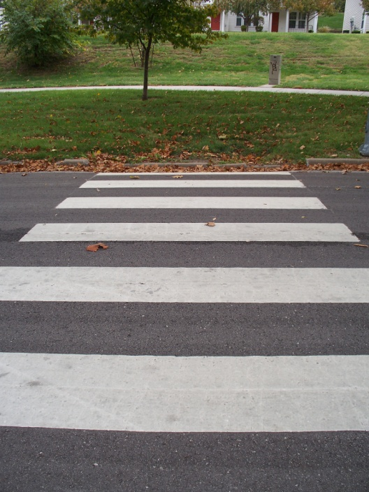
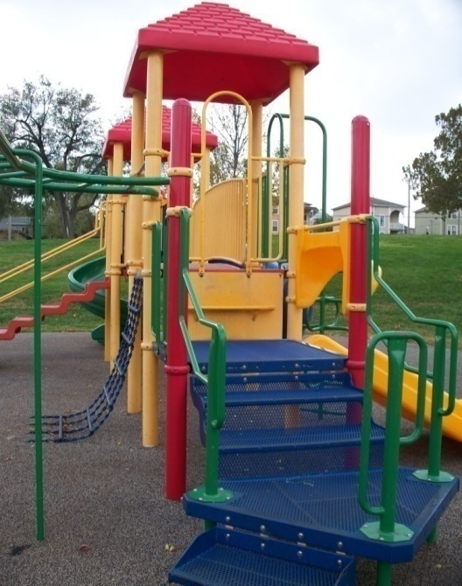
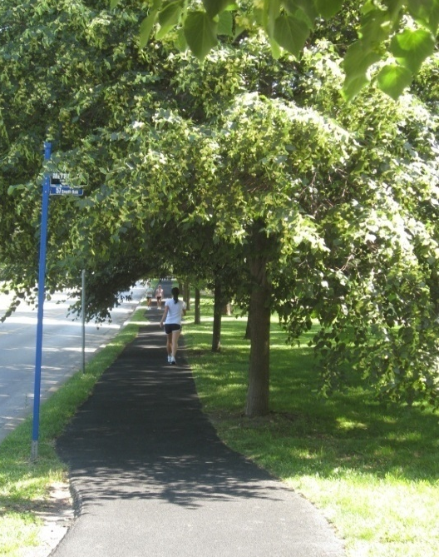
Summary
Research on the built environment and physical activity is truly interdisciplinary with respect to background knowledge, theories, and methods
Better understanding how environmental factors in diverse communities impact active living and better engaging citizens in evaluating and improving those resources can foster multiple dimensions of health-related environmental justice
Still an emerging field with exciting opportunities for furthering public health

Slide 46







Acknowledgments
Thank you to all of our partners and funding agencies

Slide 47
Built Environment and Physical Activity: Emerging Research Opportunities to Promote Environmental Justice and Community Health
Andrew T. Kaczynski, PhD
Department of Health Promotion, Education and Behavior
Prevention Research Center
University of South Carolina
atkaczyn@mailbox.sc.edu
47

