Slide 1
Maternal & child health student association

Slide 2
MCHSA Objectives
To promote the health and well-being of mothers, infants, children, and adolescents.
To bring together multidisciplinary undergraduate and graduate students with interests in maternity and child health (MCH) careers and themes.
To establish a platform for interested peers and mentors to share experiences on MCH-related practice, research, careers, and current events.

Slide 3
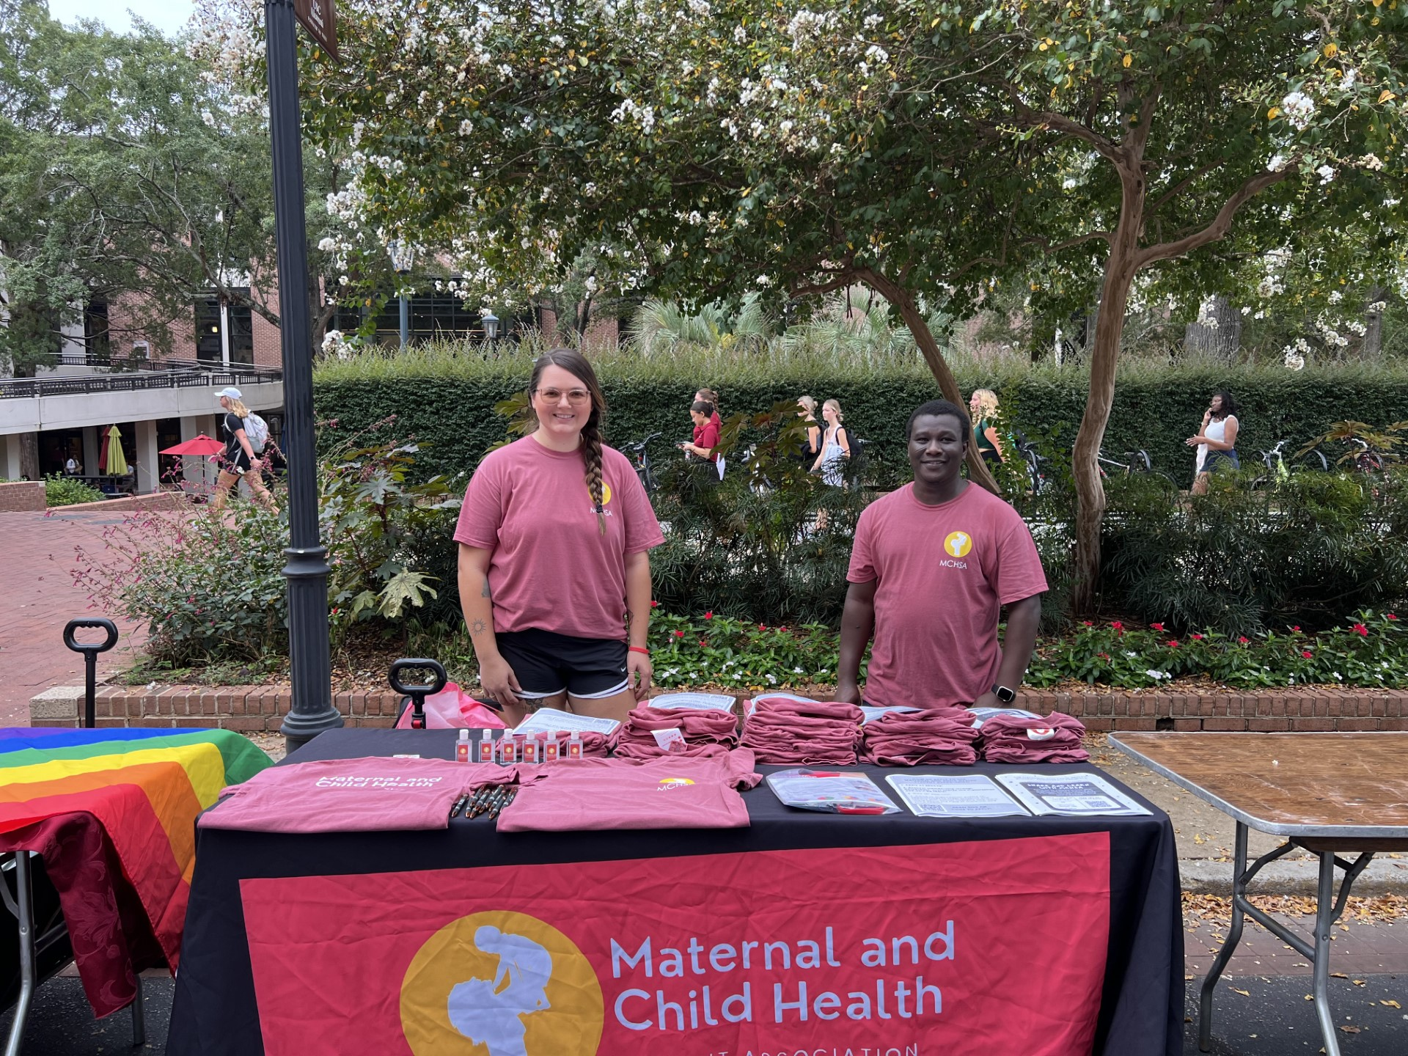
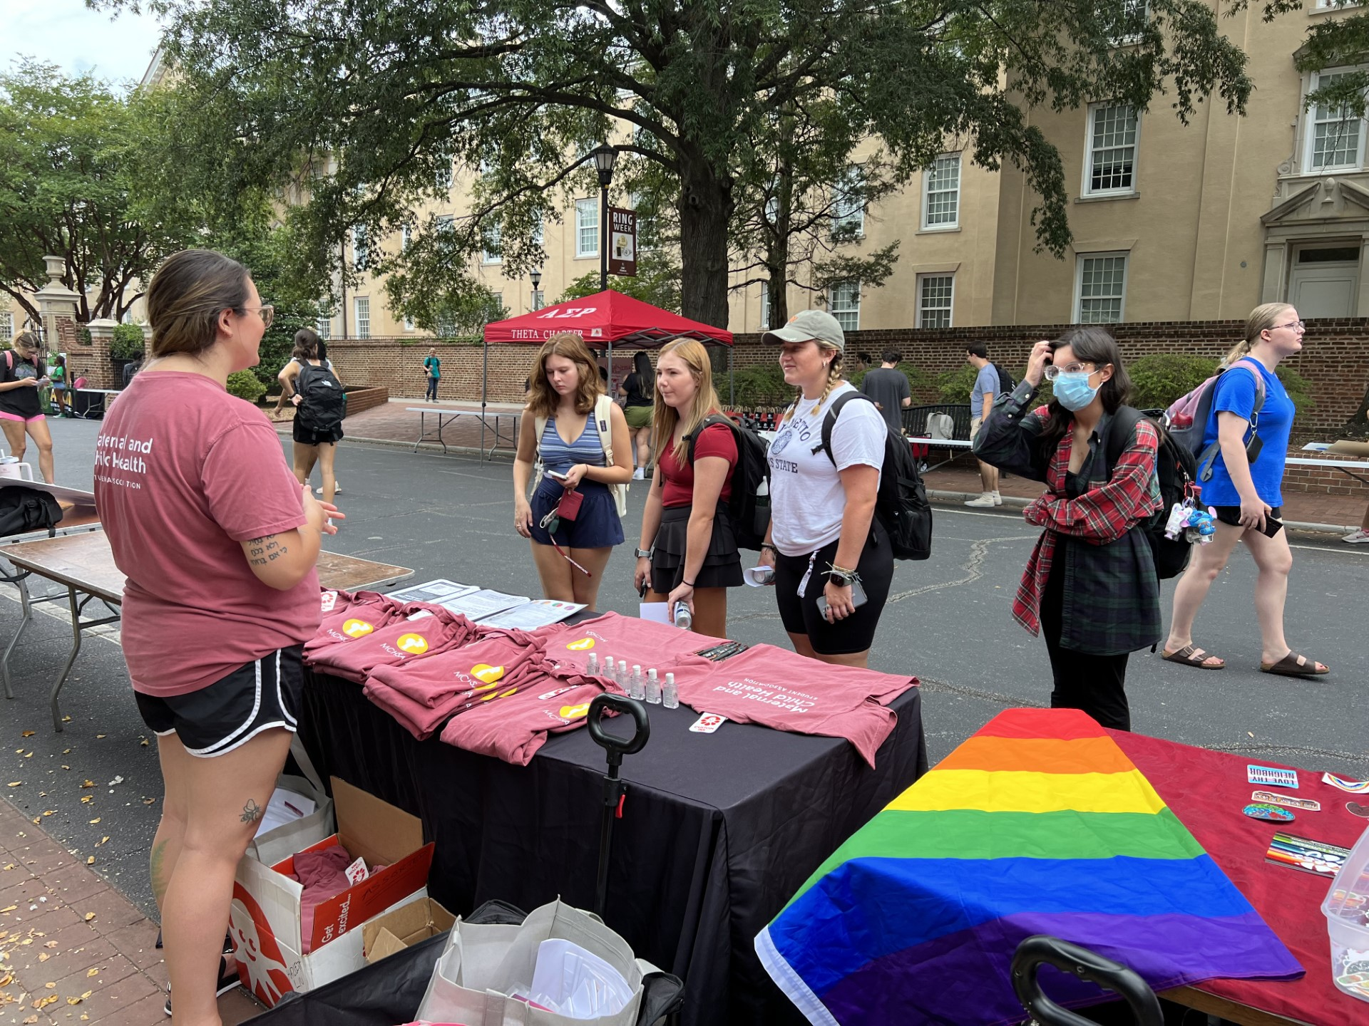
What we do
Learning
Research
Guest Speakers
Community Engagement

Slide 4
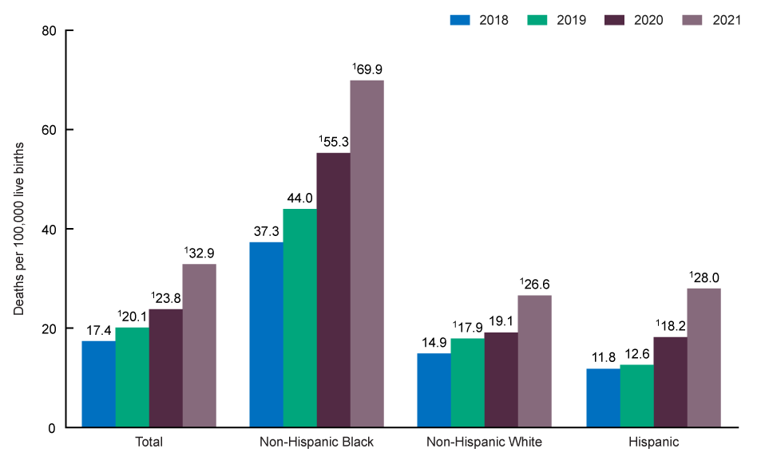
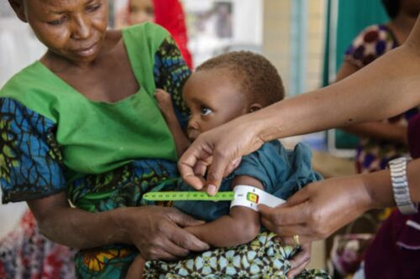
Why mch?
Maternal mortality rates, by race in the US, 2018 - 2021¹
Reduce maternal mortality and morbidity
Reduce pre-natal and neonatal mortality and morbidity
Reduce obesity and associated diseases
Positive inter-generational impact
Ensure societal well-being
Global health security
¹ Hoyert DL. Maternal mortality rates in the United States, 2021. NCHS Health E-Stats. 2023. DOI: https://dx.doi.org/10.15620/cdc:124678.

Slide 5
Upcoming events
One event per month
Networking
Yoga
Movie Night
Presentations
Guest Speakers
Panelist Led Discussions

Slide 6
Thanks!
@uofsc_mchsa
Give us a follow!
SCAN HERE TO APPLY!

